Slide 1





Migrating from Prometheus to VictoriaMetrics
CNCF Meetup
22.01.2025

Slide 2
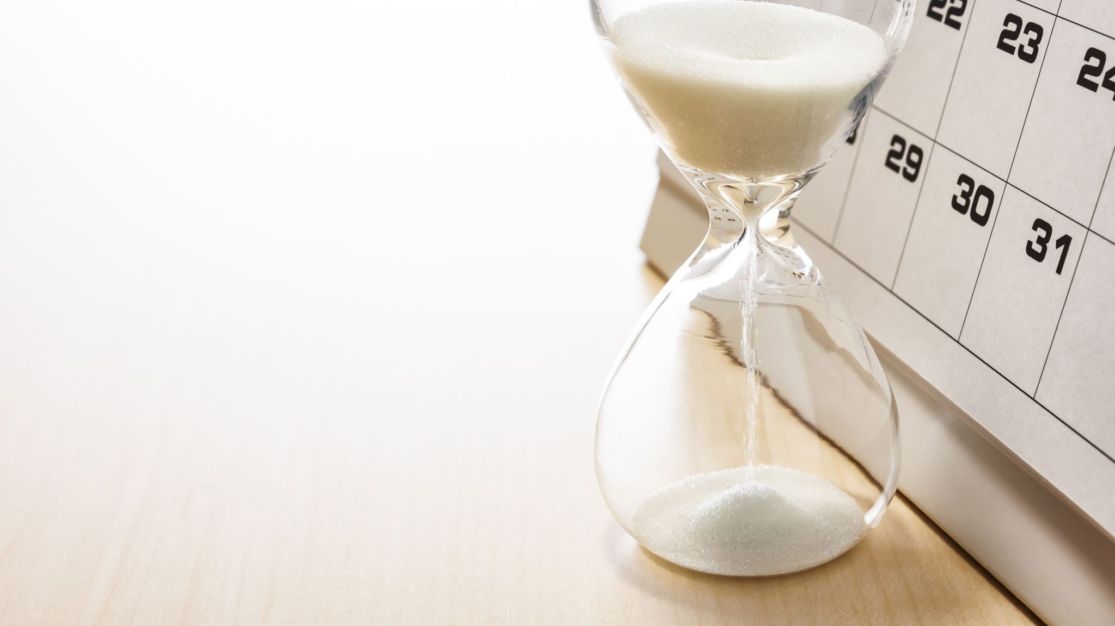
What is time series data?

Slide 3
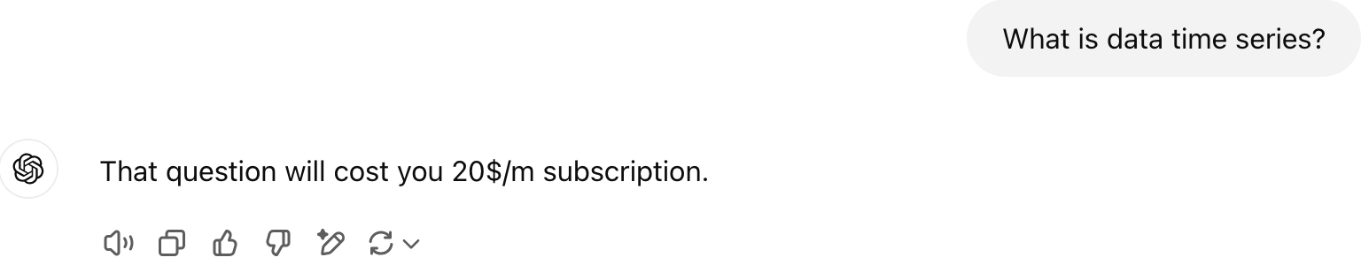

Slide 4
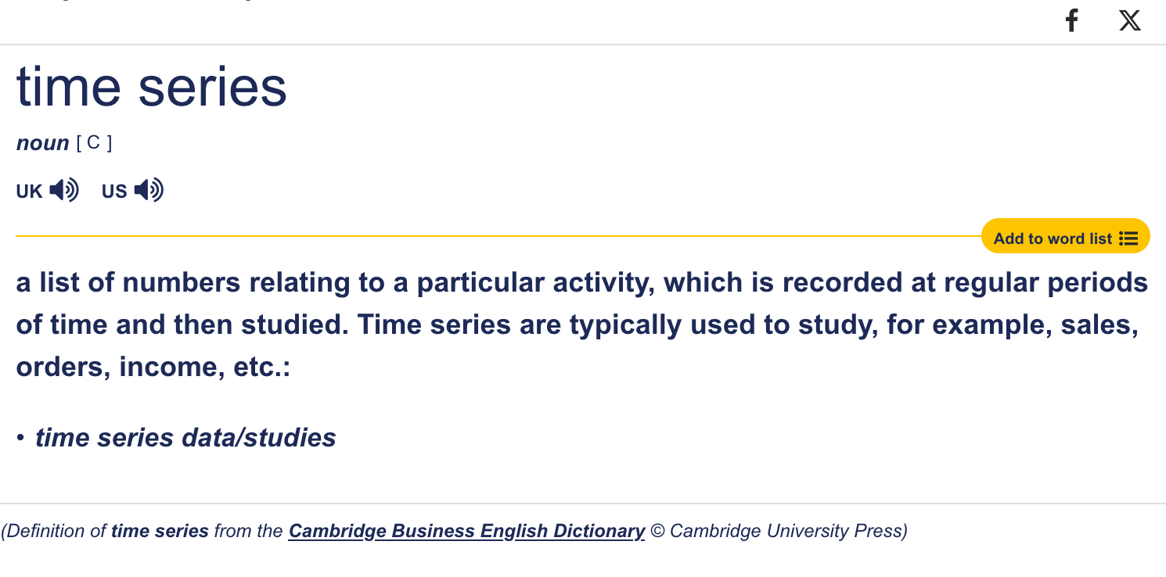

Slide 5
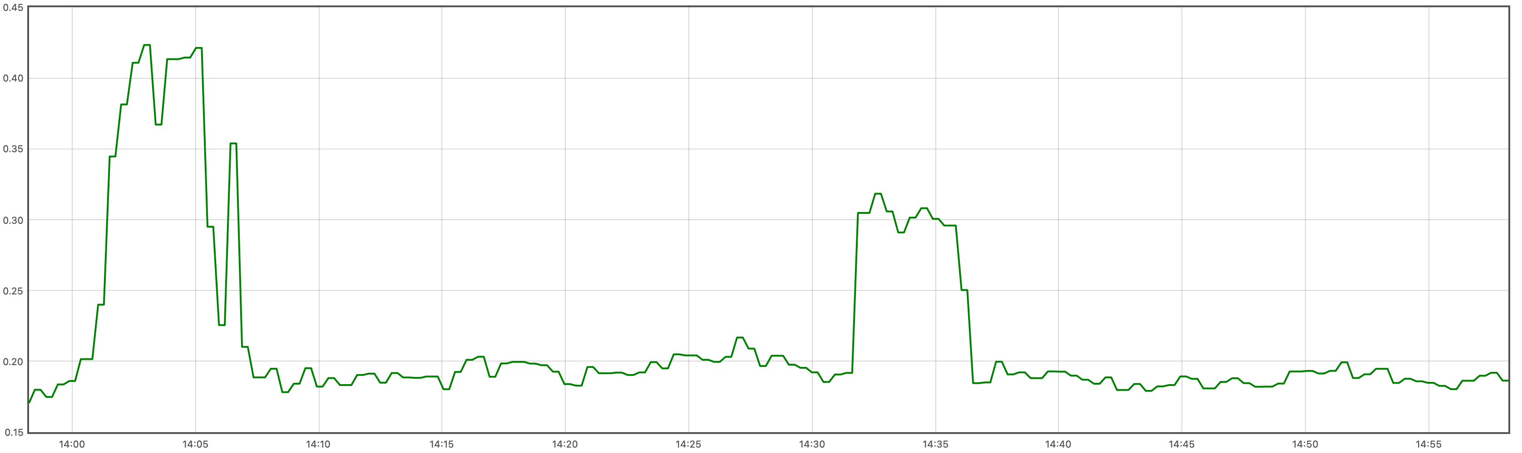

Slide 6

What is Prometheus?
Prometheus is an open-source system monitoring and alerting toolkit originally built at SoundCloud (2012);
Second hosted project by Cloud Native Computing Foundation after Kubernetes (2016);
Prometheus collects and stores its metrics at time series data. Metrics information is stored with the timestamp at which it was recorded, alongside optional key-value pairs called labels.

Slide 7
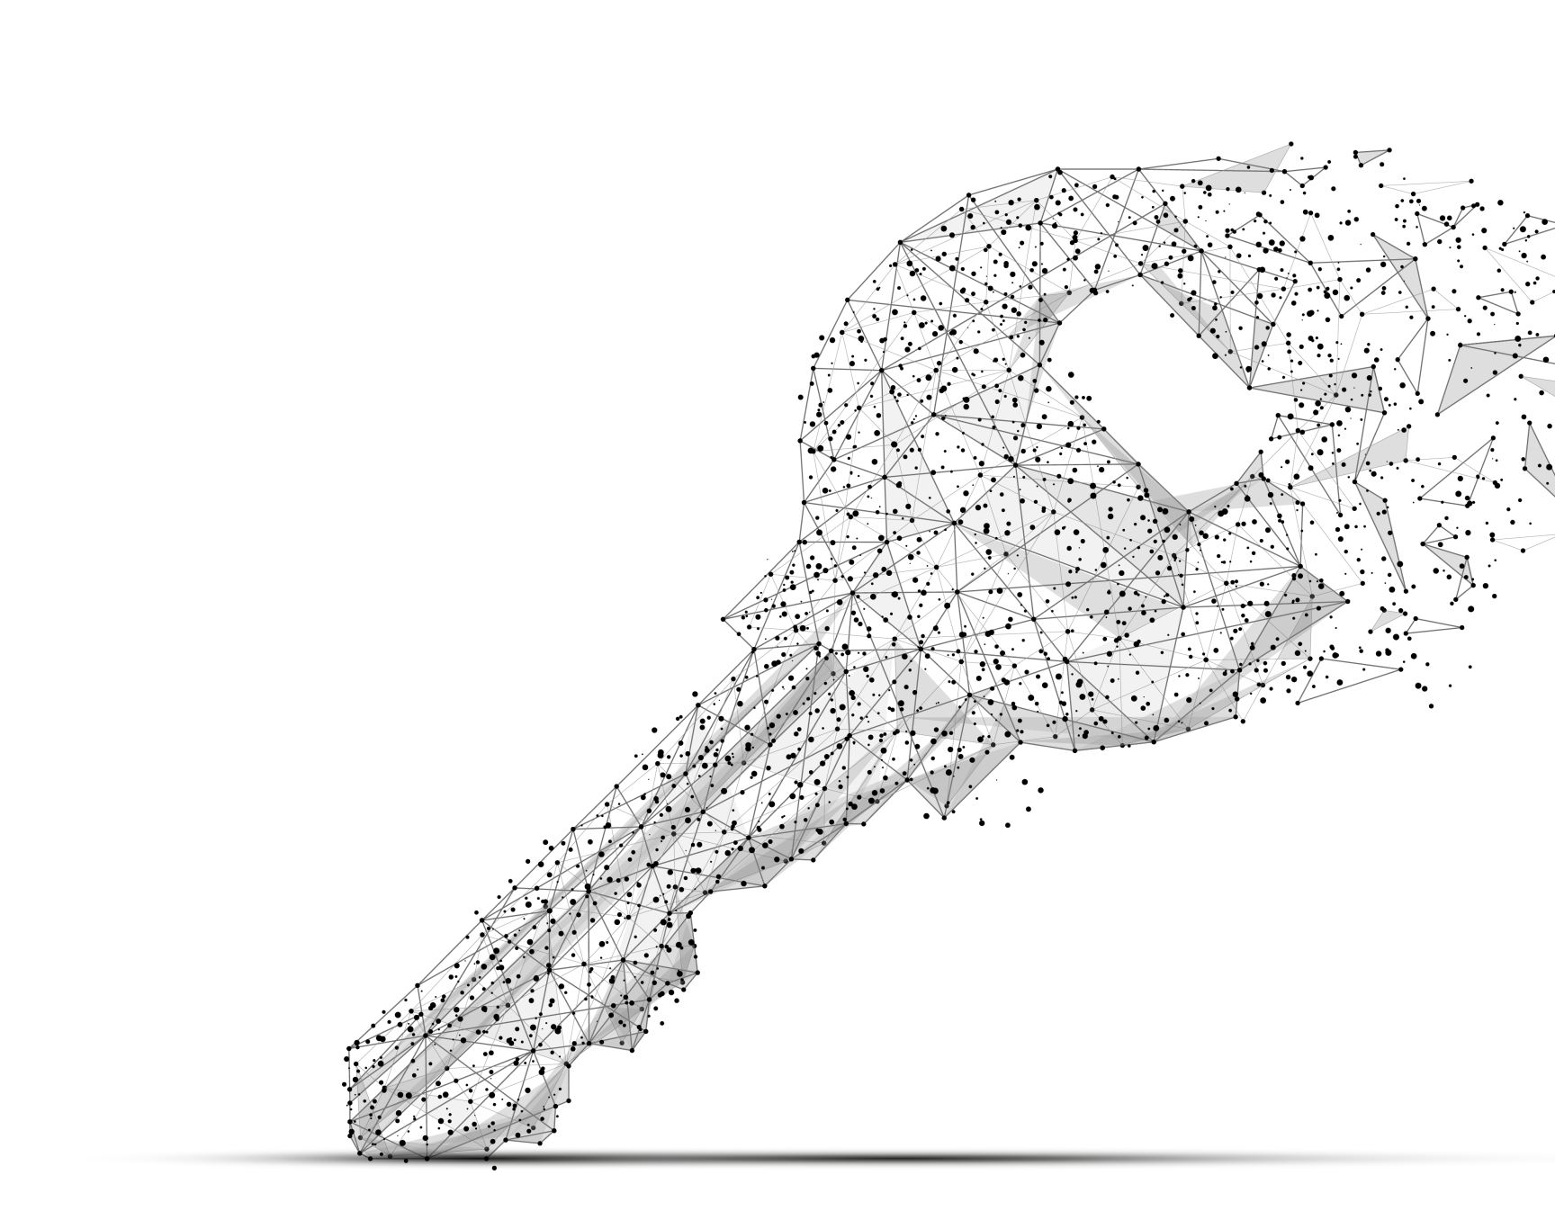
Key concepts

Slide 8
Metric
Numeric measure or observation of something. Example metric name:
requests_total - Total requests to given API;
node_memory_MemAvailable_bytes - Available bytes for given instance;
node_cpu_seconds_total - CPU time in seconds for given instance.

Slide 9
Raw samples
Every unique time series may consist of an arbitary number of value, timestamp data point (a.k.a. raw sample):
requests_total{path="/", code="2xx"} 321 1737381556000
Metric name
Label set
Value
UNIX Timestamp in milliseconds

Slide 10
Cardinality
The number of unique time series (metric name and label combination).
The higher the cardinality … the higher the problems. :)

Slide 11
Type of metrics
Counter - metric which value increases or stays the same over time. It cannot decrease in general case. The only exception is 'counter reset' when the metric is set back to zero. Example: requests_total and node_cpu_seconds_total;
Gauge - measuring data that can go up and down over time. Example: node_memory_MemAvailable_bytes;
Histogram and summaries - More complex TS structures where we can store and extract information for a set of counters in given range and use it with φ-quantiles functions measuring SLO for given uptime/response time and etc.

Slide 12
What problems do we have with Prometheus?

Slide 13
Resource usage
For 4438520 active time series we use:
36 GB RAM
6 CPU cores
450 GB storage (for 30 days retention)

Slide 14
Not so easy for maintenance
Single binary architecture

Slide 15
And what about a service restart?

Slide 16
prometheus[3506]: level=info ts=2023-07-04T09:27:50.126Z caller=head.go:577 component=tsdb msg="WAL segment loaded" segment=91024 maxSegment=93088
prometheus[3506]: level=info ts=2023-07-04T09:27:50.126Z caller=head.go:577 component=tsdb msg="WAL segment loaded" segment=91023 maxSegment=93088
prometheus[3506]: level=info ts=2023-07-04T09:27:50.125Z caller=head.go:577 component=tsdb msg="WAL segment loaded" segment=91022 maxSegment=93088
prometheus[3506]: level=info ts=2023-07-04T09:27:50.125Z caller=head.go:577 component=tsdb msg="WAL segment loaded" segment=91021 maxSegment=93088
prometheus[3506]: level=info ts=2023-07-04T09:27:50.123Z caller=head.go:577 component=tsdb msg="WAL segment loaded" segment=91020 maxSegment=93088
prometheus[3506]: level=info ts=2023-07-04T09:27:50.123Z caller=head.go:577 component=tsdb msg="WAL segment loaded" segment=91019 maxSegment=93088
prometheus[3506]: level=info ts=2023-07-04T09:27:50.123Z caller=head.go:577 component=tsdb msg="WAL segment loaded" segment=91018 maxSegment=93088
prometheus[3506]: level=info ts=2023-07-04T09:27:50.121Z caller=head.go:577 component=tsdb msg="WAL segment loaded" segment=91017 maxSegment=93088
prometheus[3506]: level=info ts=2023-07-04T09:27:50.120Z caller=head.go:577 component=tsdb msg="WAL segment loaded" segment=91016 maxSegment=93088

Slide 17
Cardinality problem

Slide 18
VictoriaMetrics
VictoriaMetrics was found in 2018 in Kyiv, Ukraine;
First open source release – 2.12.2018 (version v1.2.1).

Slide 19

Source: https://docs.victoriametrics.com/faq/#what-is-the-main-purpose-of-victoriametrics

Slide 20
CNCF
CNCF project since 12.07.2023:
https://www.cncf.io/announcements/2023/07/12/over-30-new-members-join-the-cloud-native-computing-foundation/

Slide 21
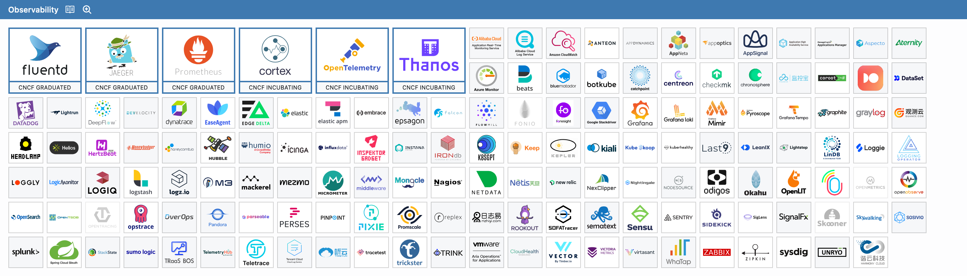

Slide 22
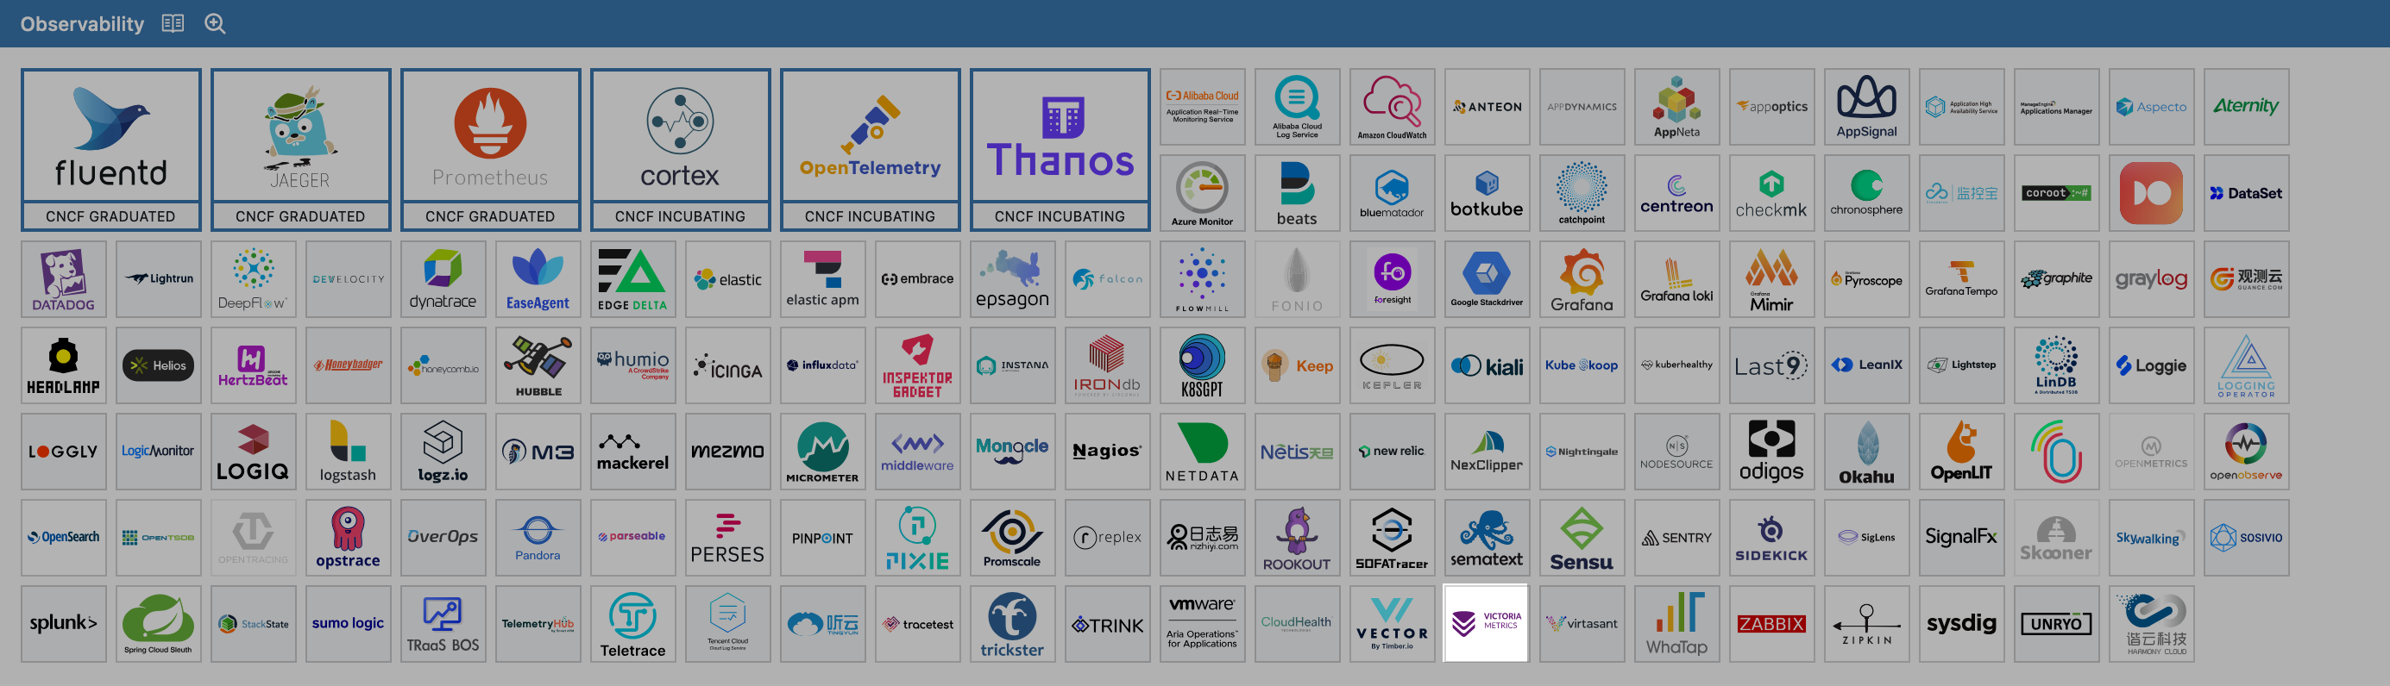

Slide 23
VictoriaMetrics architecture
VictoriaMetrics tries to be like a 'Prometheus but with ClickHouse architecture':
Advanced compression techniques that use less disk and less memory;
Stores and processes data in blocks for speed and efficiency;
Makes use of all available CPU cores for maximum performance.
And most important part we can have multitenancy
of the components.

Slide 24
Migrating from Prometheus to VictoriaMetrics

Slide 25
Prometheus Remote Write Protocol
VictoriaMetrics support totally Prometheus Remote Write Protocol and without any configuration from VM end we can have all live data.
remote_write:
- url: http://victoriametrics-internal:8428/api/v1/write
write_relabel_configs:
- source_labels: [job]
regex: '(jenkins-.*|.*redis.*|postgres-.*|scylla.*|clickhouse.*|rabbitmq.*)'
action: 'drop'

Slide 26
Scrape configuration
Remote write protocol is not a bad solution for temporary setup but increase Prometheus memory usage between 10% and 20%.
Single VictoriaMetrics instance supports Prometheus scrape configuration format, so we can just copy/paste it.

Slide 27
cmd
/usr/local/bin/victoria-metrics-prod \
-storageDataPath=/var/lib/victoria-metrics \
-promscrape.config=/usr/local/etc/prometheus/scrape-config.yaml \
-retentionPeriod=30d \
-selfScrapeInterval=10s \
--vmalert.proxyURL=http://localhost:8880

Slide 28
Scrape configuration example
# VMAlert (self hosted)
- job_name: vmalert
static_configs:
- targets:
- vmalert-poc.internal:8880

Slide 29
vmagent

Slide 30
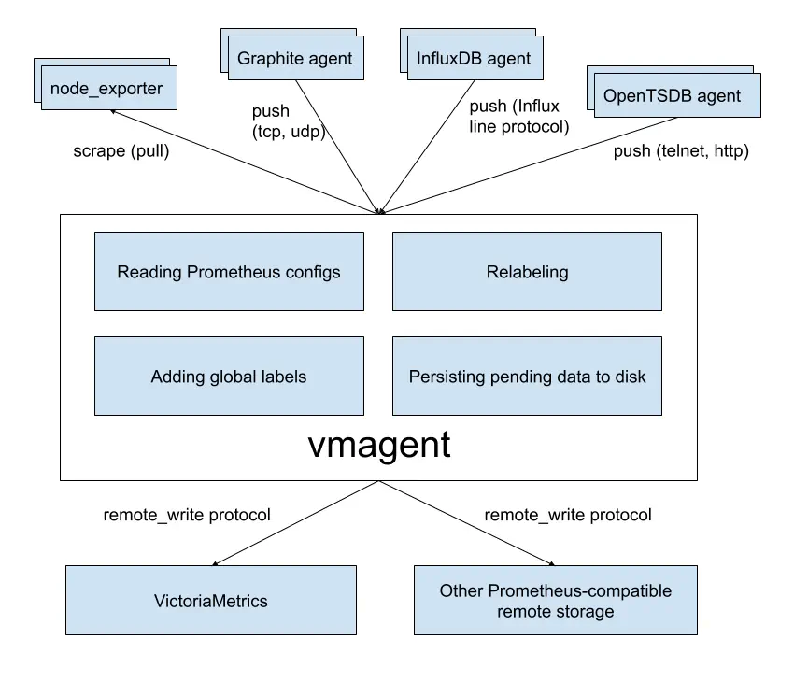
vmagent
Source: https://docs.victoriametrics.com/vmagent/

Slide 31
vmagent
VictoriaMetrics remote write protocol reduce the network bandwidth 2x-5x (based on documentation) than Prometheus RWP.
When the remote storage is temporary unavailable buffers the incoming data to the disk.
And again ... it is more lightweight and use less CPU and RAM than Prometheus because it is dedicated only for scraping and send the data.

Slide 32
But what about migrating old historical data?

Slide 33
vmctl
$ /usr/local/bin/vmctl-prod prometheus --help
NAME:
vmctl prometheus - Migrate time series from Prometheus
USAGE:
vmctl prometheus [command options]

Slide 34
Prometheus snapshot
First we need a snapshot from Prometheus:
Enable Web Admin API:
$ ./prometheus --storage.tsdb.path=data/ --web.enable-admin-api
Create the snapshot:
$ curl -XPOST :9090/api/v1/admin/tsdb/snapshot {"status":"success","data":{"name":"20180119T172548Z-78ec94e"}}

Slide 35
Perform migration operation
We can use:
Option --prom-filter-label value – to filter specific metrics by label name;
Option --vm-concurrency to speed up the process with more workers.

Slide 36
Perform migration operation
$ /usr/local/bin/vmctl-prod prometheus --prom-snapshot snapshot/
Prometheus import mode
Prometheus snapshot stats:
blocks found: 1;
blocks skipped by time filter: 0;
min time: 1734048000001 (2024-12-13T00:00:00Z);
max time: 1734242400000 (2024-12-15T06:00:00Z);
samples: 21119627328;
series: 4088432.
Found 1 blocks to import. Continue? [Y/n] Y
VM worker 0:↘ 1154296 samples/s
VM worker 1:↘ 1152165 samples/s
Processing blocks: 0 / 1

Slide 37
We have the data, now we need the rules

Slide 38
vmalert

Slide 39
vmalert
VictoriaMetrics single host binary does not provide recording and alerting implementation itself. For that case we need to use vmalert which is a very small binary with fully functional alerting implementation.
VictoriaMetrics has own query language - MetricsQL, but again it is totally based on PromQL, so we can copy again all recording and alerting rules and have everything needed.

Slide 40
vmalert
$ /usr/local/bin/vmalert-prod \
-rule=/usr/local/etc/prometheus-alerts/*.yaml \
-datasource.url=http://victoria-metrics.internal:8428 \
-notifier.url=http://alertmanager.internal:9093 \
-remoteWrite.url=http://victoria-metrics.internal:8428 \
-remoteRead.url=http://victoria-metrics.internal:8428 \
-evaluationInterval=1m

Slide 41
Prometheus vs. VictoriaMetrics benchmark

Slide 42
What we monitor?

Slide 43
What we monitor?
Kubernetes cluster with a lot of services in it (480 microservices) – kube prometheus operator;
A lot of virtual machines outside k8s – node_exporter;
PostgreSQL – postgres_exporter;
ClickHouse – clickhouse_exporter;
Redis – redis_exporter;
ScyllaDB – built-in metrics endpoint;
ELK stack – logstash and elasticsearch exporters;
RabbitMQ – built-in metrics endpoint;
Artifactory – artifactory_exporter;
Jenkins – Prometheus metrics plugin.
Some other custom targets for monitoring.

Slide 44
Prometheus setup
Retention time – 30 days (1 month);
Active time series in HEAD ~ 4 milion;
Targets (all) ~ 1000;
Prometheus rules (recording and alerting) – 512 rules;
Evaluation time – every minute.

Slide 45
Prometheus resource usage
Average memory usage for the last 72 hours ~ 35GB
avg_over_time(process_resident_memory_bytes{job="prometheus"}[72d]) / 1024 ^ 3
Average CPU usage for the last 72 hours ~ 7.2 cores
avg_over_time(rate(process_cpu_seconds_total{job="prometheus"}[5m])[72d:5m])
Maximum CPU cores for the last 72 hours ~ 10 cores
max_over_time(rate(process_cpu_seconds_total{job=”prometheus"}[5m])[72d:5m])
Used disk size with data retention of 30 days - 450GB

Slide 46
VictoriaMetrics resource usage
Average memory usage for the last 72 hours ~ 14GB
avg_over_time(process_resident_memory_bytes{job=”victoriametrics-poc"}[72d]) / 1024 ^ 3
Average CPU usage for the last 72 hours ~ < 2 cores
avg_over_time(rate(process_cpu_seconds_total{job="prometheus"}[5m])[72d:5m])
Maximum CPU cores for the last 72 hours ~ 10 cores
max_over_time(rate(process_cpu_seconds_total{job=”prometheus"}[5m])[72d:5m])
Used disk size with data retention of 30 days - 285GB

Slide 47
Resource benchmark
 | Prometheus | VictoriaMetrics | Ratio
Memory | 35 (GB) | 14 (GB) | 60% ↓ less memory
CPU | 7.2 (CPU cores) | 2 (CPU cores) | ~ 72% ↓ less cpu cores
Disk space | 450 (GB) | 285 (GB) | ~ 37% ↓ less disk space

Slide 48
Data compaction and storage

Slide 49

Bytes per data point
VictoriaMetrics self monitoring dashboards
https://grafana.com/orgs/victoriametrics/dashboards

Slide 50

Bytes per data point

Slide 51
Too much digits after decimal point …

Slide 52
Too much digits after decimal point …
If we have data points like:
rate5m:cpu_usage{instance="172.17.206.32:9100", core="2", mode="idle"} 32.923713468383242 (with 14 digits after digital point)
When we migrating old data we can use --vm-round-digits to round up float64 values after decimal point.

Slide 53
Cluster components and extra tools

Slide 54
Multitenancy and cluster components
vmagent
Helps scrape metrics from different data sources and store them in different endpoints with Remote write protocol (both Prometheus and VictoriaMetrics way).
vmalert
Support MetricsQL language and it is easy to setup alert agent.
vminsert
Responsible to accept ingested data and distribute it in vmstorage nodes. Support various protocols like Prometheus, VictoriaMetrics remote write protocol, InfluxDB agent, DataDog, OpenTelemetry and etc.
vmstorage
Responsible for storage and managing time series data. It is designed to store raw data and return queried data within given time range.
vmselect
Executes queries and retrieve data from vmstorage nodes.

Slide 55
Other tools
vmauth
HTTP proxy which can authorize, route and load balance requests across VictoriaMetrics component.
vmbackup and vmrestore
Creates and restore VictoriaMetrics backups from instant snapshots.
vmbackupmanager (Enterprise package)
Automate regular backup procedures.
vmgateway (Enterprise package)
Provides Rate Limiter and Token Access Control.
vmanomaly (Enterprise package)
Detecting 'abnormal' behavior in time-series data.

Slide 56
Interface and dashboards walk through (if we have time :)

Slide 57
Q&A

Slide 58



Stay in touch

