Slide 1

Chickpea Dashboard

Slide 2
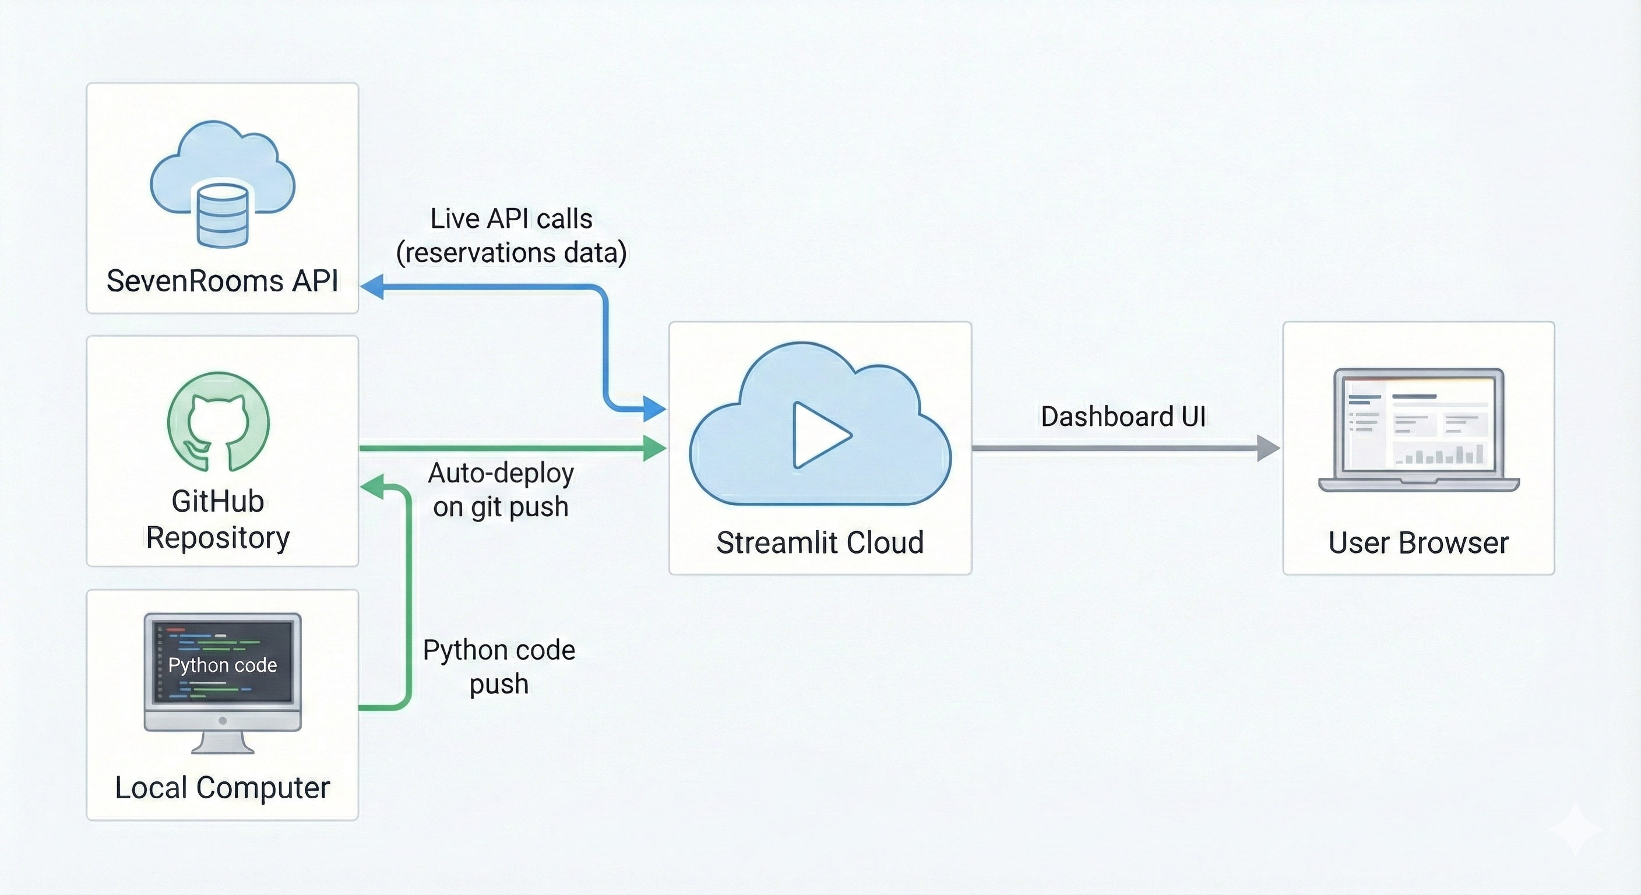
Chickpea dashboard app
User logs in through Streamlit's authentication system, which checks environment variables and secrets for credentials
The Streamlit app connects to the SevenRooms API to fetch reservation data
The system processes the raw data from SevenRooms and transforms it into a usable format
Python code written on local computer and pushed to Github repo

Slide 3

Demo

Slide 4
Issues to resolve
Additional functionality
Speed (host on our own server e.g. AWS (~£15/month)
Security (individual usernames/passwords)
Add API calls to ChatGPT for feedback analysis (requires API account)
Integrate room bookings

