Slide 1
Cold Start Link Prediction Using Temporal Graph Embeddings
Deepika Rama Subramanian
Dhruva Sahasrabudhe
Deepthi Peri

Slide 2
Introduction: Word2Vec
Word2vec: A word is defined by the company it keeps
Node2vec: A node in a graph is defined by the company it keeps (its neighborhood)

Slide 3
Introduction : Graph Embeddings
What are Graph Embeddings ? Why do we need Graph Embeddings ?
Takes a graph and returns embeddings (set of vectors) of the graph components (edges, or vertices).
Graph Embeddings : Continuous, Distributed, Compressed Representation
Can be used as input to a downstream machine learning task

Slide 4
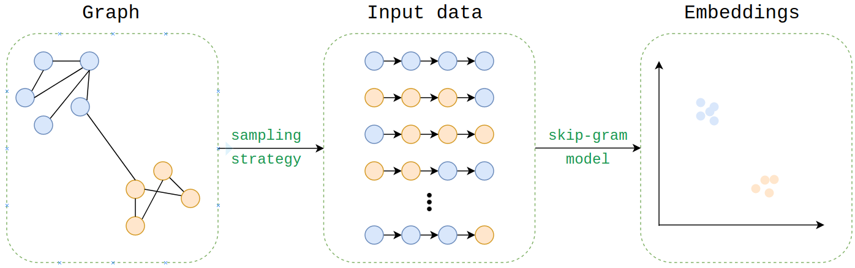
Introduction : Node2Vec
Generates Graph embeddings
Uses Word2Vec, treats each node as a word
Sampling Strategy : BFS + DFS
Return Parameter p : controls probability of returning to the previous node
InOut Parameter q: controls probability of exploring further nodes

Slide 5
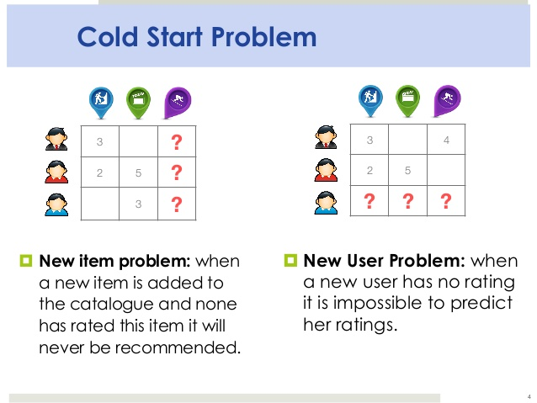
Introduction : Cold start problem

Slide 6
Problem Statement
Original motivation: modifying Node2vec’s approach to make link prediction better for cold start nodes in directed temporal graphs
We classify a node as a cold start node if it only has one edge to another node in the graph.
To address this problem, we create a temporal graph embedding technique, called the “friend of friend” method, which we use for link prediction (for both cold start and non-cold start nodes).
We compare our method with Node2vec for evaluation.

Slide 7
Intuition #1
Observation: In directed graphs, and especially for new nodes (i.e. cold starts), following a directed random walk, a la node2vec may not be the best idea.
Idea : A friend of friend node of a node is a better place to start a random walk
Friend of friend node: if u -> v is a directed edge in E, fof(u) = {u’ : u’->v in E}
Pick friends of friends with probability proportional to their degree
Justification : Jaccard similarity between the the links made by the friend of friend nodes, and the cold-start node in question is higher than the Jaccard similarity of nodes which are on a directed path starting from the cold start node.

Slide 8
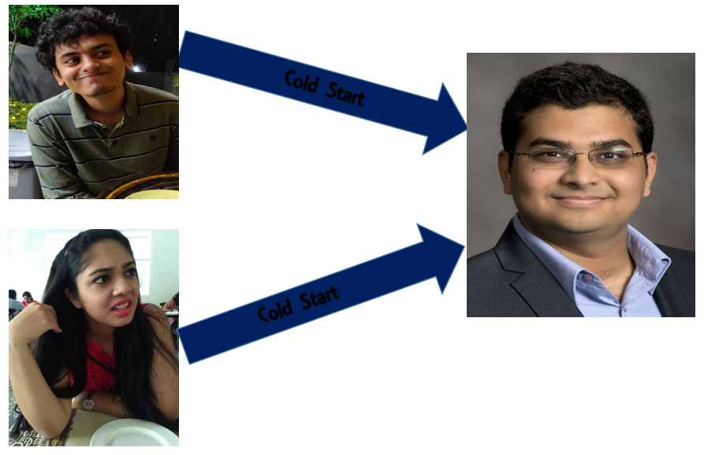
Example: Directed Temporal Graph of Emails

Slide 9
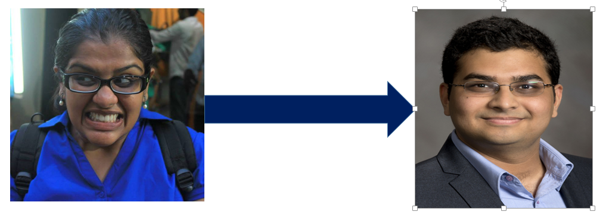
Example

Slide 10
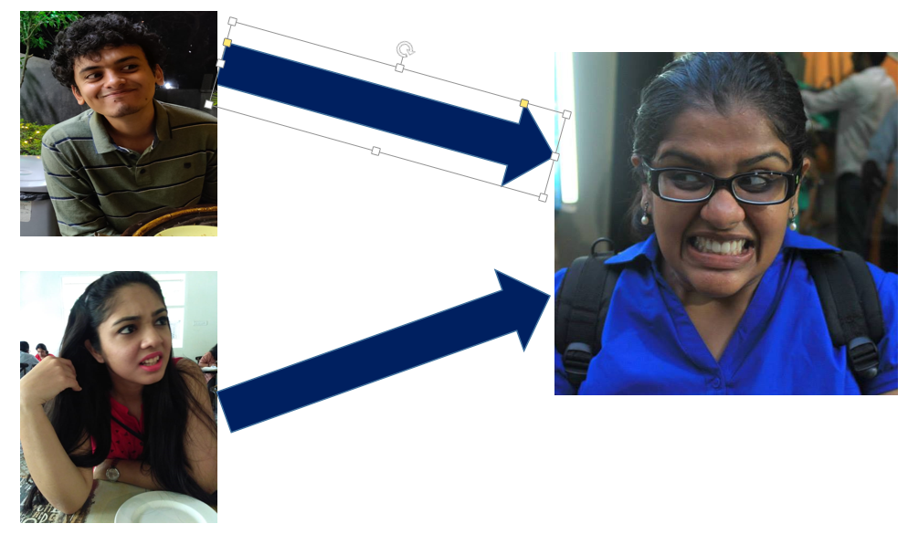
Example

Slide 11
Intuition #2
Observation: Temporal connections happen in spurts, and not uniformly, and the latest spurt should be the most important to determine the embedding of a node.
Idea: Bias the random walk by making edges in the latest spurt of connection forming have a higher probability of traversal
Justification: 1-D K -means clustering of timestamps of link-formation for a single node shows a small number of relatively dense clusters

Slide 12
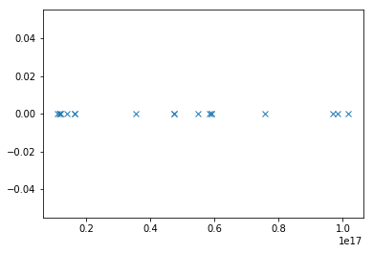
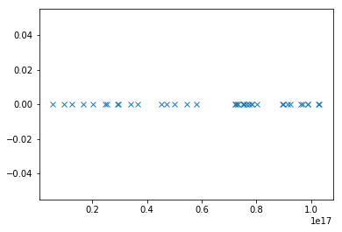
Links formed by nodes over time

Slide 13
Intuition #3
Observation: Once a node has made enough links, the friend of friend approach is not as desirable, since random walks starting at the node itself capture sufficient information
Idea: Have multiple random walks, and probabilistically choose either the friend of friend method, or the temporally biased random walk starting at the node itself. The probability should depend on the number of links the node has formed
Justification: The more links a node has, the more noise is contained in the friend of friend nodes, making them more unreliable, and the less we even need the friend of friends in the first place

Slide 14
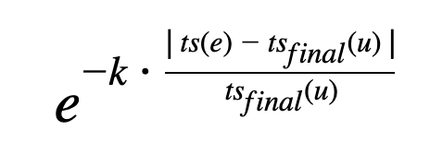
Mathematically speaking
Sampling strategy for nodes:
p * fof_sample(node) + (1 - p) * temporal_sample(node)
p = 1 / (1 + degree(node))
Temporal weighting of edge e:
e: (u -> v, timestamp= ts(e))
Temporal biasing =

Slide 15
Datasets
Nature of datasets : Temporal , Unsigned, Homogeneous networks
CollegeMSG Dataset : 1899 nodes, 59835 temporal edges, 20296 edges
Reddit Hyperlink Dataset : 55863 nodes, 858490 temporal edges, 20296 edges

Slide 16
Experiments
Node2Vec Hyper-Parameter Tuning : Optimise for p, q, num_walks, walk_length. The optimal values are as follows : p=1, q=1 ( default), num_walks = 8, walk_length = 10
Temporal Bias Factor Tuning : Optimise for the value of k, to obtain the highest Mean Average Precision MAP. The optimal obtained value was k = 5.

Slide 17
Testing and Results
Testing in two phases.
First, we predict links for cold-start nodes. we use the graph in a static fashion.
We partition our dataset into two parts, the first 75% is the training set and the rest is the test set.
We determine all the cold-start nodes in our training set and attempt to predict the links that are to appear in the test set.
We run this for 50 iterations on both datasets using Node2Vec and FriendOfFriend method.

Slide 18
Testing and Results
2.
Second, we attempt to predict links in a dynamic fashion akin to a real-world system.
For this case, we try 4 different splits of the graph into train and test, 20/80,40/60,60/40,80/20.
We attempt to predict the links that appear in the test set. We perform this for all nodes, not only cold-starts.
We run this for 50 iterations on both datasets using Node2Vec and FriendOfFriend method and then compare our results.

Slide 19
Testing and Results
Success Evaluation Measures : Average over the iterations for (i) Number of successful link Predictions and (ii) Mean Average Precision (MAP).
For cold starts, we used MAP@10, and the top 10 links as the ranked list for MAP@10, while for all nodes
(iii) Precision
(iv) Recall
(v) F1 Score

Slide 20
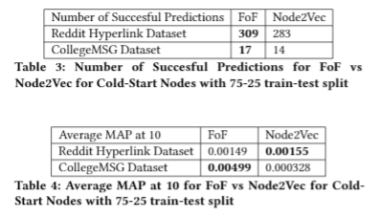
Results

Slide 21
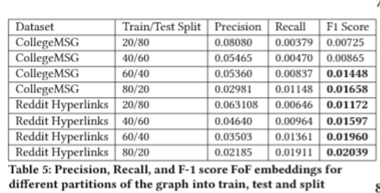
Results

Slide 22
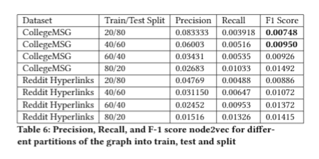
Results

Slide 23
Drawbacks
Time Complexity : High time complexity due to computing random walk for each node, FoF method for each node
Number of Datasets, Dataset Dependency : Only two datasets used. K is dataset dependent.
Parameter Tuning : Hyperparameters tuned manually

Slide 24
Conclusions and Future Work
FoF Technique is better than vanilla Node2Vec both for cold start link prediction and for link prediction for general nodes.
Our intuition has both statistical and empirical validity on the task of link prediction, as our methods outperform node2vec.
Future work :
Add parallelism to the code to make our algorithm faster.
Try the friend of friend modification for other graph embedding techniques like convolutional graph embeddings.
Evaluate our method on new datasets to find optimal hyperparameter values.

Slide 25
Questions ?

