Slide 1
Secondary Analysis
Electric Vehicle

Slide 2
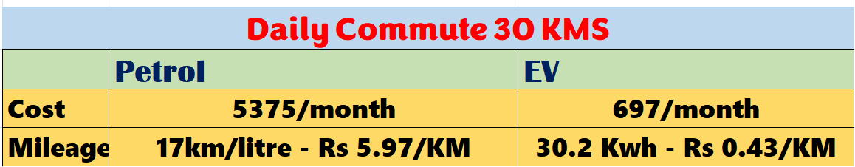
Cost Savings
Domestic power tariffs range from Rs 8-10 per unit, the monthly running cost is a fraction of cost for petrol or diesel.
Average petrol cost is Rs 98.2
Environmental Concerns
Petrol vehicles produce carbon dioxide (CO2) emissions, while EVs produce no CO2 emissions
Government Incentives
The FAME-India program provides subsidies for buying electric vehicles. FAME II has a budget of Rs 10,000 crore to make EVs more affordable.
The PLI scheme offers financial incentives to EV manufacturers to boost local production, making EVs cheaper for consumers.
The battery swapping policy aims to standardize EV batteries for efficient charging, especially for vehicles like 2-wheelers and 3-wheelers.
Import duties on EV components like lithium-ion batteries have been reduced. This lowers costs for local manufacturers.

Slide 3
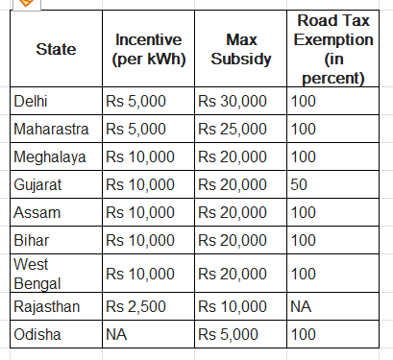
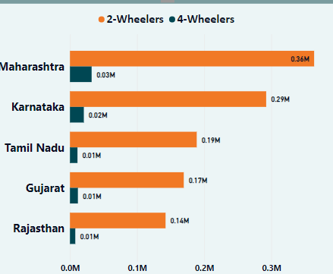
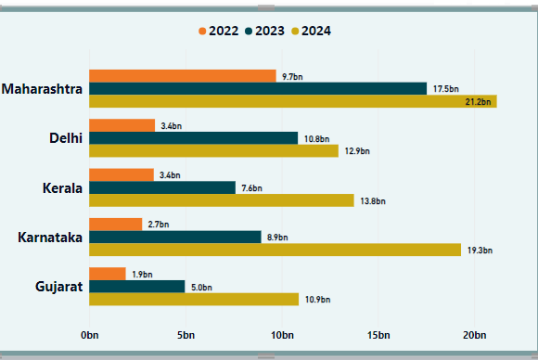
State Government subsidies
Sales and Revenue
It is interesting to note that Andhra Pradesh, Karnataka, Madhya Pradesh, Telangana, Tamil Nadu, Uttarakhand, Punjab and Uttar Pradesh do not offer any additional incentives to buyers but however, extend the 100 percent road tax exemption benefit to owners.

Slide 4
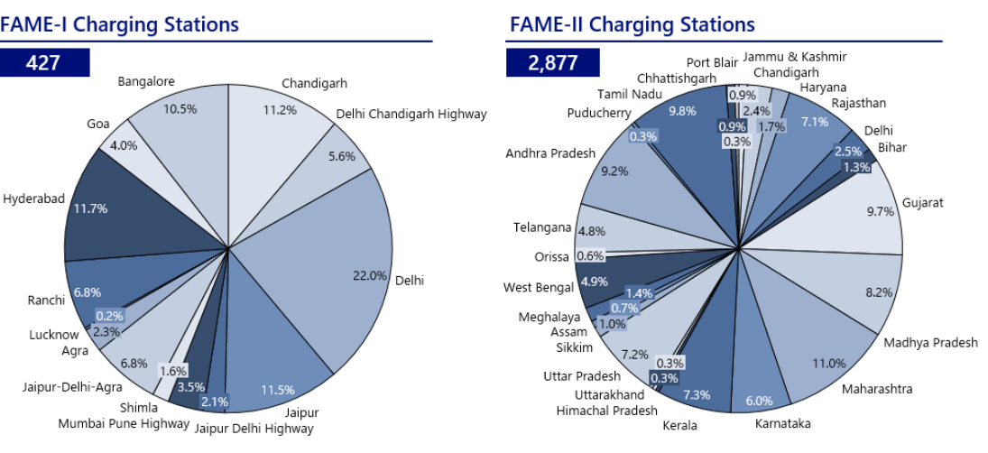
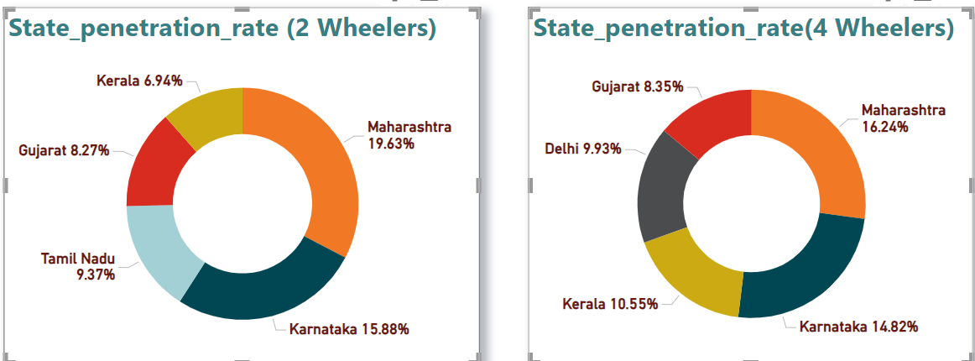
INFRASTRUCTURE Department of Heavy Industries sanctioned 3,397charging stations under FAME –I & FAME-II The top 5 states Maharastra TamilNadu Gujarat Andhra Pradesh MadhyaPradesh have been allocated with ~48% of total charging stations Avability of charging stations positively impact the sales and Revenue in these states

Slide 5
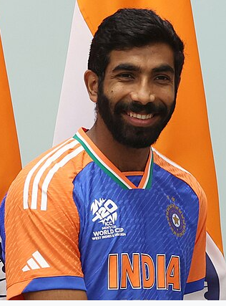
Ambassador
Jasprit Jasbirsingh Bumrah (born 6 December 1993) is an Indian international cricketer who plays for the Indian cricket team in all formats of the game. A right-arm fast bowler with a unique bowling action, Bumrah is widely regarded as one of the best bowlers in the world and one of the greatest fast bowlers India has ever produced.
Bumrah’s numbers read as follows: balls bowled, 13 wickets taken at an average of 8.15 and an economy of 4.12.
EVs would save drivers money upfront and over time, reduce emissions produced upstream during electricity generation, and limit the strain EVs have on the grid.
Bumrah is highly efficient in bowling.
EVs are more energy efficient than gasoline vehicles.

Slide 6

Top states based on subsidies provided, ease of doing business, stability in governance.
Gujarat:
Subsidies: Known for its industrial policies, Gujarat offers various subsidies for sectors like manufacturing, renewable energy, and textiles.
Ease of Doing Business: Consistently ranks high due to streamlined processes and robust infrastructure¹.
Governance: Stable governance with a focus on economic development¹.
Maharashtra:
Subsidies: Provides incentives for IT, electronics, and automobile industries.
Ease of Doing Business: Mumbai, the financial capital, contributes to its high ranking².
Governance: Strong governance with a focus on urban development and industrial growth².
Karnataka:
Subsidies: Offers subsidies for startups, especially in the tech sector.
Ease of Doing Business: Bengaluru is a major tech hub, enhancing the state’s business environment³.
Governance: Known for stable and progressive governance³.
Tamil Nadu:
Subsidies: Incentives for automobile, electronics, and textile industries.
Ease of Doing Business: High ranking due to efficient administrative processes⁴.
Governance: Stable governance with a focus on industrialization⁴.
Telangana:
Subsidies: Known for its startup-friendly policies and subsidies for IT and biotech sectors.
Ease of Doing Business: Hyderabad is a key contributor to its high ranking.
Governance: Progressive governance with a focus on innovation and technology.

Slide 7

Top 3 recommendations for AtliQ Motors.
COST : Many potential buyers still face difficulties due to the high upfront cost of EVs.
INFRASTRUCTURE : The nation’s inadequate charging infrastructure is still a source of concern.
MILEAGE : Long-distance travel is still hampered by the short driving ranges of some Electric vehicle models.
AWARENESS : The general public’s understanding of the advantages and potential of EVs needs to be further improved.

