Slide 1
Data Warehousing

Slide 2
Why Data Warehouse?
Notes:
we invent something only if there is a need for that thing….today we are going to see what data warehousing is…data warehouse is evolved to satisfy some needs….we will see some of these need now

Slide 3
Scenario 1
ABC Pvt Ltd is a company with branches at Mumbai, Delhi, Chennai and Banglore. The Sales Manager wants quarterly sales report. Each branch has a separate operational system.

Slide 4
Scenario 1 : ABC Pvt Ltd.
Mumbai
Delhi
Sales per item type per branch
for first quarter.
Sales
Manager
Chennai
Banglore

Slide 5
Solution 1:ABC Pvt Ltd.
Extract sales information from each database.
Store the information in a common repository at a single site.

Slide 6
Solution 1:ABC Pvt Ltd.
Mumbai
Data
Warehouse
Report
Delhi
Query &
Analysis tools
Sales
Manager
Chennai
Banglore

Slide 7
Scenario 2
Cakes & Cookies is a small,new company.President of the company wants his company should grow.He needs information so that he can make correct decisions.

Slide 8
Solution 2
Improve the quality of data before loading it into the warehouse.
Perform data cleaning and transformation before loading the data.
Use query analysis tools to support adhoc queries.

Slide 9
Solution 2
Expansion
sales
Data
Warehouse
Query Analysis
tool
President
time
Improvement

Slide 10
What is Data Warehouse?

Slide 11
Definition
A data warehouse is a type of data management system that is designed to enable and support business intelligence (BI) activities, especially analytics.
Data warehouses are solely intended to perform queries and analysis and often contain large amounts of historical data.
The data within a data warehouse is usually derived from a wide range of sources such as application log files and transaction applications.

Slide 12
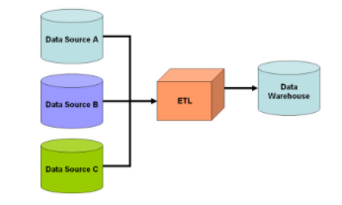
Definition
Technically Data warehouse is a warehouse filled with data
We collected data from various source to centralized it in a data warehouse
A data warehouse is not the same as a database. Data warehouse use database as a platform
Data is not moved but copied.

Slide 13
Elements of a Data Warehouse
A typical data warehouse often includes the following elements:
A relational database to store and manage data
An extraction, loading, and transformation (ELT) solution for preparing the data for analysis
Statistical analysis, reporting, and data mining capabilities
Client analysis tools for visualizing and presenting data to business users
Other, more sophisticated analytical applications that generate actionable information

Slide 14
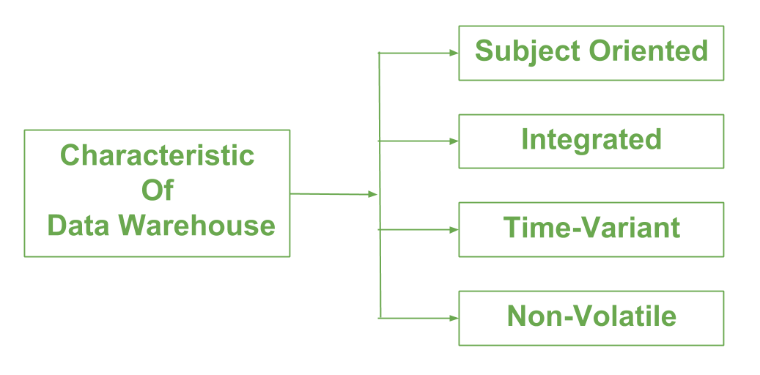
Properties
A data warehouse is
-subject-oriented,
-integrated,
-time-variant,
-nonvolatile
collection of data in support of management’s
decision making process.

Slide 15
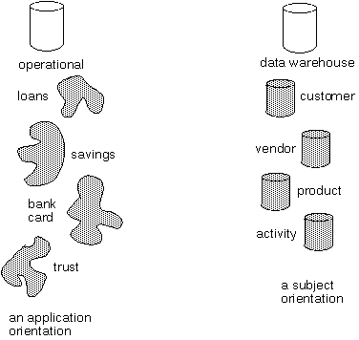
Subject-oriented
Data warehouse is organized around subjects such as sales,product,customer.
It focuses on modeling and analysis of data for decision makers.
Excludes data not useful in decision support process.

Slide 16
Integration
Data Warehouse is constructed by integrating multiple heterogeneous sources.
Data Preprocessing are applied to ensure consistency.
RDBMS
Data
Warehouse
Legacy
System
Flat File
Data Processing
Data Transformation

Slide 17
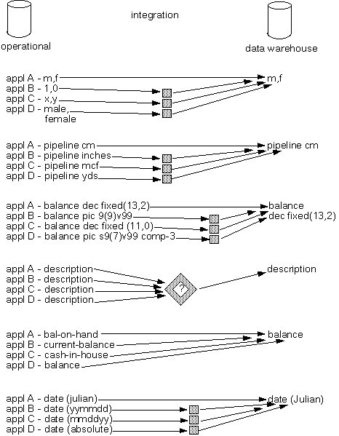
Integration
In terms of data.
encoding structures.
Measurement of
attributes.
physical attribute.
of data
naming conventions.
Data type format
remarks
Notes:
When we need to extract data from various sources, some may be manually maintained on paper, some on different legacy systems and integrating the data is a laborious work. Many systems provide some DTS systems to convert data in appropriate format and provide necessary transformations

Slide 18
Time-variant
Provides information from historical perspective e.g. past 5-10 years
Every key structure contains either implicitly or explicitly an element of time

Slide 19
Nonvolatile
Data once recorded cannot be updated.
Data warehouse requires two operations in data accessing
Initial loading of data
Access of data
load
access

Slide 20
Database v/s Data Warehouse
Features | Database | Data Warehouse
Characteristics | Operational processing | Informational processing
Orientation | Transaction | Analysis
User | Clerk,DBA,database professional | Knowledge workers
Function | Day to day operation | Decision support
Data | Current | Historical
View | Detailed,flat relational | Summarized, multidimensional
DB design | Application oriented | Subject oriented
Unit of work | Short ,simple transaction | Complex query
Access | Read/write | Mostly read

Slide 21
Database v/s Data Warehouse
Features | Database | Data Warehouse
Focus | Data in | Information out
Number of records accessed | tens | millions
Number of users | thousands | hundreds
DB size | 100MB to GB | 100 GB to TB
Priority | High performance,high availability | High flexibility,end-user autonomy
Metric | Transaction throughput | Query throughput

Slide 22
Need for Data Warehousing
Industry has huge amount of operational data
Knowledge worker wants to turn this data into useful information.
This information is used by them to support strategic decision making .

Slide 23
Need for Data Warehousing (contd..)
It is a platform for consolidated historical data for analysis.
It stores data of good quality so that knowledge worker can make correct decisions.

Slide 24
Data Warehousing includes
Build Data Warehouse
Online analysis processing(OLAP).
Presentation.
Cleaning ,Selection &
Integration
RDBMS
Presentation
Flat File
Client
Warehouse & OLAP server

Slide 25
Data Warehousing Architecture
Monitoring &
Administration
OLAP Servers
Metadata
Repository
Extract Transform Load Refresh
Reconciled data
Analysis
External
Sources
Serve
Operational
Dbs
Query/Reporting
Data Mining
DATA SOURCES
TOOLS
DATA MARTS

Slide 26
Building Data Warehouse
Data Selection
Data Pre-processing
Fill missing values
Remove inconsistency
Data Transformation & Integration
Data Loading
Data in warehouse is stored in form of fact tables and dimension tables.

Slide 27
Dimensional Modelling
Dimensional modeling always uses the concepts of facts (measures), and dimensions (context).
Facts are typically (but not always) numeric values that can be aggregated.
Dimensions are groups of hierarchies and descriptors that define the facts.
For example, sales amount is a fact; timestamp, product, register#, store#, etc. are elements of dimensions.

Slide 28
Fact Tables
A fact table or a fact entity is a table or entity in a star or snowflake schema that stores measures that measure the business, such as sales, cost of goods, or profit.
To measure data in a fact table or entity, all the measures in a fact table or entity must be of the same grain.
Fact tables and entities also contain foreign keys to the dimension tables.

Slide 29
Dimension Tables
A dimension table or dimension entity is a table or entity in a star, snowflake, or starflake schema that stores details about the facts.
For example, a Time dimension table stores the various aspects of time such as year, quarter, month, and day.
The columns of a dimensional table are used to create reports or display query results.
Typically, dimension tables that are shared by multiple fact tables (or multiple dimensional models) are called shared dimensions.

Slide 30
Data Warehouse Schema
Star Schema
Fact Constellation Schema
Snowflake Schema
Notes:
We need subject oriented and multidimensional data amodel fro data warehouse which facilitates online analysis

Slide 31
Star Schema
A single,large and central fact table and one table for each dimension.
Every fact points to one tuple in each of the dimensions and has additional attributes.
Does not capture hierarchies directly.

Slide 32
Star Schema (contd..)
Store Dimension
Fact Table
Time Dimension
Store Key
Store Name
City
State
Region
Store Key
Product Key
Period Key
Units
Price
Period Key
Year
Quarter
Month
Product Key
Product Desc
Product Dimension
Benefits: Easy to understand, easy to define hierarchies, reduces no. of physical joins.

Slide 33
SnowFlake Schema
Variant of star schema model.
A single,large and central fact table and one or more tables for each dimension.
Dimension tables are normalized i.e. split dimension table data into additional tables

Slide 34
SnowFlake Schema (contd..)
Store Dimension
Fact Table
Time Dimension
Store Key
Product Key
Period Key
Units
Price
Period Key
Year
Quarter
Month
Store Key
Store Name
City Key
City Dimension
City Key
City
State
Region
Product Key
Product Desc
Product Dimension
Drawbacks: Time consuming joins,report generation slow

Slide 35
Fact Constellation
Multiple fact tables share dimension tables.
This schema is viewed as collection of stars hence called galaxy schema or fact constellation.
Sophisticated application requires such schema.

Slide 36
Fact Constellation (contd..)
Sales
Fact Table
Shipping
Fact Table
Store Key
Product Key
Period Key
Units
Price
Product Dimension
Shipper Key
Store Key
Product Key
Period Key
Units
Price
Product Key
Product Desc
Store Dimension
Store Key
Store Name
City
State
Region

Slide 37
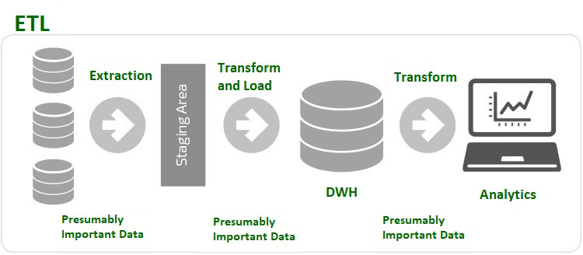
ETL Process
ETL is a process in Data Warehousing, and it stands for Extract, Transform and Load. It is a process in which an ETL tool extracts the data from various data source systems, transforms it in the staging area, and then finally, loads it into the Data Warehouse system.

Slide 38
Applications of the ETL Process
To move data in and out of data warehouses. Databases are not suitable for big data analytics therefore; data needs to be moved from databases to data warehouses which is done via the ETL process.
Data strategies are more complex than they have ever been. ETL facilitates to transform vast quantities of data into actionable business intelligence.

Slide 39
ETL: Extraction
In this step, data from various source systems is extracted which can be in various formats like relational databases, No SQL, XML, and flat files into the staging area.
The extracted data is in various formats and can be corrupted also.
Hence loading it directly into the data warehouse may damage it and rollback will be much more difficult. Therefore, this is one of the most important steps of ETL process.

Slide 40
ETL: Transformation
In this step, a set of rules or functions are applied on the extracted data to convert it into a single standard format.
It may involve following processes/tasks:
Filtering – loading only certain attributes into the data warehouse.
Cleaning – filling up the NULL values with some default values, mapping U.S.A, United States, and America into USA, etc.
Joining – joining multiple attributes into one.
Splitting – splitting a single attribute into multiple attributes.
Sorting – sorting tuples based on some attribute (generally key-attribute).

Slide 41
ETL: Loading
In this step, the transformed data is finally loaded into the data warehouse.
The rate and period of loading solely depends on the requirements and varies from system to system.

Slide 42
Approaches in ETL Process
There are two approaches in ETL:
Top-Down Approach
Kimball Methodology (Bottom-Up Approach)

Slide 43
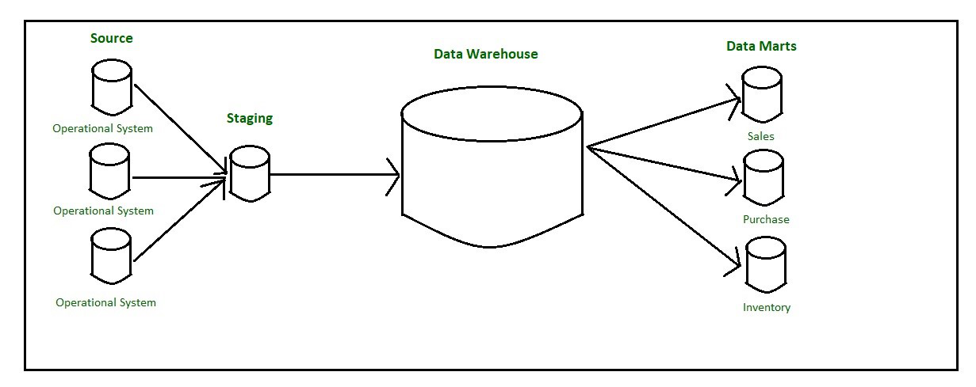
Top-Down Approach
A top‐down model approach was proposed by Inmon, to create a centralized Enterprise Data Warehouse using traditional database modeling techniques (ER Model), where the data is stored in 3NF.This data is loaded into the staging area and validated and consolidated for ensuring a level of correctness and then moved to the Operational Data Store (ODS).

Slide 44
Top-Down Approach
The data flow begins with data extraction from the operational data sources.
This data is loaded into the staging area and validated and consolidated for ensuring a level of correctness and then moved to the Operational Data Store (ODS).
Data is loaded into the Data warehouse in a parallel to avoid extracting it from the ODS.
Data is routinely extracted from the ODS and temporarily hosted in the staging area for aggregation, summarization and then extracted and loaded into the Data warehouse.

Slide 45
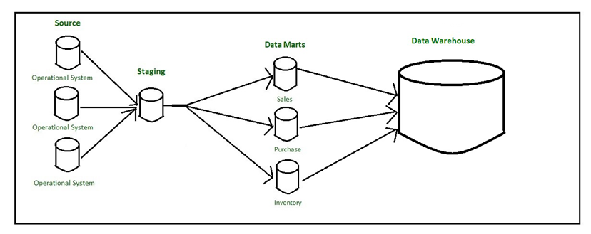
Kimball Methodology (Bottom-Up Approach)
The bottom‐up approach reverses the positions of the Datawarehouse and the Data marts. This data is loaded into the staging area and validated and consolidated for ensuring a level of correctness and then moved to the Operational Data Store (ODS).

Slide 46
Kimball Methodology (Bottom-Up Approach)
The data flow in the bottom-up approach starts with the extraction of data from operational databases into the staging area where it is processed and consolidated and then loaded into the ODS.
Once the ODS is refreshed, the present data is once again extracted into the staging area and processed.
The data from data mart is pulled to the staging area aggregated, summarized, and so on and loaded into the Data Warehouse and made available to the end-user for analysis.

Slide 47
ETL Tools
Some of the most commonly used ETL tools are:
MarkLogic,
Oracle,
Sybase,
Hevo, and
Xplenty.

Slide 48
Advantages of ETL Tools
Easy to use.
Load data from different targets at same time.
Performs data transformation as per need.
Better for complex rules and transformations.
Inbuilt Error handling functionality.
Based on GUI and offer visual flow.
Save Cost and generate higher revenue.

Slide 49
Disadvantages of ETL Tools
Not suitable for near real-time data access.
Inclined more towards batch data processing
Difficult to keep up with changing requirements.

Slide 50
Case Study
Afco Foods & Beverages is a new company which produces dairy, bread and meat products with production unit located at Baroda.
There products are sold in North, North West, and Western region of India.
They have sales units at Mumbai, Pune , Ahmedabad, Delhi, and Baroda.
The President of the company wants sales information.

Slide 51
Sales Information
Report: The number of units sold.
113
Report: The number of units sold over time
January | February | March | April
14 | 41 | 33 | 25

Slide 52
Sales Information
Report : The number of items sold for each product with
time
 | Jan | Feb | Mar | Apr
Wheat Bread |  |  | 6 | 17
Cheese | 6 | 16 | 6 | 8
Swiss Rolls | 8 | 25 | 21
Time
Product

Slide 53
Sales Information
Report: The number of items sold in each City for each product with time
 |  | Jan | Feb | Mar | Apr
Mumbai | Wheat Bread |  |  | 3 | 10
 | Cheese | 3 | 16 | 6
 | Swiss Rolls | 4 | 16 | 6
Pune | Wheat Bread |  |  | 3 | 7
 | Cheese | 3 |  |  | 8
 | Swiss Rolls | 4 | 9 | 15
City
Time
Product

Slide 54
Sales Information
Report: The number of items sold and income in each region for
each product with time.
 |  | Jan |  | Feb |  | Mar |  | Apr
 |  | Rs | U | Rs | U | Rs | U | Rs | U
Mumbai | Wheat Bread |  |  |  |  | 7.44 | 3 | 24.80 | 10
 | Cheese | 7.95 | 3 | 42.40 | 16 | 15.90 | 6
 | Swiss Rolls | 7.32 | 4 | 29.98 | 16 | 10.98 | 6
Pune | Wheat Bread |  |  |  |  | 7.44 | 3 | 17.36 | 7
 | Cheese | 7.95 | 3 |  |  |  |  | 21.20 | 8
 | Swiss Rolls | 7.32 | 4 | 16.47 | 9 | 27.45 | 15

Slide 55
Sales Measures & Dimensions
Measure – Units sold, Amount.
Dimensions – Product,Time,Region.

Slide 56
Sales Data Warehouse Model
Fact Table
City | Product | Month | Units | Rupees
Mumbai | Wheat Bread | January | 3 | 7.95
Mumbai | Cheese | January | 4 | 7.32
Pune | Wheat Bread | January | 3 | 7.95
Pune | Cheese | January | 4 | 7.32
Mumbai | Swiss Rolls | February | 16 | 42.40

Slide 57
Sales Data Warehouse Model
City_ID | Prod_ID | Month | Units | Rupees
1 | 589 | 1/1/1998 | 3 | 7.95
1 | 1218 | 1/1/1998 | 4 | 7.32
2 | 589 | 1/1/1998 | 3 | 7.95
2 | 1218 | 1/1/1998 | 4 | 7.32
1 | 589 | 2/1/1998 | 16 | 42.40

Slide 58
Sales Data Warehouse Model
Product Dimension Tables
Prod_ID | Product_Name | Product_Category_ID
589 | Wheat Bread | 1
590 | White Bread | 1
288 | Coconut Cookies | 2
Product_Category_Id | Product_Category
1 | Bread
2 | Cookies

Slide 59
Sales Data Warehouse Model
Region Dimension Table
City_ID | City | Region | Country
1 | Mumbai | West | India
2 | Pune | NorthWest | India

Slide 60
Sales Data Warehouse Model
Time
Sales Fact
Product
Product
Category
Region

Slide 61
Online Analysis Processing(OLAP)
It enables analysts, managers and executives to gain insight into data through fast, consistent, interactive access to a wide variety of possible views of information that has been transformed from raw data to reflect the real dimensionality of the enterprise as understood by the user.
Product
Data
Warehouse
Region
Time

Slide 62
OLAP Cube
City | Product | Time | Units | Dollars
All | All | All | 113 | 251.26
Mumbai | All | All | 64 | 146.07
Mumbai | White Bread | All | 38 | 98.49
Mumbai | Wheat Bread | All | 13 | 32.24
Mumbai | Wheat Bread | Qtr1 | 3 | 7.44
Mumbai | Wheat Bread | March | 3 | 7.44

Slide 63
OLAP Operations
Drill Down
Product
Category e.g Electrical Appliance
Sub Category e.g Kitchen
Product e.g Toaster
Region
Time

Slide 64
OLAP Operations
Drill Up
Product
Category e.g Electrical Appliance
Sub Category e.g Kitchen
Product e.g Toaster
Region
Time

Slide 65
OLAP Operations
Slice and Dice
Product
Product=Toaster
Region
Region
Time
Time

Slide 66
OLAP Operations
Pivot
Product
Product
Region
Time
Time
Region

Slide 67
OLAP Server
An OLAP Server is a high capacity,multi user data manipulation engine specifically designed to support and operate on multi-dimensional data structure.
OLAP server available are
MOLAP server
ROLAP server
HOLAP server

Slide 68
Presentation
Product
Reporting
Tool
Region
Report
Time

Slide 69
Data Warehousing Tools
Data Warehouse
SQL Server 2000 DTS
Oracle 8i Warehouse Builder
OLAP tools
SQL Server Analysis Services
Oracle Express Server
Reporting tools
MS Excel Pivot Chart
VB Applications

Slide 70
Thank You

