Slide 1
Directional antenna pointing system without using a navigation system to increase the UAV's communication range
BRICS2024-DroneDirection

Slide 2
What problems are we solving?
01
02
03
04
Poor signal quality over long distances
The need for GPS and compass for positioning
High cost of GPS solutions
No mass-implemented analogs in the Russian Federation

Slide 3

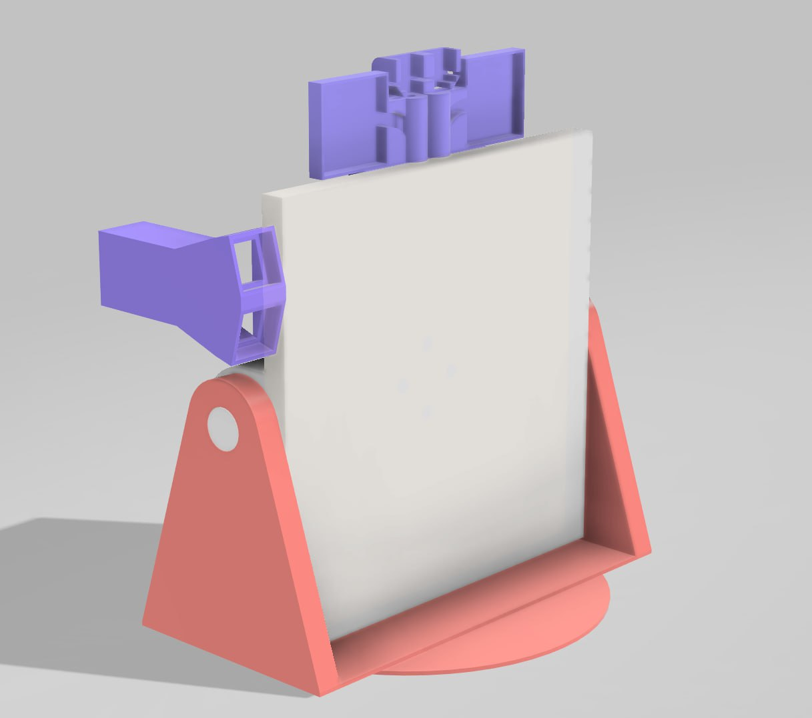
Solution
Directional antenna pointing system without using a navigation system to increase the UAV's communication range

Slide 4
Advantages
No need for drone telemetry data
Increases the working range of the antenna
No compass or GPS required
Low cost of components
Russian software
Complex product software + hardware

Slide 5
How it works

Slide 6
Process
Automatic antenna pointing and image transfer to the web application
Installation of antenna tracker
Launching web application by the user
Connection of the device to the operational network
Search for the UAV video channel

Slide 7
Key benefits
01
02
03
04
05
Automatic antenna pointing based on signal strength
Stable communication over long distances
No need for drone telemetry data
User-friendly web application for management and use
2S-6S battery power

Slide 8
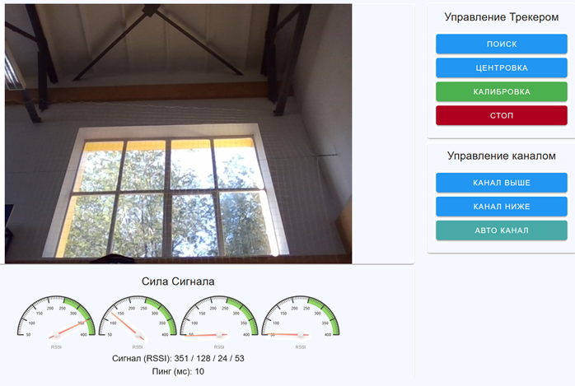
Software
Application user interface with buttons for tracker control, channel selection, and displaying telemetry from antennas.

Slide 9
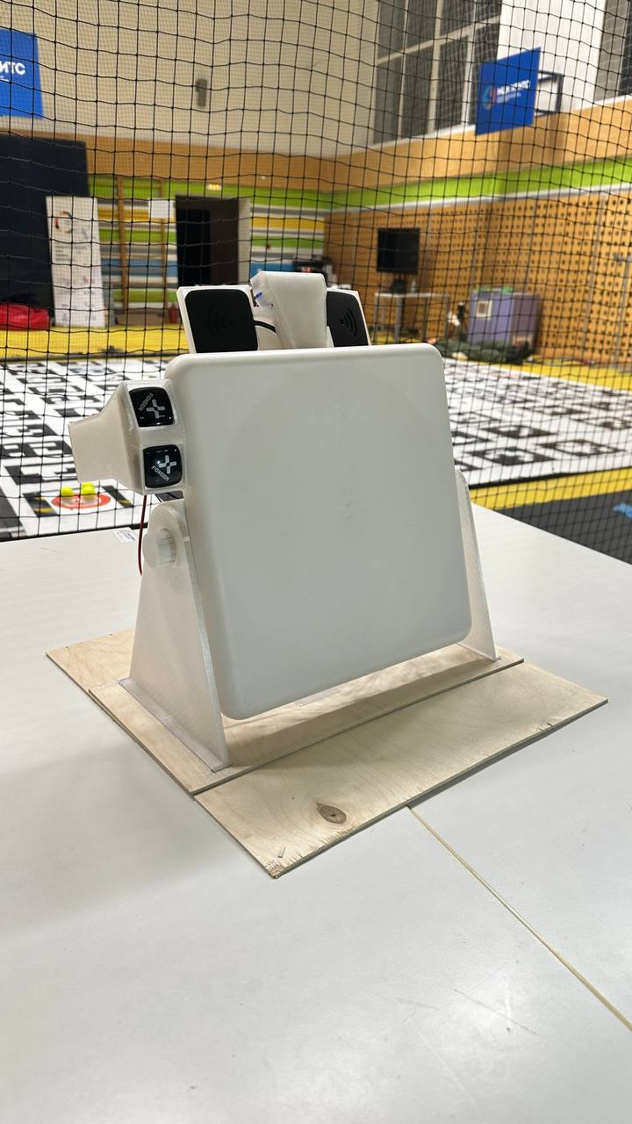
Hardware
Directional antennas for horizontal pointing
Directional antennas for vertical guidance
Directional antenna for video signal reception

Slide 10
Usage options
Racing
Forest fires
Educational institutions
Cheaper cost per flight hour when broadcasting UAV video over long distances
Low cost of components installed in the UAV in the face of the equipment loss risks
Can be used for educational purposes due to the low cost of components

Slide 11
Technology
Hardware
Development Environment
Server: Raspberry Pi
Antenna Tracker:
Arduino
SkyDroid PF V 5.8G
Directional Antennas
Frontend: Vue.js
Backend: Python (FastAPI)
Antenna Tracker: C lang

Slide 12
Progress to date
Now
In the future
developed web application
analog antenna tracker
antenna tracker design
web application modernization
implementation of a digital communication model
modernization of the design to increase durability
design simplification

Slide 13
Thanks for your attention!
Competitors:
Romanov Pavel
Kolupaev Ivan
Morochko Alexander
Laukhin Daniil
Gerasin Vladislav
Dareev Ganil

