Slide 1
Quadratic Assignment Problem
By Daniel Swikert and Glen Amante

Slide 2
About QAP
Description (from Wikipedia)
“There are a set of n facilities and a set of n locations. For each pair of locations, a distance is specified and for each pair of facilities a weight or flow is specified (e.g., the amount of supplies transported between the two facilities). The problem is to assign all facilities to different locations with the goal of minimizing the sum of the distances multiplied by the corresponding flows.”
Important for Economics and Circuit Board/Microchip design

Slide 3

A Mathematical Definition
Given a distance matrix (d) and a flow matrix (f); find the minimum of the summation of the distance between locations and the flow of the facilities in those locations
Min$\sum{d(L1,L2)∗f(L1\left[F\right],L2\left[F\right])}$

Slide 4

e.g) Given N = 3 and two matrices: d = $\begin{matrix}0 & 3 & 2 \\ 3 & 0 & 2 \\ 2 & 2 & 0\end{matrix}$ and f = $\begin{matrix}0 & 9 & 4 \\ 9 & 0 & 1 \\ 4 & 1 & 0\end{matrix}$ the minimum permutation would be {2,3,1} with a value of 58.
Distance Line
Location 1
Facility 2
Flow Line
1
9
Location 2
3
2
Location 3
Facility 3
Facility 1
2
2* x [(3 x 1) + (4 x 2) + (9 x 2)] = 58
* Multiply times 2 because of symmetrical matrices
4

Slide 5
A Recent History of QAP
July 2011
An N = 30 instance (Tai30b) was optimally solved for the first time using parallel code and the Palmetto Supercomputing Cluster at Clemson University
August 2017
An N = 256 instance (Tai256c) had a new lower bound discovered.

Slide 6
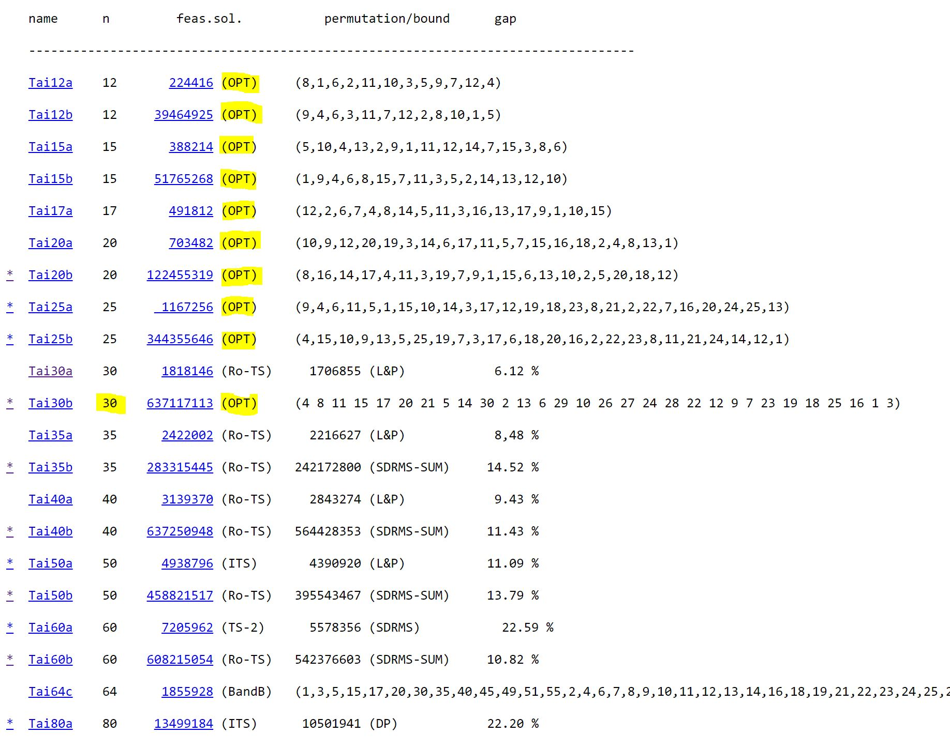
Notes:
Highest Opt solved on LIB was 128

Slide 7
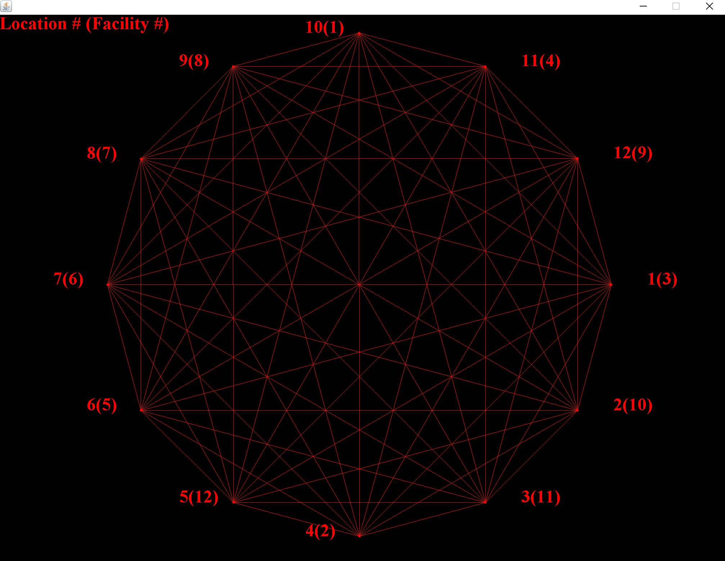
Flow Visualization (N = 12)
Notes:
1652

Slide 8
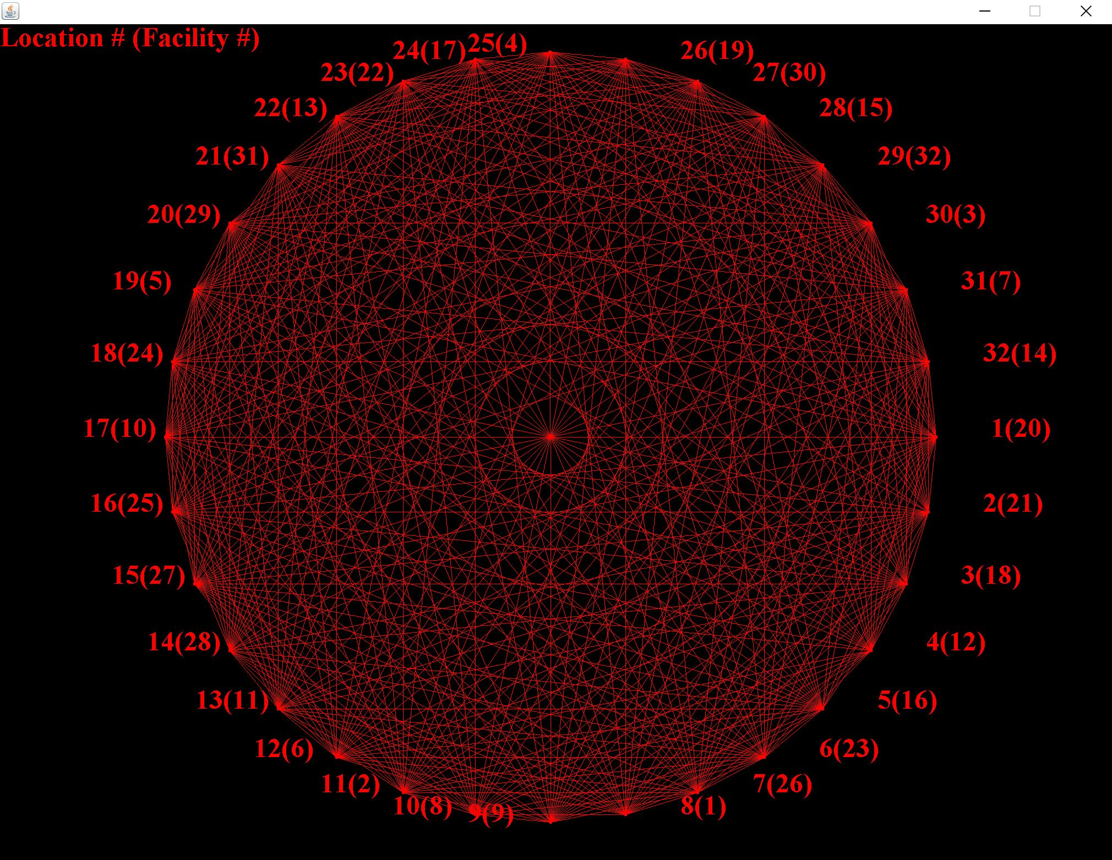
Flow Visualization (N = 32)
Notes:
471

Slide 9
Our Genetic Algorithm Approach
Setup: A population of random permutations of the “facilities” is created.
A percentage of the best permutations are selected to “reproduce”
2 “parents” are split at a random index, elements after index are added to opposite parent.
The 2 “children” replace the worst of the previous population.
Population is sorted.
Mutation odds are ran (10% chance, in order to delay convergence)
WOC is ran on % of population
This repeated for an X number of generations or convergence.
Notes:
Because one of the stopping criteria is convergence, we must have a relatively high chance of mutation to delay this.

Slide 10
Crossover Operation
Random index = 3
3
5
4
1
2
1
3
5
4
2

Slide 11
Crossover Operation
Random index = 3
3
5
4
1
2
1
3
5
2
4

Slide 12
Crossover Operation
Random index = 3
Already in array
3
5
4
2
4
1
3
5
1
2

Slide 13
Crossover Operation
Already in array
Random index = 3
3
5
4
2
4
1
3
5
1
2
Find next one NOT IN the array

Slide 14
Crossover Operation
Already in array
Random index = 3
3
5
4
2
1
1
3
5
4
2
Find next one NOT IN the array

Slide 15
Crossover Operation
Random index = 3
3
5
4
2
1
Children Arrays
1
3
5
4
2

Slide 16
Wisdom of The Crowds
Initialization
create a matrix of n x n size where n is the number of facilities/locations.
increments the matrix cell for every location-facility combination
For example if the location 3 holds facility 6 then the crowd matrix[3][6] is incremented

Slide 17
Wisdom of The Crowds
For each Location index find the Facility with the highest value.
If this facility hasn’t already been used, add it to the location.
If location has already been used add next highest facility in matrix.
Continue until all locations have unique facilities

Slide 18
Data Used
Known Optimal Data
Data files where the optimal solution is known were used to test the program
Files were from the QAPLIB http://anjos.mgi.polymtl.ca/qaplib/
Data in the form:
N
A
B
Where N is the number of facilities/location; A is the distance matrix and B is flow matrix.

Slide 19
Data Creation
A data generator was created for the project. Generates the file with random integers in symmetrical N x N matrices.
A brute force solver was also included to get optimal solution for generated files (for N <= 12)

Slide 20
Results
GA v GA & WOC (Best of 10 Runs)
N | Optimal | GA Minimum | GA & WOC Minimum
12 | 1652 | 1652 | 1652
16 | 3720 | 3724 | 3720
18 | 5358 | 5382 | 5384
20 | 6922 | 6980 | 6952
32 | 438 | 456 | 446
64 | 116 | 130 | 122
128 | 64 | 122 | 128

Slide 21
Results

Slide 22
Results

Slide 23
The End
Questions?

