Slide 1
02-10

Slide 2
Data Exploration
I found the model could be improved
MAE: 7,54ºC
Bias: -7.16ºC
Nominal load assumed PF = 1
R assumed copper losses = all losses -> s = 0

Slide 3
Adding PF and s
Adding PF and s into the model and computing least square errors to find the optimal values found:
PF = 0.85
s = -1.4
A negative value for s makes no physical sense
Thus, I concluded the factory parameters have drifted over time

Slide 4
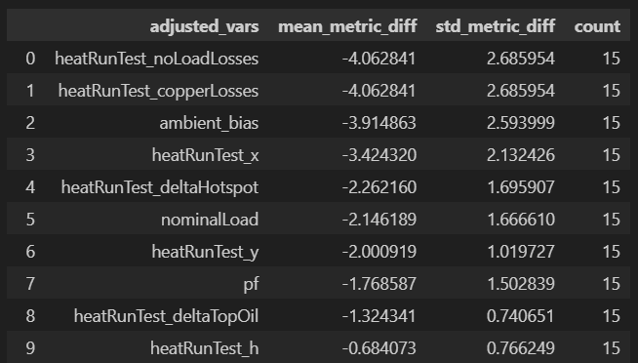
Fitting the whole model
I assumed that I would have to fit all variables to the data.
First I tried fitting one variable at a time to find the most relevant variables
They turned out to be:
(metric is MAE)

Slide 5


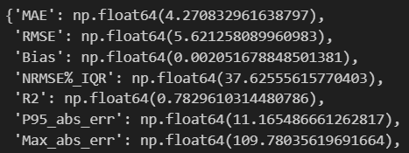
Approaches for fitting the model
Fitting all
Fitting top 4
Correcting Bias (+7.16)
R2 is much more promising for the last model? BUG

Slide 6
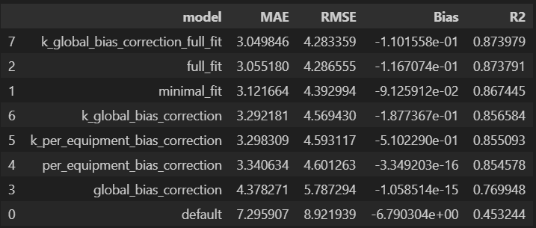
All types of models: full data

Slide 7
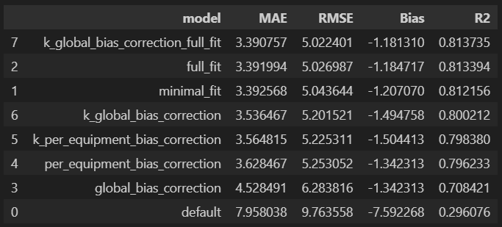
All types of models: train and test

Slide 8
Next Steps

Slide 9
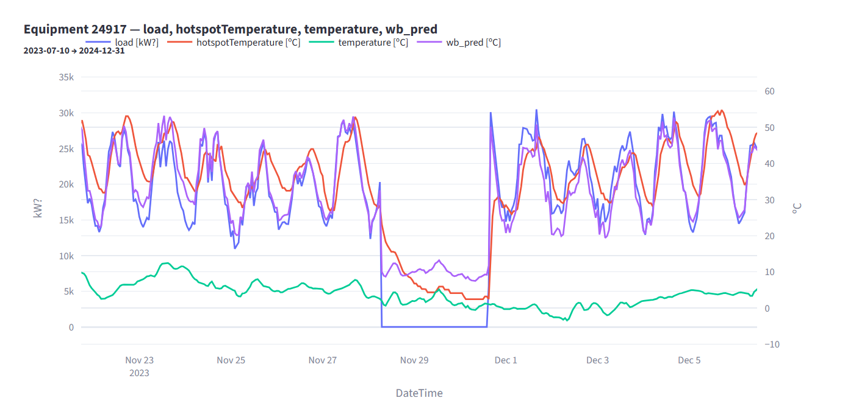
Difusion Term

Slide 10
Explore Causality
Ethan shared his report on causality algorithms.
Explore additional variables (wind speed and relativeHumidityPercentage) to justify including them as input variables.

Slide 11
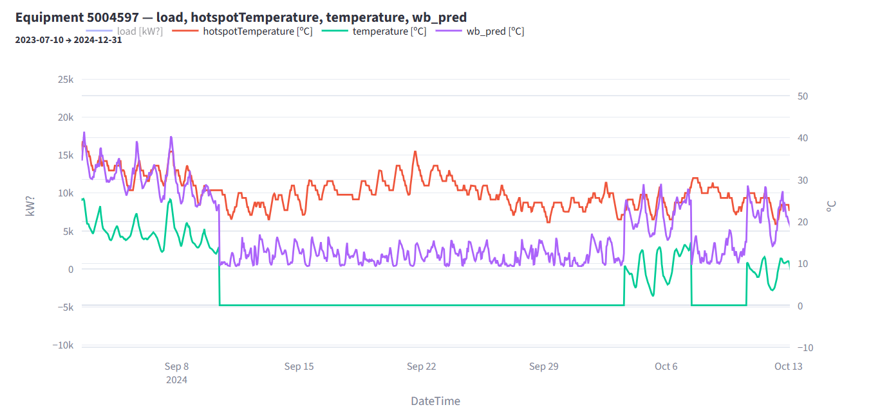
Issues with the data
Sometimes ambient T is missing (=0.0)

Slide 12
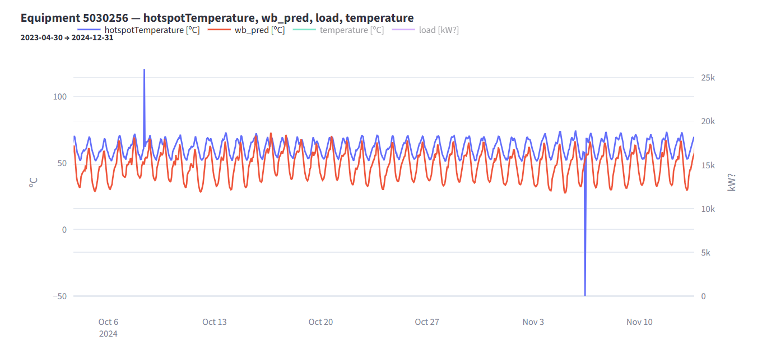
Outliers

Slide 13
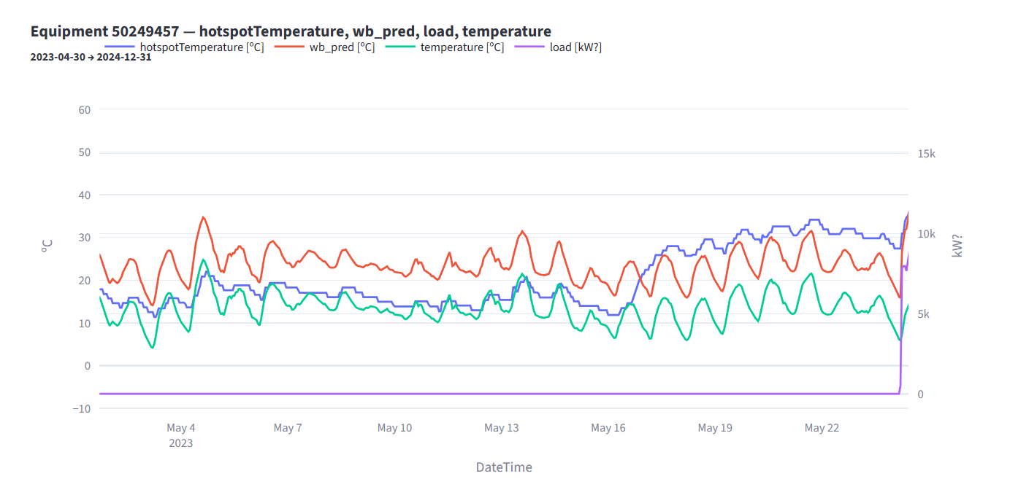
Model limitations (energized transformer assumption)

