Slide 2
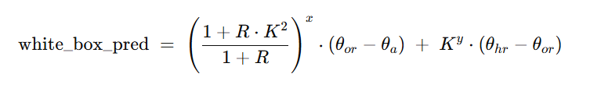
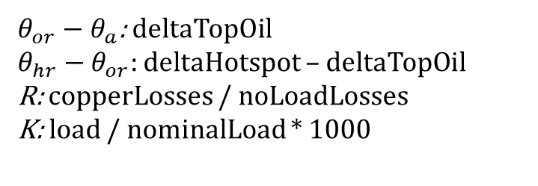
Whitebox model
Top-oil rise under load
Hot-spot rise over top-oil
$θ_{or}−θ_{a}$: deltaTopOil
$θ_{hr}−θ_{or}:$ deltaHotspot – deltaTopOil
R: copperLosses / noLoadLosses
K: load / nominalLoad * 1000
PROBLEMS:
Is nominal load measured in Watts or V A?
Should R use

