Slide 1
23-09

Slide 2
Last week
I found the model could be improved
MAE: 7,54ºC
Bias: -7.16ºC
Nominal load assumed PF = 1
R assumed copper losses = all losses -> s = 0

Slide 3
Adding PF and s
Adding PF and s into the model and computing least square errors to find the optimal values found:
PF = 0.85
s = -1.4
A negative value for s makes no physical sense
Thus, I concluded the factory parameters have drifted over time

Slide 4
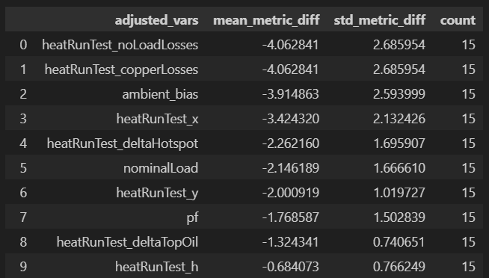
Fitting the whole model
I assumed that I would have to fit all variables to the data.
First I tried fitting one variable at a time to find the most relevant variables
They turned out to be:
(metric is MAE)

Slide 5


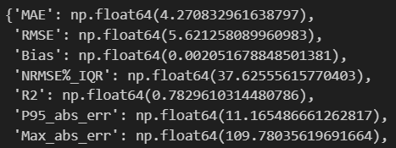
Approaches for fitting the model
Fitting top 4
Fitting all
Correcting Bias (+7.16)

Slide 6
Issues with the data
Sometimes ambient T is missing (=0.0)
(lost the picture)

Slide 7
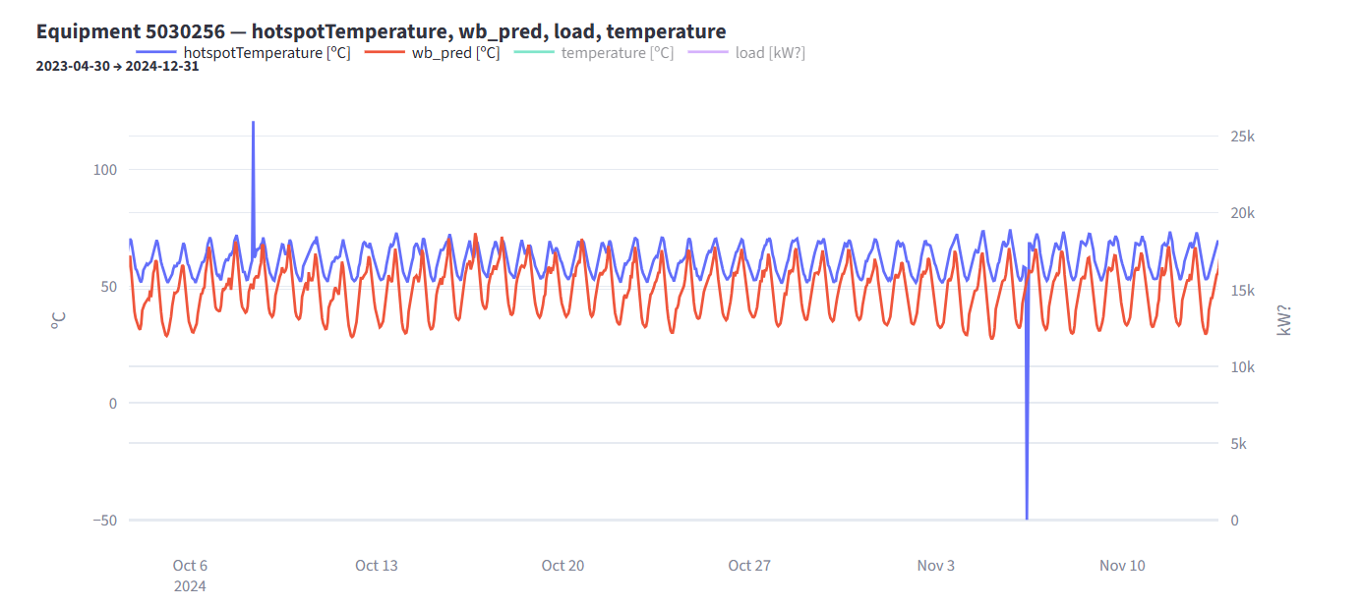
Outliers

Slide 8
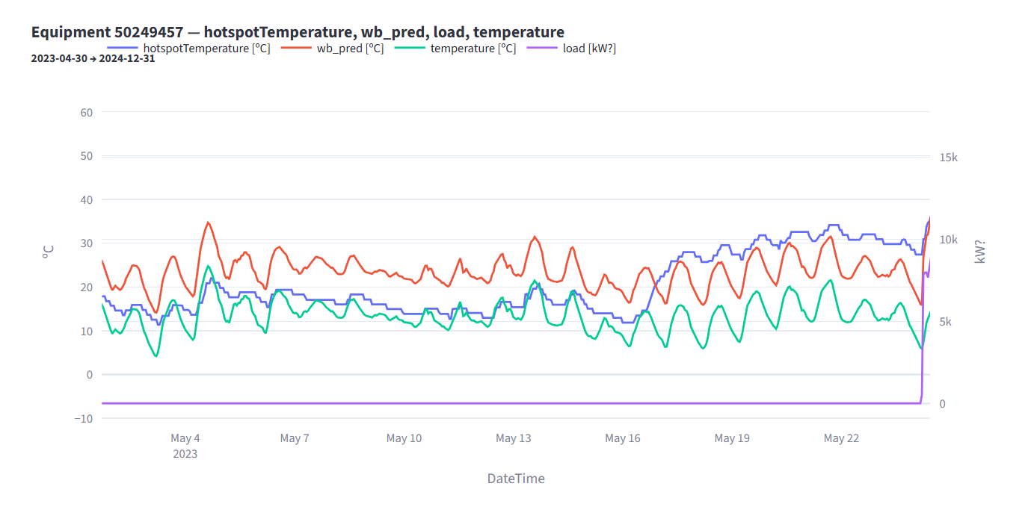
Model limitations (energized transformer assumption)

