Slide 1
Ihr Partner für digitale Transformation
Mobility, Virtualization & Security

Slide 2

Agenda
Introduction

Slide 3

1. Introduction

Slide 4
Introduction:
What?
Why?
Literature Review
Markowitz Model
LSTM
Autoencoder
Literature Review:
- Drawbacks of Markowitz
Usaga of covariance
mean variance calculated randomly
Covariance shows only sign, no stregth of movement
Linear optimization problem
Manual selection of risk vs. return
Literature Review:
- Drawbakcs of Deep Portfolio
No forecast of assets
Diversification is choosen randomly
Methodology
Methodology
Results:
Results:
Limitations:
Acknowledgement and References:

Slide 5
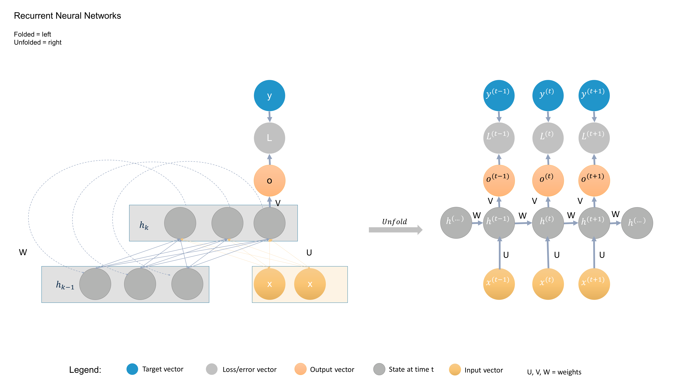



















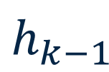
Recurrent Neural Networks
Folded = left
Unfolded = right
y
$$y^{(t−1)}$$
$$y^{(t)}$$
$$y^{(t+1)}$$
L
$$L^{(t−1)}$$
$$L^{(t)}$$
$$L^{(t+1)}$$
o
$$o^{(t−1)}$$
$$o^{(t)}$$
$$o^{(t+1)}$$
V
V
V
V
$$h^{(…)}$$
W
$$h^{(t−1)}$$
W
$$h^{(t)}$$
W
$$h^{(t+1)}$$
W
$$h^{(…)}$$
$$h_{k}$$
$$Unfold$$
W
U
U
U
U
x
x
$$x^{(t−1)}$$
$$x^{(t)}$$
$$x^{(t+1)}$$
$$h_{k−1}$$
Legend:
Target vector
Loss/error vector
Output vector
State at time t
Input vector
U, V, W = weights

Slide 6

Q & A

