Slide 1
Stock Price Prediction and Portfolio Optimization Using Recurrent Neural Networks and Autoencoders
Predictive Analytics World 2020 Berlin

Slide 2
“Prediction is very difficult, especially if it’s about the future.”
– Nils Bohr, Nobel laureate in Physics
“Only the clairvoyant could hope to predict with certainty.”
– Harry M. Markowitz, Nobel price winner in Economics

Slide 3
Introduction
Research Setup
1
Selection of least volatile stocks using autoencoders
2
Forecasting using recurrent neural networks
3
Calculating stock risk for portfolio diversification
4
Portfolio optimization using linear programming
How to automatically reduce the number of stocks used for portfolio selection?
How to forecast the value of a stock of the next 10 days?
What are the pitfalls of modern portfolio theory with regard to calculating portfolio risk?
How to better calculate portfolio risk?
How to formulate a linear programming problem to identify an optimal portfolio that includes the results of steps 1-3?

Slide 4
Literature Review

Slide 5
Literature Review
Timeline of portfolio selection methods
Heaton et.al
(Deep Portfolio)
Black-Litterman
Chamberlain and Rothschild
(Factor Model)
McKibbon
and Rose
(APT)
Markowitz, Sharpe (CAPM)
Markowitz
1952
1964
1973-1976
1983
1991
2016

Slide 6
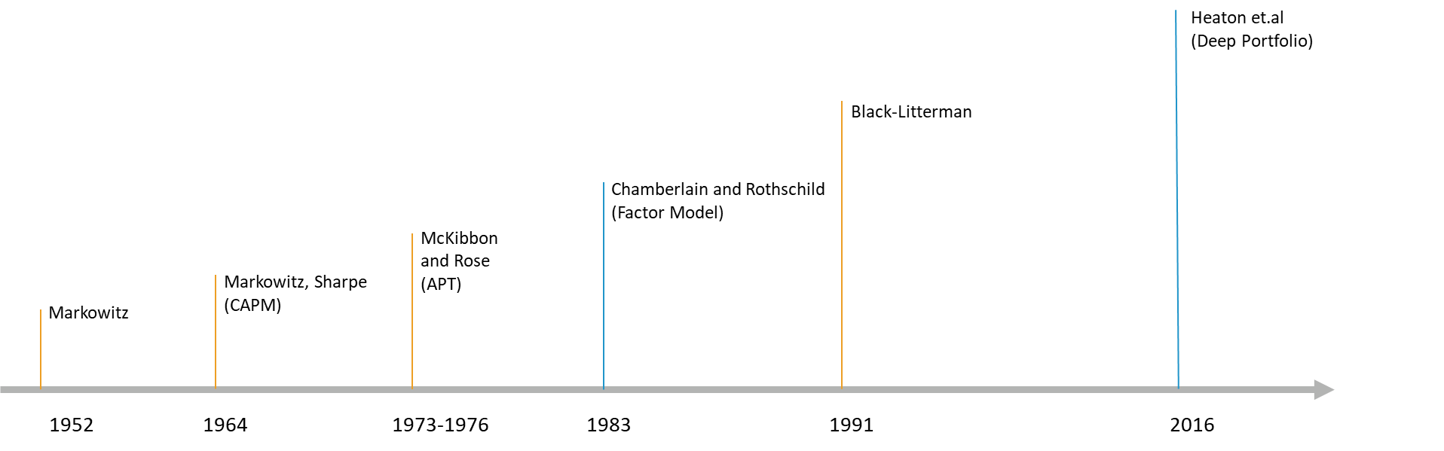
Literature Review
LSTMs
(Hochreiter, 1997)
Autoencoder
(Goodfellow et al., 2016)
Timeline of deep learning methods
Backpropagation (Werbos, 1974)
RNN
(Jordan, 1986)
BBT
(Werbos, 1990)

Slide 7
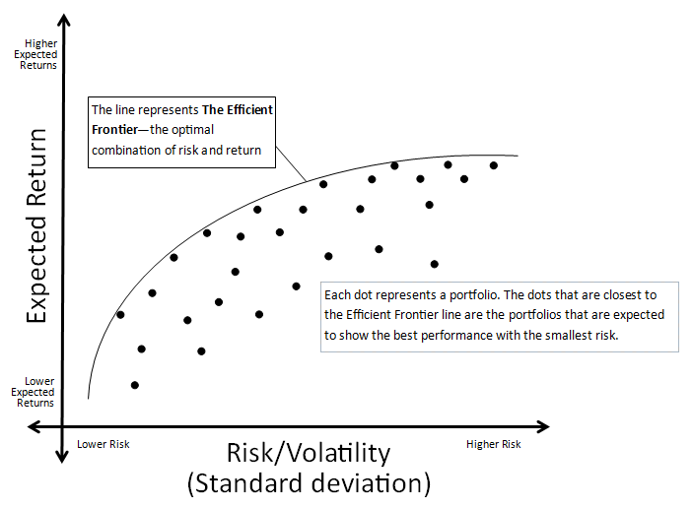
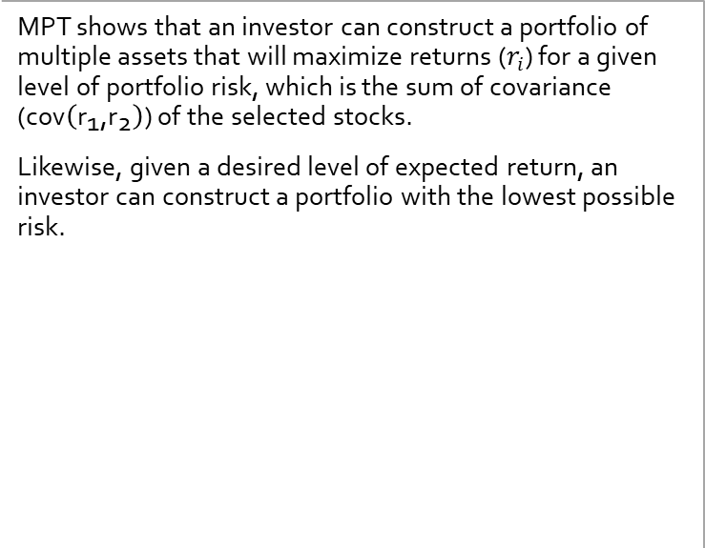
Literature Review
Modern portfolio theory (MPT) (Markowitz, 1952)
What is MPT?
MPT shows that an investor can construct a portfolio of multiple assets that will maximize returns ($r_{i}$) for a given level of portfolio risk, which is the sum of covariance ($\text{cov}\left({\text{r}}_{\text{1}}\text{,}{\text{r}}_{\text{2}}\right)$) of the selected stocks.
Likewise, given a desired level of expected return, an investor can construct a portfolio with the lowest possible risk.
Figure XX: Efficient frontier:

Slide 8

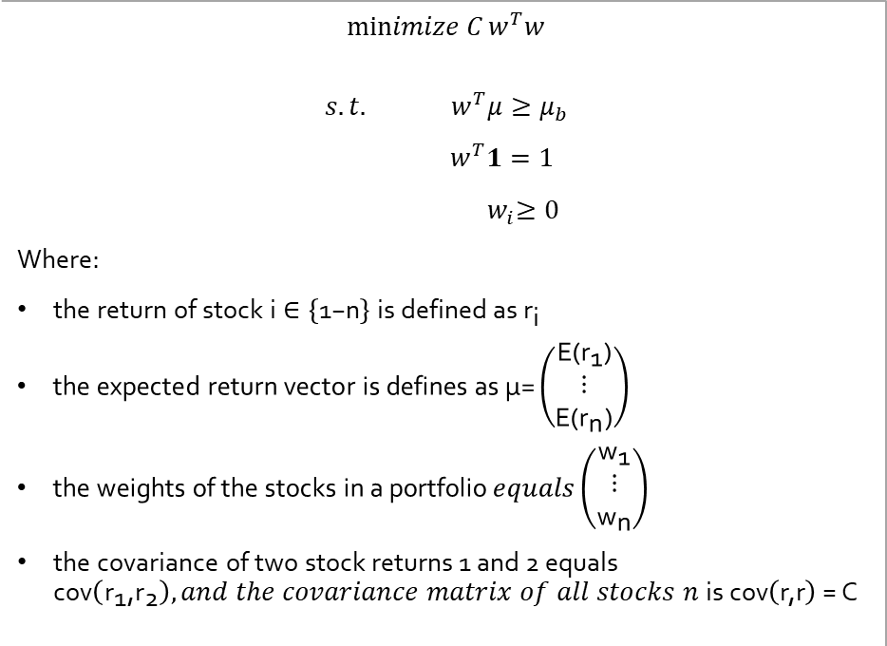
Literature Review
Modern portfolio theory (MPT) (Markowitz, 1952)
Linear programming formulation
$$\operatorname{minimize}{C}w^{T}w$$
$$s.t.{ w}^{T}μ≥μ_{b}$$
$$w^{T}1=1$$
$${ w}_{i}≥0$$
Where:
$\text{the} \text{return} \text{of} \text{stock} \text{i}∈\left\{\text{1−}\text{n}\right\} \text{is} \text{defined} \text{as}{ \text{r}}_{\text{i}}$
$\text{the} \text{expected} \text{return} \text{vector} \text{is} \text{defines} \text{as} \text{μ}\text{=}\left(\begin{matrix}\text{E}\text{(}{\text{r}}_{\text{1}}\text{)} \\ \text{⋮} \\ \text{E}\text{(}{\text{r}}_{\text{n}}\text{)}\end{matrix}\right)$
$\text{the} \text{weights} \text{of} \text{the} \text{stocks} \text{in} \text{a} \text{portfolio} equals\left(\begin{matrix}{\text{w}}_{\text{1}} \\ \text{⋮} \\ {\text{w}}_{\text{n}}\end{matrix}\right)$
$\text{the} \text{covariance} \text{of} \text{two} \text{stock} \text{returns}\text{ 1 }\text{and}\text{ 2 }\text{equals} \text{cov}\left({\text{r}}_{\text{1}}\text{,}{\text{r}}_{\text{2}}\right), and the covariance matrix of all stocks n \text{is} \text{cov}\left(\text{r}\text{,}\text{r}\right)\text{ = }\text{C}$
Figure XX: Source: https://medium.com/datadriveninvestor/simple-portfolio-optimization-harry-markowitz-mean-variance-model-using-excel-part-1-efc3f19a347

Slide 9
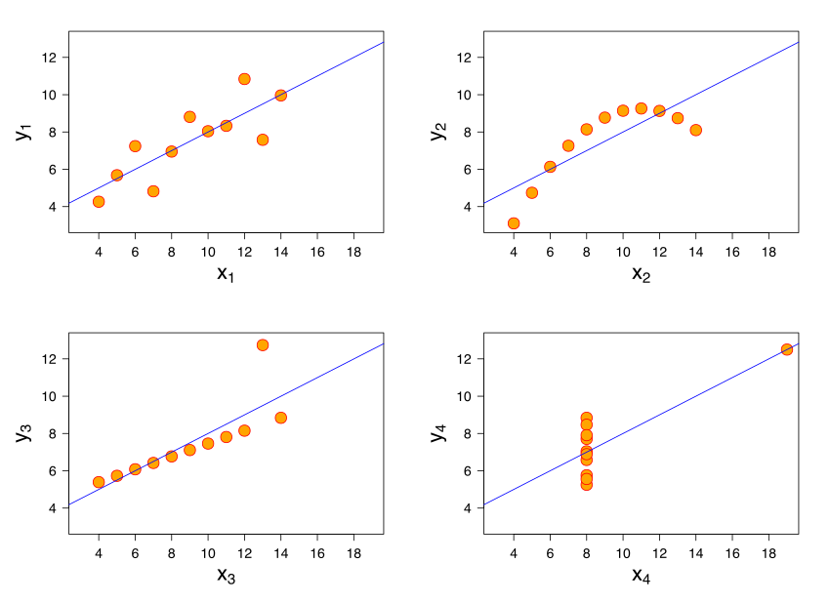
Literature Review
Modern portfolio theory (MPT) (Markowitz, 1952)
Pitfalls of covariance matrices
The covariance looks for a linear relationship between two variables. Hence it can be fallacious in situations where two variable have a relationship, but it is nonlinear.
Covariance is strongly influence by outliers.
Heteroscedasticity, a situation in which the one variable has unequal variability across the range of values of the second variable, leads to misleading covariance values.
Solutions
Random matrix theory (RMT).
RMT assumes that obly the largest eigenvalue of the matrix provide valueable information about the cross-correlation and that the remmaining is random noise.
Shrinkage
Figure XX: Anscombe's quartet: All four sets are identical when examined using simple summary statistics but vary considerably when graphed.

Slide 10
Literature Review
How does backtesting work?
Split the data into training data and test data
Build a model based on the training data
Use the model to forecast for the test data period
Compare between forecasted and actual values
Data
Train Set 1
Test Set 1
Train Set 3
Test Set 3
Train Set 3
Test Set 3
Train Set 4
Test Set 4
Time

Slide 11


















Literature Review
$$t_{1}$$
Convert Time Series to supervised learning problem
$$t_{1}$$
$$t_{2}$$
$$t_{1}$$
$$t_{2}$$
$$t_{3}$$
$$t_{1}$$
$$t_{2}$$
$$t_{3}$$
$$t_{4}$$
$$t_{1}$$
$$t_{1}$$
$$t_{2}$$
$$t_{3}$$
$$t_{4}$$
$$t_{5}$$
$$t_{2}$$
$$t_{2}$$
$$t_{3}$$
$$t_{4}$$
$$t_{5}$$
$$t_{6}$$
$$t_{3}$$
$$t_{3}$$
$$t_{4}$$
$$t_{5}$$
$$t_{6}$$
Sliding windows
$$t_{4}$$
$$t_{4}$$
$$t_{5}$$
$$t_{6}$$
$$t_{5}$$
$$t_{5}$$
$$t_{6}$$
$$t_{6}$$
$$t_{6}$$

Slide 12
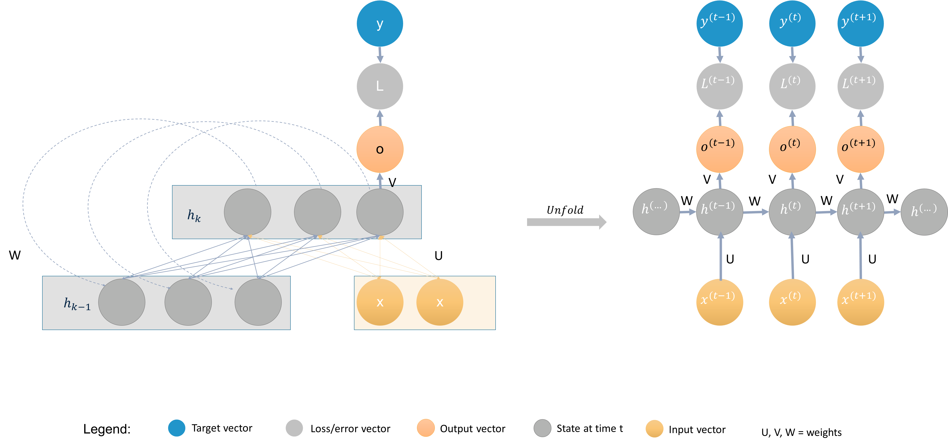
Literature Review
How do Recurrent neural networks with LSTM cells work?
Recurrent neural networks (RNNs) process sequential data.
Each state of the RNN is therefore a function depending on its previous states.

Slide 13
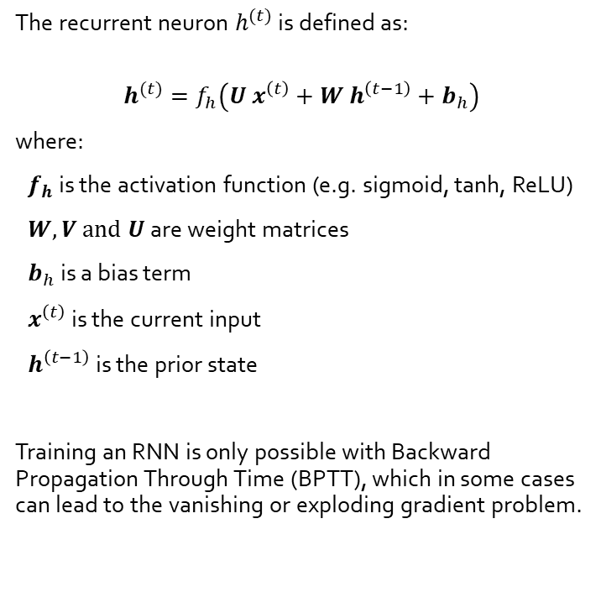
Literature Review
Mathematical formulation of RNNs
The recurrent neuron $h^{(t)}$ is defined as:
$$h^{(t)}=f_{h}\left(U x^{\left(t\right)}+W h^{\left(t−1\right)}+b_{h}\right)$$
where:
$f_{h}$ is the activation function (e.g. sigmoid, tanh, ReLU)
$W, V and U$ are weight matrices
$b_{h}$is a bias term
$x^{\left(t\right)}$ is the current input
$h^{\left(t−1\right)}$ is the prior state
Training an RNN is only possible with Backward Propagation Through Time (BPTT), which in some cases can lead to the vanishing or exploding gradient problem.

Slide 14
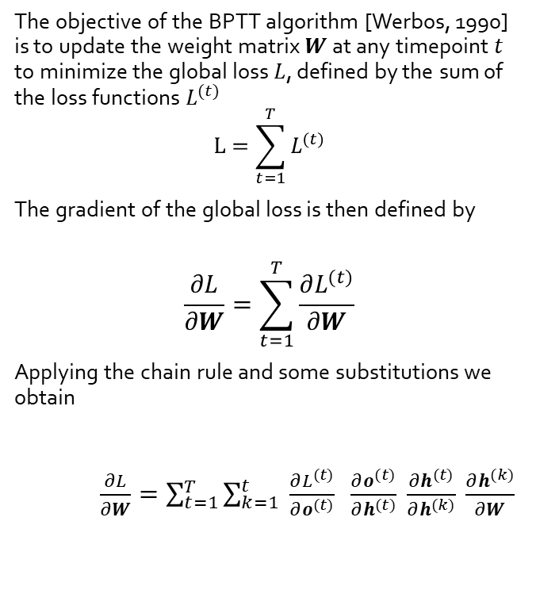
Literature Review
How to train an RNN?
The objective of the BPTT algorithm [Werbos, 1990] is to update the weight matrix $W$ at any timepoint $t$ to minimize the global loss $L$, defined by the sum of the loss functions $L^{(t)}$
$$L=\sum_{t=1}^{T}{L^{(t)}}$$
The gradient of the global loss is then defined by
$$\frac{∂L}{∂W}=\sum_{t=1}^{T}{\frac{∂L^{(t)}}{∂W}}$$
Applying the chain rule and some substitutions we obtain
$\frac{∂L}{∂W}=\sum_{t=1}^{T}{\sum_{k=1}^{t}{ \frac{∂L^{(t)}}{∂o^{(t)}} }\frac{∂o^{(t)}}{∂h^{(t)}} \frac{∂h^{(t)}}{∂h^{(k)}} \frac{∂h^{(k)}}{∂W}}$
(2)
(3)
(4)

Slide 15
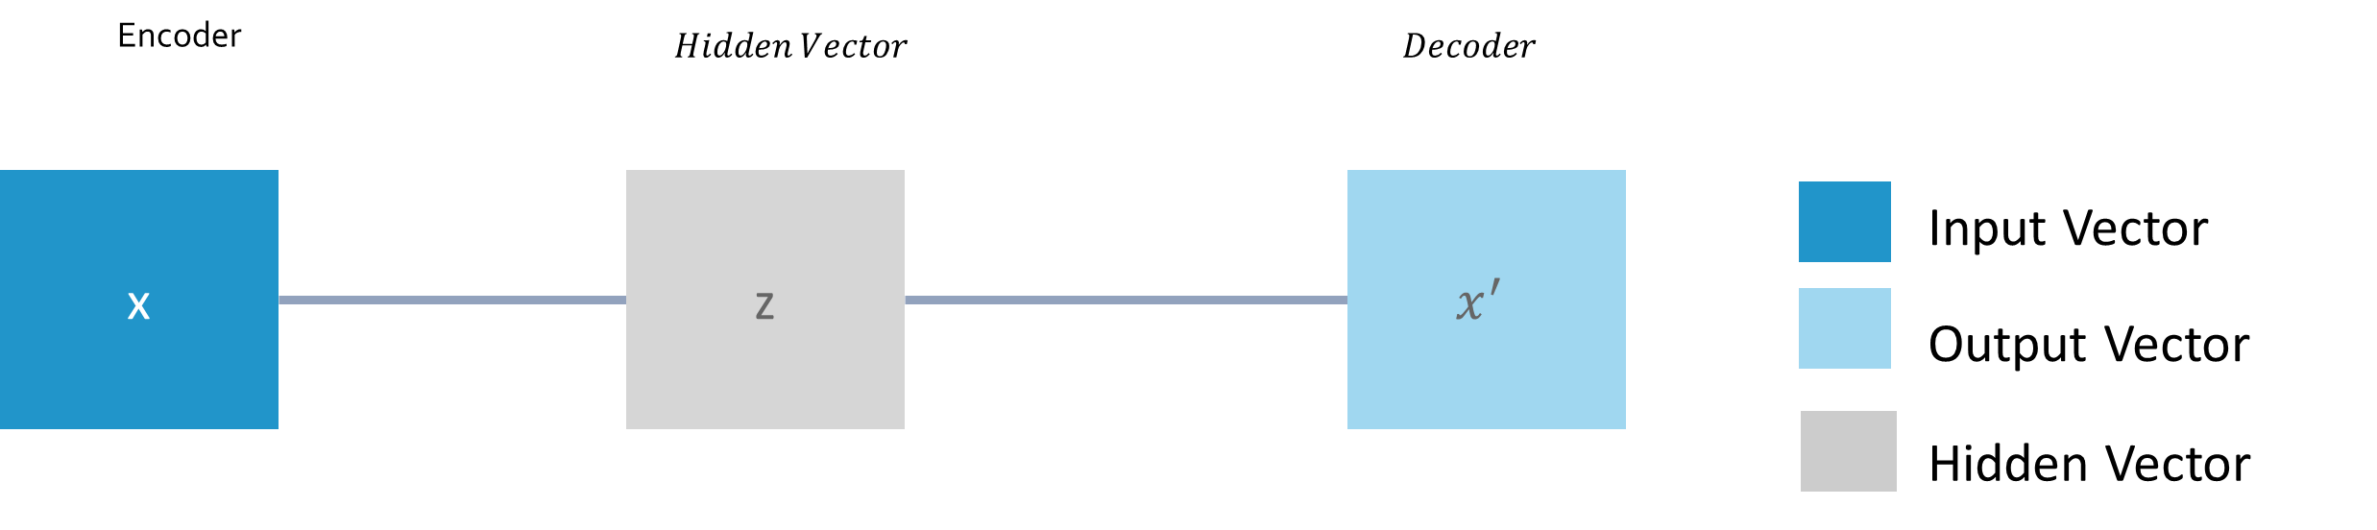

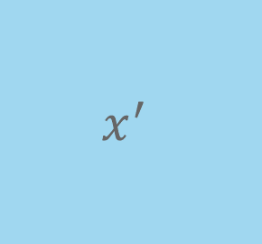
Literature Review
What are Autoencoders?
An autoencoder is an unsupervised neural network that is trained to attempt to copy its input to its output [Goodfellow et al., 2016].
Autoencoders are used for:
dimensionality reduction
removing structural noise
feature learning
outlier detection
Autoencoders are also applied in combination with recurrent neural networks (RNN) on timeseries data (e.g. (Bao et al., 2017)).
Input Cells
Hidden Cells
Output Cells
Figure: Example of an undercomplete autoencoder with three input and output layers and two hidden layers.
Encoder
$$Hidden Vector$$
$$Decoder$$
x
z
$$x^{′}$$
Input Vector
Output Vector
Hidden Vector

Slide 16

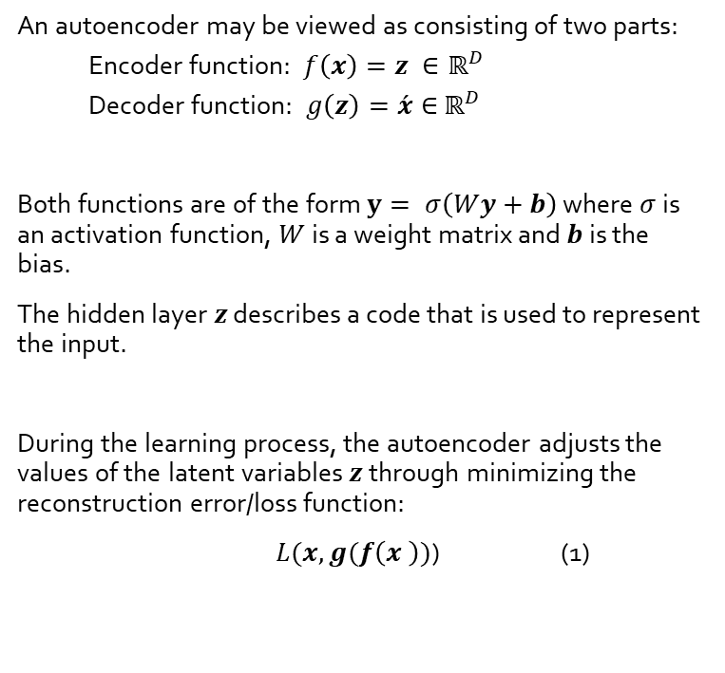



Literature Review
Mathematical formulation of Autoencoders
$$x$$
z
$$\acute{x}$$
An autoencoder may be viewed as consisting of two parts:
Encoder function: $f\left(x\right)=z ∈ℝ^{D}$
Decoder function: $g\left(z\right)=\acute{x}∈$ $ℝ^{D}$
Both functions are of the form $y= σ\left(Wy+b\right)$ where $σ$ is an activation function, $W$ is a weight matrix and $b$ is the bias.
The hidden layer $z$ describes a code that is used to represent the input.
During the learning process, the autoencoder adjusts the values of the latent variables $z$ through minimizing the reconstruction error/loss function:
$L(x, g(f\left(x \right))$) (1)
Input Cells
Hidden Cells
Output Cells
$$Encoding$$
$$Decoding$$
Figure: Example of an undercomplete autoencoder with three input and output layers and two hidden layers.

Slide 17
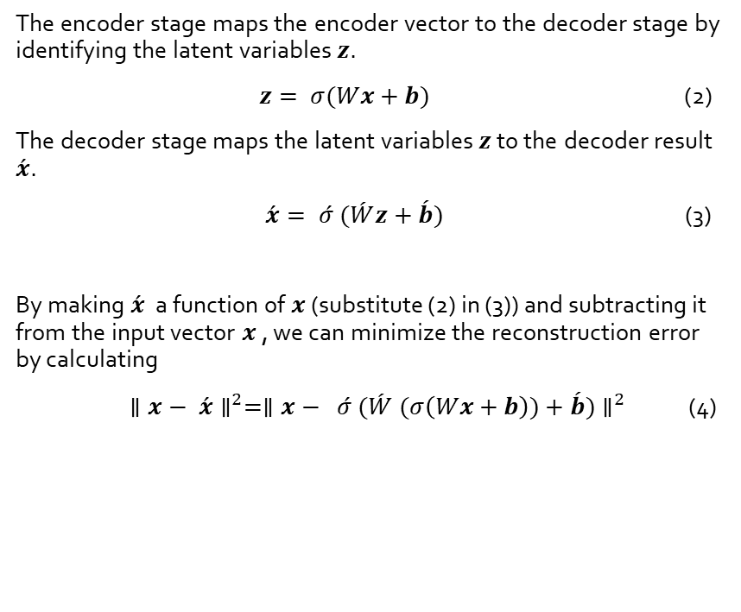
Literature Review
Mathematical formulation of Autoencoders
$$x$$
z
$$\acute{x}$$
The encoder stage maps the encoder vector to the decoder stage by identifying the latent variables $z$.
$z= σ(Wx+b)$ (2)
The decoder stage maps the latent variables $z$ to the decoder result $\acute{x}$.
$\acute{x}= \acute{σ} (\acute{W}z+\acute{b})$ (3)
By making $\acute{x}$ a function of $x$ (substitute (2) in (3)) and subtracting it from the input vector $x$ , we can minimize the reconstruction error by calculating
$∥x− \acute{x}∥^{2}=∥x− \acute{σ} (\acute{W} (σ\left(Wx+b\right))+\acute{b})∥^{2}$ (4)
Input Cells
Hidden Cells
Output Cells
$$Encoding$$
$$Decoding$$
Figure: Example of an undercomplete autoencoder with three input and output layers and two hidden layers.

Slide 18
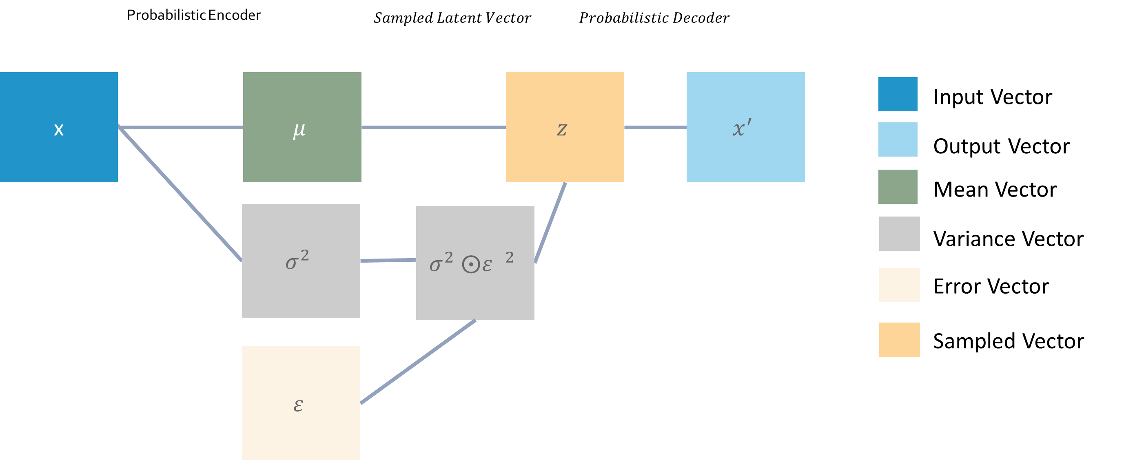


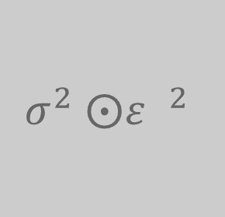
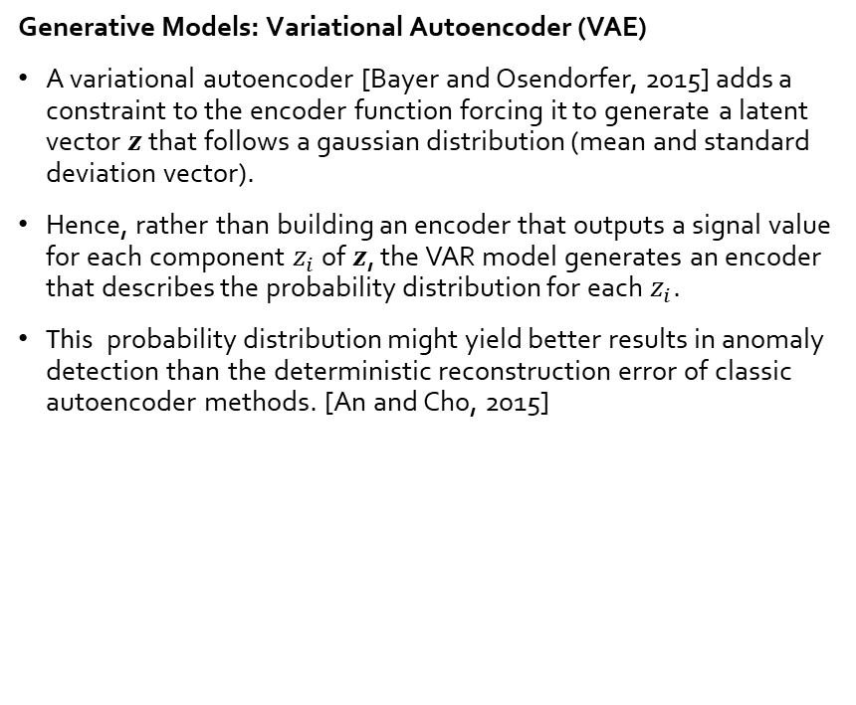

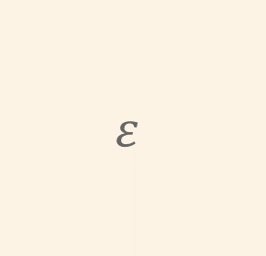
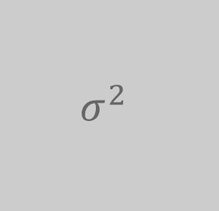

Literature Review
Variational Autoencoder
Generative Models: Variational Autoencoder (VAE)
A variational autoencoder [Bayer and Osendorfer, 2015] adds a constraint to the encoder function forcing it to generate a latent vector 𝒛 that follows a gaussian distribution (mean and standard deviation vector).
Hence, rather than building an encoder that outputs a signal value for each component $z_{i}$ of $z$, the VAR model generates an encoder that describes the probability distribution for each $z_{i}$.
This probability distribution might yield better results in anomaly detection than the deterministic reconstruction error of classic autoencoder methods. [An and Cho, 2015]
Figure: Example of a variational autoencoder with three input and output layers and two hidden layers.
Probabilistic Encoder
$$Sampled Latent Vector$$
$$Probabilistic Decoder$$
x
$$μ$$
$$z$$
$$x^{′}$$
Input Vector
Output Vector
Mean Vector
$$σ^{2}$$
$${σ^{2} ⨀ε }^{2}$$
Variance Vector
Error Vector
Sampled Vector
$$ε$$

Slide 19
Data,Methodology & Results

Slide 20
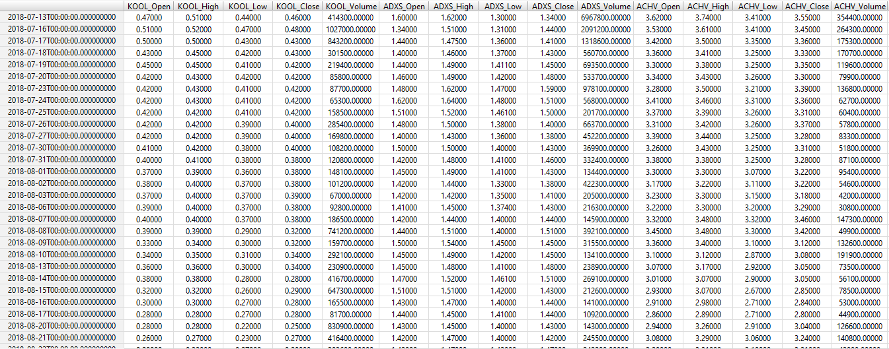
Data, Methodology & Results
Open, High, Low, Closed, Volume (OHLCV) Dataset

Slide 21
Data, Methodology & Results
Selection of least volatile stocks using autoencoders
Forecasting using recurrent neural networks
Improving stock risk calculation for portfolio diversification
Portfolio optimization using linear programming
1
2
3
4

Slide 22
Data, Methodology & Results
1
Selection of least volatile stocks using autoencoders
xxx different stocks from NYSE and NASDAQ.
4 years of daily stock prices
For the xx stocks we calculate the difference between input cells and output cells by taking the L2-norm.
Intuition:
The stocks with the lowest recreation error (L2-norm) represent the market better. They are less volatile and are considered to be similar to large cap stocks.
Stocks
Latent features
Stocks
s1
…
S_n
t1
0.3
0.2
0.1
0.1
0.3
0.2
0.4
0.1
-2
0.3
0.4
Returns
0.1
Returns
Input Cells
Hidden Cells
Output Cells
t_n
Figure: …

Slide 23
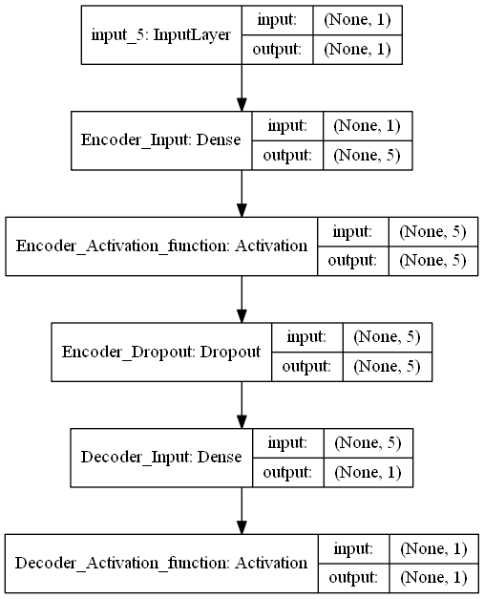
Data, Methodology & Results
1
Selection of least volatile stocks using autoencoders
Model Design:
ReLU activation function was used to guarantee fast convergence
A dropout layer is used, which esentially makes this model a denoising autoencoder, with the goal of producing a network that is more robust to noise.
Training Optimization parameters:
500 epochs per model training
Adam Optimizer was used
Mean Squared Error as loss function

Slide 24
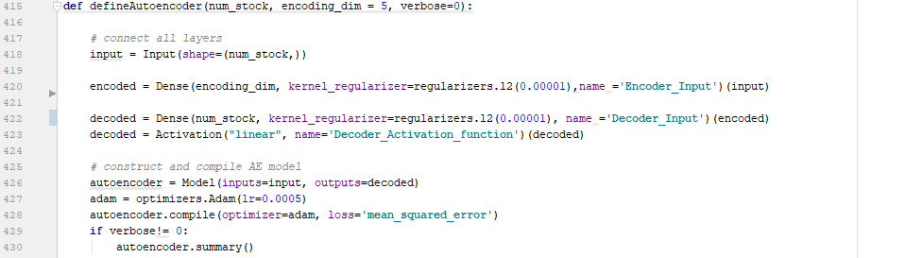
Data, Methodology & Results
1
Selection of least volatile stocks using autoencoders

Slide 25
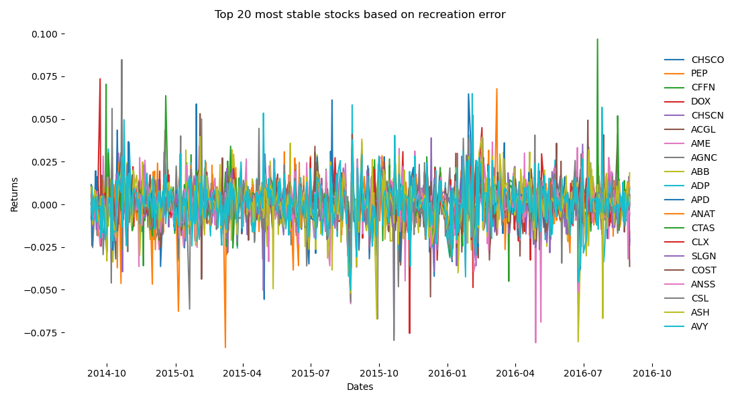
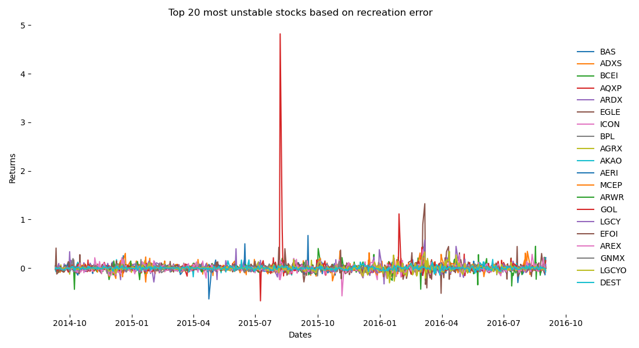
Data, Methodology & Results
1
Selection of least volatile stocks using autoencoders
→ Unstable stocks tend to be more volatile and have more unexpected spikes

Slide 26
Data, Methodology & Results
2
Forecasting using recurrent neural networks
DATA SAMPLE!!!

Slide 27
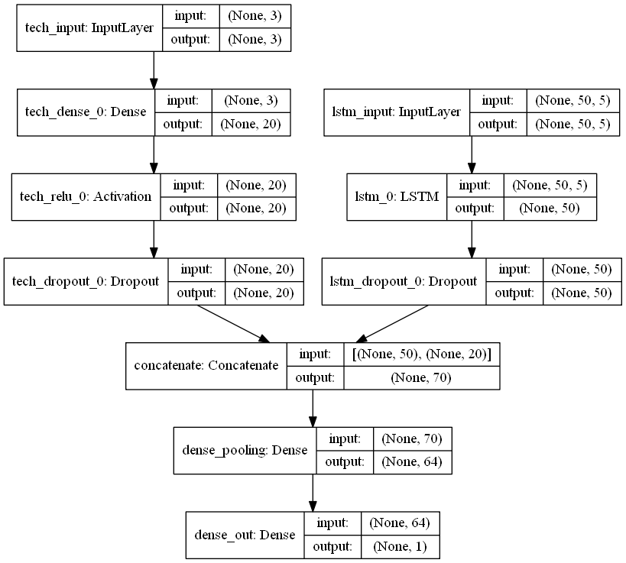
Data, Methodology & Results
2
Forecasting using recurrent neural networks
Model Design:
A multi input model has been applied using Keras functional API, to include:
historic stock prices
additional technical indicators e.g. exponential moving average
ReLU activation function was used in each input branch to guarantee fast convergence.
Sigmoid activation function were used in the concatentation layer.
Linear activation function was used in the pooling layer.
A dropout layer has been added to prevent the model from overfitting.
Training Optimization parameters:
500 epochs per model training
Adam Optimizer was used
Mean Squared Error as loss function

Slide 28
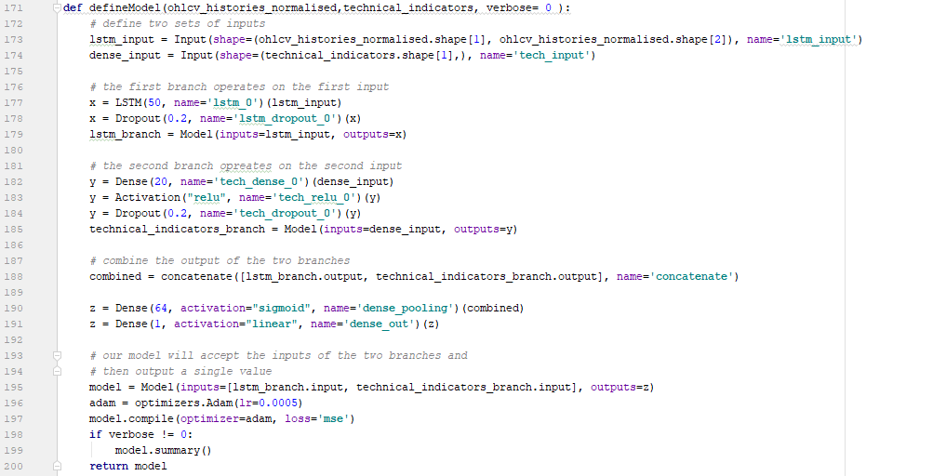
Data, Methodology & Results
2
Forecasting using recurrent neural networks

Slide 29
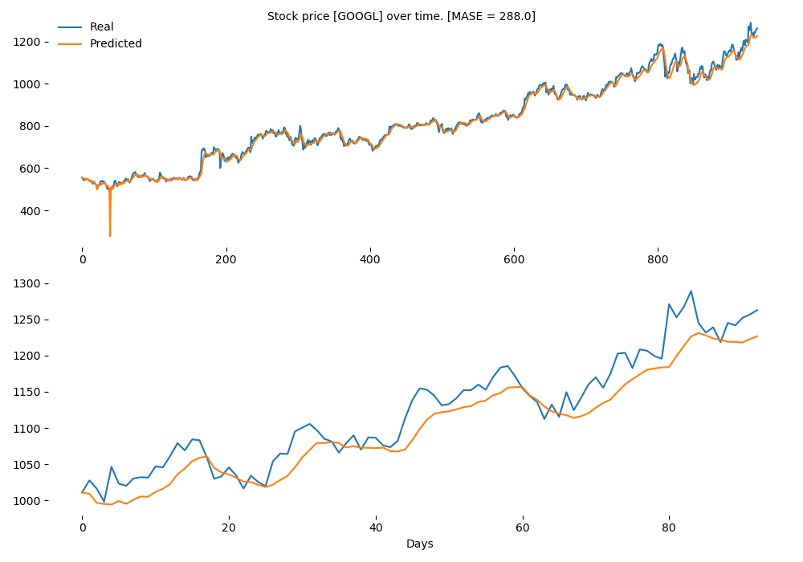
Data, Methodology & Results
2
Forecasting using recurrent neural networks
Model performance was measured using the mean absolute scaled error (MASE), which is primarily because of its interpretability.
MASE values greater than one indicate that in-sample one-step forecasts from the naïve method perform better than the forecast values under consideration.

Slide 30
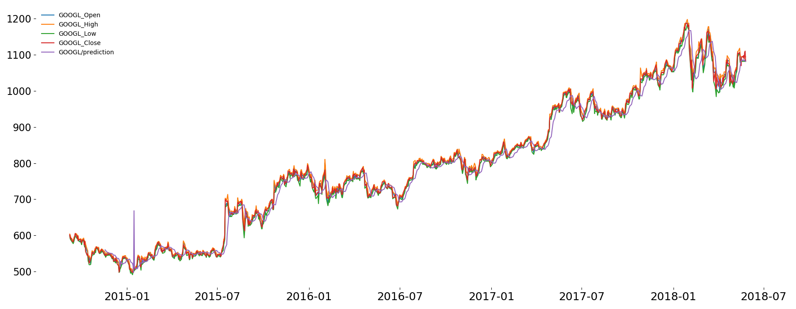
Data, Methodology & Results
2
Forecasting using recurrent neural networks

Slide 31
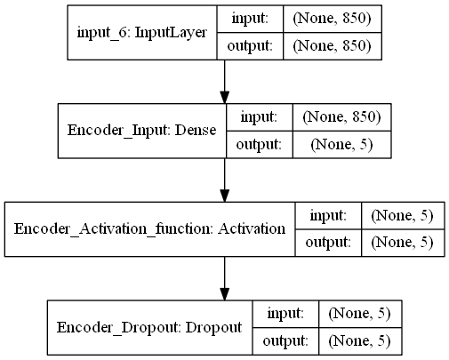
Data, Methodology & Results
3
Improving stock risk calculation for portfolio diversification
Model Design:
The model has 850 input nodes, which equals the number of selected trading days.
Only the decoder model is used, compressing the input to 5 output nodes.
Other paramteres are equivalent to the first autoencoder model
Training Optimization parameters:
500 epochs per model training
Adam Optimizer was used
Mean Squared Error as loss function

Slide 32
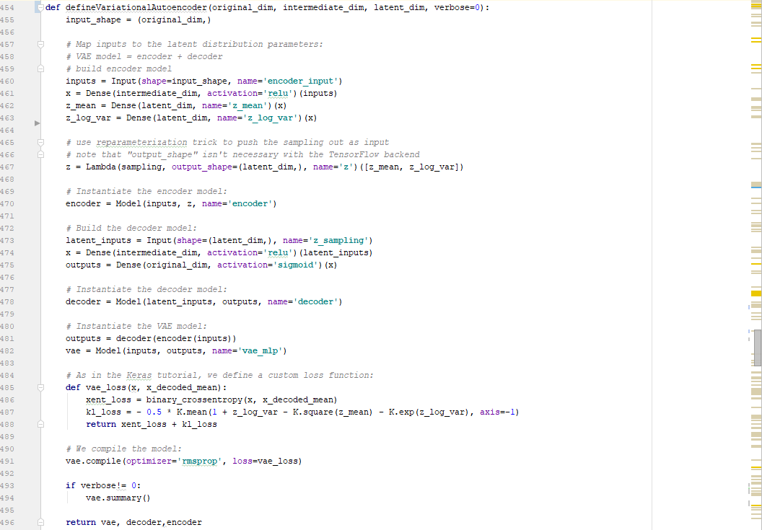
Data, Methodology & Results
3
Improving stock risk calculation for portfolio diversification

Slide 33
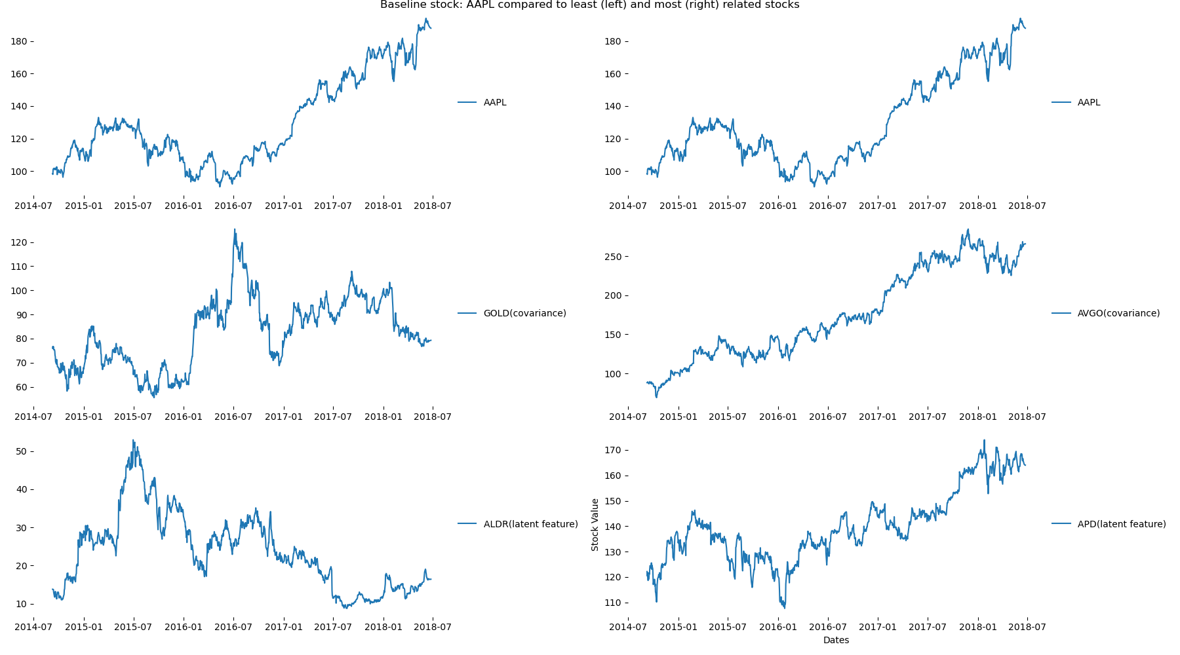
Data, Methodology & Results
3
Improving stock risk calculation for portfolio diversification

Slide 34
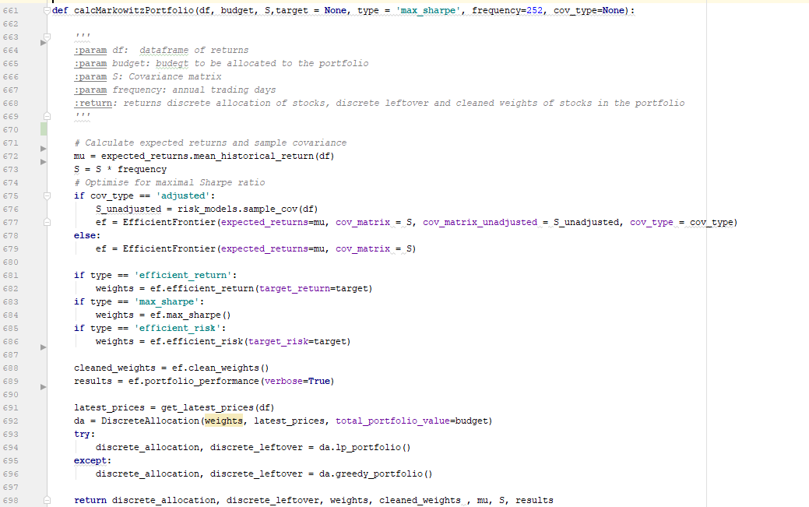
Data, Methodology & Results
4
Portfolio optimization using linear programming

Slide 35
Data, Methodology & Results
4
Portfolio optimization using linear programming
RESULTS!!!

Slide 36
Results

Slide 37
References
J. B. Heaton, N. G. Polson, & J. H. Witte. (2016). Deep Portfolio Theory.
Werbos, P. (1990): Backpropagation Through Time: What It does and How to Do It. https://doi.org/10.1109/5.58337 Retrieved from http://axon.cs.byu.edu/~martinez/classes/678/Papers/Werbos_BPTT.pdf

Slide 38

Q & A

Slide 39
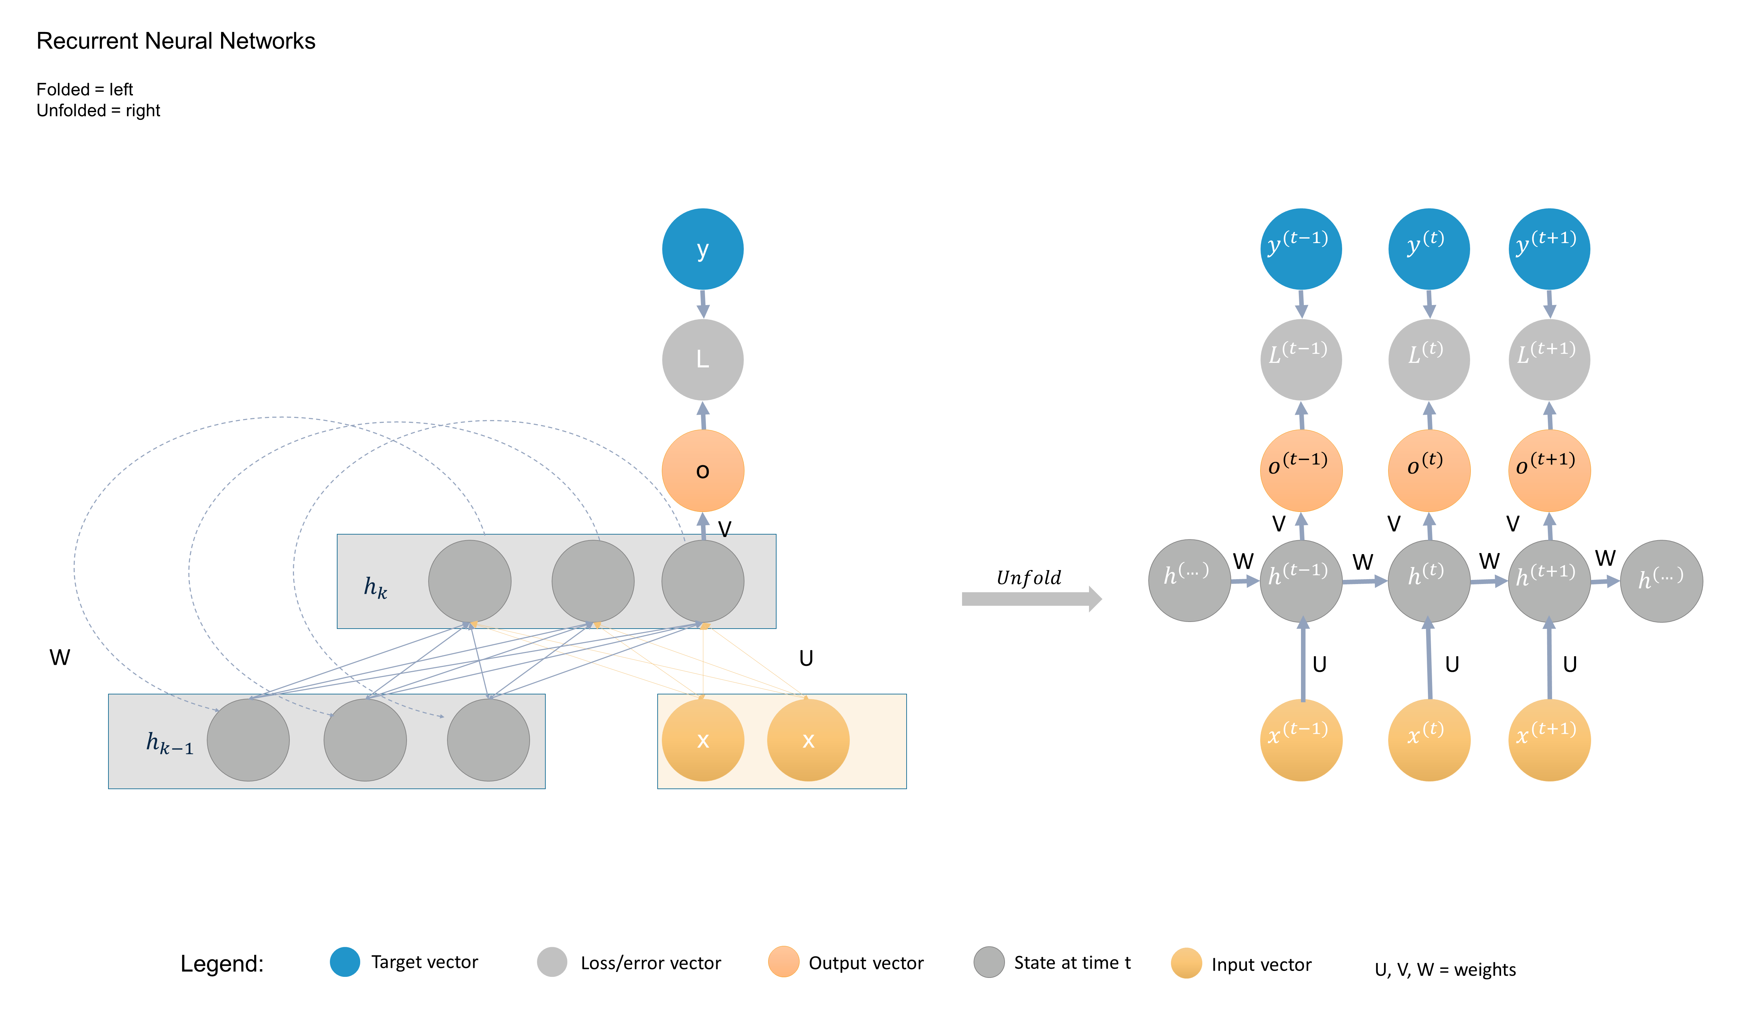



















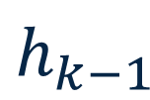
Recurrent Neural Networks
Folded = left
Unfolded = right
y
$$y^{(t−1)}$$
$$y^{(t)}$$
$$y^{(t+1)}$$
L
$$L^{(t−1)}$$
$$L^{(t)}$$
$$L^{(t+1)}$$
o
$$o^{(t−1)}$$
$$o^{(t)}$$
$$o^{(t+1)}$$
V
V
V
V
$$h^{(…)}$$
W
$$h^{(t−1)}$$
W
$$h^{(t)}$$
W
$$h^{(t+1)}$$
W
$$h^{(…)}$$
$$h_{k}$$
$$Unfold$$
W
U
U
U
U
x
x
$$x^{(t−1)}$$
$$x^{(t)}$$
$$x^{(t+1)}$$
$$h_{k−1}$$
Legend:
Target vector
Loss/error vector
Output vector
State at time t
Input vector
U, V, W = weights

Slide 40
Data and Methodology
3. Calculating stock risk for portfolio diversification
We transpose the input matrix and get a compressed time series in form of latent features.
Calculating the covariance of the latent feature vectors, we are able to compare stocks with each other over time.
In comparison to PCA analysis, the similarity score obtained from latent features better captures non-linearities in the input data.
Intuition:
Stocks with different similarity scores, have different stock price movements over time.
Returns
Stocks
0.3
0.4
0.1
0.1
0.2
0.1
-2
0.3
Input Cells
Hidden Cells
Calculate
Covariance
Figure: …

Slide 41
Agenda
Introduction
Literature Review
Data and Methodology
Results

Slide 42
Introduction
Research Questions
Research Question 1:
Research Question 2:
Can we predict the stock price of the next few days using recurrent neural networks?
Can we construct an investment portfolio using Deep Portfolio Theory (Heaton et.al, 2018) that incoprerates
stock forecasting results,
stock returns,
diversified risk

