Slide 1
Stock Price Prediction and Portfolio Optimization Using Recurrent Neural Networks and Autoencoders
Predictive Analytics World 2020 Berlin

Slide 2
Introduction:
What?
Why?
Literature Review
Markowitz Model
LSTM
Autoencoder
Literature Review:
- Drawbacks of Markowitz
Usaga of covariance
mean variance calculated randomly
Covariance shows only sign, no stregth of movement
Linear optimization problem
Manual selection of risk vs. return
Literature Review:
- Drawbakcs of Deep Portfolio
No forecast of assets
Diversification is choosen randomly
Methodology
Methodology
Results:
Results:
Limitations:
Acknowledgement and References:

Slide 3
Introduction
“Prediction is very difficult, especially if it’s about the future.”
– Nils Bohr, Nobel laureate in Physics

Slide 4
Introduction
Research Questions
Research Question 1:
Can we predict the stock price of the next few days using recurrent neural networks?
Research Question 2:
Can we construct an investment portfolio using Deep Portfolio Theory (Heaton et.al, 2018) that incoprerates
stock forecasting results,
stock returns and
stock similarity

Slide 5
Introduction
Research Setup
Stock (OHLCV) dataset
Forecasting
using recurrent neural networks
Latent feature generation using autoencoders
Portfolio optimization using linear programming

Slide 6
Literature Review
Heaton et.al
(Deep Portfolio)
Black-Litterman
Chamberlain and Rothschild
(Factor Model)
McKibbon
and Rose
(APT)
Markowitz, Sharpe (CAPM)
Markowitz
1952
1964
1973-1976
1983
1991
2016

Slide 7
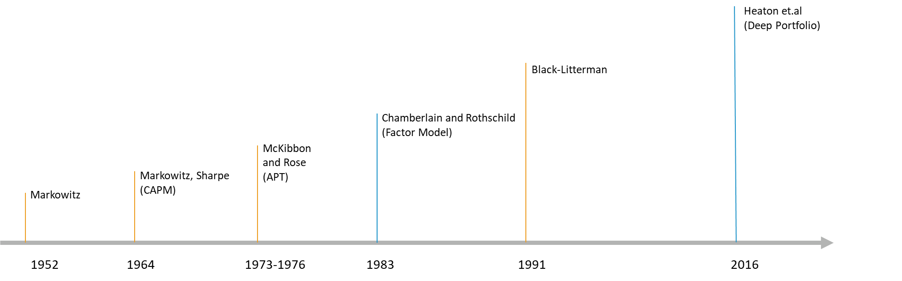
Literature Review
LSTMs
(Hochreiter, 1997)
Autoencoder
(Goodfellow et al., 2016)
Backpropagation (Werbos, 1974)
RNN
(Jordan, 1986)
BBT
(Werbos, 1990)

Slide 8
Methodology
Backtest
How does backtesting work?
Split the data into Training data and Test data
Build a model based on the training data
Use the model to forecast for the Test data period
Compare between Forecasted and Actual
Data
Train Set 1
Test Set 1
Train Set 3
Test Set 3
Train Set 3
Test Set 3
Train Set 4
Test Set 4
Time

Slide 9
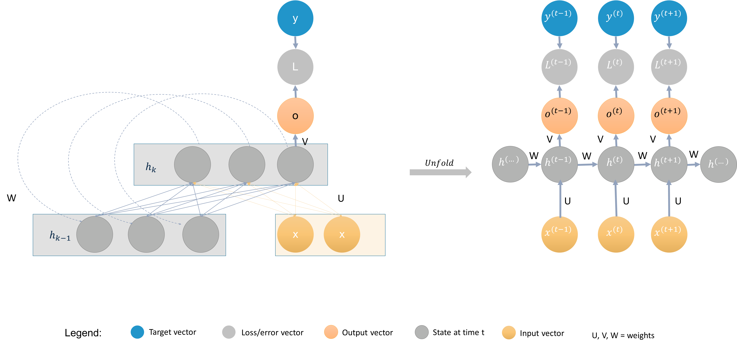
Methodology
RNNs with LSTM cells
Recurrent neural networks (RNNs) process sequential data.
Each state of the RNN is therefore a function depending on its previous states.

Slide 10
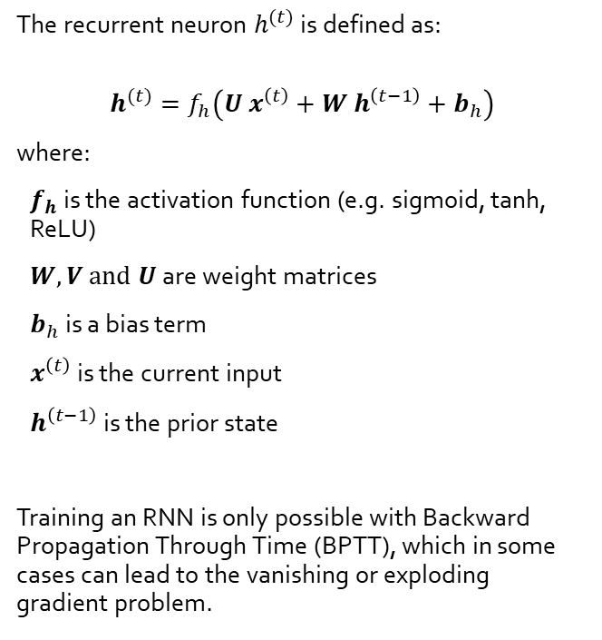
Methodology
Time series forecasting
The recurrent neuron $h^{(t)}$ is defined as:
$$h^{(t)}=f_{h}\left(U x^{\left(t\right)}+W h^{\left(t−1\right)}+b_{h}\right)$$
where:
$f_{h}$ is the activation function (e.g. sigmoid, tanh, ReLU)
$W, V and U$ are weight matrices
$b_{h}$is a bias term
$x^{\left(t\right)}$ is the current input
$h^{\left(t−1\right)}$ is the prior state
Training an RNN is only possible with Backward Propagation Through Time (BPTT), which in some cases can lead to the vanishing or exploding gradient problem.

Slide 11
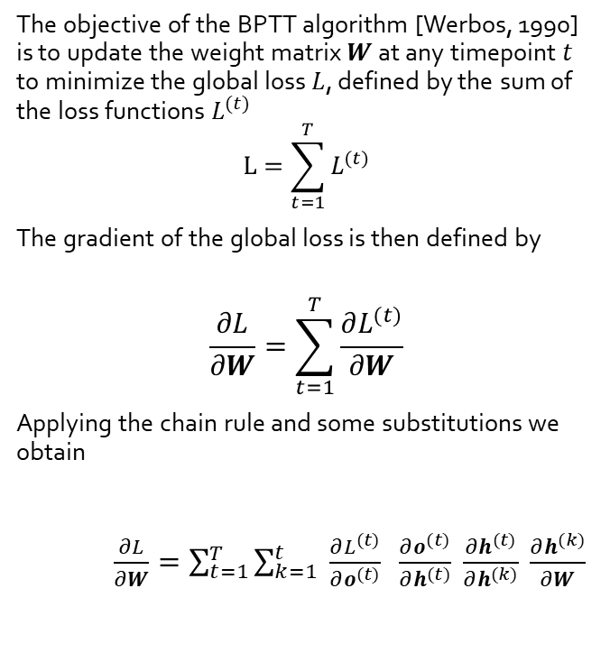
Methodology
Time series forecasting
The objective of the BPTT algorithm [Werbos, 1990] is to update the weight matrix $W$ at any timepoint $t$ to minimize the global loss $L$, defined by the sum of the loss functions $L^{(t)}$
$$L=\sum_{t=1}^{T}{L^{(t)}}$$
The gradient of the global loss is then defined by
$$\frac{∂L}{∂W}=\sum_{t=1}^{T}{\frac{∂L^{(t)}}{∂W}}$$
Applying the chain rule and some substitutions we obtain
$\frac{∂L}{∂W}=\sum_{t=1}^{T}{\sum_{k=1}^{t}{ \frac{∂L^{(t)}}{∂o^{(t)}} }\frac{∂o^{(t)}}{∂h^{(t)}} \frac{∂h^{(t)}}{∂h^{(k)}} \frac{∂h^{(k)}}{∂W}}$
(2)
(3)
(4)

Slide 12


Methodology
Autoencoders
An autoencoder is an unsupervised neural network that is trained to attempt to copy its input to its output [Goodfellow et al., 2016].
Autoencoders are able to learn useful properties of a data set during the copying process and are used for:
dimensionality reduction
removing structural noise
feature learning
outlier detection
Autoencoders are also applied in combination with recurrent neural networks (RNN) on timeseries data (e.g. (Bao et al., 2017)).
Input Cells
Hidden Cells
Output Cells
$$Encoding$$
$$Decoding$$
Figure: Example of an undercomplete autoencoder with three input and output layers and two hidden layers.

Slide 13

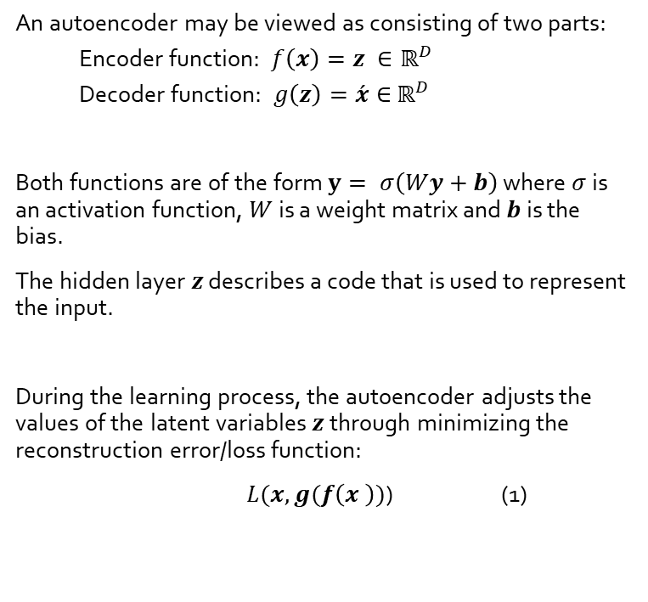



Methodology
Autoencoders – Deep Dive
$$x$$
z
$$\acute{x}$$
An autoencoder may be viewed as consisting of two parts:
Encoder function: $f\left(x\right)=z ∈ℝ^{D}$
Decoder function: $g\left(z\right)=\acute{x}∈$ $ℝ^{D}$
Both functions are of the form $y= σ\left(Wy+b\right)$ where $σ$ is an activation function, $W$ is a weight matrix and $b$ is the bias.
The hidden layer $z$ describes a code that is used to represent the input.
During the learning process, the autoencoder adjusts the values of the latent variables $z$ through minimizing the reconstruction error/loss function:
$L(x, g(f\left(x \right))$) (1)
Input Cells
Hidden Cells
Output Cells
$$Encoding$$
$$Decoding$$
Figure: Example of an undercomplete autoencoder with three input and output layers and two hidden layers.

Slide 14
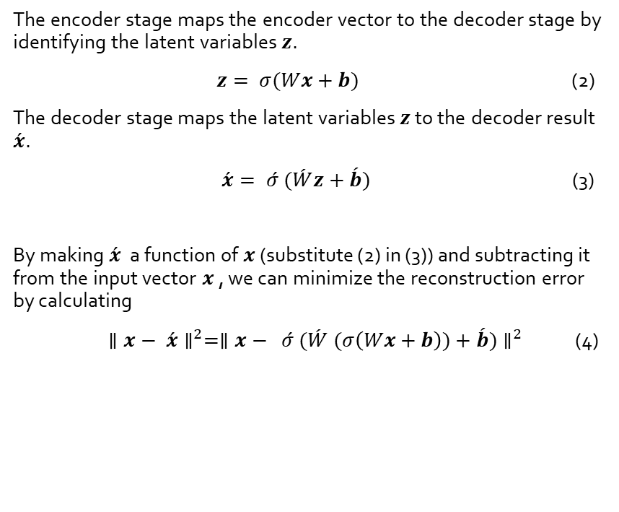
Methodology
Autoencoders – Deep Dive
$$x$$
z
$$\acute{x}$$
The encoder stage maps the encoder vector to the decoder stage by identifying the latent variables $z$.
$z= σ(Wx+b)$ (2)
The decoder stage maps the latent variables $z$ to the decoder result $\acute{x}$.
$\acute{x}= \acute{σ} (\acute{W}z+\acute{b})$ (3)
By making $\acute{x}$ a function of $x$ (substitute (2) in (3)) and subtracting it from the input vector $x$ , we can minimize the reconstruction error by calculating
$∥x− \acute{x}∥^{2}=∥x− \acute{σ} (\acute{W} (σ\left(Wx+b\right))+\acute{b})∥^{2}$ (4)
Input Cells
Hidden Cells
Output Cells
$$Encoding$$
$$Decoding$$
Figure: Example of an undercomplete autoencoder with three input and output layers and two hidden layers.

Slide 15
Methodology
Autoencoders – calculating recreation error
xxx different stocks from NYSE and NASDAQ.
4 years of daily stock prices
For the xx stocks we calculate the difference between input cells and output cells by taking the L2-norm.
Intuition:
The stocks with the lowest recreation error (L2-norm) represent the market better. They are less volatile and are considered to be similar to large cap stocks.
Stocks
Stocks
0.3
0.2
0.1
0.1
0.3
0.2
0.4
0.1
-2
0.3
0.4
Returns
0.1
Returns
Input Cells
Hidden Cells
Output Cells
Figure: …

Slide 16
Methodology
Autoencoders – calculating similarity score
We transpose the input matrix and get a compressed time series in form of latent features.
Taking again the L2-Norm we can represent the history of a stock as a single number. Now we can compare stocks with each other over time.
In comparison to PCA analysis, the similarity score obtained from latent features can better capture non-linearities in the input data.
Intuition:
Stocks with different similarity scores, have different stock price movements over time.
Returns
Returns
0.3
0.4
0.1
0.1
0.3
0.4
0.2
0.1
-2
0.3
0.2
Stocks
0.1
Stocks
Input Cells
Hidden Cells
Output Cells
Figure: …

Slide 17
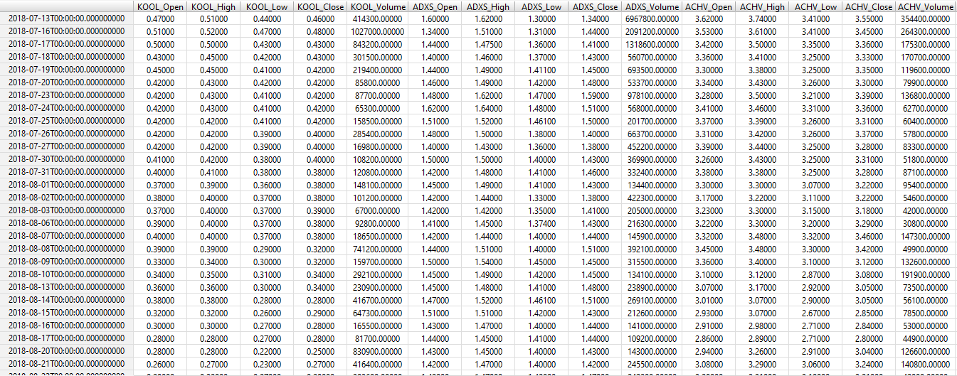
Dataset

Slide 18
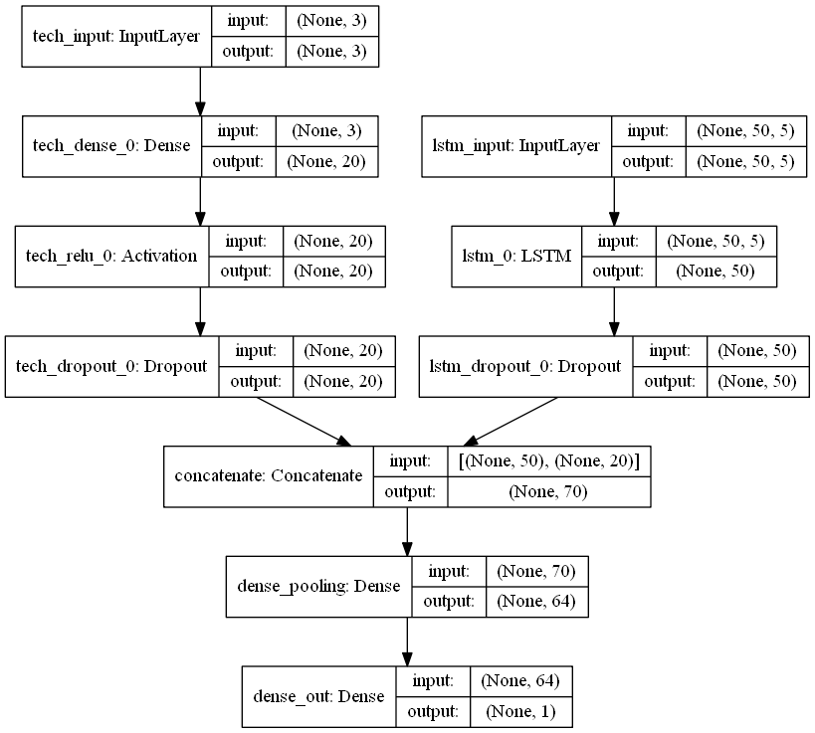
Model
Forecasting Model
Model Design:
A multi input model has been applied using Keras functional API, to include:
historic stock prices
additional technical indicators e.g. exponential moving average
ReLU activation function was used in each input branch to guarantee fast convergence.
Sigmoid activation function were used in the concatentation layer.
Linear activation function was used in the pooling layer.
A dropout layer has been added to prevent the model from overfitting.
Training Optimization parameters:
500 epochs per model training
Adam Optimizer was used
Mean Squared Error as loss function

Slide 19
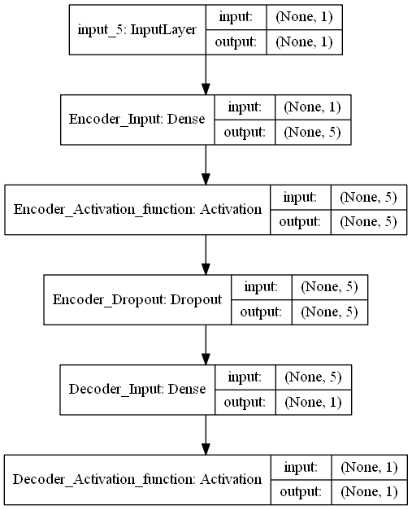
Model
Autoencoder Model
Model Design:
ReLU activation function was used to guarantee fast convergence
A dropout layer is used, which esentially makes this model a denoising autoencoder, with the goal of producing a network that is more robust to noise.
Training Optimization parameters:
500 epochs per model training
Adam Optimizer was used
Mean Squared Error as loss function

Slide 20
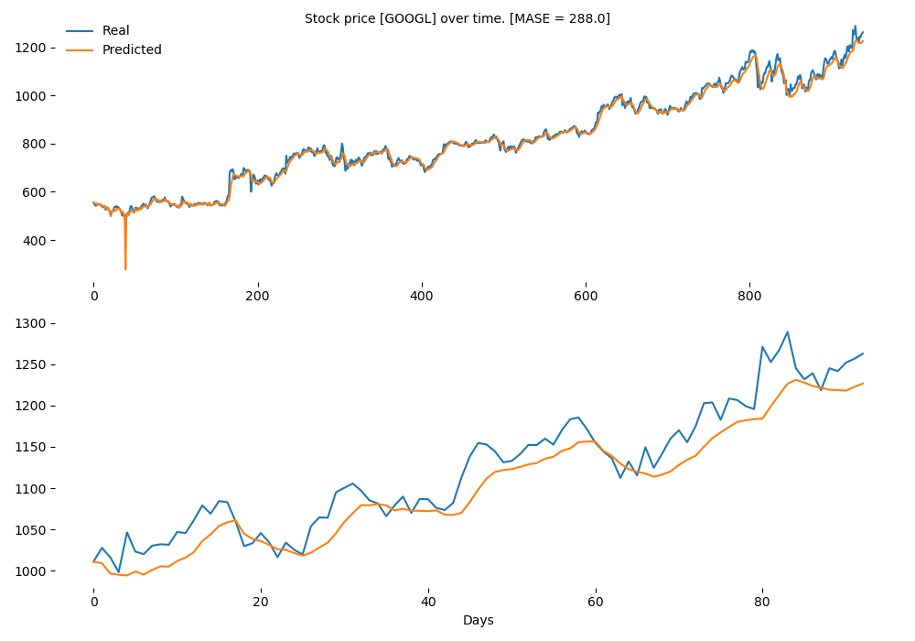
Results
Forecasting model evaluation
Model performance was measured using the mean absolute scaled error (MASE), which is primarily because of ist interpretability.
MASE values greater than one indicate that in-sample one-step forecasts from the naïve method perform better than the forecast values under consideration.

Slide 21
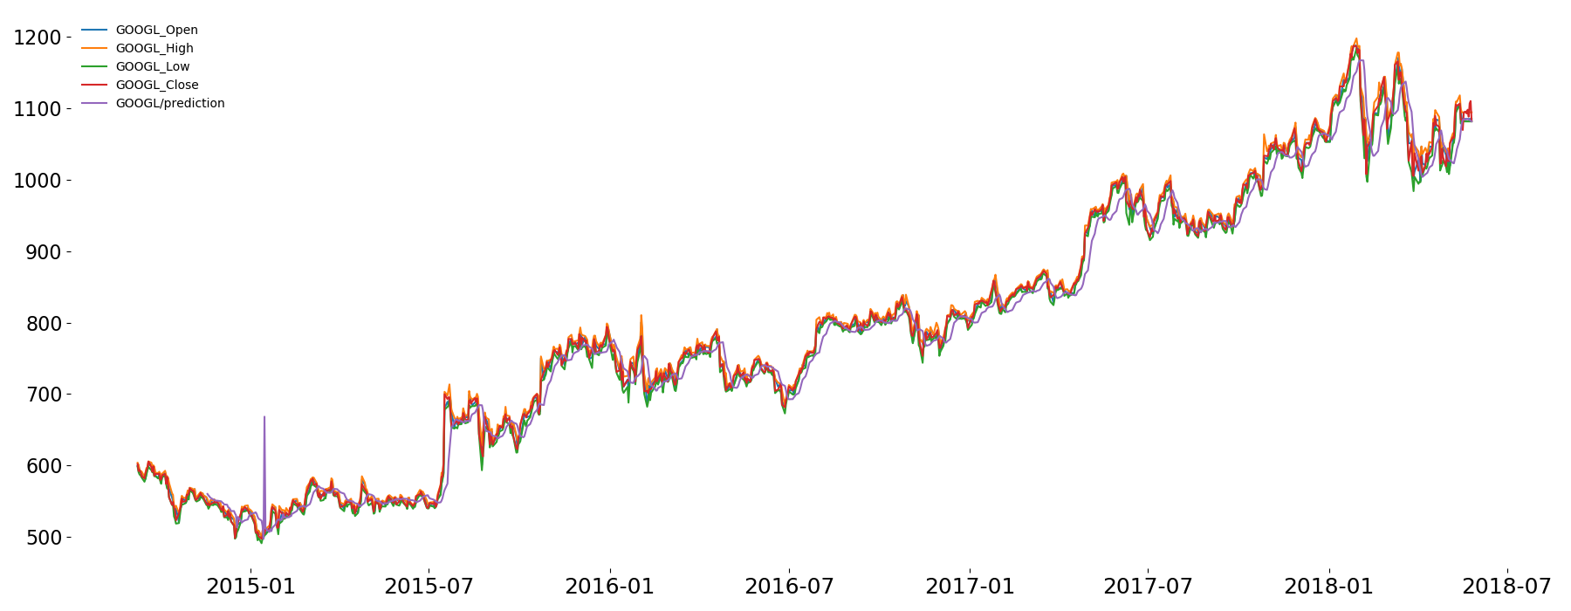
Results
Stock forecasting

Slide 22
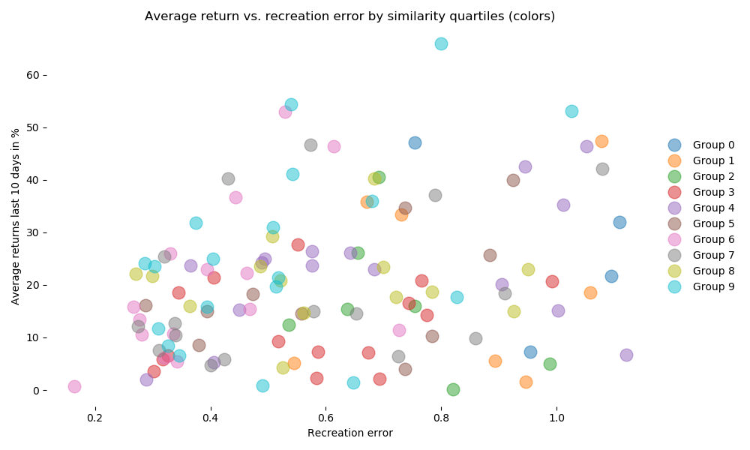
Results
Autoencoder Model
Recreation error results

Slide 23
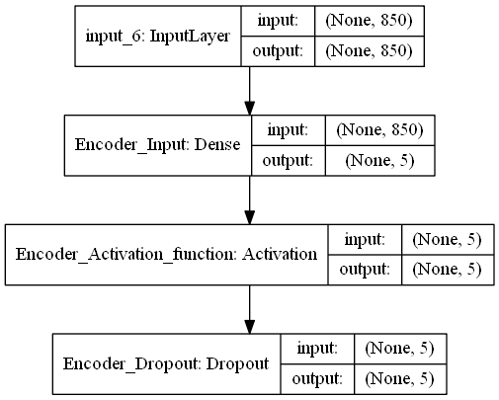
Results
Autoencoder Model
Recreation error results
Input Cells
Hidden Cells
Output Cells

Slide 24
References
J. B. Heaton, N. G. Polson, & J. H. Witte. (2016). Deep Portfolio Theory.
Werbos, P. (1990): Backpropagation Through Time: What It does and How to Do It. https://doi.org/10.1109/5.58337 Retrieved from http://axon.cs.byu.edu/~martinez/classes/678/Papers/Werbos_BPTT.pdf

Slide 25

Q & A

Slide 26
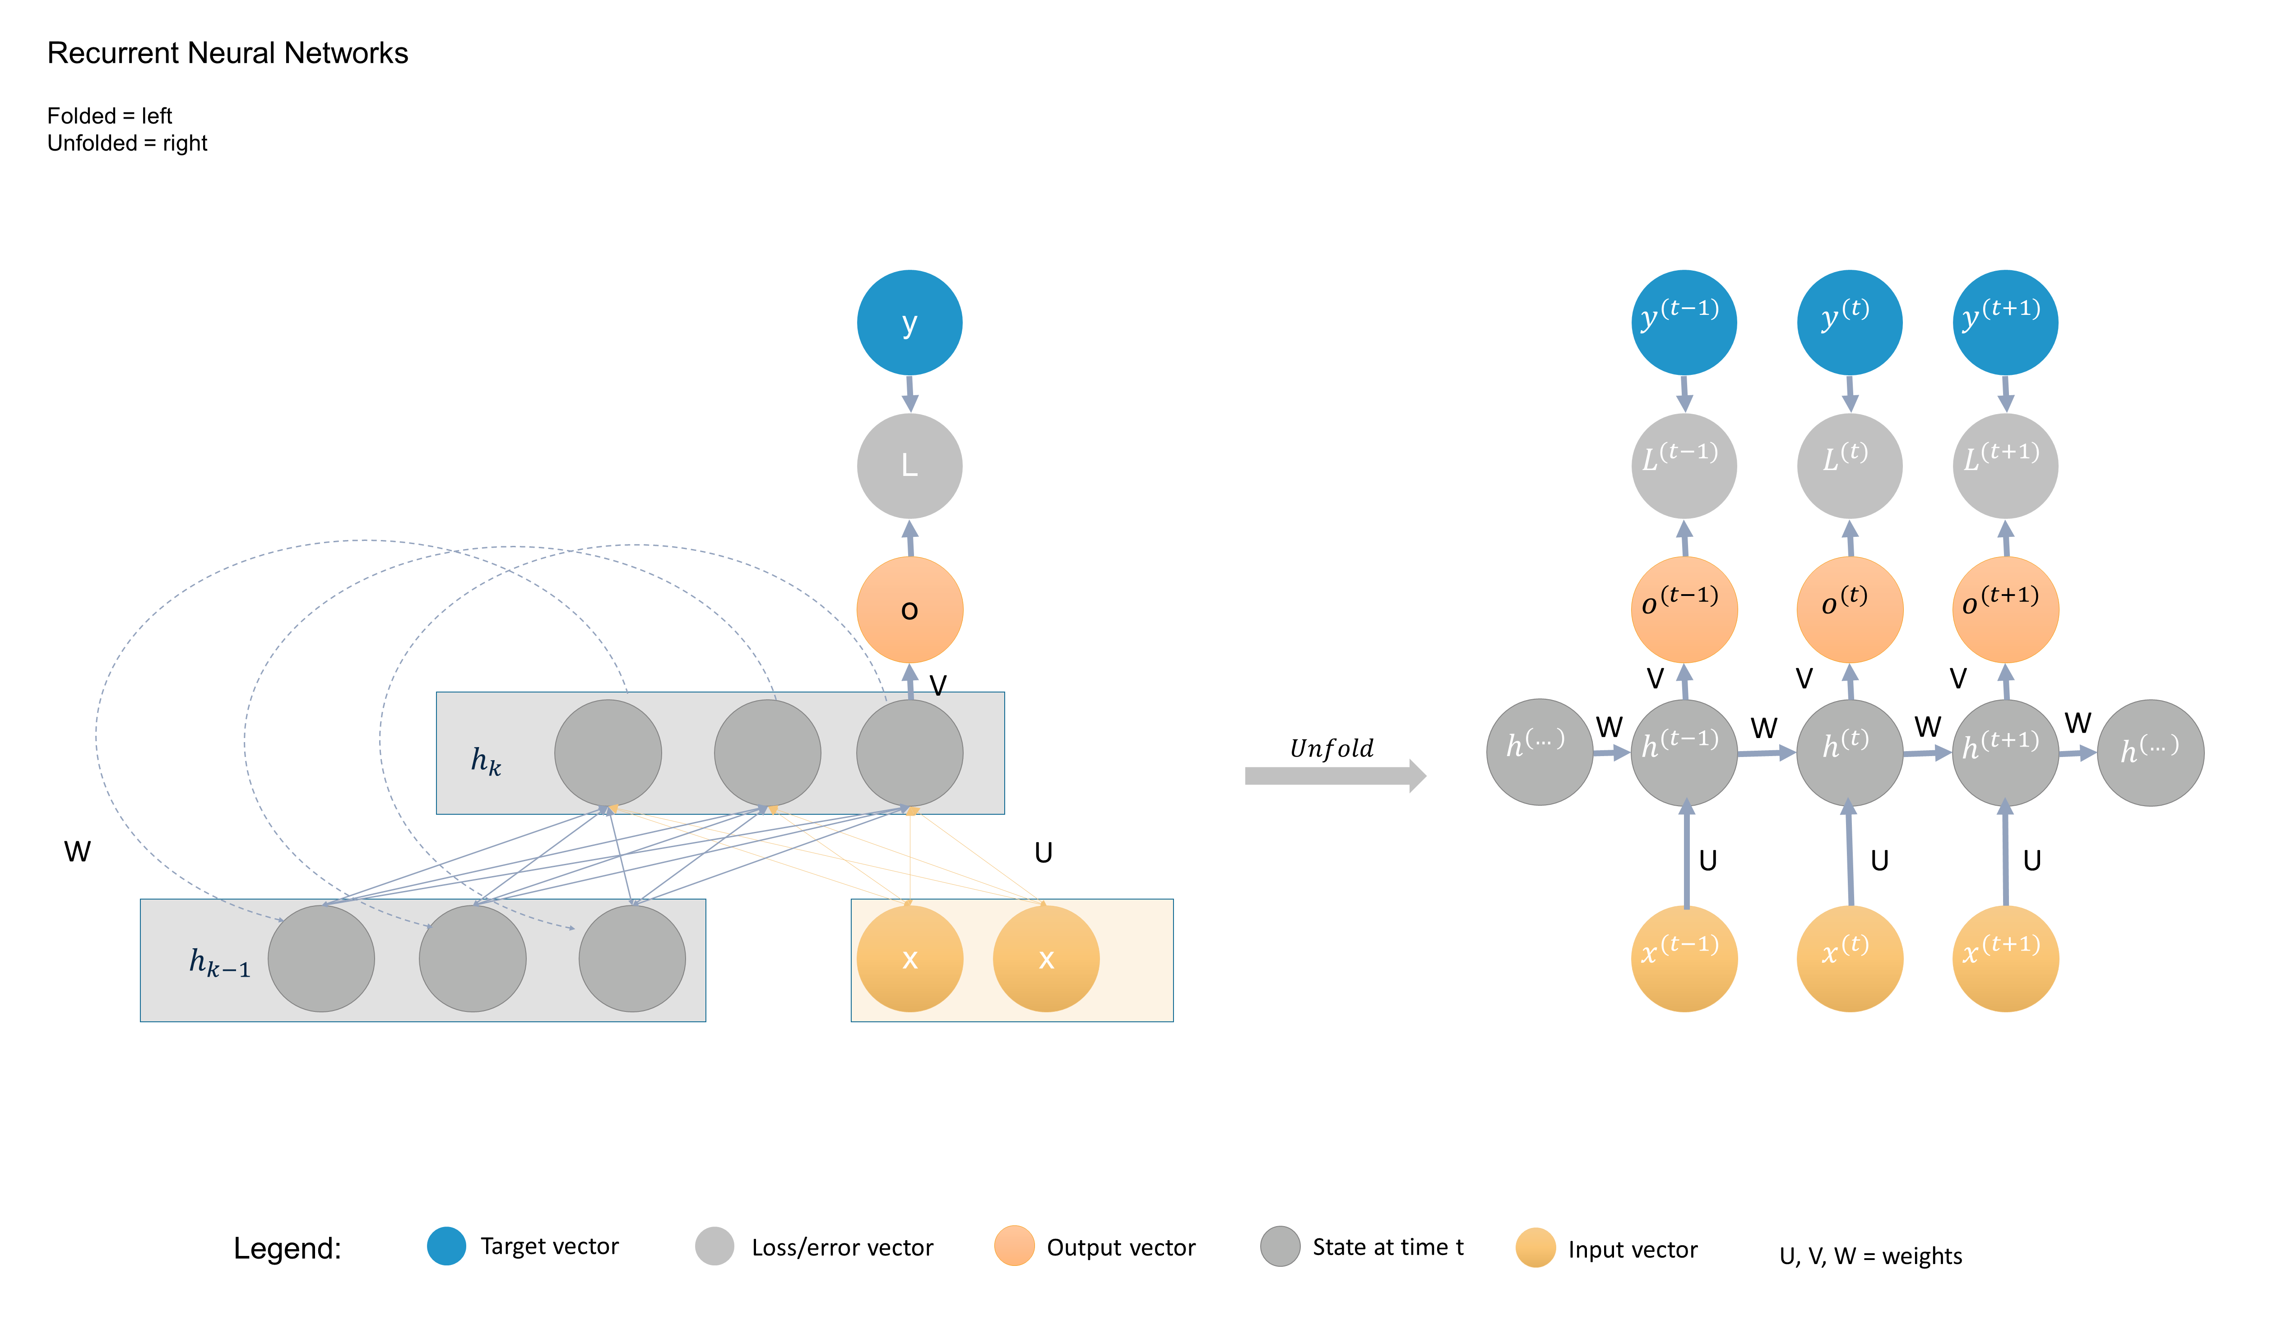



















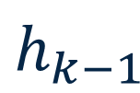
Recurrent Neural Networks
Folded = left
Unfolded = right
y
$$y^{(t−1)}$$
$$y^{(t)}$$
$$y^{(t+1)}$$
L
$$L^{(t−1)}$$
$$L^{(t)}$$
$$L^{(t+1)}$$
o
$$o^{(t−1)}$$
$$o^{(t)}$$
$$o^{(t+1)}$$
V
V
V
V
$$h^{(…)}$$
W
$$h^{(t−1)}$$
W
$$h^{(t)}$$
W
$$h^{(t+1)}$$
W
$$h^{(…)}$$
$$h_{k}$$
$$Unfold$$
W
U
U
U
U
x
x
$$x^{(t−1)}$$
$$x^{(t)}$$
$$x^{(t+1)}$$
$$h_{k−1}$$
Legend:
Target vector
Loss/error vector
Output vector
State at time t
Input vector
U, V, W = weights

