Slide 1


Slide 2
AWS ELASTIC BEANSTALK
WHAT IS ELASTIC BEANSTALK
GET STARTED USING ELASTIC BEANSTALK
SET UP: DEPLOYING WEBSITE USING ELASTIC BEANSTALK
ELASTIC BEANSTALK CONCEPTS
SECURITY
SERVICE ROLES , INSTANCES POLICY AND USER PROFILE

Slide 3
WHAT IS ELASTIC BEANSTALK
Amazon Web Services (AWS) is a collection of over a hundred services, each responsible for functional coverage. This flexibility complicates the question of what service to use and what will be the provisioning. Elastic Beanstalk is an easy way to deploy and manage applications in the AWS Cloud without learning anything about the infrastructure running those applications. By uploading your application, Elastic Beanstalk decouples the complexity of managing applications from choices and controls in hosting environments. Elastic Beanstalk orchestrates the following services: provisioning capacity, balancing loads, scaling, and monitoring application health. Elastic Beanstalk supports applications developed with Go, Java, .NET, Node.js, PHP, Python, and Ruby. While deploying your application, Elastic Beanstalk builds the supported platform version you have chosen and provisions one or more AWS resources running Amazon EC2 instances to run your application. You can interact with Elastic Beanstalk using the Elastic Beanstalk console, the AWS Command Line Interface (AWS CLI), or eb, an enhanced CLI designed for Elastic Beanstalk. To learn more about deploying a sample web application using Elastic Beanstalk, please see Getting Started with AWS: Deploying a Web App. You also can do most deployment-related tasks, like changing the size of your fleet of Amazon EC2 instances or monitoring your application directly from the Elastic Beanstalk web interface (console). To use Elastic Beanstalk, you create an application in which you upload a version of your application—that is, uploaded in the form of an application source bundle (for example, a Java .war file) to Elastic Beanstalk—and then give some information about the application. Elastic Beanstalk automatically launches an environment and creates and configures the AWS resources needed to run your code. Once your environment has been launched, you can manage your environment and deploy new application versions. The following diagram illustrates the workflow of Elastic Beanstalk.

Slide 4
Create application
Upload version
Launch environment
Manage enviornment

Slide 5
GET STARTED USING AWS ELASTIC BEANSTALK
To give you a general sense of how AWS Elastic Beanstalk works, this tutorial walks you through creating, exploring, updating, and deleting an Elastic Beanstalk application. This will take less than an hour to complete. Elastic Beanstalk is free, but the AWS resources it creates for you are live (and don't run in a sandbox). You pay the standard rates for these resources until you terminate them at the end of this tutorial. The total charge will generally be less than one dollar. For information about how to minimize charges, see the AWS free tier.
Topics
• Getting Set Up: Create an AWS account
• Step 1: Create a sample application
• Step 2: Explore your environment
• Step 3: Deploy a new version of your application
• Step 4: Configure your environment
• Step 5: Clean up

Slide 6
Set up : Deploying a website using AWS Elastic Beanstalk
SIGN UP:
1. Open https://portal.aws.amazon.com/billing/signup
2. When you sign up for an AWS account, an AWS account root user is created. This user has full access to all the AWS services and resources in the account. As a best practice in security, you would then assign administrative access to a user and only use the root user for tasks that need root user access. When you finish signing up, AWS sends you a confirmation email. At any time, you can access your up-to-date account activity and manage your account at https://aws.amazon.com/

Slide 7
3.Secure your AWS Account Root User Sign in to AWS Management Console: Go to the AWS Management Console at https://aws.amazon.com/console/. Choose "Sign in to the Console" and enter your AWS account email address as the root user. Enter your password on the next page. Enable Multi-Factor Authentication (MFA) for Root User 4.Create a User with Administrative Access Enable IAM Identity Center: IAM Identity Center is used for managing identity sources. Ensure it's enabled for your AWS account. Detailed instructions can be found in the AWS IAM Identity Center User Guide: Enabling AWS IAM Identity Center. Grant Administrative Access to a User: Once IAM Identity Center is enabled, proceed to grant administrative access to a user. Here’s a high-level outline of the steps: Log in to the AWS Management Console. Navigate to the IAM Identity Center. Identify or create the user to whom you want to grant administrative access. Assign the necessary permissions to this user. Typically, this involves attaching a policy that grants administrative permissions. AWS provides the AdministratorAccess policy, which grants full access to AWS services and resources. Configure User Access with IAM Identity Center: For detailed guidance on configuring user access using IAM Identity Center, refer to the AWS IAM Identity Center User Guide: Configure user access with the default IAM Identity Center directory. By following these steps, you will have secured your AWS root user with MFA and created a separate administrative user, reducing the risk associated with using the root user for everyday tasks. This approach aligns with AWS best practices for security and access management.
Follow the instructions in the AWS IAM User Guide to enable MFA for your root user.
Here’s the direct link: Enable a virtual MFA device for your AWS account root user (console).

Slide 8
Create application for Elastic Beanstalk
Create an application and an environment
To create your example application, you'll use the Create application console wizard. It creates an Elastic Beanstalk application and launches an environment within it. An environment is the collection of AWS resources required to run your application code.
To create an example application
1. Open the Elastic Beanstalk console.
2. Choose Create application.
3. For Application name enter getting-started-app.
4 .Optionally add application tags.
5. For Platform, choose a platform.

Slide 9
6. Proceed to the "Next" button after configuration.
7. Select "Use an existing service role" under "Service Role" on the service access configuration page.
8.Choose the appropriate option from the EC2 instance profile dropdown:
9.Select "aws-elasticbeanstalk-ec2-role" if available.
10.Choose another suitable default profile if listed.
11.If no options are shown, create an IAM Role for EC2 instance profile using provided instructions.
12.After creating the IAM Role, refresh the dropdown list and select the newly created role.
13.Skip optional steps by selecting "Skip to Review."
14.Review your selections on the "Review" page and confirm by clicking "Submit."

Slide 10
To create a an IAM Role for EC2 instance profile selection
Click View permissions boundary details. This option is at the bottom of the dropdown under the EC2 instance profile section. A modal window with the title View instance profile permissions lists the managed profiles that you will need to attach to the new EC2 instance profile that you create; it also includes a link to launch the IAM console. 2. Choose the link to the IAM console that comes in the first line of the window. 3. In the IAM console navigation pane, choose Roles. 4. Click Create role. 5. In the Trusted entity type section, select AWS service. 6. In Use case, select EC2. 7. Click Next. 8. Attach the correct managed policies. Scroll in the View instance profile permissions modal window to see the managed policies. The poli 9. Click Next. 10. Enter a Name for the Role. 11. (Optional) Label the Role. 12. Click on Create role. 13. Proceed back to the open Elastic Beanstalk console window. 14. Close Modal View Profile Instance Permissions. Important Don't close the browser tab showing the Elastic Beanstalk console. 15. Select (refresh), right of the EC2 instance

Slide 11
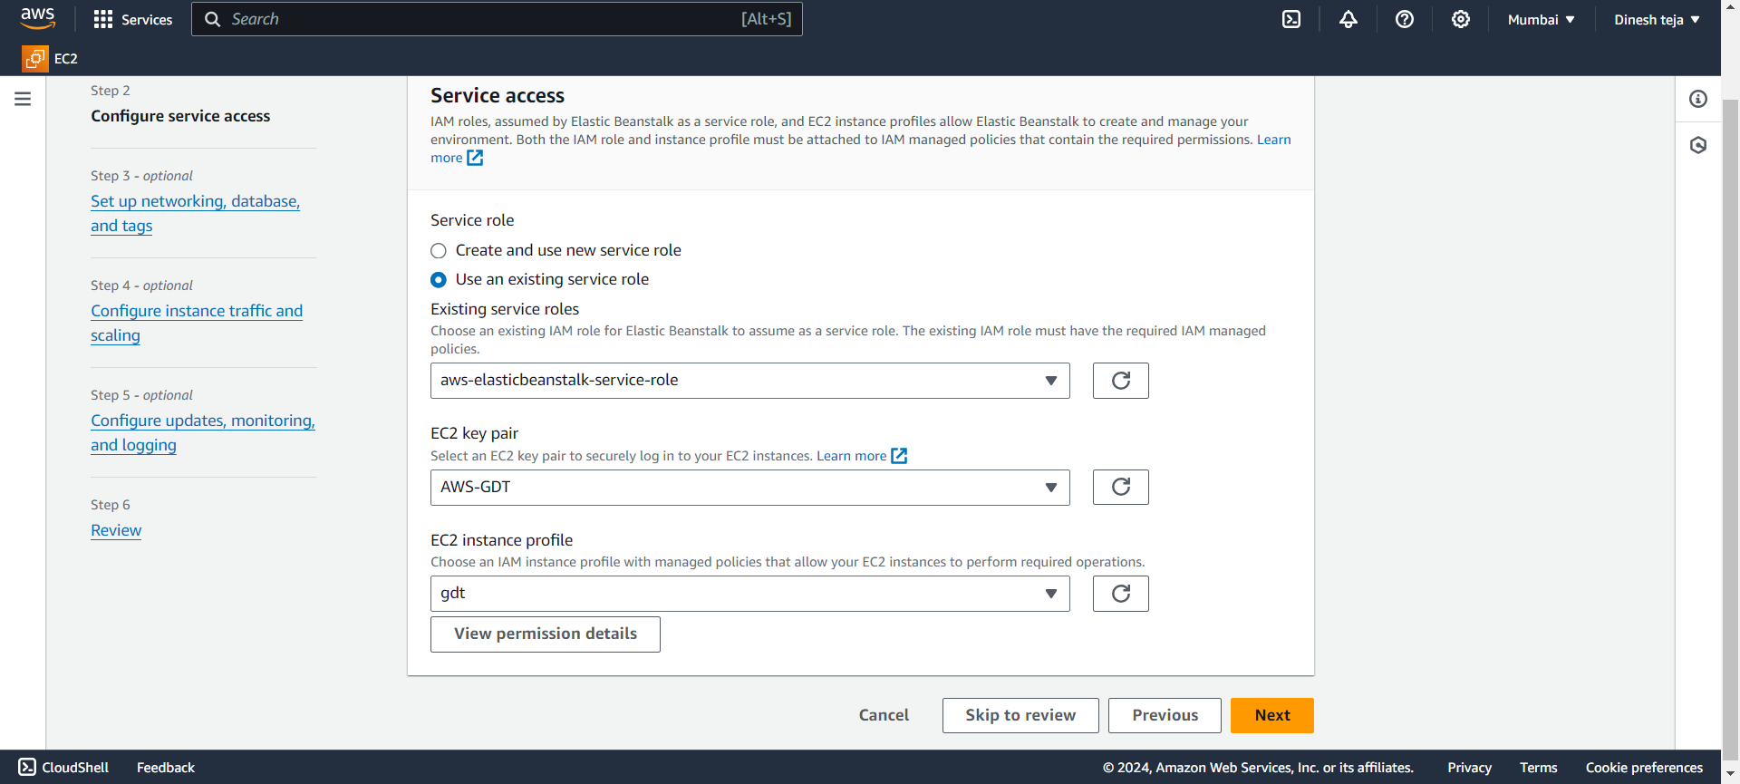
Create IAM role for EC2 instances profile

Slide 12
ELASTIC BEANSTALK WORKFLOW
To deploy and run the example application on AWS resources, Elastic Beanstalk takes the following actions. They take about five minutes to complete.
1. Creates an Elastic Beanstalk application named getting-started-app.
2. Launches an environment named GettingStartedApp-env with these AWS resources:
• An Amazon EC2 security group
• An Amazon Elastic Compute Cloud (Amazon EC2) instance (virtual machine)
• An Amazon Simple Storage Service (Amazon S3) bucket
• Amazon CloudWatch alarms
• An AWS CloudFormation stack
3. A domain name For details about these AWS resources, see the section called “AWS resources created for the example application”.
4. Creates a new application version named Sample Application. This is the default Elastic Beanstalk example application file.
5. Deploys the code for the example application to the GettingStartedApp-env environment. During the environment creation process, the console tracks progress and displays events.

Slide 13
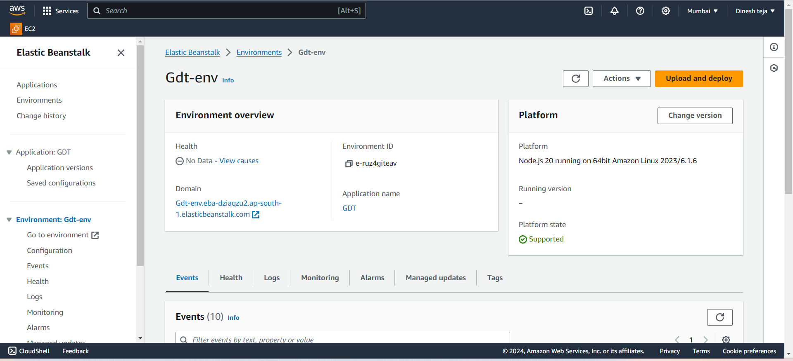

Slide 14
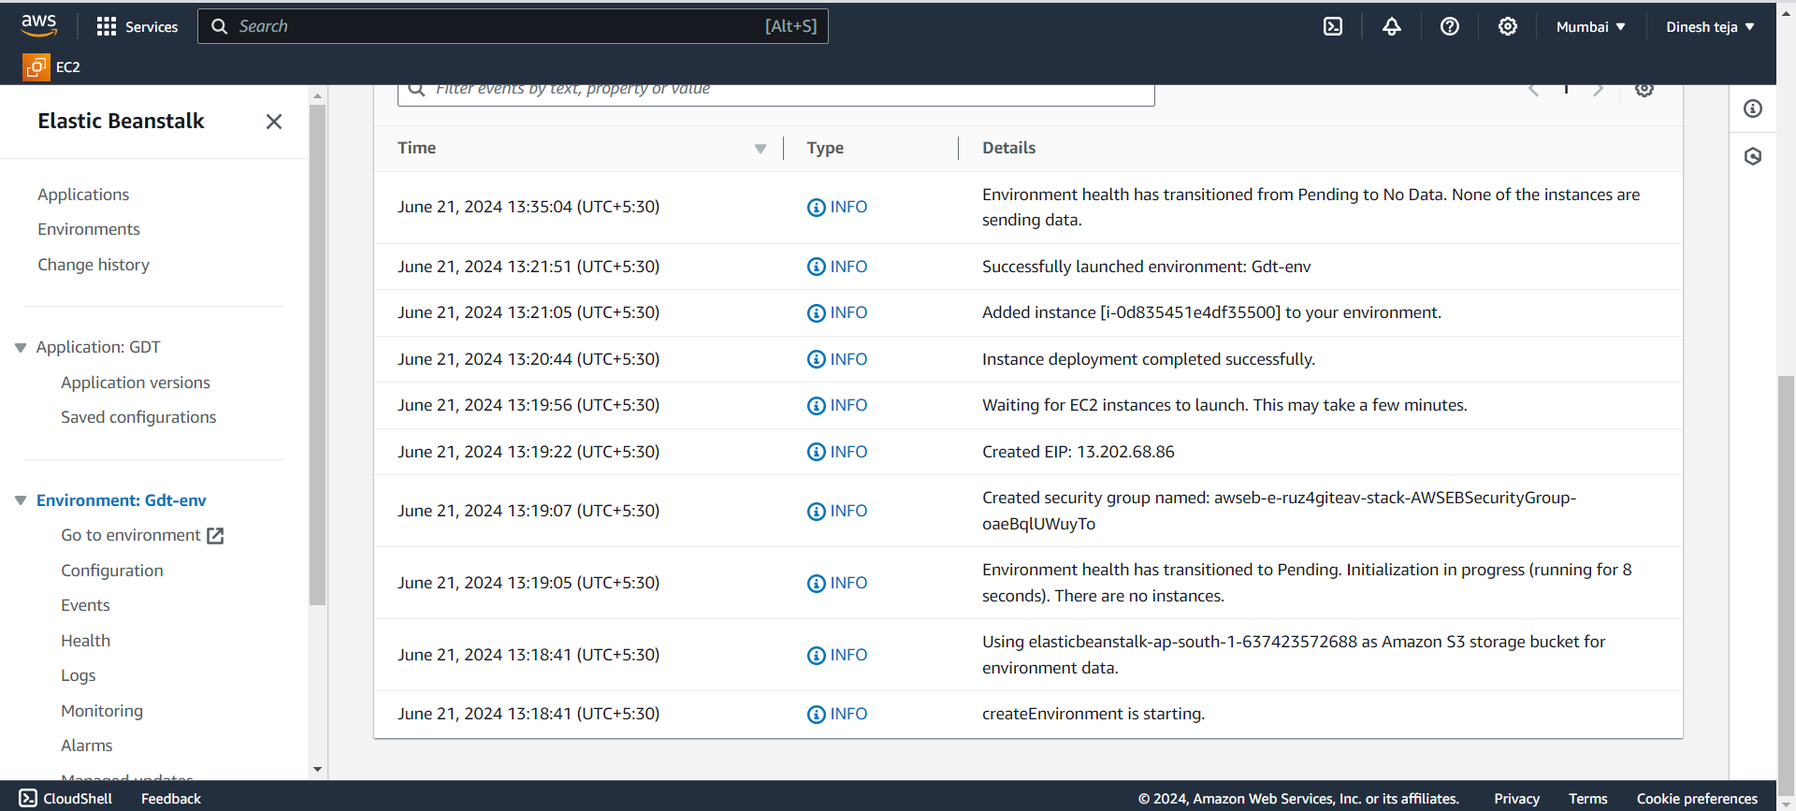

Slide 15
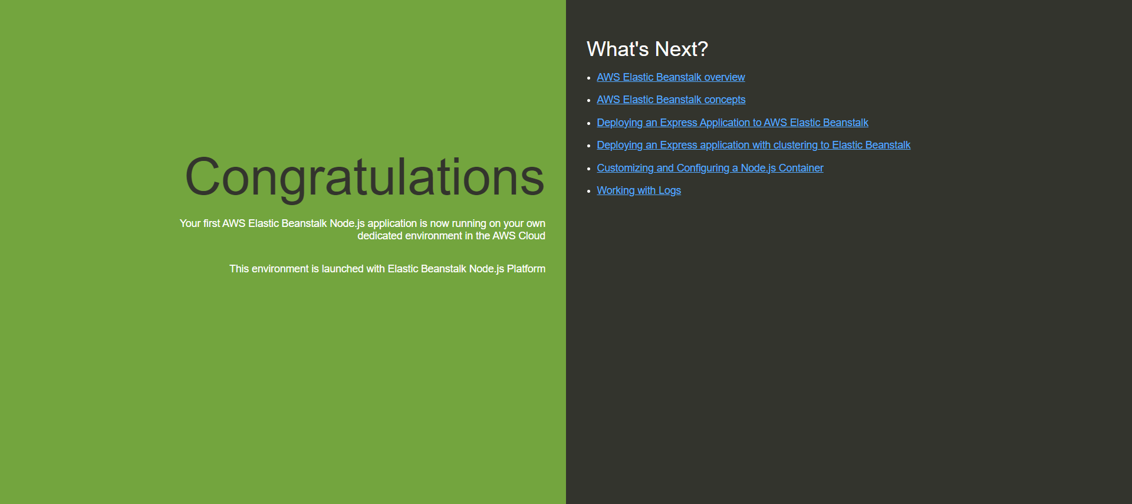
When all of the resources are launched and the EC2 instances running the application pass health checks, the environment's health changes to Ok. You can now use your web application's website.

