Slide 1
CLOUD COMPUTING AND DATA MANAGEMENT

Slide 2
AMAZON S3
Amazon S3 (Simple Storage Service) provides object storage.
S3 is a public service so, it can be accessed from anywhere as long as you have an internet connection.
S3 provides query-in-place functionality, allowing you to run powerful analytics directly on your data at rest in S3.
S3 is perfect for hosting large amounts of data such as Movies, Audio, photos, text, large data sets.
Designed for developers for easier web-scale computing,It can also store computer files up to 5 terabytes in size.

Slide 3
AWS S3
It can be accessed using a variety of methods.
GUI
Command line.
AWS APIs
Standard method such as HTTPS.

Slide 4
AWS S3 OBJECT
3 Object:’
Objects are the data the S3 stores.
E.g., Images, Videos, Large datasets.
You can think about objects as files.
An object in S3 is made up of two main components.
1. Object key It's similar to a file name.
2. Object Value → The value is the data or the content of the object.

Slide 5
AWS S3 BUCKETS BucketsAWS S3 Buckets:
Buckets are containers for objects. All objects stored within the bucket at the same level. So, this isn't the file system where you can truly have files within folders Bucket names must follow a set of rules: 1. Names must be globally unique across all of AWS. 2. Names must be 3 to 63 characters in length. 3. Names can only contain lowercase letters, numbers, and hyphens. 4. Names cannot be formatted as an IP address. e.g., 5.5.5.5

Slide 6
BENEFITS OF S3
1.Durability: S3 provides 99.999999999 percent durability.
2. Low cost: S3 lets you store data in a range of "storage classes." These classes are based on the frequency and immediacy you require in accessing files.
3. Scalability: S3 charges you only for what resources you actually use, and there are no hidden fees or overage charges. You can scale your storage resources to easily meet your organization's ever-changing demands.
4. Availability: S3 offers 99.99 percent availability of objects.
5. Security: S3 offers an impressive range of access management tools and encryption features that provide top-notch security

Slide 7
S3 STORAGE CLASSES
1. General purpose
➤ Amazon S3 Standard (S3 Standard)2. Unknown or changing access
➤ Amazon S3 Intelligent-Tiering (S3 Intelligent-Tiering)3. Infrequent access
➤ Amazon S3 Standard-Infrequent Access (S3 Standard-IA)Amazon S3 One Zone-Infrequent Access (S3 One Zone-IA)
ArchiveAmazon S3 Glacier Instant Retrieval
Amazon S3 Glacier Flexible Retrieval (Formerly S3 Glacier)
Amazon S3 Glacier Deep Archive

Slide 8
GENRAL PURPOSE
Amazon S3 Standard offers high durability, availability, and performance object storage for frequently accessed data. By default, the data that we store in S3 goes to the Amazon S3 Standard General Purpose plan.
S3 Standard is appropriate for a wide variety of use cases, including cloud applications, dynamic websites, content distribution, mobile and gaming applications, and big data analytics.
Key Points:
High Availability and low latency.
Data is stored in multiple locations. So it is resilient against events that affect an entire Availability Zone.
The durability of 99.999999999% and availability of 99.99% availability over a given year.
➤ Most expensive storage class among all others.

Slide 9
UnKNOWN OR CHANGING ACCESS
Amazon S3 Intelligent-Tiering (S3 Intelligent-Tiering)$3 Intelligent-Tiering optimizes costs by automatically moving data to the most cost-effective access tier, without performance impact or operational overhead.It moves objects that have not been accessed for 30 consecutive days to the infrequent access tier. If the object is accessed then it is automatically moved back to the frequent access tier. No retrieval fees or additional tiering fees are required.It is ideal for storing long-lived data where the access patterns are unknown.Key Points:Low latency and high throughput performance.
➤ Automatically moves the data between two access tiers. (Infrequent Access andFrequent Access).The durability of 99.999999999% and availability of 99.99% over a given year.Small monthly monitoring and auto-tiering fee.

Slide 10
INFREQUENT ACCESS
S3 Standard-IA:S3 Standard-IA is for data that is accessed less frequently, but requires rapid access when needed. S3 Standard-IA offers the high durability, high throughput, and low latency of S3 Standard, with a low per GB storage price and per GB retrieval charge.It is ideal for backups, long-term storage, and as a data store for disaster recovery.Key Points:High Availability and Low Latency (Same as S3 Standard)Offers greater availability and resiliency than the OneZone-IA storage.The durability of 99.999999999% and availability of 99.99%
➤ Less expensive than S3 Standard storage but you will be charged a retrieval fee hence suitable for infrequently accessed data.

Slide 11
ARCHIVE
It is an archive storage class that delivers the lowest-cost storage for long-lived data that is rarely accessed and requires retrieval in milliseconds
you can save up to 68% on storage costs compared to using the S3 Standard-Infrequent Access
It delivers the fastest access to archive storage, with the same throughput and milliseconds access as the S3 Standard and S3 Standard-IA storage classes.
This storage class is ideal for archive data that needs immediate access, such as medical images, news media assets, or user-generated content archives.
Key Points:
➤ Data retrieval in milliseconds with the same performance as S3 Standard
➤ Designed for durability of 99.999999999% of objects across multiple Availability Zones Data is resilient in the event of the destruction of one entire Availability Zone
➤ Designed for 99.9% data availability in a given year.

Slide 12
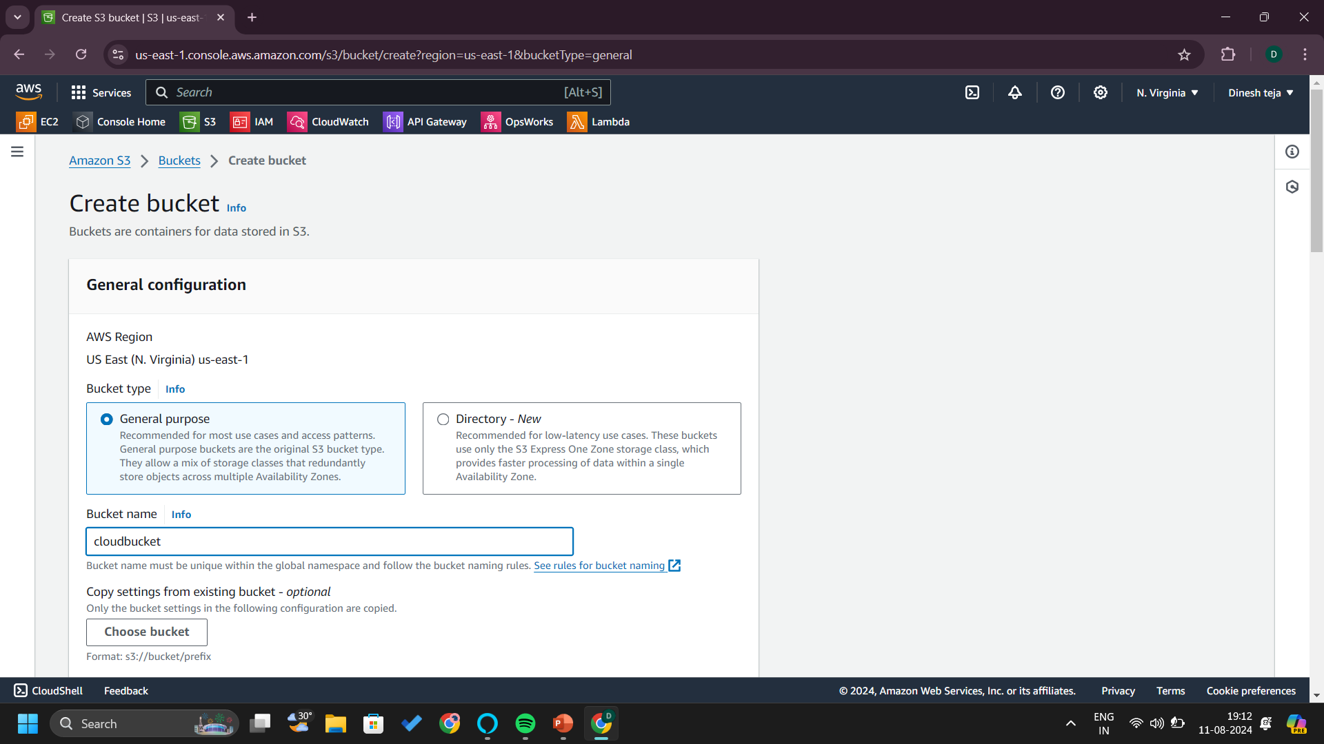

Slide 13
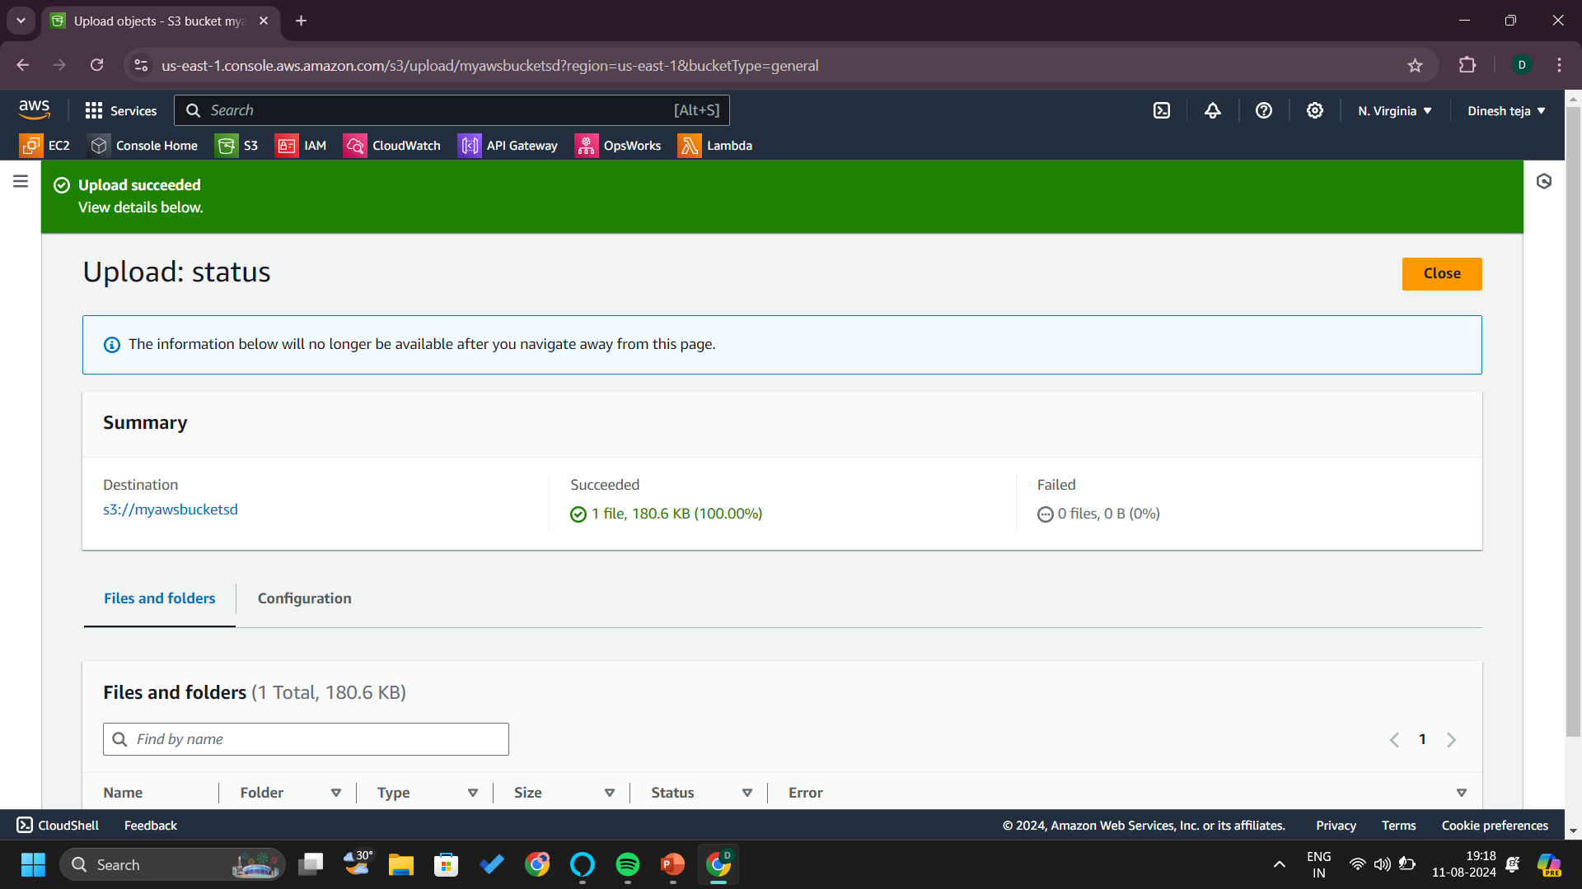

Slide 14
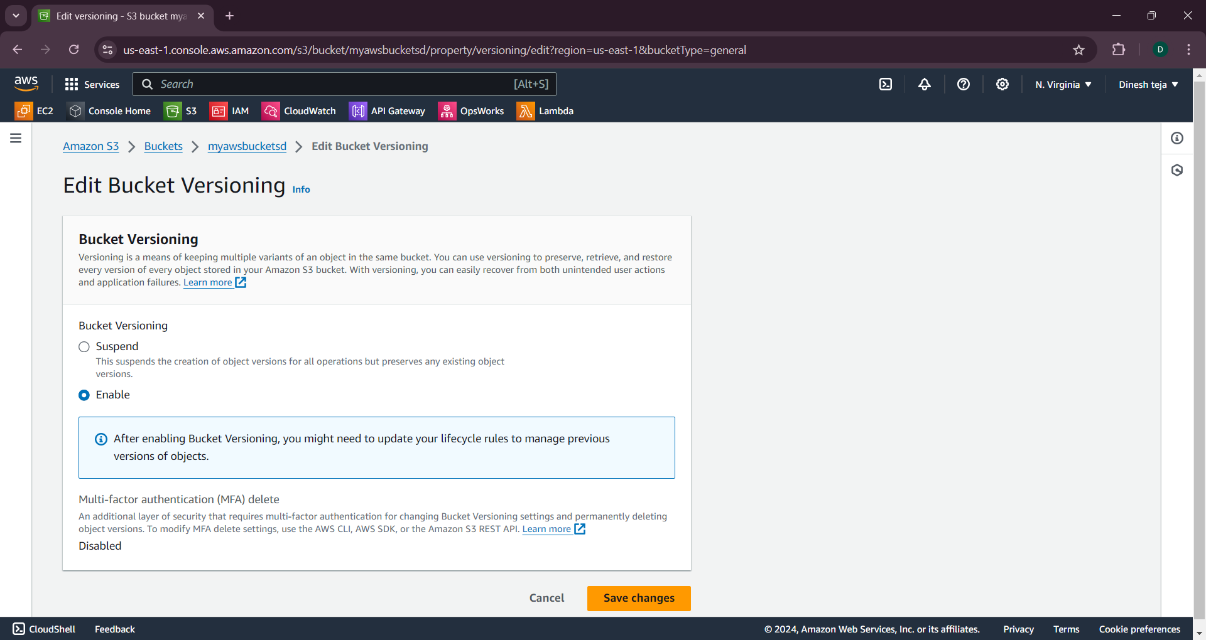

Slide 15
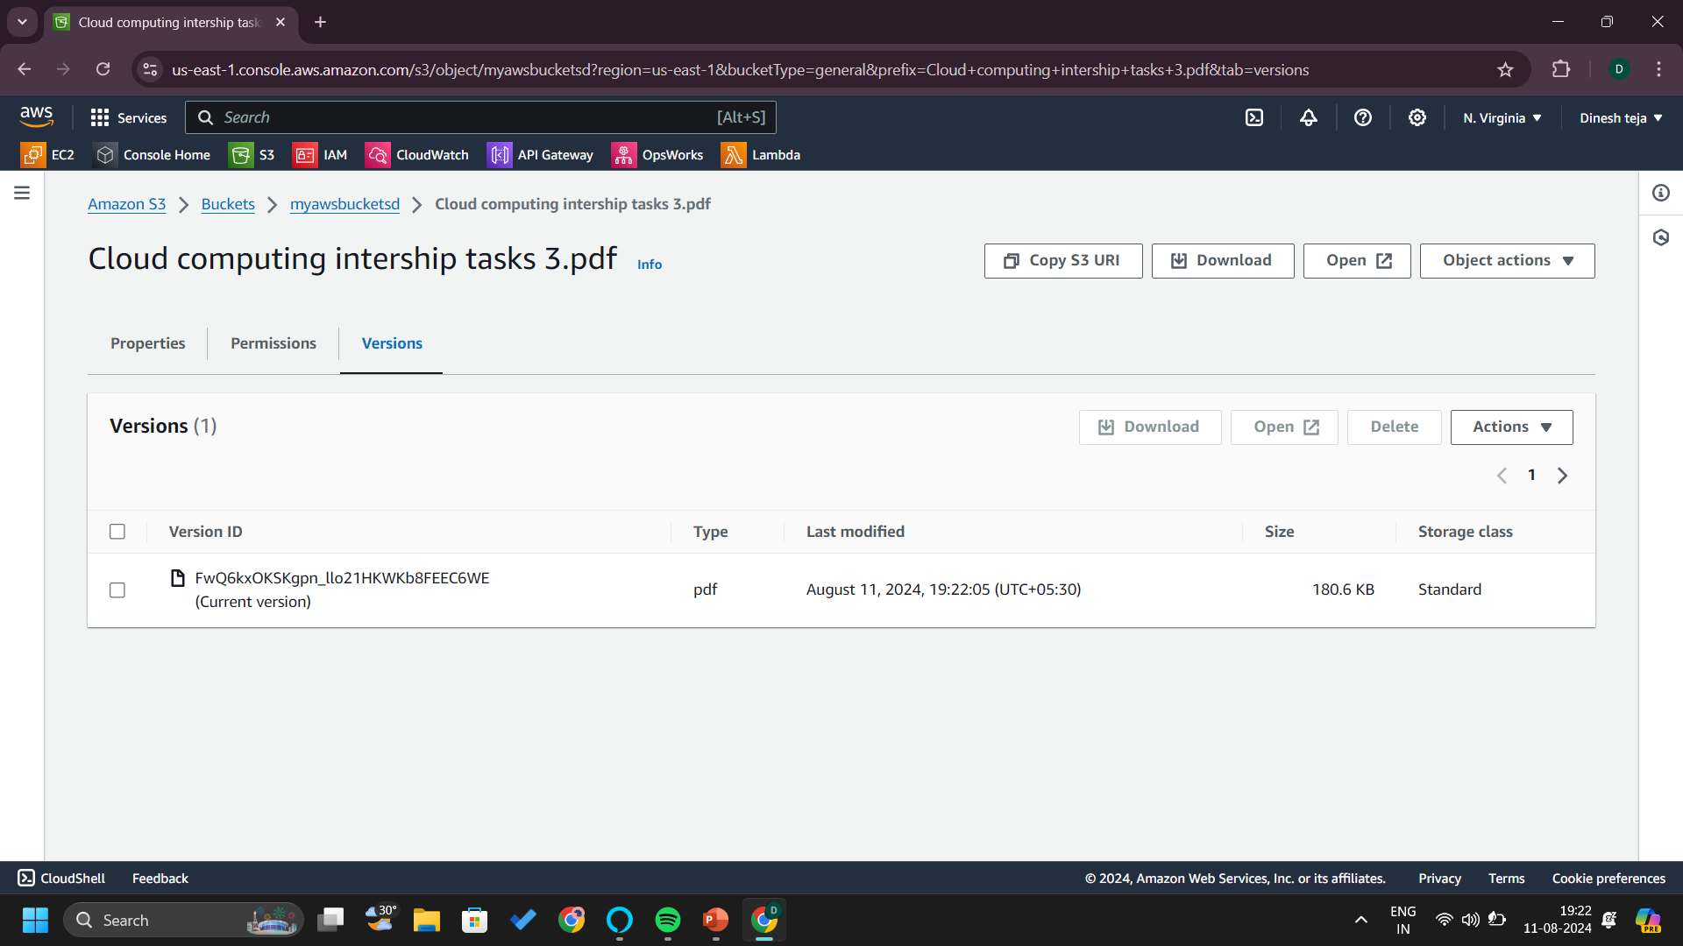

Slide 16
