Slide 1
DATA SCIENCE
For FinTech Industries(Cryptocurrency)

Slide 2
FinTech and Cryptocurrency In Brief

Slide 3
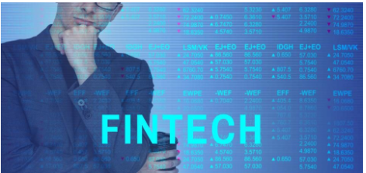
FinTech stands for Financial Technologies, and in its broadest definition, that’s exactly what it is: technologies used and applied in the financial services sector, chiefly used by financial institutions themselves on the back end of their businesses.
FinTech like crowdfunding, mobile payments, and money transfer services is revolutionizing the way small businesses start up, accept payments, and go global, and they are making it easier than ever to start and run a business.

Slide 4

The term cryptocurrency is a combination of the words 'crypto' and 'currency’.
The word crypto comes from the fact that most of the cryptocurrencies (Yes there's more than one!), use cryptography principles for generation, transfers etc. Cryptography is a branch of computer science that deals with encryption, decryption, passwords, and all that secret and safety stuff!
In simple words cryptocurrencies are digital, decentralized currencies, that rely upon cryptographic principles for generation, distribution, transferring etc.
A new cryptocurrency can be created at any time. Bitcoin is currently (January 6, 2018) the largest blockchain network

Slide 5
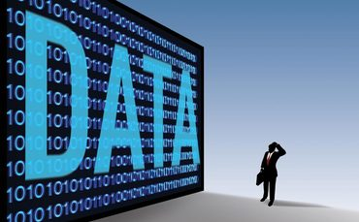
Data Science in FinTech is The “New Oil”
WHY????
WHAT???
HOW???

Slide 6
7 Reasons WHY ???
Payment and Transactions
Credit Risk Evaluation
Fraud Detection and Prevention
Portfolio Optimization and Asset Management
Corporate Compliance & Service Quality

Slide 7
WHAT we are dealing with??
Predictive analysis on dataset.
Different types of datasets in this case is :
Cross-sectional
Time-series
Panel
In Fin-Tech industry all the datasets are either time-series or cross-sectional.

Slide 8
Cross-sectional dataset :
It groups the available data into groups based on the similarities in the data and builds the model.
In statistical terms , it is a dataset that is taken at a particular time.
The error between 2 observations will be zero.
The predicted output will be numeric.
Example : the consumption expenditure of individuals for a period of one month.
Time-series dataset :
It refers to the data that is taken over a period of time at specific and equal-intervals of time.
The observations made are independent of one another.
The predicted output is numeric.
Usually regression method is used to create a model.
This mainly has 4 subtypes : Date , Date Time ,Time, Timestamp .
Example : Stock market closing rate for a time span of one year.
For our presentation , we have taken a cryptocurrency data which is a time-series data set.

Slide 9
DATA PROVIDERS
www.Kaggle.com/datasets
http://archive.ics.uci.edu/ml/datasets
https://elitedatascience.com/datasets
https://www.quandl.com/
https://www.data.gov/
https://www.census.gov/data.html
https://relational.fit.cvut.cz/

Slide 10
DATA FORMATS
Kaggle.com : csv , JSON,SQlite
archive.ics.uci.edu : csv
Quandl.com : csv,JSON,xml
Data.gov : Txt , HTML
census . gov : csv , sas
relational.fit.cvut.cz : MySQL database

Slide 11
JSON format :
http://toddhayton.com/2015/01/16/scraping-by-example-json-data/
XML format :
https://www.stat.berkeley.edu/~statcur/Workshop2/Presentations/XML.pdf
MySQL format ( specially for relational.fit.cvut.cz) :
Open any MySQL client.
Use the credentials provided by the site.
Export the database in any format that you want.

Slide 12
HTML format :
from lxml import html import requests
page = requests.get('http://econpy.pythonanywhere.com/ex/001.html') tree = html.fromstring(page.content)
<div title="buyer-name">Carson Busses</div> <span class="item-price">$29.95</span> buyers = tree.xpath('//div[@title="buyer-name"]/text()') prices = tree.xpath('//span[@class="item-price"]/text()')
print 'Buyers: ', buyers print 'Prices: ', prices

Slide 13
HOW???
DATA INGESTION/SCRAPING (searching for the data)
DATA MUNGING (Clean the data)
EDA(Know your data)
FEATURE ENGINEERING(Enhance the predictive power)

Slide 14
What is Data Ingestion/Scraping
Extracting content from a webpage programmatically
Digging up dirt from the social media
Converting data from human readable to machine readable

Slide 15
How to Extract the Data using API
Retrieve Bitcoin data using Quandl API
Quandl offers free Bitcoin exchange rates for 30+ currencies from a variety of exchanges.
Quandl’s simple API gives access to Bitcoin exchanges and daily Bitcoin values. Accessing Bitcoin data via the API is no different than the mechanism for all data on Quandl

Slide 16
EDA(Exploratory Data Analysis)
Data profiling is concerned with summarizing your dataset through descriptive statistics. EDA indeed makes sure that you explore the data in such a way that interesting features and relationships between features will become more clear.

Slide 17
FEATURE ENGINEERING
Using the knowledge of the data and coming up with a feature that will work well with the ML algorithm that you are using which you can analyze the date better and predict the future.
The important aspect of feature learning is creating a column for the new variable.
To add a column :
(in R) : use dplyr’s mutate()
(in python) : use pandas

