Slide 1

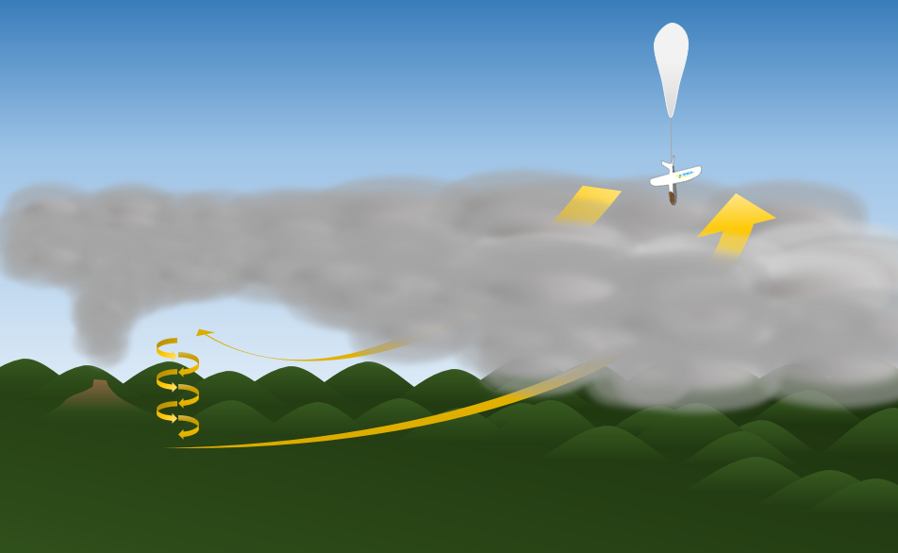


Airborne Sampling/Sensing of Distal Volcanic Ash
Introduction
UAV
Sensors & Capture
Results
Conclusion

