Slide 1
Airborne Sampling/Sensing
of Distal Volcanic Ash
Project Sponsor:
Defence Technology Agency
Project Supervisor:
Professor Maan Alkaisi
Special thanks to RNZAF, SERC & NIWA

Slide 2
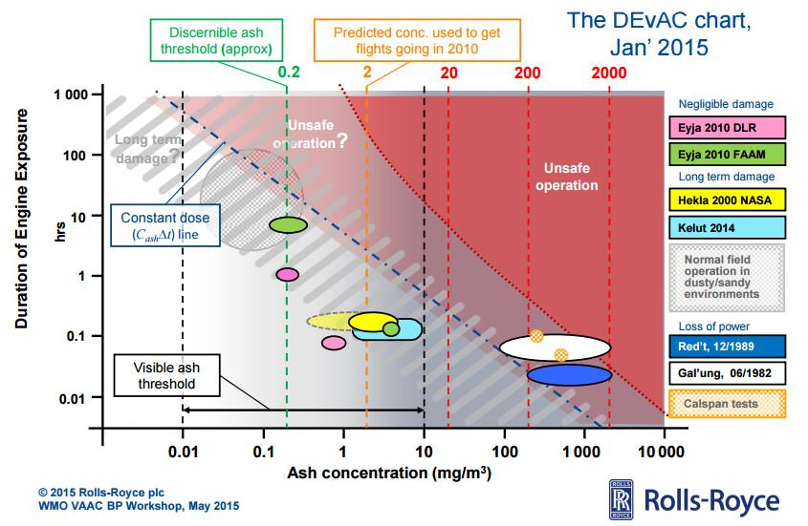

Slide 3
