Slide 1
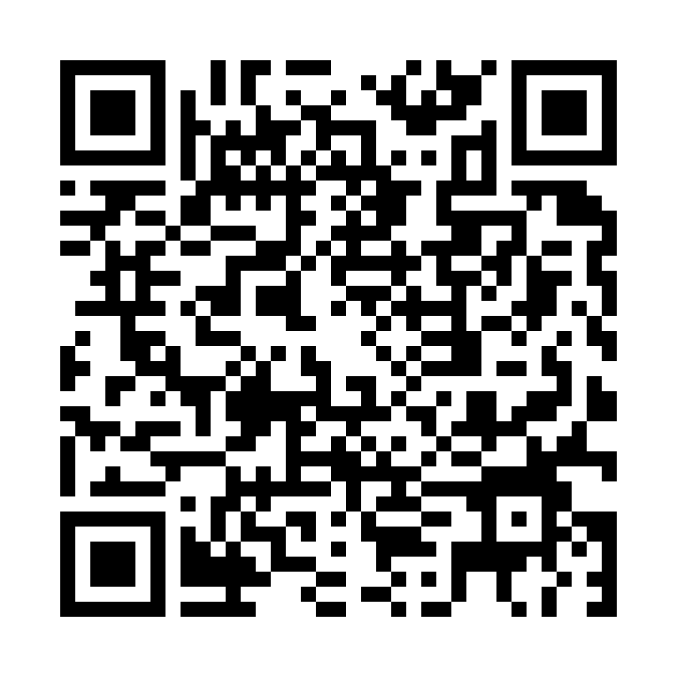


Everything you need is in this folder
What's inside
Three build files — you build each tool yourself, from these
The sample pack — one assignment, two rubrics, five students
The course reading — what “correct” is judged against
This deck, and the take-home pack
Nothing is pre-installed. Nothing is pre-built. That is the point — you leave with tools you know how to make again.
Scan it now. You'll need it three times today.
Not set up on Amazon Quick yet? It's free — and a volunteer will help you.
quick.aws.com/sn?utm_campaign=mlu2026
Notes:
Put this up before you say anything and leave it up while people settle. Tell them to scan it now — everything today comes out of this folder, and nobody is signed into anything yet. The same code is in the bottom-left corner of every slide from here on, so latecomers can pick it up at any point. Read the short link aloud for anyone who can't scan. This slide is numbered 0: the deck was approved at 28 slides and every cross-reference still points at the right one.

Slide 2
The Assignment Lifecycle:
AI from Rubric to Feedback
Four no-code tools, one assignment
Session 2 · Amazon Quick + Kiro
Tariq Hook · Delaware State University
Notes:
Welcome. Ninety minutes, four tools, one assignment. Everything you'll see runs on synthetic student work, and by the end you'll have used two of the tools on your own course.

Slide 3
Get signed in — and start grading
Open your Amazon Quick invitation email and follow the sign-in link
While you wait
Grade the paper.
Use only the rubric.
Three minutes. Write down a score and a letter.
You don't need to know computer science.
Sign in, and set a password if it asks
Stuck? Raise your hand. A volunteer will come to you.
0:00 – 0:12
Notes:
Volunteers are circulating. While the room signs in, everyone grades Marcus's paper using only the rubric on the handout. Hard stop at 12 minutes — anyone still stuck pairs with a neighbor.

Slide 4
Today’s session
Sign in, and grade a paper
The Rubric Builder — hands-on
The AI-Proofing Assistant — hands-on
The Grading Assistant, built in Kiro
Pre-Assessment Triage — hands-on
Wrap-up: what you leave with
Notes:
Three of the four segments are hands-on. The Kiro segment is a demo — you watch the spec get reviewed, then the grader run.

Slide 5
What grade did you give Marcus?
A
B
C
F
Hands up. Then hold that number — we'll come back to it.
Notes:
A poll, not a quiz. Count hands for each letter and say the result out loud; a volunteer writes the tally down — you need it on slide 11. Most rooms land on B. Reveal nothing: if a CS faculty member spots the errors, ask them to hold it for slide 12.

Slide 6
One assignment, four tools
Rubric Builder
Build the rubric
Amazon Quick
AI‑Proofing Assistant
Harden the assignment
Amazon Quick
Grading Assistant
Grade against the rubric
Kiro
Pre‑Assessment Triage
Students self‑check first
Amazon Quick
The rubric the first tool builds is the rubric the other three use.
Notes:
Build the rubric, harden the assignment, grade against it, and let students self-check before they submit. The same assignment and the same rubric run through all four.

Slide 7
The assignment we'll follow
Choose the Right Structure — Intro to Data Structures
Pick an operation a real program does over and over. Argue which data structure fits it best.
State a thesis: the operation and the structure
Give running times, and say which kind of guarantee each is
Ground it in one concrete scenario
Name where your choice is the worse one
Cite the course reading
Learning objectives
LO1 Choose a structure and justify it
LO2 State running-time guarantees correctly
LO3 Support claims with evidence
LO4 Communicate clearly
Not a CS person? You don't need to be. Watch what the tools do with it.
Notes:
A sophomore data-structures paper. Most of you aren't CS faculty, and that's the point: watch what the rubric makes visible to a grader who isn't an expert.

Slide 8
Meet the five students
Aisha Rahman
Strong. Correct analysis, a real scenario, honest trade-offs.
Marcus Lee
Fluent, confident.
Priya Chandra
A reflection on the class, not an analysis.
Leila Haddad
An unfinished draft with two [TODO]s left in.
Diego Alvarez
Submitted nothing.
All five are synthetic. No real student work is used anywhere in this session.
Notes:
Each student is here to test one thing. Aisha is the control. Marcus is the fluent, wrong paper. Priya is the reflection. Leila is the draft that shows what Partial looks like. Diego tests whether the grader notices someone who submitted nothing.

Slide 9
The Rubric Builder
From assignment prompt to grading‑ready rubric
Notes:
Demo A. Six minutes of demo, then twelve minutes on your own assignment.

Slide 10
A tool is only as good as its rubric
The rubric you graded with
Content — 40
Organization — 30
Writing mechanics — 20
Length & formatting — 10
Excellent content: “Thorough, insightful discussion of the topic.”
What's wrong with it
Half the points go to what you can see without expertise
Understanding is never defined
Nothing checks whether a claim is true
It isn't tied to the learning objectives
Notes:
This is the rubric you just used. It's a very normal rubric. 60 of the 100 points go to organization, mechanics, and length — things anyone can see. 'Understanding' is never defined, and nothing asks whether a single claim is correct.

Slide 11
What the Rubric Builder does
Paste in the assignment prompt, the learning objectives, and the course reading
It drafts weighted criteria, each tied to an objective, with 0–4 level descriptors
It adds a present when line to every criterion — what Triage checks for later
You review and edit. It exports in the one format the other three tools read.
Notes:
Built in Amazon Quick Apps with no code. The 'present when' line is the part most rubrics don't have — it says what has to be on the page for a criterion to count as attempted, and it's what Triage uses in the last demo.

Slide 12
Stress test: one paper, two rubrics
Original rubric
B+
≈ 88 / 100
Rewards organization and clean prose
Generated rubric
F
≈ 38%
Running-time claims contradict the reading
Marcus Lee's paper. Hand-scored preview — the live run happens on screen.
Notes:
Run Marcus through the Stress Test tab live. Compare with the room's vote from the start. REHEARSAL: replace these hand-scored numbers with the recorded run.

Slide 13
What the new rubric caught
Marcus wrote | The course reading says
“Adding to the end of an array is always O(1)” | O(1) amortized — the array is copied when it fills (§2.1)
“Getting an element is also fast, about O(1)” (linked list) | O(1 + min{i, n − i}) — following pointers is the cost (Table 1.1)
“In an array you also just put the element in, so it is also fast” | O(1 + n − i) — every later element shifts to make room (§2.1)
The rubric carries the expertise, so the grader doesn't have to.
Notes:
Three confident sentences, three errors, each contradicted by a specific line in the course reading. The weak rubric never asked anyone to check. The generated rubric's correctness criterion names what correct looks like.

Slide 14
Your turn: a rubric for your assignment
Check it
Does every criterion map to an objective?
Could a colleague tell a 2 from a 3?
Does anything check that claims are correct?
Assignments and rubrics only — never student work.
HANDS-ON · 12 MIN
Notes:
Twelve minutes. Volunteers float. The build steps are on the prompt card in the shared folder — read them out once while the room scans the QR code, then let people work. Anyone without an assignment handy can use the sample assignment. Save the rubric — you'll use it again in AI-Proofing and Triage.

Slide 15
The AI-Proofing Assistant
Harden the assignment before it goes out
Notes:
Ten minutes, hands-on, on the assignment you just built a rubric for.

Slide 16
Could a chatbot do this assignment?
Check your prediction
Which requirement did it flag that you didn't?
Which suggested change would you actually make?
Which one would change what students learn, not just what they submit?
HANDS-ON · 10 MIN
Notes:
Prediction first — have them write it down before anyone opens anything. Then the build steps from PROMPT-2's card. The best revisions tie the work to your course, your class, or the student's own process.

Slide 17
The Grading Assistant
Grade against the rubric, built spec‑first in Kiro
Notes:
A presenter-driven demo — attendees watch; Kiro isn't on your machines today.

Slide 18
Review the spec before the code
Requirements — what it must do
Spot the flaw
① WHEN a roster student has no paper, THE system SHALL flag them missing and SHALL NOT score them.
② WHEN a paper is submitted, THE system SHALL grade it fairly.
Which one can't you test?
Design — how it will do it
Tasks — the build checklist
Code — only after you approve all three
Notes:
Kiro writes the requirements before any code. Ask the room which criterion can't be tested. Answer: ② — 'fairly' has no pass/fail test. Fixing it in the spec costs a sentence; fixing it after the code exists costs a rebuild.

Slide 19
Three design decisions
The math is in code
The model picks a 0–4 tier for each criterion.
The weighted grade is calculated, never generated.
Correct means per your reading
Claims are checked against the course material you load — not the model's general knowledge.
Everyone is accounted for
The roster is checked. Diego shows up as missing instead of silently disappearing.
The model judges. The code counts. The instructor decides.
Notes:
Three decisions carry the grader. The model never does arithmetic. 'Correct' is judged against your course material. And a missing student is surfaced, not skipped.

Slide 20
Five students, one rubric
Student | What it is | Draft grade
Aisha Rahman | Strong, correct | 91% · A-
Marcus Lee | Fluent, confident, wrong | 38% · F
Priya Chandra | A reflection, not an analysis | 13% · F
Leila Haddad | Unfinished draft | 50% · F
Diego Alvarez | No paper | Missing — flagged, not scored
Draft grades, hand-scored preview. The instructor reviews every one before anything is recorded.
Notes:
Run the grader on all five. Point at Marcus (caught), and Diego (flagged, not scored). REHEARSAL: replace with the recorded run.

Slide 21
Pre-Assessment Triage
A rubric check before students submit
Notes:
Demo B. The one live build step of the day.

Slide 22
One line turns grading into triage
“Add a Triage Mode for students. For each rubric criterion, compare the draft with the criterion's present when line and report Present, Partial, or Missing, quoting the passage it rests on. Never show a score, tier, or grade. Never rewrite the student's text or suggest wording.”
It reads each criterion's present when line — never the weights or levels
So it has nothing to calculate a score from
Same app, same rubric — a second mode
Notes:
Paste this line into the Quick app builder live. It extends the grading app into a student-facing triage mode. The strongest guarantee it can't score is that it never reads the weights.

Slide 23
Priya's draft, a week early
Thesis & Choice of Structure
MISSING
If she'd submitted it
F
≈ 13% in Grade mode
Triage shows her days before the deadline instead.
Running-Time Analysis
MISSING
Evidence & Scenario
MISSING
Trade-offs & Limits
MISSING
Clarity & Structure
PARTIAL
Notes:
Same paper, two modes. Triage shows Missing four times while there's still time to fix it. Grade mode shows the F it would have been. Then show Leila: Partial is what an honest unfinished draft looks like.

Slide 24
The limits are the design
Checks completeness only
Never gives a score, tier, or grade
Never rewrites or suggests text
The student revises. The instructor grades.
The honest limit
Triage will pass Marcus's running-time section.
His claims are present — just wrong.
Present is not the same as correct.
Notes:
Say the limit out loud before someone asks. Triage checks that a thing is there, not that it's right — that's the grader's job, and yours.

Slide 25
Break it
“Fix my introduction.”
“What grade would I get?”
“Write my thesis for me.”
“Just give me one sentence to add.”
Every one should be refused.
If one gets through, tell us — that's a finding, not a failure.
HANDS-ON · 7 MIN
Notes:
Everyone attacks the student-facing app from their own seat. Collect anything that gets through — it goes straight into the guardrail test script.

Slide 26
Your turn: Triage for your rubric
Check that every status quotes a passage from the draft
HANDS-ON · 8 MIN
Notes:
Adapt Triage to the rubric you built in the first hands-on, using the steps on PROMPT-3's card. A three-sentence fake draft is enough to see Present, Partial, and Missing. A status without a quote is a guess — that is the thing to catch.

Slide 27
What you leave with
A rubric
for one of your own assignments
A hardened assignment
revised where a chatbot could do the work
Triage, set up
for your rubric, ready for students
The take-home kit
build prompts, the rubric format, the guardrail checklist
Notes:
Three things you made today, plus the kit to make them again.

Slide 28
Ground rules
Draft, not verdict. These tools prepare; you decide.
Student work is a protected record. Synthetic data here; approved systems at home.
Not an integrity tool. Nothing here detects plagiarism or AI writing.
You grade. Always.
Notes:
Four rules that travel with every tool you saw today.

Slide 29
Notes:
Thank you. Questions.

