Slide 1
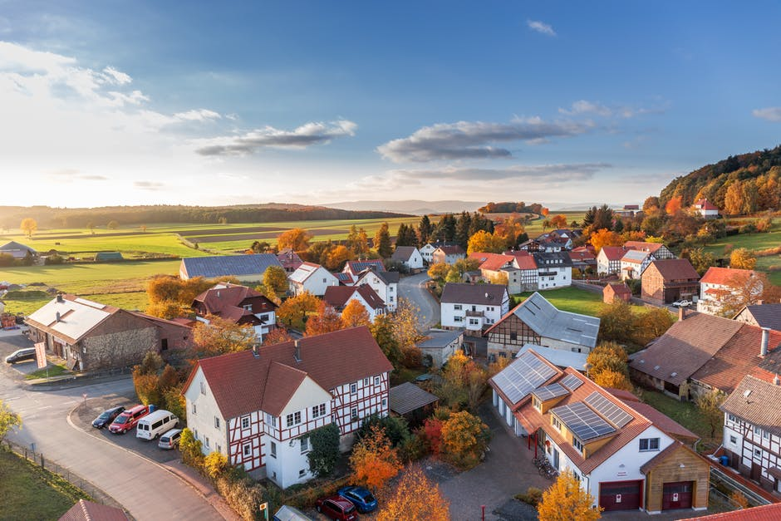
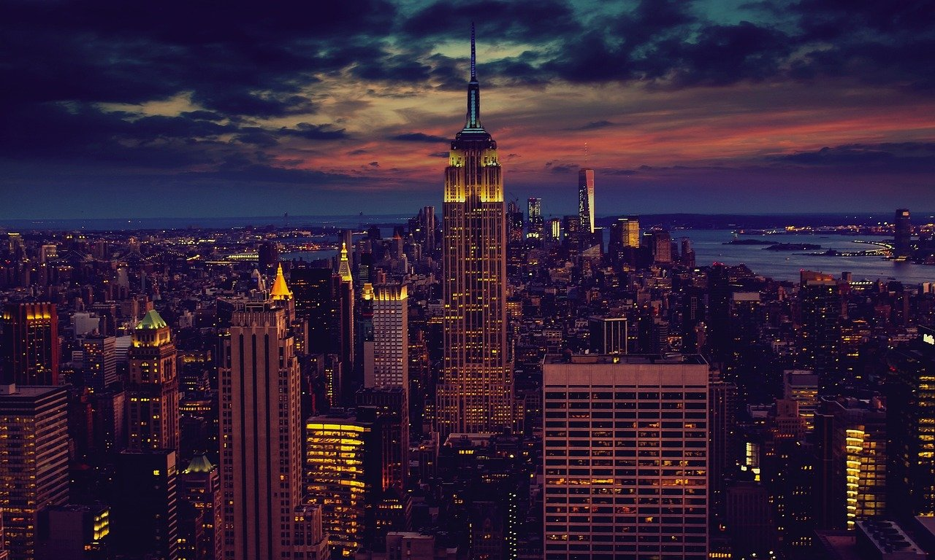
Quiet places?
Busy cities?

Slide 2
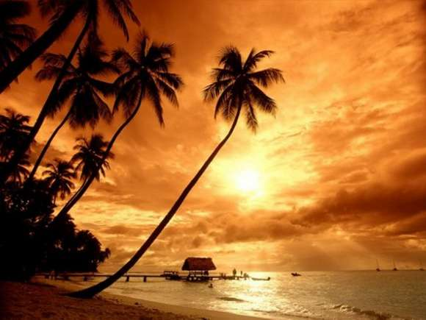
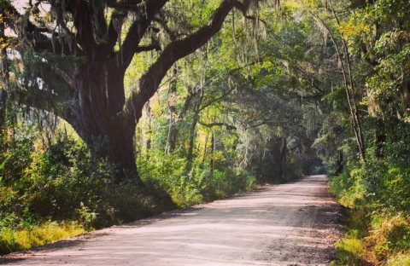
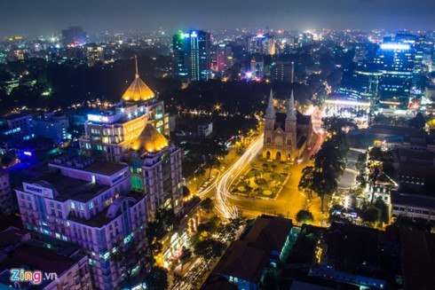
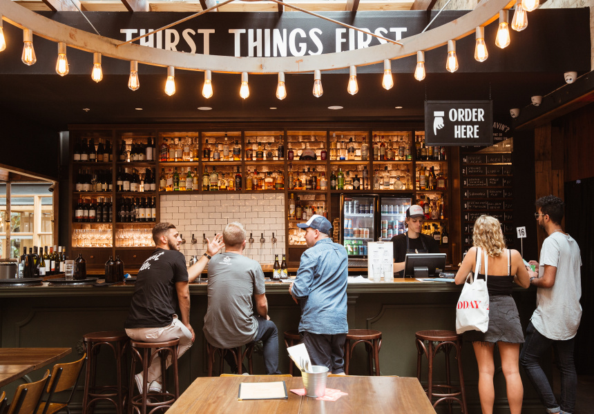
Which one do you prefer?
Which one would you choose?
- What are the differences between a peaceful hometown and a big city?
- Advantages and disadvantages (environment, people, society, culture,...)?
- Where is your dream place?
- Why did you choose this?
- What will you do if you live in peaceful/noise place?
- What do you think about living in your unexpected place (difficulty about the job, your health, your passion,...)?
- What are your plans for the future (keep living or change place)?

Slide 3
