Slide 1

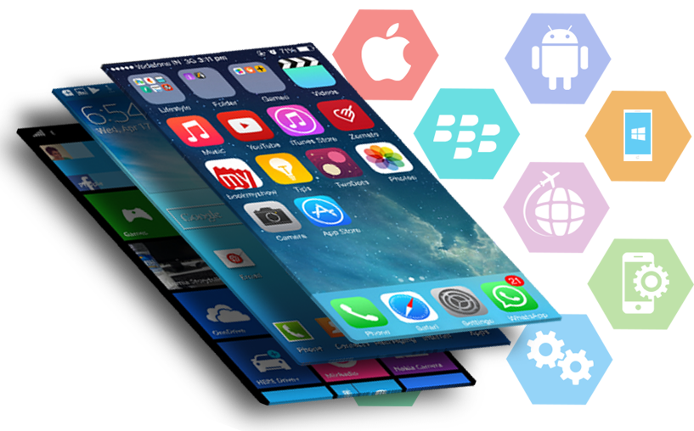
Sports events management mobile application
Author: Nguyen thanh thien
Advisor: Tran thanh tung
Reviewer: Ha Viet Uyen Synh

Slide 2
Content
* Introduction
* Background
* System Architecture
* Implementation and Result
* Conclusion

Slide 3

Introduction
- Too less applications used to follow medium and small sport events.
Problems
- The limitation about details for user to select their favorite kind of sports.
- User interaction problems: Event position, feedback, etc.
- Server side problems: Events and hosts management, image processing, wasting time for updating an event.

Slide 4
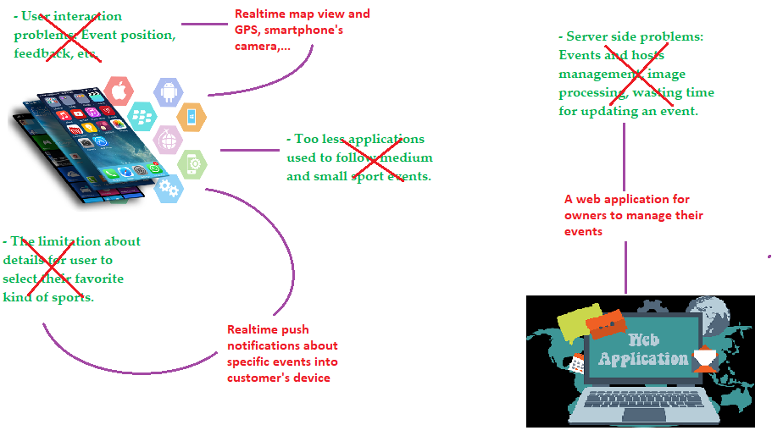
Introduction
Solutions

Slide 5


Introduction
Multi-platform
Unidirectional Data Flow - UDF
Push Notification
Realtime synchronous
Location
Device interaction

Slide 6
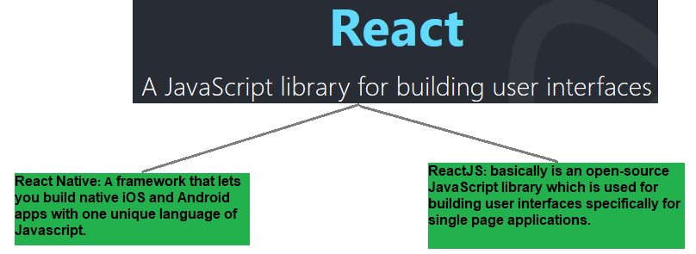
Introduction
React (React Native and React JS)
- Was introduced and developed by Facebook
System requirements

Slide 7





Introduction
System requirements
Saving time and reducing development costs
Why?
Performance
Reusability
Maintainability

Slide 8
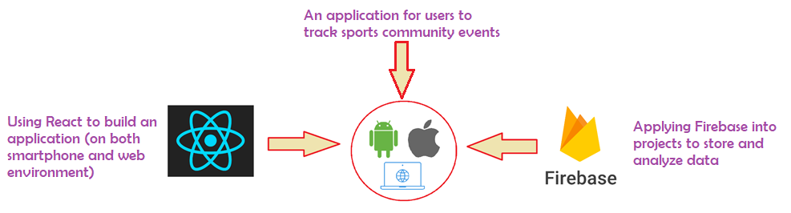
Introduction
Goal

Slide 9
Background
- To create data layers in JavaScript applications
Flux architecture
- Flux focuses on creating explicit and understandable update paths for your application's data, which makes tracking changes during development simpler and makes bugs easier to track down and fix.
- Flux follows the concept of Unidirectional Data Flow
When the data changes, this stream reboot from scratch
Making it much easier to zero in of where the error lies.

Slide 10
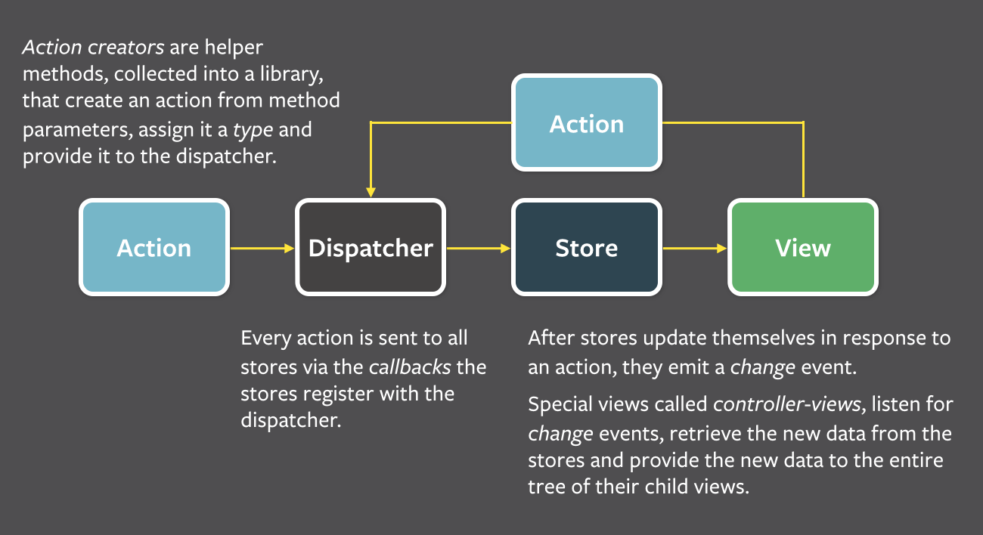
Background
Flux architecture

Slide 11

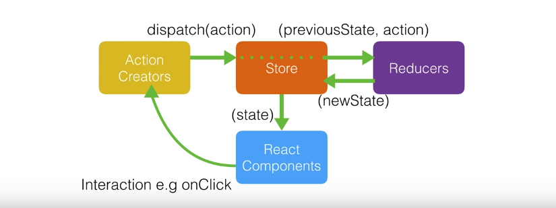
Background
An implementation library of Flux with minimal API but entirely predictable behavior.
=> It is possible to implement logging, hot reloading, etc. without any buy-in from the developer
Redux
+ All application state is contained within a single store
+ The application's state is immutable.
+ All functions that compute the new state (called reducer functions) must be pure functions.

Slide 12

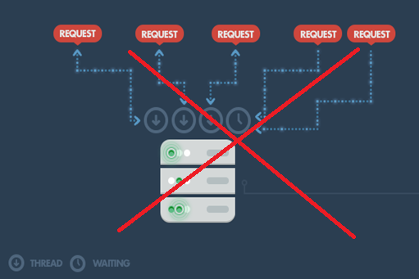
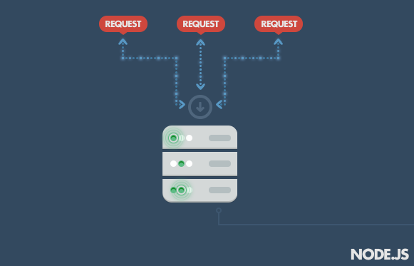
Background
Node.js
- Node.js is a compilation of Google’s V8 JavaScript engine and great library environment for executing JavaScript functions outside the browser.

Slide 13

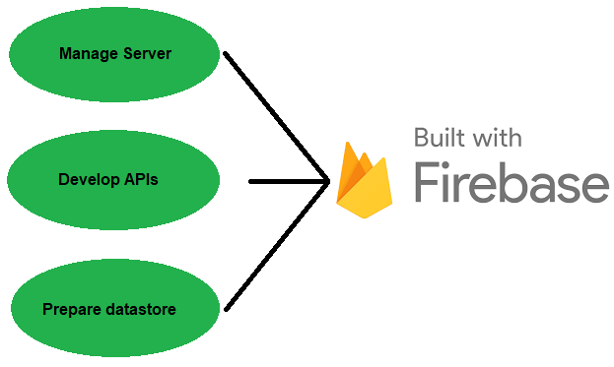
Background
- A Backend-as-a-Service — BaaS
Firebase
- Grew up into a next-generation app-development platform on Google Cloud Platform.

Slide 14


Background
- Is an event-driven computing service and does not need a server.
=> It will trigger a function (backend code) to run HTTPS requests, and Firebase features automatically.
Firebase
Cloud Function
=> Your code is stored in Google's cloud.
+ Can integrate with other features of Firebase and respond to the created event.
+ Server configures automatically and scales up the resource.
+ Cloud Function fully isolate with client side, so logic function is secured and avoid the code to be reverse engineered.

Slide 15

Background
- Is a cloud-hosted database, using real time to update and receive newest data between clients – server.
Firebase
Realtime database
- Is a NoSQL database and as such has different optimizations and functionality compared to a relational database.
- Data is remain unchanged when clients go offline.
+ Data is synchronozed every time data changes and with a lightweight APIs, the data speed updated to clients is counted by milliseconds
+ Firebase apps remain responsive even when offline
+ Defines who has access to what data and protect the users' personal information from unauthorized access by Database Rules.

Slide 16

Background
- Gives you a backend services to identify users, then makes user data become personalize.
Firebase
Authentication
+ Easy to develop your application’s Sign in page.
+ A drop-in authentication solution to identify by username - password or any identification methods.
=> The best solution for mobile and web application render sign-in UI.

Slide 17

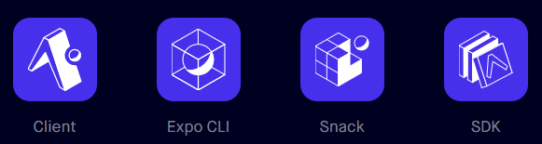
Background
Expo
- Expo is a set of tools, libraries and services help to develop mobile application using React Native.
- It also offers simple UI components used for a mobile app such as Text, Touchable, View, etc.
- Expo makes your accession to device’s system functionally (camera, contact, local storage, GPS, etc.).
- Expo SDK provides access to services and calls some general functions like Push Notification, Sign in with Google/Facebook, etc.

Slide 18
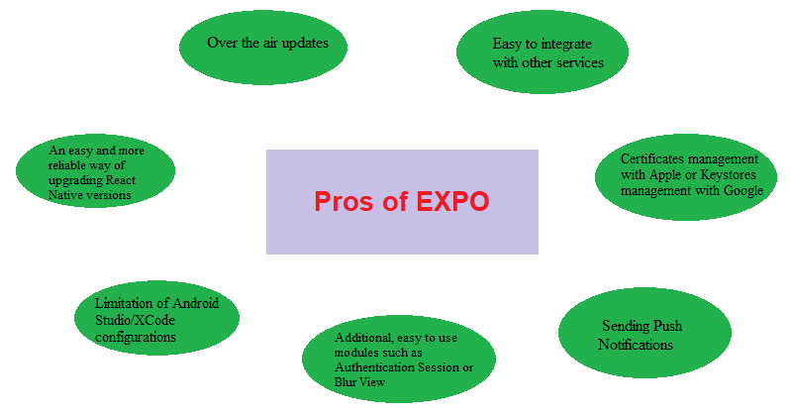
Background
Expo
=> Makes code project easier to deploy, maintain and execution

Slide 19
System architecture
User authentication/authorization
Push Notification
Map view/current position
Filter markers
Device’s camera
Comment/feedback
Events management
Personal information management
Realtime database
Update database
See event details
List of features

Slide 20
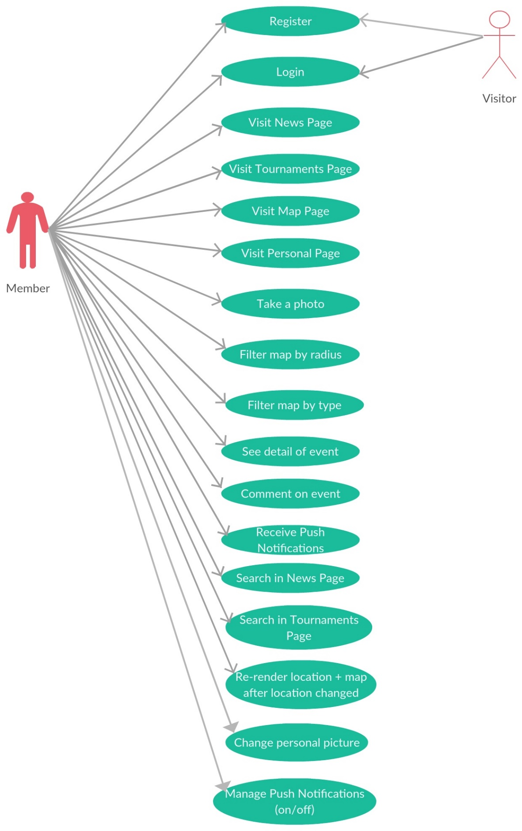
System architecture
Use case diagram for client

Slide 21
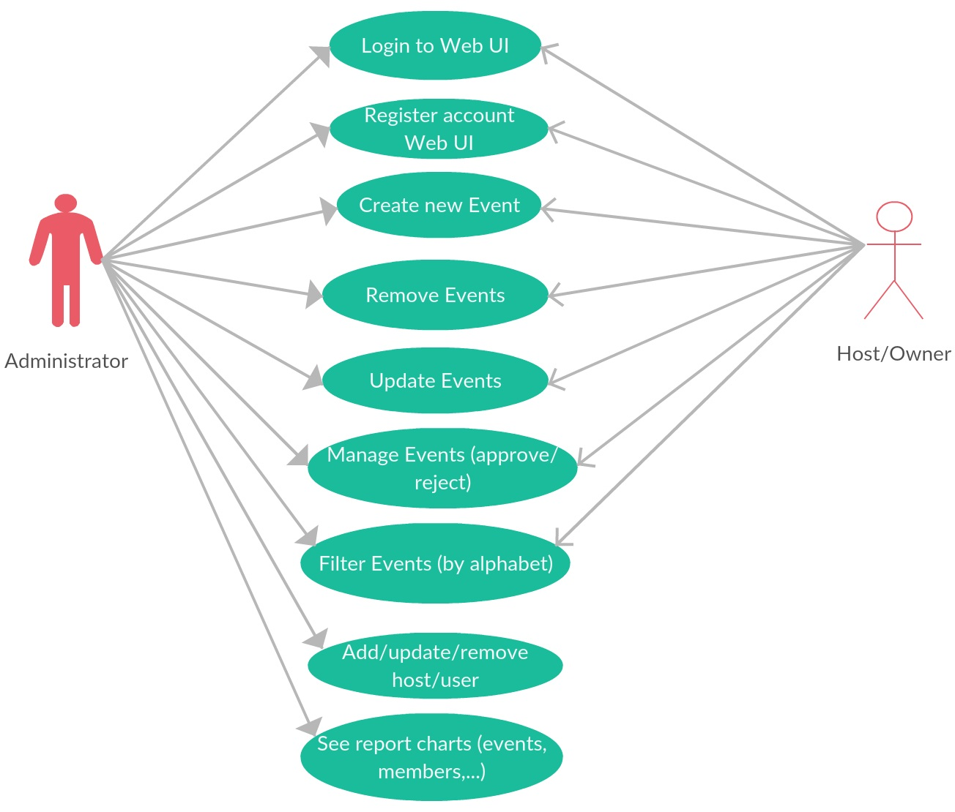
System architecture
User case diagram for server

Slide 22
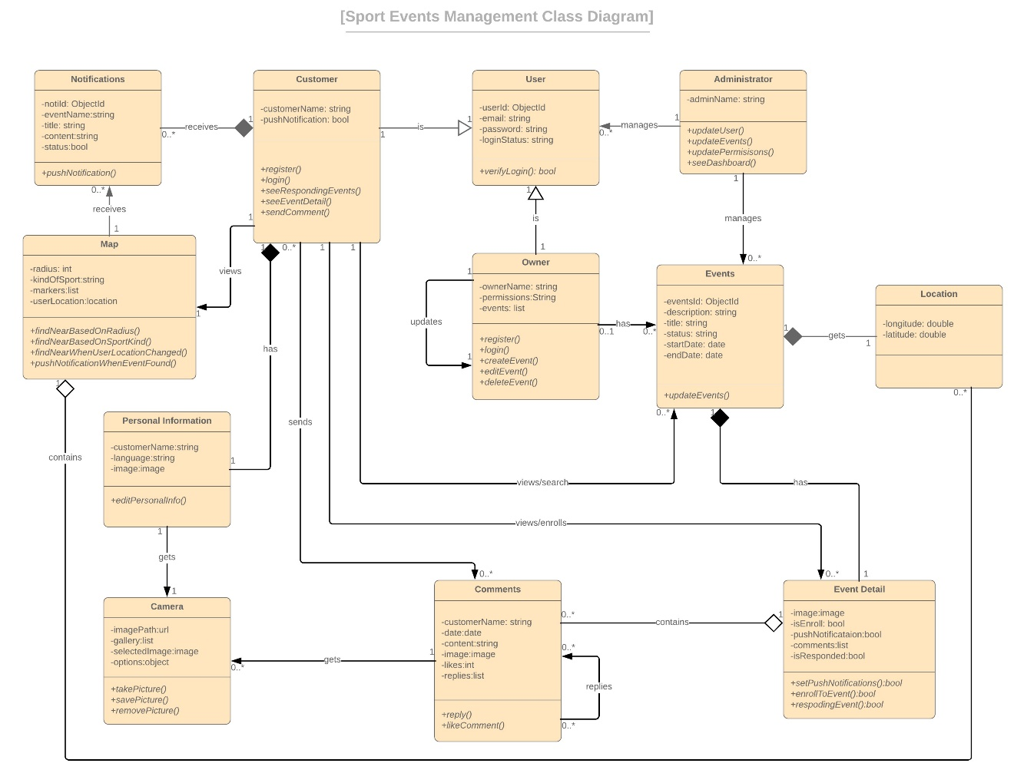
System architecture
Class diagram

Slide 23
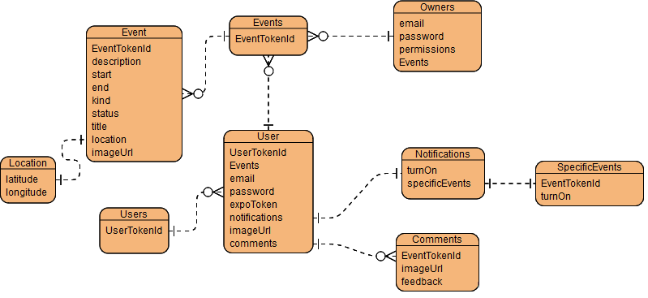
System architecture
Database diagram

Slide 24

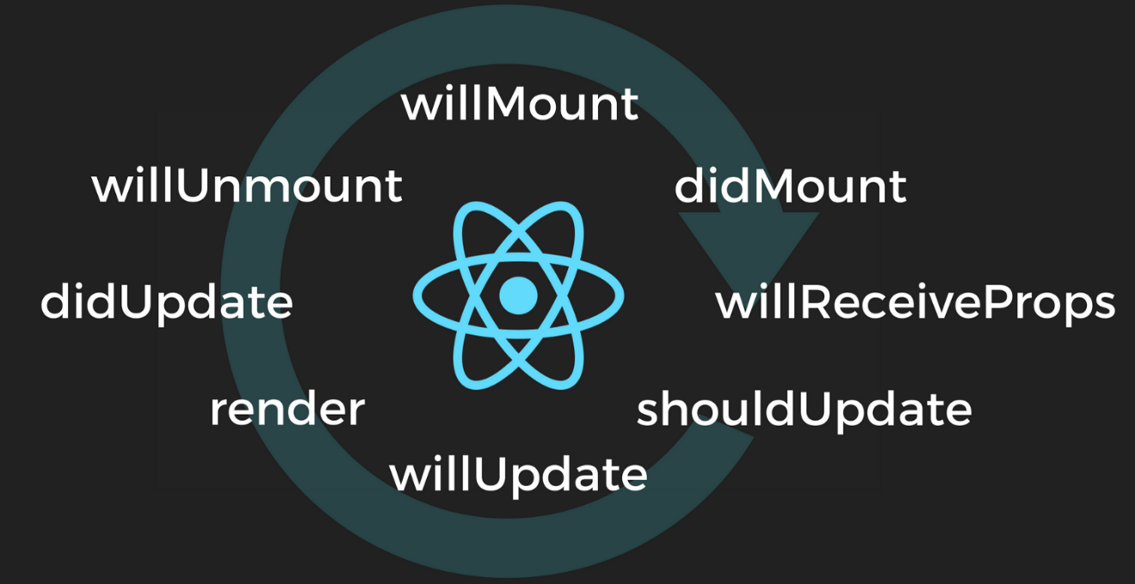
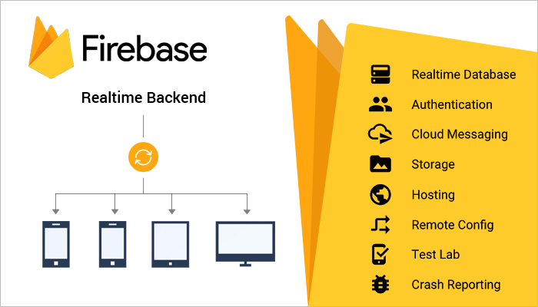
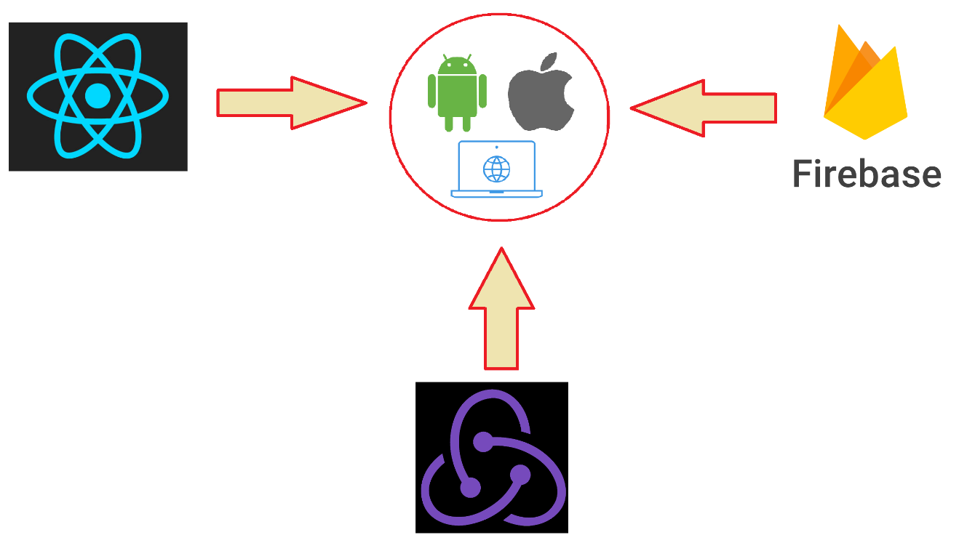

Implementation and Result
Overall

Slide 25
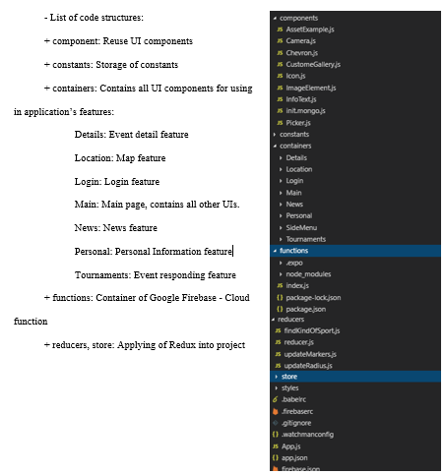
Implementation and Result
Mobile application

Slide 26
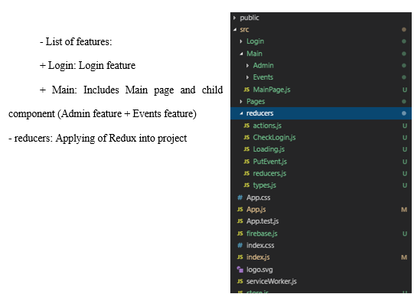
Implementation and Result
Web application

Slide 27


Conclusion
Hard problems of end users and technologies
Valuable experiences

Slide 28
Thank you for your listening!!

