Slide 1
VKIST PILOT PROJECT PITCHING
9, June, 2026
By: Dat Tran Tien

Slide 2
The Agenda of The Presentation
Project Motivation
Project Scope Introduction
Development Plan Proposing
Current Sprint Checkup

Slide 3
Project Motivation
Why the project exist ?

Slide 4
Project Motivation
From Research to Product: Building on the foundation of VKIST-PILOT research to drive active product development – essential for marketing the team’s value toward community.
Technology Evolution: Combining VKIST’s core Machine Learning results with current latest advancements in NLP and Software Engineering.
End-User Focus: Repackaging complex technology into an intuitive, accessible healthcare solution that can integrate seamlessly & affordable.
Target Audience: Designed specifically for clinicians and patients within the Musculoskeletal (MSK) domain in Vietnam.
Notes:
NLP: Natural Language Processing

Slide 5
Project Scope Introduction
What is challenge this project shall handle ?

Slide 6
Project Scope Introduction
Empowering Clinicians
Alongside with Patients
Deliver advanced diagnostic support, objective professional checks, and continuous clinical education.
Provide usable & easy & no-friction & multi-modal interface
Drive
Collaboration
Interactive & Intuitive
Experience
Unite multidisciplinary clinical teams and empower patients in a single, seamless workspace.
Ready & Always with Patient from start & end & after treatment
Notes:
The scope of the workspace: Develop an interactive musculoskeletal care and education platform that transforms standard DICOM X-rays into a collaborative workspace . The system empowers clinicians with continuous education, diagnostic support, and objective clinical checks , while actively educating patients about their locomotive health to foster a true partnership throughout their treatment journey.

Slide 7
Project Scope Introduction
How we attempt to reach these scope
Using ML-research result from VKIST & Controlled RAG on credible & academic resource
01
Multi-modal Chatbot for human-like bidirectional interaction + Mobile-ready usage
02
LLM as the translator & medium for autonomous & cross-domain collaboration.
04
Edge-oriented deployment & Progressive Web-App for accessibility & continuous support
03
Notes:
How to you do this on highlevel
ML: machine learning
RAG: Retrieval Augmented Generation – LLM text-generation being support by data-base + Guardrailing

Slide 8
Project Scope Introduction
Who is the End-User of this Project
Diagnostic Radiologist
01
Rheumatologist & Orthopedic Surgeon
03
MSK-Patient & Their Caregiver
04
Physical Therapist
02
Notes:
The Diagnostic Radiologist (Bác sĩ Chẩn đoán hình ảnh)
The Physical Therapist / PhysioTherapy (Chuyên Viên Vật Lý Trị Liệu)
The Rheumatologist & Orthopedic Surgeon (Bác sĩ Cơ xương khớp / Chấn thương chỉnh hình)
The MSK Patient & Family Caregiver (Bệnh nhân Cơ xương khớp & Người nhà)

Slide 9
Project Scope Introduction
Who shall be dev-team primary consultants & allies
Healthcare Senior Expert
(policy & procedural approval )
01
Practitioner
(frontline practicality verifier)
03
Support-Staffs & Patients
(actual impact signal)
04
Professional Clinician
(clinical-domain tester & reviewer)
02

Slide 10
Development Plan Proposal
What is the timeline & keymark for this project ?

Slide 11
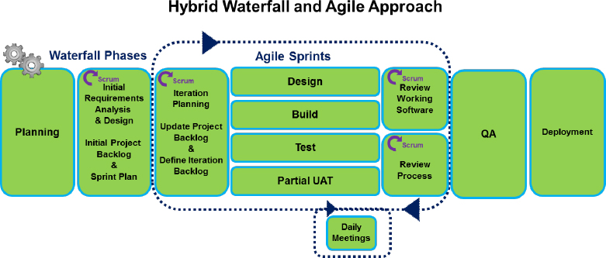
Development Plan
The Time Range: 2/6/2026 to 2/9/2026 - (3 months)
Software Development Process Selection:
Macro-Planning with Waterfall
Micro-manage implement with Scrum
Incremental & iterative & rapid development is essential
Flexibility & Agility is possible while roburst.
Image From: PMI

Slide 12
Development Plan
Current Mottos :
Fast & Proof-of-Concept for gaining community attention
Continuous & Evolution based on the Development Circumstance
Community feedback is a vital signal that drives critical-domain decisions and consultant strategy

Slide 13
Development Plan
Requirement Engineering
1
Product Design & Tech-Research
2
Launch &
Deploy
5
Implementation
3
Testing
4
Community Feedback
6
6 Essential Tasks During Project
Notes:
The core-task of the team shall include within these phase
But these shall update dynamically depends on the actual development enviroment

Slide 14
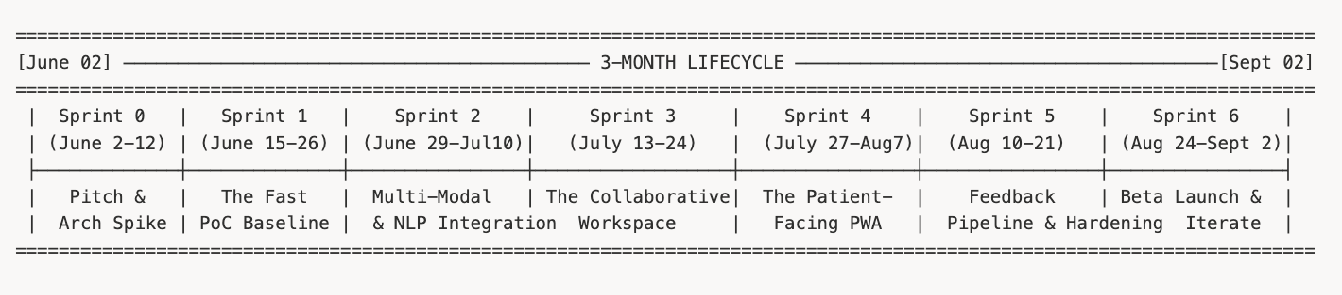
Development Plan – The Sprint Timeline
Notes:
→ Requirement Engineering (first half of Jun)
User Researching (1-2 days)
Users identification
Painpoint identification
User-profile construction
→ These 2 task below run async
Functional requirement engineering (3-4 days)
functional requirement engineering identification (listing)
functional requirement engineering validation
Use-case identification
Use-case design
Non-Functional requirement engineering (3-4 days)
non-functional requirement engineering identification
non-functional requirement engineering validation
→ Product Design & Tech-Research (Last-half of Jun - First half of July)
→ these execute asynchronously
UI-UX Design (brainstorm → val → prototype → val → mock-up) <1-1,5 weeks>
Paper-based design
Figma-based design
System-Design <1-2 weeks>
System-Context Design
Architecture Design
API-Design
Logical Design
Deployment Context Design
Deployment Pipeline Design
Techstack design
Test-System design
Test-case design <1-2 weeks>
White-box test
Blackbox test
Integration test
Automatical test-pipeline <1-2 weeks>
Test-case update
→ Implementation: (Run-along side Product-Design - (Last-half of Jun - First half of July))
→ These are execute async <1-3 weeks>
→ Implementing the logical aspect of modules
→ Implementing utility-framework
→ Module building
→ Build PWA application
→ setup the deployment config
→ Testing <1-2 weeks>
→ Executing the test-case
→ Test-case validation
→ Deployment <1 weeks>
→ CI/CD integration
→ setup user’s feedback portal
→ setup the project page
→ community feedback <undefined>
→ build community feedback collecting pipeline
→ insight driven

Slide 15
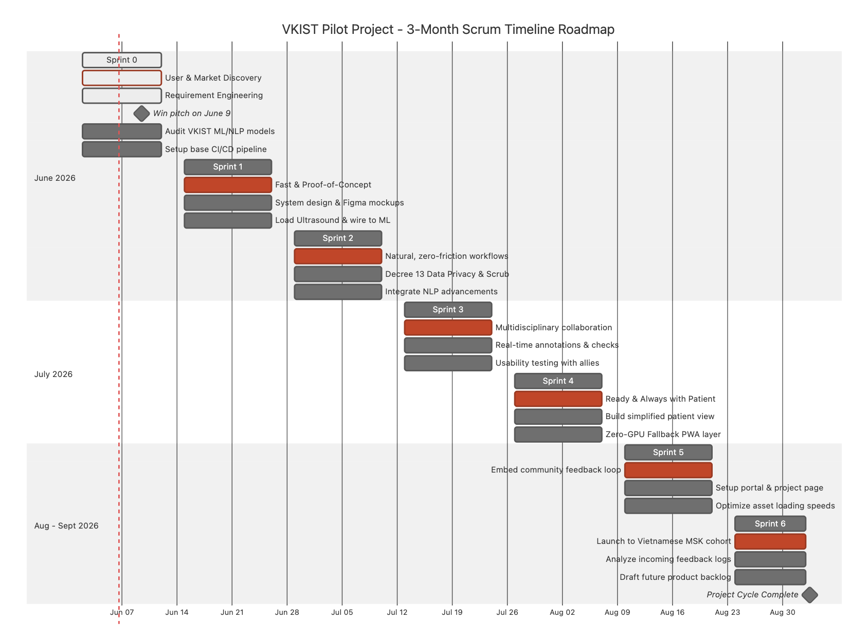

Slide 16
Current Sprint Checkup (Sprint 0)
Already Build the User-Functional Requirement
Already have the User-Profile Requirement (4 User-Profile)
Already to design & collect the Non-Functional Requirement

Slide 17
Current Sprint Checkup
Next-Actions with in the Sprint
Design the Usecase & Description for each Functional Requirement
Auditing the VKIST-ML stack & verify can be effectively deploy on web

