Slide 1
DSM use case
A data analysis workflow
Anneke Sijbers, Wytze Vlietstra, Arnold Kuzniar & Anand Gavai
Notes:
Some background on BreeDB
What it is
Why we would like to use ODEX platform

Slide 2
ODEX Project
Examine and solve use cases from various domains with knowledge graphs
Demonstrate value of integrating datasets (of varying quality) with each other to improve generated results
Slide content borrowed from Wytze Vlietstra

Slide 3
Objective
Identification of gene-phenotype trait associations in yeast
Develop a workflow to identify genes indirectly associated with a certain yeast phenotype using EKP (butanol tolerance) and visualize them in an interactive knowledge graph

Slide 4
EKP (Euretos Knowledge Platform)
Content:
Over 50 domain specific datasets
Access:
Through web portal, keyword input one by one
Through API's -> scripting
Output:
Possibilities to filter
Some graphical representation of a (huge) network
Slide content borrowed from Wytze Vlietstra

Slide 5
Tools Used
Jupyter Notebook
Python (Infrastructure and automation)
EKP (REST API)
R (Analysis and workflows)
Spot(Visualization)

Slide 6
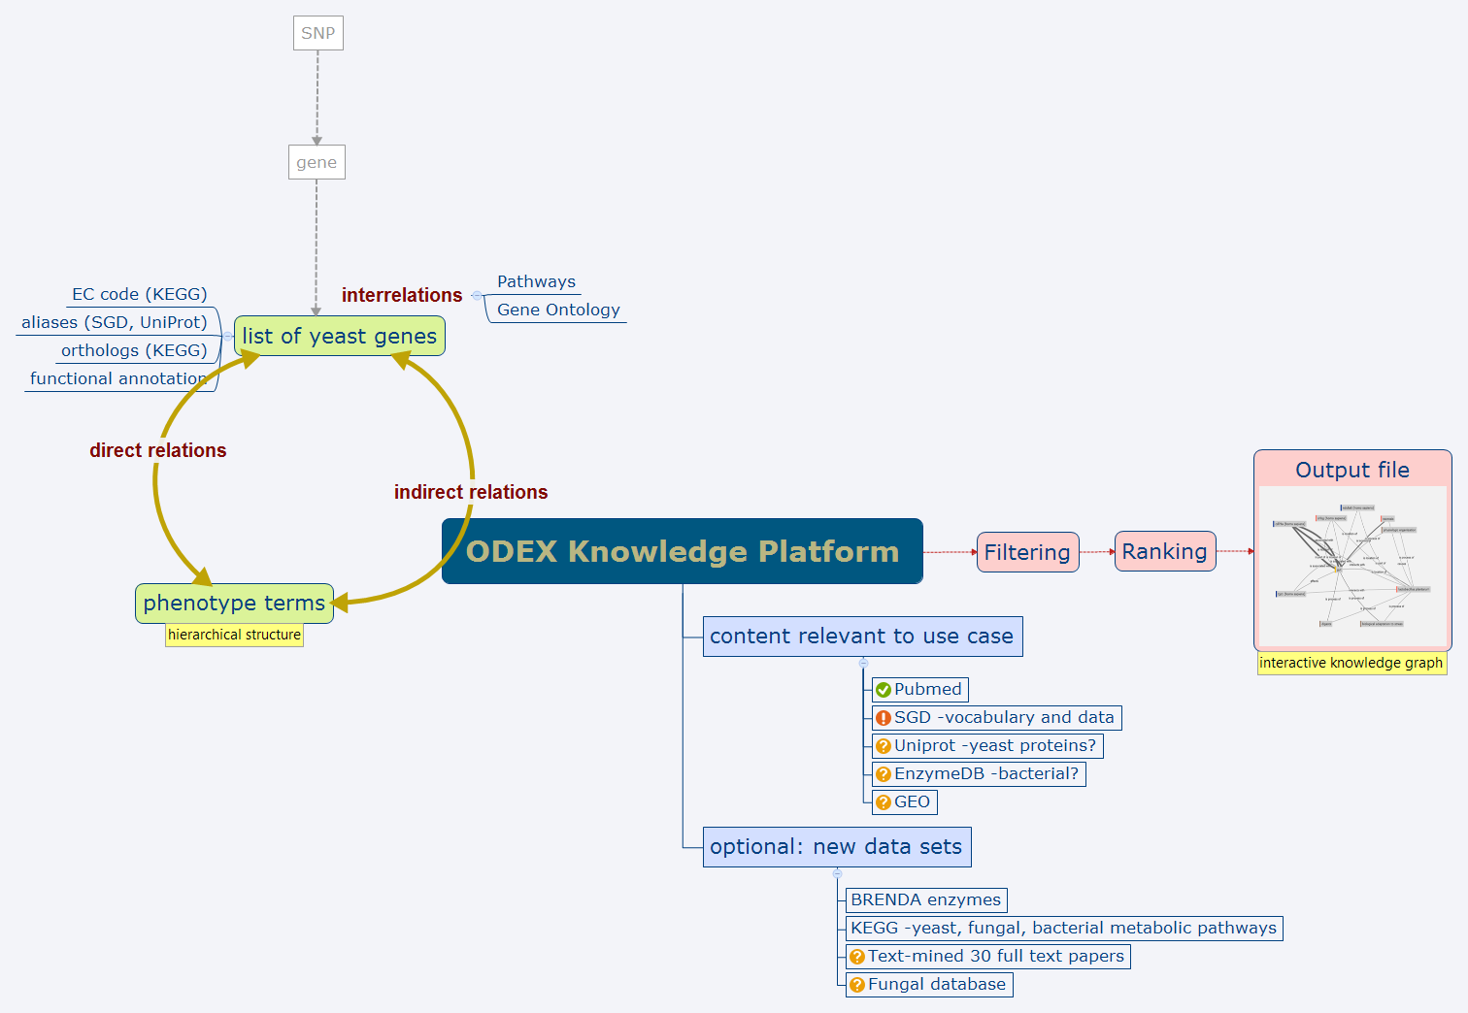
Slide borrowed from Anneke Sijbers

Slide 7
Steps:
Starting Concepts
List of 15 genes (Starting Concepts)
Goal
To Search Indirect relationship of these 15 genes within EKP with
1-Butanol
Resistance to Chemicals

Slide 8
Steps:
Select overlapping Concepts
Generate data
Prepare data in the form of triples (linked framework)
Visualize data in Spot

Slide 9
Example queries and filters:
Indirect relationships example:
{ "additionalFields": ["publicationIds", "tripleIds", "predicateIds", "semanticCategory", "semanticTypes", "taxonomies"] , "positiveFilters":["sc:Chemicals & Drugs","sc:Genes & Molecular Sequences","sc:Physiology"] , "leftInputs":[ start ekpid ] , "rightInputs":[ end ekpid ] }
Other wrappers for EKP are available within the GIT repository of this usecase !

Slide 10
Workflow Documented
Jupyter Notebook:
http://localhost:8888/notebooks/DSM_workflow.ipynb

Slide 11
Visualization
Triples are large in number
Good visualization is important in identifying new relationships as well as understanding the nature of these relationship

Slide 12
Spot Features
Exploratory Data Analysis
Downstream Data Analysis
Filtering of data

Slide 13
Downstream analysis
Spot (http://localhost:9966/)

Slide 14
Preliminary results
Genes | Relationships
ucc1 | 90
pro2 | 89
hal1 | 80
ino1 | 80
mpc1 | 80
mse1 | 80
msn2 | 80
rpn4 | 80
rtg1 | 80
snx4 | 80
ump1 | 80
vma22 | 80
adp1 | 72
dog1 | 72
hsp60 | 40

