Slide 1
DSM use case
A data analysis workflow
Anneke Sijbers, Wytze Vlietstra, Arnold Kuzniar & Anand Gavai
Notes:
Some background on BreeDB
What it is
Why we would like to use ODEX platform

Slide 2
ODEX Project
Examine and solve use cases from various domains with knowledge graphs
Demonstrate value of integrating datasets (of varying quality) with each other to improve generated results
Slide content borrowed from Wytze Vlietstra

Slide 3
Objective
Identification of gene-phenotypic trait associations in yeast
Develop a workflow to identify genes indirectly associated with a certain yeast phenotype using EKP (butanol tolerance) and visualize them in an interactive knowledge graph

Slide 4
EKP (Euretos Knowledge Platform)
Content:
Over 50 domain specific datasets
Access:
Through web portal, keyword input one by one
Through API's -> scripting
Output:
Possibilities to filter
Some graphical representation of a (huge) network
Slide content borrowed from Wytze Vlietstra

Slide 5
Tools Used
Jupyter Notebook
Python (Infrastructure and automation)
EKP (REST API)
R (Analysis and workflows)
Javascript / Typescript (Visualization)

Slide 6
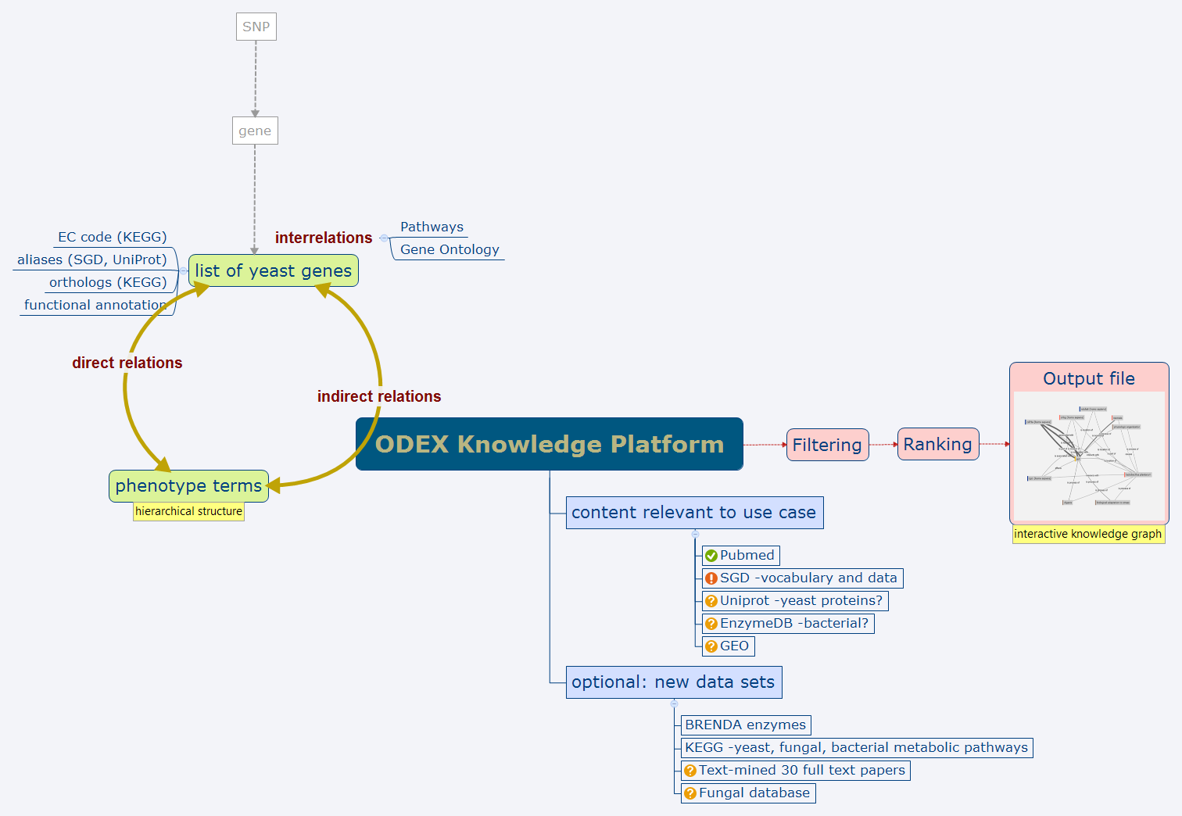
Slide borrowed from Anneke Sijbers

Slide 7
Jupyter Notebook
http://localhost:8888/notebooks/DSM_workflow.ipynb

Slide 8
Visualization
Triples are large in number
Good visualization is important in identifying new relationships as well as understanding the nature of relationship
A small prototype build in Typescript with a filter on predicates

Slide 9
Exploratory analysis
http://localhost:3000/

Slide 10
Downstream analysis
Spot (http://localhost:9966/)

Slide 11
To do
Automate generation of notebook into deliverable notebook
Dockerize this workflow !
Notes:
Changing input will change the notebook dynamically

