Slide 1

Project #33 Warehouse Manager Dan Prendergast Jon Magiera Max Hollingsworth
CSCI 5448
Object-Oriented Analysis & Design

Slide 2
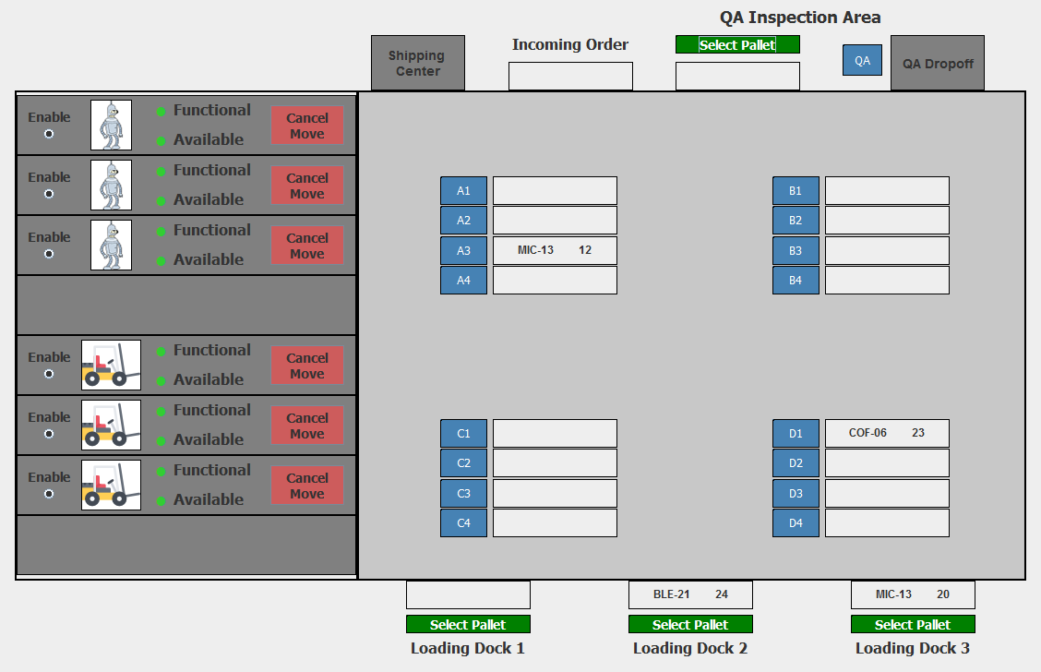
Warehouse Management System Overview
System allows warehouse personnel to manage warehouse inventory and operations
Manage the movement of products in a warehouse using automated forklifts/robots
Track inventory as pallets arrive and product orders are fulfilled
Database back-end keeps track of inventory

Slide 3
Warehouse Details
3 truck loading docks for incoming products
1 shipping center for outgoing products
16 storage shelves
3 autonomous forklifts move pallets from loading dock to shelves
3 autonomous robots move products from shelves to shipping center

Slide 4
Warehouse Details
Shipping Center
Retrieval robots
Storage Shelves
Autonomous Forklifts
Loading Docks

Slide 5
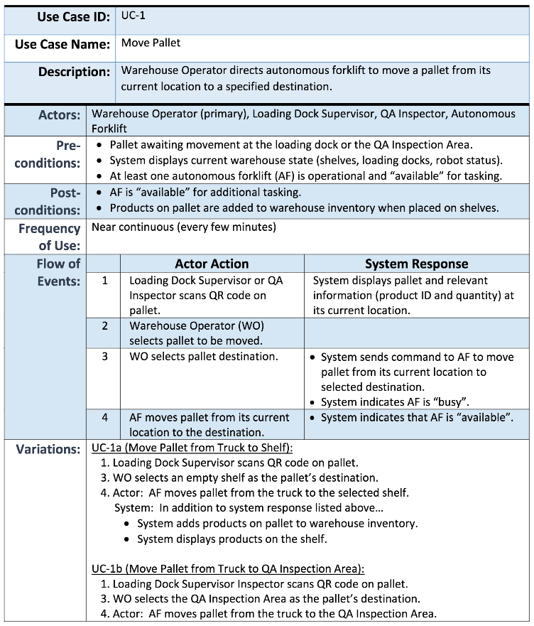
Demo: Use Case 1a – Stock Shelves

Slide 6
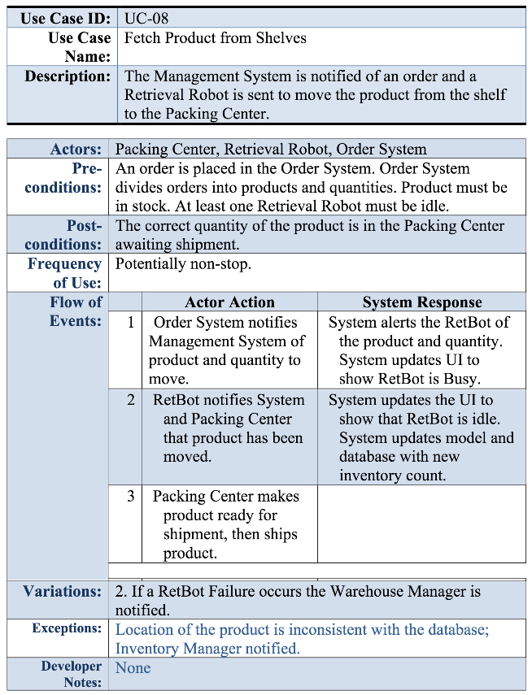
Demo: Use Case 08 – Fetch Product

Slide 7
Model View Presenter vs. Model View Controller

Slide 8
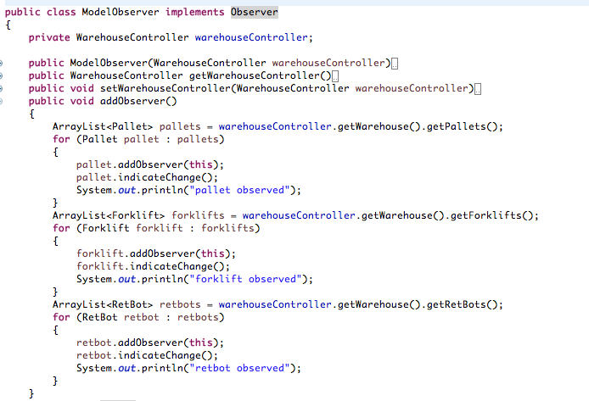
Observer Design Pattern
Uses many-to-one dependency between objects so that if one object is modified, all of its dependents are updated automatically. -Gang of Four

