Slide 1
Deep learning workshop
4th workshop

Slide 2
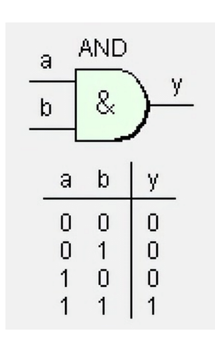
Linear problems
AND and OR → Linear

Slide 3
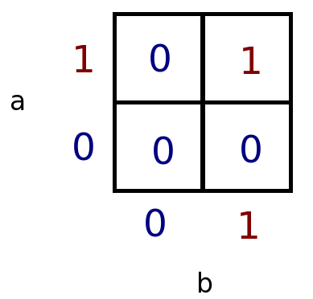
Linear problems
AND and OR → Linear

Slide 4
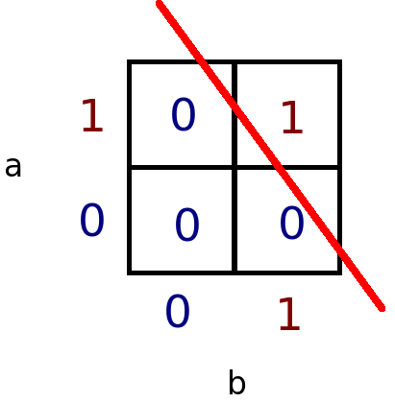
Linear problems
AND and OR → Linear

Slide 5
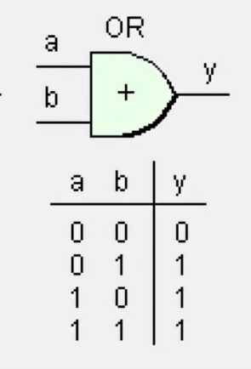
Linear problems
AND and OR → Linear

Slide 6
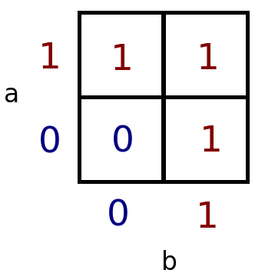
Linear problems
AND and OR → Linear

Slide 7
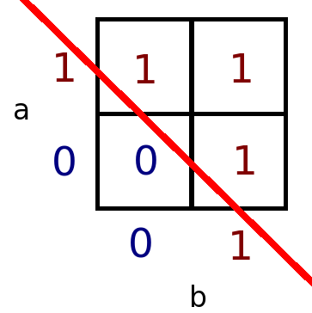
Linear problems
AND and OR → Linear

Slide 8
Linear models
The loss space of linear models are convex:
Every local minimum is a global minimum!
No matter where you start (initial parameters) you will always find the optimal solution.

Slide 9
Linear models
This property made linear models very popular
- SVM
- logistic regression
- linear regression
- perceptron
….

Slide 10
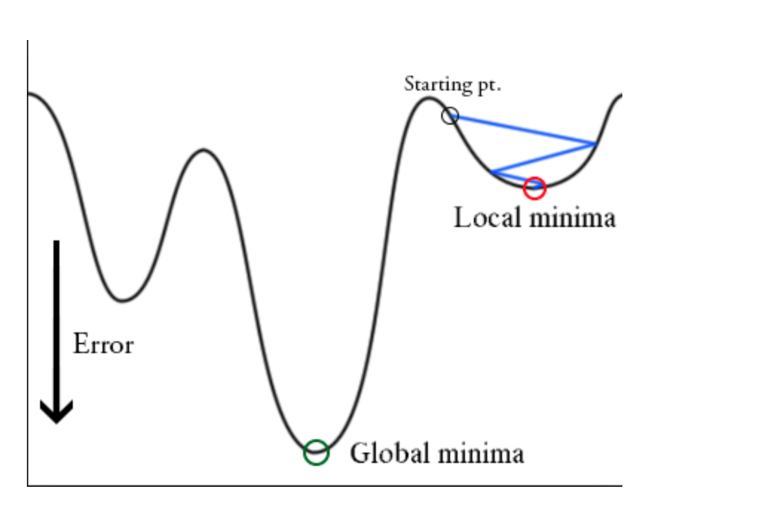
Non-linear models...
Gradient descent: optimizes toward nearest local minimum...

Slide 11
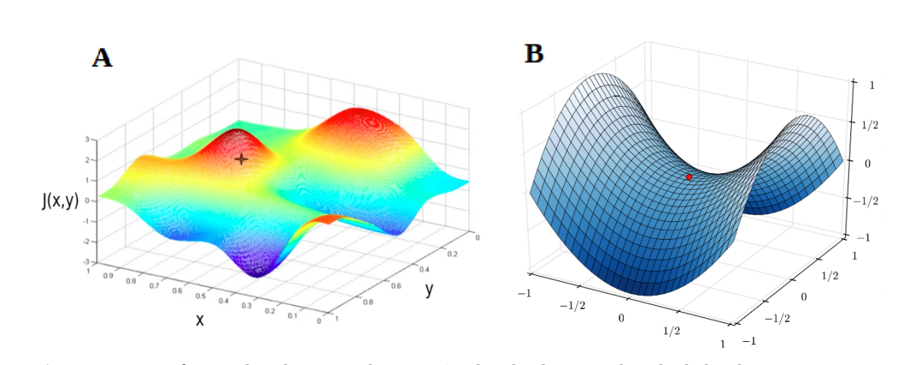
However...
Empirical proof of deep neural networks successfully trained using only gradient descent however showed that this initial concern was premature.
It was discovered that saddle points, not local minima, had to be overcome in very high dimensional loss-surfaces, which is an easier to solve problem (Dauphin et al. 2014).

Slide 12
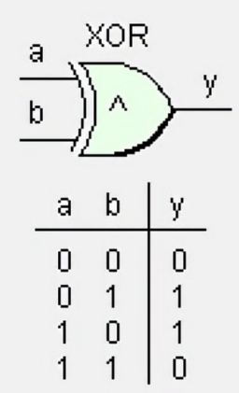
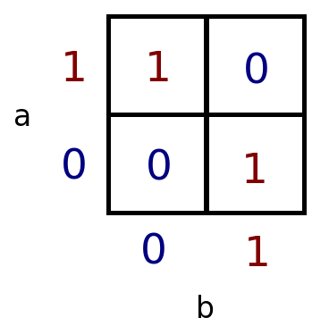
Non-linear problems
XOR is slightly different...

Slide 13
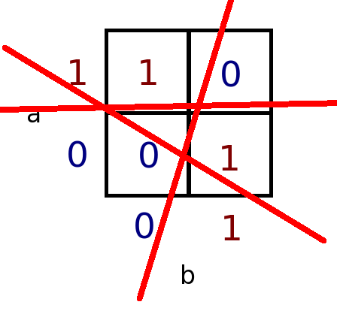
Non-linear problems
Cannot separate with straight singe line...

Slide 14
Non linear problem
To solve this, the neural network will have to first make a new representation of the input:

Slide 15
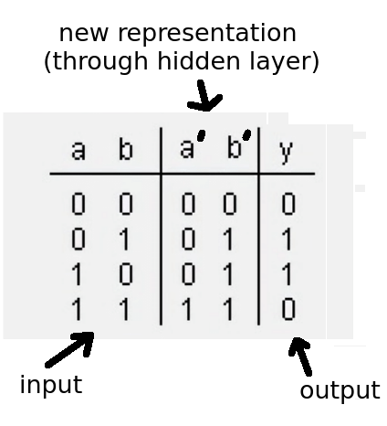
Non linear problem
To solve this, the neural network will have to first make a new representation of the input:

Slide 16
Non linear problem
To solve this, the neural network will have to first make a new representation of the input:

Slide 17
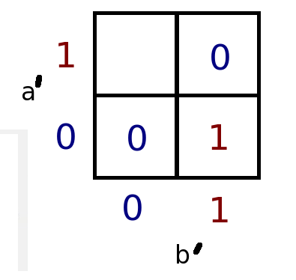
Non linear problem
To solve this, the neural network will have to first make a new representation of the input:

Slide 18
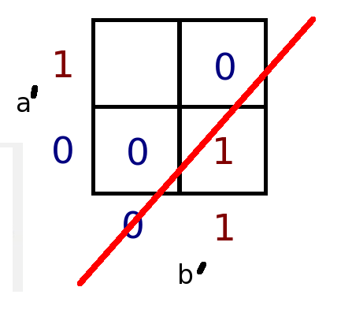
Non linear problem
Eureka! :)

Slide 19
Hidden layers
In a classifier:
Each hidden layer is a new representation of the input!

Slide 20
Hidden layers
In a classifier:
Each hidden layer is a new representation of the input!
Keep creating new representations until last layer is linearly separable by output layer.

Slide 21
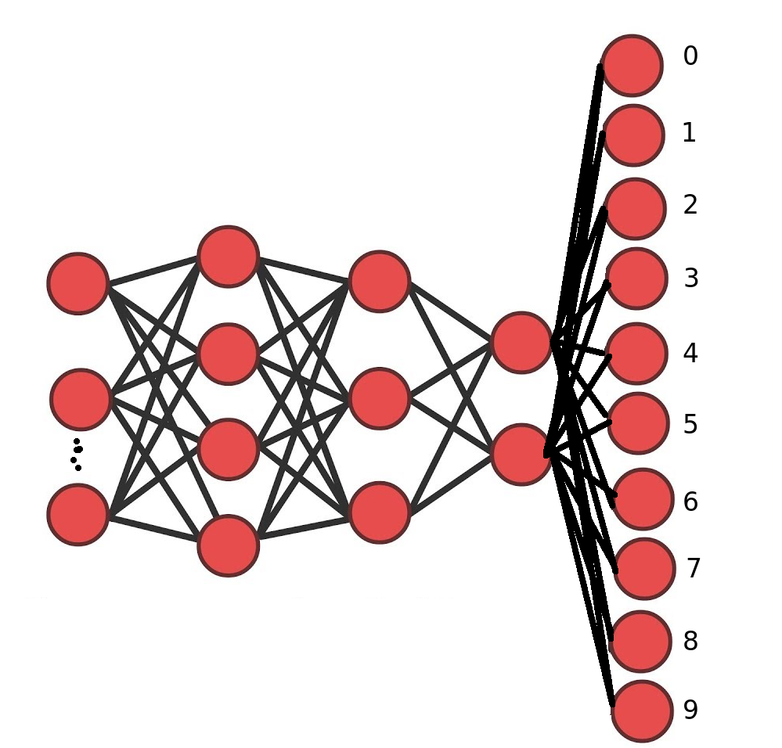
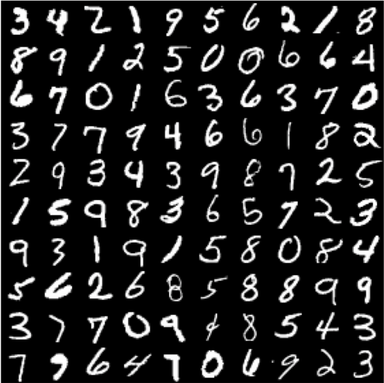
MNIST toy example

Slide 22
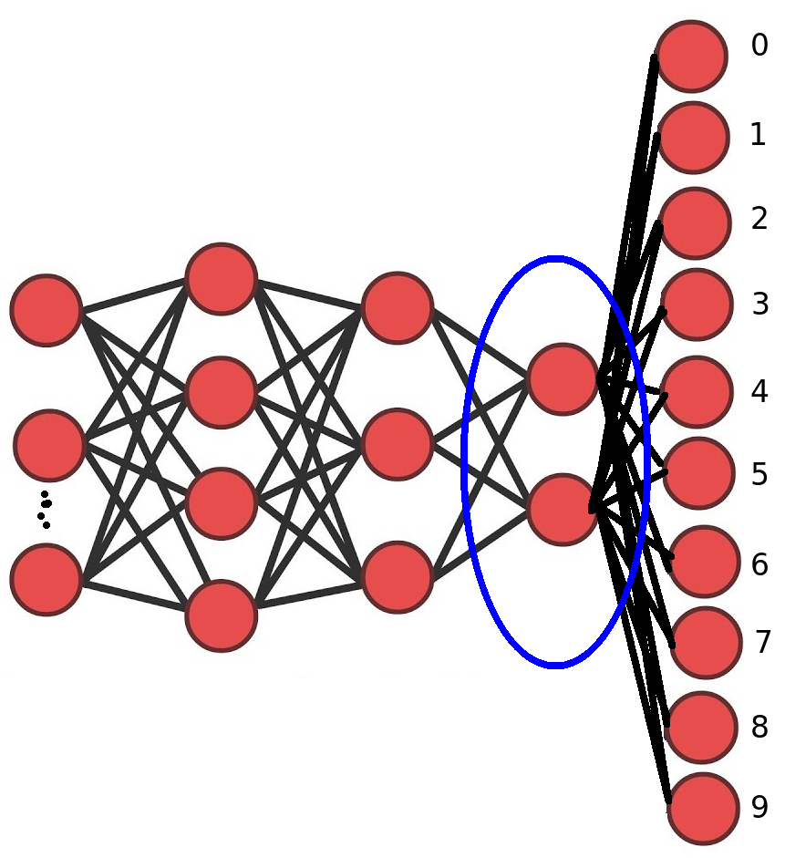
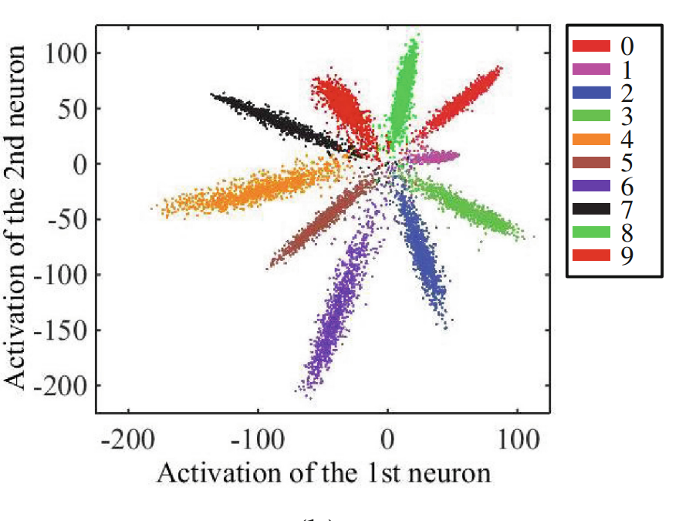
MNIST toy example
https://ydwen.github.io/papers/WenECCV16.pdf

Slide 23
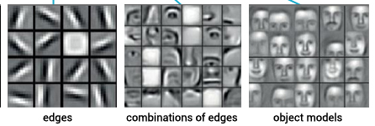
Non-linear
Through hidden layers neural networks can solve non-linear problems.
Each hidden layer is a new representation of the input.
Each layer becomes a more abstract representation of the input

Slide 24
?
Next week neural architectures
Starting with ConvNets or autoencoders?
Or the limits of deep learning?

