Slide 1
Recurrent Neural Networks

Slide 2
Why use an RNN?
QUESTION: how would you build a neural network to predict the last amino acid of a peptide?
Consider:
Previous amino acids important
Variable peptide sizes
padding not desirable
Want to use representations of an amino acid (encoding)

Slide 3
Why use an RNN?
Variable input / output length
But same input / output dimensions!
Memory of previous states
Encode sequences (future lecture (?))
Note: RNN is an umbrella term

Slide 4
RNN key concepts
Predict something based on previous states (e.g. last word of a sentence)
Uses representation of previous state(s)
Add new information for each iteration
Representation just another set of neurons
Representation often called hidden

Slide 5
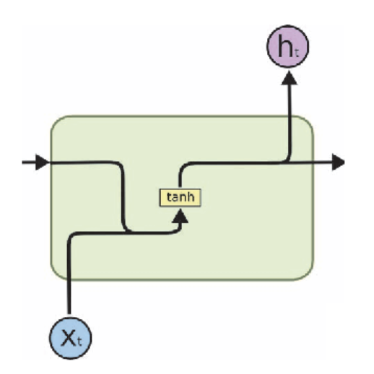
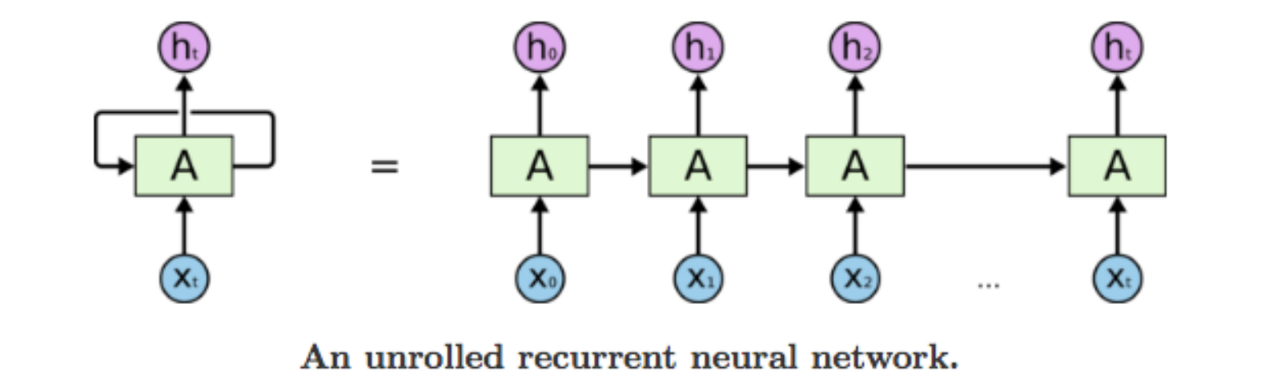
RNN Schematics
x

Slide 6
MIT lecture
https://www.youtube.com/watch?v=_h66BW-xNgk
Why not feed-forward: 00:00 – 7:15
RNN concept: 10:07 – 13:56
Backprop: 13:56 – 17:42
Vanishing gradient: 17:42 – 20:38

Slide 7
Visual representation of data flow
https://youtu.be/8HyCNIVRbSU?t=187
https://towardsdatascience.com/illustrated-guide-to-lstms-and-gru-s-a-step-by-step-explanation-44e9eb85bf21

Slide 8
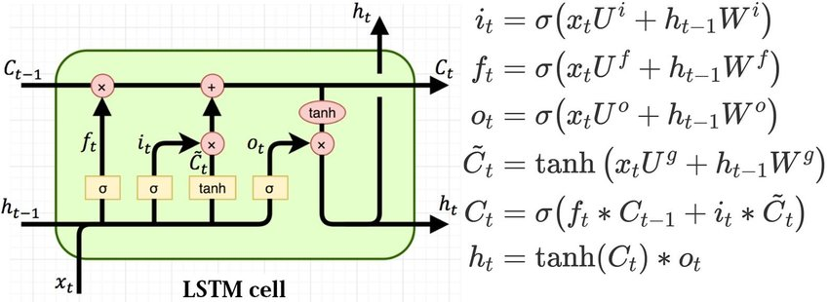
LSTM key concepts
Long Short Term Memory RNN
Selectively remove, use and change memory
Forget what is irrelevant, update with new information
Use only what is relevant

Slide 9
MIT lecture
https://youtu.be/_h66BW-xNgk?t=1228
30:30-end: applications
Extra if time allows for it

Slide 10
Visual representation of data flow
https://youtu.be/8HyCNIVRbSU?t=175
https://towardsdatascience.com/illustrated-guide-to-lstms-and-gru-s-a-step-by-step-explanation-44e9eb85bf21

Slide 11
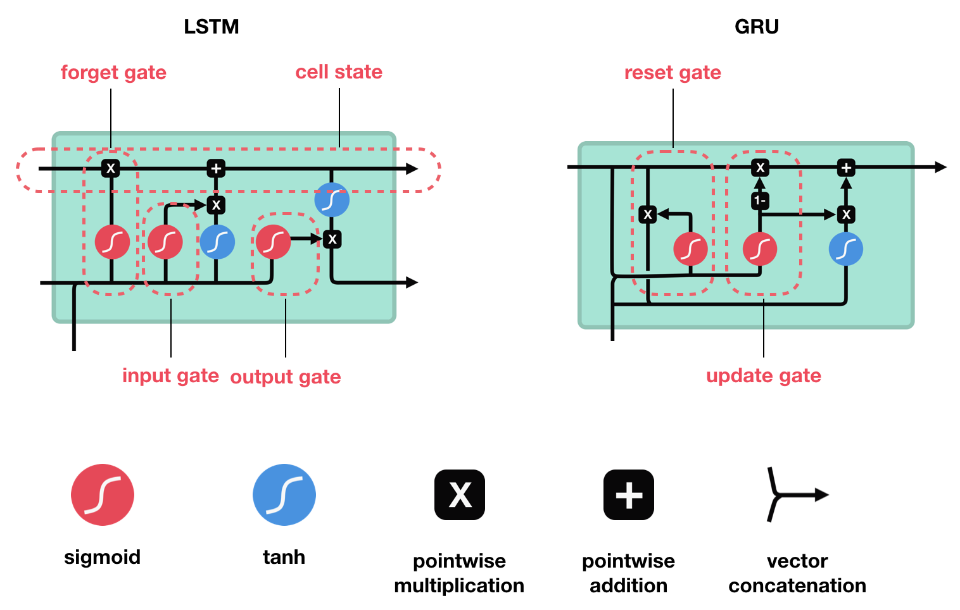
GRU key concepts
Another RNN
Forget and update gate

Slide 12
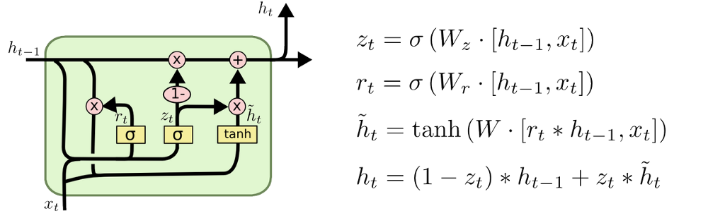
GRU Lecture
https://youtu.be/8Q582ng8Lxo?t=291
Watch until 7:40

Slide 13
GRU vs LSTM
GRU newer and less computation
LSTM arguably slightly better
No major differences as far as I know
Try both

Slide 14
Further reading
Background / other explanations
Understanding LSTM networks: http://colah.github.io/posts/2015-08-Understanding-LSTMs/
Understanding GRU networks: https://towardsdatascience.com/understanding-gru-networks-2ef37df6c9be
Long Short-Term Memory: From Zero to Hero with PyTorch: https://blog.floydhub.com/long-short-term-memory-from-zero-to-hero-with-pytorch/
Interesting
The Unreasonable Effectiveness of Recurrent Neural Networks: http://karpathy.github.io/2015/05/21/rnn-effectiveness/

