Slide 1
Recurrent Neural Networks

Slide 2

Why use an RNN?
QUESTION: how would you build a neural network to predict the last amino acid of a peptide?
Consider:
Previous amino acids important
Variable peptide sizes
padding not desirable
Want to use representations of an amino acid (encoding)

Slide 3
Why use an RNN?
Variable input / output length
But same input / output dimensions!
Memory of previous states
Encode sequences (future lecture (?))
Note: RNN is an umbrella term

Slide 4
RNN key concepts
Predict something based on previous states (e.g. last word of a sentence)
Uses representation of previous state(s)
Add new information for each iteration
Representation just another set of neurons
Representation often called hidden

Slide 5
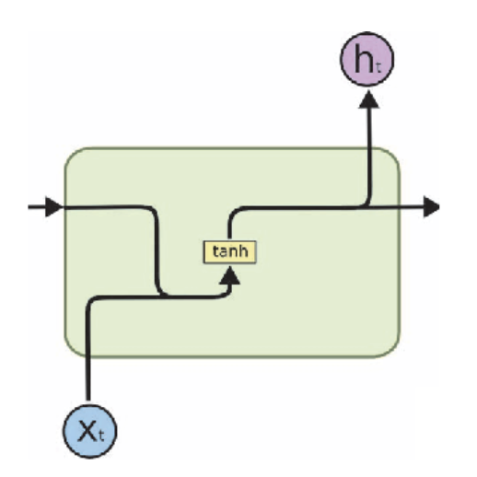
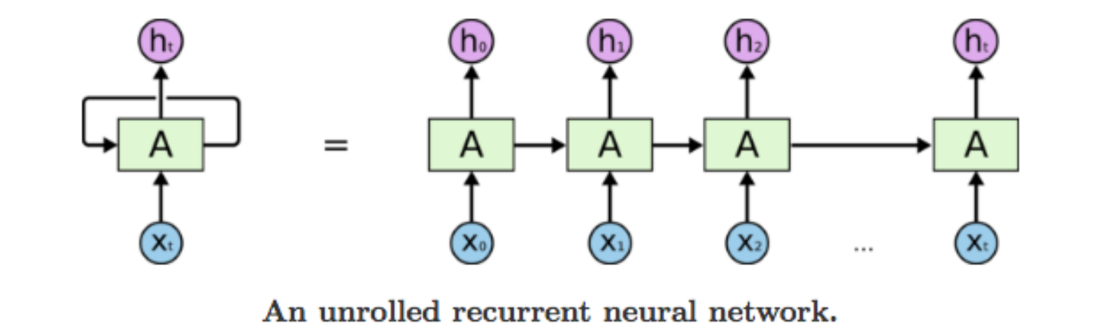
RNN Schematics
x

Slide 6
MIT lecture
https://www.youtube.com/watch?v=_h66BW-xNgk
Why not feed-forward: 00:00 – 7:15
RNN concept: 10:07 – 13:56
Backprop: 13:56 – 17:42
Vanishing gradient: 17:42 – 20:38

Slide 7
Visual representation of data flow
https://youtu.be/8HyCNIVRbSU?t=187
https://towardsdatascience.com/illustrated-guide-to-lstms-and-gru-s-a-step-by-step-explanation-44e9eb85bf21

Slide 8
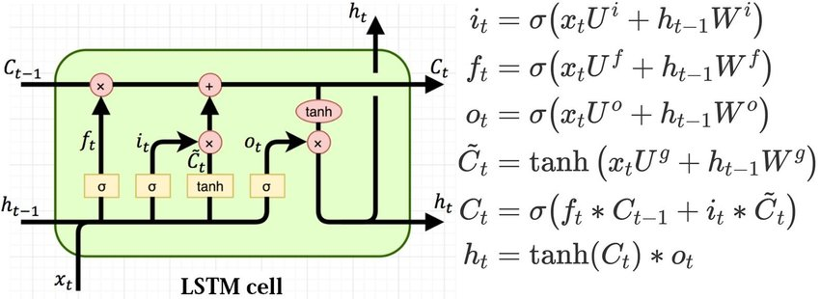
LSTM key concepts
Long Short Term Memory RNN
Selectively remove, use and change memory
Forget what is irrelevant, update with new information
Use only what is relevant

Slide 9
Neural Networks part 2 LSTM, GRU, Pytorch

Slide 10
RECAP
RNN has memory
LSTM had memory cell; remove vanishing gradient
https://colah.github.io/posts/2015-08-Understanding-LSTMs/

Slide 11
MIT lecture
https://youtu.be/_h66BW-xNgk?t=1228
30:30-end: applications
Extra if time allows for it

Slide 12
Visual representation of data flow
https://youtu.be/8HyCNIVRbSU?t=175
https://towardsdatascience.com/illustrated-guide-to-lstms-and-gru-s-a-step-by-step-explanation-44e9eb85bf21

Slide 13
LSTM walkthrough
https://colah.github.io/posts/2015-08-Understanding-LSTMs/

Slide 14
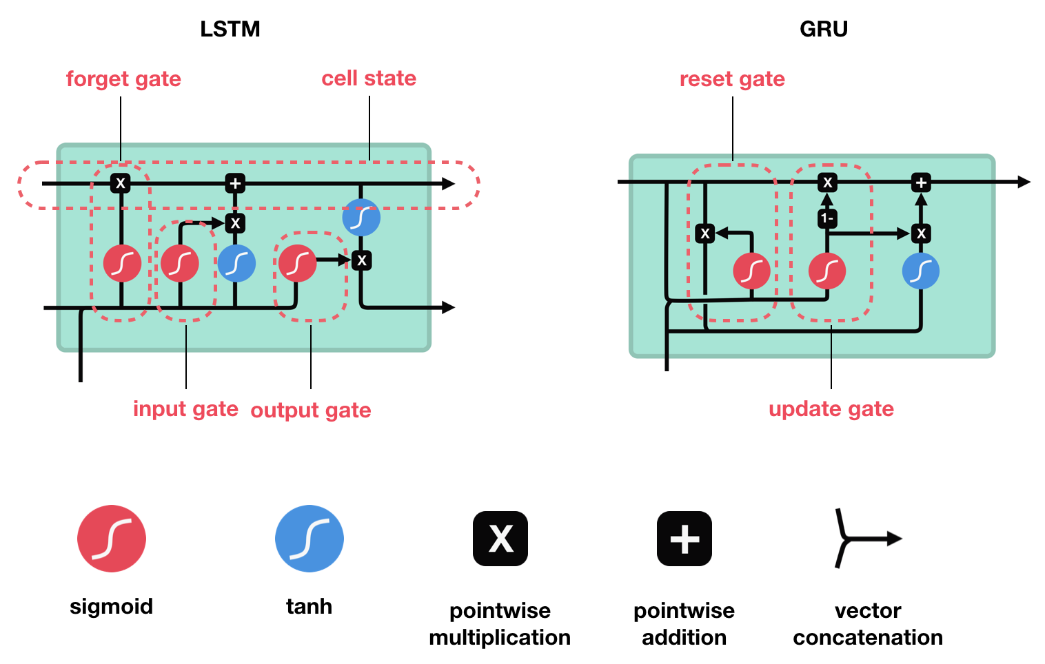
GRU key concepts
Another RNN
Forget and update gate

Slide 15
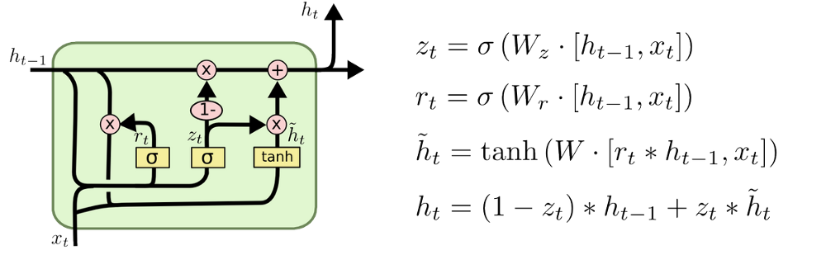
GRU Lecture
https://youtu.be/8Q582ng8Lxo?t=291
Watch until 7:40

Slide 16
GRU vs LSTM (vs basic RNN)
GRU and LSTM only for long-term dependency
GRU newer and less computation
LSTM arguably slightly better
No major differences as far as I know
Try both

Slide 17
Example: create a word-generator
Ask for your ideas
Program it together

Slide 18
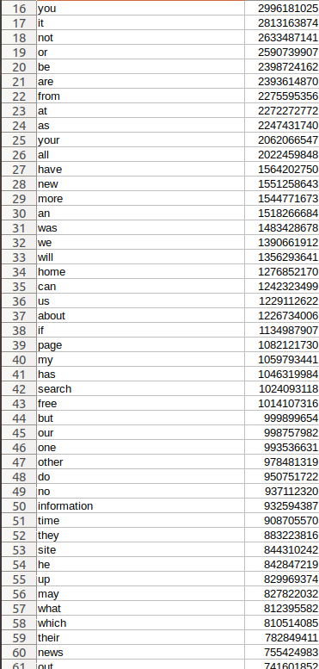
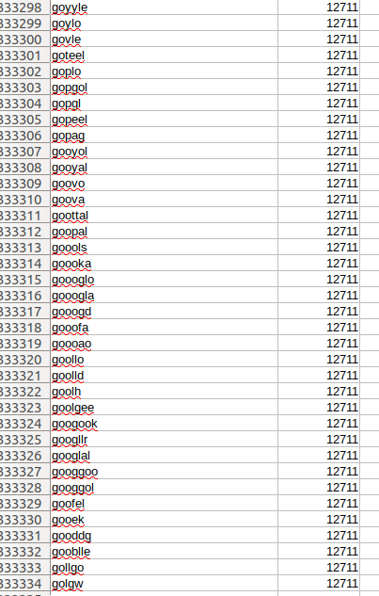
Dataset
https://www.kaggle.com/rtatman/english-word-frequency/data
“333,333 most commonly-used derived from the Google Web Trillion Word Corpus

Slide 19
How to clean data
Where did the data come from?
How could the words look?
Do we need to filter?
How can we filter?

Slide 20
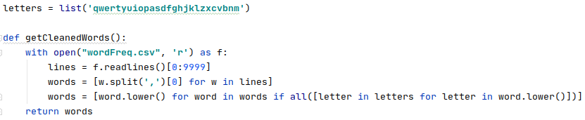
Clean dataset
10000 most used once nice threshold
Filter out weird symbols
Only lower case

Slide 21
Encoding a word
What options are there?
Which options are suitable for this problem

Slide 22
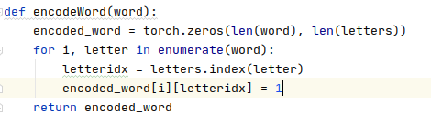
Encoding a word
One hot encoding per letter

Slide 23
Where to start predicting?
Network needs a first input, what can we use?

Slide 24
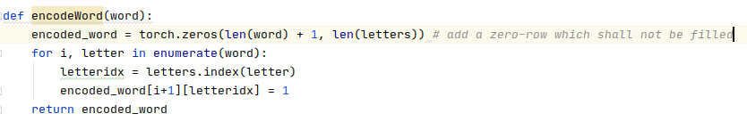
Where to start predicting
Use a zero tensor to generate fully random words
Could also give first letter to generate words with that starting letter

Slide 25
Type of network?
RNN?
LSTM?
GRU?

Slide 26
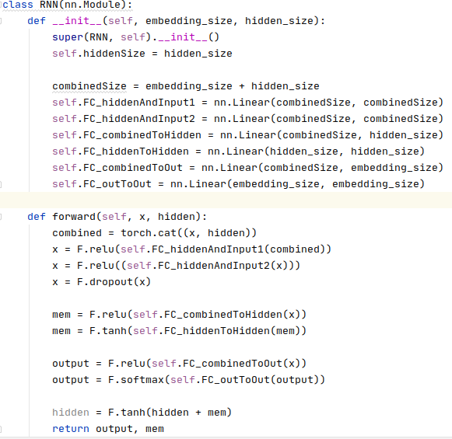

Type of network
Simple RNN
Memory in and out
Alternative: keep memory internal

Slide 27
How to evaluate a word?
We need a loss, can we use?
What should we use?

Slide 28
How to evaluate a word?
Evaluate each letter by binary cross entropy
Don’t forget to normalize on size!

Slide 29
When is it done generating?
When a network starts generating words, how will we know a word is complete?
Example:
c a t f i s h e r a b s t e m a n d w e r s

Slide 30
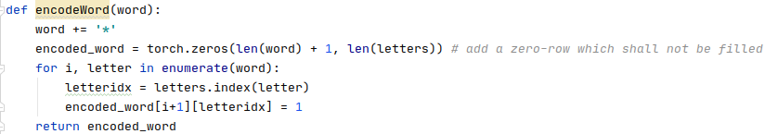
When is it done generating?
Stop symbol *
catfish*sd*fdva*

Slide 31
Training the network
When to stop training?
How to select samples?

Slide 32
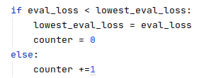
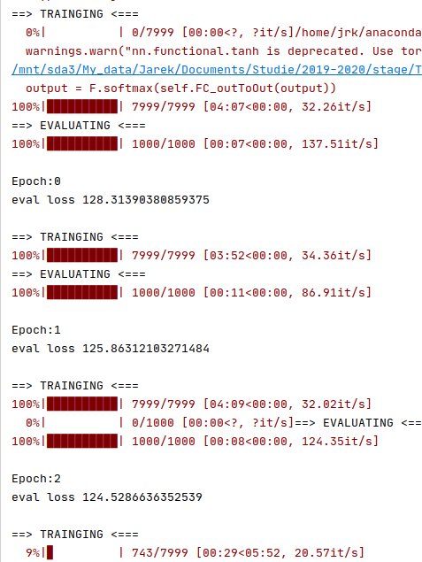
Training the network
Work with epochs
train/test/eval set
Keep training as long as eval improves
See code for actual code

Slide 33
Generating words
How can we now generate words?
Should we always pick most likely one?

Slide 34
Generating words
Use weighted choise
Power to get more deterministic
Disclaimer: network not done training yet
Should we always pick most likely one?

Slide 36
Neural Networks part 3
Attention Model, transformers

Slide 37
Further reading
Background / other explanations
http://colah.github.io/
Vanishing gradient problem: https://medium.com/datadriveninvestor/how-do-lstm-networks-solve-the-problem-of-vanishing-gradients-a6784971a577https://www.youtube.com/watch?v=3Hn_hEPtciQ
Understanding LSTM networks: http://colah.github.io/posts/2015-08-Understanding-LSTMs/
Understanding GRU networks: https://towardsdatascience.com/understanding-gru-networks-2ef37df6c9be
Long Short-Term Memory: From Zero to Hero with PyTorch: https://blog.floydhub.com/long-short-term-memory-from-zero-to-hero-with-pytorch/
Interesting
The Unreasonable Effectiveness of Recurrent Neural Networks: http://karpathy.github.io/2015/05/21/rnn-effectiveness/

