Slide 1
Network representation and learning

Slide 2
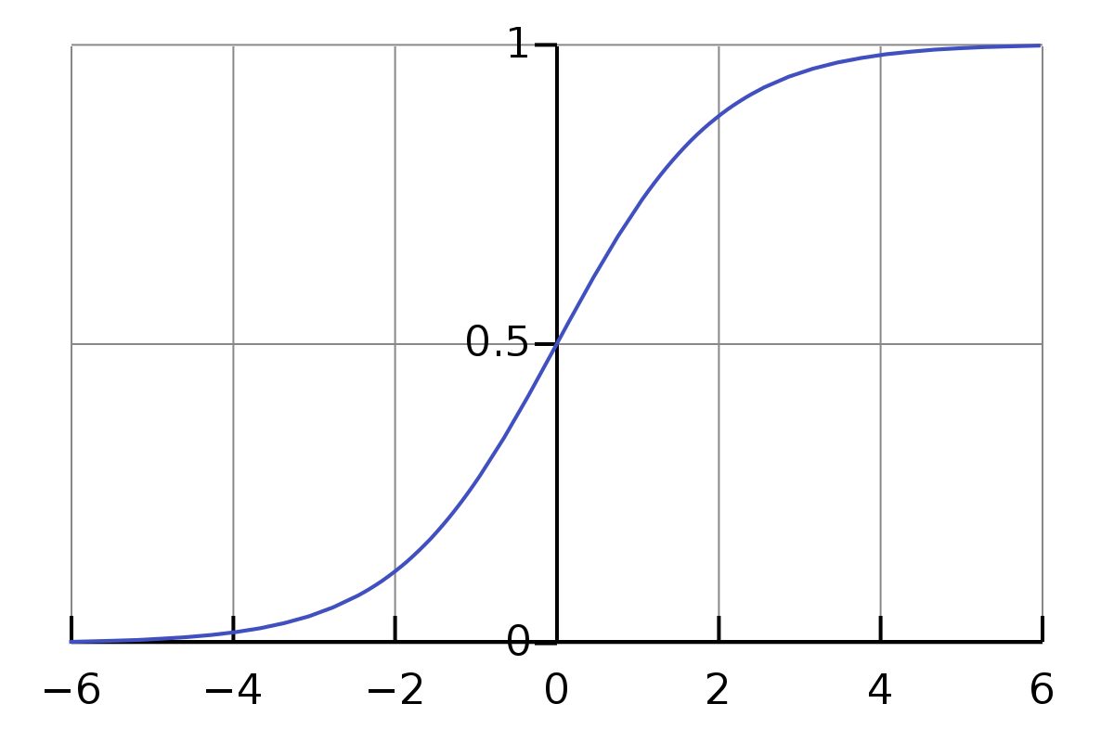




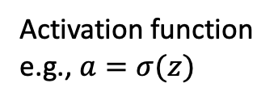




One neuron
$$x_{0}$$
$$w_{0}$$
Activation function
e.g., $a=σ(z)$
$$w_{1}$$
z
Output (activation): $a$
$$x_{1}$$
$$Σ$$
$$w_{2}$$
$$x_{2}$$
Input (features)

Slide 3
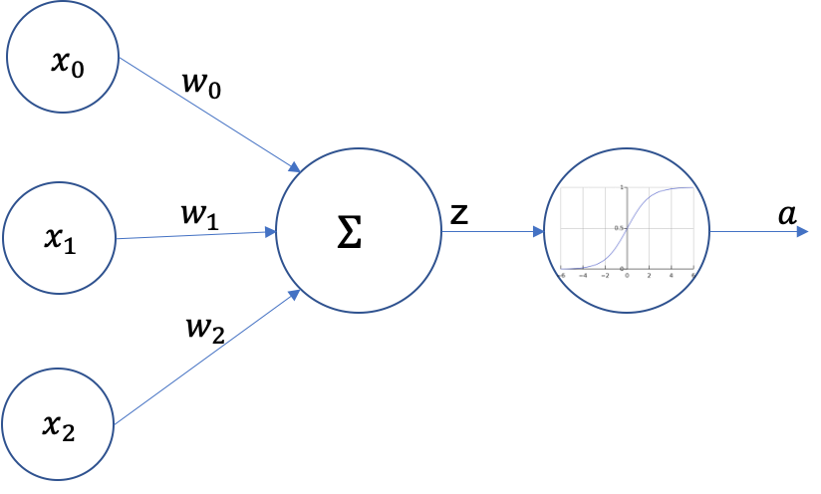








One neuron
$$x_{0}$$
$$w_{0}$$
$$w_{1}$$
$$Σ$$
$$a$$
$$x_{1}$$
$$w_{2}$$
$$x_{2}$$
The more common representation

Slide 4
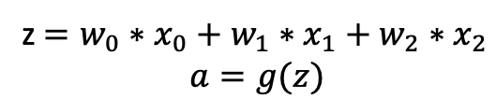
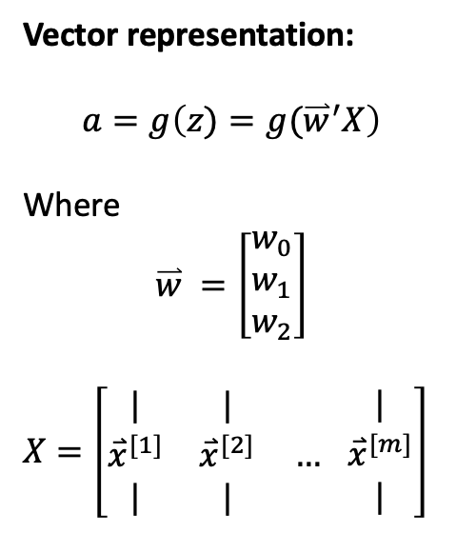
One neuron
$$x_{0}$$
$$w_{0}$$
z $=w_{0}∗x_{0}+w_{1}∗x_{1}+w_{2}∗x_{2}$
$$a=g(z)$$
$$w_{1}$$
$$Σ$$
$$a$$
$$x_{1}$$
Vector representation:
$$a=g\left({z)=g(\overset{⃑}{w}}^{′}X\right)$$
Where
$$\overset{⃑}{w} =\left[\begin{matrix}w_{0} \\ w_{1} \\ w_{2}\end{matrix}\right]$$
$X=\left[\begin{matrix}| & | & \\ {\overset{⃑}{x}}^{[1]} & {\overset{⃑}{x}}^{[2]} & … \\ | & | & \end{matrix} \begin{matrix}| \\ {\overset{⃑}{x}}^{[m]} \\ |\end{matrix}\right]$
$$w_{2}$$
$$x_{2}$$
The more common representation
m data points

Slide 5

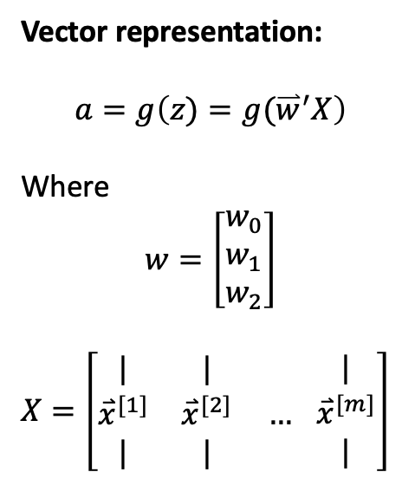



One neuron
$$x_{0}$$
$$w_{0}$$
z $=w_{0}∗x_{0}+w_{1}∗x_{1}+w_{2}∗x_{2}$
$$a=g(z)$$
$$w_{2}$$
$$a$$
$$x_{1}$$
Vector representation:
$$a=g\left({z)=g(\overset{⃑}{w}}^{′}X\right)$$
Where
$$w=\left[\begin{matrix}w_{0} \\ w_{1} \\ w_{2}\end{matrix}\right]$$
$X=\left[\begin{matrix}| & | & \\ {\overset{⃑}{x}}^{[1]} & {\overset{⃑}{x}}^{[2]} & … \\ | & | & \end{matrix} \begin{matrix}| \\ {\overset{⃑}{x}}^{[m]} \\ |\end{matrix}\right]$
$$w_{3}$$
$$x_{2}$$
$$z$$
$$a$$
m data points

Slide 6
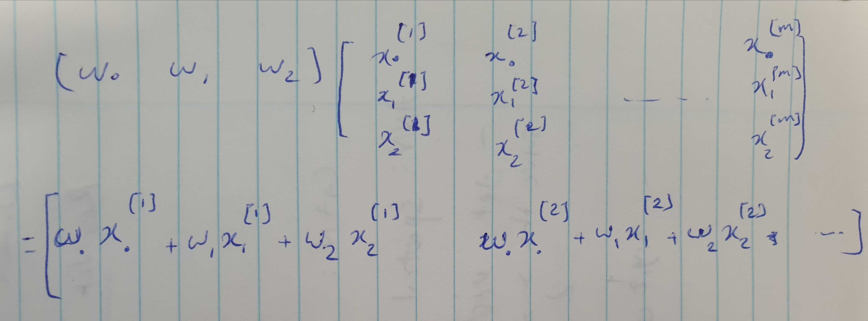

Slide 7




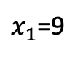


One neuron – an example
$$x_{0}=1$$
$$w_{0}=10$$
z $=w_{0}∗x_{0}+w_{1}∗x_{1}+w_{2}∗x_{2}$
$$a=g(z)$$
$$w_{1}=−3$$
$$Σ$$
$$a$$
$x_{1}$=9
What is the $a$value?
$$w_{2}=5$$
$x_{2}$=1
The more common representation

Slide 8
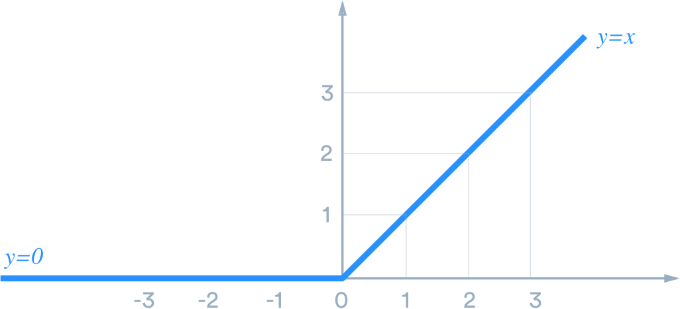


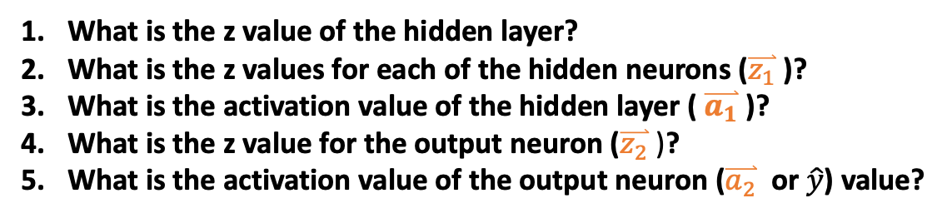



A network – an example
Activation function for all nodes:
Hidden
Input
-1
-10
Output
10
2
-2
10
1
$$\hat{y}$$
1
4
10
-2
$$\overset{⃑}{z_{2}}$$
$$\overset{⃑}{a_{2}}$$
$$\overset{⃑}{z_{1}}$$
$$\overset{⃑}{a_{1}}$$
What is the z value of the hidden layer?
What is the z values for each of the hidden neurons ($\overset{⃑}{z_{1}}$ )?
What is the activation value of the hidden layer ( $\overset{⃑}{a_{1}}$ )?
What is the z value for the output neuron ($\overset{⃑}{z_{2}}$ )?
What is the activation value of the output neuron ($\overset{⃑}{a_{2}}$ or $\hat{y}$) value?

Slide 9










A network
Activation function for all nodes: $a=g(z)$
Hidden
Input
$$w_{11}^{}$$
$$w_{1}^{}$$
Output
$$x_{0}$$
$$w_{12}^{}$$
$$w_{2}^{}$$
$$\hat{y}$$
$$x_{2}$$
$$w_{3}^{}$$
$$\overset{⃑}{z_{2}}$$
$$\overset{⃑}{a_{2}}$$
$$W^{[1]}$$
$$W^{[2]}$$
$$\overset{⃑}{z_{1}}$$
$$\overset{⃑}{a_{1}}$$
What is the z value of the hidden layer?
What is the z values for each of the hidden neurons ($\overset{⃑}{z_{1}}$ )?
What is the activation value of the hidden layer ( $\overset{⃑}{a_{1}}$ )?
What is the z value for the output neuron ($\overset{⃑}{z_{2}}$ )?
What is the activation value of the output neuron ($\overset{⃑}{a_{2}}$ or $\hat{y}$) value?

Slide 10
Background knowledge for backpropagation
Watch gradient descent video (11 min, we will have 15 min to watch and discuss): https://www.coursera.org/learn/neural-networks-deep-learning/lecture/A0tBd/gradient-descent
Watch derivative video 1 (7min length, 15 min to watch and discuss): https://www.coursera.org/learn/neural-networks-deep-learning/lecture/0ULGt/derivatives
Watch derivative video 2 (10 min length, 15 min to watch): https://www.coursera.org/learn/neural-networks-deep-learning/lecture/oEcPT/more-derivative-examples
Chain rules for derivatives (19 min length, 30 min to watch): https://www.youtube.com/watch?v=HaHsqDjWMLU
Derivatives with a computation graph (15 min length, 20 min watch) https://www.coursera.org/learn/neural-networks-deep-learning/lecture/0VSHe/derivatives-with-a-computation-graph

Slide 11
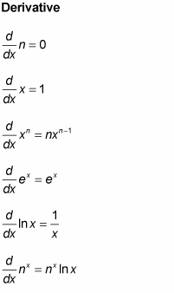
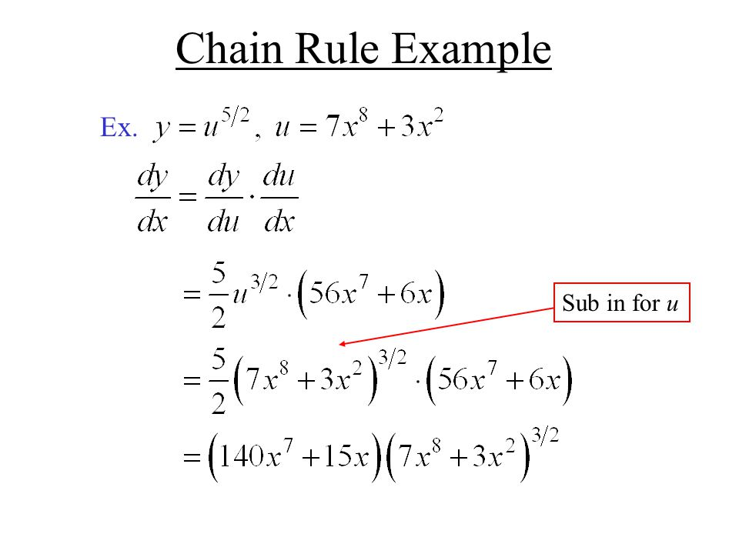
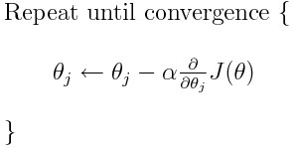
Background knowledge for backpropagation
Gradient Descent Equation

Slide 12


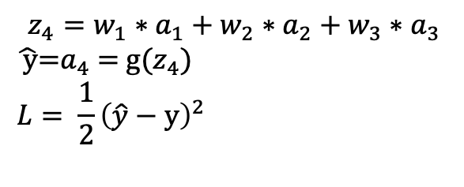
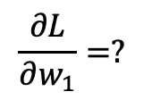



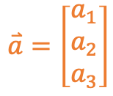
Backpropagation – regression, one sample
Hidden
Forward:
Input
$$z_{4}=w_{1}∗a_{1}+w_{2}∗a_{2}+w_{3}∗a_{3}$$
$\hat{ y}$=$a_{4}$ = g($z_{4}$)
$$L= \frac{1}{2}{\left(\hat{y}−y\right)}^{2}$$
$$w_{1}^{}$$
Output
$$x_{1}$$
$$w_{2}^{}$$
$$\hat{y}$$
Backward:
$$x_{2}$$
$$w_{3}^{}$$
$$\frac{∂L}{∂w_{1}}=?$$
$$z_{4}$$
$$a_{4}$$
$$\overset{⃑}{a}=\left[\begin{matrix}a_{1} \\ a_{2} \\ a_{3}\end{matrix}\right]$$
$$\overset{⃑}{z}$$

Slide 13
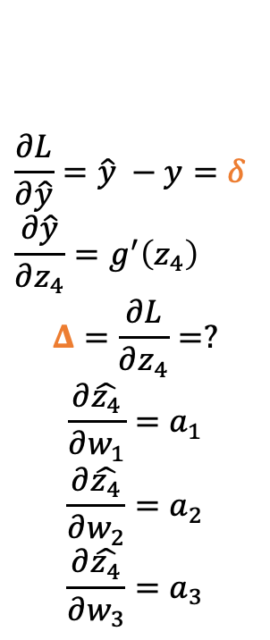
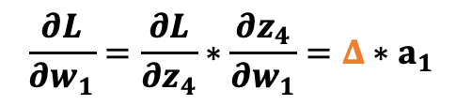
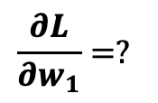
Backpropagation – regression, one sample
Hidden
Forward:
Input
$$z_{4}=w_{1}∗a_{1}+w_{2}∗a_{2}+w_{3}∗a_{3}$$
$\hat{ y}$=$a_{4}$ = g($z_{4}$)
$$L= \frac{1}{2}{\left(\hat{y}−y\right)}^{2}$$
$$w_{1}^{}$$
Output
$$x_{1}$$
$$\frac{∂L}{∂\hat{y}}=\hat{y} −y=δ$$
$$\frac{∂\hat{y}}{∂z_{4}}=g^{′}\left(z_{4}\right)$$
$$Δ=\frac{∂L}{∂z_{4}}=?$$
$$\frac{∂\hat{z_{4}}}{∂w_{1}}=a_{1}$$
$$\frac{∂\hat{z_{4}}}{∂w_{2}}=a_{2}$$
$$\frac{∂\hat{z_{4}}}{∂w_{3}}=a_{3}$$
$$w_{2}^{}$$
$$\hat{y}$$
Backward:
$$\frac{∂L}{∂w_{1}}=?$$
$$x_{2}$$
$$w_{3}^{}$$
$$z_{4}$$
$$a_{4}$$
$$\overset{⃑}{a}=\left[\begin{matrix}a_{1} \\ a_{2} \\ a_{3}\end{matrix}\right]$$
$$\overset{⃑}{z}$$
$$\frac{∂L}{∂w_{1}}=\frac{∂L}{∂z_{4}}∗\frac{∂z_{4}}{∂w_{1}}=Δ∗a_{1}$$

Slide 14
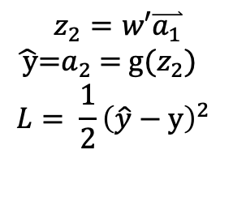








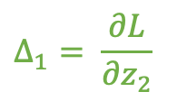

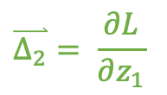
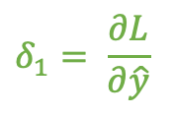

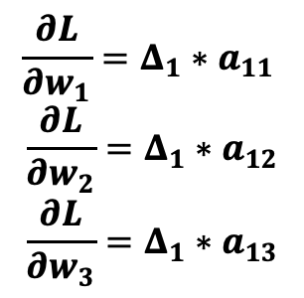
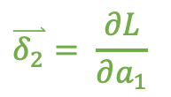
Backpropagation – regression, one sample
Input
Hidden
Output
Forward:
$$\overset{⃑}{Δ_{2}}= \frac{∂L}{∂z_{1}}$$
$$\overset{⃑}{δ_{2}}= \frac{∂L}{∂a_{1}}$$
$$z_{2}=w′\overset{⃑}{a_{1}}$$
$\hat{ y}$=$a_{2}$ = g($z_{2}$)
$$L= \frac{1}{2}{\left(\hat{y}−y\right)}^{2}$$
$$Δ_{1}= \frac{∂L}{∂z_{2}}$$
$$δ_{1}= \frac{∂L}{∂\hat{y}}$$
Backward:
$$x_{1}$$
$$w_{1}$$
$$\frac{∂L}{∂w_{1}}=Δ_{1}∗a_{11}$$
$$\frac{∂L}{∂w_{2}}=Δ_{1}∗a_{12}$$
$$\frac{∂L}{∂w_{3}}=Δ_{1}∗a_{13}$$
$$w_{2}$$
$$\hat{y}$$
$$x_{2}$$
$$w_{3}$$
$$\overset{⃑}{z_{2}}$$
$$\overset{⃑}{a_{2}}$$
$$\overset{⃑}{z_{1}}$$
$$\overset{⃑}{a_{1}}=\left[\begin{matrix}a_{11} \\ a_{12} \\ a_{13}\end{matrix}\right]$$

Slide 15
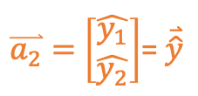
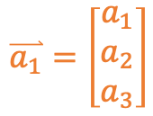
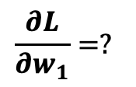


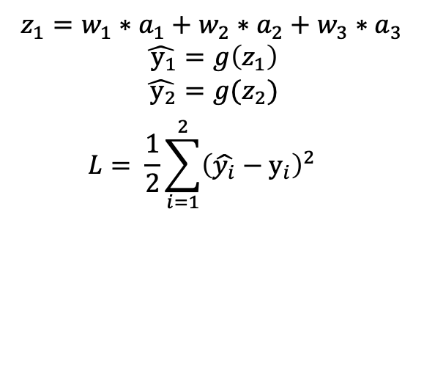





Backpropagation – regression, one sample
Hidden
Output
Forward:
Input
$$z_{1}=w_{1}∗a_{1}+w_{2}∗a_{2}+w_{3}∗a_{3}$$
$$\hat{ y_{1}}=g\left(z_{1}\right)$$
$$\hat{ y_{2}}=g(z_{2})$$
$$L= \frac{1}{2}{\sum_{i=1}^{2}{{\left(\hat{y_{i}}−y_{i}\right)}^{2}}}^{}$$
$$w_{1}$$
$$x_{1}$$
$$w_{2}$$
$$\hat{y_{1}}$$
$$x_{2}$$
$$w_{3}$$
$$\hat{y_{2}}$$
Backward:
$$\frac{∂L}{∂w_{1}}=?$$
$\overset{⃑}{z_{2}}=$ $\left[\begin{matrix}z_{1} \\ z_{2}\end{matrix}\right]$
$\overset{⃑}{a_{2}}=$ $\left[\begin{matrix}\hat{y_{1}} \\ \hat{y_{2}}\end{matrix}\right]$= $\overset{⃑}{\hat{y}}$
$$\overset{⃑}{z_{1}}$$
$$\overset{⃑}{a_{1}}=\left[\begin{matrix}a_{1} \\ a_{2} \\ a_{3}\end{matrix}\right]$$

Slide 16
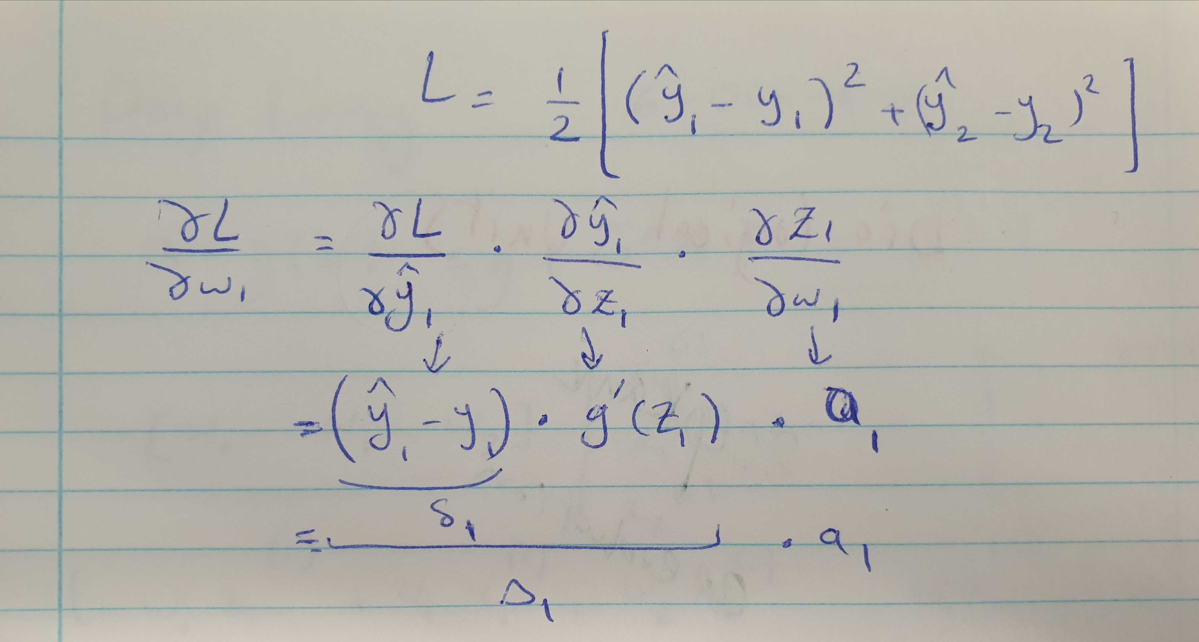

Slide 17
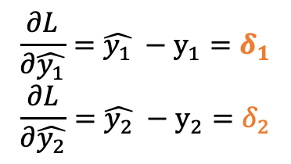
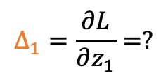
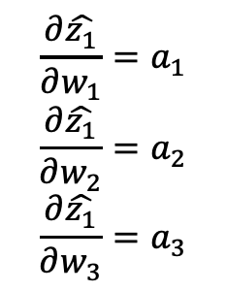
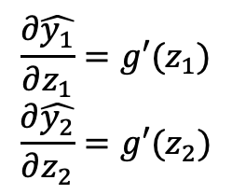
Backpropagation – regression, one sample
Hidden
Output
Forward:
Input
$$z_{1}=w_{1}∗a_{1}+w_{2}∗a_{2}+w_{3}∗a_{3}$$
$$\hat{ y_{1}}=g\left(z_{1}\right)$$
$$\hat{ y_{2}}=g(z_{2})$$
$$L= \frac{1}{2}{\sum_{i=1}^{2}{{\left(\hat{y_{i}}−y_{i}\right)}^{2}}}^{}$$
$$w_{1}$$
$$x_{1}$$
$$w_{2}$$
$$\hat{y_{1}}$$
$$x_{2}$$
$$w_{3}$$
$$\hat{y_{2}}$$
Backward:
$$\frac{∂L}{∂w_{1}}=?$$
$\overset{⃑}{z_{2}}=$ $\left[\begin{matrix}z_{1} \\ z_{2}\end{matrix}\right]$
$\overset{⃑}{a_{2}}=$ $\left[\begin{matrix}\hat{y_{1}} \\ \hat{y_{2}}\end{matrix}\right]$= $\overset{⃑}{\hat{y}}$
$$\frac{∂L}{∂\hat{y_{1}}}=\hat{y_{1}} −y_{1}=δ_{1}$$
$$\frac{∂L}{∂\hat{y_{2}}}=\hat{y_{2}} −y_{2}=δ_{2}$$
$$\overset{⃑}{z_{1}}$$
$$\overset{⃑}{a_{1}}=\left[\begin{matrix}a_{1} \\ a_{2} \\ a_{3}\end{matrix}\right]$$
$$\frac{∂\hat{z_{1}}}{∂w_{1}}=a_{1}$$
$$\frac{∂\hat{z_{1}}}{∂w_{2}}=a_{2}$$
$$\frac{∂\hat{z_{1}}}{∂w_{3}}=a_{3}$$
$$\frac{∂\hat{y_{1}}}{∂z_{1}}=g′(z_{1})$$
$$\frac{∂\hat{y_{2}}}{∂z_{2}}=g′(z_{2})$$
$$Δ_{1}=\frac{∂L}{∂z_{1}}=?$$

Slide 18
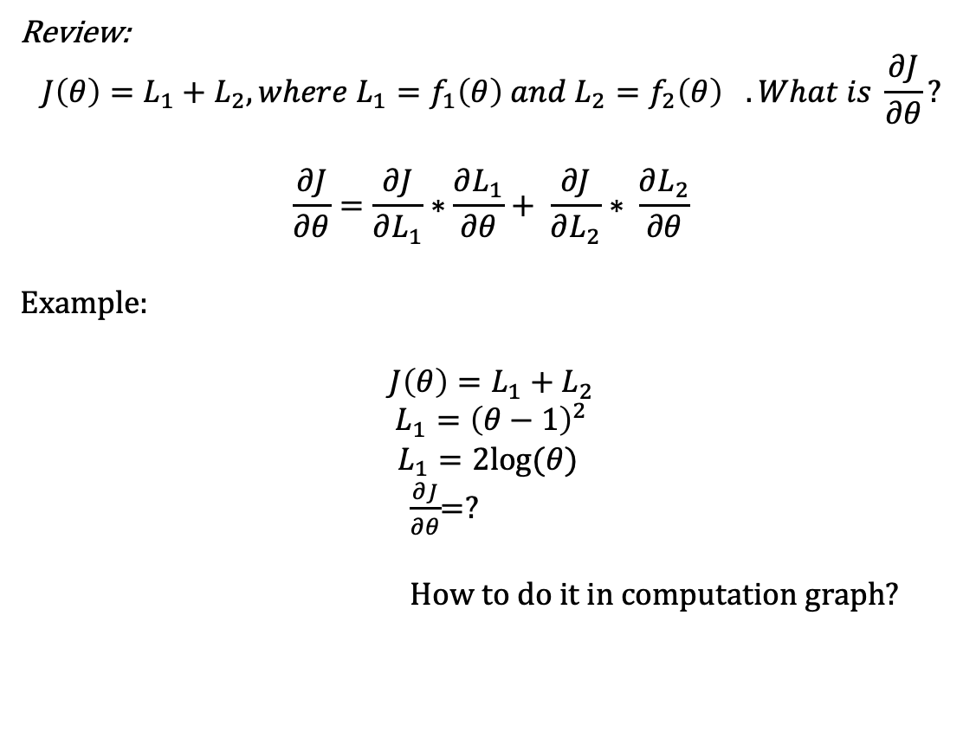
Backpropagation – regression, m samples
Review:
$${J\left(θ\right)=L_{1}+L_{2}, where L_{1}=f_{1}\left(θ\right) and L_{2}=f_{2}\left(θ\right)}_{}. What is \frac{∂J}{∂θ}?$$
$$\frac{∂J}{∂θ}=\frac{∂J}{∂L_{1}}∗\frac{∂L_{1}}{∂θ}+ \frac{∂J}{∂L_{2}}∗ \frac{∂L_{2}}{∂θ}$$
Example:
$$J\left(θ\right)=L_{1}+L_{2}$$
$$L_{1}={\left(θ−1\right)}^{2}$$
$$L_{1}=2log⁡(θ)$$
$\frac{∂J}{∂θ}$=?
How to do it in computation graph?

Slide 19

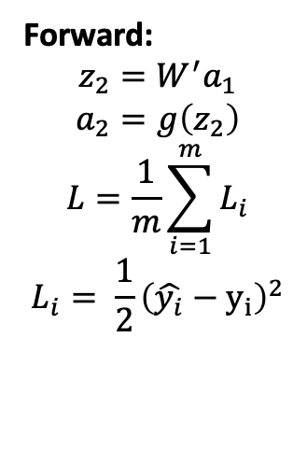
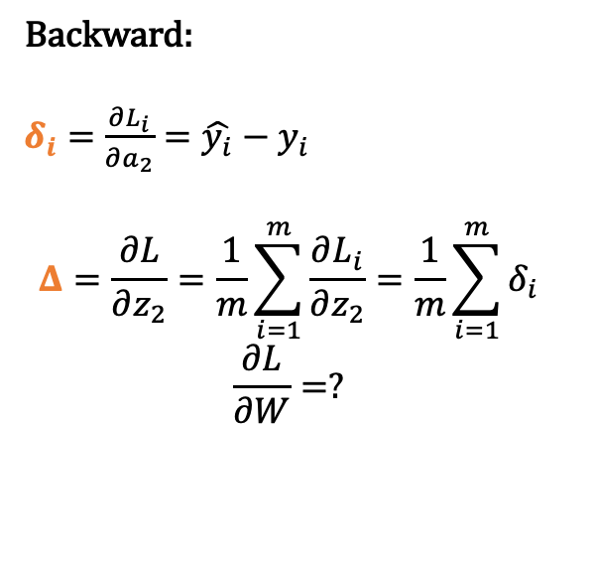



Backpropagation – regression, m samples
Hidden
Forward:
$$z_{2}=W^{′}a_{1}$$
$$a_{2}=g\left(z_{2}\right)$$
$$L=\frac{1}{m}\sum_{i=1}^{m}{L_{i}}$$
$$L_{i}= \frac{1}{2}{\left(\hat{y_{i}}−y_{i}\right)}^{2}$$
Input
Output
$$x_{1}$$
W
$$\hat{y}$$
$$x_{2}$$
$$z_{2}$$
$$a_{2}$$
Backward:
$δ_{i}=$ $\frac{∂L_{i}}{∂a_{2}}=\hat{y_{i}}−y_{i}$
$$Δ=\frac{∂L}{∂z_{2}}=\frac{1}{m}\sum_{i=1}^{m}{\frac{∂L_{i}}{∂z_{2}}}=\frac{1}{m}\sum_{i=1}^{m}{δ_{i}}$$
$$\frac{∂L}{∂W}=?$$
$$\overset{⃑}{z_{1}}$$
$${\overset{⃑}{a}}_{1}$$

Slide 20
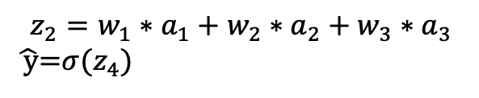


Backpropagation – classification, one sample
Hidden
Input
$$z_{2}=w_{1}∗a_{1}+w_{2}∗a_{2}+w_{3}∗a_{3}$$
$\hat{ y}$=$σ(z_{4})$
Output
$$x_{1}$$
W
$$L=−ylog\hat{y}−\left(1−y\right)log⁡(1−\hat{y})$$
$$δ= \frac{∂L}{∂\hat{y}}=−\frac{y}{\hat{y}}+\frac{1−y}{1−\hat{y}}$$
$$\frac{∂\hat{y}}{∂z_{4}}=σ^{′}\left(z_{4}\right)=\hat{y}(1−\hat{y})$$
$Δ=\frac{∂L}{∂z_{4}}=\frac{∂L}{∂\hat{y}}$* $\frac{∂\hat{y}}{∂z_{4}}$=?
$$\frac{∂\hat{z_{4}}}{∂w_{1}}=a_{1}$$
$$\frac{∂\hat{z_{4}}}{∂w_{2}}=a_{2}$$
$$\frac{∂\hat{z_{4}}}{∂w_{3}}=a_{3}$$
$$\hat{y}$$
$$x_{2}$$
$$z_{4}$$
$$a_{4}$$
$$\overset{⃑}{z}$$
$$\overset{⃑}{a}=\left[\begin{matrix}a_{1} \\ a_{2} \\ a_{3}\end{matrix}\right]$$

Slide 21




Backpropagation – classification, one sample
Hidden
Output
$$z_{1}=w_{1}∗a_{1}+w_{2}∗a_{2}+w_{3}∗a_{3}$$
$$\hat{ y_{1}}=g\left(z_{1}\right)$$
$$\hat{ y_{2}}=g(z_{2})$$
$$L=−y_{1}log\hat{y_{1}}−y_{2}log⁡\hat{y_{2}}$$
$$δ_{1}= \frac{∂L}{∂\hat{y_{1}}}=−\frac{y_{1}}{\hat{y_{1}}}+\frac{1−y_{1}}{1−\hat{y_{1}}}$$
$Δ_{1}=\frac{∂L}{∂z_{1}}=\frac{∂L}{∂\hat{y_{1}}}$* $\frac{∂\hat{y_{1}}}{∂\hat{z_{1}}}=δ_{1}∗g^{′}\left(z_{1}\right)= \hat{y_{1}}−y_{1}$
Input
$$w_{1}$$
$$x_{1}$$
$$w_{2}$$
$$\hat{y_{1}} y_{1}$$
$$x_{2}$$
$$w_{3}$$
$$\hat{y_{2}} y_{2}$$
$$\frac{∂\hat{z_{1}}}{∂w_{1}}=a_{1}$$
$$\frac{∂\hat{z_{1}}}{∂w_{2}}=a_{2}$$
$$\frac{∂\hat{z_{1}}}{∂w_{3}}=a_{3}$$
$\overset{⃑}{z_{2}}=$ $\left[\begin{matrix}z_{1} \\ z_{2}\end{matrix}\right]$
$\overset{⃑}{a_{2}}=$ $\left[\begin{matrix}\hat{y_{1}} \\ \hat{y_{2}}\end{matrix}\right]$= $\overset{⃑}{\hat{y}}$
$$\overset{⃑}{z_{1}}$$
$$\overset{⃑}{a_{1}}=\left[\begin{matrix}a_{1} \\ a_{2} \\ a_{3}\end{matrix}\right]$$

