Slide 1
Cross Entropy
July 31st 2020

Slide 2
Information Content of a random variable X
Information content of a random variable X, I(X), measures how much information X contains. The more information it has, the more bits (Shannon entropy) are needed for encoding them in sending messages.
Toss a fair coin, i.e., P(X = tail) = ½, and P(X = head) = ½
Only one bit is needed to transfer/communicating this message
For X has a single outcome
=> no need to transfer this message as it is ground truth
Toss a fair dice with 8 sides, i.e., P(X = n) = 1/8, where n = 1, 2, …, 8
=> How many possible outcomes?
=> How many bits are needed to communicating this message?

Slide 3
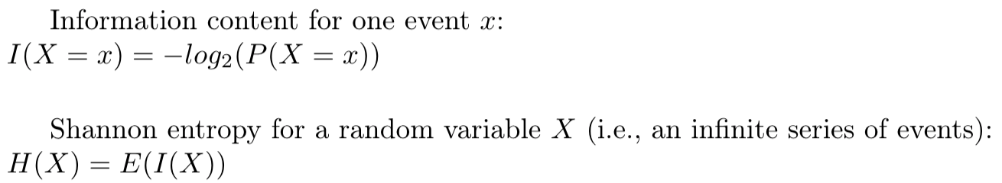
Information Content of a random variable X and Shannon entropy
Information content of a random variable X, I(X), measures how much information X contains. The more information it has, the more bits are needed for encoding them in sending messages.
Side notes:
X is a random variable, x is a specific value of X
E(X) is the expectation of X (the average of observed values).
Claude Shannon
(1916-2001)

Slide 4
Side notes: random variables and expectations
X (upper-case) is a random variable, x (lower-case) is a specific value of X
Toss a fair coin:
Situation 1: X is defined observed head or not after one toss, x = head or tail. X ~ Ber(p = ½)
Situation 2: X is defined as the number of heads after n tosses, x = 0, 1, …n. X~Bin(p =1/2, n = 100)
Question: What is the average number you get if you toss the coin many many times? (i.e., what are your expectations of the average outcome)?
Claude Shannon

Slide 5

Side notes: random variables and expectations
X (upper-case) is a random variable, x (lower-case) is a specific value of X
Toss a coin:
Situation 1: X is defined observed head or not after one toss, x = head or tail. X ~ Ber(p = ½)
Situation 2: X is defined as the number of heads after n tosses, x = 0, 1, …n. X~Bin(p =1/2, n = 100)
E(X) is the expectation of X (the average of observed values).
Situation 1: E(X) = 0 * P(X =0) + 1 * P(X=1) = ½
Situation 2: E(X) =
X | 0 (tail) | 1 (head)
P(X) | 1/2 | 1/2
E(X) = 0 * P(X =0) + 1 * P(X=1) = 1/2
Claude Shannon

Slide 6

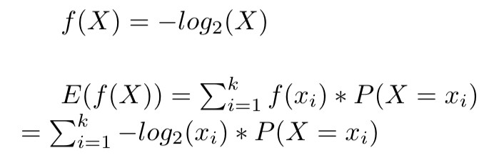
Side notes: expectation of f(X)
Toss a coin:
Situation 1: X is defined observed head or not after one toss, x = head or tail. X ~ Ber(p = ½)
X | 0 (tail) | 1 (head)
P(X) | 1/2 | 1/2
f(X) = - log2(X) | 1 | 1
E(f(X)) = 1 * P(X =0) + 1 * P(X=1) = 1
Claude Shannon

Slide 7
Information Content of a random variable X and Shannon entropy
Information content of a random variable X, I(X), measures how much information X contains. The more information it has, the more bits are needed for encoding them in sending messages.
Toss a fair coin, i.e., P(X = tail) = ½, and P(X = head) = ½
Head -> 1
Tail -> 0
Head -> 1
Head -> 1
....
Conclusion: One bit is enough.
X | 0 (tail) | 1 (head)
P(X) | 1/2 | 1/2
I(X=x) = -Log2(P(X=x)) | 1 | 1
H(X) = E(I(X)) = P(X=0) * I(X=0) + P(X=1) * I(X=1) = 1 bit
Claude Shannon

Slide 8
Information Content of a random variable X and Shannon entropy
Toss a fair dice with 8 sides, i.e., P(X = n) = 1/8, where n = 1, 2, …, 8
Based on Shannon’s information content, how many bits (i.e., Shannon entropy, i.e., expected Shannon information content) are needed to communicating this message?
Conclusion: Three bits are enough.
1 -> 000
2 -> 001
3 -> 010
….
8 -> 111
X | 1 | 2 | … | 8
P(X) | 1/8 | 1/8 |  | 1/8
I(X = x) = - log2(P(x)) | 3 | 3 |  | 3
H(X) = E(I(X)) = P(X=0) * I(X=1) + P(X=1) * I(X=2) + … + P(X=8) * I(X=8) = 3 bits
Claude Shannon

Slide 9
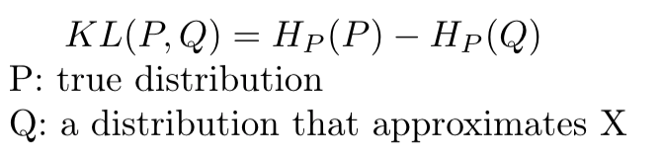
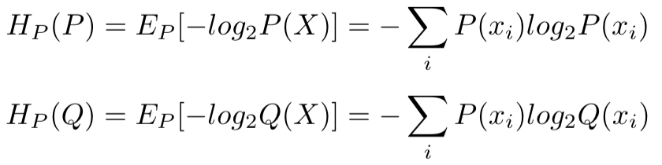
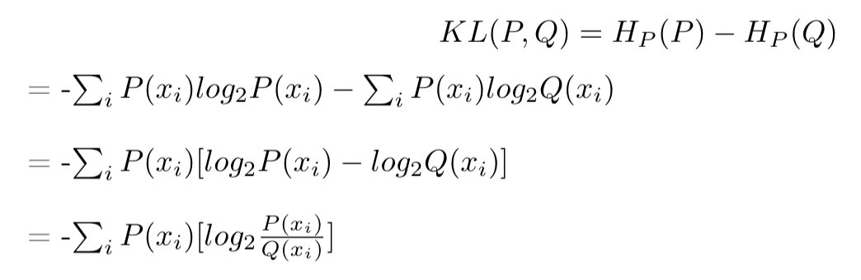
KL divergence
“the KL divergence is the average number of extra bits needed to encode the data, due to the fact that we used distribution Q to encode the data instead of the true distribution P. “
KL divergence measures the difference between two distributions, P(true distribution) and Q (a distribution approximating P).

Slide 10
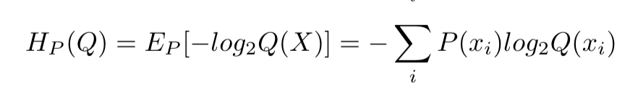
Cross Entropy
For most machine learning problems, this term is fixed, thus can ignore.

Slide 11
Cross Entropy in machine learning
input X = [ 0.9 0.8 2.3 4.5 -1.2 …]
Predicted_scores: Q(X) = [ 0.6 0.4]
Target = 0 (this data point belongs to class 0) => P(X) = [1 0]
One data point
Predicted score for class 0
Predicted score for class 1

Slide 12
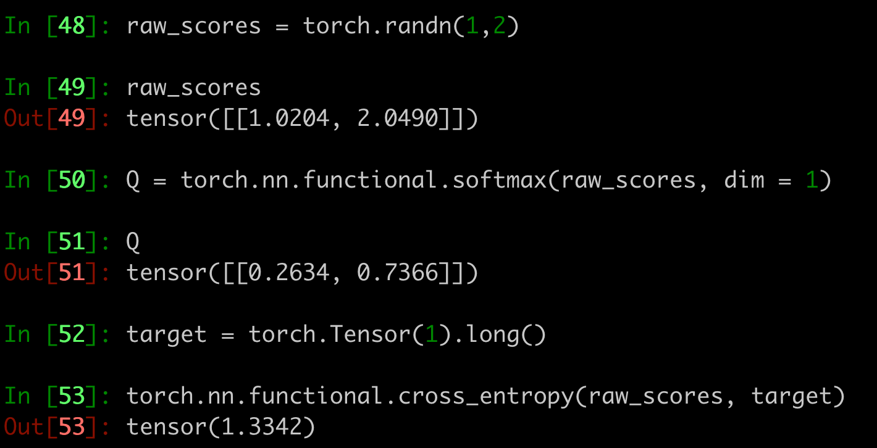
Cross Entropy in machine learning

