Slide 1
Sudoku
Donald Stolz

Slide 2
Sudoku Concepts
Goal: To completely fill a 9 x 9 array with integer values (1 – 9)
Rules:
Each Row contains integers 1 – 9
Each Column contains integers 1 – 9
Each Box contains integers 1 - 9

Slide 3
Original Plan
Build a Sudoku Solver
User inputs numbers into board GUI
Solver Returns solution and steps requiredd

Slide 4
Final Project
Sudoku Game App
User inputs number of holes to generate
A new random solution is generated
Holes are removed while ensuring valid Sudoku
The new puzzle is copied to the GUI board
User is able to fill in holes to solve Sudoku

Slide 5
Object Classes
Sudoku
main
SudokuBoard
createBoard(blanks)
SudokuSolution
makeNewSolution()
fillCell(x, y)
SudokuGUI
Extends JFrame
CellBox
Extends JPanel
Cell
Extends JTextField
Implements KeyListener

Slide 6
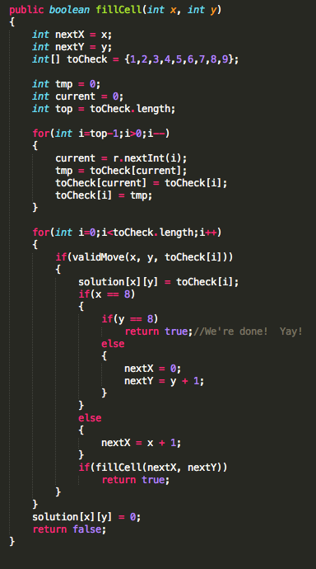
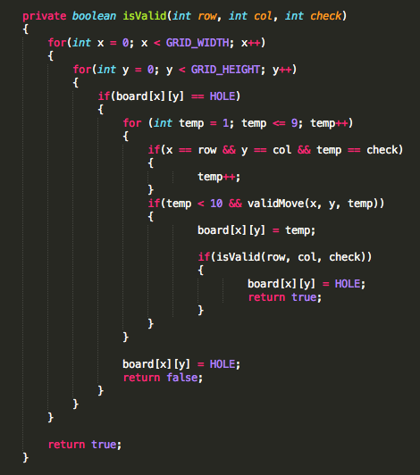
Key Algorithm - Recursive Backtracking
Used in:
SudokuBoard.isValid(int row, int col, int check)
SudokuSolution.fillCell(int x, int y)

Slide 7
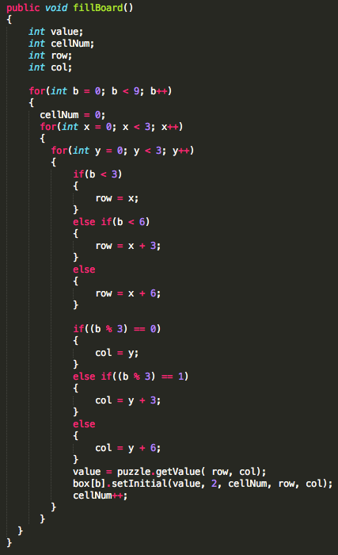
Key Problem - Aligning board[][] with GUI
GUI is made of 9 3x3 boxes
Generated board is made of 9 x 9 cells
Solution: SudokuGUI.fillBoard()

Slide 8
Unsolved Problems
Implementing menu to “Select Difficulty”, “Start New Game”,
& “Show Solution”
Implementing a method to check GUI board
Or call SudokuBoard from Cell class

Slide 9
Testing & What I Learned
For testing:
Used NetBeans IDE
Key Tests:
Board matches Sudoku
Holes were made validly
User GUI matches Board
New Concepts:
Java Swing class
GUI in general
ActionListeners

