Slide 1
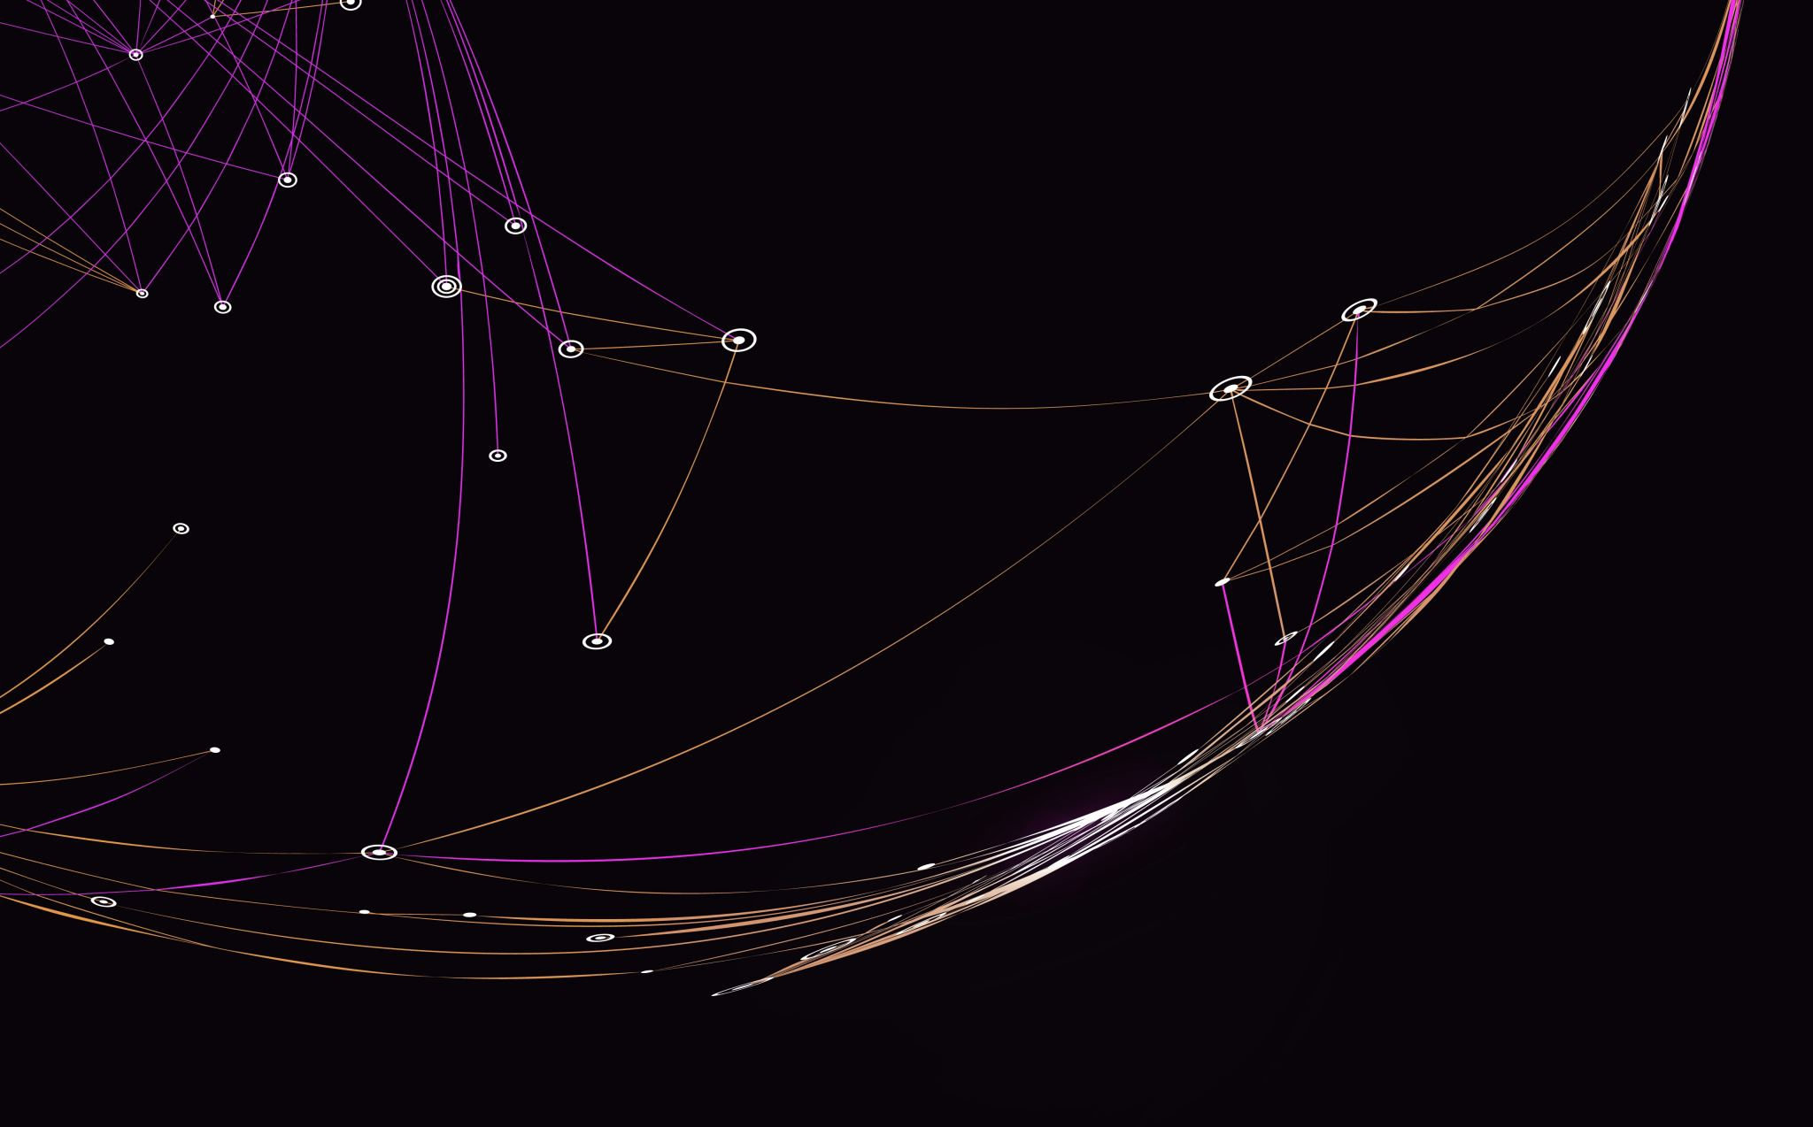
Obesity in America
Samuel Burkart

Slide 2
Why Do We Care?
Linked to:
High Blood Pressure
Type 2 diabetes
Coronary heart disease
Stroke
Gallbladder disease
Osteoarthritis
Low Quality of Life/Mental Health
https://www.cdc.gov/obesity/adult/causes.html

Slide 3
How Can We Avoid It?
Look into:
Diet
Exercise/Activity Level
Region

Slide 4
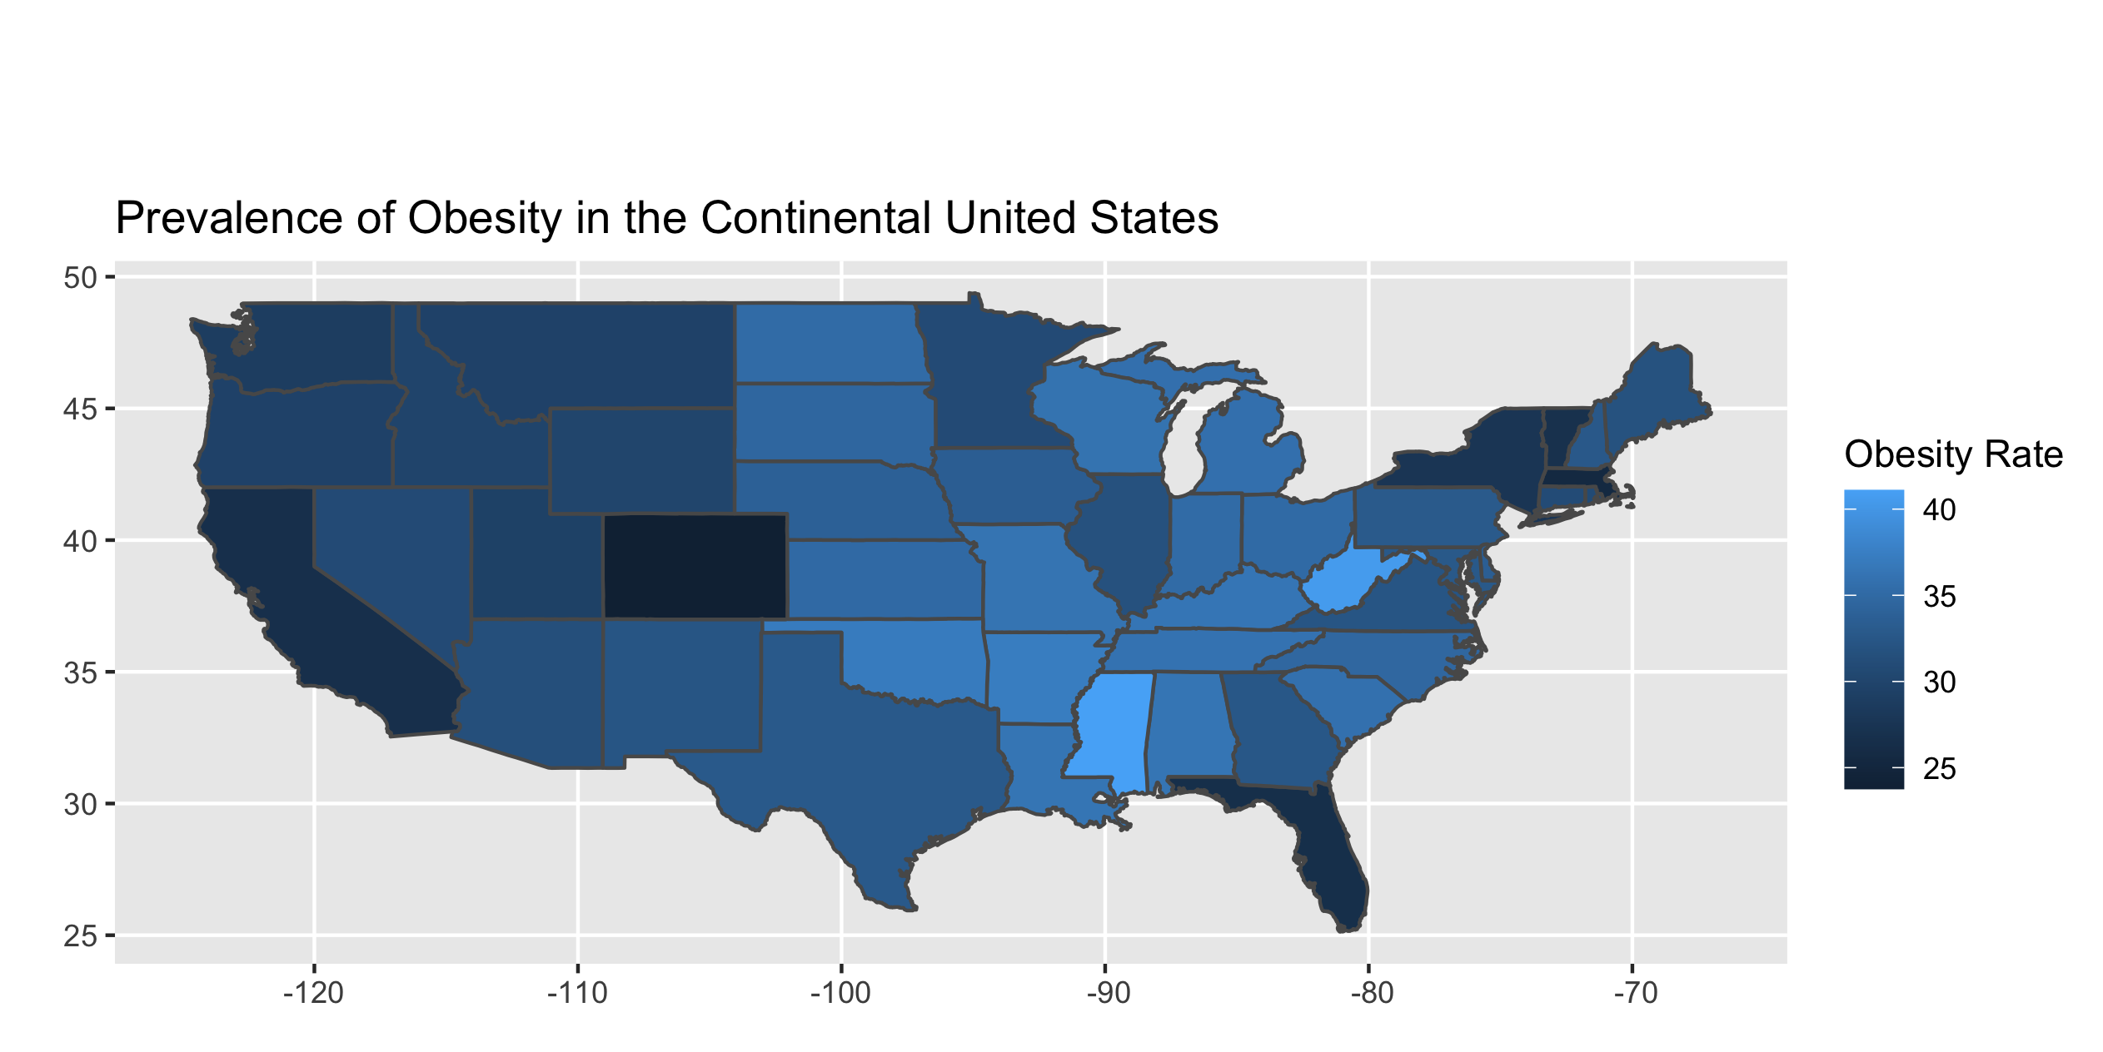

Slide 5
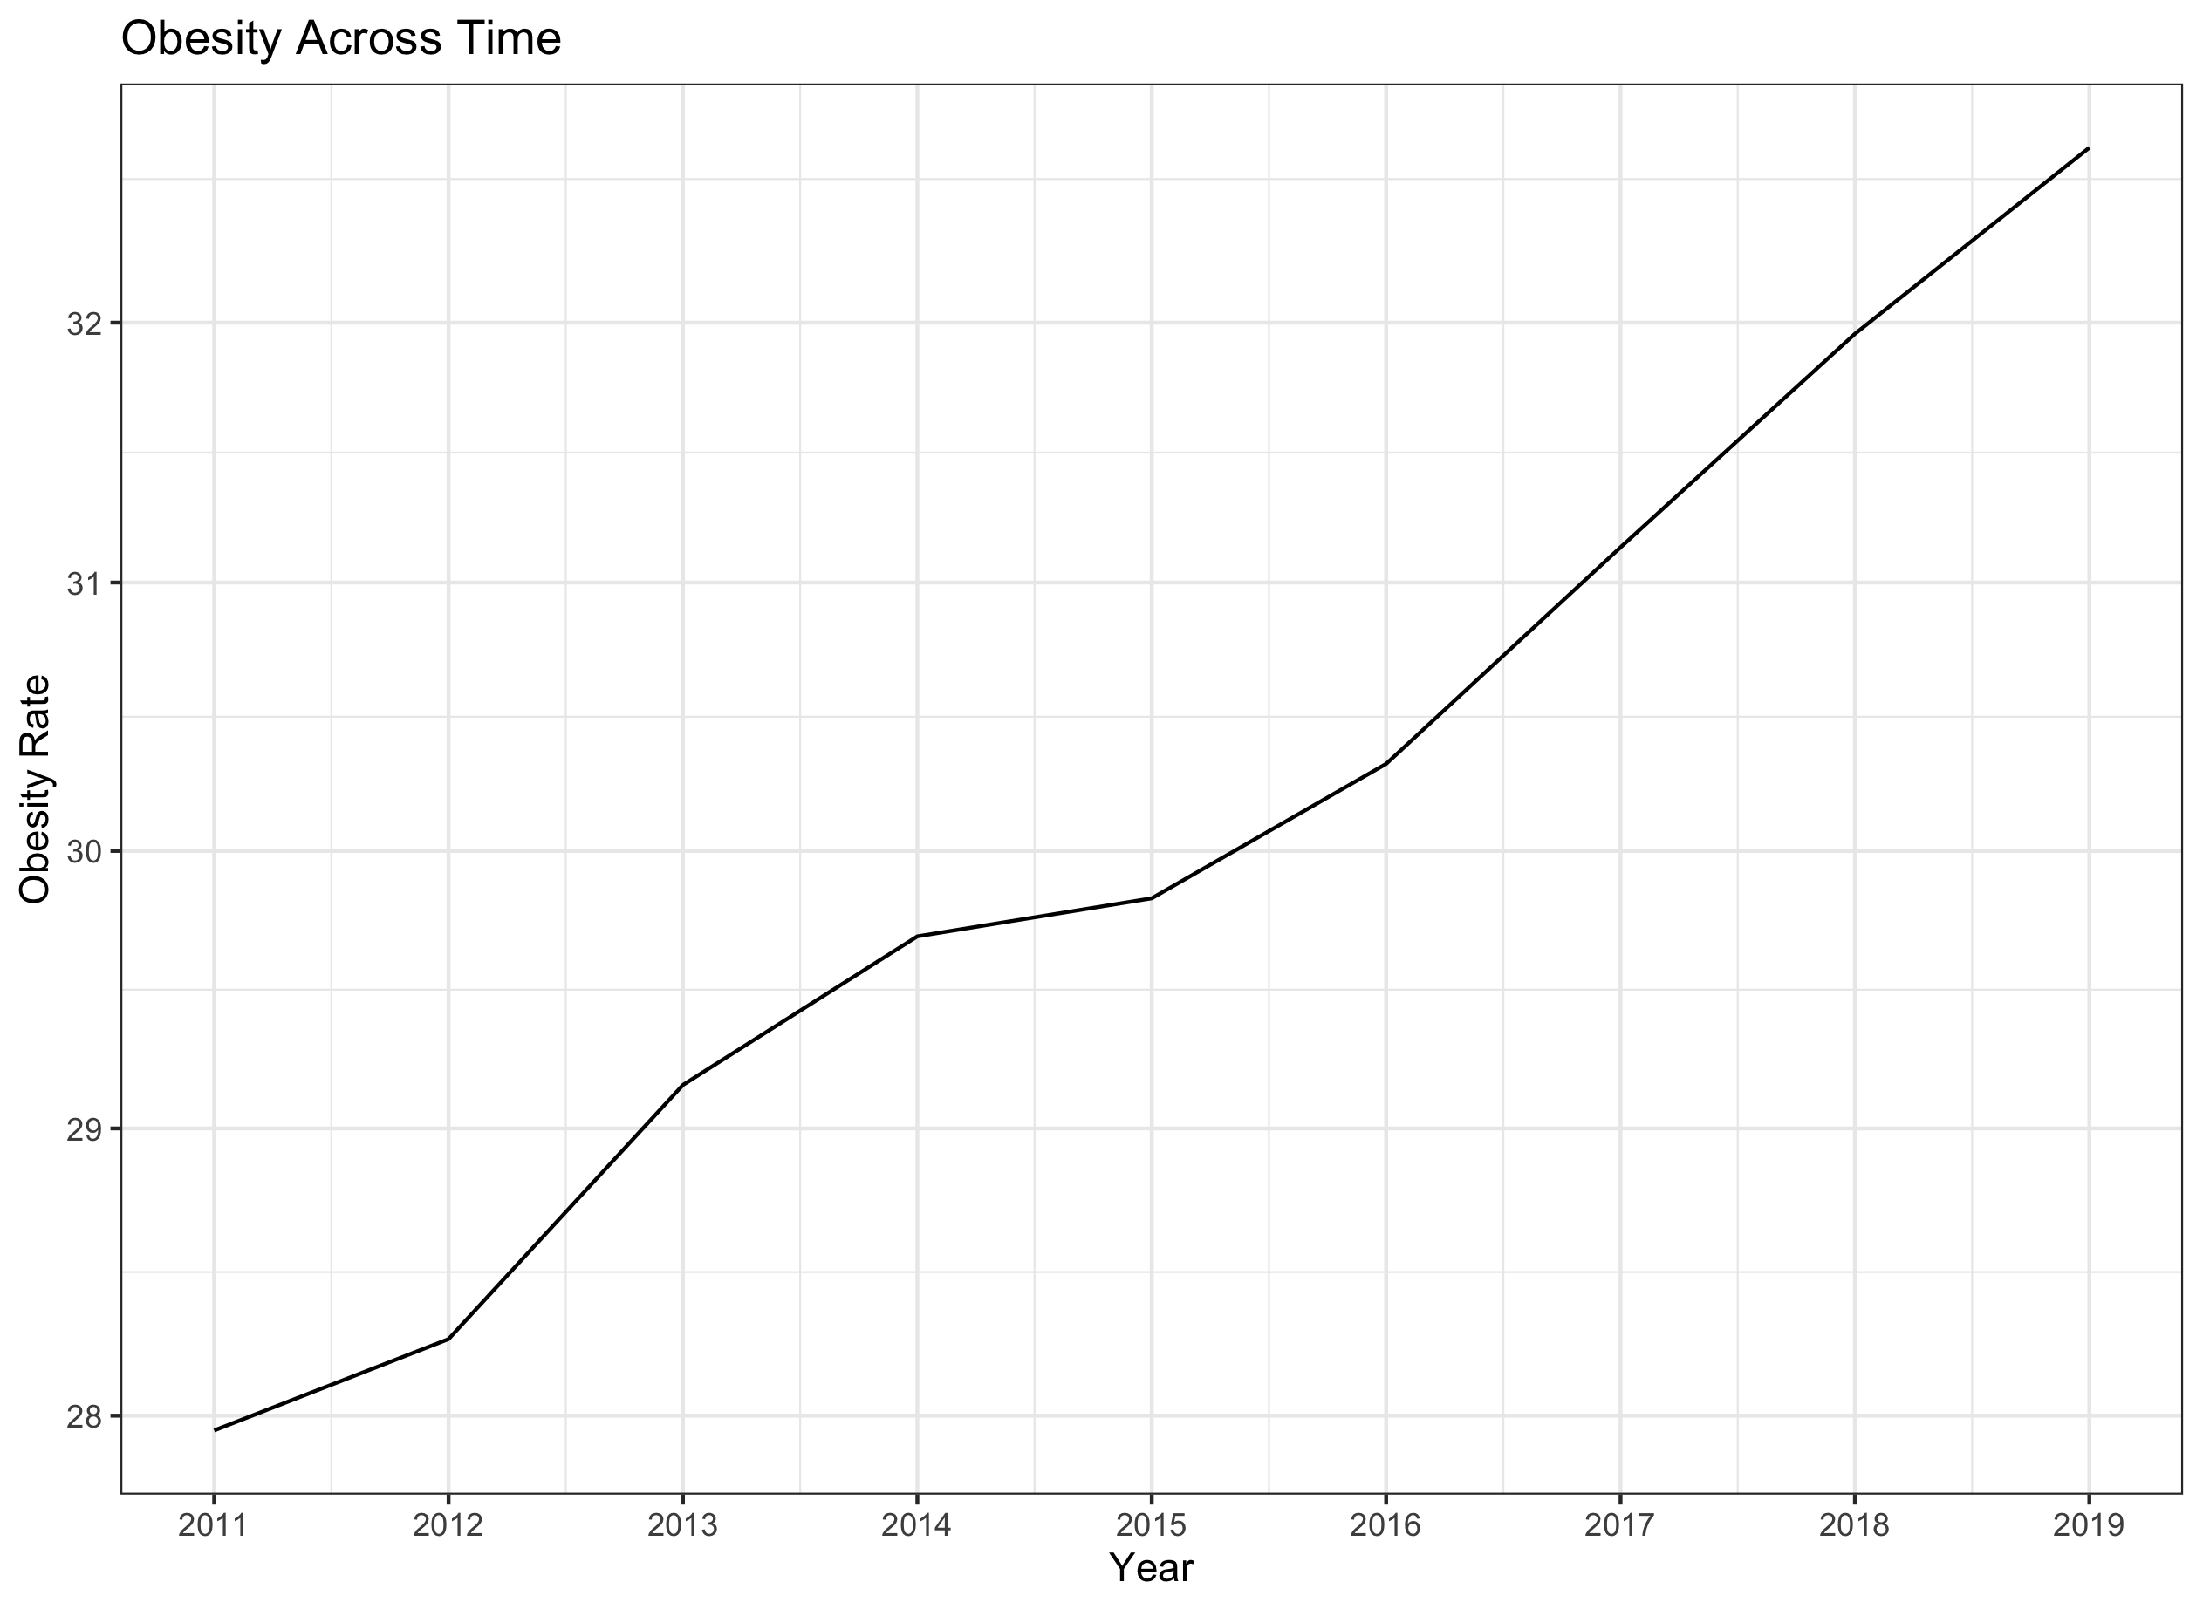

Slide 6
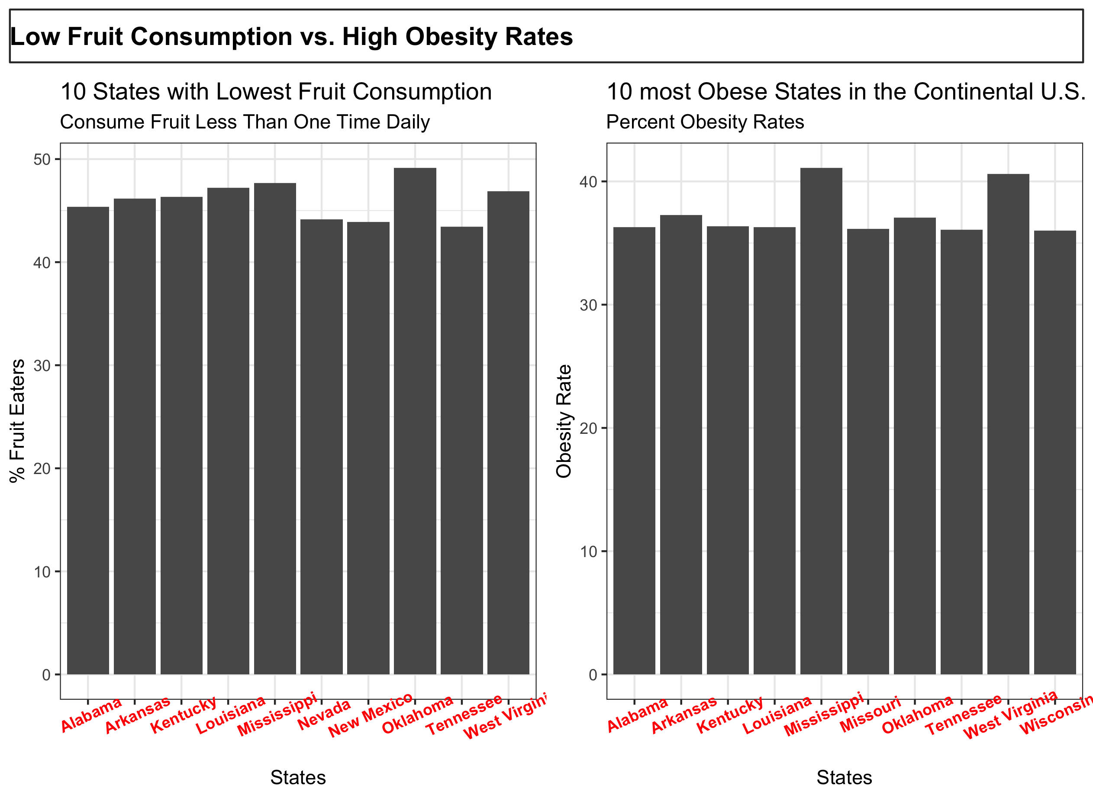

Slide 7
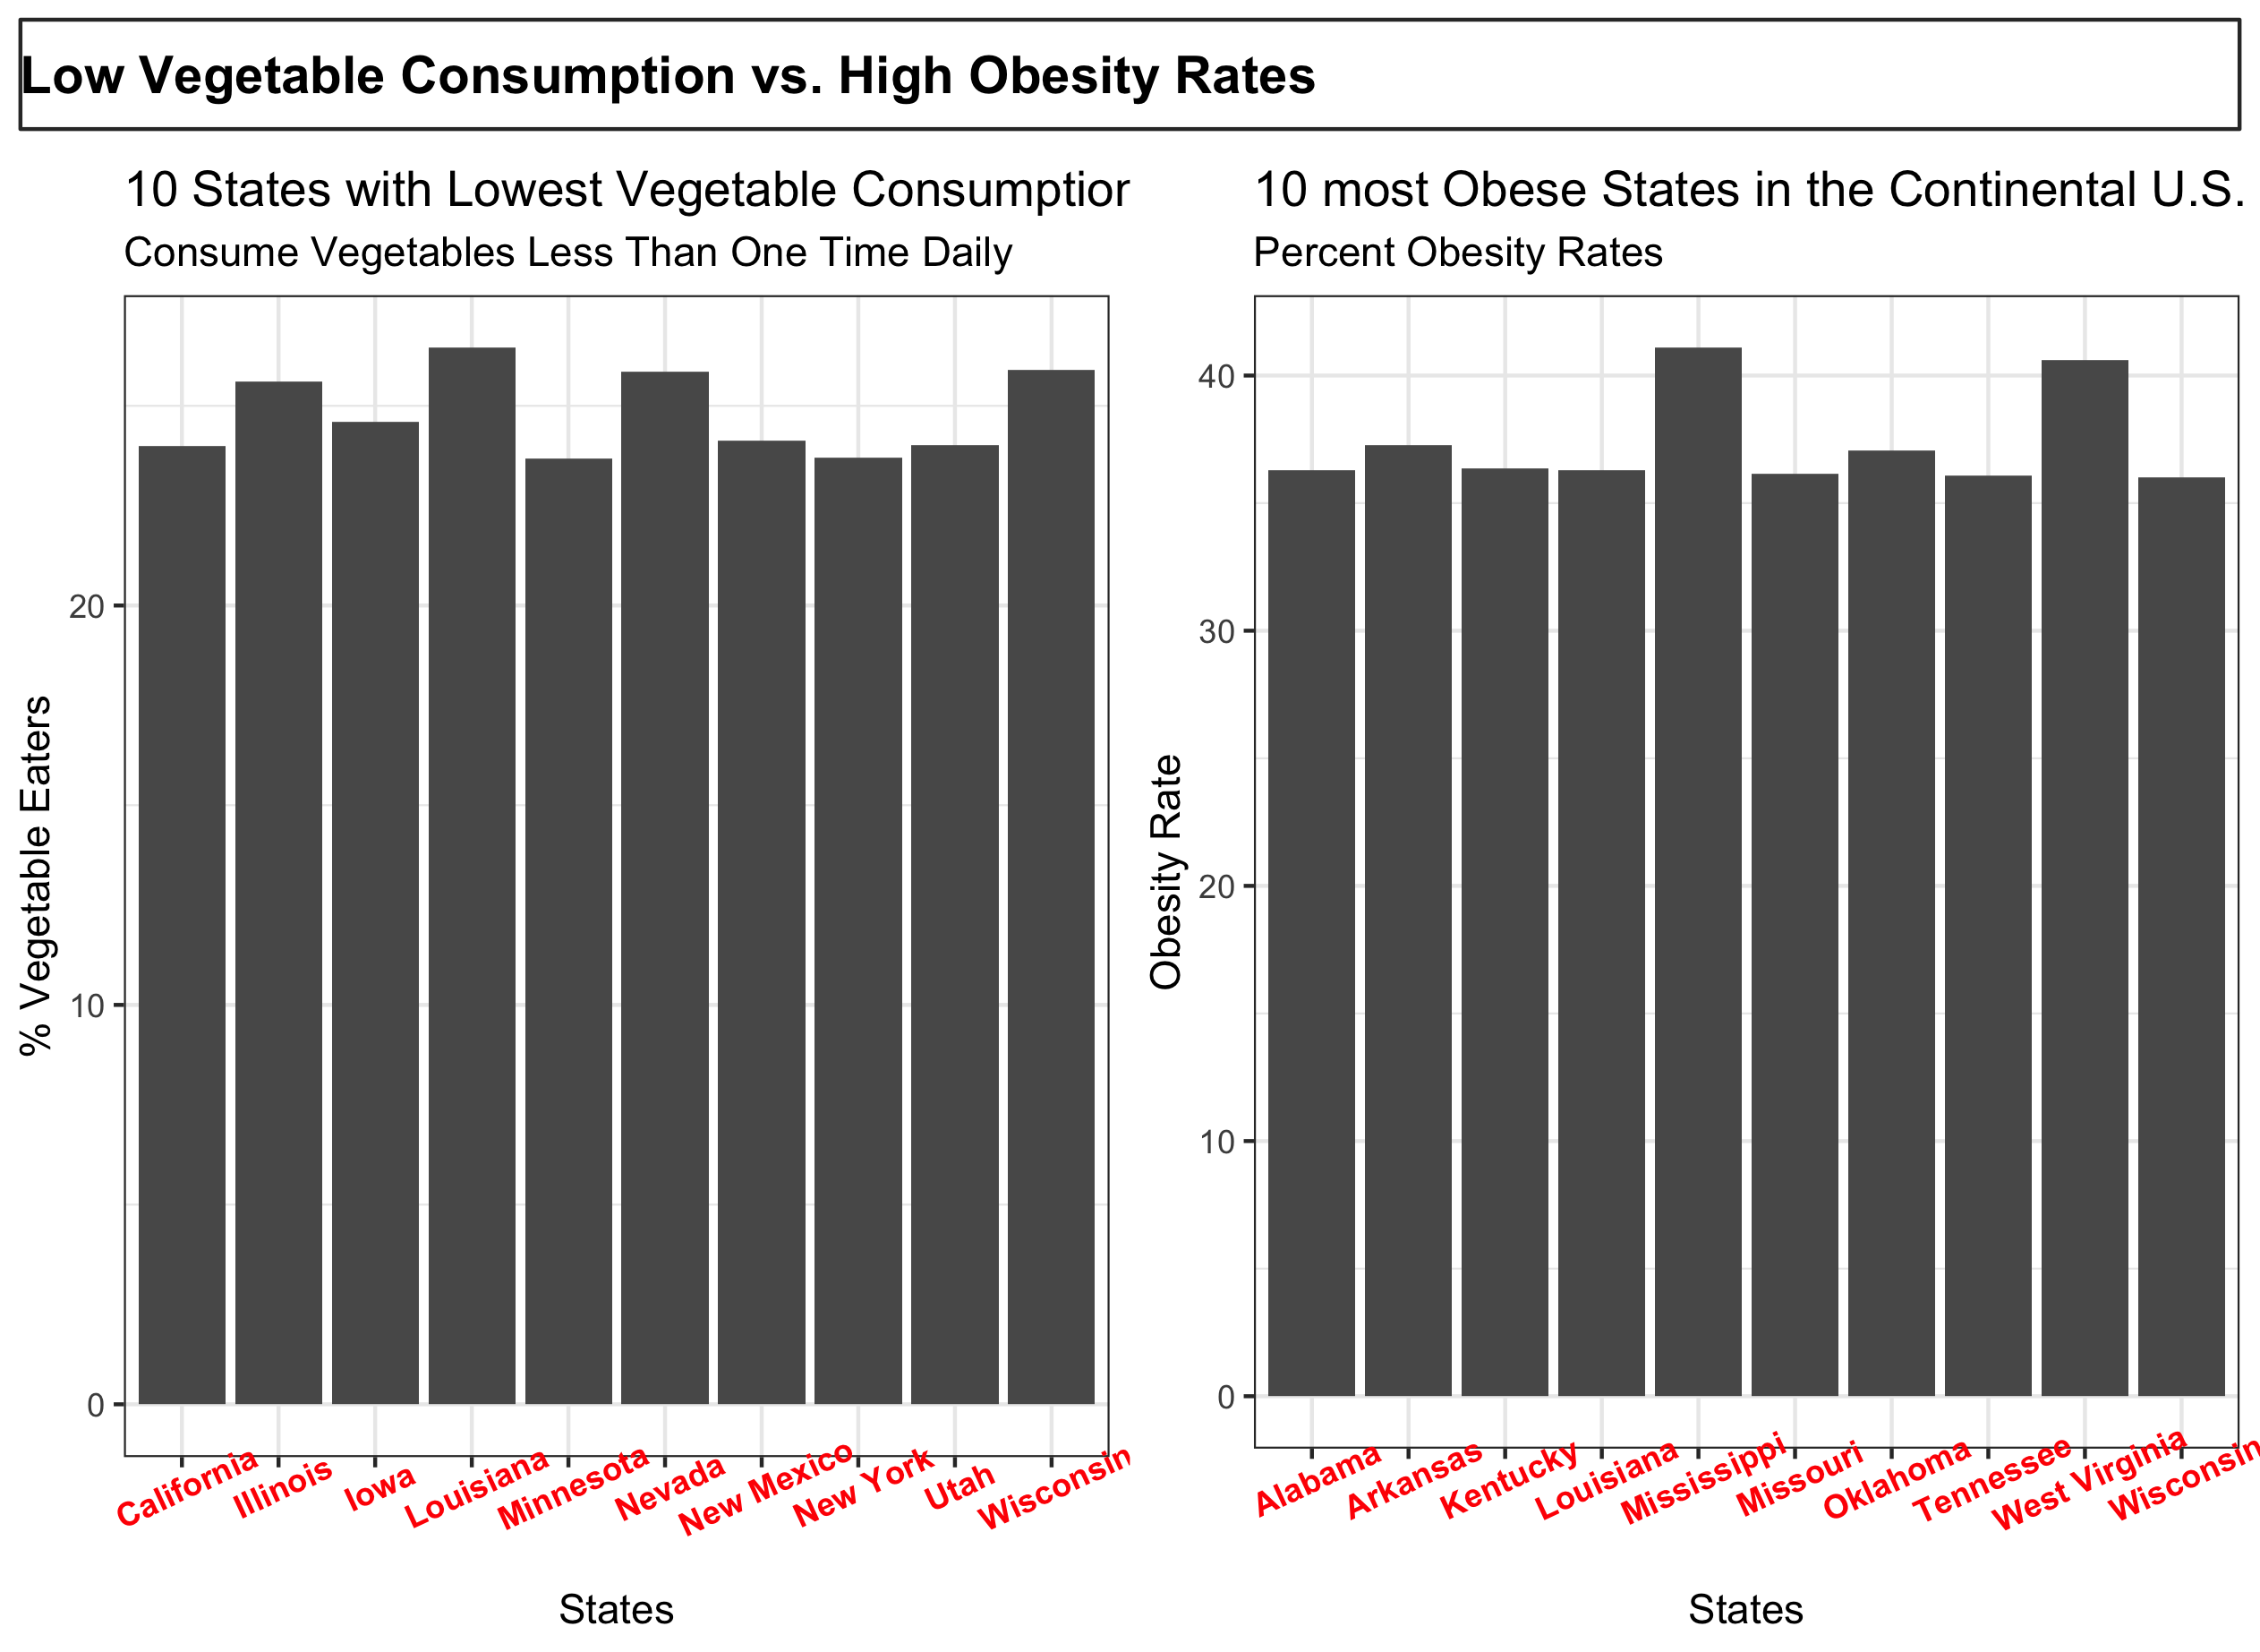

Slide 8
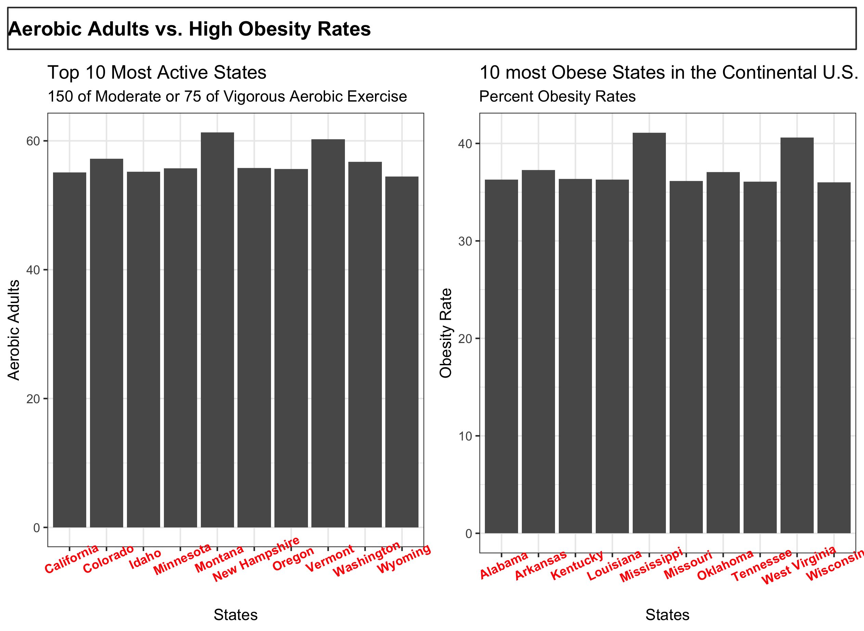

Slide 9
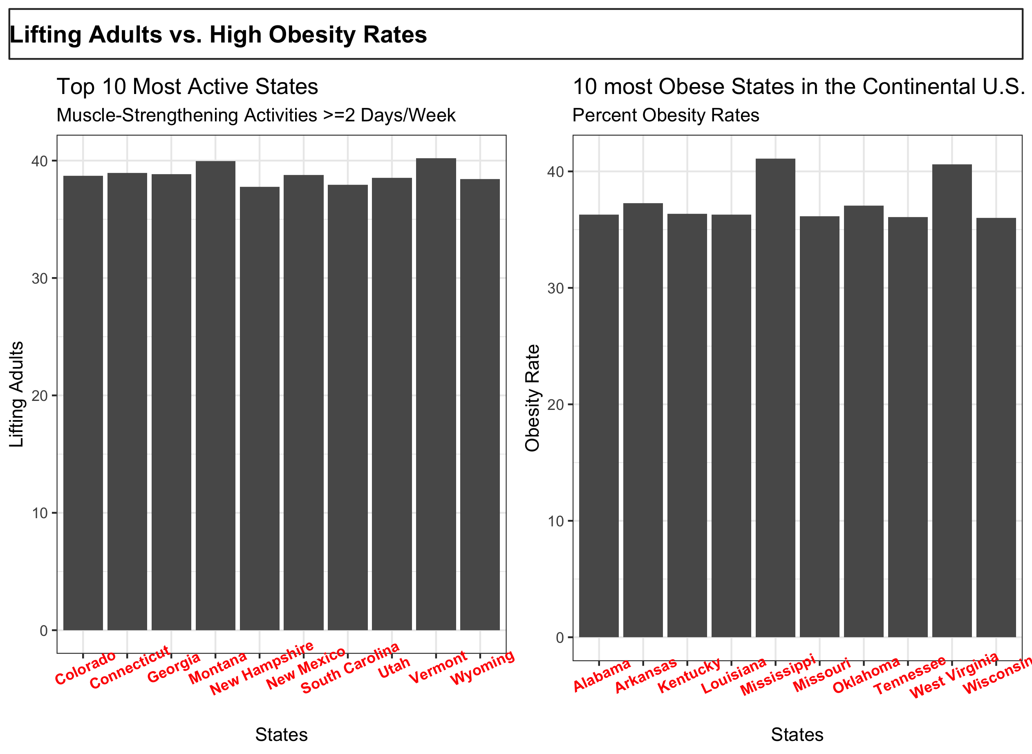

Slide 10
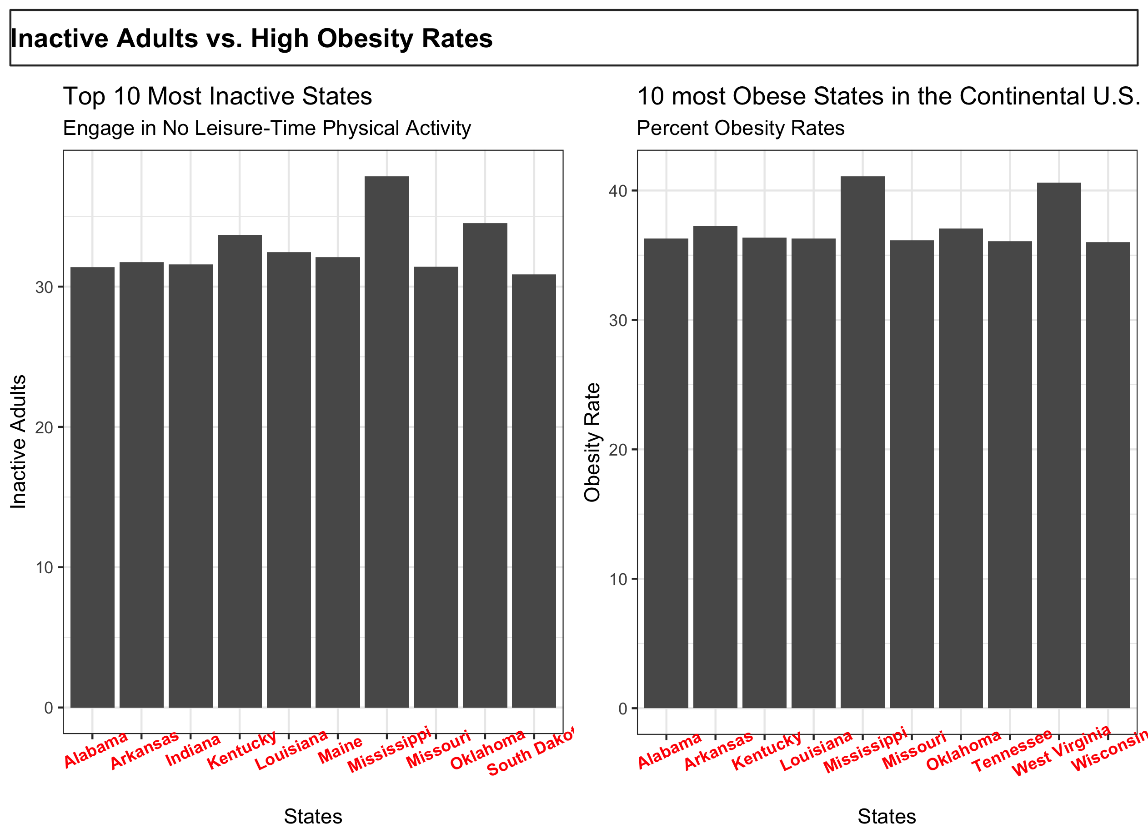

Slide 11
Solutions
Habits (Inc. Obesity):
Consume fruit/vegetables <once/day
Inactive lifestyles
Habits(Dec. Obesity):
Consume fruit/vegetables>=once/day
Increasing exercise: aerobic &/or lifting
Active Regions: The beaches/hiking areas

Slide 12
Deeper Questions?
Diseases prone to contract?
How does obesity affect mortality rate?
Life expectancy (obese vs. not)
Is there a race component?
How is your mental health affected?
Income correlation?

Slide 13
Conclusion

