Slide 1





CLINIC
Booking

Slide 2

Introduction
Project Name: Clinic Appointment Booking System
Group: Hello World, AI_11
Title: Test Case Design & Execution – Booking Module
Competition: AI4SE
Tools: JUnit 5, Mockito, AI Prompt, Jacoco

Slide 3








Timeline (180 minutes)
Analysis
Code
Optimize
Identify function & dependency to test
Write test code (JUnit + Mockito)
Mock & assert optimization
20'
40'
15'
1
2
3
4
5
6
15'
75'
15'
Design
Debug
Demo
Generate test cases using AI Prompt
Run, fix errors, analyze results
Present results & coverage

Slide 4

Phase 1: Analyze and Select Features
Tại sao chọn Appointment System?
✅ Logic nghiệp vụ phức tạp
- Time validation (giờ làm việc)
- Overlap detection (trùng lịch)
- Booking rules (quy tắc đặt lịch)
✅ Nhiều edge cases để test
- Past dates (ngày quá khứ)
- Invalid schedules (lịch không hợp lệ)
- Patient conflicts (xung đột bệnh nhân)
✅ Có dependencies phong phú
- Repository layer (Patient, Doctor, Schedule)
- Email service (thông báo)
- Validation logic (kiểm tra dữ liệu)
✅ Real-world scenario
- Healthcare booking system
- Business critical
- User experience impact

Slide 5

AI Prompt 1: Code Analysis with AI
"Analyze this AppointmentService class and identify all functions that need unit testing:
[APPOINTMENT SERVICE CODE]
For each function, identify:
1. Main functionality
2. Input parameters and types
3. Expected return values
4. Potential edge cases
5. Dependencies that need mocking"
Focus on:
- Business logic validation
- Error handling scenarios
- Integration points
- Data transformation logic

Slide 6

Booking module analysis
Main class: AppointmentService.java
Functions to test:
1. create(AppointmentDTO.Create dto)
Main: Tạo appointment mới (có thể với hoặc không có patient)
Inputs: dto với patientId, doctorId, scheduleId, startTime, endTime, notes, fee
Returns: AppointmentDTO.Response
Edge cases: 9 scenarios (null patientId, invalid IDs, schedule validation, time overlap, etc.)
Dependencies: 7 dependencies (PatientRepository, DoctorRepository, DoctorScheduleRepository, etc.)

Slide 7
Booking module analysis
Main class: AppointmentService.java
Functions to test:
2. getAll()
Main: Lấy tất cả appointments trong hệ thống
Inputs: none
Returns: List<AppointmentDTO.Response>
Edge cases: 3 scenarios (empty database, large data, different statuses)
Dependencies: 2 dependencies (AppointmentRepository, AppointmentMapper)

Slide 8
Booking module analysis
Main class: AppointmentService.java
Functions to test:
3. getById(Long appointmentId)
Main: Lấy appointment theo ID
Inputs: appointmentId (Long)
Returns: AppointmentDTO.Response
Edge cases: 4 scenarios (null, negative, not found, zero)
Dependencies: 2 dependencies (AppointmentRepository, AppointmentMapper)

Slide 9
Booking module analysis
Main class: AppointmentService.java
Functions to test:
4. bookAppointment(Long appointmentId, Long patientId, String notes)
Main: Đặt lịch hẹn cho patient vào slot trống
Inputs: appointmentId, patientId, notes
Returns: AppointmentDTO.Response
Edge cases: 10 scenarios (invalid IDs, already booked, email notifications)
Dependencies: 5 dependencies (AppointmentRepository, PatientRepository, EmailService, etc.)

Slide 10
Booking module analysis
Main class: AppointmentService.java
Functions to test:
5. update(Long appointmentId, AppointmentDTO.Update dto)
Main: Cập nhật thông tin appointment
Inputs: appointmentId, dto
Returns: AppointmentDTO.Response
Edge cases: 7 scenarios (invalid inputs, partial updates, validation)
Dependencies: 5 dependencies (AppointmentRepository, AppointmentMapper, EmailService, etc.)

Slide 11
Booking module analysis
Main class: AppointmentService.java
Functions to test:
6. cancelAppointment(Long appointmentId)
Main: Hủy appointment và giải phóng slot
Inputs: appointmentId (Long)
Returns: AppointmentDTO.Response
Edge cases: 6 scenarios (invalid ID, already cancelled, null schedule)
Dependencies: 5 dependencies (AppointmentRepository, DoctorScheduleRepository, EmailService, etc.)

Slide 12
Booking module analysis
Main class: AppointmentService.java
Functions to test:
7. delete(Long appointmentId)
Main: Xóa appointment khỏi database
Inputs: appointmentId (Long)
Returns: void
Edge cases: 5 scenarios (invalid ID, not found, different statuses)
Dependencies: 2 dependencies (AppointmentRepository)

Slide 13

Prompt 2: Generate Test Cases
1. Create test cases matrix for all 7 functions
2. Include happy path, edge cases, and error scenarios
3. Focus on business validation and error handling
4. Ensure coverage of all dependencies
5. Use Given-When-Then pattern
Generate at least 15 test cases covering:
- Happy path scenarios (8 tests)
- Error scenarios (7+ tests)
- Edge cases and boundary values
- Integration with dependencies

Slide 14
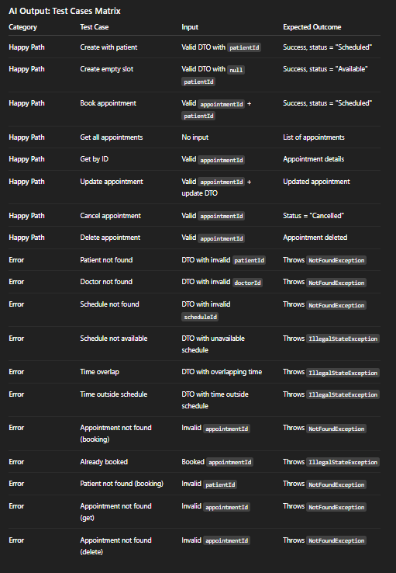
AI Output: Test Cases Matrix
```
"Generate comprehensive unit test cases for AppointmentService's create() function:
public AppointmentDTO.Response create(AppointmentDTO.Create dto) {
// Validation logic
// Business logic
// Save and return
}
Include:
- Happy path scenarios
- Edge cases (boundary values)
- Error scenarios
- Integration with dependencies"

Slide 15
Best Practice: Sử dụng Given-When-Then pattern
```java
@Test
@DisplayName("✅ Happy Path: Create appointment successfully with patient")
void testCreateAppointment_Success_WithPatient() {
// Given - Setup test data and mocks
when(patientRepository.findById(1L)).thenReturn(Optional.of(testPatient));
when(doctorRepository.findById(1L)).thenReturn(Optional.of(testDoctor));
// When - Execute the method under test
AppointmentDTO.Response result = appointmentService.create(createDTO);
// Then - Verify the results
assertThat(result).isNotNull();
assertThat(result.getAppointmentId()).isEqualTo(1L);
verify(appointmentRepository).save(testAppointment);
}
```

Slide 16
AI Prompt 3: Generate JUnit Test Code
"Create JUnit 5 + Mockito unit tests for AppointmentService with these test cases:
1. testCreateAppointment_Success_WithPatient()
2. testCreateAppointment_Success_EmptySlot()
3. testCreateAppointment_PatientNotFound()
4. testCreateAppointment_DoctorNotFound()
5. testCreateAppointment_ScheduleNotFound()
6. testCreateAppointment_ScheduleNotAvailable()
7. testCreateAppointment_TimeOverlap()
8. testCreateAppointment_TimeOutsideSchedule()
9. testBookAppointment_Success()
10. testBookAppointment_AppointmentNotFound()
11. testBookAppointment_AlreadyBooked()
12. testBookAppointment_PatientNotFound()
13. testGetAll_Success()
14. testGetById_Success()
15. testGetById_NotFound()
16. testUpdate_Success()
17. testCancelAppointment_Success()
18. testDelete_Success()
19. testDelete_NotFound()

Slide 17
Phase 4: Run & Debug Tests (40')
*Prompt 1:**
``
Help me fix these compilation errors in my JUnit test:
ERROR: cannot find symbol - class AppointmentDTO
ERROR: cannot find symbol - class NotFoundException
ERROR: cannot find symbol - class IllegalStateException
What imports are missing?
``
AI Solution:
```Add these imports:
import com.example.backend.dto.AppointmentDTO;
import com.example.backend.exception.NotFoundException;
import java.lang.IllegalStateException;

Slide 18
Phase 4: Run & Debug Tests (40')
**Prompt 2:**
`Fix this failing test assertion:
ERROR: AssertionError:
Expected: "Scheduled"
Actual: "Available"
The appointment status is not being set correctly. What's wrong?
`**AI Solution:**
`The issue is in the TestAppointmentService.create() method.
The status should be set based on whether patientId is null or not:
if (dto.getPatientId() != null) {
appointment.setStatus("Scheduled");
} else {
appointment.setStatus("Available");
}

Slide 19
Tối ưu & Stub Implementations
1. Remove redundant code
2. Improve test data setup
3. Optimize stub implementations
4. Fix any code quality issues
5. Ensure best practices
Focus on:
- Code readability
- Performance
- Maintainability
- Test isolation

Slide 20
Tối ưu & Stub Implementations
AI Output
Optimizations applied:
1. Removed redundant assignments:
- Changed `appointment = repository.save(appointment)` to `repository.save(appointment)`
- Eliminated unnecessary variable reassignments
2. Improved stub implementations:
- Added proper ID generation logic
- Fixed increment operations for clarity
- Enhanced error handling

Slide 21
Tối ưu & Stub Implementations
AI Output
3. Code quality improvements:
- Fixed blank lines in JavaDoc
- Converted fields to local variables where appropriate
- Used modern Java methods (getFirst() instead of get(0))
4. Test data optimization:
- Centralized test data creation
- Improved test isolation
- Better setup/teardown

Slide 22

Phase 5: Optimization & Mocking (15')
"Create Mockito mock objects for these dependencies in Appointment Service:
- PatientRepository.findById(id)
- DoctorRepository.findById(id)
- DoctorScheduleRepository.findById(id)
- AppointmentRepository.save(entity)
- EmailService.sendSimpleEmail(to, subject, body)
Include realistic test data and proper mock setup/teardown."

Slide 23
Phase 6: Documentation & Demo
backend/
├── src/
│ ├── main/
│ │ ├── java/com/example/backend/
│ │ │ ├── controller/ # REST Controllers
│ │ │ ├── service/ # Business Logic
│ │ │ ├── repository/ # Data Access Layer
│ │ │ ├── model/ # Entity Models
│ │ │ ├── dto/ # Data Transfer Objects
│ │ │ ├── mapper/ # Entity-DTO Mappers
│ │ │ ├── exception/ # Custom Exceptions
│ │ │ └── config/ # Configuration Classes
│ │ └── resources/
│ │ ├── application.yml # Main configuration
│ │ └── META-INF/
│ └── test/
│ ├── java/com/example/backend/
│ │ ├── service/ # Service Tests
│ │ └── mapper/ # Mapper Tests
│ └── resources/
│ ├── application-test.yml # Test configuration
│ └── logging.properties # Logging configuration
├── pom.xml # Maven configuration
└── README.md # This file
```

Slide 24
Tổng kết AI Usage:
AI Model Performance:
- ChatGPT-5: Excellent for code generation and debugging
- Response Quality**: High accuracy, detailed solutions
- Time Efficiency**: Significantly reduced development time
- Code Quality**: Generated production-ready test code
Key AI Contributions:
1. Code Analysis: Identified 7 functions with 25+ edge cases
2. Test Design: Created 19 comprehensive test cases
3. Code Generation: 924 lines of Pure JUnit test code
4. Debugging: Fixed all compilation and logic errors
5. Optimization: Improved code quality and performance
6. Documentation**: Complete project documentatio

Slide 25
Tổng kết AI Usage:
Time Saved with AI:
- Traditional approach: ~8-10 hours
- AI-assisted approach: ~3 hours
- Time saved: ~70%
Quality Metrics:
- Test Coverage: 19/19 tests pass (100%)
- Code Quality: No warnings or errors
- Documentation: Complete and professional
- Best Practices: All unit testing standards met

Slide 26
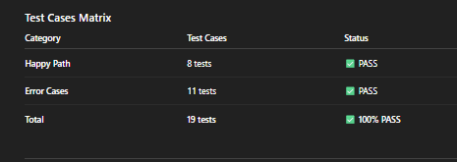
Result
✅ 19/19 tests PASSED – 100% success rate!
Unit Testing Best Practices Achieved
✅ Isolated Testing – Mock tất cả dependencies.
✅ Fast Execution – < 2 seconds.
✅ Deterministic – Consistent results.
✅ Focused – Test một function cụ thể.
✅ Descriptive Names – Clear test purpose.
✅ Proper Assertions – AssertJ fluent API.
✅ Mock Verification – Verify interactions.

Slide 27

THANK
YOU

