Slide 1
Collaboration discussion
02.11.2026

Slide 2
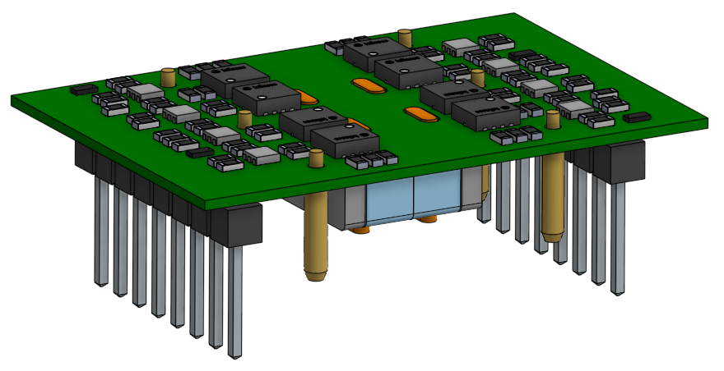
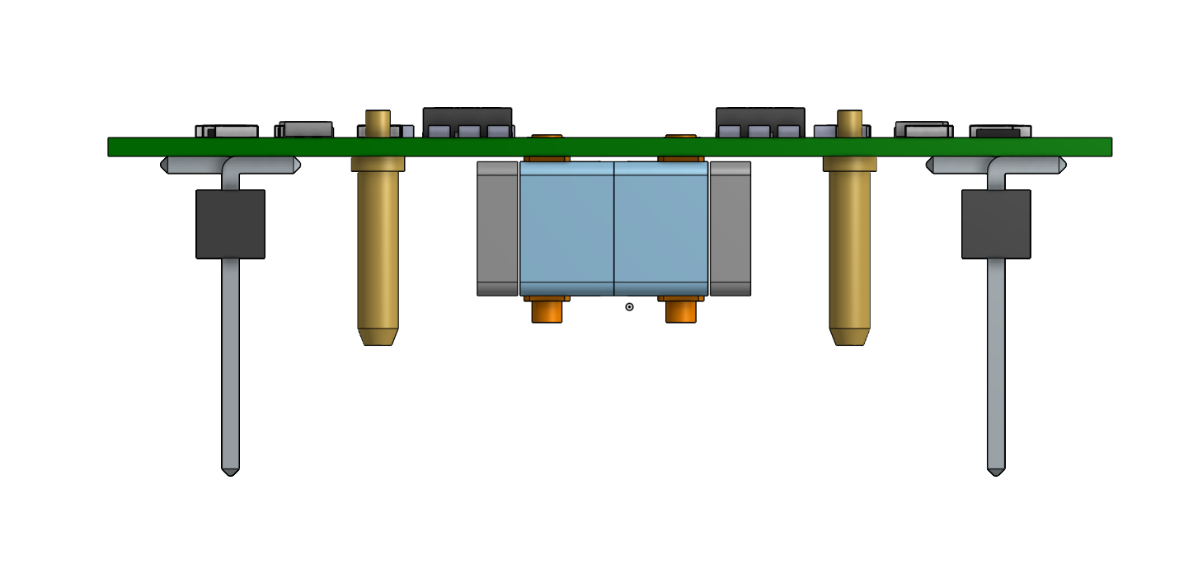
Power converter module
Interconnects
Core shape

Slide 3
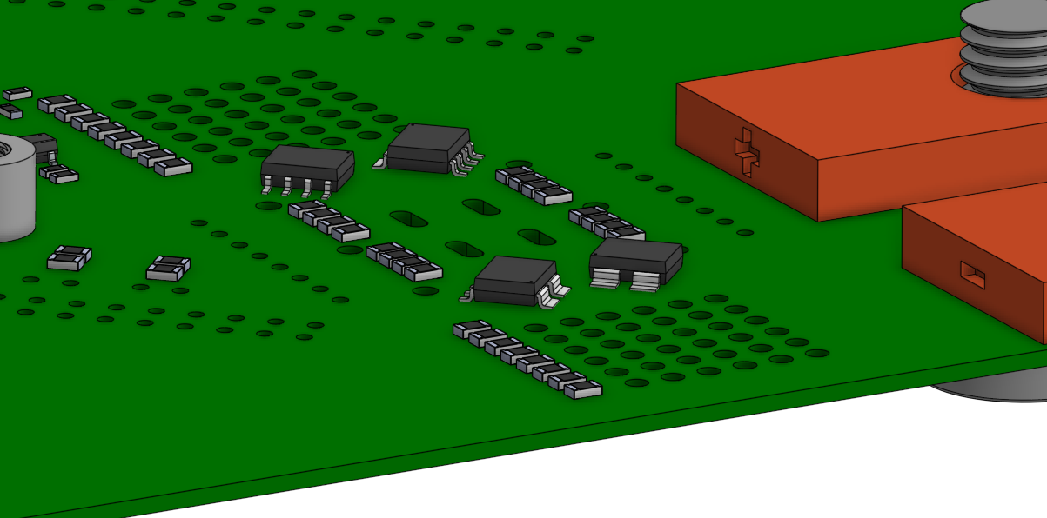

Slide 4
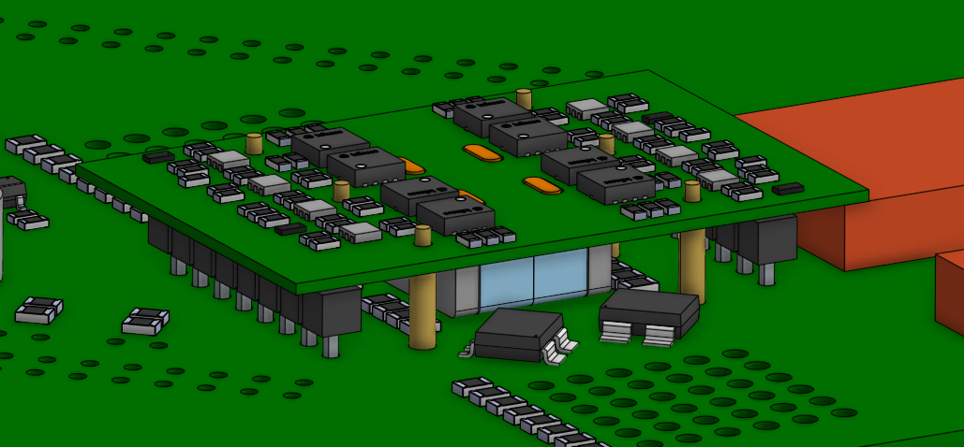

Slide 5
Electrical insulator to 3d print
keep things together
thermal conductor:
kerafol inspiration
Interconnects to 3d print
Simple pcb,
top side for components
bottom side to interface with copper 3d connectors
Core shape to 3d print

Slide 6
Cross-section view

Slide 7
Prerequisites
Tested FGF printing process
Magnetic pellets
Conductive material
Thermally conductive, electrically isolating material
Material properties

Slide 8
Backups

