Slide 1
Towards Multi-Permeability Cores Through
Composition-Controlled Pellet Extrusion
Student Seminar

Slide 2

Agenda
Who am I?
Introduction to additive manufacturing (AM)
Constant flux inductor (CFI)
Multi-permeability magnetic cores
Current field of 3D printing magnetics
Outlined research direction
Research questions

Slide 3

Who am I?
Artis Fils
Experience:
BSc in Mechatronics from University of Southern Denmark (SDU)
MSc in Mechatronics from University of Southern Denmark (SDU)
Additive Manufacturing student worker for 4.5 years
Interests:
Additive manufacturing
3D printed electronics
Hybrid manufacturing
Currently:
Research assistant focusing on 3D printing magnetics since 1st of October 2026.

Slide 4
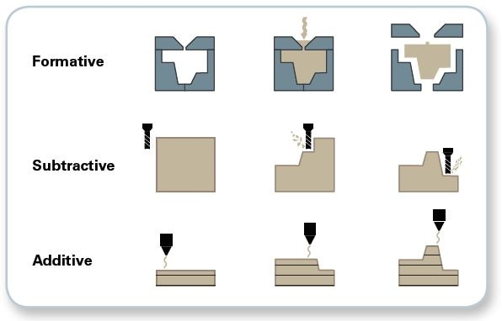
What is additive manufacturing?

Slide 5
3D printing vs additive manufacturing
Model
Slice
Print

Slide 6
Why additive manufacturing?
Advantages
Fast design iterations
Complex geometries
Multi material capabilities
Disadvantages
Slow manufacturing
Resolution & surface finish
Feedstock limitations

Slide 7
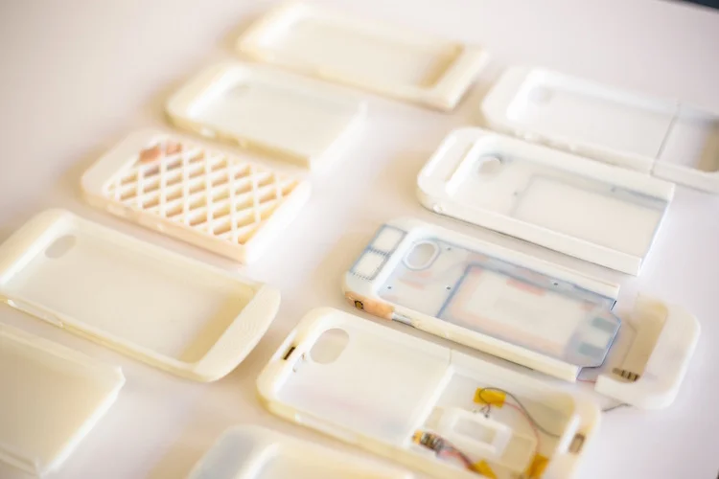
Advantage – Fast Design iterations

Slide 8
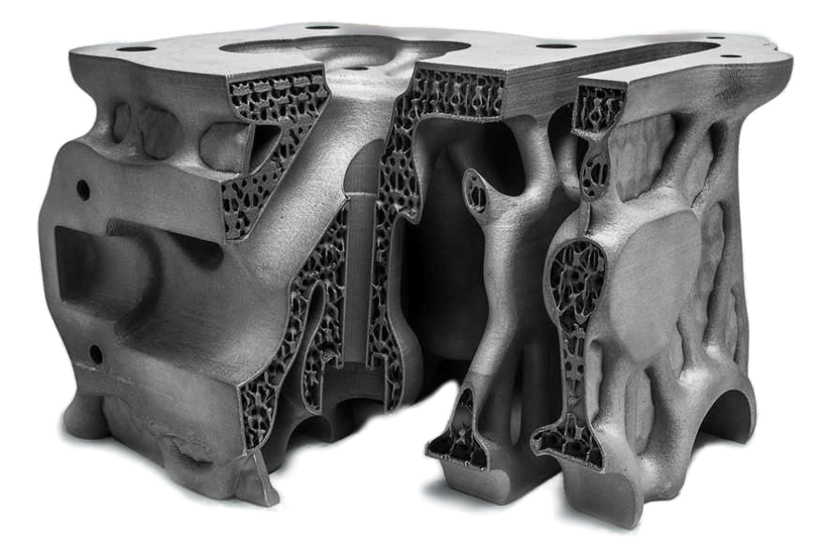
Advantage – Complex geometries

Slide 9
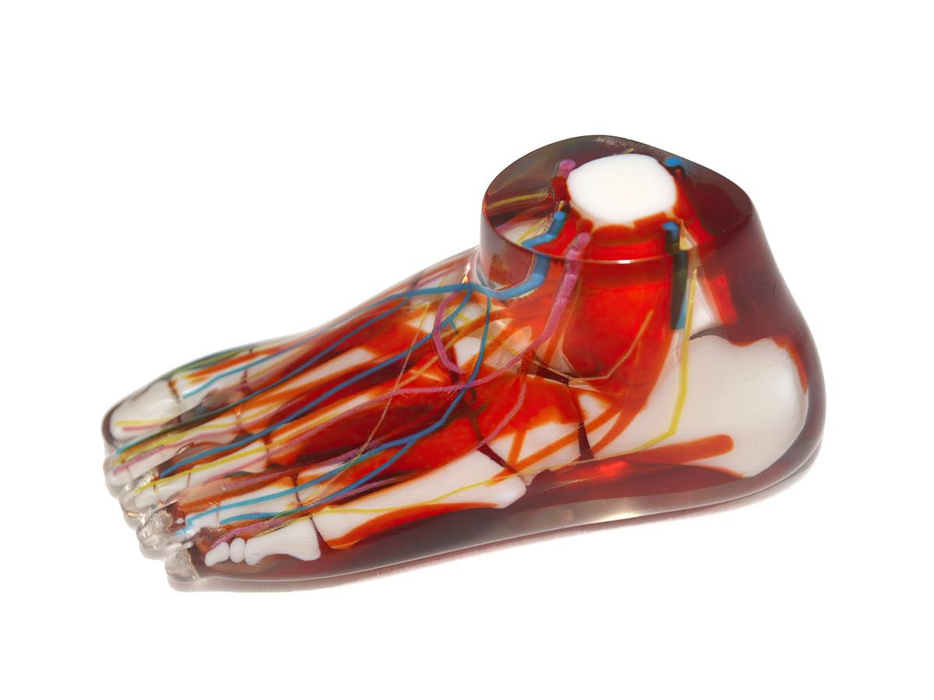
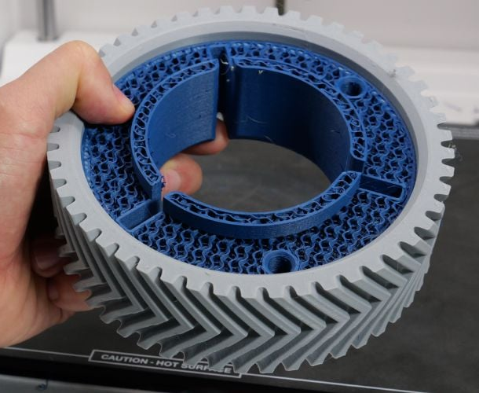
Advantages – Multi-material capabilities

Slide 10
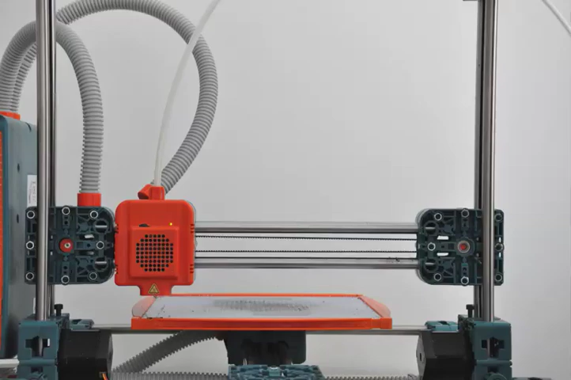
Disadvantage – Slow manufacturing

Slide 11
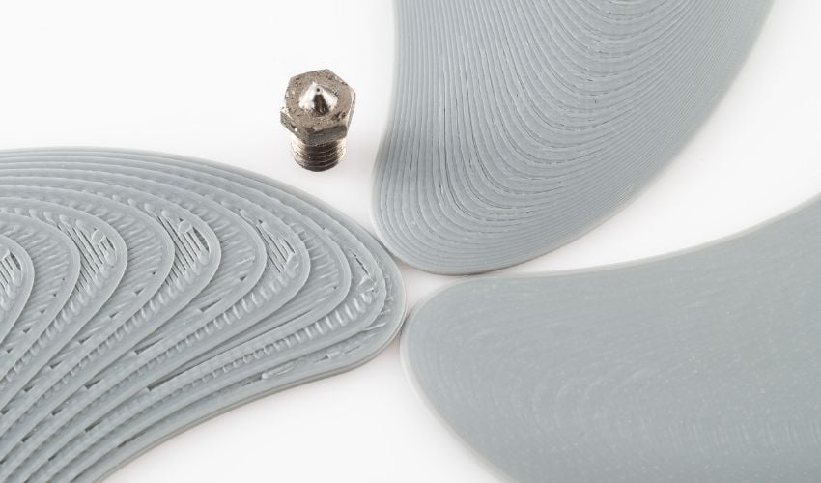
Disadvantage – Resolution & surface finish

Slide 12
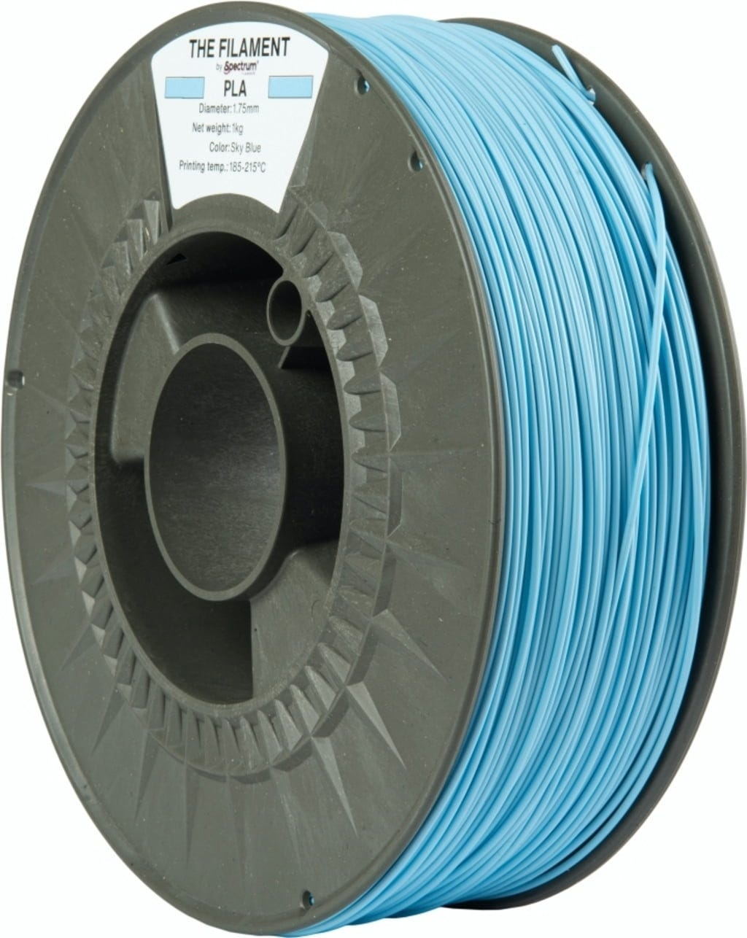
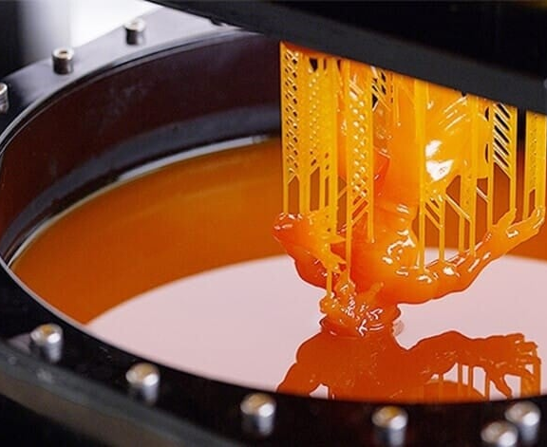
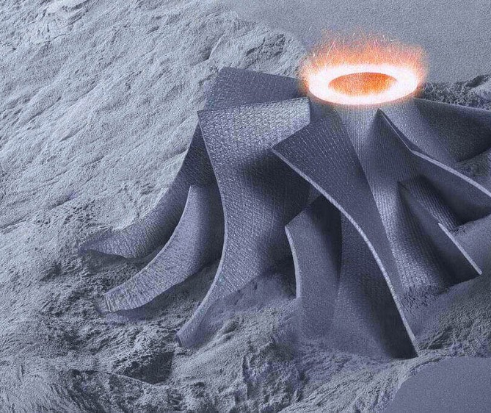
Disadvantage – Feedstock limitations

Slide 13
Most common methods of additive manufacturing

Slide 14
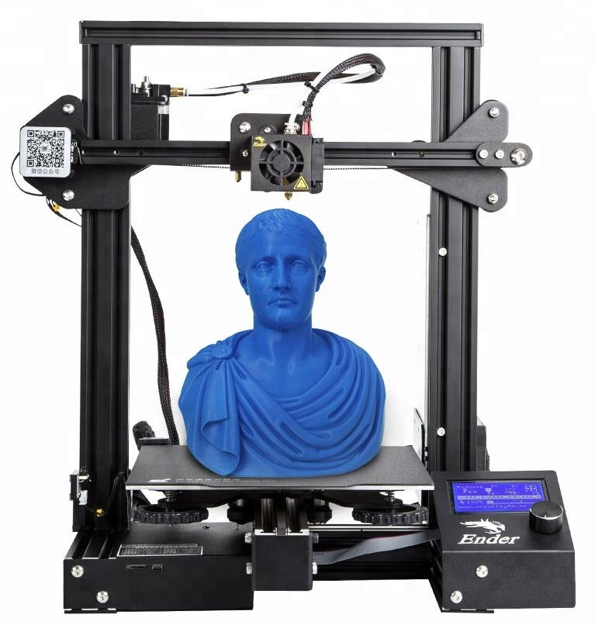
What is Fused Deposition Modeling (FDM)?

Slide 15
Constant-flux inductor (CFI)
A constant-flux inductor is an magnetic component designed to distribute magnetic flux uniformly across its core.

Slide 16
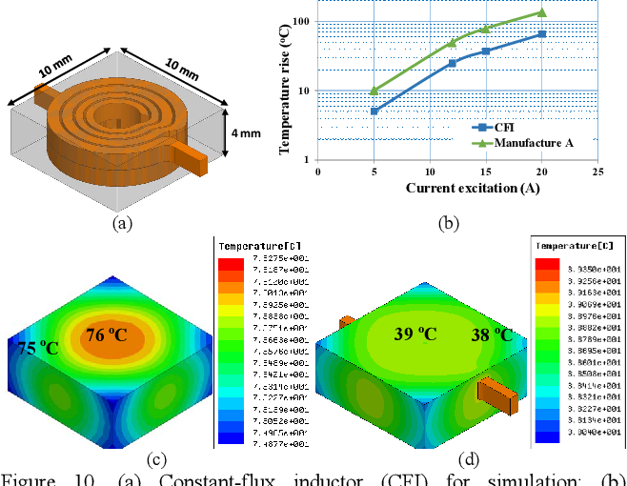
Constant-flux inductor (CFI)
A constant-flux inductor is an magnetic component designed to distribute magnetic flux uniformly across its core.
Benefits:
Prevents localized saturation
Distributes the temperature
Reduces the footprint

Slide 17
Constant-flux inductor (CFI)
A constant-flux inductor is an magnetic component designed to distribute magnetic flux uniformly across its core.
Benefits:
Prevents localized saturation
Distributes the temperature
Reduces the footprint
Tradeoff:
Manufacturing complexity
Cost
Physical tuning

Slide 18
Methods of designing a CFI
Specialized geometry
Multi-permeability

Slide 19
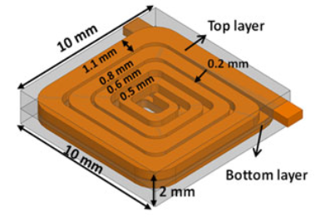
Methods of designing a CFI
Specialized geometry
Multi-permeability

Slide 20
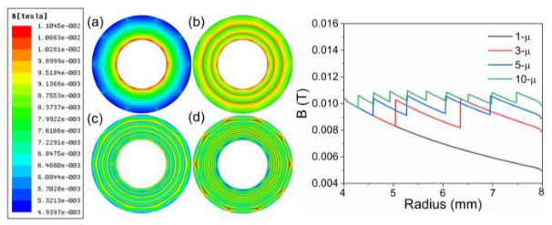
Methods of designing a CFI
Specialized geometry
Multi-permeability

Slide 21
Methods of designing a CFI
Specialized geometry
Multi-permeability
Geometry and permeability are not mutually exclusive design variables, and optimizing both may offer further benefits.
Custom and complex -> perfectly suited for AM.

Slide 22
Current field of 3D printing magnetics
3D printing magnetics
Vat polymerization
Powder bed fusion
Binder jetting
Material extrusion
Fused deposition modeling
Direct ink writing
Fused granulate fabrication

Slide 23
Current field of 3D printing magnetics
3D printing magnetics
Vat polymerization
Powder bed fusion
Binder jetting
Material extrusion
Fused deposition modeling
Direct ink writing
Fused granulate fabrication

Slide 24
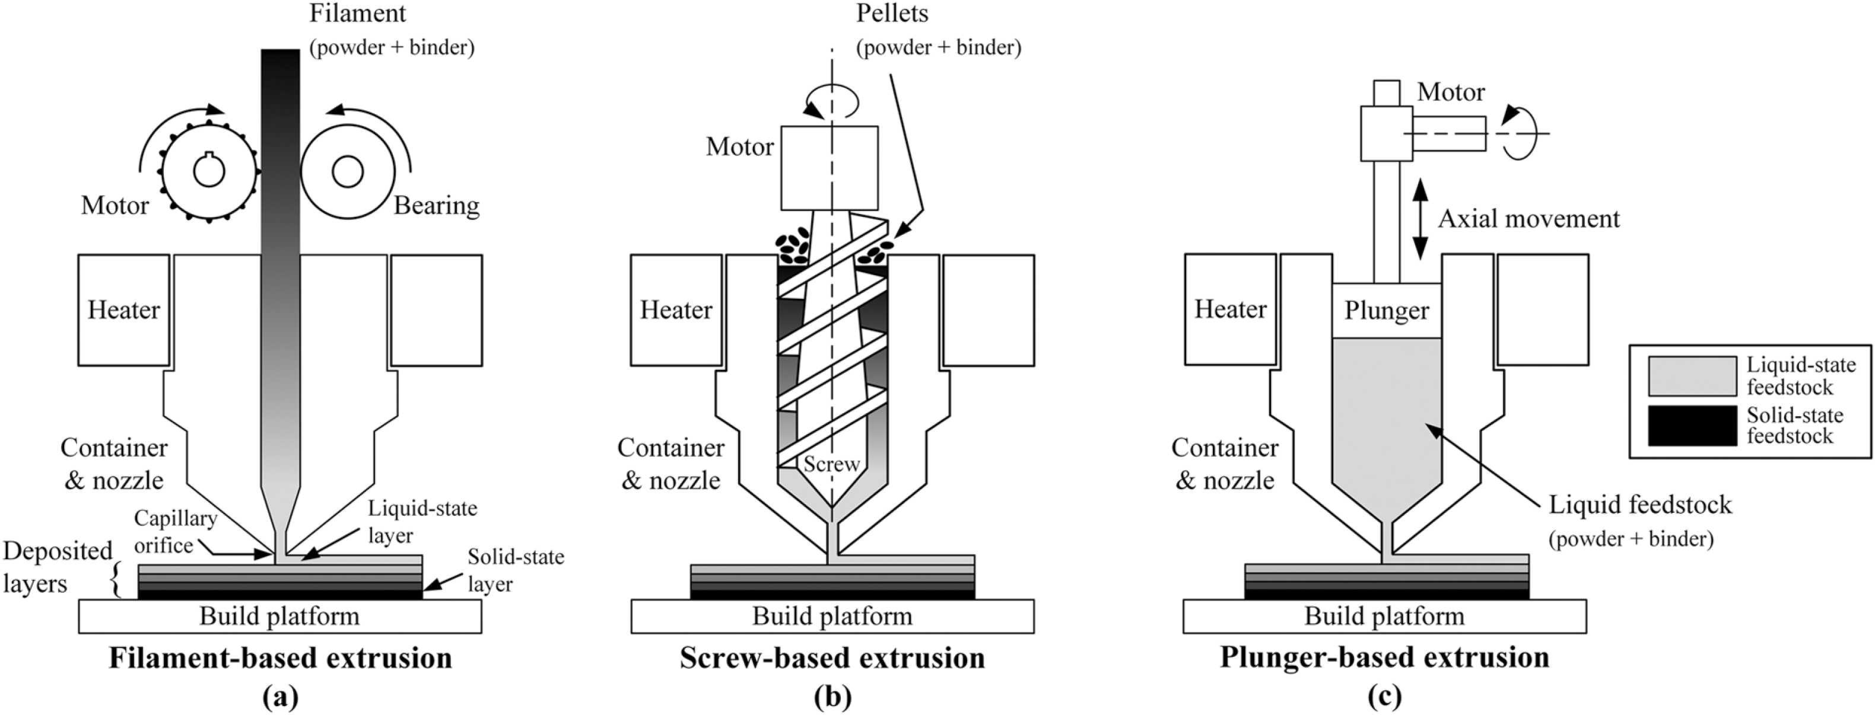
FDM vs FGF vs DIW
Fused Deposition Modeling (FDM)
Fused Granulate Fabrication (FGF)
Direct Ink Writing (DIW)

Slide 25
FDM vs FGF vs DIW
Fused Deposition Modeling (FDM)
Fused Granulate Fabrication (FGF)
Direct Ink Writing (DIW)
Process complexity
Low
High
Permeability

Slide 26
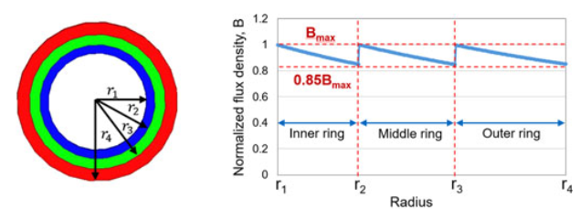
Research direction
Fused Granulate Fabrication (FGF)
Multi-permeability cores

Slide 27
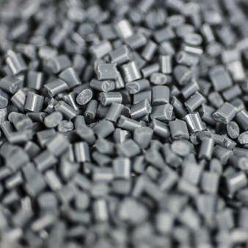
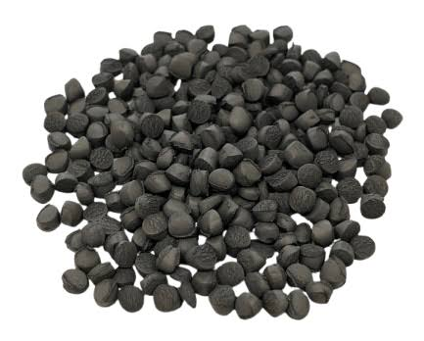
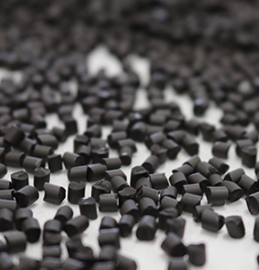
Multi-permeability via different materials
PA12 with x wt% FeSiAl (μ_{rx})
PA12 with y wt% FeSiAl (μ_{ry})
PA12 with z wt% FeSiAl (μ_{rz})

Slide 28
Multi-permeability via different materials
PA12 with x wt% FeSiAl (μ_{rx})
PA12 with y wt% FeSiAl (μ_{ry})
PA12 with z wt% FeSiAl (μ_{rz})

Slide 29
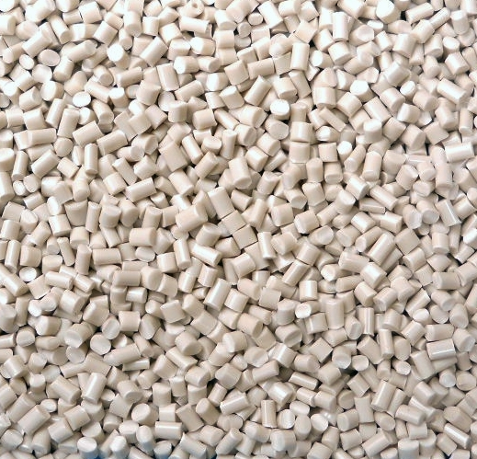
Multi-permeability via mixing different ratios
PA12
PA12 with 86 wt% FeSiAl (μ_{r_100:0})

Slide 30
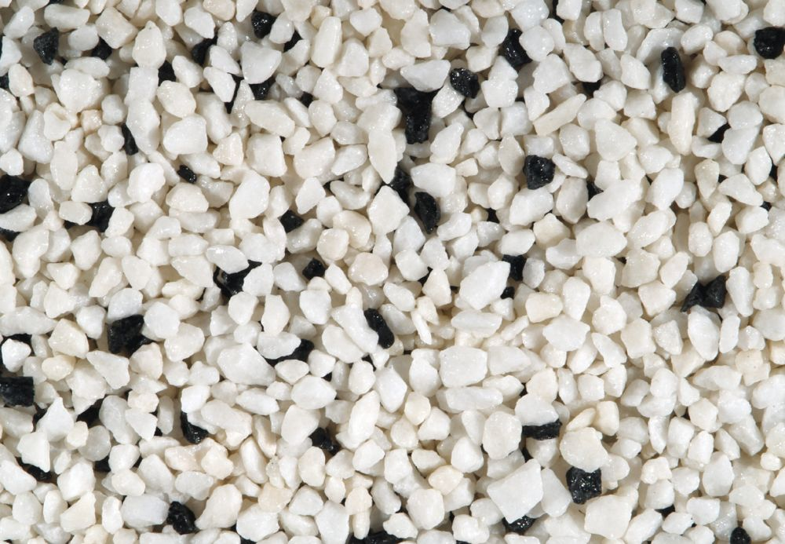
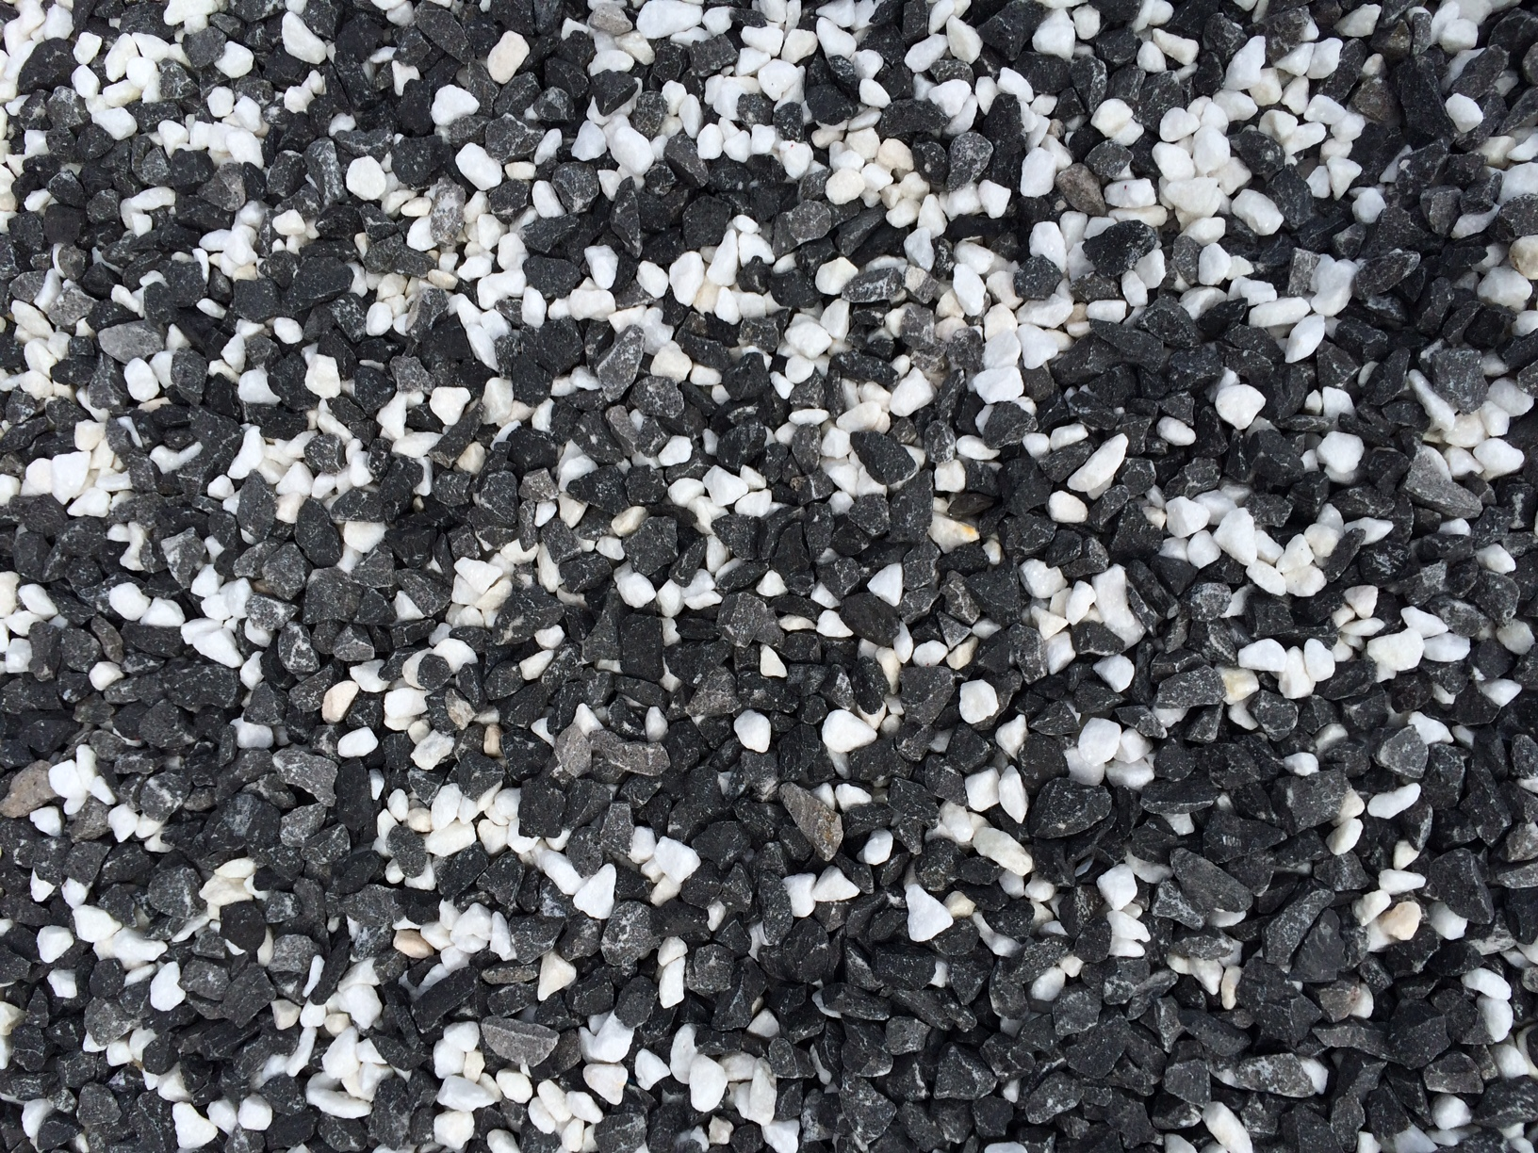
Multi-permeability via mixing different ratios
μ_{r_25:75}
PA12
PA12 with 86 wt% FeSiAl (μ_{r_100:0})
μ_{r_75:25}

Slide 31
Research questions
Can varying the blend ratio of magnetic-filled and unfilled polymer pellets produce reproducible changes in the permeability of a soft-magnetic composite manufactured using a commercial pellet extruder?
μ_{r_25:75_1} = μ_{r_25:75_2} ?
μ_{r_75:25_1} = μ_{r_75:25_2} ?

Slide 32
Research questions
Can varying the blend ratio of magnetic-filled and unfilled polymer pellets produce reproducible changes in the permeability of a soft-magnetic composite manufactured using a commercial pellet extruder?
Process
Filler amount
Filler uniformity
Permeability
Specimen
Correlation?

Slide 33
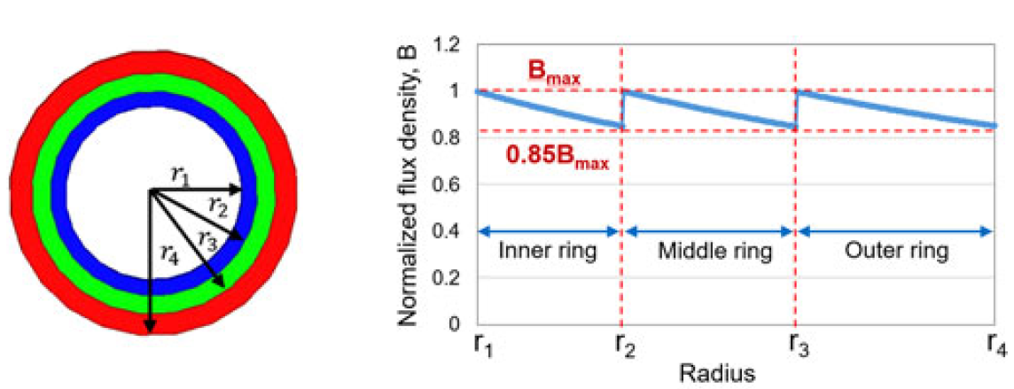
Research questions
Can discrete permeability regions be fabricated by sequentially printing pre-blended pellet batches, using controlled purging to achieve distinct and reproducible material compositions?

Slide 34
Research questions
Can discrete permeability regions be fabricated by sequentially printing pre-blended pellet batches, using controlled purging to achieve distinct and reproducible material compositions?
Purging
Single-permeability specimen
Inductance
Saturation behaviour
Core loss
Multi-permeability specimen
Inductance
Saturation behaviour
Core loss
Comparisson

Slide 35
Summary
Constant flux inductors (CFI) are beneficial with a complexity tradeoff.
Multi-permeability cores are an approach to produce CFI.
Additive manufacturing (AM) provides multi-material and complex geometry capabilities.
AM methods have been used to manufacture CFIs.
Fused Granulate Fabrication (FGF) strikes as a balanced approach in material extrusion.
Whether FGF can be used to manufacture multi-permeability cores is unanswered.

Slide 36


Contacts
Office – Building 325, Room 222
Email – artfi@dtu.dk
LinkedIn – Artis Fils
ORCID – Artis Fils

