Slide 1
Towards Multi-Permeability Cores Through
Composition-Controlled Pellet Extrusion
Brainstorming

Slide 2

Agenda
Who am I?
Introduction to additive manufacturing (AM)
My previous work
Constant flux inductor (CFI)
Multi-permeability magnetic cores
Current field of 3D printing magnetics
Outlined research direction
Research questions
Requirements and methodology
Potential collaboration

Slide 3

Who am I?
Artis Fils
Experience:
BSc in Mechatronics from University of Southern Denmark (SDU)
MSc in Mechatronics from University of Southern Denmark (SDU)
Additive Manufacturing student worker for 4.5 years
Interests:
Additive manufacturing
3D printed electronics
Hybrid manufacturing
Currently:
Research assistant focusing on 3D printing magnetics

Slide 4
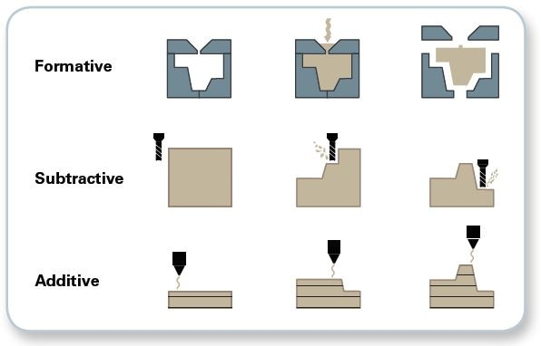
What is additive manufacturing?

Slide 5
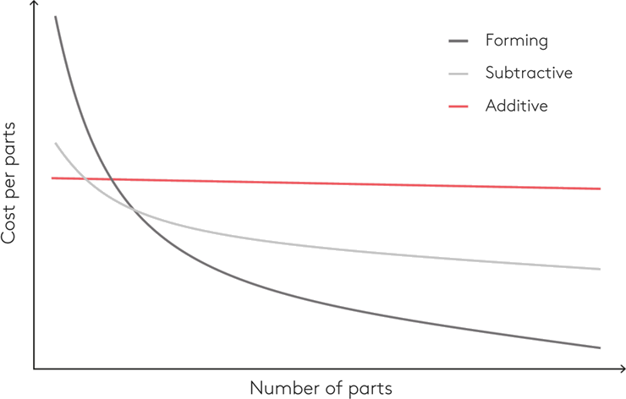
What is additive manufacturing?

Slide 6
Why additive manufacturing?
Advantages
Fast design iterations
Cheaper failures
Complex geometries
Lighter stronger parts
On demand manufacturing
Waste reduction
Multi material capabilities
Disadvantages
Slow
Resolution & surface finish
Size constraints
Hardware reliability
Material limitations
Expensive at scale

Slide 7
3D printing vs additive manufacturing
Model
Slice
Print

Slide 8
Most common methods of additive manufacturing

Slide 9
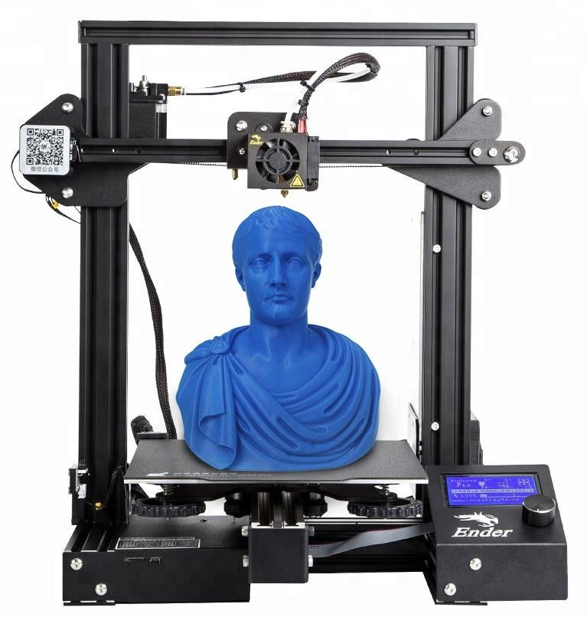
What is Fused Deposition Modeling (FDM)?

Slide 10
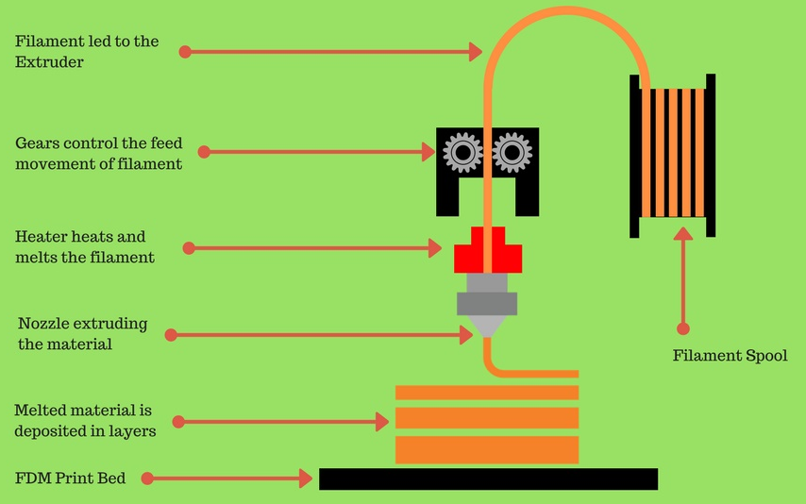
What is Fused Deposition Modeling (FDM)?

Slide 11
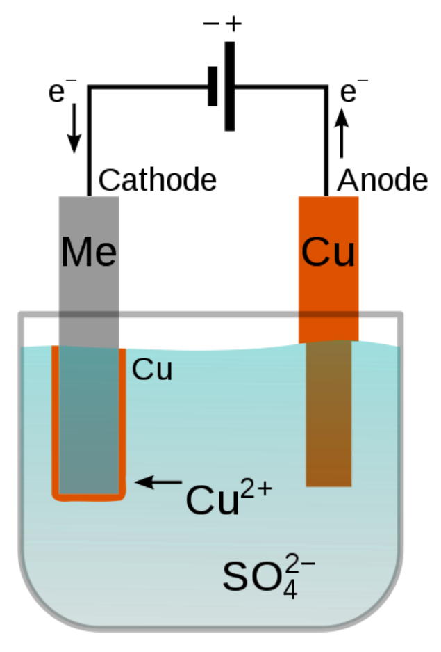
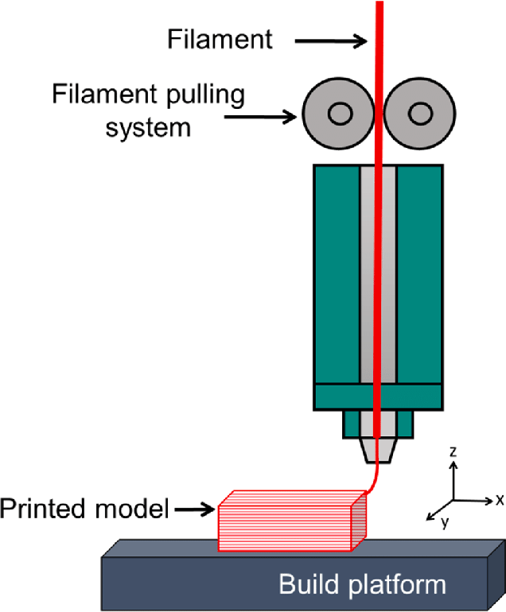
BSc Thesis and Publication
“From Composite Filaments to Low-loss Circuits: A Novel Hybrid Manufacturing Approach to 3D-Printed Electronics”
FDM
Electroplating

Slide 12
BSc Thesis and Publication
“From Composite Filaments to Low-loss Circuits: A Novel Hybrid Manufacturing Approach to 3D-Printed Electronics”
Cup-based electroplating

Slide 13
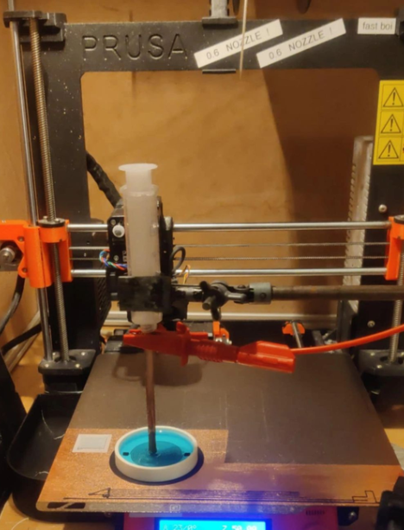
BSc Thesis and Publication
“From Composite Filaments to Low-loss Circuits: A Novel Hybrid Manufacturing Approach to 3D-Printed Electronics”
Cup-based electroplating
Physical setup

Slide 14
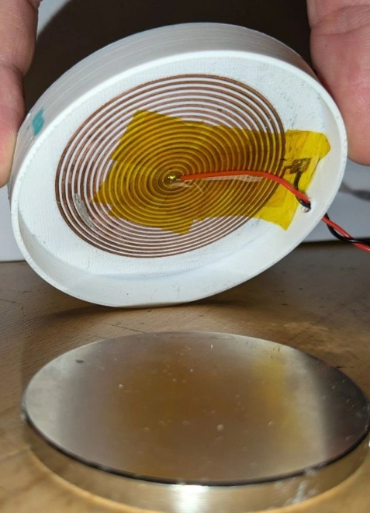
BSc Thesis and Publication
“From Composite Filaments to Low-loss Circuits: A Novel Hybrid Manufacturing Approach to 3D-Printed Electronics”
Cup-based electroplating
Physical setup
Resulting speaker

Slide 15
MSc Thesis
“Recyclable 3D Printing of Aqueous PNIPAM for Sustainable Electroforming”

Slide 16
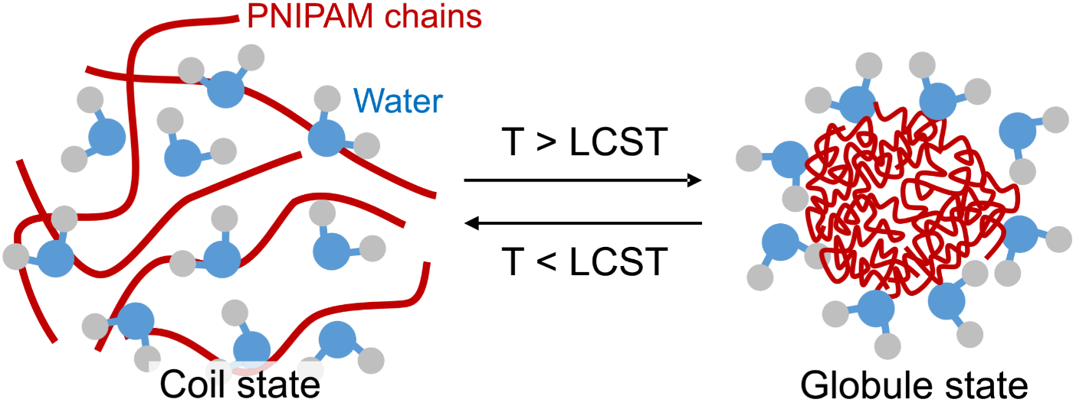
MSc Thesis
“Recyclable 3D Printing of Aqueous PNIPAM for Sustainable Electroforming”
PNIPAM solidification cycle

Slide 17
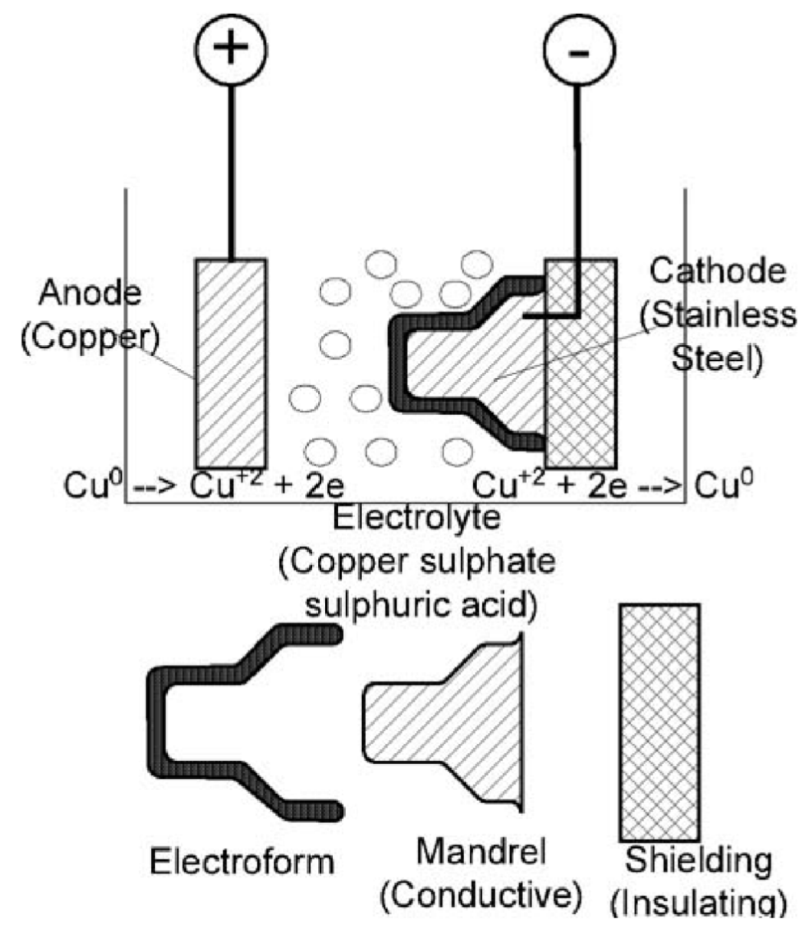
MSc Thesis
“Recyclable 3D Printing of Aqueous PNIPAM for Sustainable Electroforming”
PNIPAM solidification cycle
Electroforming

Slide 18
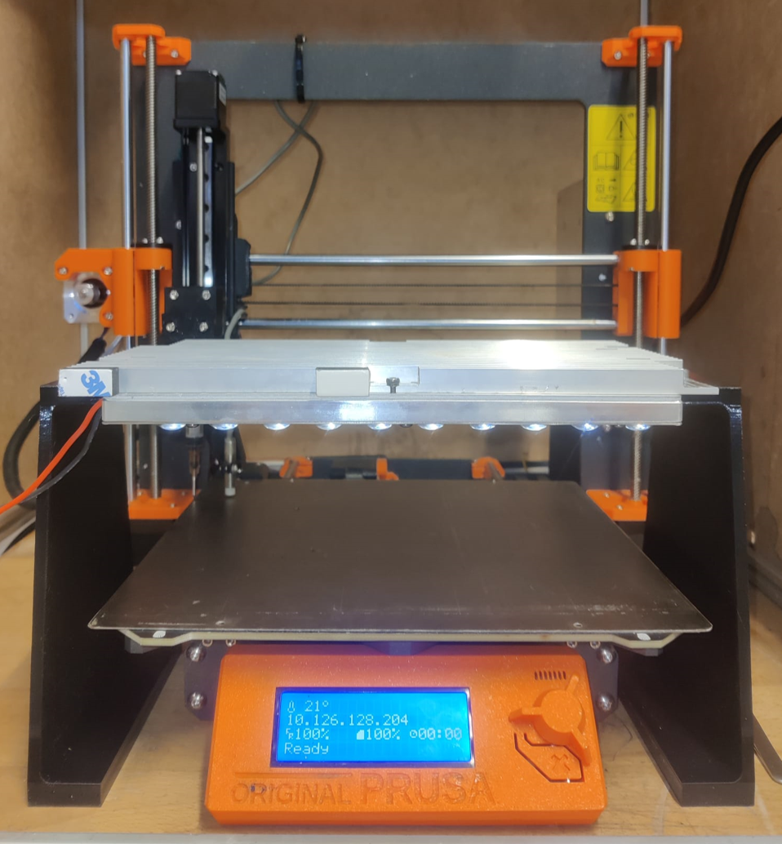
MSc Thesis
“Recyclable 3D Printing of Aqueous PNIPAM for Sustainable Electroforming”
Developed 3D printer

Slide 19
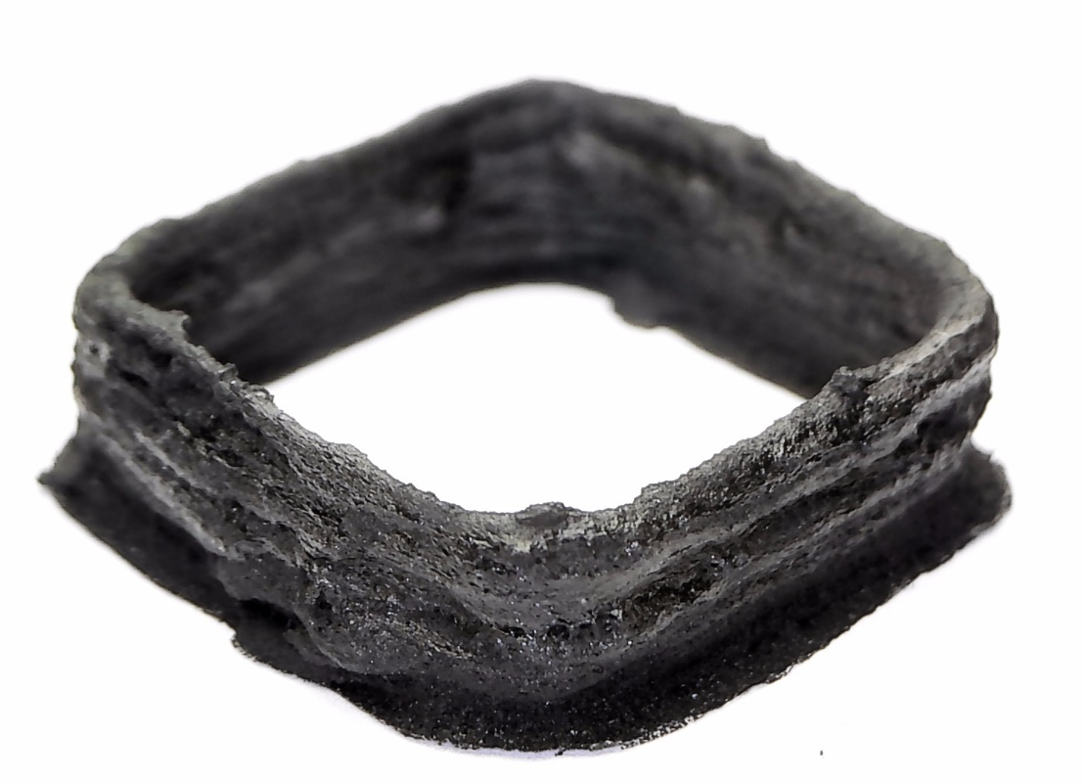
MSc Thesis
“Recyclable 3D Printing of Aqueous PNIPAM for Sustainable Electroforming”
PNIPAM/CNT specimen
Developed 3D printer

Slide 20
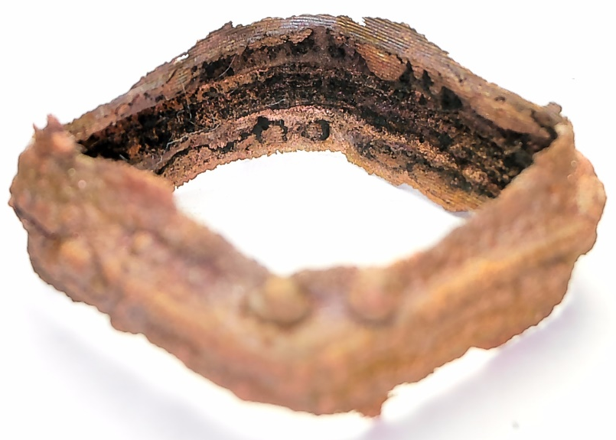
MSc Thesis
“Recyclable 3D Printing of Aqueous PNIPAM for Sustainable Electroforming”
PNIPAM/CNT specimen
PNIPAM/CNT electroform
Developed 3D printer

Slide 21
Constant-flux inductor (CFI)
A constant-flux inductor is an magnetic component designed to distribute magnetic flux uniformly across its core.

Slide 22
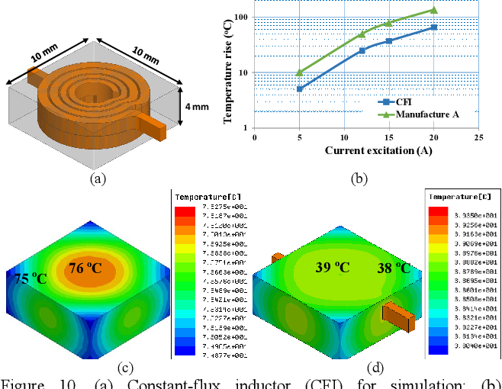
Constant-flux inductor (CFI)
A constant-flux inductor is an magnetic component designed to distribute magnetic flux uniformly across its core.
Benefits:
Prevents localized saturation
Distributes the temperature
Reduces the footprint

Slide 23
Constant-flux inductor (CFI)
A constant-flux inductor is an magnetic component designed to distribute magnetic flux uniformly across its core.
Benefits:
Prevents localized saturation
Distributes the temperature
Reduces the footprint
Tradeoff:
Manufacturing complexity
Cost
Physical tuning

Slide 24
Methods of designing a CFI
Specialized geometry
Multi-permeability

Slide 25
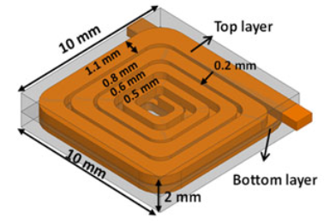
Methods of designing a CFI
Specialized geometry
Multi-permeability

Slide 26
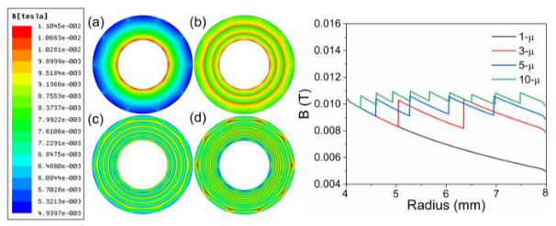
Methods of designing a CFI
Specialized geometry
Multi-permeability

Slide 27
Methods of designing a CFI
Specialized geometry
Multi-permeability
Geometry and permeability are not mutually exclusive design variables, and optimizing both may offer further benefits.
Custom and complex -> perfectly suited for AM.

Slide 28
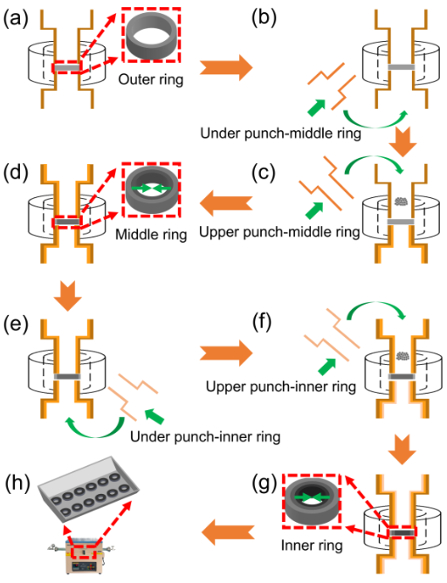
Methods of manufacturing a multi-permeability core
Multi-step pressing
Complex tooling
Limited design freedom

Slide 29
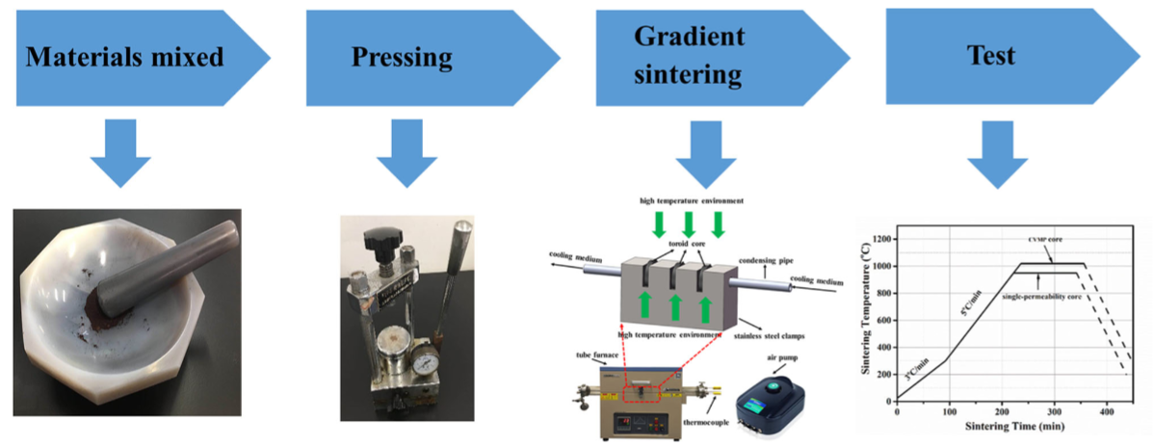
Methods of manufacturing a multi-permeability core
Multi-step pressing
Temperature gradient sintering
Complex tooling
Limited design freedom
Complex sintering
Limited design freedom

Slide 30
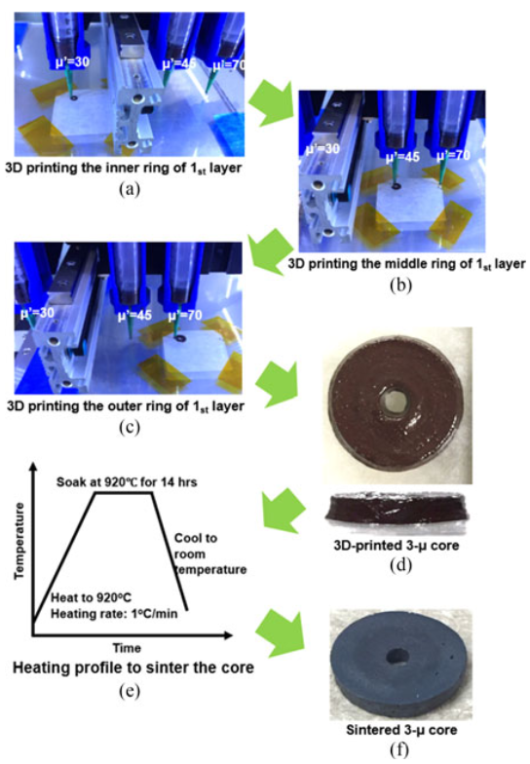
Methods of manufacturing a multi-permeability core
Multi-step pressing
Temperature gradient sintering
Multi-material AM
Complex tooling
Limited design freedom
Complex sintering
Limited design freedom
Requires sintering

Slide 31
Current field of 3D printing magnetics
3D printing magnetics
Vat polymerization
Powder bed fusion
Binder jetting
Material extrusion
Fused deposition modeling
Direct ink writing
Fused granulate fabrication

Slide 32
Current field of 3D printing magnetics
3D printing magnetics
Vat polymerization
Powder bed fusion
Binder jetting
Material extrusion
Fused deposition modeling
Direct ink writing
Fused granulate fabrication
Inability to perform multi-material printing in the same layer

Slide 33
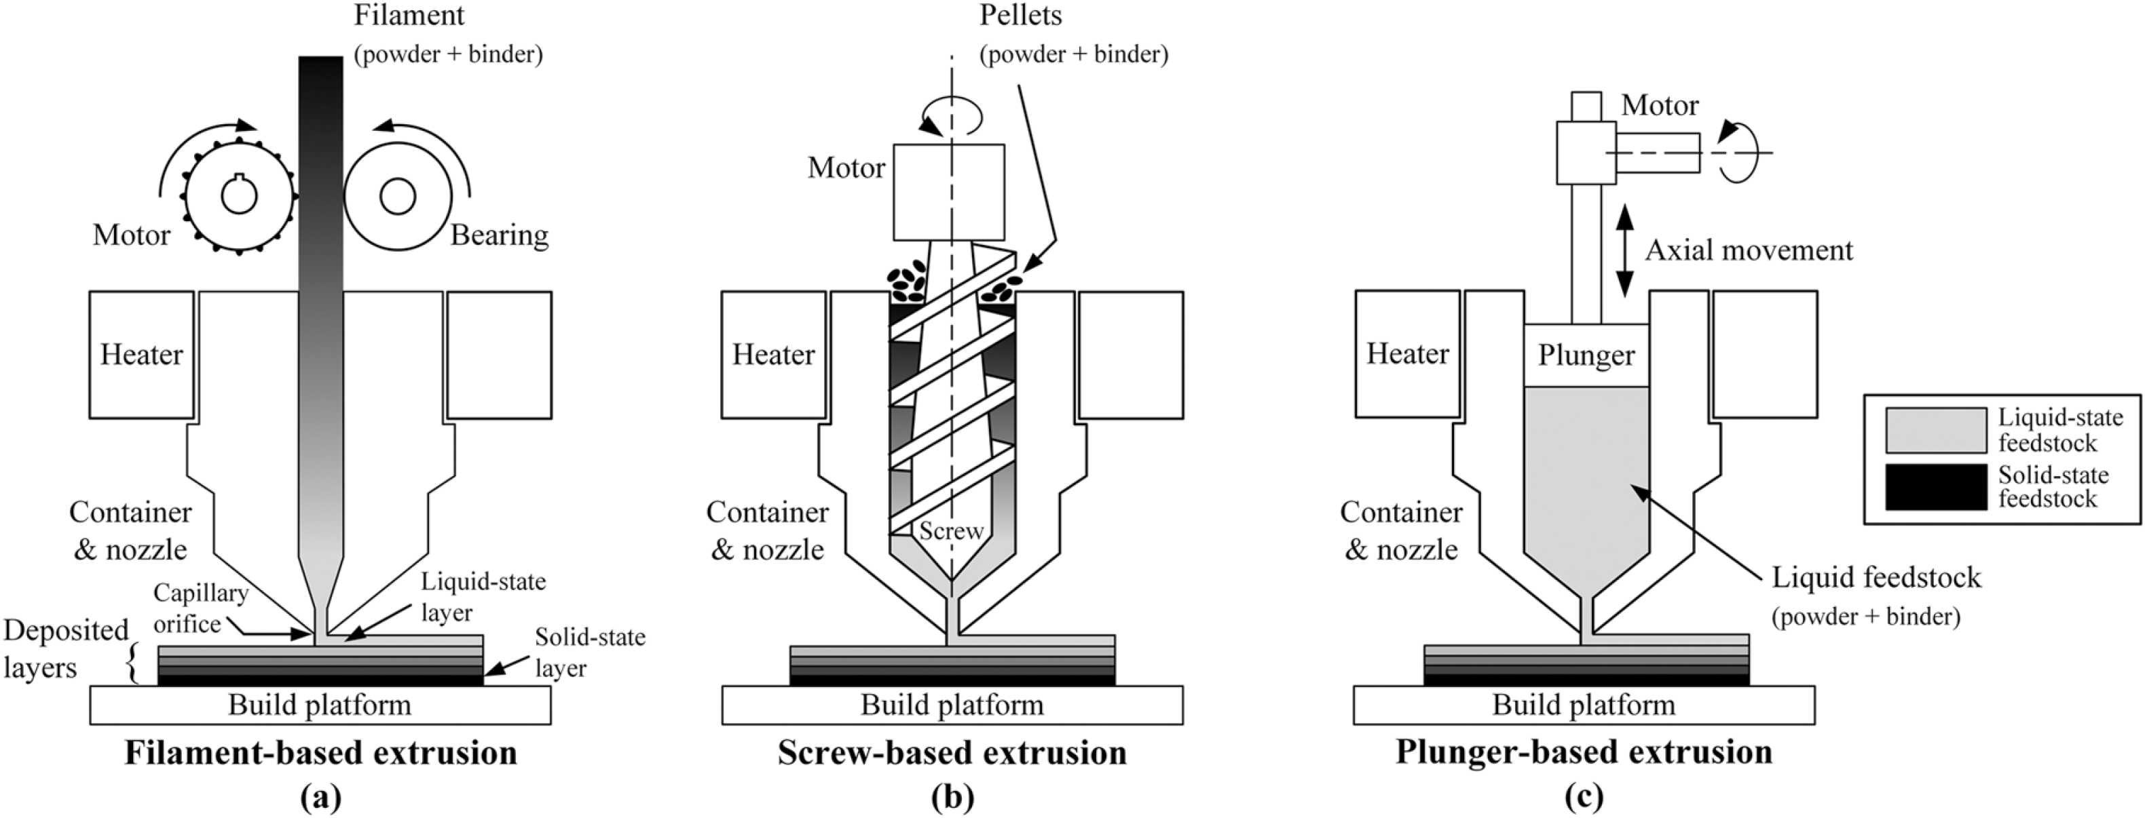
FDM vs FGF vs DIW
Fused Deposition Modeling (FDM)
Fused Granulate Fabrication (FGF)
Direct Ink Writing (DIW)

Slide 34
Current field of 3D printing magnetics
3D printing magnetics
Vat polymerization
Powder bed fusion
Binder jetting
Material extrusion
Fused deposition modeling
Direct ink writing
Fused granulate fabrication
Inability to perform multi-material printing in the same layer
μ_{r} = 1.4 - 4
μ_{r} = 35 - 500
μ_{r} = 42

Slide 35
Current field of 3D printing magnetics
3D printing magnetics
Vat polymerization
Powder bed fusion
Binder jetting
Material extrusion
Fused deposition modeling
Direct ink writing
Fused granulate fabrication
Inability to perform multi-material printing in the same layer
μ_{r} = 1.4 - 4
Low permeability
μ_{r} = 35 - 500
μ_{r} = 42

Slide 36
Current field of 3D printing magnetics
3D printing magnetics
Vat polymerization
Powder bed fusion
Binder jetting
Material extrusion
Fused deposition modeling
Direct ink writing
Fused granulate fabrication
Inability to perform multi-material printing in the same layer
μ_{r} = 1.4 - 4
Low permeability
μ_{r} = 35 - 500
Requires sintering
μ_{r} = 42

Slide 37
Current field of 3D printing magnetics
3D printing magnetics
Vat polymerization
Powder bed fusion
Binder jetting
Material extrusion
Fused deposition modeling
Direct ink writing
Fused granulate fabrication
Inability to perform multi-material printing in the same layer
μ_{r} = 1.4 - 4
Low permeability
μ_{r} = 35 - 500
Requires sintering
Selected
μ_{r} = 42

Slide 38
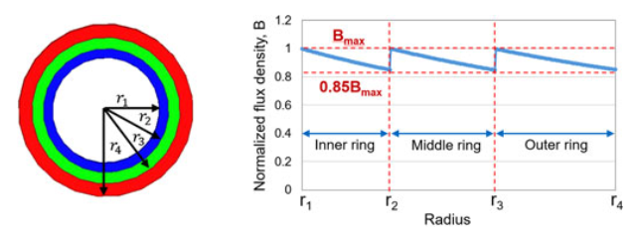
Research direction
Fused Granulate Fabrication (FGF)
Multi-permeability cores

Slide 39
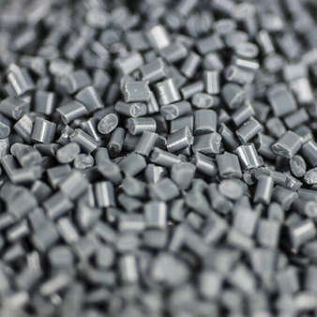
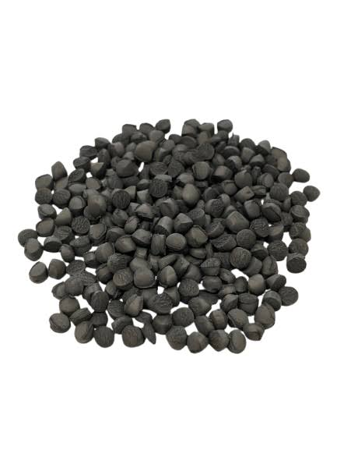
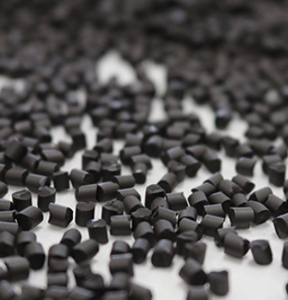
Multi-permeability via different materials
PA12 with x wt% FeSiAl (μ_{rx})
PA12 with y wt% FeSiAl (μ_{ry})
PA12 with z wt% FeSiAl (μ_{rz})

Slide 40
Multi-permeability via different materials
PA12 with x wt% FeSiAl (μ_{rx})
PA12 with y wt% FeSiAl (μ_{ry})
PA12 with z wt% FeSiAl (μ_{rz})

Slide 41
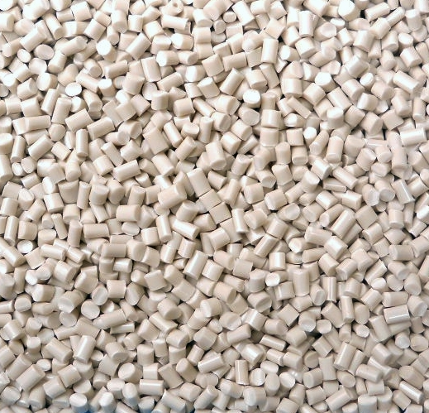
Multi-permeability via mixing different ratios
PA12
PA12 with 86 wt% FeSiAl (μ_{r_100:0})

Slide 42
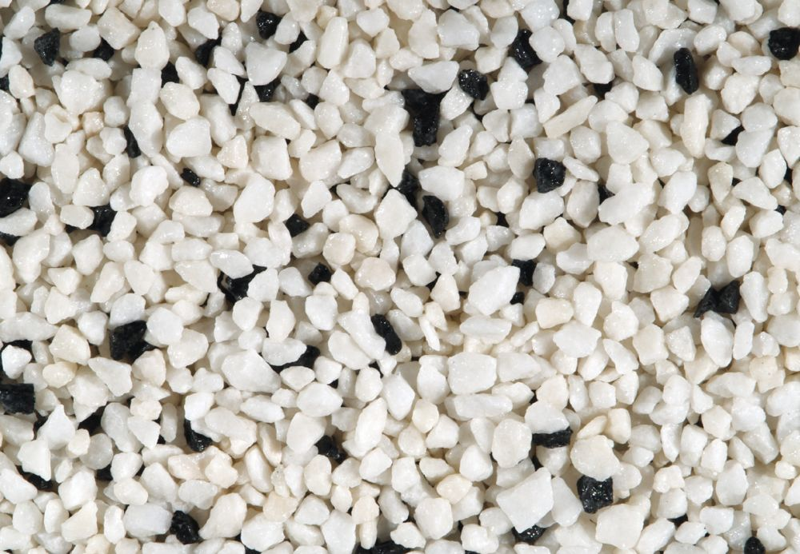
Multi-permeability via mixing different ratios
μ_{r_25:75}
PA12
PA12 with 86 wt% FeSiAl (μ_{r_100:0})

Slide 43
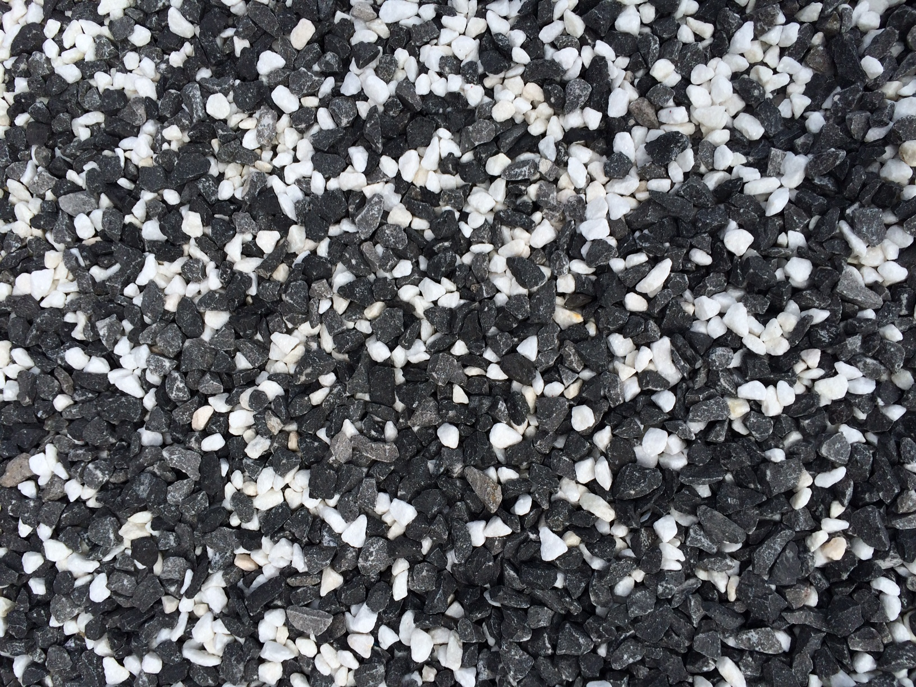
Multi-permeability via mixing different ratios
μ_{r_25:75}
PA12
PA12 with 86 wt% FeSiAl (μ_{r_100:0})
μ_{r_75:25}

Slide 44
Research questions
Can varying the blend ratio of magnetic-filled and unfilled polymer pellets produce reproducible changes in the permeability of a soft-magnetic composite manufactured using a commercial pellet extruder?
μ_{r_25:75_1} = μ_{r_25:75_2} ?
μ_{r_75:25_1} = μ_{r_75:25_2} ?

Slide 45
Research questions
Can varying the blend ratio of magnetic-filled and unfilled polymer pellets produce reproducible changes in the permeability of a soft-magnetic composite manufactured using a commercial pellet extruder?
Process
Filler amount
Filler uniformity
Permeability
Specimen
Correlation?

Slide 46
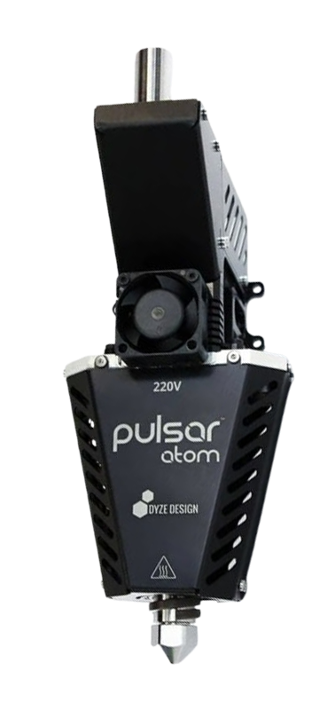
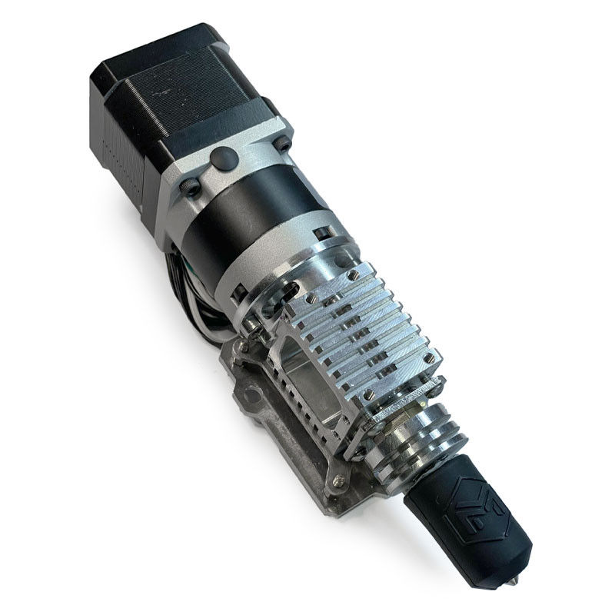
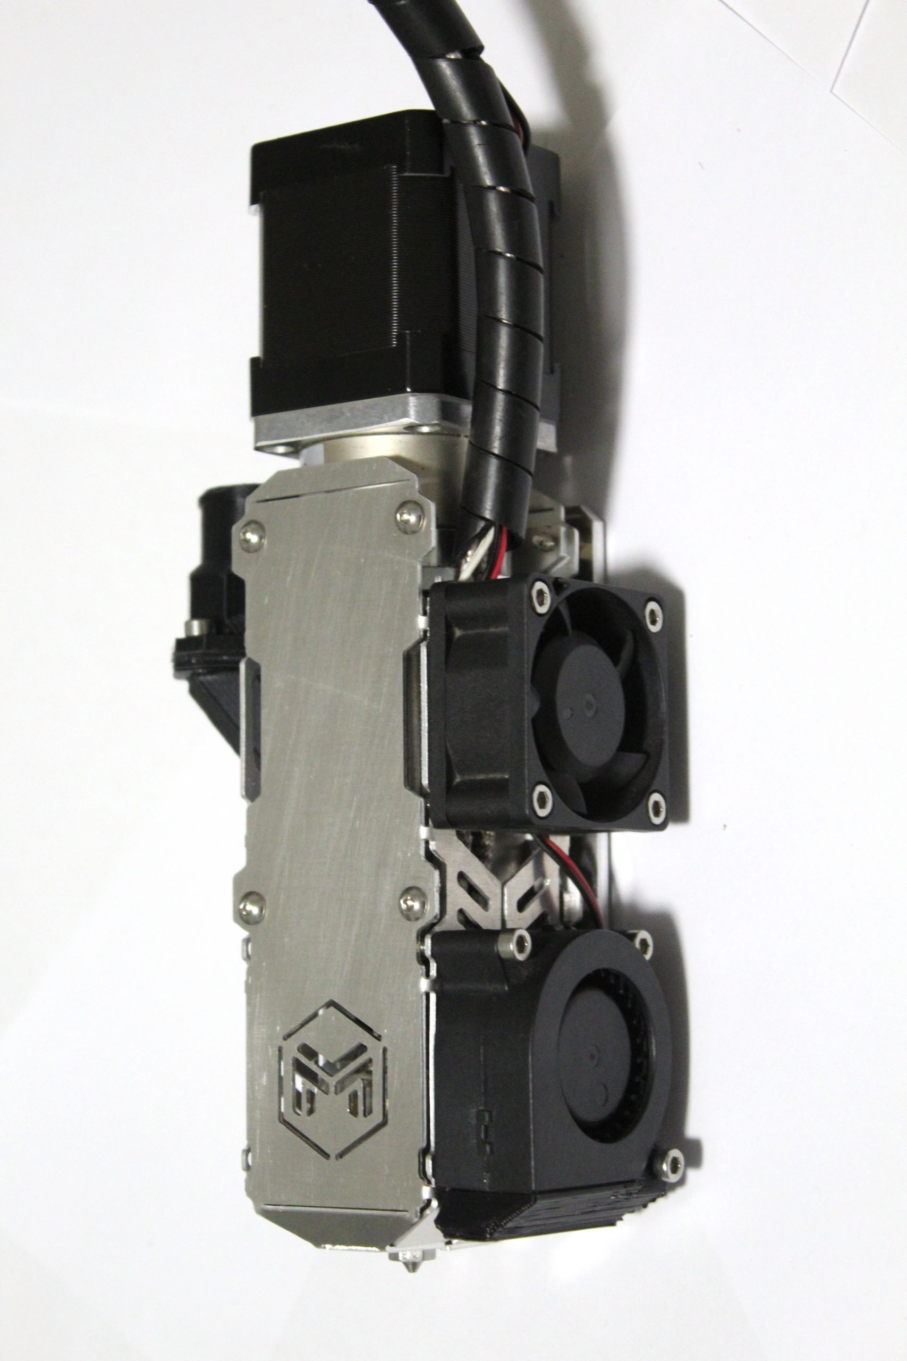
Requirement and methodology – Nr. 1
Requirement
Establish a repeatable pellet-extrusion process for producing test specimens from the selected magnetic-filled and unfilled polymer pellets.
Methodology
Conduct a targeted review of commercially available pellet extruders and compatible polymer feedstocks.
Create an evaluation matrix, setting out project criterion with their specific weight. Select the highest rated path of solutions. Develop and assemble the selected manufacturing process.
Investigate appropriate printing parameters.

Slide 47
Requirement and methodology – Nr. 2
Requirement
Manufacture three specimen per each magnetic-filled-to-unfilled pellet mass ratio (0:100, 25:75, 50:50, 75:25 and 100:0) for characterization.
Methodology
Design a specimen geometry. Using the developed manufacturing process, fabricate three specimen at each specific (0:100, 25:75, 50:50, 75:25, 100:0) magnetic-filled-to-unfilled pellet mass ratios.
Ratio\Number | 1 | 2 | 3
0:100
25:75
50:50
75:25
100:0

Slide 48
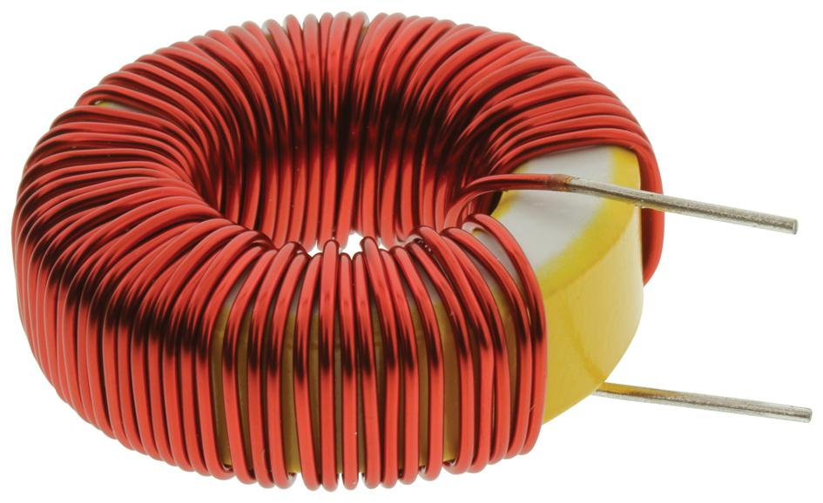
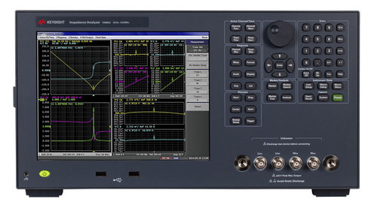
Requirement and methodology – Nr. 3
Requirement
Characterize the effective permeability and its variance between each specimen in a given ratio.
Methodology
Wind the same number of turns of isolated copper wire around each specimen, ensuring consistent winding arrangement. Measure the inductance and its between-specimen variability using an impedance analyzer across a specific frequency range.
Ratio\Number | 1 | 2 | 3
0:100 | L_{0:100_1} | L_{0:100_2} | L_{0:100_3}
25:75 | L_{25:75_1} | L_{25:75_2} | L_{25:75_3}
50:50 | L_{50:50_1} | L_{50:50_2} | L_{_50:50_3}
75:25 | L_{75:25_1} | μ_{e_75:25_2} | L_{75:25_3}
100:0 | L_{100:0_1} | L_{100:0_2} | L_{100:0_3}

Slide 49
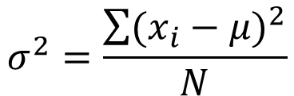
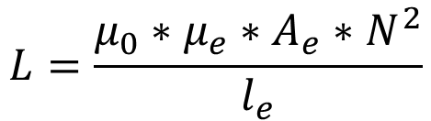
Requirement and methodology – Nr. 3
Requirement
Characterize the effective permeability and its variability between each specimen in a given ratio.
Methodology
Wind the same number of turns of isolated copper wire around each specimen, ensuring consistent winding arrangement. Measure the inductance and its between-specimen variability using an impedance analyzer across a specific frequency range. Calculate the effective permeability and variance.
$$L=\frac{μ_{0}∗μ_{e}∗A_{e}∗N^{2}}{l_{e}}$$
$$σ^{2}=\frac{\sum{{(x_{i}−μ)}^{2}}}{N}$$
Ratio\Number | 1 | 2 | 3 | σ_{x Hz}
0:100 | μ_{e_0:100_1} | μ_{e_0:100_2} | μ_{e_0:100_3} | σ_{0:100}
25:75 | μ_{e_25:75_1} | μ_{e_25:75_2} | μ_{e_25:75_3} | σ_{25:75}
50:50 | μ_{e_50:50_1} | μ_{e_50:50_2} | μ_{e_50:50_3} | σ_{50:50}
75:25 | μ_{e_75:25_1} | μ_{e_75:25_2} | μ_{e_75:25_3} | σ_{75:25}
100:0 | μ_{e_100:0_1} | μ_{e_100:0_2} | μ_{e_100:0_3} | σ_{100:0}

Slide 50
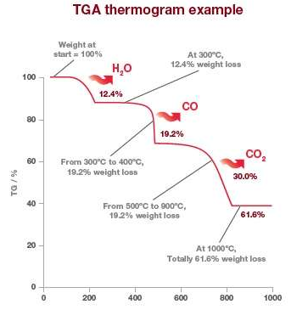
Requirement and methodology – Nr. 4
Requirement
Characterize the amount of magnetic filler present in each of the specimen.
Methodology
Use Thermogravimetric Analysis (TGA) under inert gas (to avoid oxidation) to estimate bulk filler content, calibrated to the known filler content.
Samples from independent extrusion runs and different specimen locations will be analyzed.

Slide 51
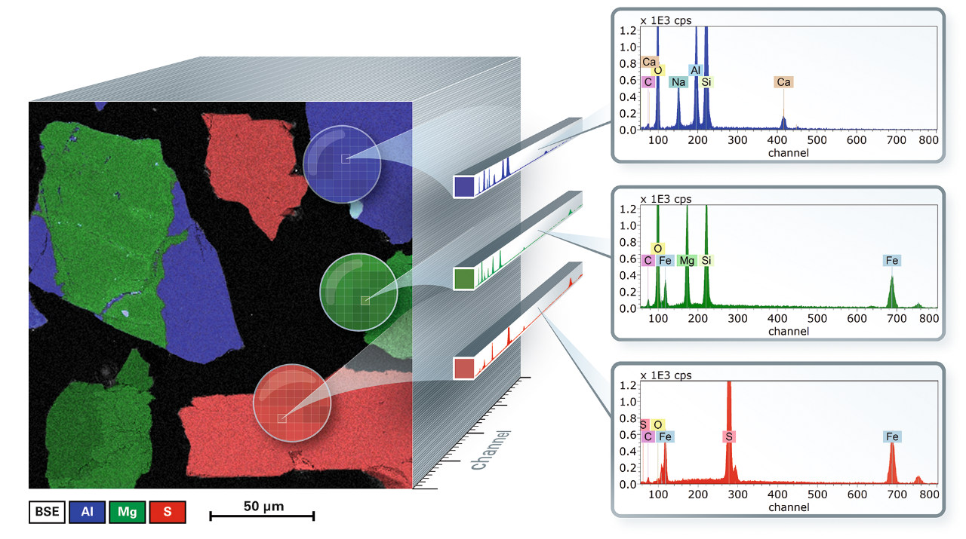
Requirement and methodology – Nr. 5
Requirement
Characterize the uniformity of magnetic filler in each of the specimen.
Methodology
Use Scanning Electron Microscopy paired with Energy-Dispersive X-ray Spectroscopy (SEM–EDS) mapping of cross-sections to quantify local FeSiAl distribution.
Samples from independent extrusion runs and different specimen locations will be analyzed.
Use image processing to quantify numerically the filler distribution.

Slide 52
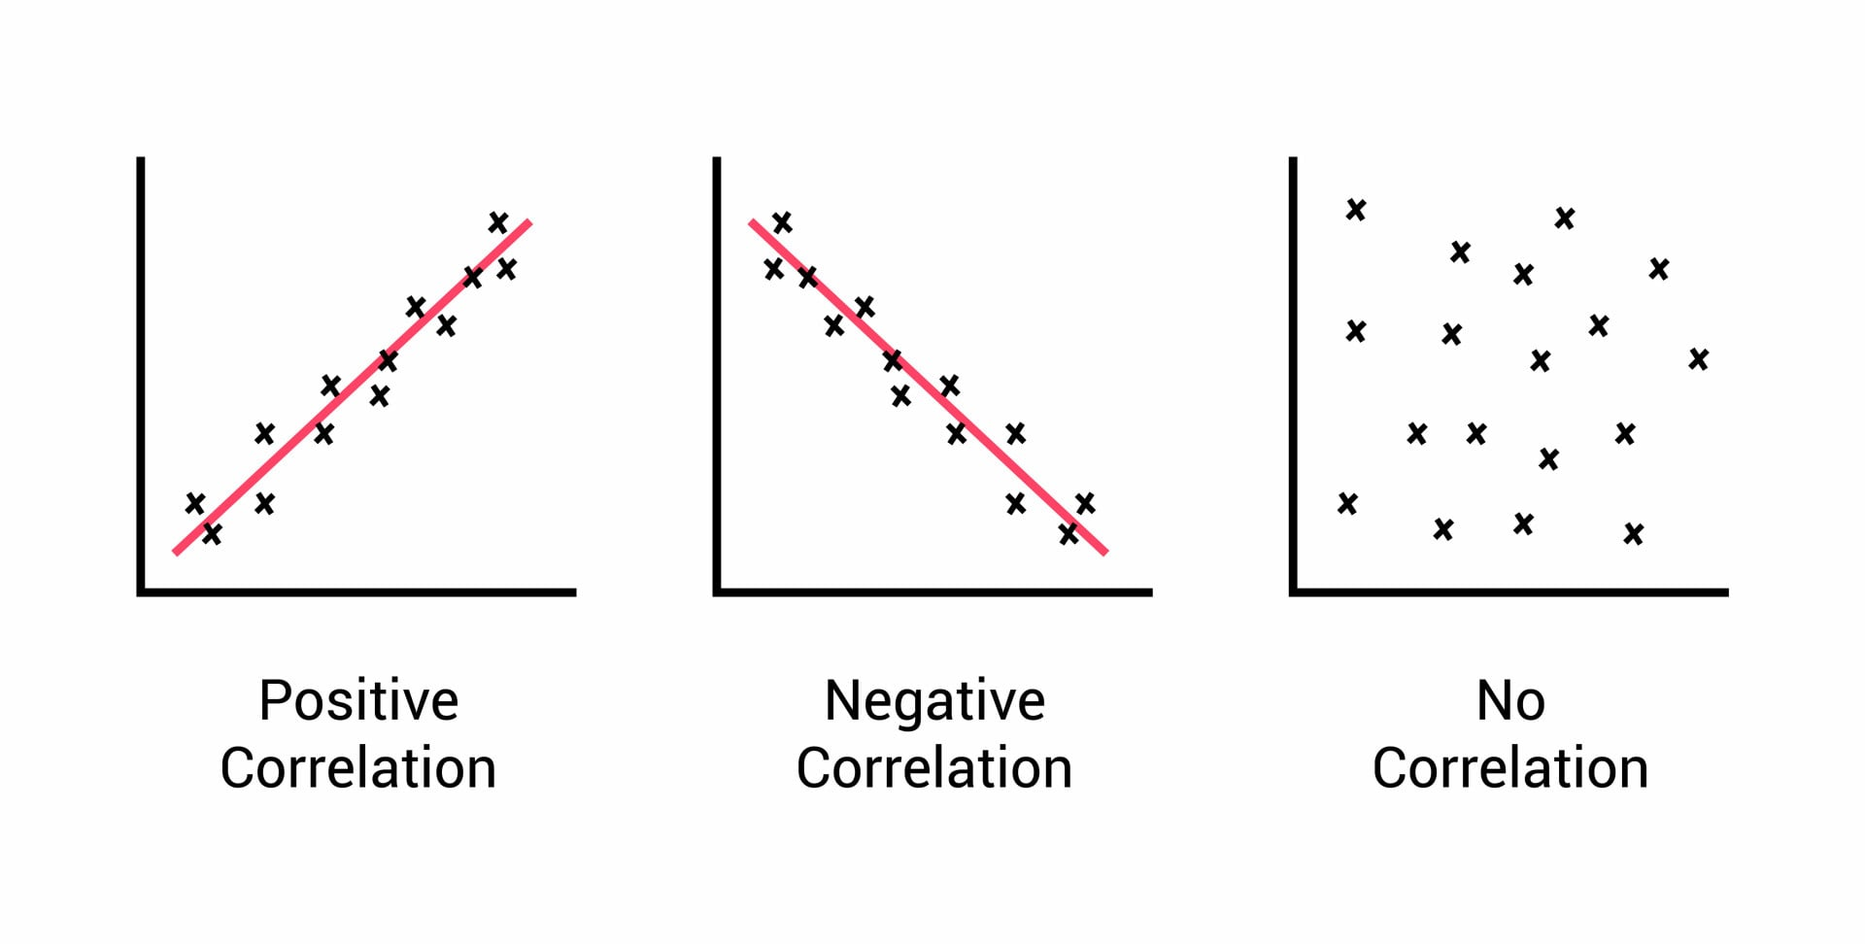
Requirement and methodology – Nr. 6
Requirement
Assess the correlation between effective permeability, amount of magnetic filler present and the uniformity of magnetic filler.
Methodology
Plot the results from TGA, SEM-EDS and effective permeability. Visually inspect whether there are trends. Draw a conclusion.

Slide 53
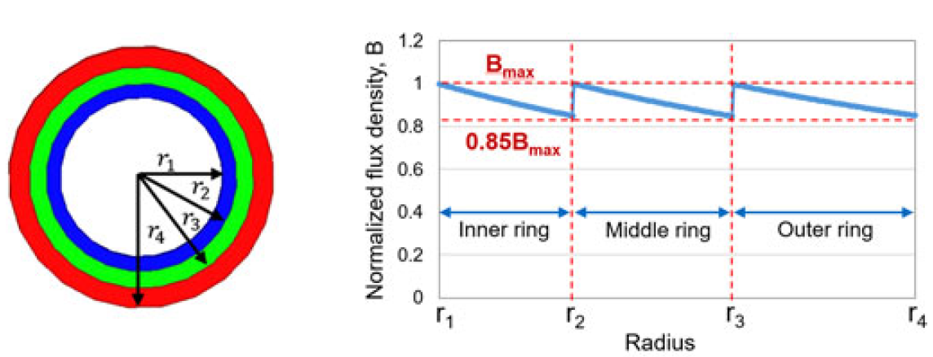
Research questions
Can discrete permeability regions be fabricated by sequentially printing pre-blended pellet batches, using controlled purging to achieve distinct and reproducible material compositions?

Slide 54
Research questions
Can discrete permeability regions be fabricated by sequentially printing pre-blended pellet batches, using controlled purging to achieve distinct and reproducible material compositions?
Purging
Single-permeability specimen
Inductance
Saturation behaviour
Core loss
Multi-permeability specimen
Inductance
Saturation behaviour
Core loss
Comparisson

Slide 55
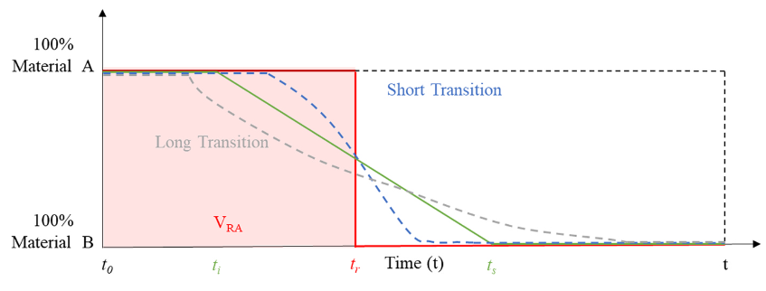
Requirement and methodology – Nr. 7
Requirement
Establish a repeatable pause–purge–resume procedure that limits residual material from the previous pellet batch when switching blend ratios.

Slide 56
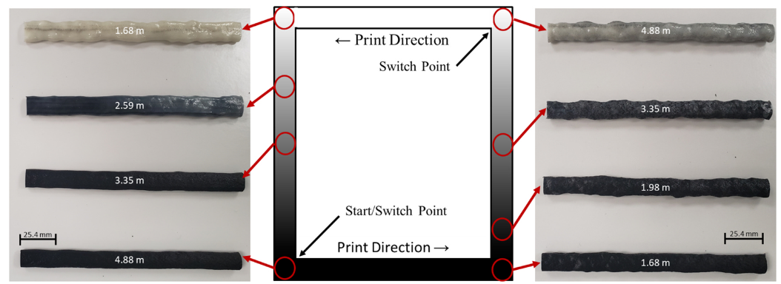
Requirement and methodology – Nr. 7
Requirement
Establish a repeatable pause–purge–resume procedure that limits residual material from the previous pellet batch when switching blend ratios.
Methodology
To determine the required purge amount, a print will be paused after reaching steady state extrusion with a 0:100 blend, and the remaining pellets will be removed from the hopper before loading the 100:0 blend.
The extruder will then be purged into separately collected samples at defined cumulative extruded masses.
TGA will be used to estimate the composition of each sample, using known blend ratios to establish a calibration.
The composition will be plotted against the cumulative purge mass to determine how much material must be purged before the new blend reaches a stable composition.
The procedure will be repeated to additionally for the transition from 100:0 to 0:100 ratio.

Slide 57
Requirement and methodology – Nr. 8
Requirement
Evaluate the feasibility of fabricating a core with three distinct permeability regions by sequentially printing pre-blended pellet batches.
Methodology
Design a multi-permeability CFI using the blend ratios based on the experimentally characterized permeability values. Manufacture the core using the established pause-purge-resume procedure.
Visually assess whether the intended regions have distinct compositions.

Slide 58
Requirement and methodology – Nr. 9
Requirement
Manufacture single-permeability core for comparison.
Methodology
Design a single-permeability inductor using the blend ratios based on the experimentally characterized permeability values. Manufacture the core using the established printing process.

Slide 59
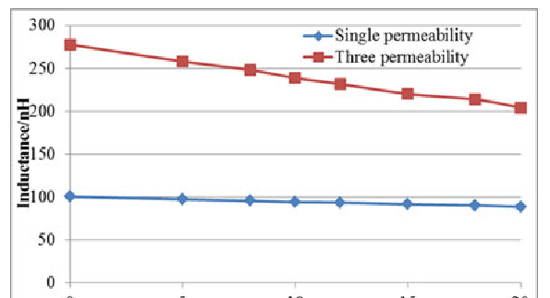
Requirement and methodology – Nr. 10
Requirement
Characterize the inductance of the single-permeability and multi-permeability cores.
Methodology
Assemble both magnetic cores with copper wire to create an inductor. Measure the inductance of the multi-permeability specimen and uniform permeability specimen with an impedance analyzer across a specific frequency range. Remove the winding.

Slide 60
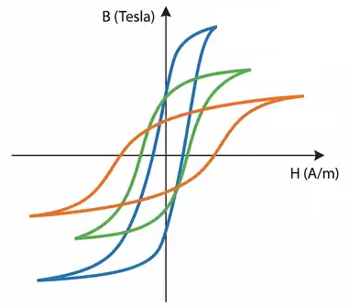
Requirement and methodology – Nr. 11
Requirement
Characterize saturation behaviour for both cores.
Methodology
Wind an excitation coil and a separate sensing coil around the core. Drive the excitation coil with a controlled AC source. Measure the excitation current and sensing coil voltage. Calculate the magnetic field strength and flux density.

Slide 61
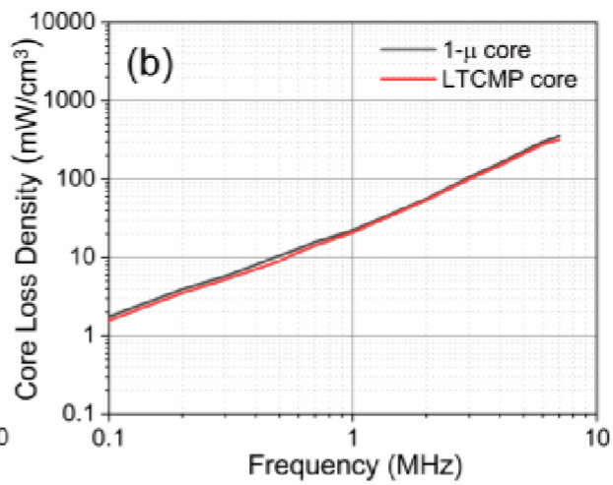
Requirement and methodology – Nr. 12
Requirement
Characterize the core losses for both cores.
Methodology
To measure the core losses, adjust the source, so the core reaches the peak flux density. Record the B-H loop. Calculate the energy loss from its enclosed area. Repeat the procedures for uniform permeability specimen.

Slide 62
Requirement and methodology – Nr. 13
Requirement
Compare the measured results.
Methodology
Plot together the results from the measurements. Visually inspect the differences. Draw conclusions.

Slide 63






Active communication

Slide 64
Potential collaboration areas
Current scope:
Help with magnetic core geometry and measuring effective permeability.
Help setting up Characterizing saturation behavior and core losses.
Simulation of multi-permeability cores.
Design of multi-permeability cores.
Distant future:
Design of CFI with tailored geometry and multi-permeability.
Automating multi-material capabilities for FGF.
Research immersion or colleague collaboration?

Slide 65
Summary
Constant flux inductors (CFI) are beneficial with a complexity tradeoff.
Multi-permeability cores are an approach to produce CFI.
Additive manufacturing (AM) provides multi-material and complex geometry capabilities.
Established AM method of manufacturing CFIs require complex post-processing.
Fused Granulate Fabrication (FGF) does not require post-processing although produces lower permeability magnetic cores.
Whether FGF can be used to manufacture multi-permeability cores is unanswered.
Requirements and methodology attempt to address the research questions.
There are potential collaboration opportunities.

