Slide 1
3D printing magnetics
Research Immersion
1st Feb.- 12 May 2027

Slide 2
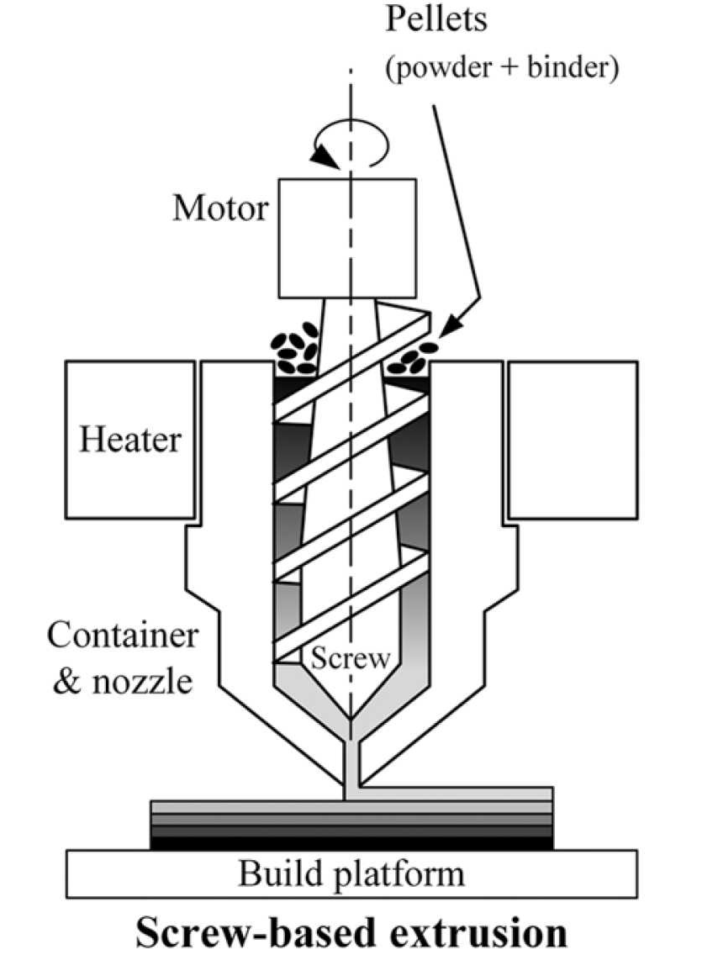
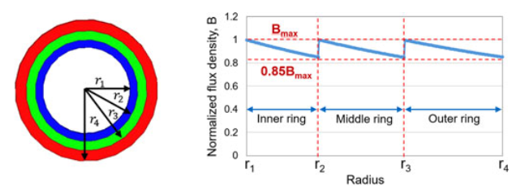
Research direction
Fused Granulate Fabrication (FGF)
Multi-permeability cores

Slide 3
Topic 1 - The problem
I focus on the 3D printing, looking for someone who could specialize in characterizing the multi-permeability cores.
Relative permeability in the tens, so large magnetizing current is necessary.
We have a machine, but it assumes:
Uniform magnetic flux
Specific geometry
Low excitation voltage (up to 25V)
Identified metrics:
Inductance
Saturation
B-H loop
Core losses

Slide 4
Topic 1 - Suggested plan
Familiarisation: magnetics basics, the multi-permeability core measurement literature
Requirements: the current, voltage, frequency and flux-density ranges
Circuit design
Build and debug: PCB or prototype board
Validation: measure commercial reference cores and compare with datasheets;
Measurement: printed multi-permeability and uniform cores.
Reporting: report, documentation of the setup so others can use it

Slide 5
Details
Type of assessment: Report (potentially journal or conference paper)
Objective: Prototype
Evaluation: 7 step scale
2 student / groups limit
Prerequisites:
    Power Electronics 1 + 2 Laboratory course (before project start)
Supervisor : Ziwei Ouyang
Co-supervisor: Artis Fils
Budget:

Slide 6
Inspiration for an open topic
Multi material vertical inductor
(Cross-section view)
Notes:
Here, I will briefly talk about a project I will be doing with Andreas, and discuss that we will be using multiple materials in one component. I would be doing this, to give inspiration for an open topic.

Slide 7
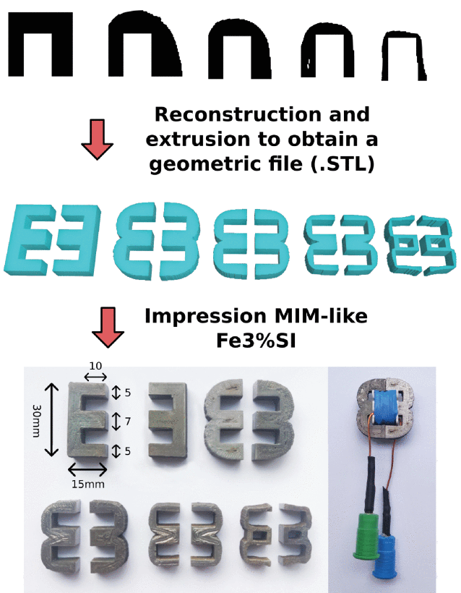
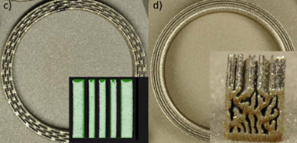
Inspiration for an open topic
Topology optimization 10.1109/TMAG.2023.3254599
Topology optimization 10.1109/ACCESS.2022.3218669
Notes:
Here I will just briefly mention interesting research I found, which takes advantage of 3D printing complex geometries.

Slide 8
Contact
Ziwei Ouyang
ziou@dtu.dk
325, Office 224
Artis Fils
artfi@dtu.dk
325, Office 222

