Slide 1
Extending analytics for eye tracking data linked to source code based on iTrace
Dennis Bøgelund Olesen

Slide 2
Issues and Goals
Issue, motivation
Eye tracking is used to understand how people comprehend text, commercials and other visual stimuli. There is little work done on the process of comprehension using an editor with no fixed image size.
Goal
Analysis across several users using process mining

Slide 3
Background theory

Slide 4
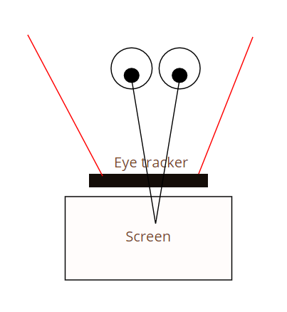
Eye tracking
Mapping eyes to gaze point
Eye trackers
Tobii tracker 4C, laptop
Gazes, fixations

Slide 5
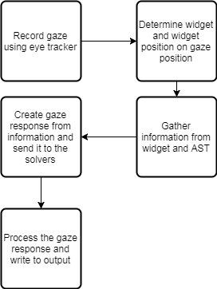
iTrace
Eclipse plugin
Gaze to source code mapping
XML and JSON output

Slide 6
Process mining
Extracting event logs
Creates diagrams and statistics
Most used paths
Total,avg,mean duration, frequency
Tool: Disco by Fluxicon.

Slide 7
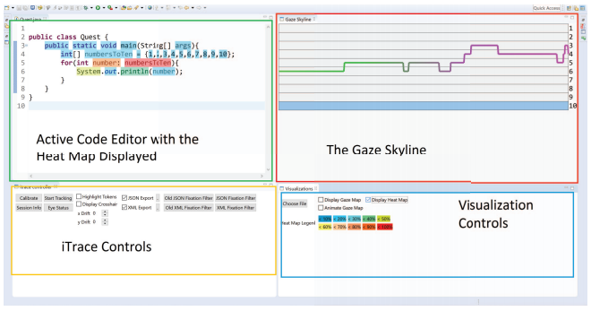
Related work - iTraceVis
Heatmaps
Gaze maps
SkyLines

Slide 8
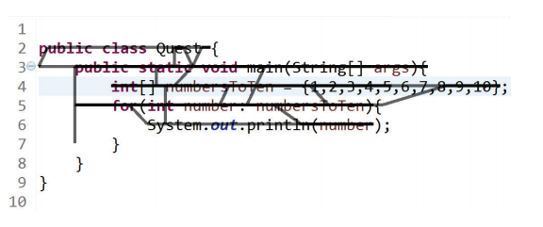
Related work - iTraceVis
Heatmaps
Gaze maps
SkyLines

Slide 9
Proposed solution

Slide 10
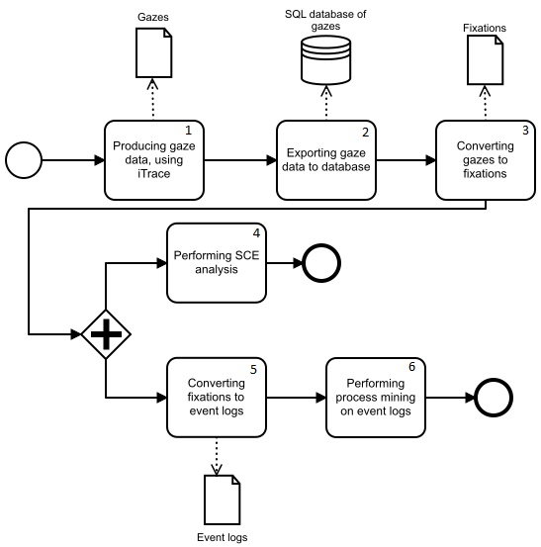
The process

Slide 11
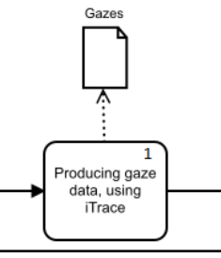
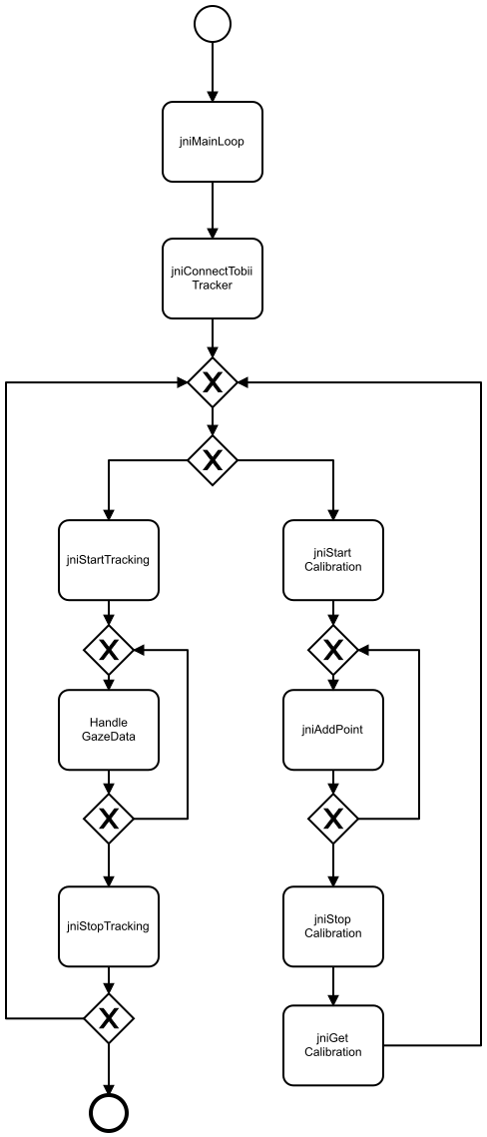
Producing gaze data using iTrace
Java native interface
Tobii Pro SDK

Slide 12
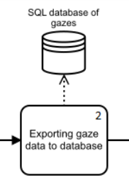
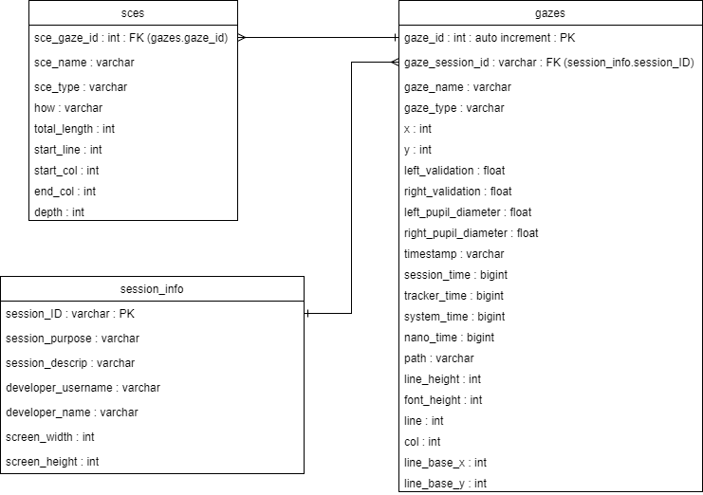
Exporting gaze data to database
Keep same information
Old setup used XML or JSON in separate folders.

Slide 13
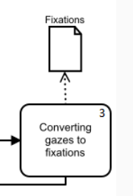
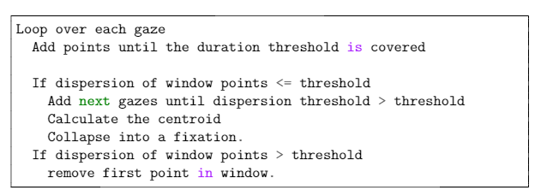
Converting gazes to fixations
Fixation identification algorithms
Dispersion based, I-DT

Slide 14
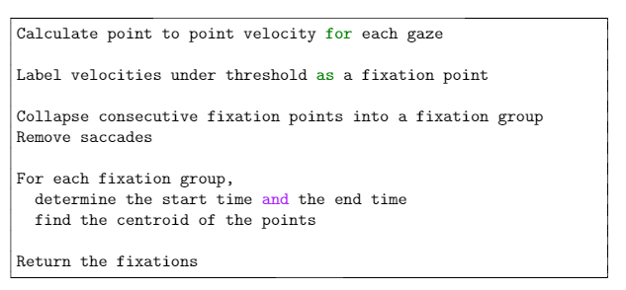
Converting gazes to fixations
Fixation identification algorithms
Velocity based, I-VT

Slide 15
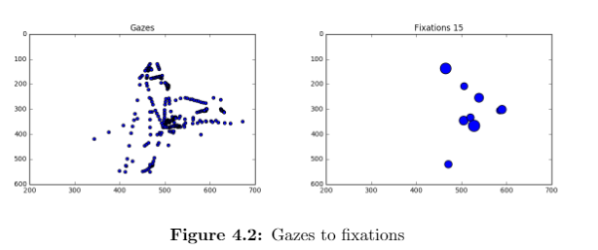
Converting gazes to fixations
Fixation identification algorithms
Result of the dispersion based implementation.

Slide 16
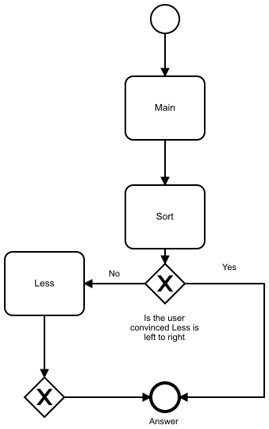
Collecting data from participants
What we did:
Insertion Sort
Five users
Four finished
Test quality:
Calibration within a line accuracy
Informal, but focused.
Expected output:
Main -> Sort -> less (See Model)

Slide 17
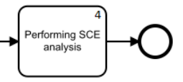
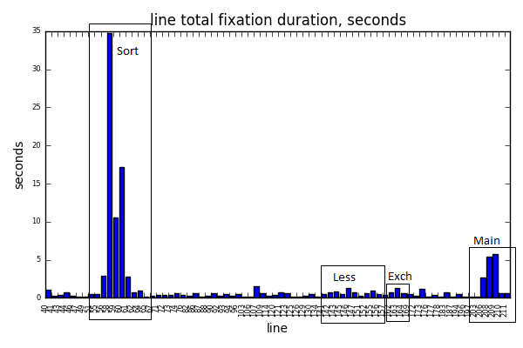
Performing SCE analysis

Slide 18
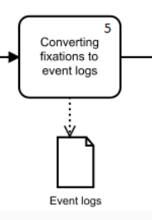
Converting fixations to
event logs
Area of interest
Event log
Consecutive fixations on the same area are collapsed
Session ID, area name, start, end

Slide 19
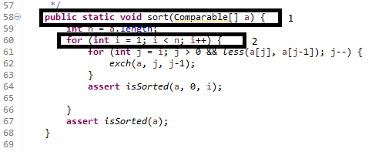
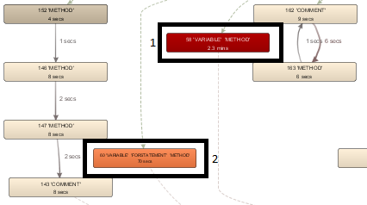
Line by line events
Generic, works with all single-file code.
Large and difficult to read for larger files
Specific, based on small areas of interest.

Slide 20
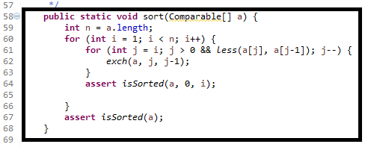
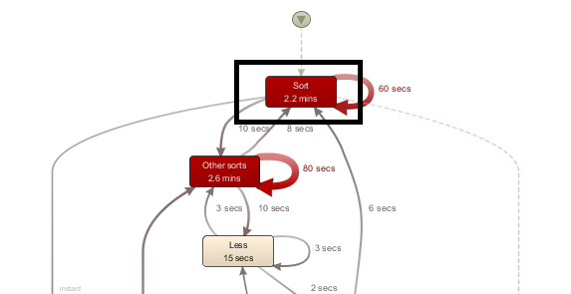
User defined events
User defined
Requires definition of areas of interest.
Size depends on AoI definitions.
May be easier to read due to fewer defined areas.

Slide 21
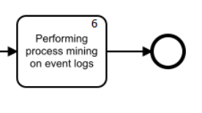
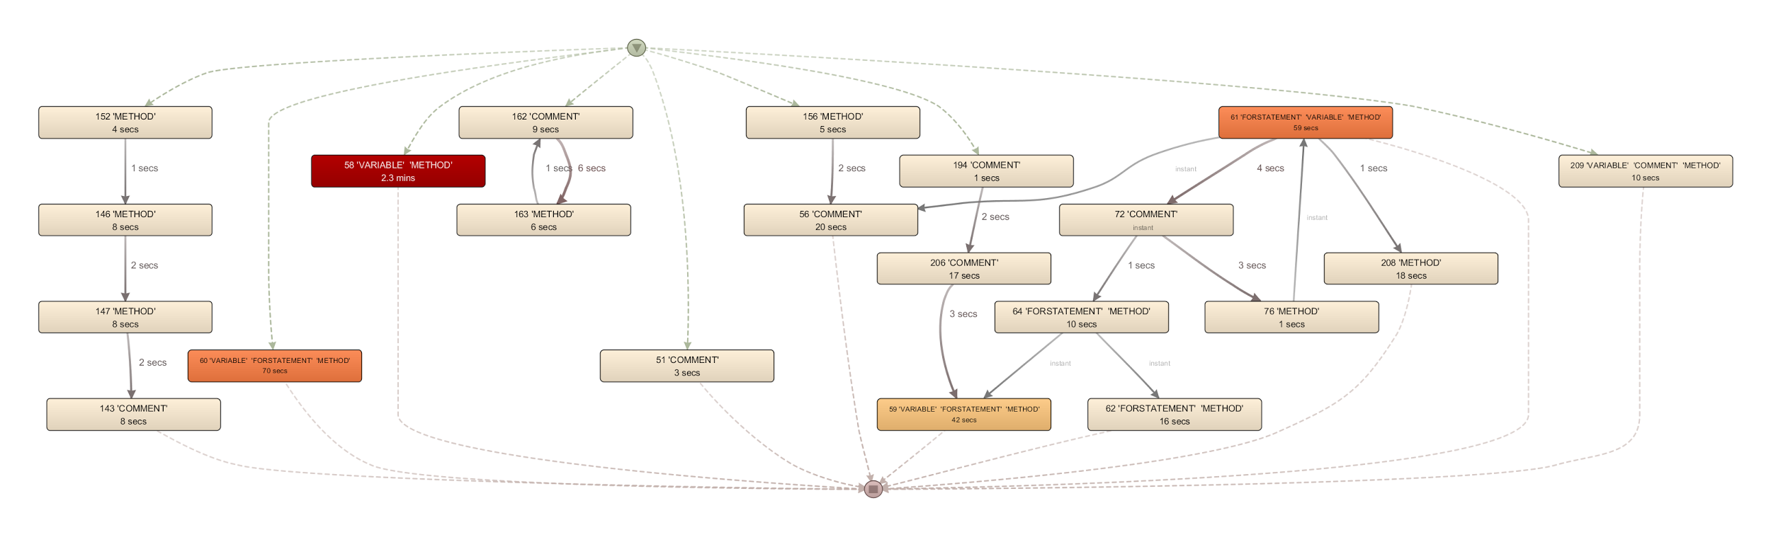
Performing process mining on event logs

Slide 22
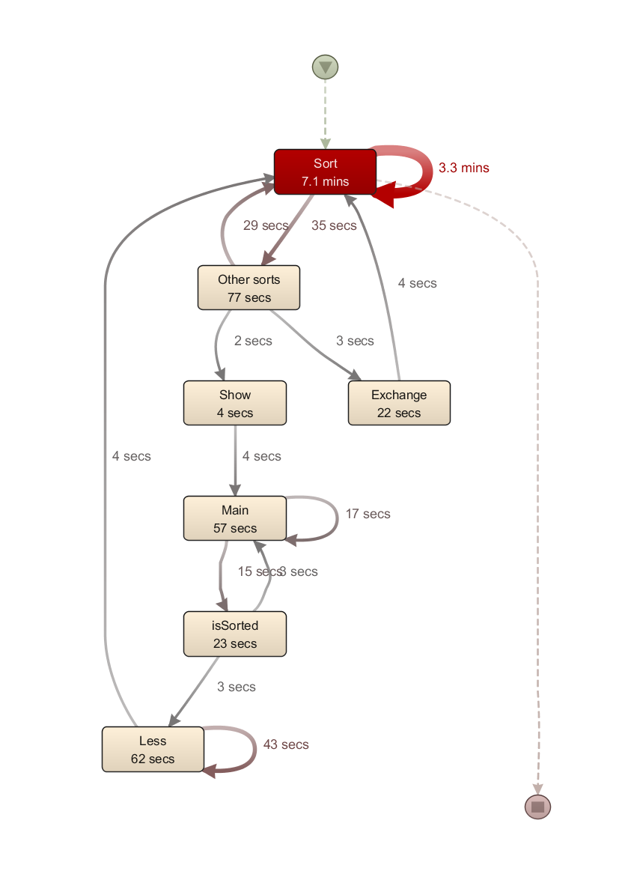
Performing process mining on event logs
Sort most viewed
Exchange independent
Flow: Top (Sort) -> Main -> Less -> Sort

Slide 23
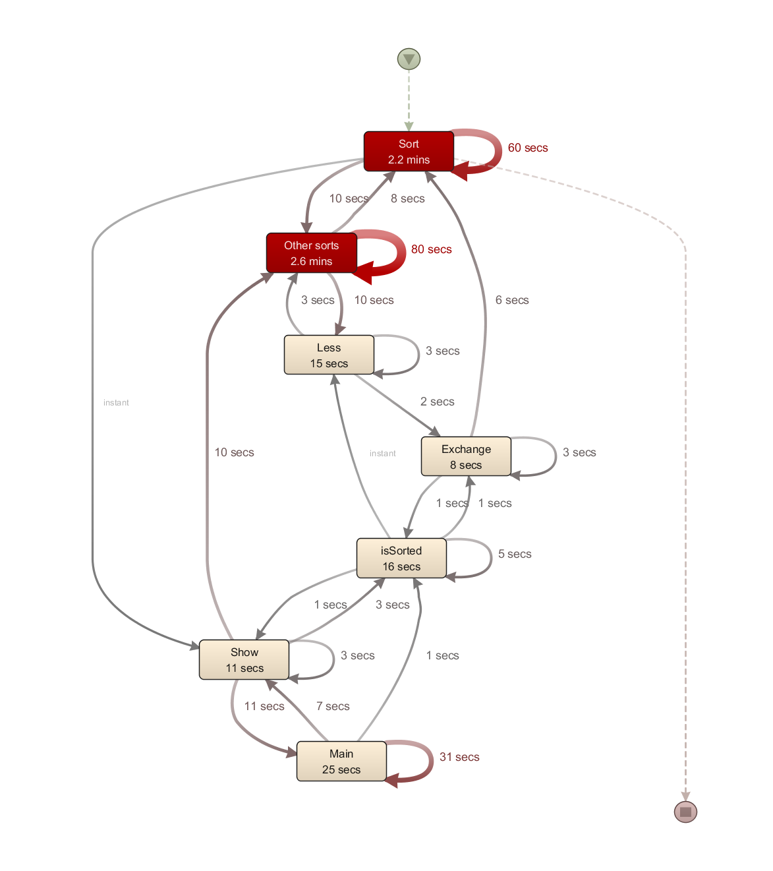
Performing process mining on event logs
User who did not finish
Lots of time spent in the wrong sections
Read everything in order, with some backtracking.

Slide 24
Conclusion
The process collects the data and returns event logs readable by process mining tools
The data presented this way allow for extensive exploration

Slide 25
Future work
More complex and complete process mining exploration of the data
Conformance checking against expected subpaths.
Automatic heuristic scores to detect users not performing as expected

Slide 26

Thanks!
Extending analytics for eye tracking data linked to source code based on iTrace
Dennis Bøgelund Olesen

