Slide 1
Approaches to expose C++ to Python
Dimitar Tasev
Mantid Development Team
ISIS, STFC UKRI

Slide 2
Use cases
Have a C++ codebase
  Want to expose it to Python
  Likely to use Boost Python or Qt SIP
Have a Python codebase
  Want to make it faster by using C++
  Likely to use Boost Python, or Python C interface

Slide 3
Use cases
Have a C++ codebase
  Want to expose it to Python
  Likely to use Boost Python or Qt SIP
Have a Python codebase
  Want to make it faster by using C++
  Likely to use Boost Python, or Python C interface

Slide 4
A few Notes
Boost Python is used in the examples

Slide 5
C++ to Python (Boost Python)
Benefits
  Write code once, use everywhere in Python
Drawbacks
  Requires additional work to maintain Python interface

Slide 6
C++ to Python (Boost Python)
Functions and classes can be exported
Complications
  Classes’ interface needs to be explicitly declared for Python
Boost provides indexing suites for std::vector and std::map

Slide 7
C++ to Python (Boost Python)
Functions and classes can be exported
Complications
  Classes’ interface needs to be explicitly declared for Python
Boost provides indexing suites for std::vector and std::map

Slide 8
C++ to Python (Boost Python)
A simple example
  A single function

Slide 9
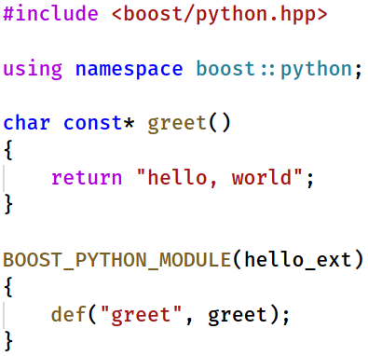
C++ to Python (Boost Python)
hello.cpp
1. Compile to C++ to Position Independent Code (-fpic)
g++ -Wall -fpic -I/usr/include/python2.7/ -I/usr/include/ -c hello.cpp
→ Produces hello.o
2. Turn the compiled object into a shared library
g++ -shared -o hello_ext.so hello.o
-L/usr/lib -lpython2.7 -lboost_python
→ Produces hello_ext.so
3. Importing into Python
import hello_ext
hello_ext.greet()

Slide 10
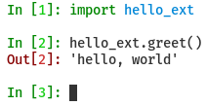
C++ to Python (Boost Python)
hello.cpp
1. Compile to C++ to Position Independent Code (-fpic)
g++ -Wall -fpic -I/usr/include/python2.7/ -I/usr/include/ -c hello.cpp
→ Produces hello.o
2. Turn the compiled object into a shared library
g++ -shared -o hello_ext.so hello.o
-L/usr/lib -lpython2.7 -lboost_python
→ Produces hello_ext.so
3. Importing into Python

Slide 11
C++ to Python (Boost Python)
A simple example
  A single function
A more complicated example
  A class with functions

Slide 12
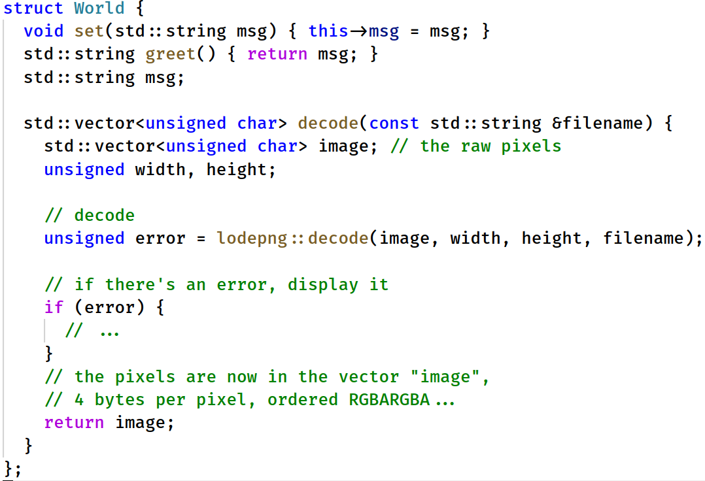
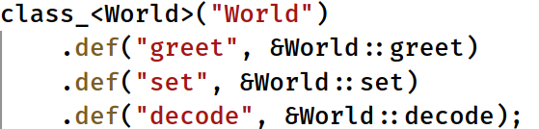
C++ to Python (Boost Python)

Slide 13
C++ to Python (Boost Python)
Compiles.. fine.

Slide 14
C++ to Python (Boost Python)
Compiles.. fine.
When ran:
Traceback (most recent call last):
File "run.py", line 5, in <module>
img = w.decode("img.png")
TypeError: No to_python (by-value) converter found
for C++ type: std::vector<unsigned char, ...>

Slide 15
C++ to Python (Boost Python)
Python does not know what std::vector<unsigned char> is
It does not know how to use it

Slide 16
C++ to Python (Boost Python)
Python does not know what std::vector<unsigned char> is
It does not know how to use it
So we tell it
vector_indexing_suite is provided by Boost

Slide 17
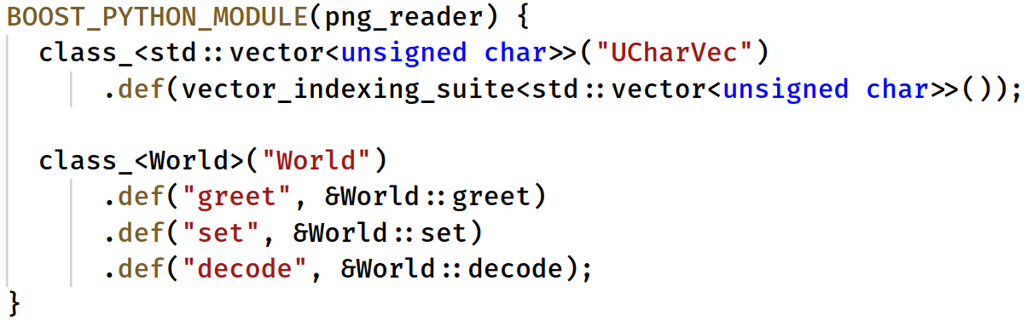
C++ to Python (Boost Python)

Slide 18
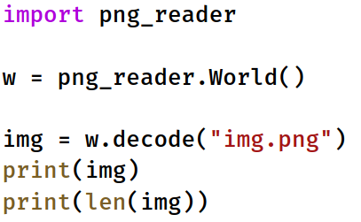
C++ to Python (Boost Python)
python run.py
<png_reader.UCharVec object at 0x7f7cc442ccd0>
47697440
47697440 = 4604 (width) * 2590 (height) * 4 (RGBA)

Slide 19
C++ to Python (Boost Python)
Same work for loading a PNG image
Different approach
Data is fully kept inside a C++ class

Slide 20
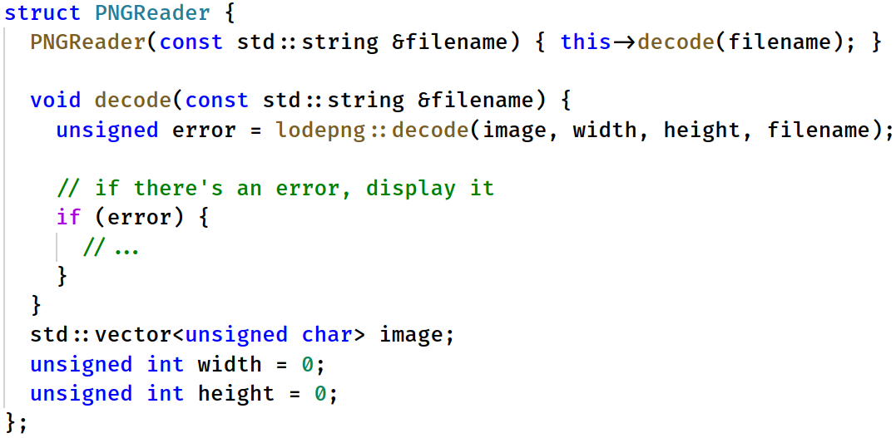
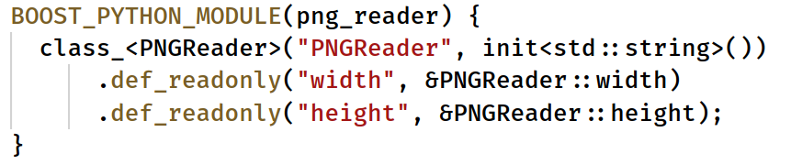
C++ to Python (Boost Python)

Slide 21
C++ to Python
If exporting Qt classes SIP should be used

Slide 22
Python to C++
Benefits
  Speed
Drawbacks
  More complex project setup
  Compile step introduced

Slide 23
Python to C++
Do your research first
  Python has a rich ecosystem
  A library that does what you need might exist
  No need to reinvent the wheel

