Slide 1
Pseudomonas Putida: Gene Regulatory Network Construction
A bioinformatics project
By David Teixeira
Supervisor: Leighton Pritchard

Slide 2
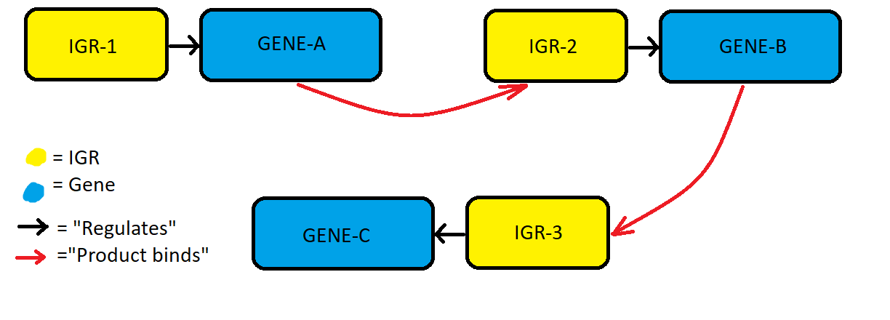
Introduction: What are Gene Regulatory Networks?
Genes are units of DNA encoding proteins/RNA. Expression regulated by sequences upstream/downstream of gene.
Gene Regulatory networks depict how changes to a genes expression affects other genes.
The network allows visualisation of the knock-on effect changes to Gene-A expression affects gene expression as a whole.
Notes:
Cell activities are dictated, in part, by genes and the degree to which they’re expressed which is constantly subject to change. Likewise, gene expression is influenced by the products of genes

Slide 3
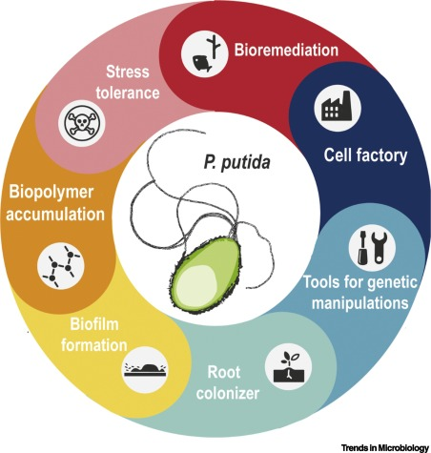
Introduction: What is Pseudomonas Putida
Gram-Negative diverse rod-shaped species of Pseudomonas Genus
>100 Strains – Species exhibit pangenome with accessory genome adaptation to environment.
Why is Pseudomonas putida important?
Common Lab & Industrial use - Manufacture
Uncommon Opportunistic pathogen - causes sepsis & bacteraemia.
AIM: Expand Gene regulatory networks for 222 Pseudomonas Putida genomes produced in a prior internship.
Enables optimisation of lab/industrial use.
Allows study of phylogeny of strains.
Framework for in silico cell models.
Daniel C. Volke et al, Pseudomonas putida, Trends in Microbiology, Volume 28, Issue 6, 2020, https://doi.org/10.1016/j.tim.2020.02.015.
Notes:
Very easy to culture in vitro due to high adaptability and versatile metabolism.
adding new links between genes and removing inaccurate/duplicate data.

Slide 4
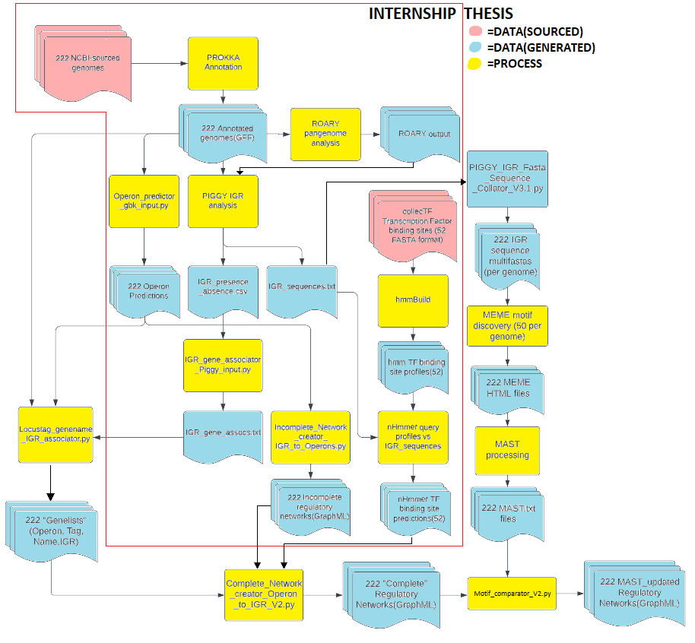
Methods: Summary of internship and Thesis work
Notes:
Entire diagram given to understand how the current point was reached, only thesis part will be discussed

Slide 5
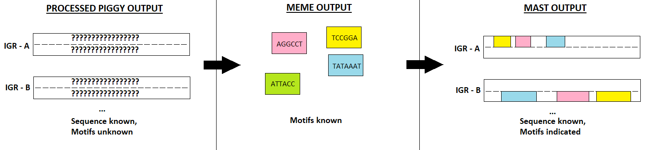
Methods: IGR motif analysis
PIGGY returns whole region(IGR) between genes, not only functional regions.
Protein to DNA binding is sequence specific.
Regions binding same protein(s) have shared features(motifs).
Shared features(motifs) indicate regions bind same protein(s).
MEME identifies motifs, MAST finds given motifs in target.
Notes:
The IGR multifastas were per genome – i.e the file listed the IGR sequences that occurred throughout a single genome – end result was 222 multifastas
Essentially, we ran meme to identify 50 motifs present in each genome
To identify such IGRs, motif identification and comparison is used:
Motifs are short, conserved, repeating sequences with distinct function. IGRs that bind the same TFs have the same/similar motifs.
MEMEsuite is a collection of motif analysis tools, 2 were used with WSL:
MEME for motif identification from IGR multifastas.
MAST for listing motif composition of IGRs according to MEME.HTML & IGR multifastas.
IGRs then merged by motif composition similarity according to MAST using self-made script.

Slide 6
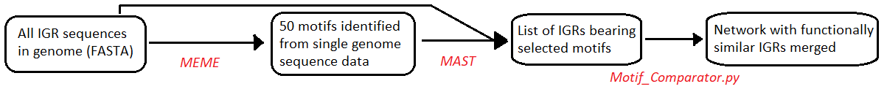
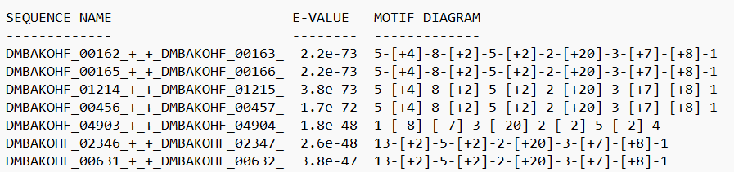
Methods: IGR motif analysis - CONT
Example MAST.txt shown above. Numbers in [] represent motifs, sign represents strand.

Slide 7
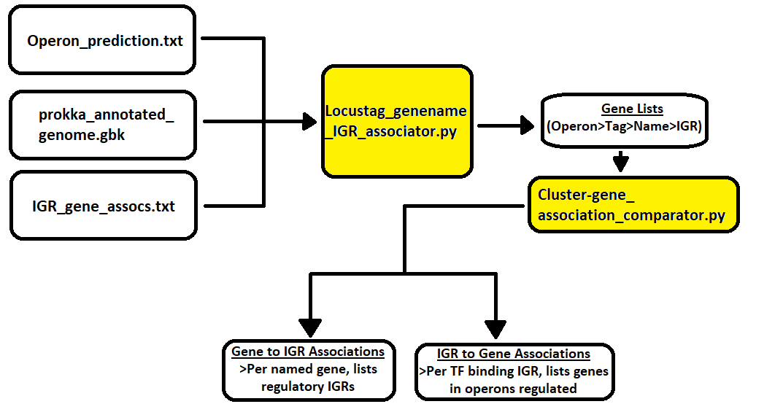
Methods: IGR-gene association analysis
Lack of Transcription factor binding site data limits network development.
Genes downstream of IGRs were analysed as a side-project
Different IGR-gene association may be responsible for differing phenotypes in genetically similar strains.
Notes:
Generally, most genes had a single major(frequent) IGR and a few minor(infrequent) IGRs to associate with.

Slide 8
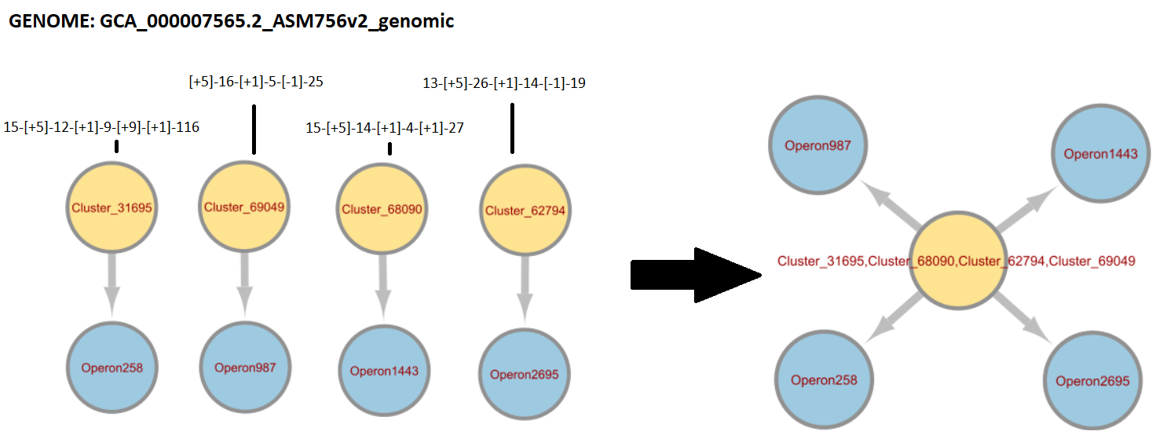
Results: IGR motif analysis merges
>3000 IGRs(Clusters) identified per genome – 20-150 merged per genome.
Genes grouped into (predicted) operons to reduce graph clutter.
Notes:
“Cluster nodes” refer to IGRs bearing “x” sequence, rather than specific occurrences of IGR

Slide 9
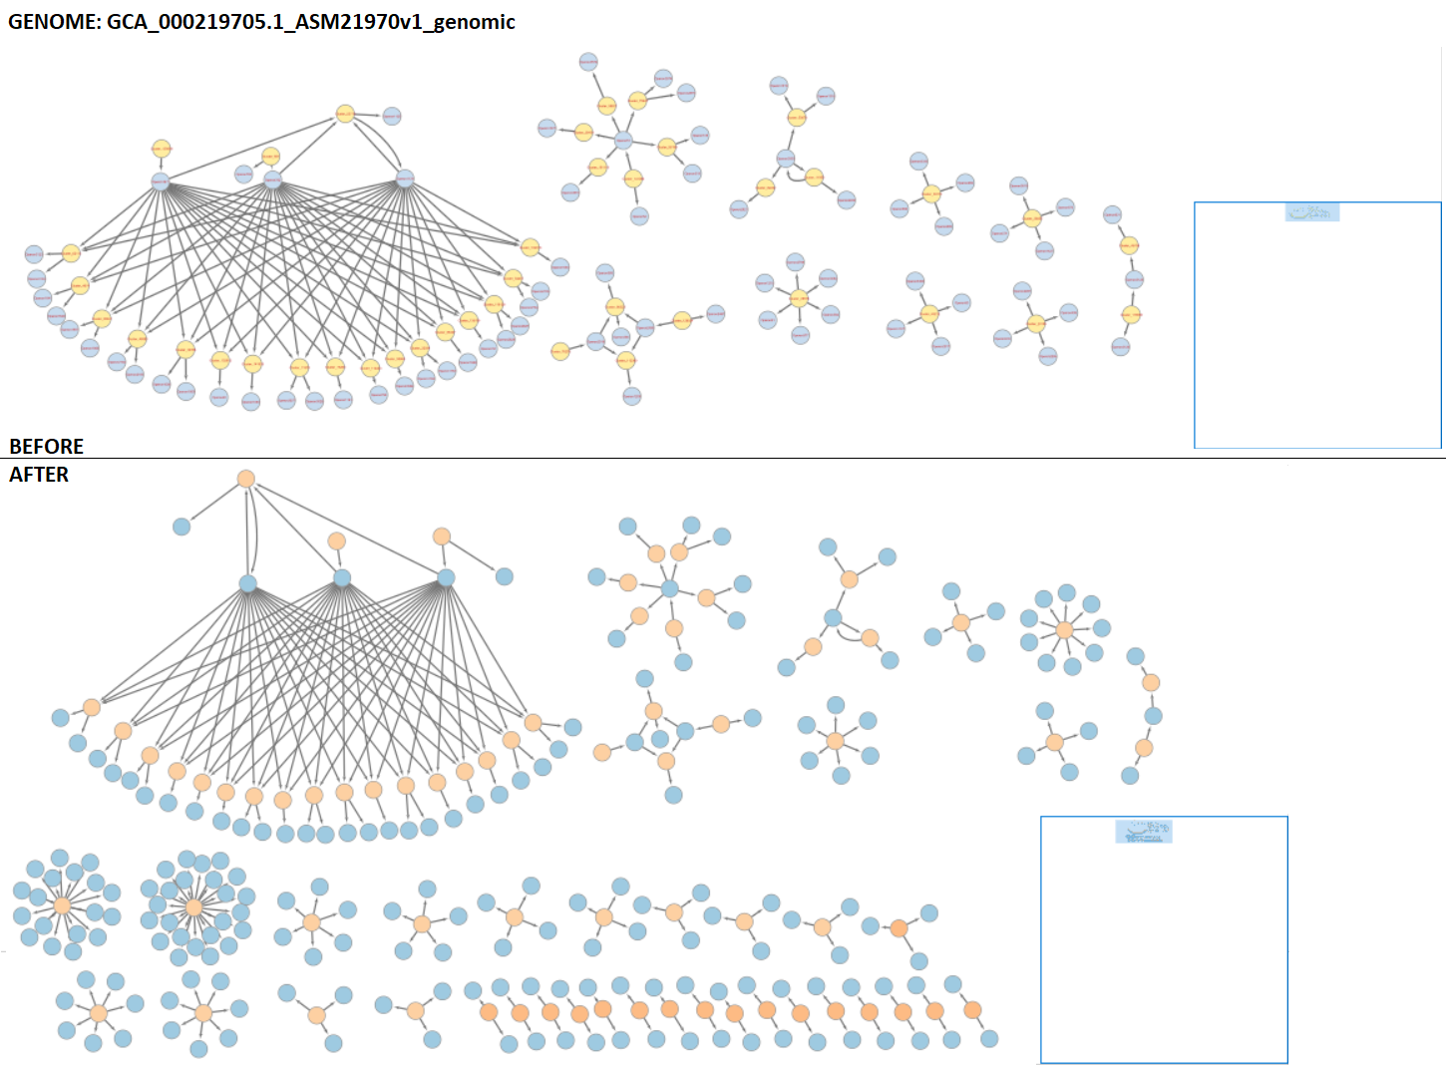
Results: IGR motif analysis merges - CONT
Notes:
Not intended for viewer to be able to read, just to show the beginnings of the network forming(igrs forming edge to operon forming edge to diff IGR forming edge to diff operon…) whilst highlighting that not much more can be done without further transcription factor binding data for p putida

Slide 10
Discussion & future work
Motif comparison enabled IGR merging according to functionality.
Networks less cluttered and more connected but still very incomplete.
IGR association analysis tools produced but yield no results so far
Requires manual review & more complete networks – time consuming.
Next steps?
Identifying the ~2000 unidentified genes per genome.
Obtain further binding site data.
Account for positive & negative regulation by TFs.
Analyse IGR-gene association differences & effect on overall gene expression.

