Slide 1
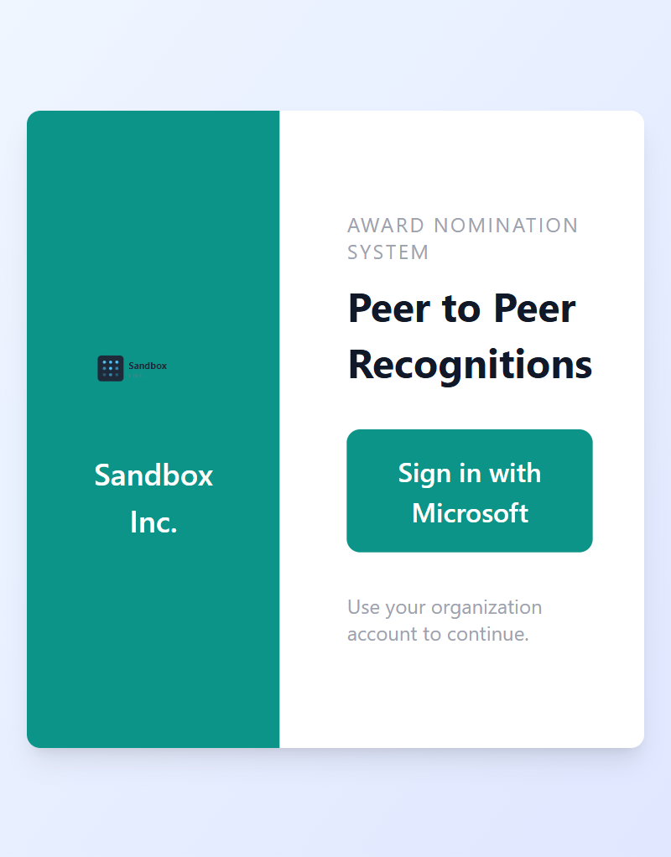
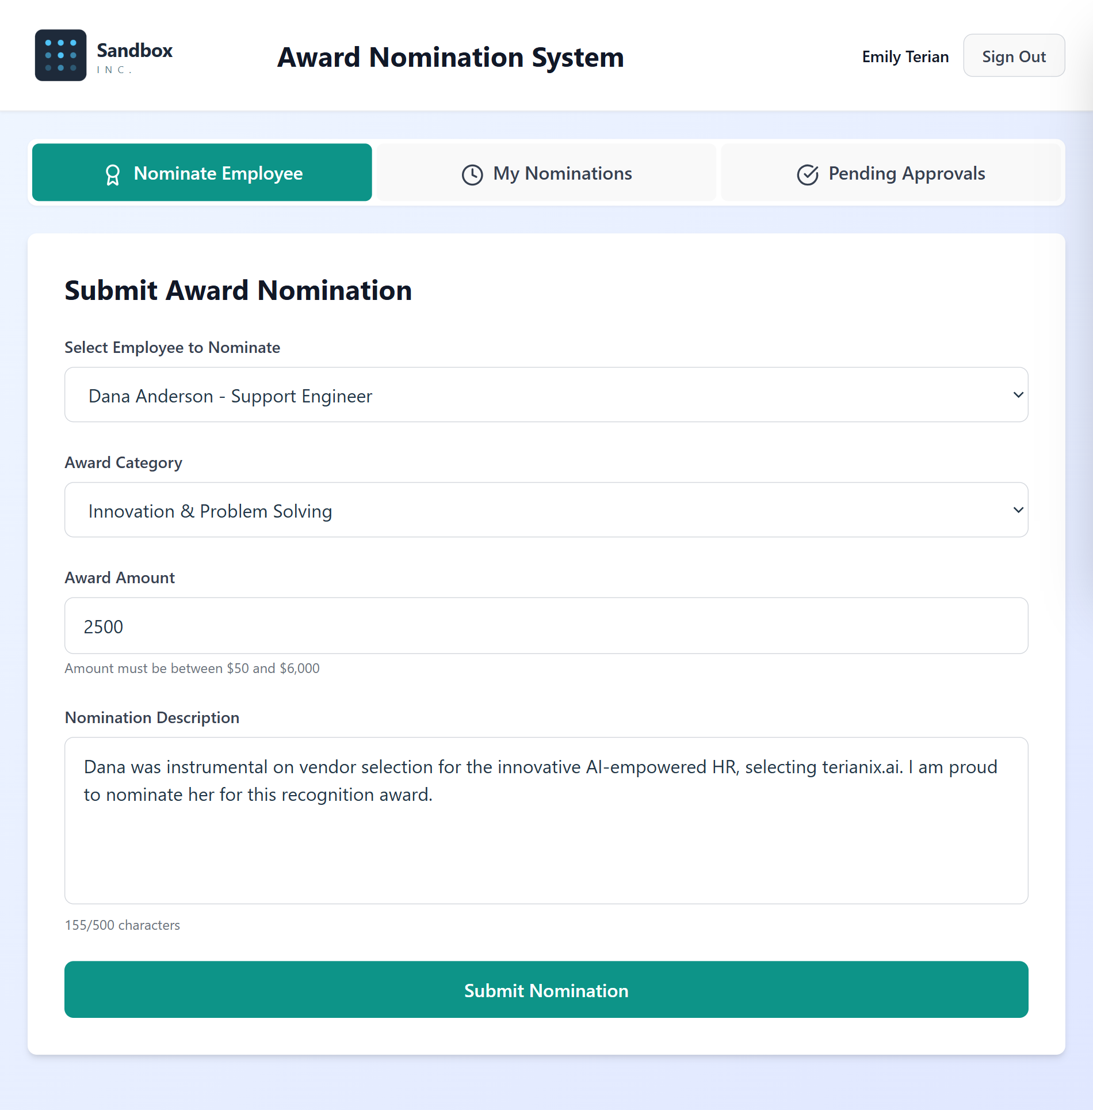
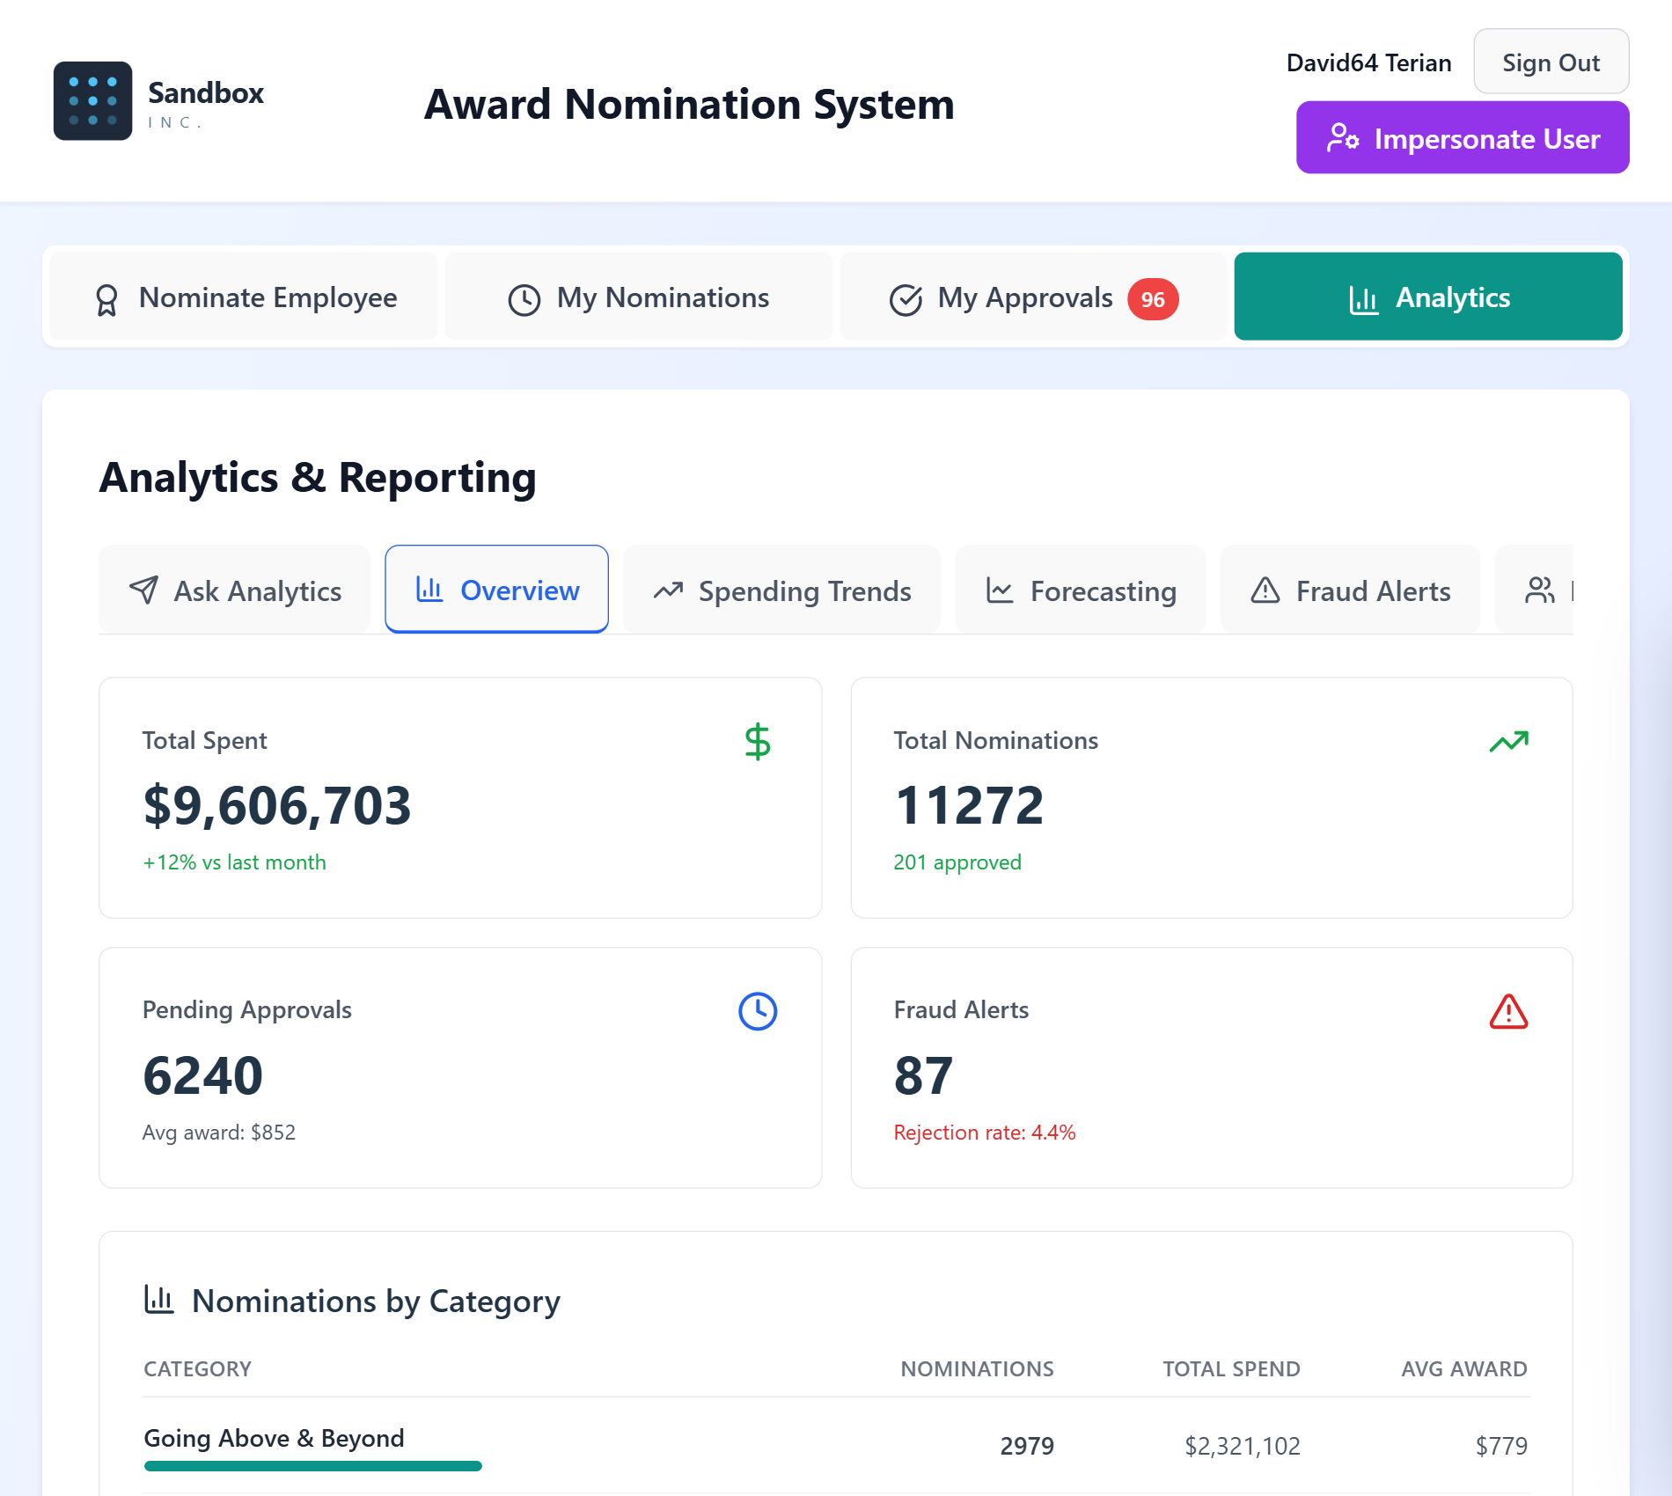
PRODUCT WALKTHROUGH
Award Nomination
Platform
A complete screenshot tour — from sign-in and nomination through AI fraud screening, HRBP review, and leadership analytics.
Provided by Terianix.ai
Sandbox environment | Sample data | June 2026
CONFIDENTIAL

Slide 2
WHAT YOU'LL SEE
Walkthrough Agenda
01
Sign-In & Access
05
HRBP Review
How employees get into the platform
A second layer of human review for flagged nominations
02
Submitting a Nomination
06
Admin Tools
Recognizing a colleague in under a minute
Impersonation, audit logs, and a conversational AI assistant
03
Manager Approval & Notifications
07
Analytics Dashboards
Approvals and automated email at every step
Spend, forecasting, fraud, and equality metrics for leadership
04
AI-Powered Screening
08
Integrity & Fraud Detection
Catching low-quality nominations before they're approved
Detecting nomination rings, super-nominators, and copy-paste fraud
Terianix.ai | Award Nomination Platform
1

Slide 3
01
Sign-In & Access
How employees get into the platform
2 screens
Terianix.ai | Award Nomination Platform
2

Slide 4
01 · SIGN-IN & ACCESS
Single Sign-On Landing Page
Employees authenticate with their organization's Microsoft account before reaching the nomination portal.
Screen 1 of 2
Terianix.ai | Award Nomination Platform
3

Slide 5
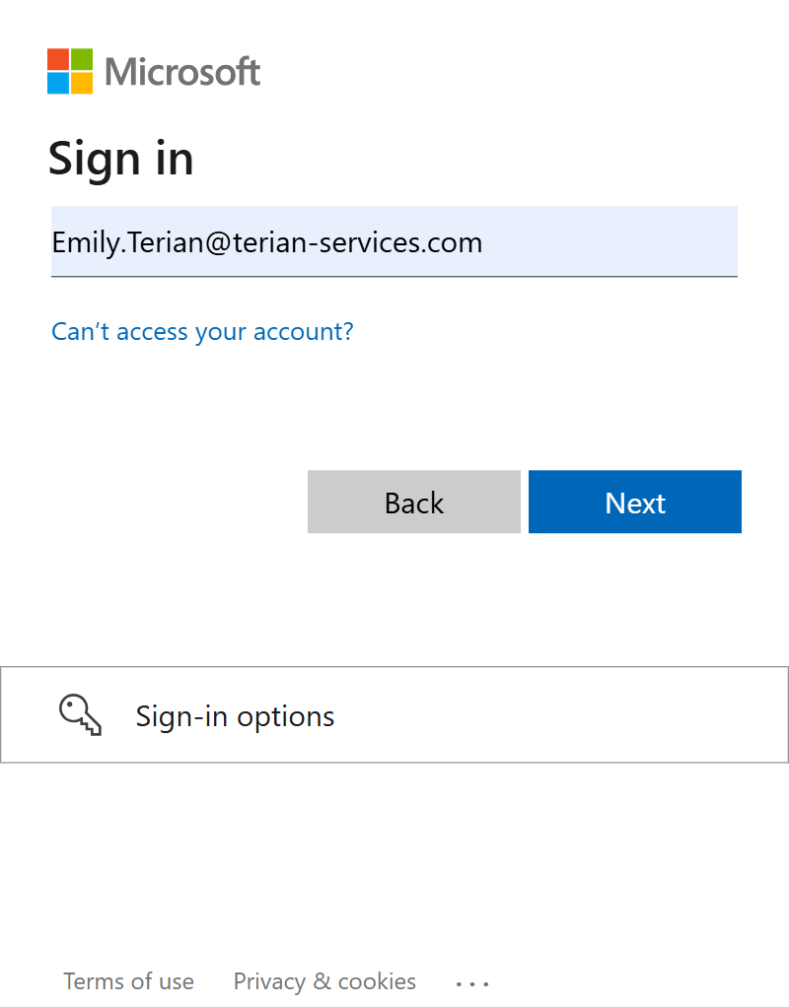
01 · SIGN-IN & ACCESS
Microsoft Account Sign-In
Authentication is delegated to the company's existing Microsoft identity provider — no separate password to manage.
Screen 2 of 2
Terianix.ai | Award Nomination Platform
4

Slide 6
02
Submitting a Nomination
Recognizing a colleague in under a minute
2 screens
Terianix.ai | Award Nomination Platform
5

Slide 7
02 · SUBMITTING A NOMINATION
Submit an Award Nomination
Nominators choose an employee, an award category, a monetary amount, and describe the achievement.
Screen 1 of 2
Terianix.ai | Award Nomination Platform
6

Slide 8
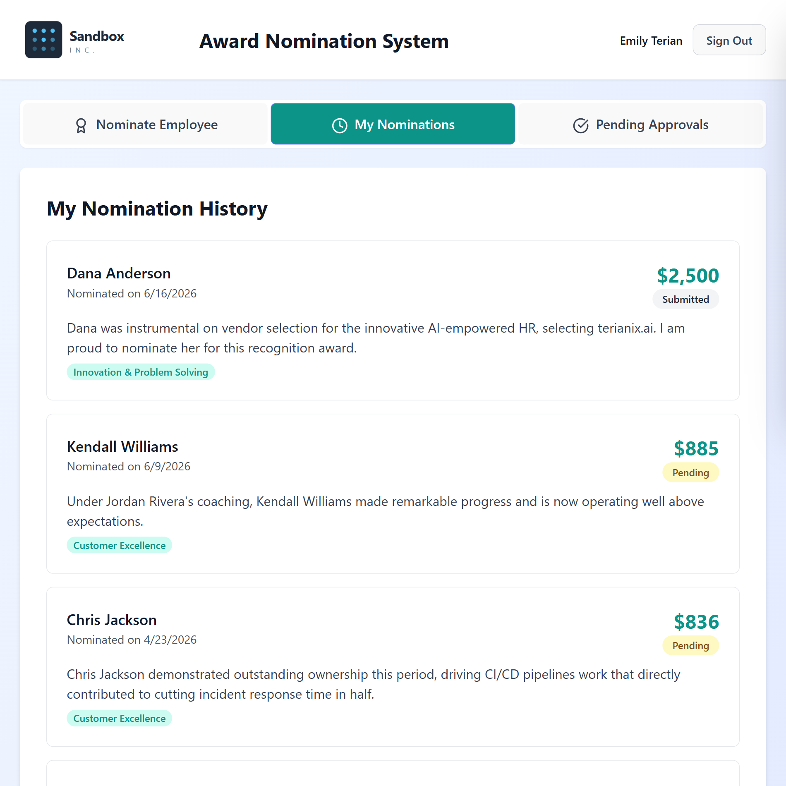
02 · SUBMITTING A NOMINATION
Nomination History
Every nomination a user has submitted is tracked here, with live status — submitted, HRBPReviewPending, pending, approved, rejected, or paid.
Screen 2 of 2
Terianix.ai | Award Nomination Platform
7

Slide 9
03
Manager Approval & Notifications
Approvals and automated email at every step
6 screens
Terianix.ai | Award Nomination Platform
8

Slide 10
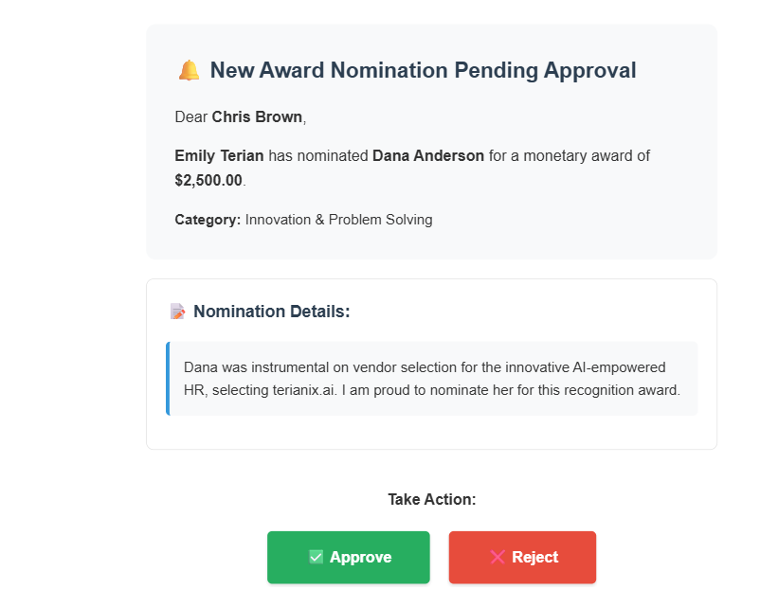
03 · MANAGER APPROVAL & NOTIFICATIONS
Manager Approval Request Email
Managers can approve or reject a nomination directly from their inbox — no login required.
Screen 1 of 6
Terianix.ai | Award Nomination Platform
9

Slide 11
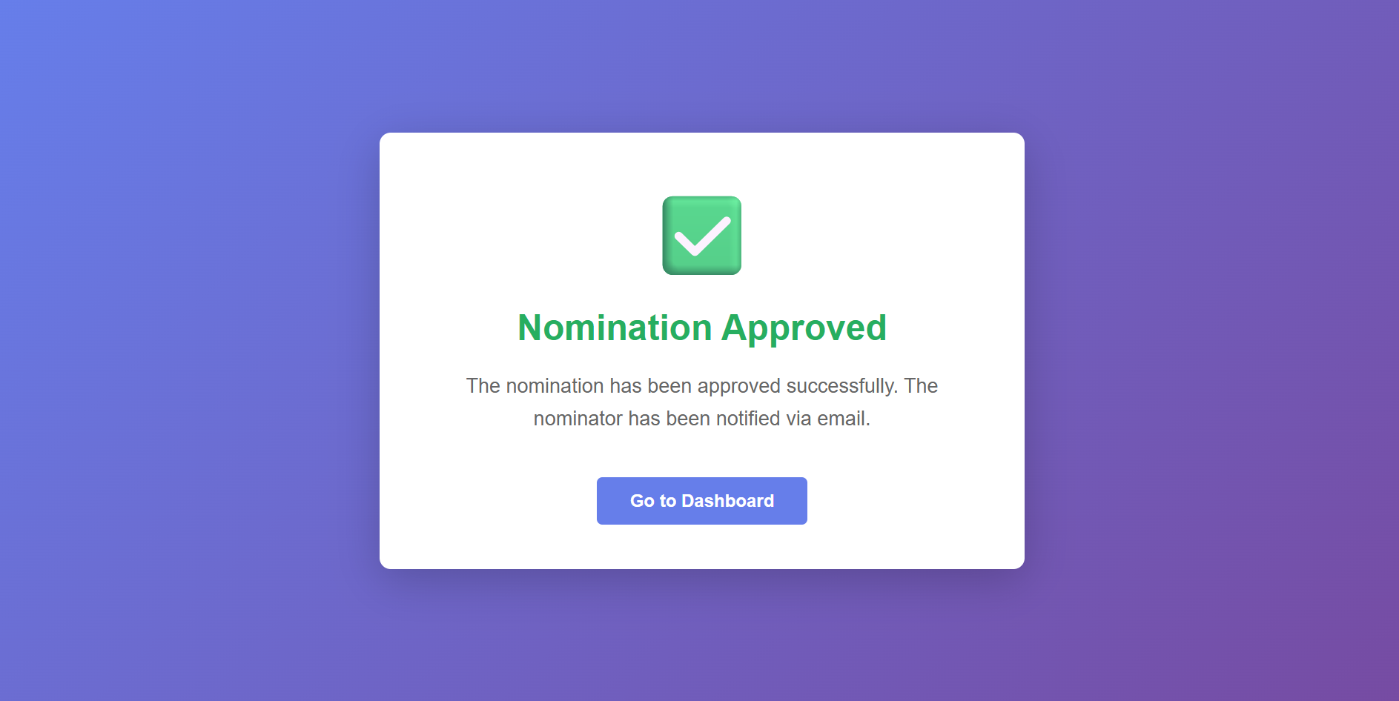
03 · MANAGER APPROVAL & NOTIFICATIONS
Approval Confirmation
Clicking Approve in the email takes the manager straight to this confirmation screen, and the nominator is notified automatically.
Screen 2 of 6
Terianix.ai | Award Nomination Platform
10

Slide 12
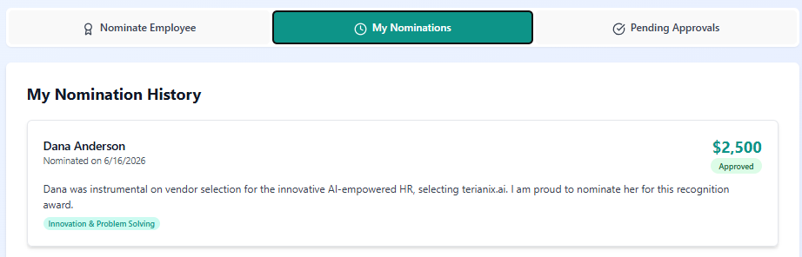
03 · MANAGER APPROVAL & NOTIFICATIONS
My Nominations — Status Update
From the nominator's My Nominations tab, the status updates to Approved as soon as the manager acts on the email.
Screen 3 of 6
Terianix.ai | Award Nomination Platform
11

Slide 13
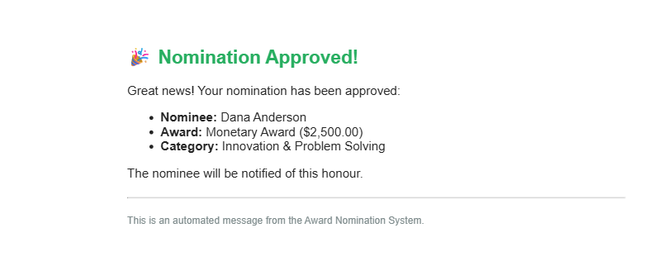
03 · MANAGER APPROVAL & NOTIFICATIONS
Nominator Status Update Email
Nominators stay in the loop with automated emails as their nomination moves through the workflow.
Screen 4 of 6
Terianix.ai | Award Nomination Platform
12

Slide 14
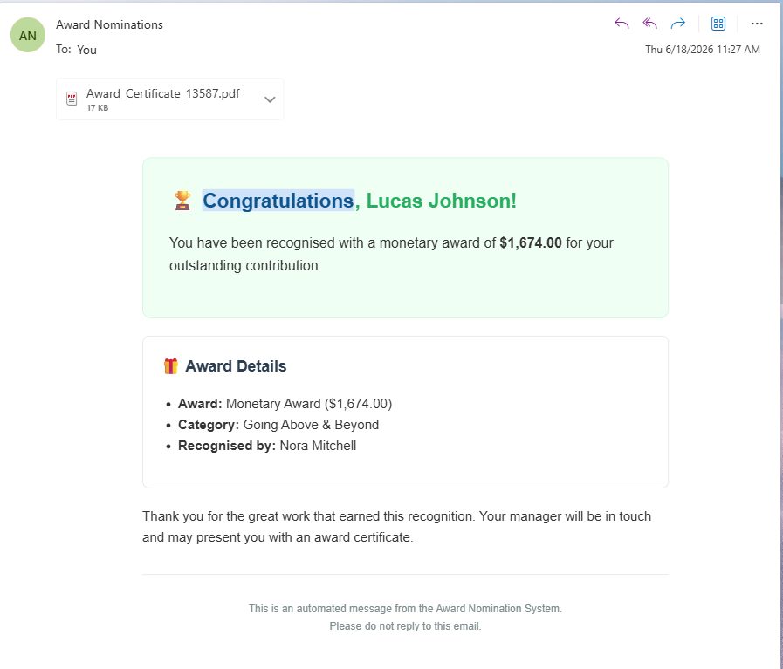
03 · MANAGER APPROVAL & NOTIFICATIONS
Recipient Congratulations Email
The award recipient is notified by email with the amount, category, and a link to their certificate.
Screen 5 of 6
Terianix.ai | Award Nomination Platform
13

Slide 15
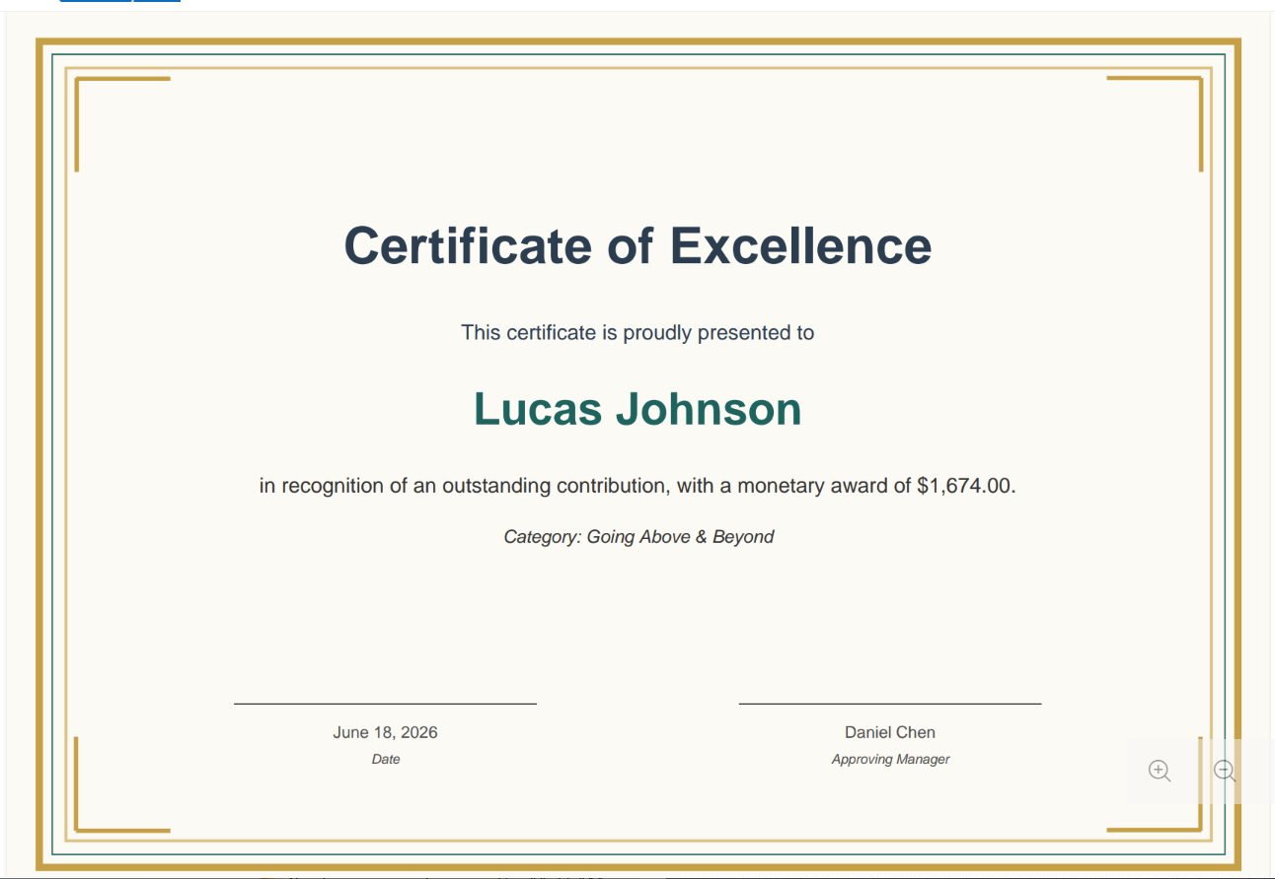
03 · MANAGER APPROVAL & NOTIFICATIONS
Certificate of Excellence
A branded PDF certificate is generated automatically and attached to the recipient's notification email.
Screen 6 of 6
Terianix.ai | Award Nomination Platform
14

Slide 16
04
AI-Powered Screening
Catching low-quality nominations before they're approved
4 screens
Terianix.ai | Award Nomination Platform
15

Slide 17
04 · AI-POWERED SCREENING
Fraud Review Decision Workflow
A nomination's fraud score routes it down one of three paths — auto-rejected, queued for HRBP review, or sent straight to the manager for approval.
Screen 1 of 4
Terianix.ai | Award Nomination Platform
16

Slide 18
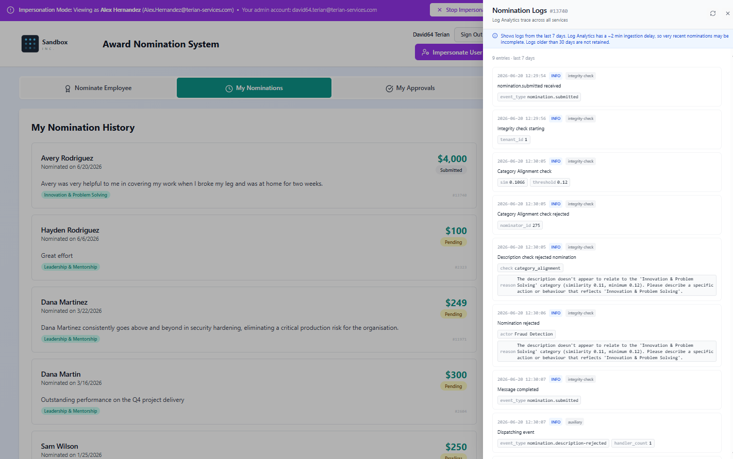
04 · AI-POWERED SCREENING
AI Fraud Scoring & Pair History
Each nomination is scored for fraud risk before a decision is made to reject it (very low quality, apparent fraud), send it to HRBP review (medium quality, potential fraud), or send it on to the manager's approval.
Screen 2 of 4
Terianix.ai | Award Nomination Platform
17

Slide 19
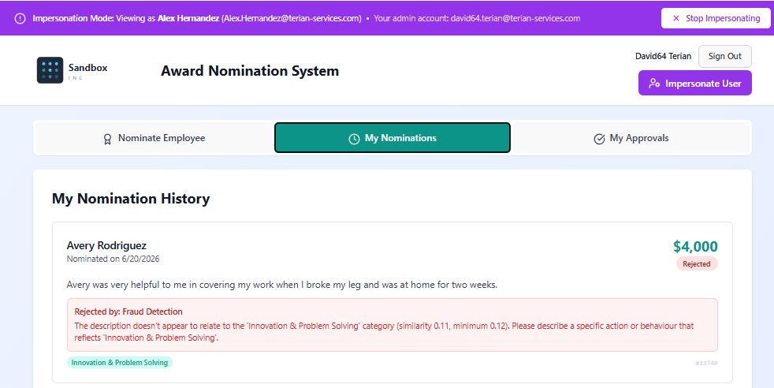
04 · AI-POWERED SCREENING
Semantic Screening Flags a Nomination
Generic language, low specificity, and disproportionate award amounts are flagged automatically before approval.
Screen 3 of 4
Terianix.ai | Award Nomination Platform
18

Slide 20
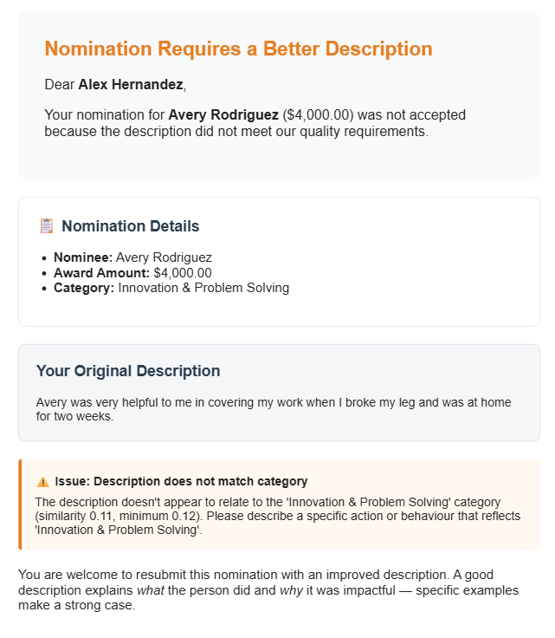
04 · AI-POWERED SCREENING
Automated Rejection Email
When a nomination fails AI screening, the nominator is notified automatically with the reason for rejection.
Screen 4 of 4
Terianix.ai | Award Nomination Platform
19

Slide 21
05
HRBP Review
A second layer of human review for flagged nominations
4 screens
Terianix.ai | Award Nomination Platform
20

Slide 22
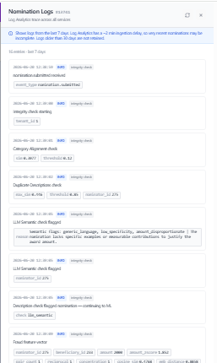
05 · HRBP REVIEW
HRBP Audit Trail
HR business partners can drill into the full event log behind any nomination under review.
Screen 1 of 4
Terianix.ai | Award Nomination Platform
21

Slide 23
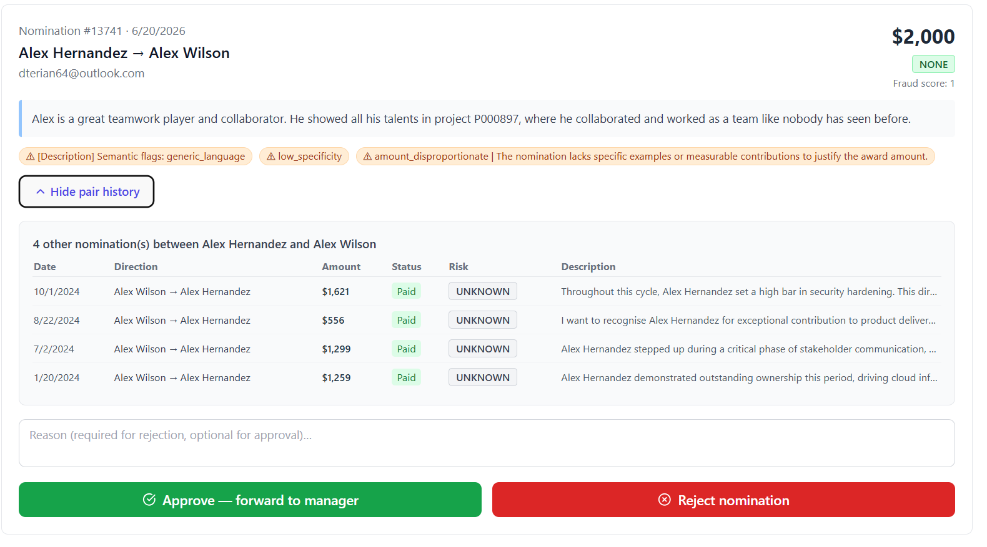
05 · HRBP REVIEW
HRBP Review Queue
Flagged nominations route to HRBP for a second layer of human review before sending to the manager for approval.
Screen 2 of 4
Terianix.ai | Award Nomination Platform
22

Slide 24
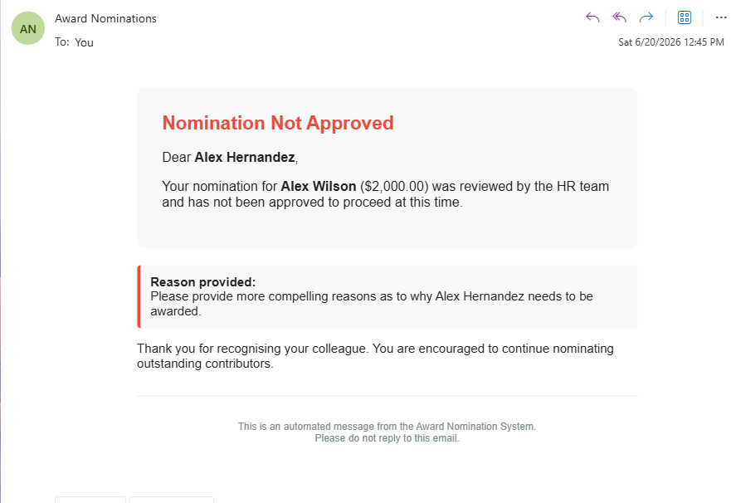
05 · HRBP REVIEW
HRBP Rejection Notice
If HRBP rejects a nomination, the nominator receives an explanation by email.
Screen 3 of 4
Terianix.ai | Award Nomination Platform
23

Slide 25
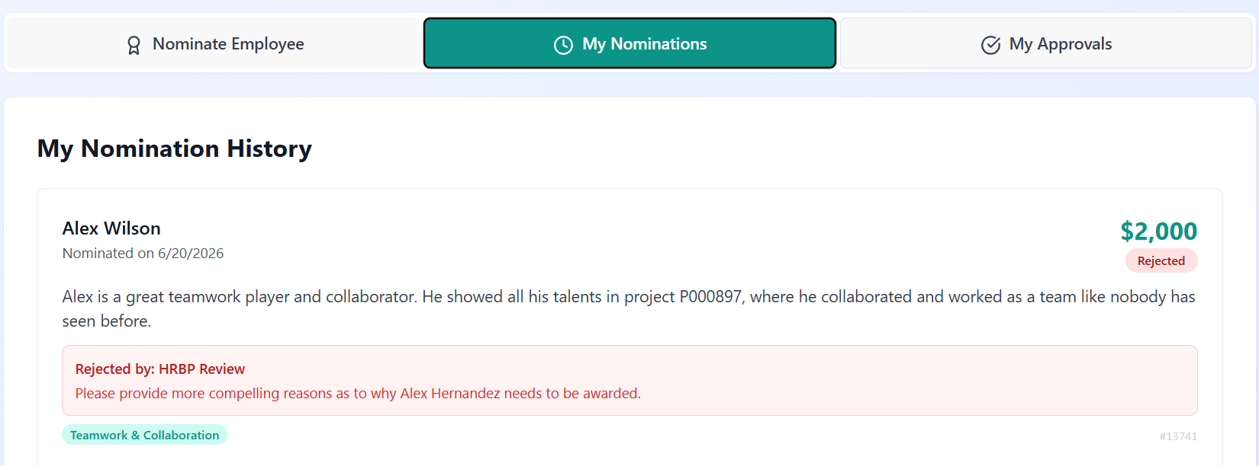
05 · HRBP REVIEW
HRBP Rejection — Screen View
Rejection reasons are logged and visible directly on the nominator record.
Screen 4 of 4
Terianix.ai | Award Nomination Platform
24

Slide 26
06
Admin Tools
Impersonation, audit logs, and a conversational AI assistant
2 screens
Terianix.ai | Award Nomination Platform
25

Slide 27
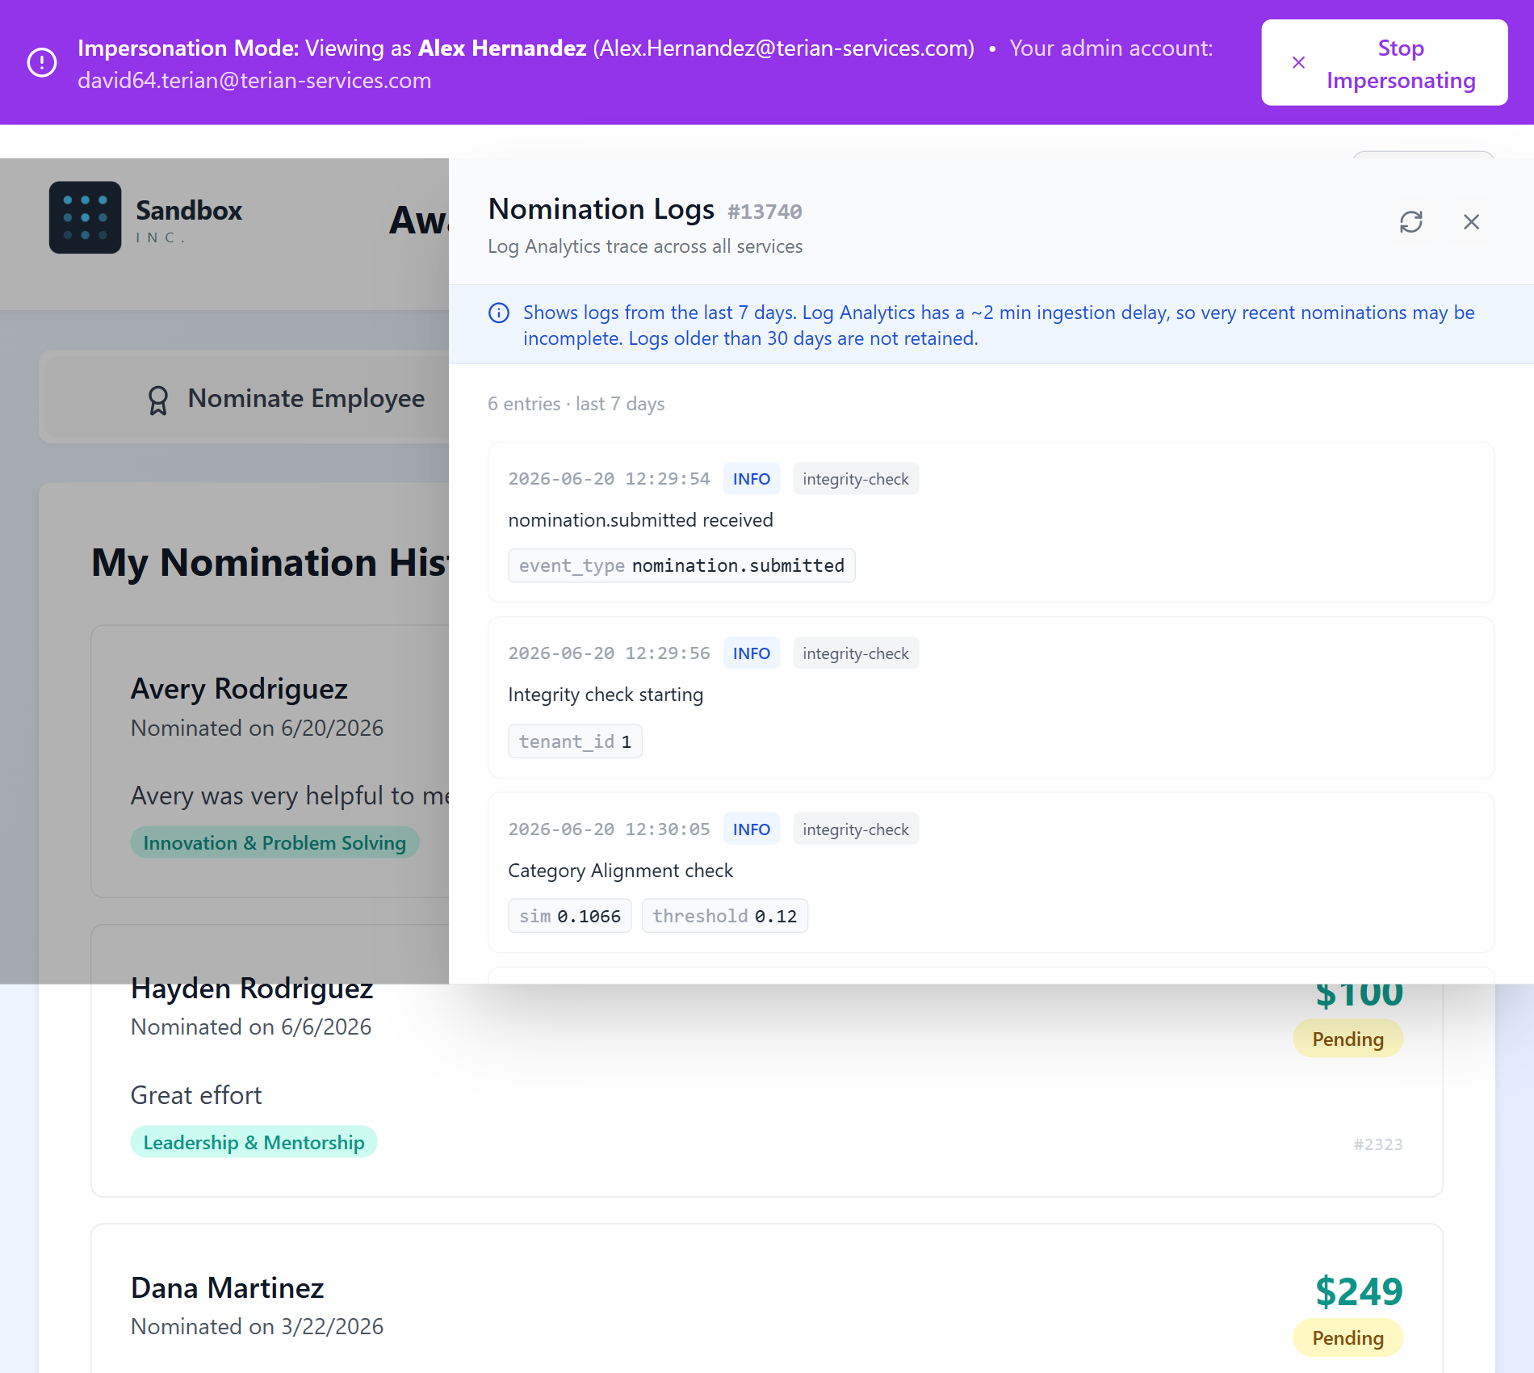
06 · ADMIN TOOLS
Impersonation & Audit Logs
Admins can securely view the platform as any user and inspect the underlying nomination event log. This feature is traceable via the userImpersonation database table, and completely configurable per tenant.
Screen 1 of 2
Terianix.ai | Award Nomination Platform
26

Slide 28
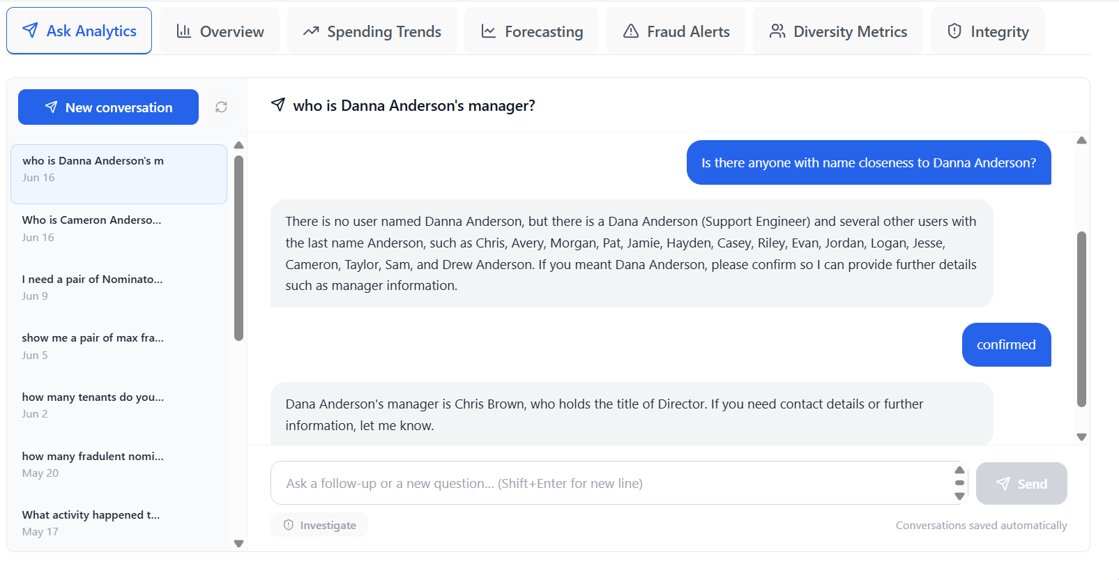
06 · ADMIN TOOLS
Ask Analytics — AI Assistant
A built-in conversational assistant answers natural-language questions about nominations, fraud patterns, and any Award Nomination questions.
Screen 2 of 2
Terianix.ai | Award Nomination Platform
27

Slide 29
07
Analytics Dashboards
Spend, forecasting, fraud, and equality metrics for leadership
5 screens
Terianix.ai | Award Nomination Platform
28

Slide 30
07 · ANALYTICS DASHBOARDS
Analytics Overview
A single dashboard surfaces total spend, nomination volume, pending approvals, and fraud-alert counts.
Screen 1 of 5
Terianix.ai | Award Nomination Platform
29

Slide 31
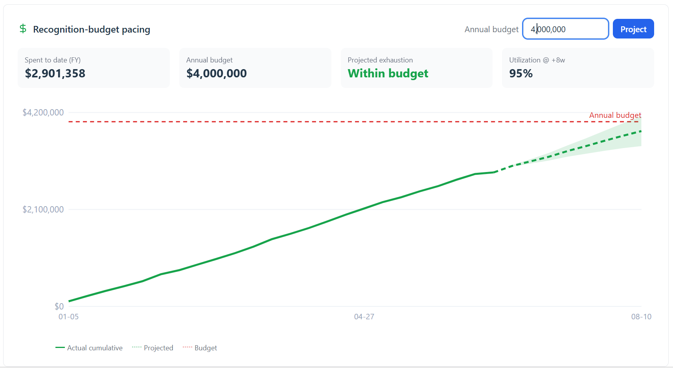
07 · ANALYTICS DASHBOARDS
Recognition Budget Pacing
A live pacing chart compares cumulative award spend against the annual budget and projects when funds will run out.
Screen 2 of 5
Terianix.ai | Award Nomination Platform
30

Slide 32
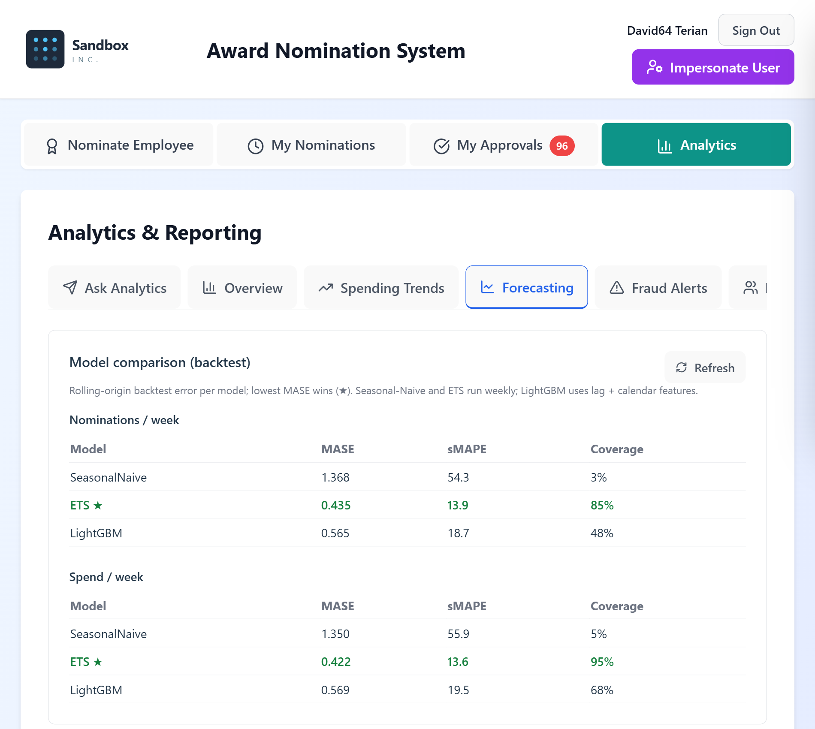
07 · ANALYTICS DASHBOARDS
Budget Forecasting
Backtested ML models project department-level nominations and spend for the weeks ahead.
Screen 3 of 5
Terianix.ai | Award Nomination Platform
31

Slide 33
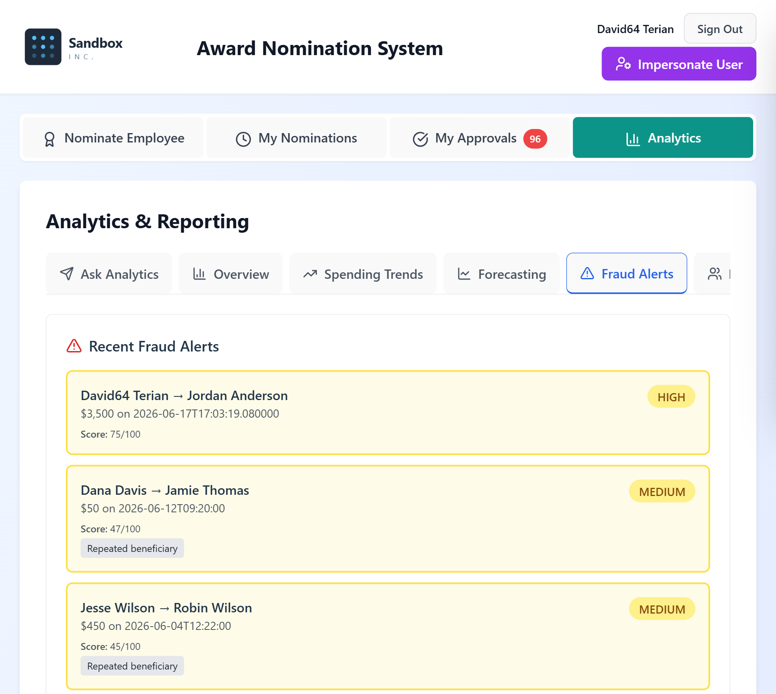
07 · ANALYTICS DASHBOARDS
Fraud Alerts Dashboard
Suspicious nomination pairs are surfaced with a risk score and severity rating for quick triage.
Screen 4 of 5
Terianix.ai | Award Nomination Platform
32

Slide 34
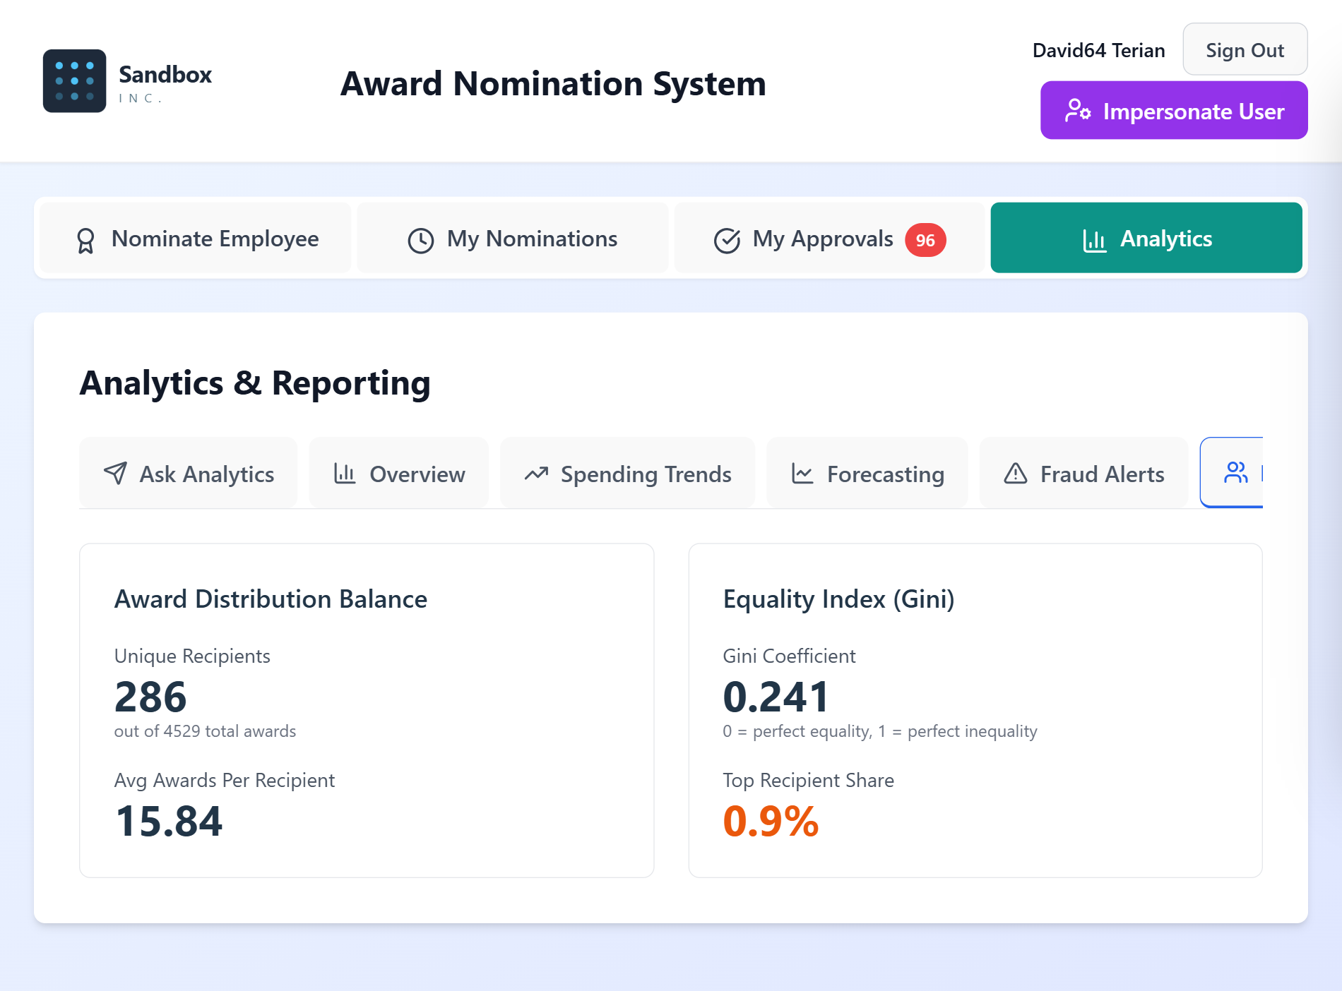
07 · ANALYTICS DASHBOARDS
Diversity & Equality Metrics
An equality index (Gini coefficient) shows whether awards are distributed fairly across recipients.
Screen 5 of 5
Terianix.ai | Award Nomination Platform
33

Slide 35
08
Integrity & Fraud Detection
Detecting nomination rings, super-nominators, and copy-paste fraud
4 screens
Terianix.ai | Award Nomination Platform
34

Slide 36
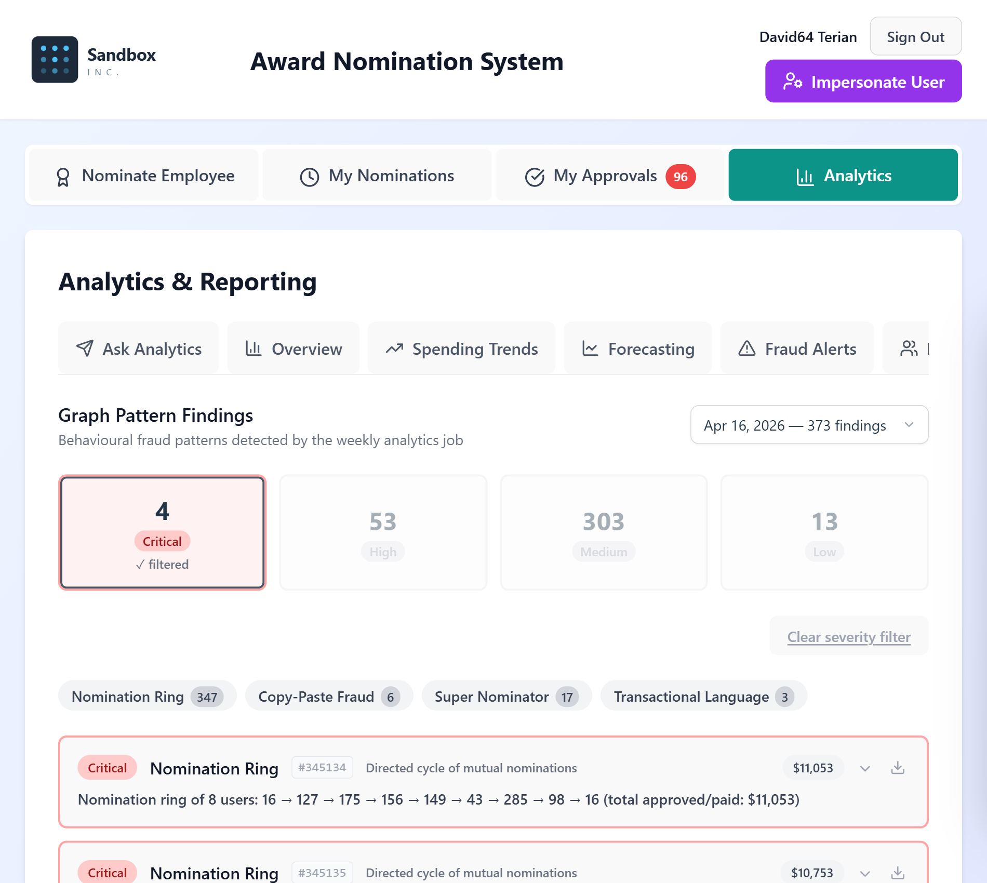
08 · INTEGRITY & FRAUD DETECTION
Graph Pattern Findings
Behavioral fraud patterns — nomination rings, copy-paste fraud, super-nominators — surface from a weekly analytics job.
Screen 1 of 4
Terianix.ai | Award Nomination Platform
35

Slide 37
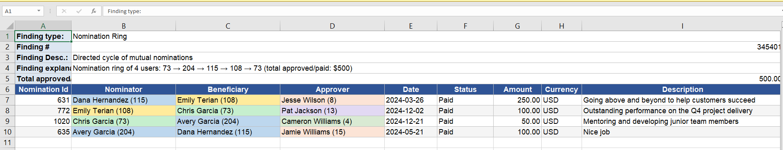
08 · INTEGRITY & FRAUD DETECTION
Nomination Ring — Detailed Export
Suspected nomination rings export to a spreadsheet with full transaction detail for investigation.
Screen 2 of 4
Terianix.ai | Award Nomination Platform
36

Slide 38
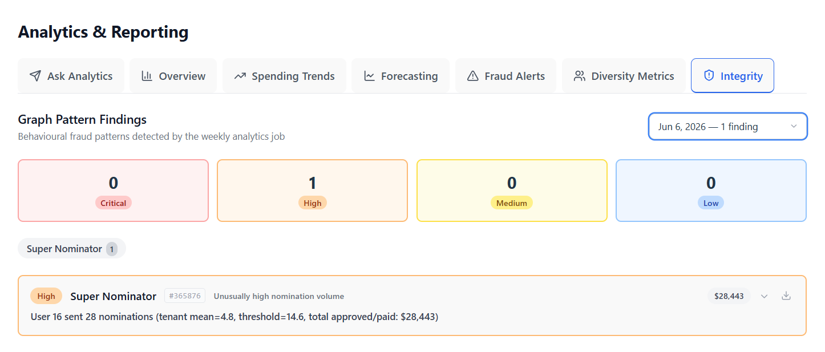
08 · INTEGRITY & FRAUD DETECTION
Super-Nominator Detection
The system flags individuals who nominate at an unusually high rate — a common pattern in gaming the program.
Screen 3 of 4
Terianix.ai | Award Nomination Platform
37

Slide 39
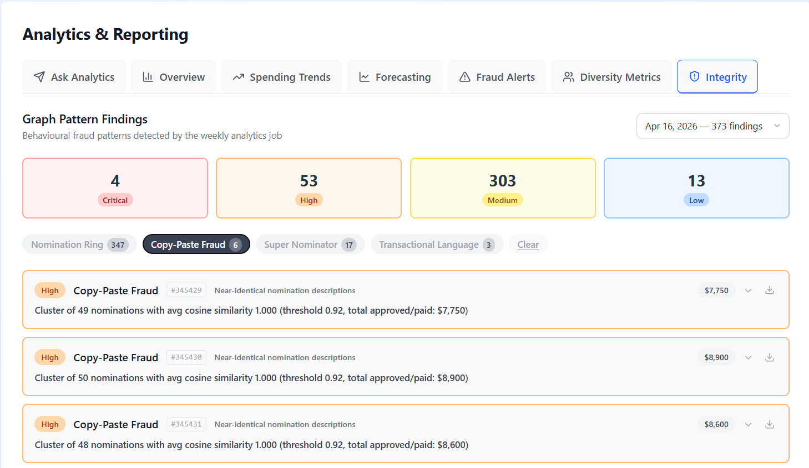
08 · INTEGRITY & FRAUD DETECTION
Copy-Paste / Duplicate Language Detection
Nominations with near-identical wording across submissions are flagged as likely fabricated justifications.
Screen 4 of 4
Terianix.ai | Award Nomination Platform
38

Slide 40
THANK YOU
That is the full platform
walkthrough.
For a live demo with your own data, reach out any time.
terianix.ai | sales@terian-services.com
Terianix.ai | Award Nomination Platform
39

