Slide 1

Provided by: Terianix.ai
CONFIDENTIAL | {{PRESENTATION_DATE}}
Award Nomination
Platform
Enterprise SaaS Solution for Employee Recognition
Presented to:
{{CLIENT_NAME}}
terianix.ai | sales@terian-services.com

Slide 2
Provided by: Terianix.ai
Agenda
Today's Discussion
01
Platform Capabilities
04
Support SLA
Core nomination workflow, fraud detection, AI analytics
Response times, escalation paths, and maintenance windows
02
Architecture & Security
05
Pricing & Tiers
Multi-tenant SaaS, private networking, high availability
Starter, Professional & Enterprise tiers
03
Onboarding Roadmap
06
Next Steps
Four-phase onboarding from kick-off to go-live (4–6 weeks)
Pilot agreement, timeline, and sign-off

Slide 3
Provided by: Terianix.ai
Platform Overview
Award Nomination Platform
A cloud-native, multi-tenant SaaS solution for employee recognition — built on Microsoft Azure.
99.99%
2
< 60s
GPT-4o
API Gateway Uptime
(Azure Front Door)
Active Regions
(East + West US)
Automatic Failover
RTO
AI Analytics Engine
(Azure OpenAI)
Employee Nominations
Manager Approval Flow
ML Fraud Detection
AI Analytics Agent
Intuitive React SPA — employees nominate colleagues with amount, reason, and supporting evidence.
Email-based approval with cryptographic single-use tokens. No portal login required for managers.
20+ feature Random Forest classifier plus SQL rule-based checks automatically block high-risk nominations.
Ask natural language questions about nomination data. Powered by GPT-4o with direct SQL tool access.

Slide 4
Provided by: Terianix.ai
Platform Capabilities — Nomination Workflow
Core Nomination Workflow
1
Submit Nomination
2
Fraud Screening
Employee logs in via their company portal (custom subdomain). Selects a colleague, enters award amount, and describes the achievement.
Platform instantly scores the nomination using ML + SQL rules. CRITICAL risk (score 70–100) is blocked automatically. Others proceed.
3
Manager Notification
4
Approval & Audit
Manager receives an email with full nomination details, plus one-click Approve / Reject buttons using secure, single-use tokens.
Approved nominations are logged with timestamp, approver, and full history. Admins can view all activity via the audit dashboard.
Fully automated flow — from submission to approval record, with no manual system intervention required.

Slide 5
Provided by: Terianix.ai
Platform Capabilities — Fraud Detection
Built-In Fraud Detection
Every nomination is automatically screened before it reaches a manager — protecting {{CLIENT_NAME}} from misuse.
Layer 1 — Rule-Based SQL Checks
Layer 2 — ML Classifier (Random Forest)
High nomination frequency
Repeated beneficiary patterns
Circular / reciprocal schemes
Unusually high amounts (> 2σ from baseline)
Rapid approvals (< 1 hour)
Self-dealing network detection
20+ engineered features · Temporal + behavioural signals · Peer-group amount anomalies
CRITICAL
Score 70–100
Auto-blocked
HIGH
Score 50–69
Manual review
MEDIUM
Score 30–49
Monitored
LOW
Score 1–29
Logged & passed

Slide 6
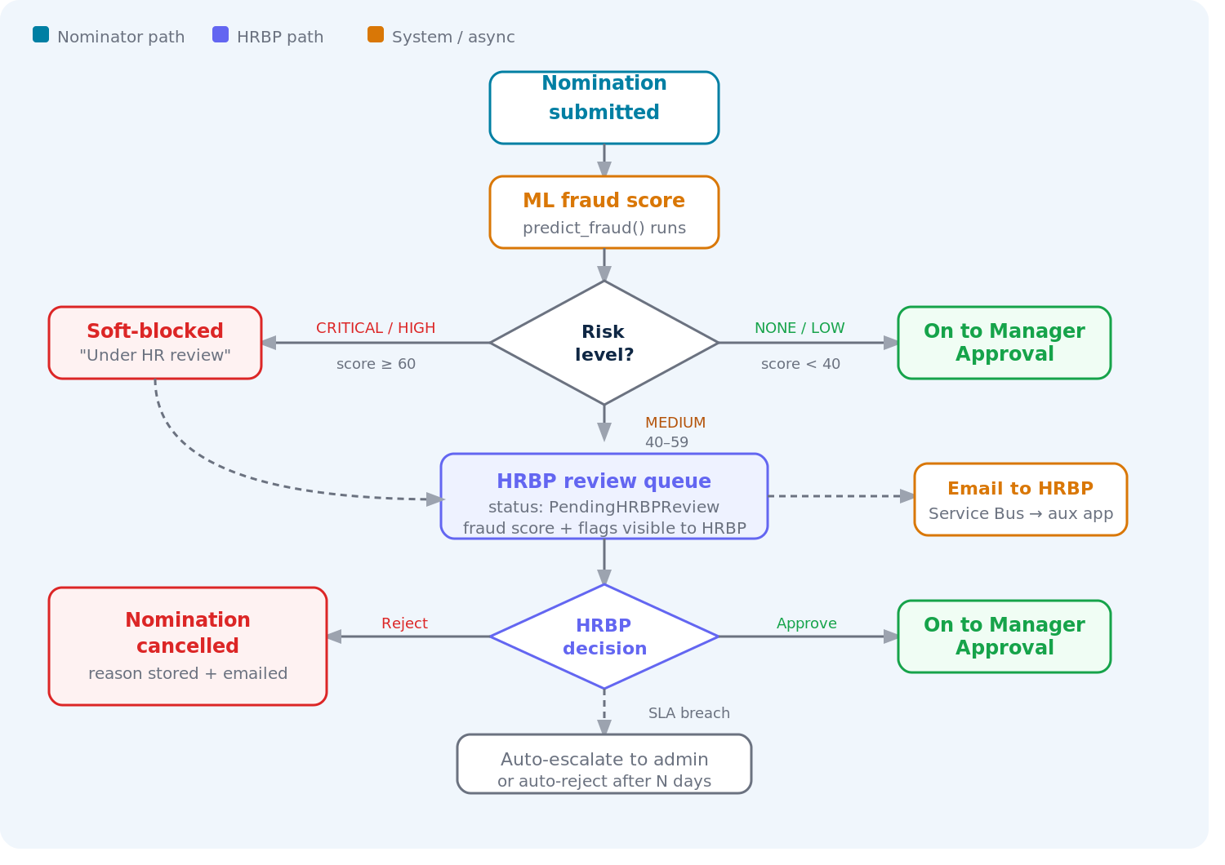
Provided by: Terianix.ai
Platform Capabilities
Fraud Detection — Review Workflow

Slide 7
Provided by: Terianix.ai
Platform Capabilities
Integrity Analytics — Rings & Super Nominator
Nomination Rings
Super Nominator
WHAT IT DETECTS
WHAT IT DETECTS
Circular nomination networks: A nominates B, B nominates C, C nominates A. Detects cycles of 3 or more hops — flagging collusive reciprocal award behaviour across any network depth.
One individual nominating at a statistically anomalous volume — a signal of coordinated slate management or a broker gaming the recognition programme at scale.
HOW IT WORKS
HOW IT WORKS
NetworkX simple_cycles() on the directed nominations graph, deduplicated by frozenset. Severity scales with total $ at risk: Critical ≥$10K, High ≥$5K, Medium ≥$1K, Low below $1K.
Out-degree outlier: flags users exceeding mean + 2 standard deviations AND 3x the tenant median, minimum 5 nominations. High at 1.5x threshold, Medium otherwise.
SEVERITY LEVELS
SEVERITY LEVELS
CRITICAL
HIGH
MEDIUM
LOW
HIGH
MEDIUM

Slide 8
Provided by: Terianix.ai
Platform Capabilities
Integrity Analytics — Copy-Paste & Transactional
Copy-Paste Fraud
Transactional Language
WHAT IT DETECTS
WHAT IT DETECTS
Clusters of near-identical nomination write-ups submitted across different nominators — a hallmark of template-driven fraud where the same justification text is recycled across multiple awards.
Quid-pro-quo phrasing inside nomination text — phrases like "in exchange for" or "I will return the favour" that signal explicit or implied reciprocity agreements between colleagues.
HOW IT WORKS
HOW IT WORKS
Sentence-transformer embeddings (all-MiniLM-L6-v2), cosine similarity threshold 0.92. Union-find clusters groups of 3 or more near-duplicate nominations. Embeddings cached in SQL to avoid re-computation on subsequent runs.
Regex pattern library scans nomination descriptions for personal-benefit phrases. Minimum 2 hits required to flag, reducing false positives. High severity at 4 or more hits, Medium at 2 to 3 hits.
SEVERITY LEVELS
SEVERITY LEVELS
HIGH
HIGH
MEDIUM

Slide 9
Provided by: Terianix.ai
Platform Capabilities — AI Analytics
AI Analytics Agent
Ask plain-English questions about your nomination data. Powered by Azure OpenAI GPT-4o — admin access only.
Example query:
"Which department had the highest fraud score last month, and who were the top nominees?"
Text-to-SQL Queries
Spending Analysis
Fraud Insights
Multi-Format Export
Agent converts plain-English questions into SQL queries against the live nomination database.
Analyse award distribution by department, manager, or time period — identify trends and outliers.
Inspect ML model decisions, review high-risk nominations, and track fraud pattern evolution.
Export answers and supporting data as CSV, Excel, PDF, or directly to Azure Blob Storage.
All AI agent actions are scoped to the authenticated admin's identity — context-aware, secure, and audit-logged.

Slide 10
Provided by: Terianix.ai
Architecture & Security
Layered Security Architecture
All backend services are private — Azure Front Door is the sole public entry point. Zero Trust by design.
Layer 0 — DNS / Edge
Azure DNS → Azure Front Door (HTTPS only, HSTS enforced)
Layer 1 — Public Perimeter
Azure Front Door · WAF (OWASP rules) · DDoS protection · TLS 1.2+ termination
Layer 2 — Application
Container Apps (VNet-injected) · JWT validation on every request · RBAC app roles · TenantId isolation
Layer 3 — Data Plane
SQL · Key Vault · Blob · ACR · OpenAI — private endpoints only, traffic stays on Azure backbone
Layer 4 — Secrets
Azure Key Vault · RBAC-only access · Soft-delete 90 days · Managed Identity injection at runtime
Microsoft Entra ID (Azure AD) · OAuth2 / OIDC · JWT validation · Managed Identities · TLS 1.2+ everywhere · SQL TDE + Blob encryption at rest

Slide 11
Provided by: Terianix.ai
Architecture & Security — Multi-Tenant SaaS
Multi-Tenant SaaS — {{CLIENT_NAME}} Configuration
Each client organisation receives a fully isolated, branded environment — no data is shared between tenants.
{{CLIENT_NAME}} Tenant Configuration
Custom Domain
Your own subdomain under terianix.ai from day one.
Portal URL
{{CLIENT_SUBDOMAIN}}-awards.terianix.ai
Azure AD Tenant
{{CLIENT_SUBDOMAIN}}-terianix.onmicrosoft.com
Brand Theming
Primary colour, logo, and locale applied across the entire portal.
Primary Colour
Configured to {{CLIENT_NAME}} brand
Private Data
Locale / Currency
en-US / USD (configurable)
All nominations, users, and analytics are TenantId-scoped — invisible to other tenants.
Data Isolation
TenantId filter on every DB query
Admin Portal
App Roles
Award_Nomination_Admin + Employee + HRBP
Full audit log, fraud dashboard, AI agent, and ML model controls.

Slide 12
Provided by: Terianix.ai
Architecture & Security — High Availability
High Availability & Reliability
Component
SLA
Mechanism
Frontend (Azure Static Web Apps)
99.95%
Azure CDN edge, globally distributed
API Gateway (Azure Front Door)
99.99%
Microsoft global edge network
Backend API (Container Apps — 2 regions)
99.95%
East US + West US, auto-failover
Database (Azure SQL)
99.99%
Built-in SQL HA with auto-failover
Disaster Recovery
< 5 min
≈ 0
3 probes
35 days
RTO — Automatic AFD failover
RPO — Active-active dual-region
Failover Trigger — HEAD / every 100 seconds
SQL Backup — Point-in-time restore

Slide 13
Provided by: Terianix.ai
Onboarding Roadmap
Client Onboarding Roadmap
From signed agreement to full go-live in 4–6 weeks, across four structured phases.
1
2
3
4
Wk 1
Wk 2–3
Wk 3–4
Wk 5–6
Kick-Off &
Discovery
Tenant
Provisioning
UAT &
Training
Go-Live &
Handover
Requirements gathering
Azure AD tenant details
Brand / locale config
User import format
Tenant DB record
Custom subdomain DNS
Azure AD app reg
User provisioning
Sandbox environment
Admin & user training
Acceptance testing
Feedback & fixes
Production cutover
Final data migration
Hypercare support
Documentation handover

Slide 14
Provided by: Terianix.ai
Onboarding Roadmap — Phases 1 & 2
Onboarding: Phases 1 & 2
Phase 1–2 Deliverables
1
Kick-Off & Discovery (Week 1)
Joint call to confirm requirements, collect Azure AD tenant details, brand assets, and user import CSV.
✓ Requirements sign-off document
2
Tenant Record & DNS (Week 2)
✓ {{CLIENT_SUBDOMAIN}}-awards.terianix.ai live
Terianix.ai creates the tenant DB record, provisions the custom subdomain ({{CLIENT_SUBDOMAIN}}-awards.terianix.ai), and configures DNS.
✓ Azure AD app registration complete
3
Azure AD App Registration (Week 2)
OAuth2 app registration configured for {{CLIENT_NAME}}'s Azure AD tenant. Redirect URIs and app roles assigned.
✓ Employee directory imported
✓ Sandbox environment accessible
4
User Provisioning (Week 2–3)
Employee directory imported from CSV or Azure AD sync. Manager hierarchy configured for approval routing.
✓ Admin credentials issued to 2 key contacts
Terianix.ai manages all provisioning tasks. {{CLIENT_NAME}} provides: Azure AD tenant ID, brand assets (logo, hex colour), and employee CSV. No infrastructure setup required on your side.

Slide 15
Provided by: Terianix.ai
Onboarding Roadmap — Phases 3 & 4
Onboarding: Phases 3 & 4
Phase 3 — UAT & Training (Week 3–4)
Phase 4 — Go-Live & Handover (Week 5–6)
Sandbox Access
Production Cutover
{{CLIENT_NAME}} team gets sandbox credentials. Full nomination workflow available for testing.
Environment promoted to production. DNS updated. SSL certificate verified.
Admin Training
Data Migration
45-min walkthrough: fraud dashboard, AI agent, user management, audit log.
Final employee directory loaded. Historical data imported if required.
User Training
Hypercare Period
Short-form guide + video for employees and managers (nomination + approval flows).
14-day intensive support. Daily check-in call available. Priority P1 response.
UAT Sign-Off
Documentation Handover
Terianix.ai resolves all raised issues within SLA. Formal sign-off document issued.
Admin runbook, API docs (Swagger), architecture overview, and escalation contacts.
Week 1
Week 2–3
Week 3–4
Week 5–6
Kick-Off
Provisioning
UAT
Go-Live

Slide 16
Provided by: Terianix.ai
Support SLA
Support Service Level Agreement
Priority
Definition
Response
Resolution
Channel
P1 Critical
Platform down or data loss
< 1 hour
< 4 hours
Phone + Email
P2 High
Feature broken, workaround exists
< 4 hours
< 24 hours
Email + Ticket
P3 Medium
Degraded performance or minor bug
< 1 day
< 5 days
Ticket
P4 Low
Enhancement request or question
< 2 days
Next release
Ticket / Email
Support Scope
Maintenance Windows
Application bugs and incident resolution
User and admin account management
Fraud model retraining (quarterly or on demand)
Minor configuration changes (locale, theme, roles)
Scheduled: Sundays 02:00–04:00 UTC
48-hour advance notice for planned downtime
Zero-downtime deploys via blue/green (target)
Emergency patches applied outside windows as needed

Slide 17
Provided by: Terianix.ai
Pricing & Tiers
Pricing & Tiers
Starter
★ MOST POPULAR ★
Enterprise
Professional
$189/mo
$624/mo
Custom
or $1,788/yr
or $5,988/yr
pricing
($149/mo billed annually)
($499/mo billed annually)
Contact sales for a quote
Up to 50 users
50 – 500 users
500+ users
· Core nomination workflow
· Full workflow + advanced AI analytics
· Custom implementation & config
· Fraud detection & AI analytics
· Multi-region failover
· Dedicated support team
· Standard support (email)
· Priority support (24-hour response)
· Custom analytics & integrations
· Single-region deployment
· Advanced reporting & audit logs
· Multi-region + contractual SLA

Slide 18
Provided by: Terianix.ai
Next Steps
Next Steps — Getting Started
Three actions to kick off the {{CLIENT_NAME}} onboarding:
1
Pilot Agreement
Sign the Terianix.ai SaaS Pilot Agreement (30-day no-obligation pilot). No infrastructure commitment required. Covers data privacy, uptime commitment, and support scope.
2
Provide Onboarding Inputs
Share your Azure AD tenant ID, primary brand colour (hex), company logo (PNG), and an employee CSV (name, email, manager email). Terianix.ai handles everything from there.
3
Kick-Off Call
Schedule a 60-minute kick-off call with Terianix.ai. We'll confirm all requirements, walk through the sandbox live, and set the go-live target date.
Contact: Terianix.ai · sales@terian-services.com · terianix.ai

Slide 19
Provided by: Terianix.ai
CONFIDENTIAL | {{PRESENTATION_DATE}}
Thank You
{{CLIENT_NAME}}
Get in touch:
David Terian
sales@terian-services.com
terianix.ai
Award Nomination Platform · Enterprise SaaS · Built on Microsoft Azure

Slide 20
Provided by: Terianix.ai
Appendix A
Application Screenshots
Live views from the Award Nomination Platform
CONFIDENTIAL — {{CLIENT_NAME}} Onboarding | © 2025 Terianix.ai

Slide 21
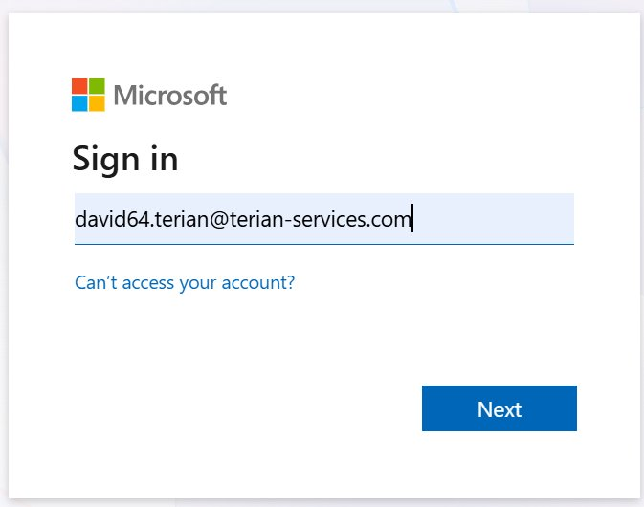
Provided by: Terianix.ai
Login Screen
A1
Microsoft SSO
Award Nomination Login
Secure Microsoft SSO (Azure AD / MSAL) authentication with MFA. The branded app login card routes directly to Microsoft's identity platform, ensuring enterprise-grade security from first click.
CONFIDENTIAL — {{CLIENT_NAME}} Onboarding | © 2025 Terianix.ai

Slide 22
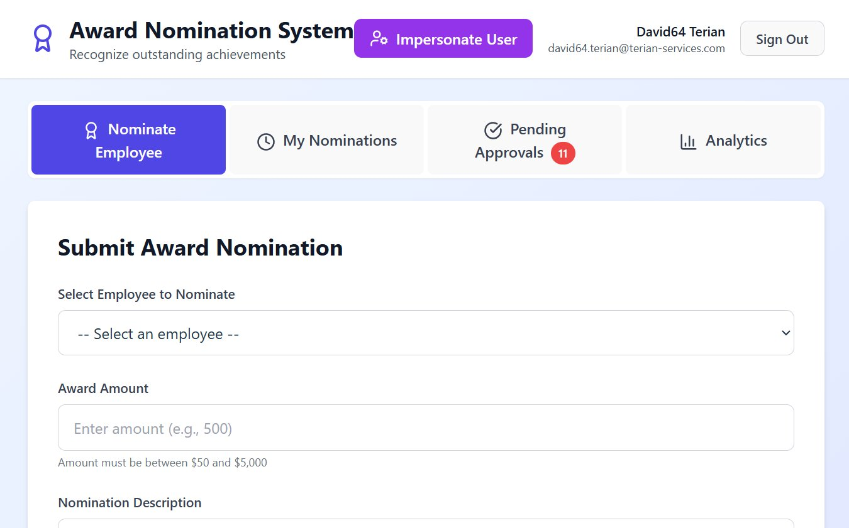
Provided by: Terianix.ai
Landing Screen
A2
The main navigation bar provides one-click access to all four modules: Nominate Employee, My Nominations, Pending Approvals (with live badge count), and Analytics & Reporting.
CONFIDENTIAL — {{CLIENT_NAME}} Onboarding | © 2025 Terianix.ai

Slide 23
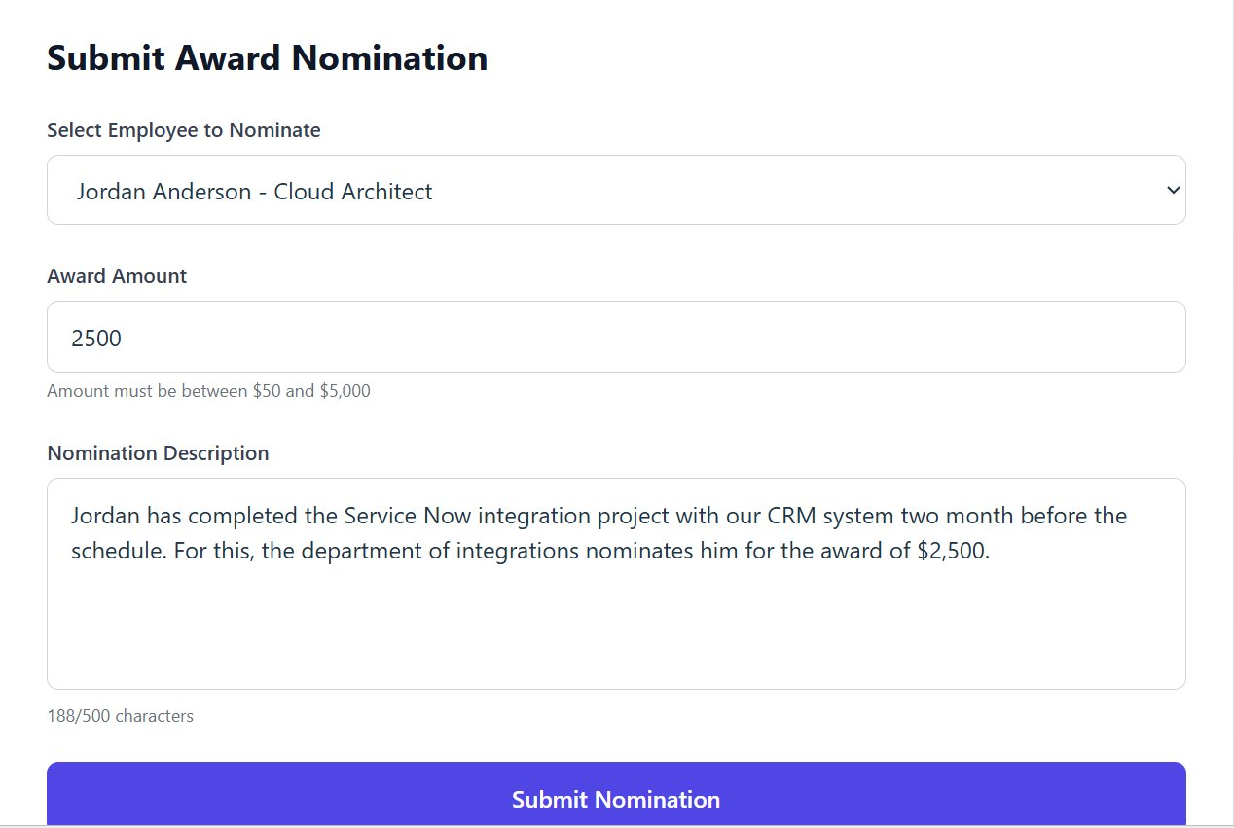
Provided by: Terianix.ai
Submit Award Nomination
A3
Employees select a nominee from the company directory, enter an award amount ($50–$5,000), and provide a supporting description. One click submits the nomination for manager approval.
CONFIDENTIAL — {{CLIENT_NAME}} Onboarding | © 2025 Terianix.ai

Slide 24
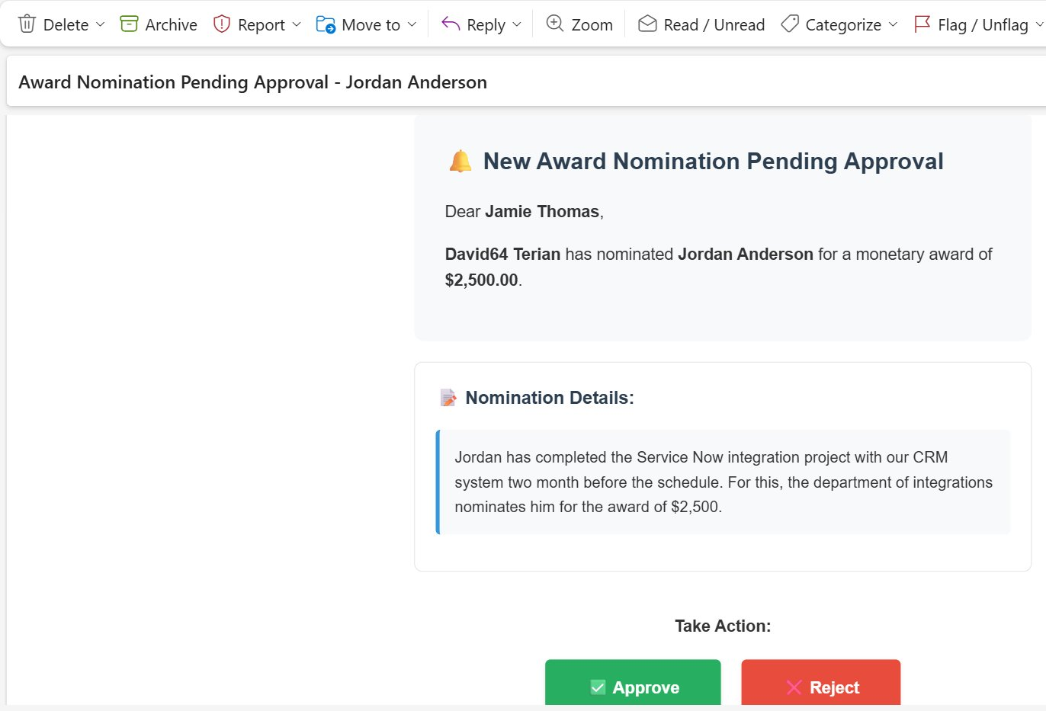
Provided by: Terianix.ai
Approval Notification Email
A4
The approving manager receives a rich HTML email with full nomination details and embedded Approve / Reject action buttons — no app login required to act on a nomination.
CONFIDENTIAL — {{CLIENT_NAME}} Onboarding | © 2025 Terianix.ai

Slide 25
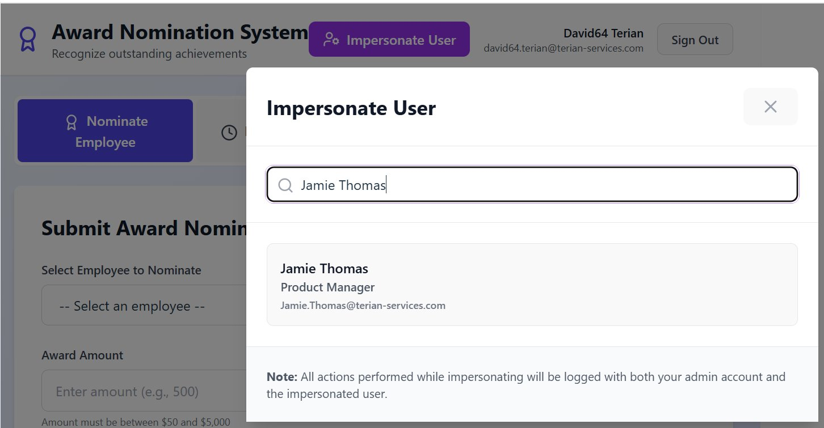
Provided by: Terianix.ai
Admin Impersonation
A5
Admins search for any user and assume their identity for support or troubleshooting. All actions during an impersonation session are fully audit-logged with both accounts recorded.
CONFIDENTIAL — {{CLIENT_NAME}} Onboarding | © 2025 Terianix.ai

Slide 26
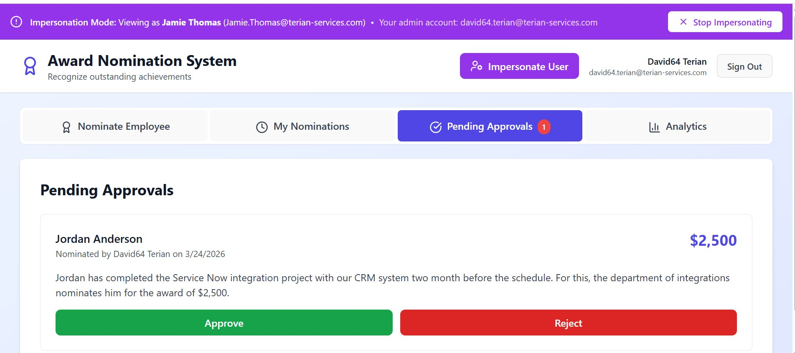
Provided by: Terianix.ai
Manager Approval Queue
A6
Managers see all pending nominations with nominee details, award amounts, and submitter info. Inline Approve / Reject controls trigger instant status updates and email confirmations. The purple banner indicates an active admin impersonation session.
CONFIDENTIAL — {{CLIENT_NAME}} Onboarding | © 2025 Terianix.ai

Slide 27
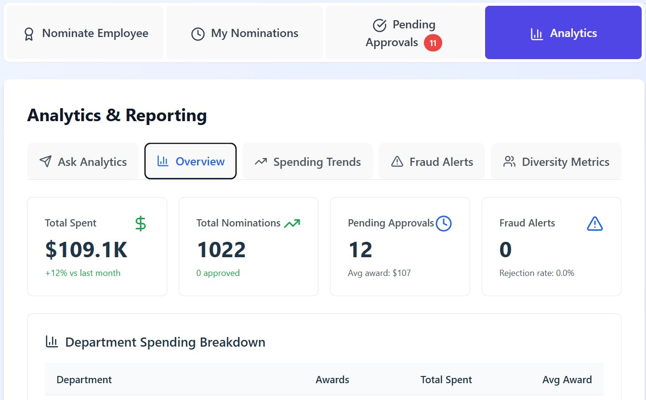
Provided by: Terianix.ai
Analytics & Reporting
A7
The Overview dashboard presents real-time KPIs: Total Spent, Nomination Volume, Pending Approvals, and Fraud Alerts — with department-level spending breakdowns and month-over-month trend indicators.
CONFIDENTIAL — {{CLIENT_NAME}} Onboarding | © 2025 Terianix.ai

Slide 28
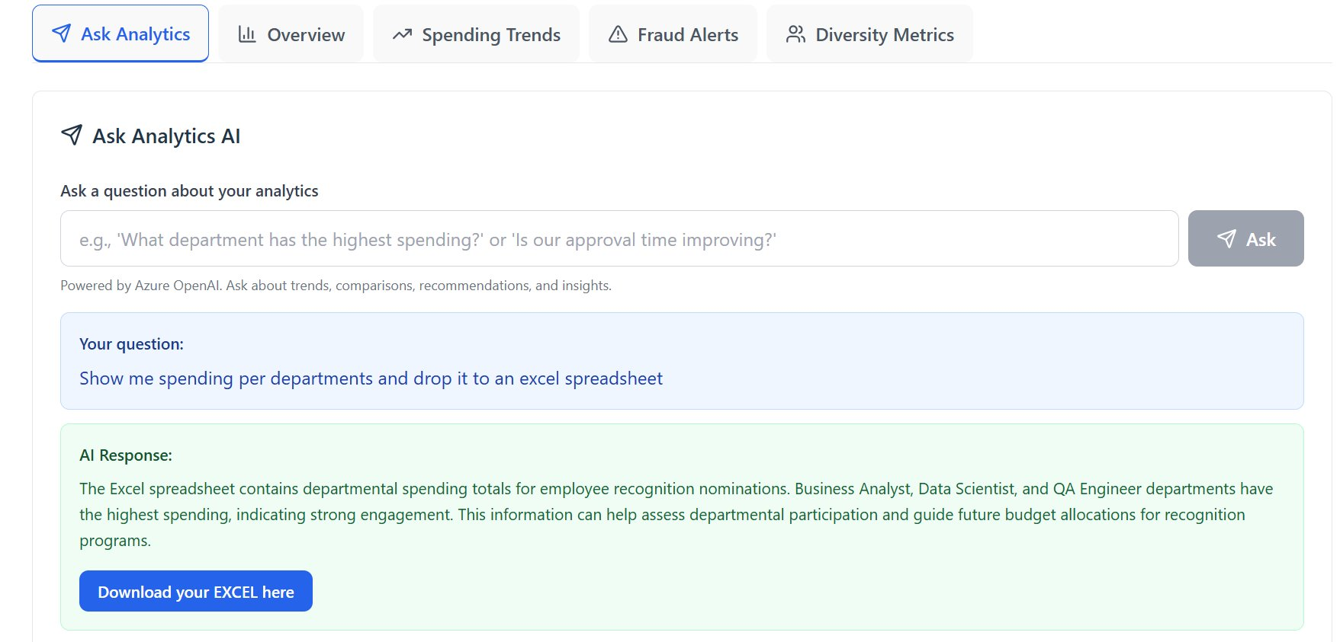
Provided by: Terianix.ai
AI Analytics Agent
A8
Users ask plain-English questions — e.g. "Show spending per department and export to Excel" — and the GPT-4o powered agent translates them into SQL, runs the query, and returns a narrative answer with a downloadable Excel export.
CONFIDENTIAL — {{CLIENT_NAME}} Onboarding | © 2025 Terianix.ai

