Slide 1
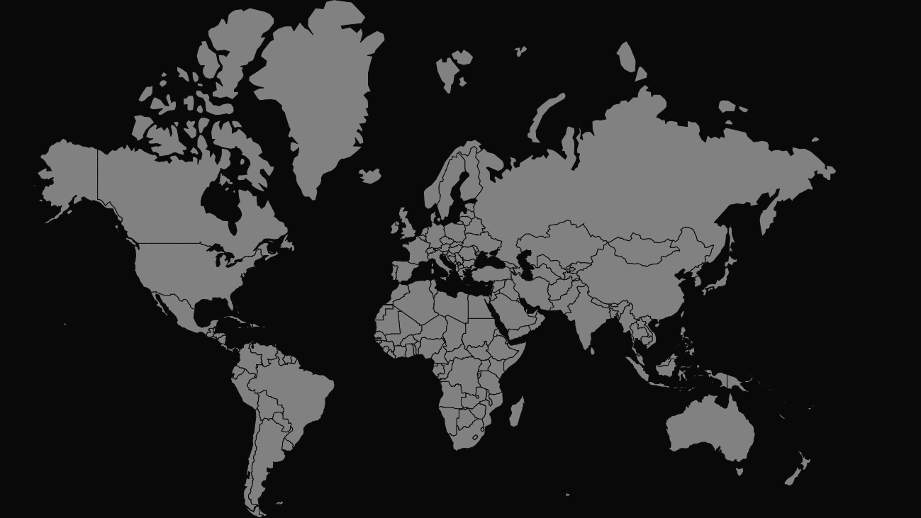
8-BIT WORLD ADVENTURE
Deekshitha Thumma, Michael Min, Gabriel Cohen, Jeffery Kim, Jeffery Won
Notes:
D

Slide 2
Overview
Moving around the world map to explore and learn about world geography
Description
Create a fun and easy way to learn geography for all types of people
Methodologies
Motivation
“Teaching geography to kids in the most entertaining way”
Vision statement

Slide 3
TOOLS

Slide 4


Methodology
Agile
Methodologies
Notes:
Gabe
Continuous activities and testing
-Quality improves because testing starts from day one
-Visibility improves because you are ½ the way through the project when you have built ½ the features
-Risk is reduced because you’re getting feedback early
-Customers are happy because they can make changes without paying exorbitant costs

Slide 5

Methodology
Pair Programming
Methodologies
Notes:
JK

Slide 6


Project tracker
Trello
Tools
Notes:
D

Slide 7
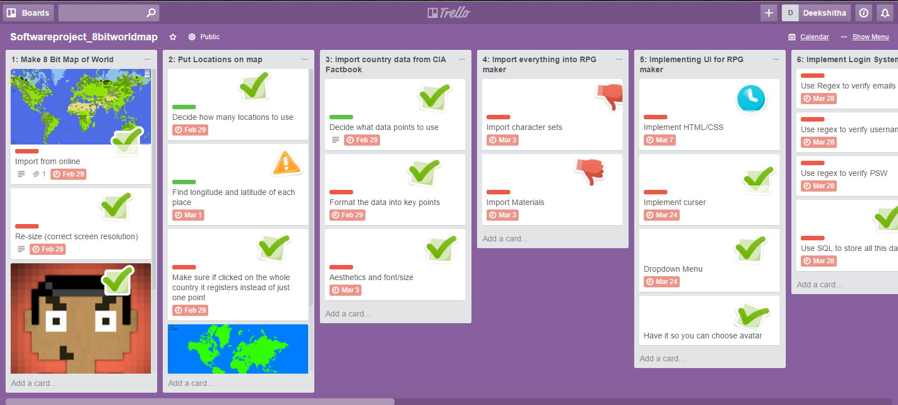
Project tracker
Tools

Slide 8

VCS Repository
Github
Tools
Notes:
G

Slide 9
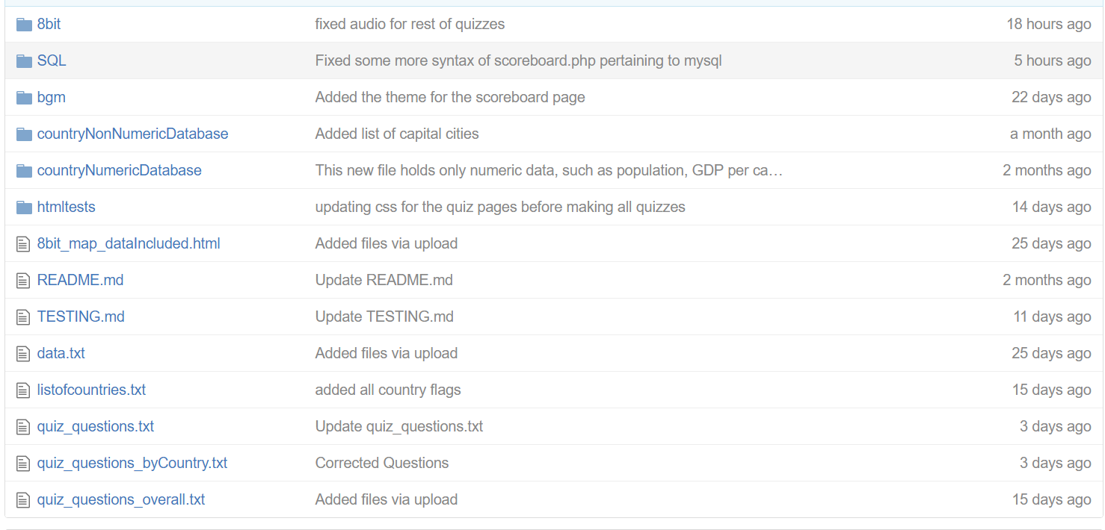
VCS Repository
Tools

Slide 10


Database
MySQL
Tools
Notes:
M

Slide 11

Testing
Selenium
Tools
Notes:
D

Slide 12
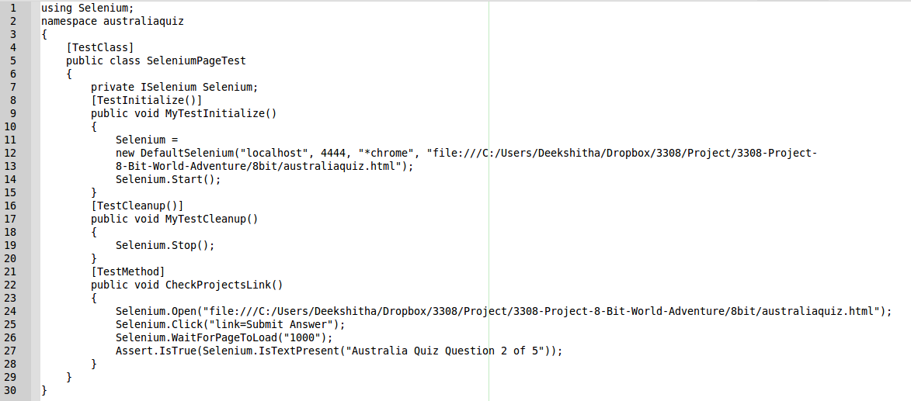
Testing
Tools

Slide 13

Auto Documenter
Jsdoc
Tools
Notes:
JW

Slide 14

Deployment Environment
Dropbox
Tools
Notes:
JW

Slide 15

PHP
Server-side scripting
Tools
Notes:
M

Slide 16
CHALLENGES

Slide 17
Using PHP
PHP required a certain local server that supported it, like XAMPP, to be running in order for it to work correctly
Notes:
M

Slide 18
Using SQL
We came across some technical difficulties when trying to access SQL databases inside of PHP
Notes:
M

Slide 19
Editing JSON Objects in Map
Had to make a Python script to edit every pixel of the map since the map was formatted as JSON objects
Over 120,000 objects
Notes:
D

Slide 20
DEMO
Notes:
JW, JK, G

