Slide 1


Multivariate projection methodologies for the integration of large biological data sets
Application in R using mixOmics
math.univ-toulouse.fr/biostat

Slide 2
Agenda
Introduction
Reminders (?)
Explore one data set (PCA)
Discriminant analysis (LDA, PLS-DA)
Data integration (PLS, CCA, GCCA)
Graphical outputs
Extensions: sparse and multilevel
Conclusion

Slide 3
Introduction

Slide 4
Research hypothesis
Molecular entities act together to trigger cells’ responses and need to be appropriately modelled and identified using novel statistical techniques.
Multivariate statistical methods to shift the univariate statistics paradigm to obtain deeper insight into biological systems
  Identify a combination of biomarkers rather than univariate biomarkers
  Integrate multiple sources of biological data
  Reduce the dimension of the data for a better understanding of complex biological systems

Slide 5

Multidisciplinarity!
Nearly unlimited quantity of data from multiple and heterogeneous sources
Computational issues to foresee
Biological interpretation for validation
Keep pace with new technologies
A close interaction between statisticians, bioinformaticians and molecular biologists is essential to provide meaningful results
BLAST
FASTA
BAM
DNA
RNA
ATGCC
« Bio »
« Stat »
« Bio-info »

Slide 6
Data integration
Generally, data integration can be defined as the process of combining data residing in diverse sources to provide users with a comprehensive view of such data. There is no universal approach to data integration, and many techniques are still evolving.
From Schneider, M. V., & Jimenez, R. C. (2012). Teaching the Fundamentals of Biological Data Integration Using Classroom Games. PLoS Computational Biology, 8(12)
mixOmics philisophy in this context:
R toolkit for multivariate data analysis of ‘omics data
Statistical data integration
Data-driven approaches (≠ database or knowledge-based approaches)

Slide 7
Overview
Quantitative
Qualitative
Transcriptome
Proteome
Metabolome
Autre...
Samples
Genotype
Condition
Univariate
Mean, median, standard deviation...
Bivariate: 2 quantitatives or 1 quantitative + 1 qualitative or 2 qualitatives
Correlation, statistical test (Student, ANOVA, Chi2)
Multivariate unsupervised
PCA
Multivariate supervised
PLS-DA
Multi-block unsupervised
PLS (2 blocks), GCCA
Multi-block supervised
GCC-DA

Slide 8

The mixOmics story
Started with two phD projects in Université de Toulouse:
  Ignacio González (2004-2007): rCCA
  Kim-Anh Lê Cao (2005-2008): sPLS
The Australian mixOmics immigration processed began in 2008 ...
  K-A moved to UQ for a postdoc (IMB)
  Core team established: Kim-Anh Lê Cao (FR, AUS), Ignacio González (FR), Sébastien Déjean (FR)
First R CRAN release in May 2009
Today
  21,000 downloads (unique IP adress) in 2016 (4,000 in 2014, 10,000 in 2015)
  Website: www.mixomics.org
  Two web-interfaces (shiny and PHP, also Galaxy but not advertised)
  19 multivariate methodologies and sparse variants (13 are our own methods)
  Team: 3 core members and 4 key contributors
  Move to in october 2018

Slide 9
Guidelines
I want to explore one single data set (e.g. microarray data):
  I would like to identify the trends or patterns in your data, experimental bias or, identify if your samples ‘naturally’ cluster according to the biological conditions: Principal Component Analysis (PCA)
I have one single data set (e.g. microarray data) and I am interested in classifying my samples into known classes:
  Here X = expression data and Y = vector indicating the classes of the samples. I would like to know how informative my data are to rightly classify my samples, as well as predicting the class of new samples: PLS-Discriminant Analysis (PLS-DA)
I want to want to unravel the information contained in two data sets, where two types of variables are measured on the same samples (e.g. metabolomics and transcriptomics data)
  I would like to know if I can extract common information from the two data sets (or highlight thecorrelation between the two data sets). The total number of variables is less than the number of samples: Canonical Correlation Analysis (CCA) or Projection to Latent Sructures (PLS) canonical mode. The total number of variables is greater than the number of samples: Regularized Canonical Correlation Analysis (rCCA) or Projection to Latent Sructures (PLS) canonical mode

Slide 10
Practical works
Based on the vignette of the package
bioconductor.org/packages/release/bioc/vignettes/mixOmics/inst/doc/vignette.html
Quick start section for every methods
Focus on PCA, (Sparse-)PLS-DA and (Sparse-)PLS

Slide 11
Reminders (?)

Slide 12
Variance and Standard Deviation
Mean of the squared deviations to the mean
Square root of the variance
Properties of the standard deviation:
  Positif (zero if the serie is constant)
  Unchanged by translation
  Sensitive to extreme values
  In the same unit as the data (as the mean but unlike the variance): If the data are expressed in m then the standard deviation also express in m (as the mean) and the variance in m² !

Slide 13
Variance and Standard Deviation
Square root of the
mean of the
squared
deviation to the
mean
Variance
X4
X3
X2
X1
X
X5
Standard deviation

Slide 14
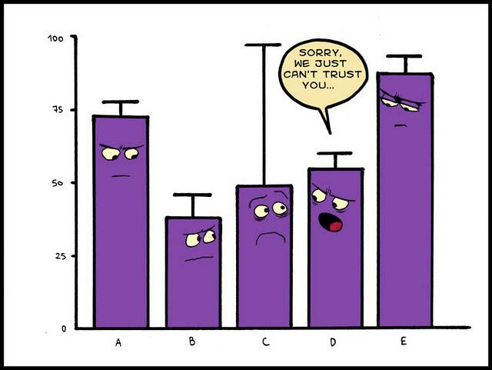
Humour for statistician...
Source : xkcd.com

Slide 15
Covariance
Covariance
cov(X,X)=var(X)
Sign of the product (Xi-X)(Yi-Y)
Intuitively :
If the + win
→positive linear relationship
If the – win
→négative linear relationship
On this example : cov(X,Y)=-1.36
Y
Y
X
Y
The covariance depends on the physical units ➔ correlation coefficient
X
X

Slide 16


Correlation
Some properties of correlation coefficients:
  Between –1 and 1
  Pearson correlation coefficient: linear relationship
  Spearman correlation coefficient (ranks): monotone relationship
  If the coefficient is positive : when a variable is high the other is also high. Replace high with low.
  If the coefficient is negative : when a variable is high the other is low. Replace high with low and inversely.
X Y RX RY
12 5 3 1
15 3 1 2
14 2 2 3

Slide 17
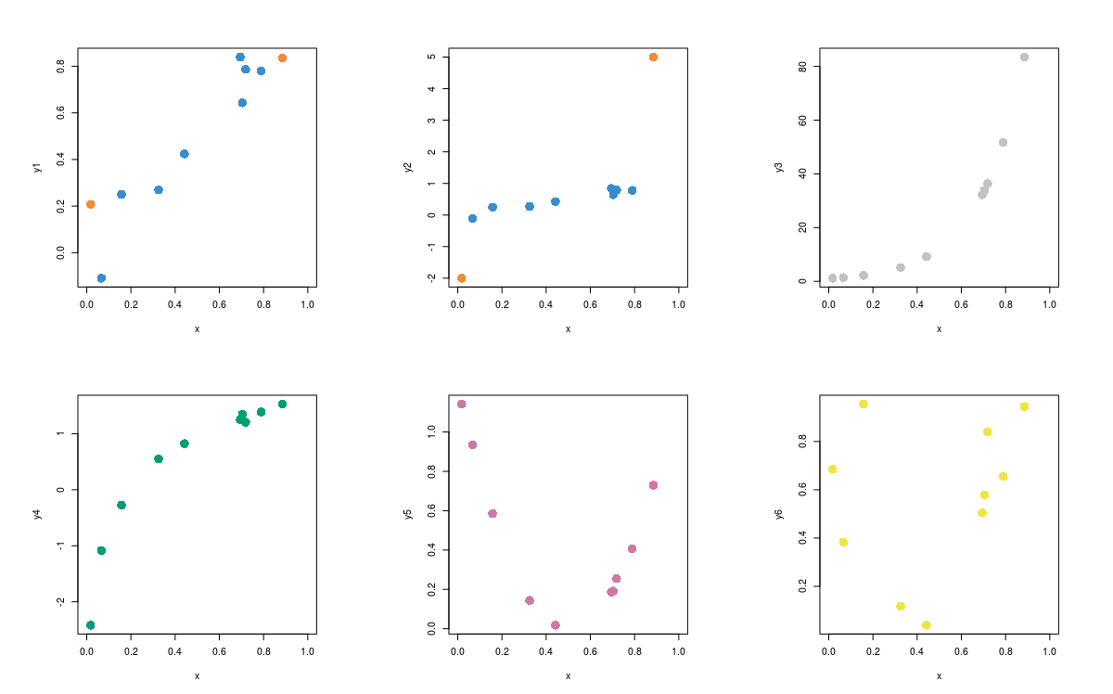
Correlation
ρ = 0.944 - ρ_{s} = 0.855
ρ = 0.722 - ρ_{s} = 0.915
ρ = 0.89 - ρ_{s} = 1
ρ = 0.914 - ρ_{s} = 0.964
ρ = -0.518 - ρ_{s} = -0.248
ρ = 0.24 - ρ_{s} = 0.248

Slide 18
Linear combination
2 variables
2 coefficients : c1 = 0.5 ; c2 = 2
W =
0.5
2
Height
Weight
174.0 175.3 193.5 186.5 187.2 181.5 184.0 184.5 175.0 184.0
65.6 71.8 80.7 72.6 78.8 74.8 86.4 78.4 62.0 81.6
Linear combination of the 2 variables Height and Weight with coefficients c1 and c2
174.0 175.3 193.5 186.5 187.2 181.5 184.0 184.5 175.0 184.0
65.6 71.8 80.7 72.6 78.8 74.8 86.4 78.4 62.0 81.6
218.20 231.25 258.15 238.45 251.20 240.35 264.80 249.05 211.50 255.20
LC = 0.5 + 2 =
X
Matrix notation: LC = XW
A principal component is a linear combination of the initial variables.

Slide 19


Center / scale
Center: remove the mean
Scale: divide by the standard deviation
Express different variables on a common scale, without physical unit; the observations are thus expressed as numbers of standard deviations related to the mean.
After centering and scaling, the mean is zero and the standard deviation is 1 (as the variance).
Sometimes called « z-transformation » ou « z-score »

Slide 20
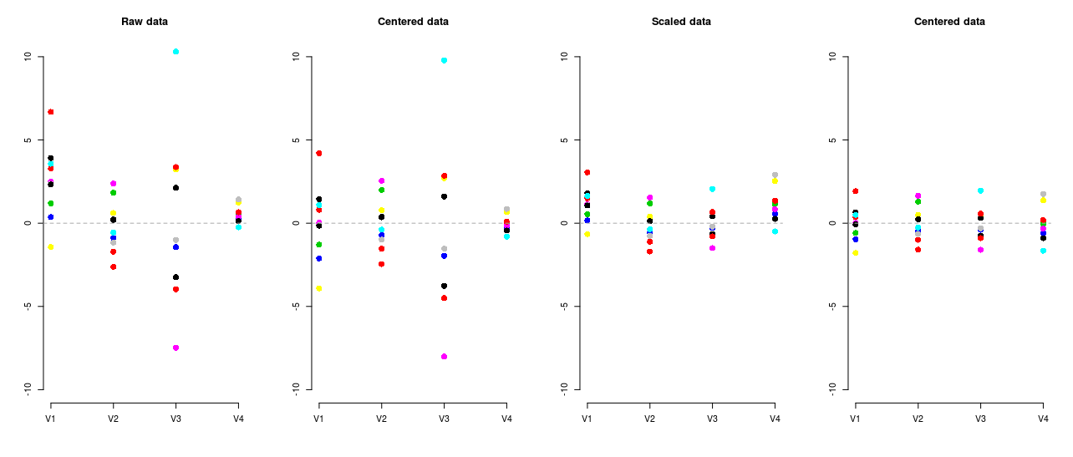
Center / scale
X
X-mean(x)
X/sd(x)
[X-mean(x)] / sd(X)
v1 v2 v3 v4
1 3.9 0.2 -3.2 0.6
2 3.3 -1.7 -4.0 0.6
3 1.2 1.8 3.3 0.6
4 0.4 -0.9 -1.4 0.3
5 3.6 -0.6 10.3 -0.2
6 2.5 2.4 -7.5 0.4
7 -1.4 0.6 3.2 1.2
8 2.4 -1.2 -1.0 1.4
9 2.3 0.2 2.1 0.1
10 6.7 -2.6 3.4 0.7
Mean 2.5 -0.2 0.5 0.6
S.D. 2.2 1.5 5.0 0.5
v1 v2 v3 v4
1 1.4 0.4 -3.8 0.1
2 0.8 -1.5 -4.5 0.0
3 -1.3 2.0 2.8 0.0
4 -2.1 -0.7 -2.0 -0.3
5 1.1 -0.4 9.8 -0.8
6 0.0 2.5 -8.0 -0.2
7 -3.9 0.8 2.7 0.7
8 -0.1 -1.0 -1.5 0.9
9 -0.2 0.4 1.6 -0.4
10 4.2 -2.5 2.8 0.1
Mean 0 0 0 0
S.D. 2.2 1.5 5.0 0.5
v1 v2 v3 v4
1 1.1 0.1 -0.6 0.8
2 1.0 -1.1 -0.8 0.8
3 0.3 1.2 0.7 0.7
4 0.1 -0.6 -0.3 0.4
5 1.0 -0.4 2.0 -0.3
6 0.7 1.5 -1.5 0.5
7 -0.4 0.4 0.6 1.6
8 0.7 -0.7 -0.2 1.8
9 0.7 0.1 0.4 0.2
10 2.0 -1.7 0.7 0.9
Mean 1.1 -0.1 0.1 1.2
S.D. 1 1 1 1
v1 v2 v3 v4
1 0.7 0.3 -0.8 0.1
2 0.4 -1.0 -0.9 0.0
3 -0.6 1.3 0.6 0.0
4 -1.0 -0.5 -0.4 -0.6
5 0.5 -0.3 2.0 -1.7
6 0.0 1.7 -1.6 -0.3
7 -1.8 0.5 0.5 1.4
8 -0.1 -0.6 -0.3 1.7
9 -0.1 0.2 0.3 -0.9
10 1.9 -1.6 0.6 0.2
Mean 0 0 0 0
S.D. 1 1 1 1

Slide 21
Log transformation
City Population Log10
Toulouse 441 802 5.65
Colomiers 35 186 4.55
Tournefeuille 25 340 4.40
Muret 23 864 4.38
...
Castanet-Tolosan 11 033 4.04
Saint-Orens... 10 918 4.04
Saint-Jean 10 259 4.01
Revel 9 361 3.97
Portet-sur-Garonne 9 435 3.97
Auterive 9 107 3.96
...
La Magdelaine-sur-T/ 1 006 3.00
Grépiac 990 2.99
Landorthe 946 2.98
Vigoulet-Auzil 944 2.97
...
Belbèze-de-Lauragais 104 2.02
Saint-Germier 103 2.01
Seyre 102 2.01
Gouzens 95 1.98
Lourde 98 1.99
Pouze 97 1.99
...
Saccourvielle 13 1.11
Cirès 13 1.11
Bourg-d'Oueil 8 0.90
Trébons-de-Luchon 8 0.90
Caubous 6 0.78
Baren 5 0.70
X | Log2(X)
0.125 = 2⁻³ | -3
0.25 = 2⁻² | -2
0.5 = 2⁻¹ | -1
1 = 2⁰ | 0
2 = 2¹ | 1
4 = 2² | 2
8 = 2³ | 3
4 < 5 < 8 | 2 < ~2.3 < 3
2 < 3 < 4 | 1 < ~1.6 < 2
0.1 < 0.125 | ~ -3.3 < -3
Y = log2(X) ↔ X = 2^{Y}
Y = log10(X) ↔ X = 10^{Y}
Y = ln(X) ↔ X = e^{Y} = exp(Y)

Slide 22
Explore one data set

Slide 23
Principal Components Analysis
Describe with no prior a data set exclusively composed of quantitatives variables
p variables
n individuals

Slide 24
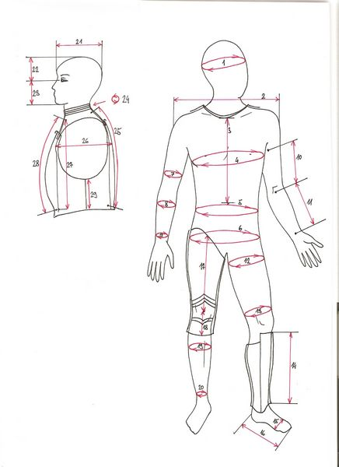
Body data set
20 individuals
5 variables
V1 V2 V3 V4 V5
H 1 106.2 89.5 71.5 65.6 174.0
H 2 110.5 97.0 79.0 71.8 175.3
H 3 115.1 97.5 83.2 80.7 193.5
H 4 104.5 97.0 77.8 72.6 186.5
H 5 107.5 97.5 80.0 78.8 187.2
H 6 119.8 99.9 82.5 74.8 181.5
H 7 123.5 106.9 82.0 86.4 184.0
H 8 120.4 102.5 76.8 78.4 184.5
H 9 111.0 91.0 68.5 62.0 175.0
H 10 119.5 93.5 77.5 81.6 184.0
F 1 105.0 89.0 71.2 67.3 169.5
F 2 100.2 94.1 79.6 75.5 160.0
F 3 99.1 90.8 77.9 68.2 172.7
F 4 107.6 97.0 69.6 61.4 162.6
F 5 104.0 95.4 86.0 76.8 157.5
F 6 108.4 91.8 69.9 71.8 176.5
F 7 99.3 87.3 63.5 55.5 164.4
F 8 91.9 78.1 57.9 48.6 160.7
F 9 107.1 90.9 72.2 66.4 174.0
F 10 100.5 97.1 80.4 67.3 163.8
V1 : shoulder girth (cm)
V2 : chest girth (cm)
V3 : waist girth (cm)
V4 : weight (kg)
V5 : height (cm)

Slide 25

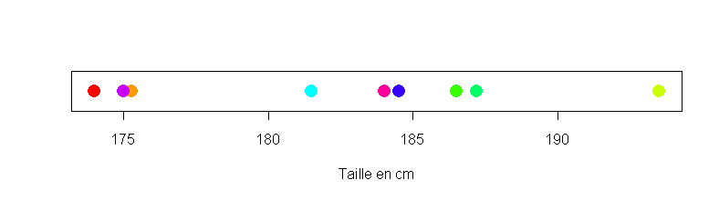
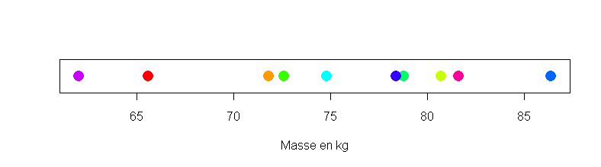
1D graphical output: stripchart
Height 174.0 175.3 193.5 186.5 187.2 181.5 184.0 184.5 175.0 184.0
Height in cm
Weight 65.6 71.8 80.7 72.6 78.8 74.8 86.4 78.4 62.0 81.6
Weight in kg

Slide 26
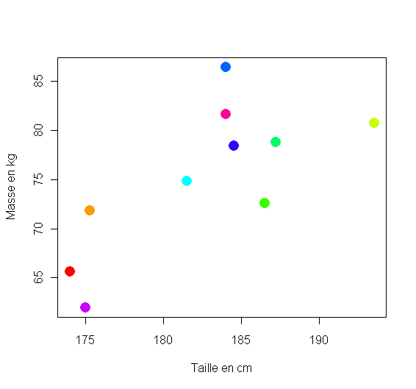
2D graphical output: scatter plot
Height 174.0 175.3 193.5 186.5 187.2 181.5 184.0 184.5 175.0 184.0
Weight 65.6 71.8 80.7 72.6 78.8 74.8 86.4 78.4 62.0 81.6
Weight in kg
Height in cm

Slide 27
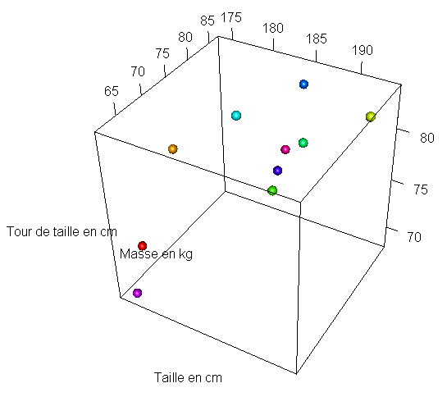
3D graphical output: scatter plot
Height 174.0 175.3 193.5 186.5 187.2 181.5 184.0 184.5 175.0 184.0
Weight 65.6 71.8 80.7 72.6 78.8 74.8 86.4 78.4 62.0 81.6
Waist g. 71.5 79.0 83.2 77.8 80.0 82.5 82.0 76.8 68.5 77.5
Waist g. in cm
Weight in kg
Height in cm

Slide 28



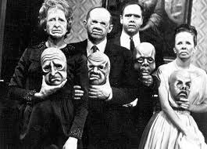


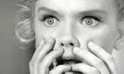

4D ?

Slide 29
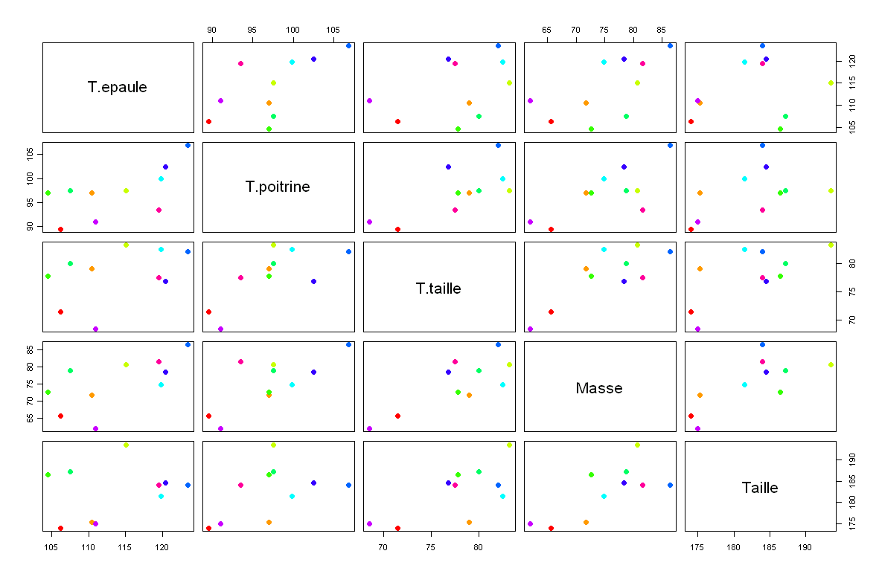
Alternative to 4D (or more)
Shoulder g.
Chest g.
Waist g.
Weight
Height

Slide 30



Shoulder girth
Chest girth
Waist girth

Slide 31

Shoulder girth
Chest girth
Waist girth
1st Principal Component : «beefyness»

Slide 33
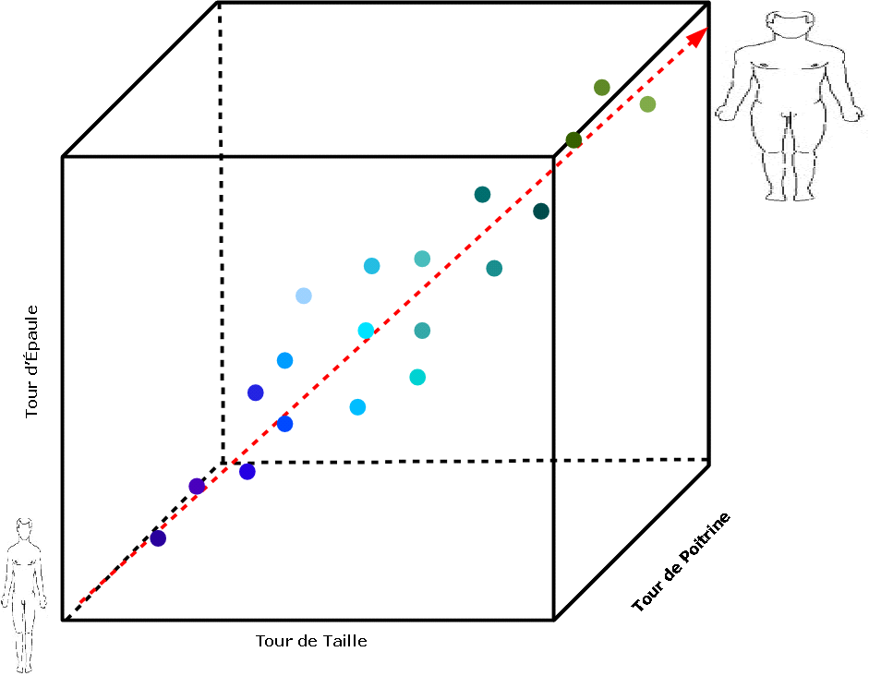
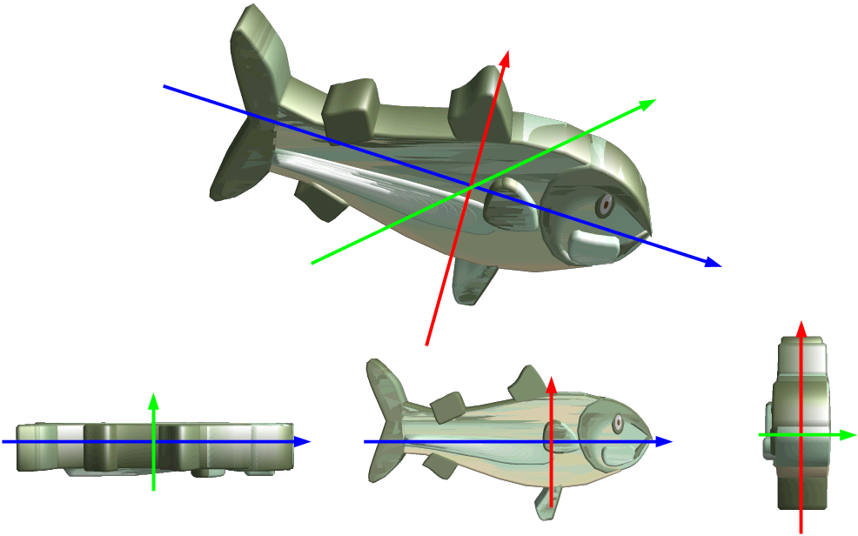
Comments
The measurements are rather strongly correlated. Indeed, one can assume that a person with a high shoulder girth will also have high chest girth (even if exceptions exist...). In these conditions, the information brought by the 5 variables are redundant. Graphically, in the cube determined by shoulder girth, chest girth and waist girth, there are nearly emplty areas. One variable calculated as a combination of these 3 variables (represented as the dotted arrow) would be enough to represent the individuals with a minimal loss in information because all the points are located along these direction that is the first principal component.
Among the potential projections in 2D spaces, all does not enable to identify easily the object. Among the 3 proposed projections, the image at the center is the nearest from the original. One can easily recongnize the initial object because the projection was made on the plane formed by the 2 directions along which the object spreads out the most (high variability). The information brought by the 3rd dimension is minimal and its loss is not a problem to recongnize the fish.

Slide 34
In other words
PCA allow determine the sub-spaces of lower dimension than the initial space on which the projection of the individuals is the least modified, that is to say, the sub-spaces that keep the greatest part of the information (i.e. variability).
The principle of PCA consists in finding a direction (the first PC), calculated as a linear combination of the initial variables, such that the variance of the points around this direction is maximal. Iterate this process in orthogonal directions to determine the following principal components. The number of PC that can be calculated is equal to the number of initial variables.
Concerning the variables, the PCA keeps at best the correlation structure between the initial variables.

Slide 35
PCA: simulated examples
Data set : 50 observations, 3 variables (V1 – V2 - V3)
Case 1)
{V1} - {V2} - {V3}
Case 2)
{V1 - V2} - {V3}
Case 3)
{V1 - V2 - V3}
Pearson Correlation matrices
1) V1 V2 V3
V1 1.0 -0.10 0.00
V2 -0.1 1.00 -0.12
V3 0.0 -0.12 1.00
2) V1 V2 V3
V1 1.00 0.88 -0.05
V2 0.88 1.00 -0.11
V3 -0.05 -0.11 1.00
3) V1 V2 V3
V1 1.00 0.88 0.92
V2 0.88 1.00 0.81
V3 0.92 0.81 1.00

Slide 36

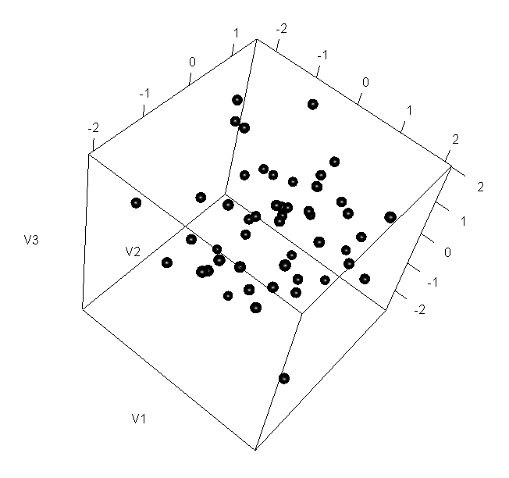

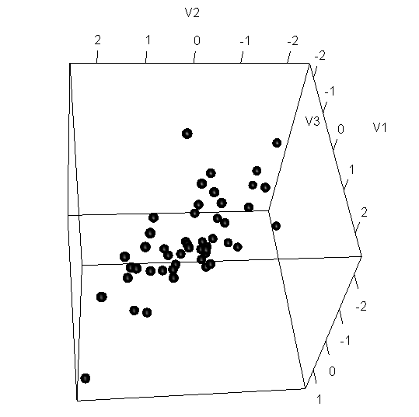
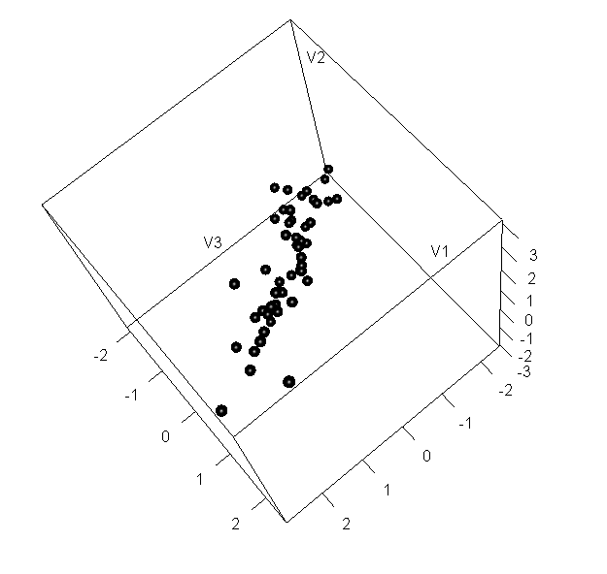
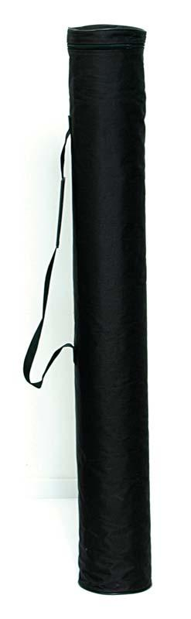
Example: 3D scatter plots
Case 1)
Case 2)
Case 3)

Slide 37
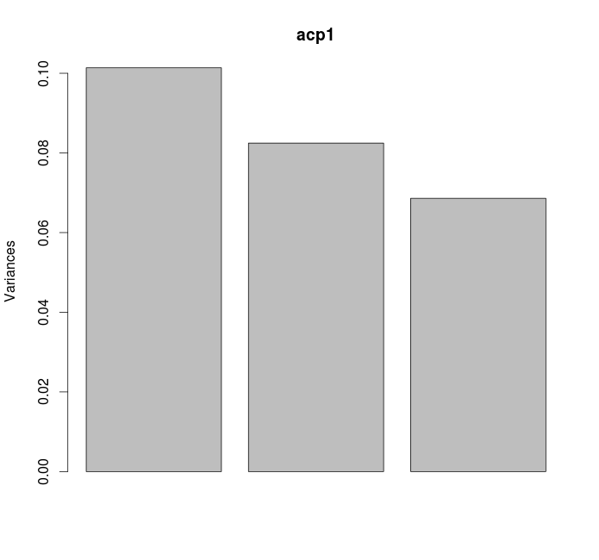
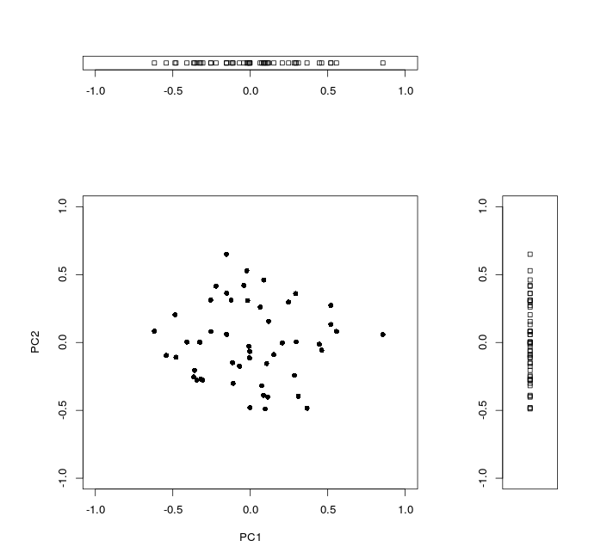
Example: individuals plot
1)

Slide 38
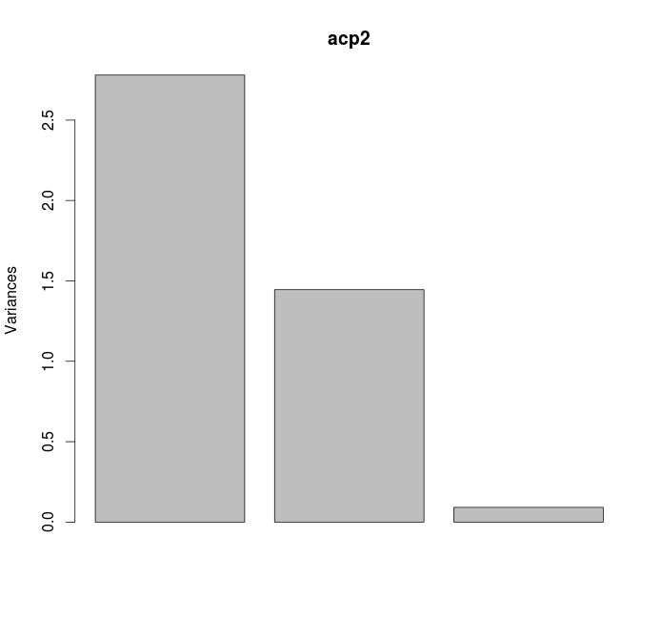
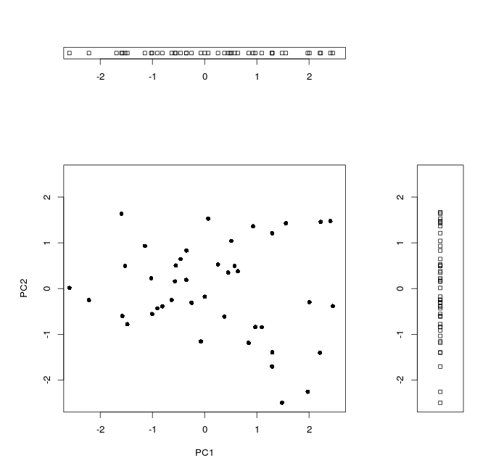
Example: individuals plot
2)

Slide 39
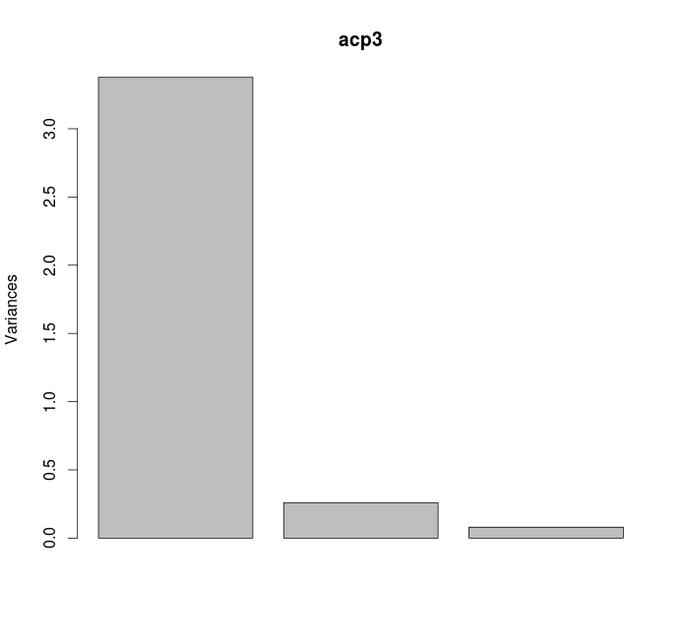
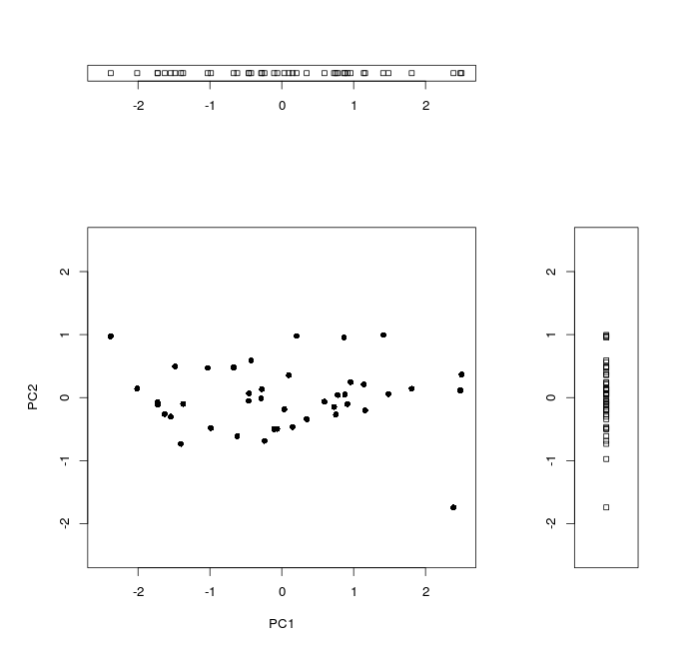
Example: individuals plot
3)

Slide 40
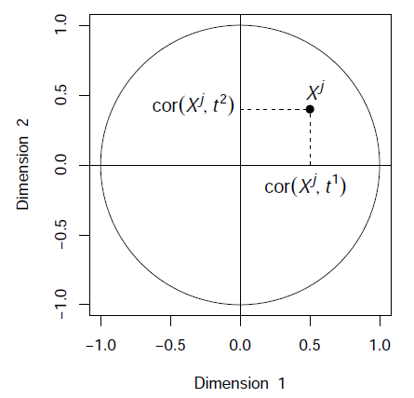
Variables plot
The coordinates of a variable X^{j} on a principal component PC^{i} is given by the correlation between this variable and the component PC^{i}.

Slide 41
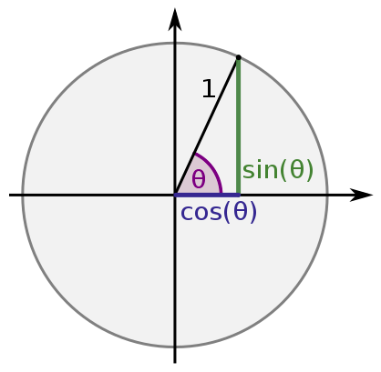
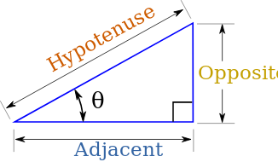
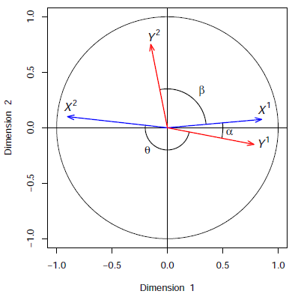
Variables plot
Remember trigonometry and right triangles:
Correlation ≈ cosine
The correlation between two variables is represented as:
An acute angle (cos(α) > 0) if it is positive
An obtuse angle (cos(θ) < 0) if it is negative
A right angle (cos(β)≈0) if it is near zero

Slide 42
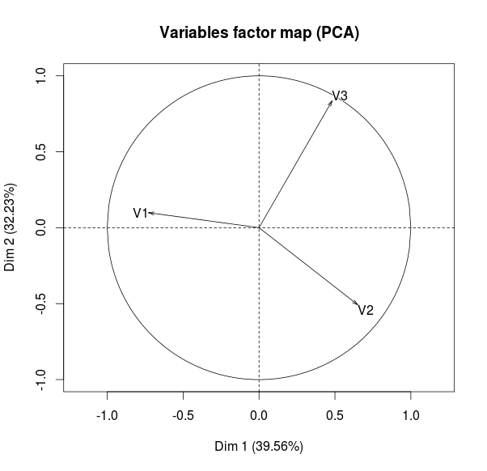
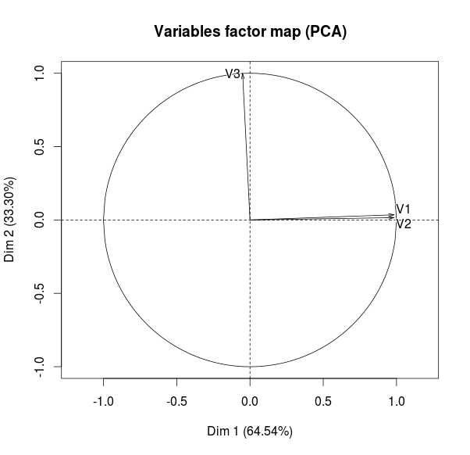
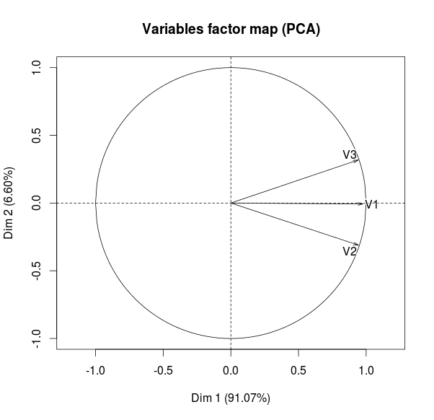
Variables plot
1)
2)
3)
Correlation matrices
1) V1 V2 V3
V1 1.0 -0.10 0.00
V2 -0.1 1.00 -0.12
V3 0.0 -0.12 1.00
2) V1 V2 V3
V1 1.00 0.88 -0.05
V2 0.88 1.00 -0.11
V3 -0.05 -0.11 1.00
3) V1 V2 V3
V1 1.00 0.88 0.92
V2 0.88 1.00 0.81
V3 0.92 0.81 1.00

Slide 43
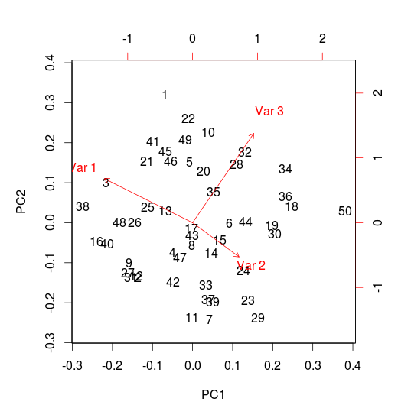
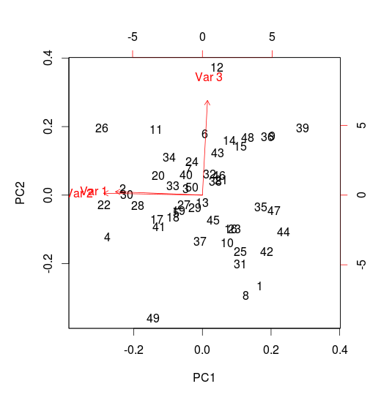
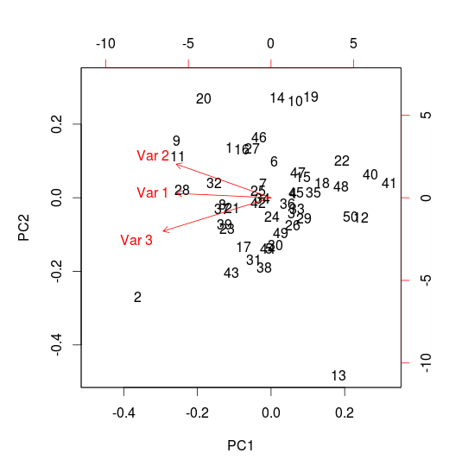
Example: biplot representation
Individuals and variables are plotted on the same graph
1)
2)
3)

Slide 44
And what about PCA?
Mathematically, to perform a PCA consists in diagonalising the covariance (or the correlation for scaled PCA) matrix.
Indeed, it can be shown that the sub-space in which the projected points have a maximal variance is given by the first eigen vectors of the covariance (or correlation) matrix ; the variance are given by the corresponding eigen values.
The first eigen vector provides the direction (via the coefficients of the linear combination to apply to initial variables) that explains the greatest part of variability. The second explains the greatest past of the remaining variance and so on...

Slide 45
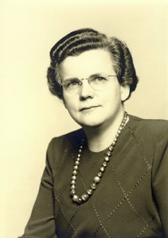
PCA: practical aspects
Should I scale my data before performing PCA?
  Without scaling: one variable with high variance will structure nearly alone the first principal component
  With scaling: one noisy variable with low variability will be given the same variance as others meaningful variables
Can I perform PCA with missing values?
  Specific algorithms to deal with missing values exist (for instance, NIPALS - implemented in mixOmics). It can be used to impute missing values but it requires « many » components.
The best thing to do about missing data is not to have any.
Gertrude Cox, 1900-1978, American statistician

Slide 46
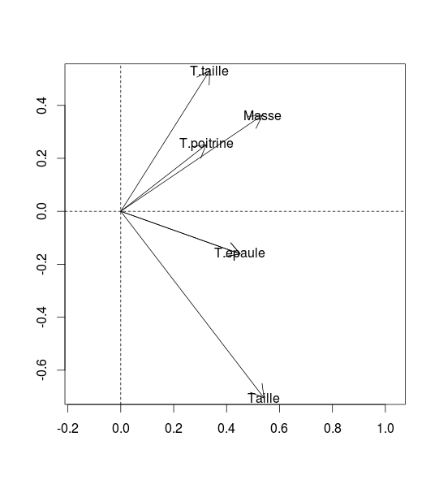
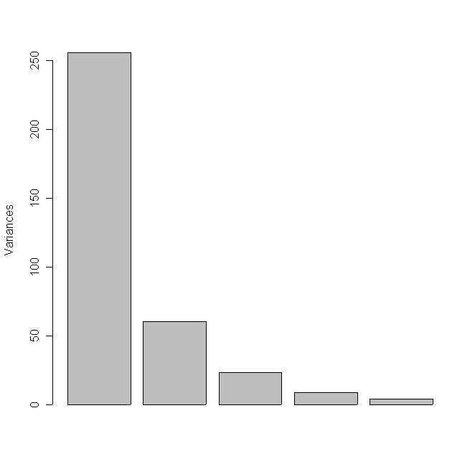
PCA: body data set
Variables plot
73 %
Screeplot
17 %
7 %
2 %
1 %
90% of the variability is explained by the first two PCs
10% of the information is lost when projecting from 5 to 2 dimensions.
PC 1 «beefyness»: separation of beefy people on the right (high values for the 5 variables) and weakling ones on the left.
PC 2 «fatness, rotundity»: bottom, variables linked to height and shoulders; top, weight, waist and chest girth.
T.ep T.p T.t M T
T.ep 1.00 0.74 0.48 0.72 0.71
T.p 0.74 1.00 0.78 0.81 0.51
T.t 0.48 0.78 1.00 0.86 0.37
M 0.72 0.81 0.86 1.00 0.61
T 0.71 0.51 0.37 0.61 1.00
Correlation matrix

Slide 47
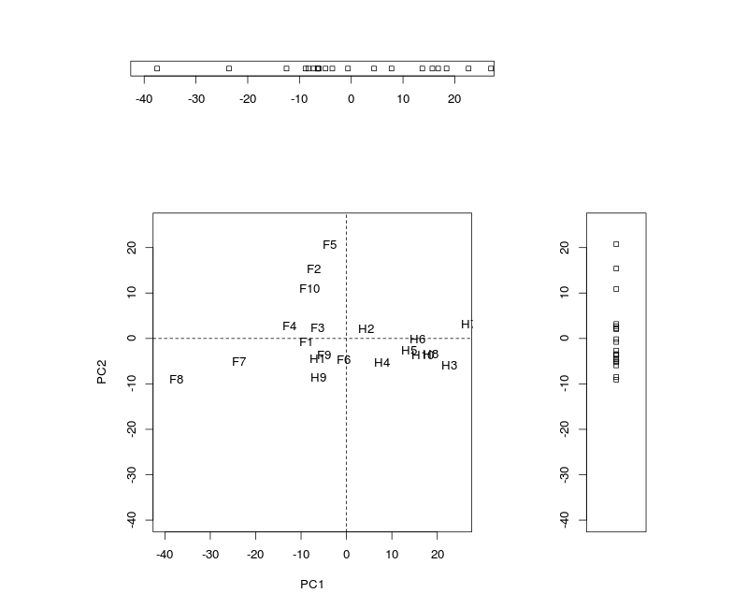
PCA: body data set
73 %
17 %
7 %
2 %
1 %
Individual plots

Slide 48
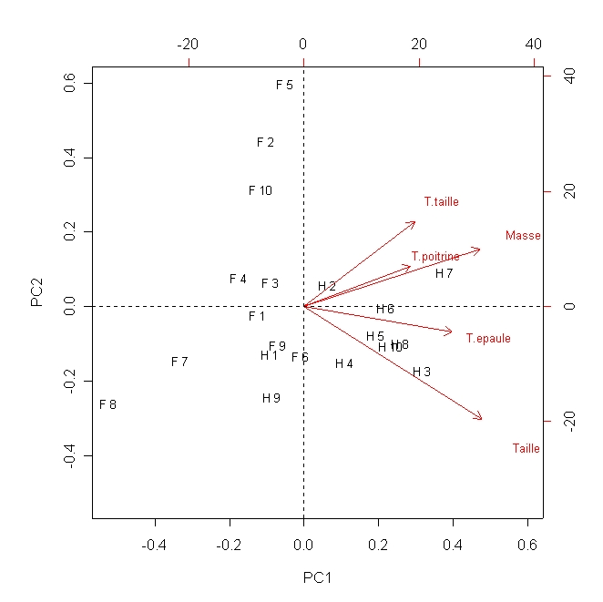
PCA: body data set
s.g c.g w.g w h
H 1 106.2 89.5 71.5 65.6 174.0
H 2 110.5 97.0 79.0 71.8 175.3
H 3 115.1 97.5 83.2 80.7 193.5
H 4 104.5 97.0 77.8 72.6 186.5
H 5 107.5 97.5 80.0 78.8 187.2
H 6 119.8 99.9 82.5 74.8 181.5
H 7 123.5 106.9 82.0 86.4 184.0
H 8 120.4 102.5 76.8 78.4 184.5
H 9 111.0 91.0 68.5 62.0 175.0
H 10 119.5 93.5 77.5 81.6 184.0
F 1 105.0 89.0 71.2 67.3 169.5
F 2 100.2 94.1 79.6 75.5 160.0
F 3 99.1 90.8 77.9 68.2 172.7
F 4 107.6 97.0 69.6 61.4 162.6
F 5 104.0 95.4 86.0 76.8 157.5
F 6 108.4 91.8 69.9 71.8 176.5
F 7 99.3 87.3 63.5 55.5 164.4
F 8 91.9 78.1 57.9 48.6 160.7
F 9 107.1 90.9 72.2 66.4 174.0
F 10 100.5 97.1 80.4 67.3 163.8
Origin (coordinate (0,0)): average individual
s.g c.g w.g w h
108.1 94.2 75.4 70.6 174.4

Slide 49
PCA: body data set
Data
Covariance matrix
s.g c.g w.g w h
H 1 106.2 89.5 71.5 65.6 174.0
H 2 110.5 97.0 79.0 71.8 175.3
H 3 115.1 97.5 83.2 80.7 193.5
H 4 104.5 97.0 77.8 72.6 186.5
H 5 107.5 97.5 80.0 78.8 187.2
H 6 119.8 99.9 82.5 74.8 181.5
H 7 123.5 106.9 82.0 86.4 184.0
H 8 120.4 102.5 76.8 78.4 184.5
H 9 111.0 91.0 68.5 62.0 175.0
H 10 119.5 93.5 77.5 81.6 184.0
F 1 105.0 89.0 71.2 67.3 169.5
F 2 100.2 94.1 79.6 75.5 160.0
F 3 99.1 90.8 77.9 68.2 172.7
F 4 107.6 97.0 69.6 61.4 162.6
F 5 104.0 95.4 86.0 76.8 157.5
F 6 108.4 91.8 69.9 71.8 176.5
F 7 99.3 87.3 63.5 55.5 164.4
F 8 91.9 78.1 57.9 48.6 160.7
F 9 107.1 90.9 72.2 66.4 174.0
F 10 100.5 97.1 80.4 67.3 163.8
Mean 108.1 94.2 75.3 70.6 174.4
Var. 68.6 37.5 50.8 85.7 109.3
s.g c.g w.g w h
Shoulder.g 68.64 37.74 28.08 55.32 61.19
Chest.g 37.74 37.51 33.90 45.70 32.40
Waist.g 28.08 33.90 50.77 56.58 27.70
Weight 55.32 45.70 56.58 85.71 59.52
Height 61.19 32.40 27.70 59.52 109.31
68.64 + 37.51 + 50.77 + 85.71 + 109.31 = 351.94
351.94 represents (somehow) the quantity of information contained in the data.

Slide 50
PCA: body data set
Coordinates of the individuals on the PCs
Coefficients (optimally calculated) to build principal components
Dim1 Dim2 Dim3 Dim4 Dim5
H1 -6.50 -4.48 -0.37 -1.03 1.27
H2 4.40 2.04 0.81 1.87 1.38
H3 22.66 -5.94 -6.18 0.11 1.97
H4 7.78 -5.24 -8.38 4.10 -1.74
H5 13.73 -2.67 -8.02 0.82 -2.15
H6 15.67 -0.15 4.49 2.33 4.40
H7 26.99 3.19 6.29 0.04 -3.08
H8 18.41 -3.43 5.63 1.09 -1.96
H9 -6.25 -8.48 4.97 0.79 1.86
H10 16.78 -3.67 1.99 -7.08 1.22
F1 -8.83 -0.78 0.28 -3.02 0.07
F2 -7.28 15.41 -2.31 -3.00 -2.35
F3 -6.45 2.25 -7.60 0.95 1.15
F4 -12.51 2.68 8.91 4.27 -1.53
F5 -3.65 20.76 -0.30 -2.45 1.99
F6 -0.63 -4.62 0.34 -3.46 -2.80
F7 -23.61 -5.07 2.20 1.19 -1.15
F8 -37.50 -9.07 -1.33 -1.89 -0.02
F9 -4.98 -3.61 0.33 -0.50 1.02
F10 -8.24 10.89 -1.74 4.86 0.44
Mean 0 0 0 0 0
Var. 255.7 60.2 23.5 8.61 4.0
Dim1 Dim2 Dim3 Dim4 Dim5
shoulder.g 0.45 -0.16 0.78 -0.18 0.36
chest.g 0.32 0.25 0.26 0.72 -0.49
waist.g 0.34 0.53 -0.33 0.24 0.66
weight 0.54 0.36 -0.17 -0.60 -0.44
height 0.54 -0.70 -0.43 0.17 0.02
PC1 = 0.45*shoulder.g + 0.32*chest.g
+ 0.34*waist.g + 0.54*weight + 0.54*height
PC2 = -0.16*shoulder.g + 0.25*chest.g
+ 0.53*waist.g + 0.36*weight – 0.70*height
PC3 = ...
PC1 PC2 PC3 PC4 PC5
PC1 255.66 0.00 0.00 0.00 0.00
PC2 0.00 60.18 0.00 0.00 0.00
PC3 0.00 0.00 23.48 0.00 0.00
PC4 0.00 0.00 0.00 8.61 0.00
PC5 0.00 0.00 0.00 0.00 4.01
Covariance matrix between PCs
255.66 + 60.18 + 23.48 + 8.61 + 4.01 = 351.94
255.66 is the greatest value of variance that we can obtain on the individuals with a linear combination of the initial variables.
The same quantity of information (351.94) is kept but it is ``optimally’’ allocated.

Slide 51

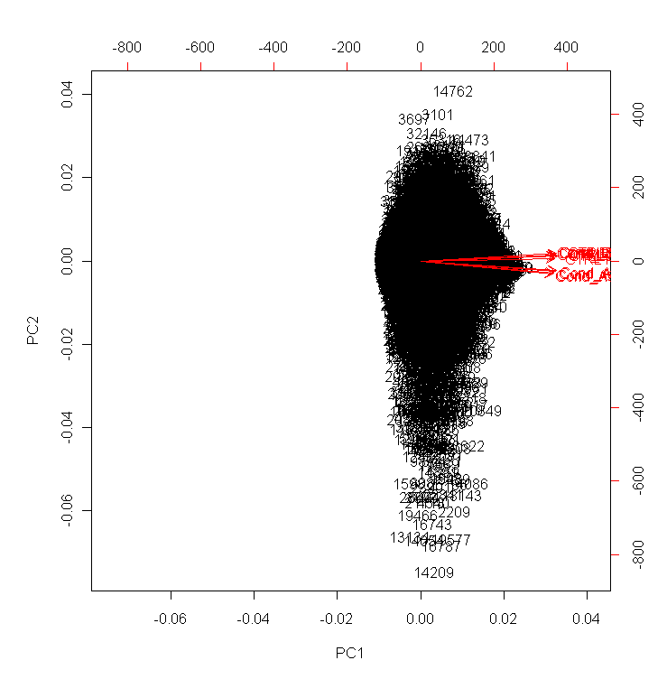
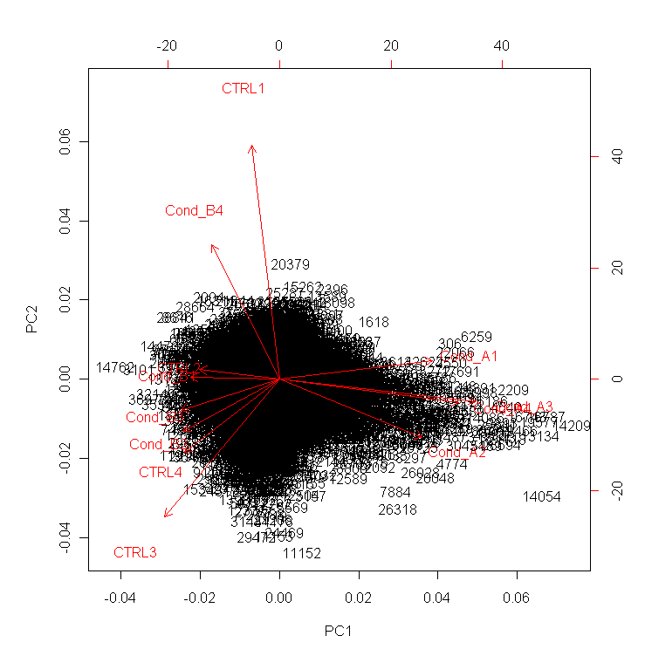
Biological data set (1)
PCA for quality control!
3 conditions, 4 replicates, 38000 genes, chip Affymetrix
1 replicate contrôle (to be removed?)
4 replicates condition A
1 replicat condition B (to be removed?)
3 replicates condition B et 3 replicats control

Slide 52
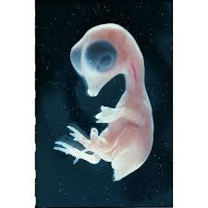
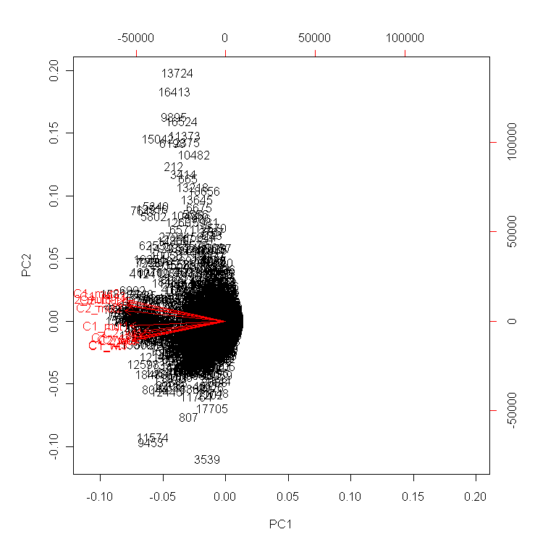
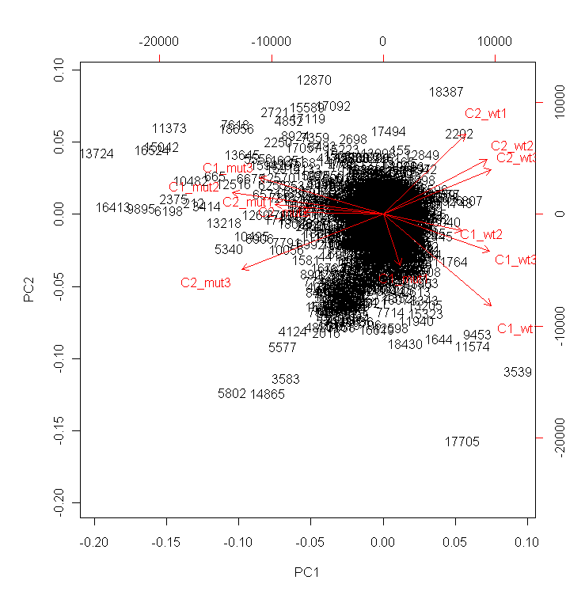
Biological data set (2)
PCA for quality control!
4 conditions (2 treatments * 2 genotypes), 3 replicates, 20000 genes (Affymetrix)
3 replicates C2_wt
2 replicates C1_mut
3 replicates C2_mut
1 replicate C1_mut
(to be removed?)
3 replicates C1_wt

Slide 53

PCA = projection
To interpret the graphical results of PCA must be done keeping in mind that one is looking at a projection on a plane (or in a volume for 3D representation).
Be careful when interpreting visual proximities
Illustration in comics with the only true super-heros ...

Slide 54
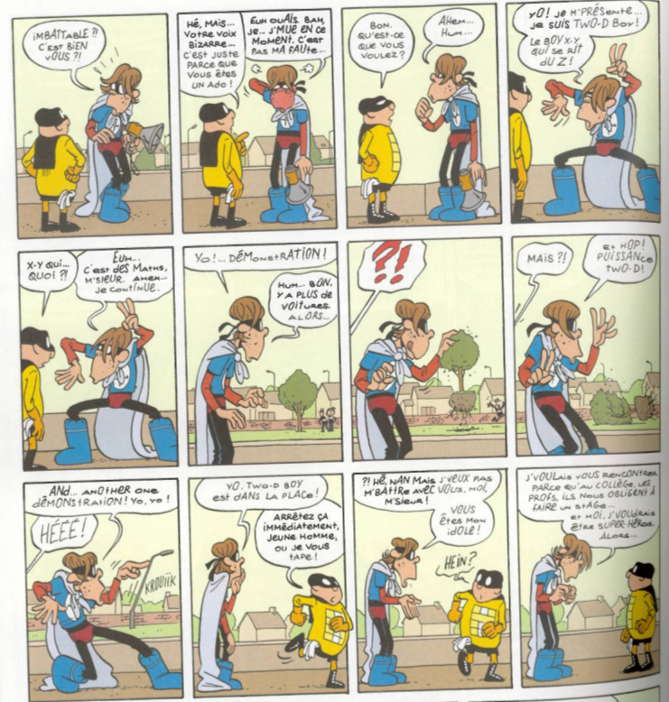
PCA = projection
I’m TWO-D boy. The boy X-Y who doesn’t care about the Z !
Scenario & illustration
Pascal Jousselin
Colour
Laurence Croix
Web
pjousselin.free.fr

Slide 55
Discriminant analysis

Slide 56
Linear Discriminant Analysis (LDA)
Explore a data set composed of quantitative variables and one qualitative variable in order to separate the individuals based on their membership to the categories of the qualitative variable.
p quantitatives variables
1 qualitative variable
n individuals

Slide 57
Body data set
V1 V2 V3 V4 V5 S
I 1 106.2 89.5 71.5 65.6 174.0 M
I 2 110.5 97.0 79.0 71.8 175.3 M
I 3 115.1 97.5 83.2 80.7 193.5 M
I 4 104.5 97.0 77.8 72.6 186.5 M
I 5 107.5 97.5 80.0 78.8 187.2 M
I 6 119.8 99.9 82.5 74.8 181.5 M
I 7 123.5 106.9 82.0 86.4 184.0 M
I 8 120.4 102.5 76.8 78.4 184.5 M
I 9 111.0 91.0 68.5 62.0 175.0 M
I 10 119.5 93.5 77.5 81.6 184.0 M
I 11 105.0 89.0 71.2 67.3 169.5 W
I 12 100.2 94.1 79.6 75.5 160.0 W
I 13 99.1 90.8 77.9 68.2 172.7 W
I 14 107.6 97.0 69.6 61.4 162.6 W
I 15 104.0 95.4 86.0 76.8 157.5 W
I 16 108.4 91.8 69.9 71.8 176.5 W
I 17 99.3 87.3 63.5 55.5 164.4 W
I 18 91.9 78.1 57.9 48.6 160.7 W
I 19 107.1 90.9 72.2 66.4 174.0 W
I 20 100.5 97.1 80.4 67.3 163.8 W
Can we found a space where the projection of the individuals will separate men and women (qualitative variable S) according to the 5 body measurements (V1 to V5)?

Slide 58
LDA: simulated example
V1 V2 V3 Groupe
1 -2.02 1.93 2.09 A
2 1.37 -0.12 2.01 A
3 6.02 4.15 1.77 A
4 0.50 -4.84 2.63 A
5 -3.46 0.40 2.04 A
6 2.03 0.22 2.09 A
7 -4.27 -0.19 1.84 A
8 10.44 -0.08 1.43 A
9 7.53 3.55 1.59 A
10 -2.75 -2.69 2.06 A
11 -7.16 5.18 2.00 A
12 11.82 -4.89 2.25 A
13 -0.52 -5.94 2.05 A
14 -0.62 -0.77 1.97 A
15 0.67 0.64 1.76 A
16 2.34 -0.93 1.74 A
17 2.79 -2.98 2.07 A
18 -1.87 0.05 2.02 A
19 -0.09 -0.69 2.32 A
20 5.07 5.57 2.08 A
21 0.38 0.90 1.69 A
22 1.50 3.79 1.96 A
23 0.78 -4.40 1.81 A
24 1.40 1.16 2.13 A
25 1.64 0.38 1.77 A
26 -4.00 -2.60 -1.95 B
27 5.15 0.59 -1.94 B
28 6.98 -1.14 -2.17 B
29 5.57 -6.49 -2.15 B
30 -5.84 -1.83 -1.82 B
31 -3.20 -0.07 -2.14 B
32 3.20 0.87 -1.50 B
33 -6.63 4.56 -1.92 B
34 -2.80 -1.53 -1.70 B
35 3.43 2.98 -2.14 B
36 -4.24 -2.61 -2.18 B
37 2.20 0.55 -1.89 B
38 -3.07 -2.07 -1.97 B
39 0.26 1.30 -1.85 B
40 0.32 0.79 -1.78 B
41 1.14 5.79 -1.64 B
42 -1.21 -2.88 -1.50 B
43 1.38 1.71 -2.11 B
44 -0.80 -0.38 -1.99 B
45 -2.04 -4.60 -2.00 B
46 7.67 5.84 -2.09 B
47 -4.50 -0.15 -1.85 B
48 -0.19 3.95 -1.89 B
49 5.92 1.54 -1.72 B
50 4.82 -1.70 -2.41 B
Data set
50 individuals, 4 variables
3 quantitatives V1 – V2 – V3
1 qualitative Group with 2 categories A and B
Can we find a space where the projections of the individuals from groups A and B are well separated?
V1 V2 V3
Mean 0 0 0
Variance 20 10 2

Slide 59
LDA: simulated example
Results of a PCA applied only on the quantitative variables (without considering the qualitative variable).
58%
30%
12%
The 3 PC are clearly identified to the 3 initial variables.
Most part of the variability in the data is explained by V1, then by V2, then by V3.

Slide 60
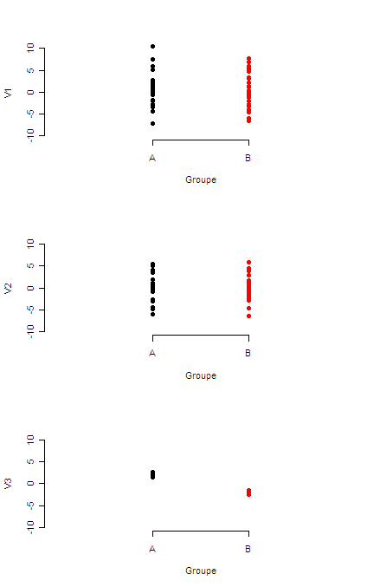
LDA: simulated example
Representation of the 50 individuals according the 3 variables. Color depends on the categorie (A-black or B-red)
Although displaying the smallest variability, V3 is relevant when addressing a discrimination purpose.

Slide 61
LDA: simulated example
LDA result
2 categories → 1 discriminant variable (graphical representation in)
Linear combination of the initial variables:
LD1 = -0.058 * V1 - 0.028 * V2 - 4.41 * V3
LD1 roughly corresponds to V3 (with negative coefficient, but the sign doesn’t matter).

Slide 62
LDA: body data set
Centroïd of the 2 groups
s.g c.g w.g w h LD1
F 102.31 91.15 72.82 65.88 166.17 33.81
H 113.80 97.23 77.88 75.27 182.55 36.82
Coefficients of linear discriminants:
LD1
shoulder g. 0.12
chest g. -0.02
waist g. 0.11
weight -0.11
height 0.14
The coefficients indicates that chest girth is the less discriminant variable (loading -0.02)... The other variables participate nearly in the same way (loadings around 0.1 in absolute value).

Slide 63
LDA: principle
LDA is similar to a PCA performed on the centroid of the groups determined by the categories of the qualitative variable.
Thus, we are looking for a sub-space of small dimension in which the centroids are the furthest possible (having a maximal variability)
If the number of categories is 2, then the dimension the sub-space is 1; so LDA will provide only LD1.

Slide 64
Decision-making with LDA
For a supplementary individual, when knowing the quantitative variables, the decision-making problem relies on the affectation of this individual to a categorie of the qualitative variable.
Naive (and not so bad) rule: affect the new individual to the categorie whose centroid is the closest (many others more sophisticated rules exist).
Application: credit scoring, quality control, diagnostic...

Slide 65
Iris data set
Sepal.Length Sepal.Width Petal.Length Petal.Width Species
1 5.1 3.5 1.4 0.2 setosa
2 4.9 3.0 1.4 0.2 setosa
3 4.7 3.2 1.3 0.2 setosa
4 4.6 3.1 1.5 0.2 setosa
5 5.0 3.6 1.4 0.2 setosa
----------------------------------------------------------------
45 5.1 3.8 1.9 0.4 setosa
46 4.8 3.0 1.4 0.3 setosa
47 5.1 3.8 1.6 0.2 setosa
48 4.6 3.2 1.4 0.2 setosa
49 5.3 3.7 1.5 0.2 setosa
50 5.0 3.3 1.4 0.2 setosa
51 7.0 3.2 4.7 1.4 versicolor
52 6.4 3.2 4.5 1.5 versicolor
53 6.9 3.1 4.9 1.5 versicolor
54 5.5 2.3 4.0 1.3 versicolor
55 6.5 2.8 4.6 1.5 versicolor
----------------------------------------------------------------
95 5.6 2.7 4.2 1.3 versicolor
96 5.7 3.0 4.2 1.2 versicolor
97 5.7 2.9 4.2 1.3 versicolor
98 6.2 2.9 4.3 1.3 versicolor
99 5.1 2.5 3.0 1.1 versicolor
100 5.7 2.8 4.1 1.3 versicolor
101 6.3 3.3 6.0 2.5 virginica
102 5.8 2.7 5.1 1.9 virginica
103 7.1 3.0 5.9 2.1 virginica
104 6.3 2.9 5.6 1.8 virginica
105 6.5 3.0 5.8 2.2 virginica
----------------------------------------------------------------
145 6.7 3.3 5.7 2.5 virginica
146 6.7 3.0 5.2 2.3 virginica
147 6.3 2.5 5.0 1.9 virginica
148 6.5 3.0 5.2 2.0 virginica
149 6.2 3.4 5.4 2.3 virginica
150 5.9 3.0 5.1 1.8 virginica
This famous (Fisher's or Anderson's) iris data set gives the measurements in centimeters of the variables sepal length and width and petal length and width, respectively, for 50 flowers from each of 3 species of iris. The species are Iris setosa, versicolor, and virginica.
R documentation

Slide 66
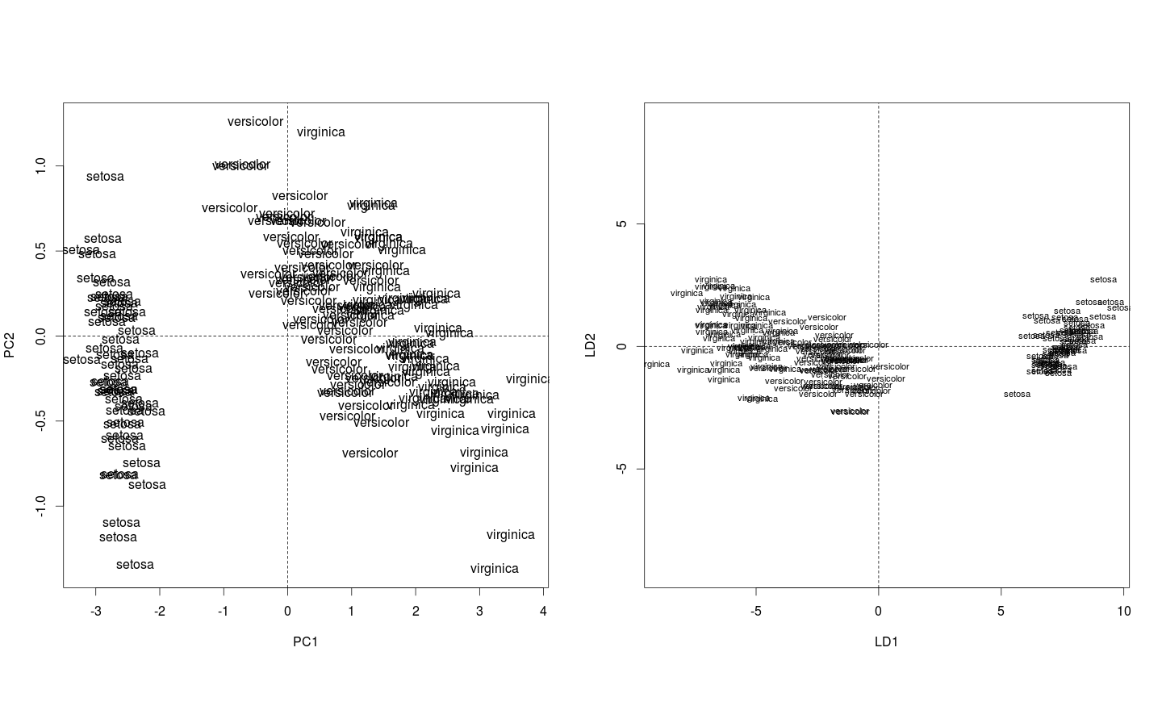
Iris data set
PCA
LDA

Slide 67
Projection to Latent Structure Discriminant Analysis (PLS-DA)
p quantitatives variables
1 qualitative variable
F
G1 G2
X
F
G1
G2
G1
G1
G2
G2
G1
1 0
0 1
1 0
1 0
0 1
0 1
1 0
n individuals
The PLS regression^{(*)} has been extended to deal with discrimination issues. To do that, the qualitative variable is converted into a dummy matrix (composed of 0 and 1) with as many rows as individuals and as many columns as catagories of the qualitative variable.
Please wait for few slides (section integration) to know more about PLS!

Slide 68
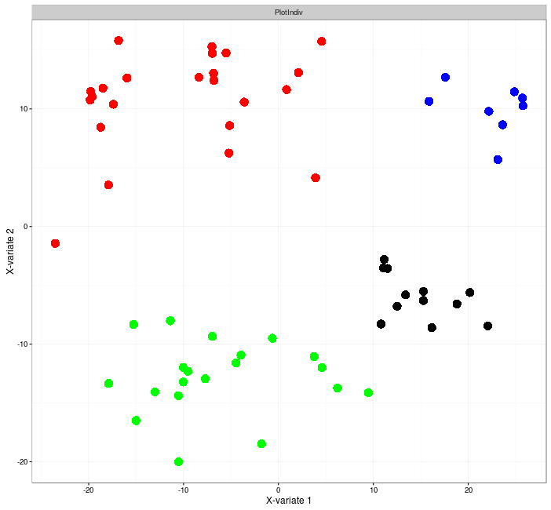
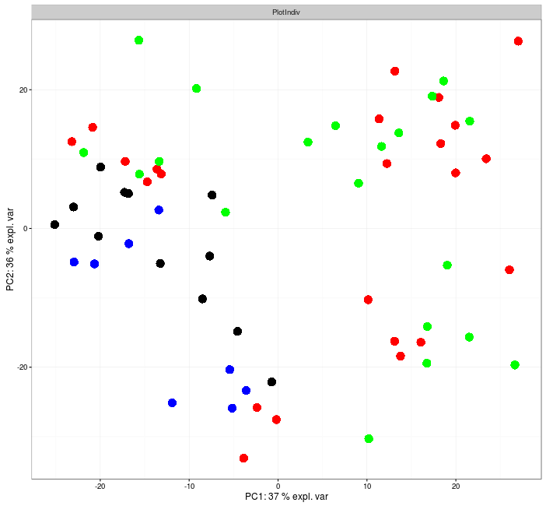
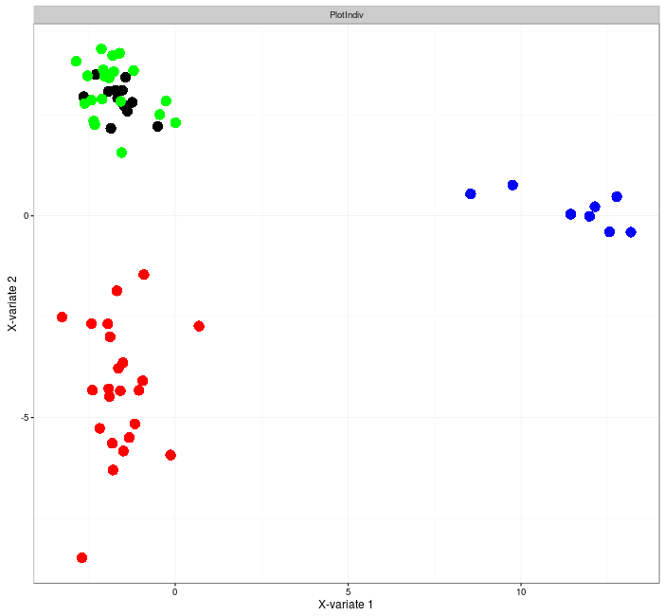
Comparison ACP-PLSDA
PCA
PLS-DA
The Small Round Blue Cell Tumors dataset from Khan et al., (2001) contains information of 63 samples and 2308 genes. The samples are distributed in four classes as follows: 8 Burkitt Lymphoma (BL), 23 Ewing Sarcoma (EWS), 12 neuroblastoma (NB), and 20 rhabdomyosarcoma (RMS).
PLS-DA with variables selection (see extensions sparse)
Voir en 3D

Slide 69
Data integration

Slide 70
Data integration
The two types of variables are measured on the same matching samples: X (n x p) and Y (n x q), n << p + q
p quantitative variables
q quantitative variables
n individuals
Aims:
Understand the correlation/covariance structure between two data sets
Select co-regulated biological entities across samples

Slide 71
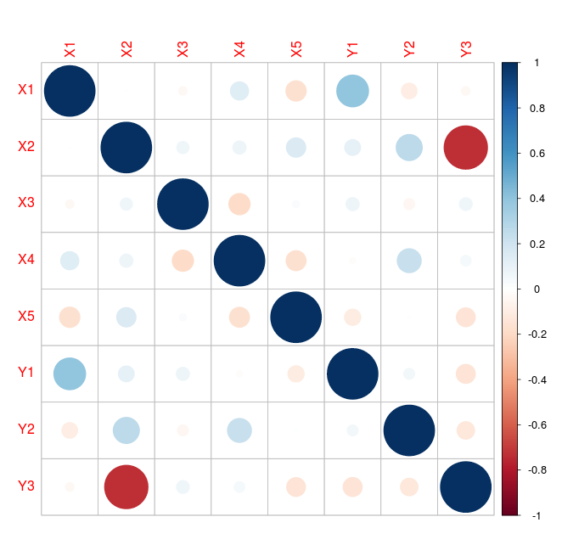
CCA: simulated example
X
Y
Correlation matrix (X,Y)
X1 X2 X3 X4 X5
0.87 0.31 0.24 0.06 0.29
0.76 0.8 0.52 0.1 0.95
0.65 0.76 0.57 0.1 0.17
0.86 0.47 0.00 0.21 0.75
0.65 0.46 0.41 0.23 0.86
0.11 0.56 0.84 0.14 0.49
0.85 0.81 0.42 0.65 0.39
0.74 0.73 0.15 0.81 0.80
0.75 0.30 0.72 0.48 0.99
0.55 0.06 0.30 0.87 0.67
0.41 0.52 0.21 0.51 0.59
0.59 0.87 0.99 0.67 0.28
0.34 0.35 0.56 0.03 0.56
0.07 0.02 0.59 0.04 0.54
0.17 0.08 0.50 0.37 0.89
0.39 0.54 0.53 0.65 0.46
0.06 0.17 0.28 0.82 0.46
0.22 0.83 0.90 0.17 0.49
0.83 0.27 0.51 0.38 0.55
0.02 0.51 0.56 0.34 0.99
0.04 0.46 0.81 0.47 0.46
0.32 0.95 0.65 0.10 0.43
0.42 0.27 0.17 0.36 0.37
0.39 0.68 0.94 0.79 0.87
0.48 0.30 0.83 0.60 0.22
0.84 0.25 0.54 0.00 0.52
0.31 0.14 0.33 0.48 0.38
0.15 0.80 0.09 0.87 0.29
0.99 0.07 0.81 0.96 0.01
0.26 0.21 0.20 0.24 0.66
0.99 0.07 0.86 0.84 0.36
0.91 0.19 0.82 0.04 0.25
0.46 0.17 0.48 0.38 0.02
0.95 0.94 0.41 0.83 0.48
0.80 0.34 0.54 0.72 0.58
0.09 0.01 0.81 0.02 0.63
0.93 0.75 0.54 0.79 0.90
0.78 0.99 0.67 0.08 0.84
0.83 0.05 0.04 0.70 0.41
0.97 0.68 0.37 0.88 0.34
0.13 0.35 0.16 0.95 0.81
0.5 0.04 0.17 0.49 0.15
0.37 0.64 0.55 0.96 0.14
0.01 0.98 0.48 0.94 0.76
0.40 0.44 0.80 0.40 0.94
0.44 0.67 0.67 0.42 0.20
0.92 0.07 0.48 0.92 0.06
0.30 0.39 0.54 0.23 0.92
0.60 0.75 0.22 0.60 0.50
0.25 0.77 0.02 0.51 0.18
Y 1 Y2 Y3
0.71 0.33 -0.53
0.62 0.07 -0.78
0.77 0.10 -0.52
0.49 0.57 -1.09
0.76 0.67 -0.30
0.53 0.84 -0.55
0.71 0.57 -0.75
0.24 0.89 -0.50
1.62 0.18 -0.80
-0.51 0.16 0.25
0.29 0.72 -0.61
1.11 0.80 -0.95
0.49 0.27 -0.06
0.51 0.02 -0.46
0.20 0.48 0.36
0.27 0.88 -0.48
0.61 0.98 -0.51
0.02 0.82 -0.74
0.40 0.08 -0.39
-0.53 0.46 -0.69
0.49 0.59 -0.28
0.07 0.61 -1.19
0.06 0.51 -0.31
0.05 0.76 -0.18
-0.25 0.25 -0.13
0.96 0.11 -1.58
0.24 0.74 0.41
0.23 0.89 -1.57
0.06 0.76 -0.29
0.42 0.61 -0.22
0.64 0.09 0.12
1.44 0.08 0.12
1.12 0.70 0.18
1.29 0.58 -1.37
1.60 0.51 -0.38
-0.02 0.23 0.05
-0.01 0.65 -1.20
1.12 0.81 -1.12
1.53 0.87 0.09
1.15 0.71 -0.52
0.28 0.23 -0.07
-0.89 0.20 0.25
1.15 0.73 -0.48
0.60 0.01 -1.49
0.28 0.64 0.23
0.71 0.61 -1.18
0.98 0.24 0.71
1.01 0.83 -0.51
0.09 0.56 -1.04
0.67 0.15 -0.87
X1 X2 X3 X4 X5 Y1 Y2 Y3
X1 1.00 0.00 -0.03 0.13 -0.17 0.40 -0.10 -0.03
X2 0.00 1.00 0.06 0.07 0.15 0.10 0.27 -0.74
X3 -0.03 0.06 1.00 -0.18 0.02 0.07 -0.05 0.07
X4 0.13 0.07 -0.18 1.00 -0.16 -0.02 0.23 0.05
X5 -0.17 0.15 0.02 -0.16 1.00 -0.11 0.01 -0.14
Y1 0.40 0.10 0.07 -0.02 -0.11 1.00 0.05 -0.15
Y2 -0.10 0.27 -0.05 0.23 0.01 0.05 1.00 -0.12
Y3 -0.03 -0.74 0.07 0.05 -0.14 -0.15 -0.12 1.00
Package R corrplot

Slide 72


CCA: simulated example
Graphical outputs
Variable plot
Individual plot

Slide 73
CCA: principle
The CCA can be viewed as an interative algorithm (like PCA)
    Maximize the correlation (ρ₁) between two linear combinations: one from variables X (t₁), the other from variables Y (u₁).
t1 = a₁₁X₁ + a₁₂X₂ + … + a_{1p}X_{p}
u₁ = b₁₁Y₁ + b₁₂Y₂ + … + b_{1q}Y_{q}
ρ₁ = cor(t₁,u₁) = max_{t,u} cor(t,u)
    For next levels, iterate the process under orthogonality constraints
CCA is analog to PCA for the production and the interpretation of graphical outputs.
Mathematical aspects are in the same vein as PCA (eigen decomposition of matrices)
t₁ and u₁ are the first canonical variates and p₁ is the first canonical correlation.

Slide 74

CCA: nutrimouse data set
CYP4A10 CYP4A14 CAR1 RXRa C16SR
-0.81 -0.81 -0.97 -0.67 1.66
-0.88 -0.84 -0.92 -0.59 1.65
-0.71 -0.98 -0.98 -0.68 1.57
-0.65 -0.41 -0.97 -0.72 1.61
-1.16 -1.16 -1.06 -0.78 1.66
-0.99 -1.09 -1.03 -0.62 1.70
-0.62 -0.76 -0.91 -0.65 1.58
-0.82 -0.87 -1.11 -0.76 1.62
-0.48 -0.37 -0.85 -0.55 1.72
-0.79 -0.95 -0.99 -0.67 1.55
-0.51 -0.15 -0.92 -0.60 1.69
-1.00 -1.13 -1.02 -0.69 1.57
-0.88 -0.99 -0.99 -0.67 1.60
-1.05 -1.15 -1.19 -0.75 1.59
-0.72 -0.73 -0.93 -0.58 1.61
-0.67 -0.85 -0.99 -0.72 1.60
-1.19 -1.22 -1.15 -0.69 1.60
-0.56 -0.73 -0.95 -0.55 1.78
-1.03 -1.10 -1.02 -0.59 1.67
-1.01 -1.06 -1.01 -0.70 1.60
-1.21 -1.17 -0.91 -0.67 1.65
-1.15 -1.29 -0.90 -0.69 1.55
-1.22 -1.25 -0.88 -0.67 1.55
-1.15 -1.19 -0.90 -0.58 1.65
-1.16 -1.18 -0.87 -0.67 1.57
-0.93 -0.90 -0.73 -0.52 1.74
-1.13 -1.10 -0.83 -0.62 1.61
-1.09 -1.08 -0.85 -0.63 1.64
-1.33 -1.22 -0.85 -0.66 1.60
-1.18 -1.08 -0.74 -0.63 1.62
-1.18 -1.14 -0.84 -0.67 1.57
-0.96 -1.05 -0.70 -0.49 1.72
-1.07 -1.03 -0.83 -0.63 1.60
-1.12 -1.11 -0.84 -0.57 1.60
-1.22 -1.15 -0.90 -0.62 1.59
-1.05 -0.96 -0.88 -0.53 1.65
-1.07 -1.03 -0.73 -0.58 1.62
-1.23 -1.18 -0.98 -0.64 1.64
-1.08 -1.12 -0.63 -0.53 1.72
-1.13 -1.14 -0.79 -0.61 1.55
C22.6n.3 C16.0 C20.2n.6
10.39 26.45 0.00
2.61 24.04 0.30
2.51 23.70 0.33
14.99 25.48 0.00
6.69 24.80 0.23
2.56 26.04 0.00
9.84 25.94 0.00
10.40 28.63 0.00
16.36 25.34 0.00
1.86 28.49 0.00
16.21 25.73 0.00
6.61 24.28 0.21
3.27 24.63 0.36
7.04 26.04 0.19
2.71 24.76 0.35
10.96 26.46 0.00
1.99 23.45 0.00
17.35 29.72 0.00
2.44 27.00 0.00
5.97 24.09 0.23
0.64 23.59 0.05
2.16 19.95 0.31
1.70 17.64 0.61
11.56 22.73 0.27
0.91 14.65 0.83
1.22 20.49 0.32
3.44 18.44 0.09
4.02 17.72 0.12
13.26 21.70 0.24
4.45 16.25 0.10
1.16 22.91 0.00
0.28 23.27 0.00
1.41 20.25 0.33
1.11 20.18 0.54
11.57 20.71 0.24
0.64 21.79 0.07
2.29 21.57 0.11
16.28 25.23 0.26
3.87 16.20 0.13
1.83 20.70 0.59
40 mice (2 genotypes)
Expression of 5 genes
Concentration of 3 lipids
Question: are there any genes related to lipids?
Correlation matrix

Slide 75


CCA: nutrimouse data set
Individual plot
color depending on the genotype added a posteriori
Variable plot
Canonical correlations : 0.853 0.627 0.253

Slide 76
CCA: a fundamental method...
If one data set has only one quantitative variable, CCA is equivalent to multiple linear regression.
If one data set is a dummy matrix corresponding to the categories of a qualitative variable, CCA is equivalent to Linear Discriminant Analysis.
If the two data sets are dummy matrices corresponding to the categories of two qualitative variables, CCA is equivalent to Correspondance Analysis.

Slide 77
… with limits
CCA can only be perfomed with « enough » observations: n >> p+q (sounds like a joke regarding ‘omics data...)
Variables X and Y must not be « too » correlated
Alternative: regularised CCA

Slide 78
Alternatives
PLS related methods. In PLS, the algorithm is equivalent to find linear combinations from X and Y variables that have the greatest covariance.
Regularized CCA. Apply a « ridge » penalty using regularization parameters to make the computation possible.

Slide 79
CCA: simulated example
variables X¹ and Y¹ are strongly correlated (0.9)
variables X² and Y² are less strongly correlated (0.7)
Canonical correlations for X et Y are approximately
ρ₁ = 0.9, ρ₂ = 0.7 et ρ₃ = … = ρ_{p} = 0
simulations are run for
n = 50, p = 10 et q = 10; 25 et 39

Slide 80

CCA: simulated example

Slide 81

Generalisation
Generalized CCA (GCCA): integration of more than 2 data sets ; maximizes the sum of every pairwise covariances between two components.
Sparse (see extensions) GCCA (SGCCA): variable selection is performed on each data set
Tenenhaus, A., Philippe, C., Guillemot, V., Lê Cao K-A., Grill, J., Frouin, V. 2014,
Variable selection for generalized canonical correlation analysis, Biostatistics

Slide 82
Graphical outputs
The same principles as those for PCA are still true for other multivariate methods mentioned here:
Individuals plots: the coordinates of the individuals are given by the components calculated with the method (PCA, PLS-DA, PLS, CCA...)
Variables plot: the variables are usually represented using their correlation with the components defining the axes. In other words, the coordinate of one variable X^{j} on the component t^{i} is given by cor(X^{j},t^{i})

Slide 83
Alternative graphical outputs
Motivations: usual plots are difficult to read and interpret when
The numer of variables is too high
The number of relevant components is greater than 2 inducing a « more than 2D » representation space.
Propositions:
Identify the pairs of highly related variables
Produce graphical display making easy the interpretation
I. González, K-A. Lê Cao, M. Davis, S. Déjean (2012) – Visualising associations between paired ‘omics’ data sets. BioData Mining

Slide 84

Alternative graphical outputs
Clustered Image Maps (CIM), Weinstein et al. (1997)
Heatmaps, Eisent et al. (1998)
Variables set 2
Differ from usual heatmaps crossing individuals and variables
Variables set 1

Slide 85


Alternative graphical outputs
Covariance Graph, Cox et Wermuth (1993)
Relevance Network, Butte et al. (2000)

Slide 86


Alternative graphical outputs
Be careful when interpreting network-based visualisation!
The same network (same links between same edges) can be represented in very different ways.
8
8
9
2
7
10
7
1
6
1
10
6
4
5
2
3
3
5
4
3
9

Slide 87
Extensions sparse

Slide 88
Curse of dimensionality
https://en.wikipedia.org/wiki/Curse_of_dimensionality
The curse of dimensionality refers to various phenomena that arise when analyzing and organizing data in high-dimensional spaces (often with hundreds or thousands of dimensions) that do not occur in low-dimensional settings such as the three-dimensional physical space of everyday experience. The expression was coined by Richard E. Bellman when considering problems in dynamic optimization.
→ Sparse methods aim at dealing with problems related to the high dimension of the data.
Occam's razor (law of parsimony): this principle states that among competing hypotheses, the one with the fewest assumptions should be selected.
https://en.wikipedia.org/wiki/Occam’s_razor

Slide 89

Sparse PCA
High throughput experiments: too many variables, noisy or irrelevant. PCA is difficult to visualise and understand.
→ clearer signal if some of the variable weights {a1, …, ap} were set to 0 for the ‘irrelevant’ variables (small weights):
t = 0.x1 + a₂.x₂ + … + 0.x_{p}
Important weights : important contribution to define the Pcs.
Null weights : those variables are not taken into account when calculating the PCs

Slide 90


Graphical outputs
PCA
Sparse PCA
Représentation des variables
Représentation des individus

Slide 91
Extensions multilevel

Slide 92
Principle
In repeated measures experiments, the subject variation can be larger than the time/treatment variation
Multivariate projection based methodes make the assumption that samples are independent of each other
In univariate analysis we use a paired t-test rather than a t-test
In multivariate analysis we use a multilevel approach
Different sources of variation can be separated (treatment effect within subjects and differences between subjects)

Slide 93

Paired data
No paired structure (A): no significant difference between ctrl and trt
Paired analysis (B): the data is decomposed into a mean (black circles) and a difference (d) per subject. The differences (net treatment effect) are projected on the Y-axis per subject, and are all different from 0.
Fig. from Westerhuis et al. (2009). Multivariate paired data analysis: multilevel PLSDA versus OPLSDA. Metabolomics 6(1).

Slide 94
Data decomposition
Decomposition of the data into within and between variations
X = X_{m} + X_{b} + X_{w}
offset term between-sample within-sample
The multilevel approach extracts the within variation matrix
Classical multivariate tools can then be applied on the within matrix
→ We take into account the repeated measures of the design of experiments
Liquet, B. Lê Cao, K-A., et al. (2012). A novel approach for biomarker selection and the integration of repeated measures experiments from two platforms, BMC Bioinformatics, 13:325.

Slide 95
Multilevel: simulated example
3 variables (A, B, C) measured for 10 sujets (1...10) in 2 conditions control ou treatment.
Raw data set
condition subject A B C
control 1 20 10 20
control 2 18 12 17
control 3 16 15 14
control 4 14 16 11
control 5 10 2 8
control 6 9 3 5
control 7 7 7 2
control 8 7 7 8
control 9 3 9 14
control 10 2 9 17
treatment 1 21 12 20
treatment 2 21 14 17
treatment 3 17 17 14
treatment 4 17 18 11
treatment 5 11 4 8
treatment 6 12 5 5
treatment 7 8 9 2
treatment 8 10 9 8
treatment 9 4 11 14
treatment 10 5 11 17
Between-subject matrix
subject A B C
1 20.5 11 20
2 19.5 13 17
3 16.5 16 14
4 15.5 17 11
5 10.5 3 8
6 10.5 4 5
7 7.5 8 2
8 8.5 8 8
9 3.5 10 14
10 3.5 10 17
1 20.5 11 20
2 19.5 13 17
3 16.5 16 14
4 15.5 17 11
5 10.5 3 8
6 10.5 4 5
7 7.5 8 2
8 8.5 8 8
9 3.5 10 14
10 3.5 10 17
Within-subject matrix
DA DB DC
-1 -2 0
-3 -2 0
-1 -2 0
-3 -2 0
-1 -2 0
-3 -2 0
-1 -2 0
-3 -2 0
-1 -2 0
-3 -2 0
1 2 0
3 2 0
1 2 0
3 2 0
1 2 0
3 2 0
1 2 0
3 2 0
1 2 0
3 2 0
From Westerhuis et al. (2009).
Multivariate paired data analysis: multilevel PLSDA versus OPLSDA. Metabolomics 6(1).

Slide 96

Multilevel: simulated example
PCA on raw data
The main information relies on the close locations of the two measurements made on each subject (1-11, 2-12, …, 9-19, 10-20)
No treatment effect can be observed

Slide 97


Multilevel: simulated example
PCA on between matrix
PCA on within matrix
Nearly the same information as obtained on the raw data
Because variability between subjects is greater than the variability due to the treatment
Only 4 distinct points (related to the 4 unique rows in the within matrix)
Treatment effect clearly appears

Slide 98




To put it in a nustshell
Multivariate linear methods enables to answer a wide range of biological questions
  data exploration
  classification
  integration of multiple data sets
Variable selection (sparse)
Cross-over design (multilevel)
Principles
PCA : max var(aX) →a ?
PLS1 : max cov(aX, by) →a, b ?
PLS2 : max cov(aX, bY) →a, b ?
CCA : max cor(aX,bY) →a, b ?
PLSDA →PLS2
GCCA : max Σ cov(a_{i}X_{i},b_{j}X_{j}) →a_{i}, b_{i} ?

Slide 99

Questions, feedback
Web site with tutorial :
www.mixomics.org
Contact : mixomics@math.univ-toulouse.fr
Register to our newsletter for the latest updates :
http://mixomics.org/a-propos/contact-us/

Slide 100


mixOmics would not exist without...
mixOmics development
Kim-Anh Lê Cao, Univ. Melbourne
Ignacio González, INRA Toulouse
Benoît Gautier, UQDI
Florian Rohart, TRI, UQ
Sébastien Déjean, Univ. Toulouse
François Bartolo, Methodomics
Xin Yi Chua, QFAB
Methods development
Amrit Singh, UBC, Vancouver
Benoît Liquet, Univ. Pau
Jasmin Straube, QFAB
Philippe Besse, INSA Toulouse
Christèle Robert, INRA Toulouse
Data providers and biological point of view
Pascal Martin, INRA Toulouse
And many many mixOmics users and attendees!

