Slide 1
A General Overview of Natural language processing
By: Rohola Zandie
August 2017

Slide 2
History of NLP
In 1950, Alan Turing published his famous article "Computing Machinery and Intelligence" which proposed what is now called the Turing test as a criterion of intelligence
His approach heavily influenced by behaviorism.
It was a response to depth psychology of Sigmund Freud.
In order to be justified in ascribing a mental state to an entity, there must be some true claims about the observable behavior of that entity.
The most important behavior of human is manifested in language

Slide 3
History of NLP
In 1957, Noam Chomsky’s “Syntactic Structures” revolutionized Linguistics with 'universal grammar', a rule based system of syntactic structures.
During the 70's many programmers began to write 'conceptual ontologies', which structured real-world information into computer-understandable data.
During this time, many chatterbots were written including PARRY, Racter, and Jabberwacky.
Starting in the late 1980s, there was a revolution in NLP with the introduction of machine learning algorithms for language processing.
Recent research has increasingly focused on unsupervised and semi-supervised learning algorithms.

Slide 4
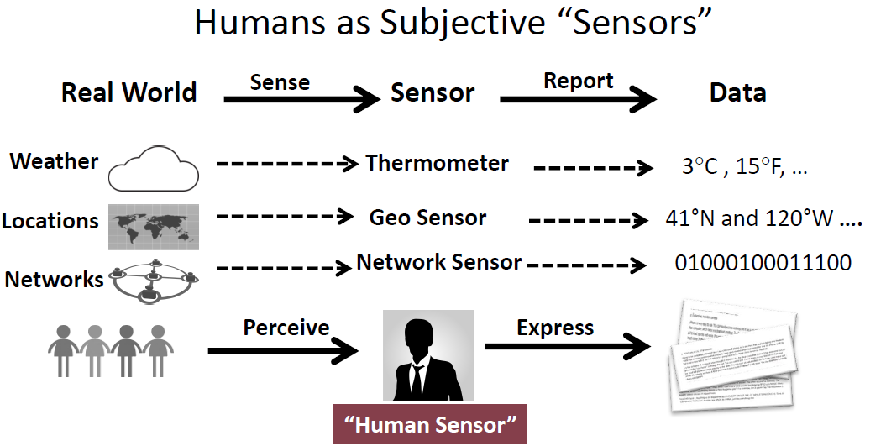
Text vs Non-Text Data

Slide 5
Challenges
Ambiguity
Knowledge Representation
Data Sparsity
Evaluation

Slide 6
Ambiguity
I made her duck
I cooked waterfowl for her benefit (to eat)
I cooked waterfowl belonging to her
I created the (plaster?) waterfowl she owns
I caused her to quickly lower her head or body
I recognized the true identity of her spy waterfowl
I waved my magic wand and turned her into undifferentiated waterfowl

Slide 7
Ambiguity
Ambiguity is pervasive
I caused her to quickly lower her head or body
Part of speech: “duck” can be a Noun or Verb
I cooked waterfowl belonging to her.
Part of speech:
“her” is passive pronoun (“of her”)
“her” is dative pronoun (“for her”)
I made the (plaster) duck statue she owns
Word Meaning : “make” can mean “create” or “cook”

Slide 8
Ambiguity
Grammar: make can be (Syntactic ambiguity)
Transitive: (verb has a noun direct object)
Ditransitive: (verb has 2 noun objects)
Action-transitive (verb has a direct object + verb)
I caused [her] [to move her body]
I
cooked
[waterfowl belonging to her]
Object
I
made
[her]
into
[undifferentiated waterfowl
Object 1
Object 2
I
caused
[her]
[to move her body]
Object
Verb

Slide 9
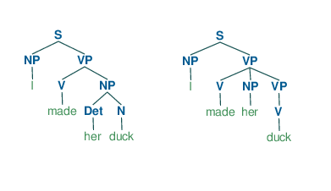
Ambiguity
Lexical ambiguity
Duck can be Noun or Verb
Syntactic ambiguity
Different Parse trees
Generated in python
Semantic ambiguity
Make can be “create” or “cook”
Metaphors
a figure of speech in which a word or phrase is applied to an object or action to which it is not literally applicable
He drowned in a sea of grief

Slide 10
Knowledge Representation
Designing computer representations that capture information about the world
Question answering
Dialog systems
Factual knowledge: The scientifically verified facts about the world.
Water boils at 100 C
The minimum price of the book titled “Introduction to Security” by David Walters now is 41$
Common sense knowledge: Collection of information that an ordinary person is expected to know. (general to specific)
Preconditions of actions and events
Effects (post conditions) of actions and events
Subjects and objects of actions
Behaviors of devices
Stereotypical situations or scripts
Human goals and needs
Emotions
Plans and strategies
Story themes

Slide 11
Knowledge Reasoning
Formal reasoning:
Deductive reasoning: logical deduction
Based mostly on first and second order logic
All men are mortal.
Socrates is a man.
Therefore, Socrates is mortal.
Inductive reasoning:
Based mostly on Bayes inference:
All biological life forms that we know of depend on liquid water to exist.
Therefore, if we discover a new biological life form it will probably depend on liquid water to exist.

Slide 12
Knowledge Reasoning
Informal reasoning (Heuristics reasoning)
Influenced heavily by Cognitive biases
Example:
The effort heuristic: the quality or worth of an object is determined from the perceived amount of effort that went into producing that object
Suffer from cognitive biases: For example they tend to search for, interpret and recall information in a way that confirms one's preexisting beliefs or hypotheses
Folk psychology, naïve physics, political debates and everyday reasoning
In order to simulate human behavior we need to incorporate human errors!

Slide 13
Knowledge Reasoning
Deductive
representation:
Semantic nets, system architecture, frames and ontologies
reasoning:
Inference engines, theorem provers.
Inductive
representation
Feature vectors
reasoning
Statistical reasoning (Bayes inference)

Slide 14
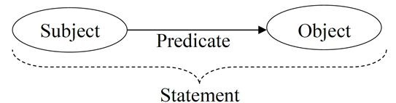
Ontology
Ontology is a formal way for naming properties, types and relationships between some entities in a domain of discourse.
The statement is a predicate based on formal second order logic.
Subject and Object can be classes or instances.
relationship between two classes : Lions eat deer
relationship between two individuals: John loves Jessica.

Slide 15
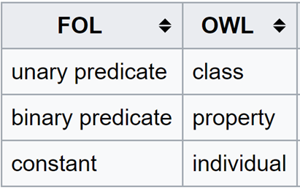
Ontology
The most widely used language for ontology is OWL. It consists of:
Individuals
Classes
Attributes
Relations
…
Example:
Unary predicates:
P(x)= x is a person
x belongs to the “person” class
Binary predicates
R(x,y)= x has age y
y is the “age” property of x
Constant
C= John
John is an individual of class student

Slide 16
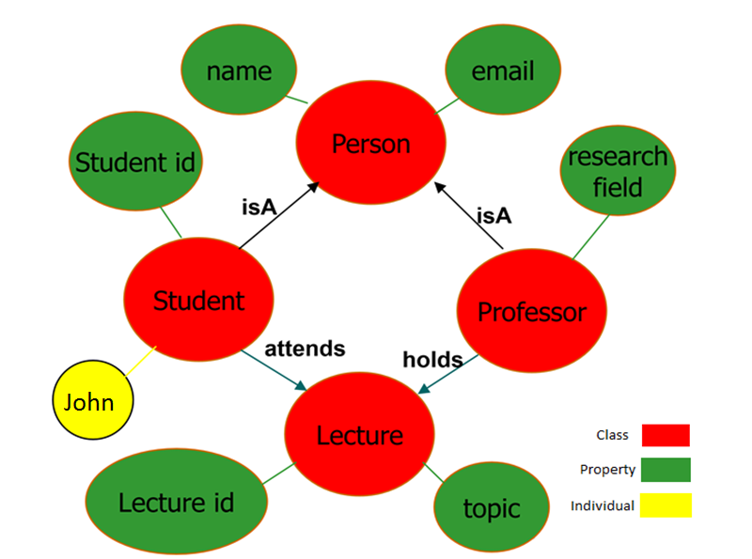
Ontology

Slide 17
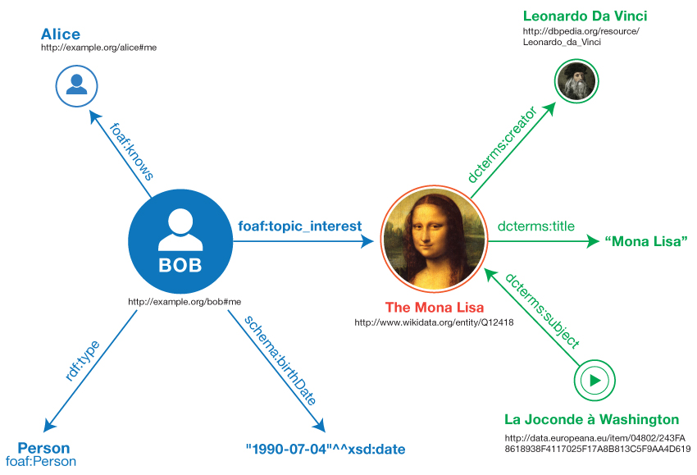
Ontology
The extension of this idea to web is called semantic web.
Imagine all the resources on the web make a big ontology.

Slide 18


Ontology
Linked Data: a method of publishing structured data so that it can be interlinked and become more useful through semantic queries.
It is based on web 2.0 technologies: RDF, URI’s, OWL
The most important datasets of Linked Data known as Knowledge bases are:
Dbpedia:
a dataset containing extracted data from Wikipedia
3.4 million concepts described by 1 billion triples
YAGO:
has knowledge of more than 10 million entities
contains more than 120 million facts about these entities
Cyc:
a comprehensive ontology and knowledge base of everyday common sense knowledge
FOAF
a dataset describing persons, their properties and relationships

Slide 19
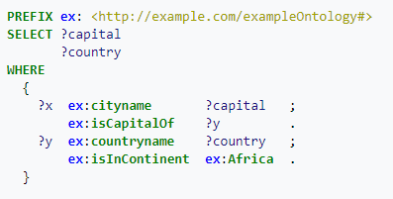
Ontology
Semantic query: Semantic queries enable the retrieval of both explicitly and implicitly derived information based on syntactic, semantic and structural information contained in data.
It is mainly based on SPARQL
Example: What are all the country capitals in Africa?

Slide 20
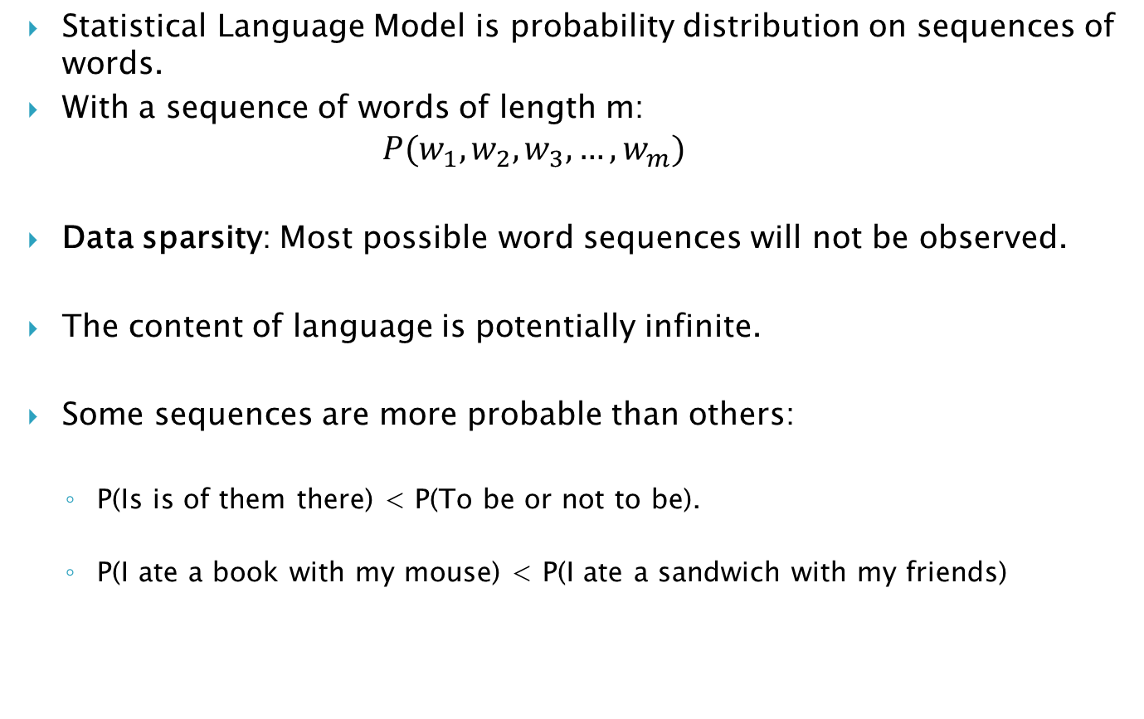
Language Model
Statistical Language Model is probability distribution on sequences of words.
With a sequence of words of length m:
$$P(w_{1},w_{2},w_{3},…,w_{m})$$
Data sparsity: Most possible word sequences will not be observed.
The content of language is potentially infinite.
Some sequences are more probable than others:
P(Is is of them there) < P(To be or not to be).
P(I ate a book with my mouse) < P(I ate a sandwich with my friends)

Slide 21
Language Model
Statistical Language processing main hypothesis: Distributional Semantics
Distributional Semantics: linguistic items with similar distributions have similar meanings.
Topical similarity: linguistic items occurring in similar text regions
“European League” and “FIFA” words are in the same topic: Football
“European League” and “Optimization” words belong to different topics
Paradigmatic similarities: linguistic items with similar co-occurrence(closer than text regions)
“G5” and “summit”
Syntagmatic similarities: linguistic items with similar syntactic forms.
“post”, “postal”

Slide 22
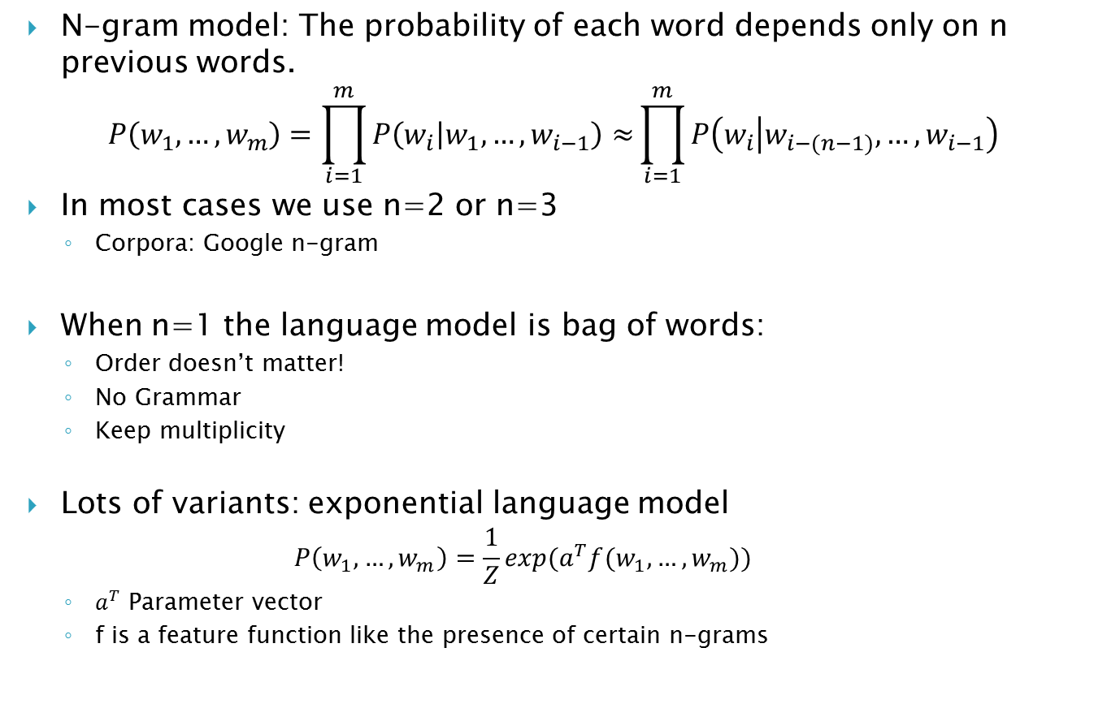
Language Model
N-gram model: The probability of each word depends only on n previous words.
$$P\left(w_{1},…,w_{m}\right)=\prod_{i=1}^{m}{P\left(w_{i} | w_{1},…,w_{i−1}\right)≈}\prod_{i=1}^{m}{P\left(w_{i} | w_{i−(n−1)},…,w_{i−1}\right)}$$
In most cases we use n=2 or n=3
Corpora: Google n-gram
When n=1 the language model is bag of words:
Order doesn’t matter!
No Grammar
Keep multiplicity
Lots of variants: exponential language model
$$P\left(w_{1},…,w_{m}\right)=\frac{1}{Z}{exp(a}^{T}f(w_{1},…,w_{m}))$$
$a^{T}$ Parameter vector
f is a feature function like the presence of certain n-grams

Slide 23
Vector space model
Vector space model is an algebraic model for representing words and text documents as numerical real valued vectors
Naïve modeling: consider each word as an index vector. A sentence represented as:
TF-IDF: the above model can be modified in two ways
Term frequency
Terms that occur more frequently are more important
Inverse of document frequency
A word like “the” occurs very frequently(almost uniformly) among documents and have less information than a word like “book”
Book | Lion | Read | … | Can | Single | The | a
1 | 0 | 1 |  | 1 | 0 | 1 | 1

Slide 24
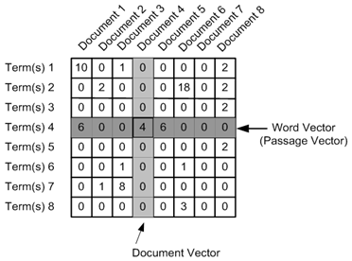
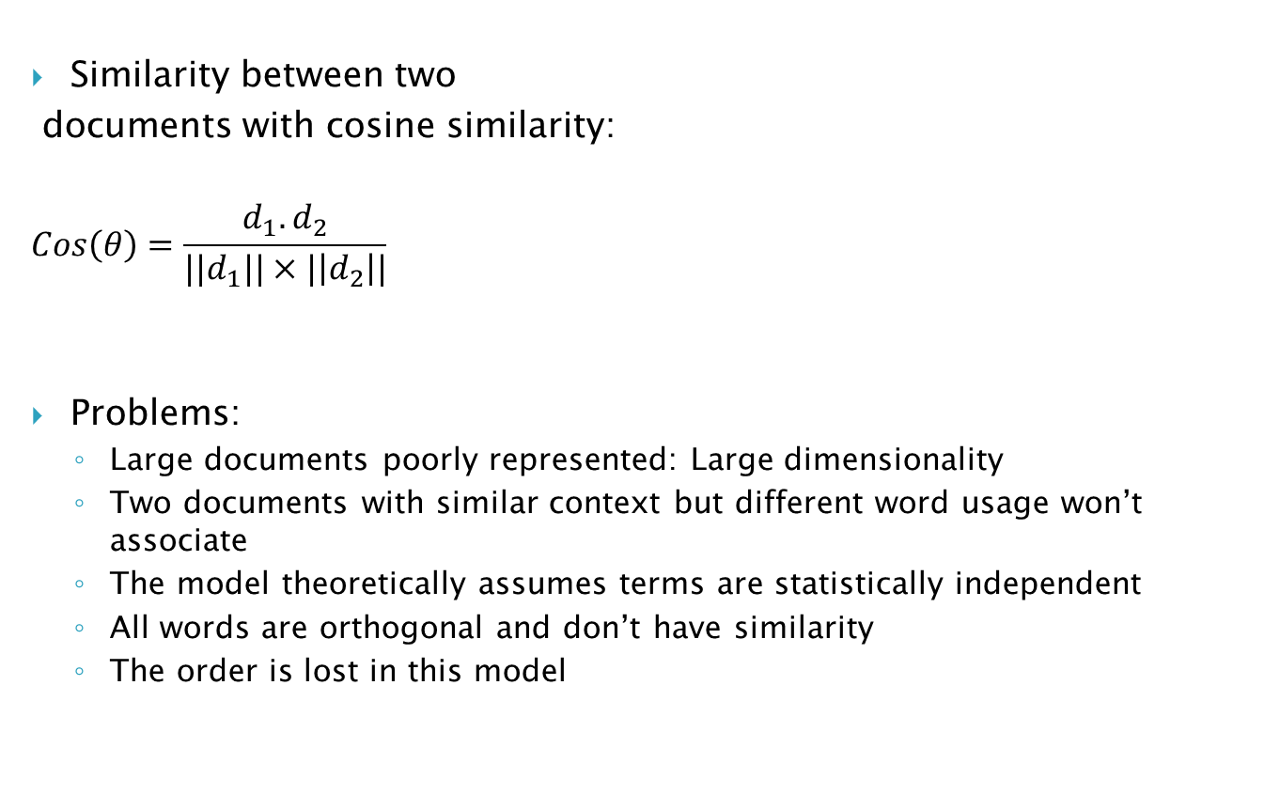
Vector space model
Similarity between two
documents with cosine similarity:
$$Cos\left(θ\right)=\frac{d_{1}.d_{2}}{{||d}_{1}||×|\left|d_{2}\right||}$$
Problems:
Large documents poorly represented: Large dimensionality
Two documents with similar context but different word usage won’t associate
The model theoretically assumes terms are statistically independent
All words are orthogonal and don’t have similarity
The order is lost in this model

Slide 25
Vector space model
Generalized Vector space model: Introduces term correlation to alleviate the orthogonality assumption.
Correlation between words can be defined in many different ways:
Semantic similarity relatedness in Wordnet, DBPedia, YAGO Taxonomy and other Linked Open Data
Compute frequency co-occurrence statistics from large corpora
Explicit Semantic Analysis: Introduces using of inverted index on large corpora like Wikipedia.
Each word can be represented as the vector of all Wikipedia articles that the word occurred in them.
For example: consider “meet”
Article1 | Article2 | Article3 | … | Article(n-2) | Article(n-1) | Article(n)
3 | 0 | 1 |  | 2 | 0 | 0

Slide 26
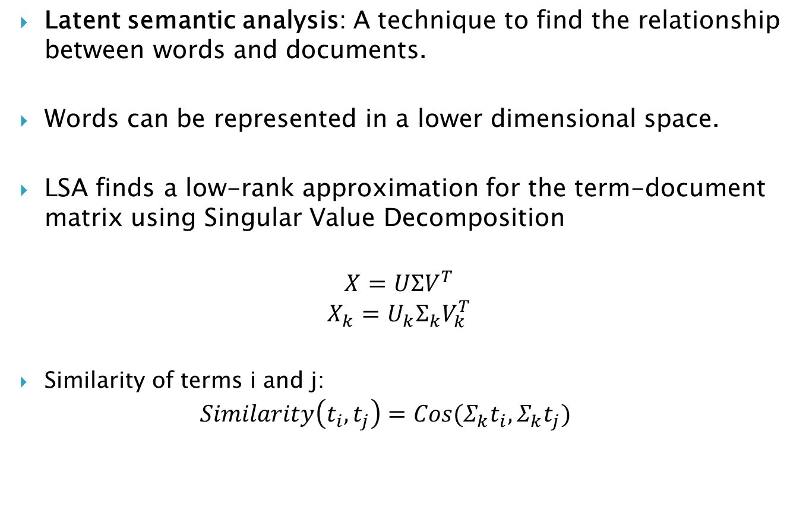
Vector space model
Latent semantic analysis: A technique to find the relationship between words and documents.
Words can be represented in a lower dimensional space.
LSA finds a low-rank approximation for the term-document matrix using Singular Value Decomposition
$$X=UΣV^{T}$$
$$X_{k}=U_{k}Σ_{k}V_{k}^{T}$$
Similarity of terms i and j:
$$Similarity\left(t_{i},t_{j}\right)=Cos(Σ_{k}t_{i},Σ_{k}t_{j})$$

Slide 27
Vector space model
The result is that some dimensions combined (usaully synonym words)
{(car), (truck), (flower)} ↦ {(1.3452 * car + 0.2828 * truck), (flower)}
Problems:
The interpretation of new dimensions are not always easy
{(car), (bottle), (flower)} ↦ {(1.3452 * car + 0.2828 * bottle), (flower)}
Cannot Capture polysemy: Multiple meaning of one word
It has Bag of words limitations

Slide 28
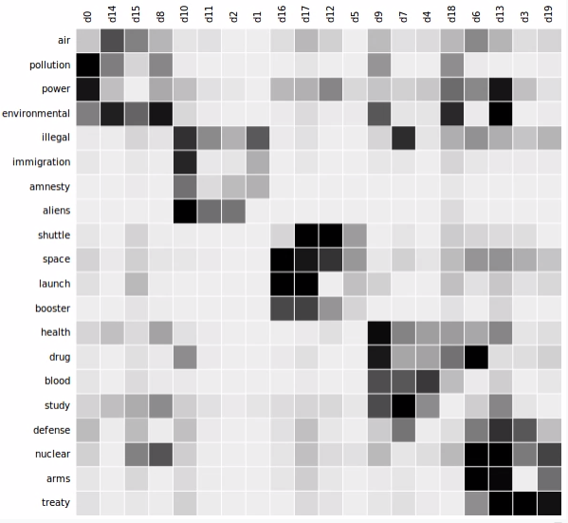
Vector space model

Slide 29
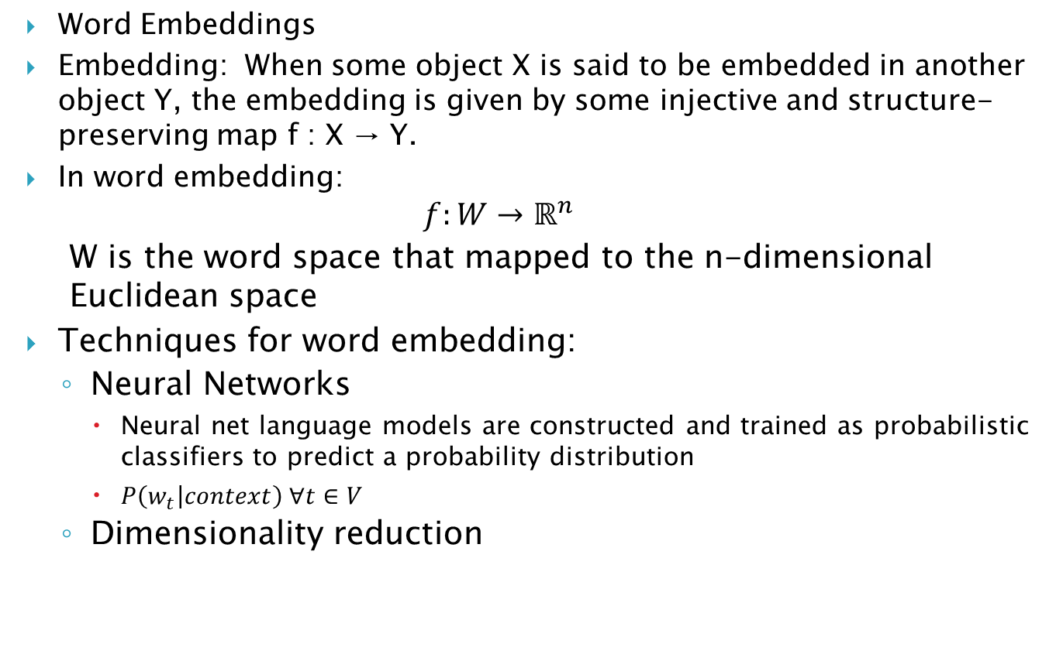
Vector space model
Word Embeddings
Embedding: When some object X is said to be embedded in another object Y, the embedding is given by some injective and structure-preserving map f : X → Y.
In word embedding:
$$f:W→ℝ^{n}$$
W is the word space that mapped to the n-dimensional Euclidean space
Techniques for word embedding:
Neural Networks
Neural net language models are constructed and trained as probabilistic classifiers to predict a probability distribution
$P\left(w_{t} | context\right) ∀t∈V$
Dimensionality reduction

Slide 30
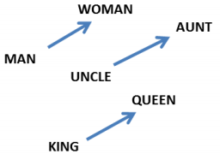
Vector space model
Word2Vec: A shallow two layer neural network trained to reconstruct linguistic context.
Input: a large corpus of text
Output: a vector space, typically of several hundred dimensions
W(‘‘cat")=(0.2, -0.4, 0.7, ...)
W(‘‘mat")=(0.0, 0.6, -0.1, ...)
Remarkable properties:
1- Analogy:
W(‘‘woman")−W(‘‘man") ≃ W(‘‘aunt")−W(‘‘uncle")
W(‘‘woman")−W(‘‘man") ≃ W(‘‘queen")−W(‘‘king")
2- Finding matches and doesn’t matches:
doesnt_match(["breakfast”, “cereal”, “dinner”, “lunch“])
'cereal'

Slide 31
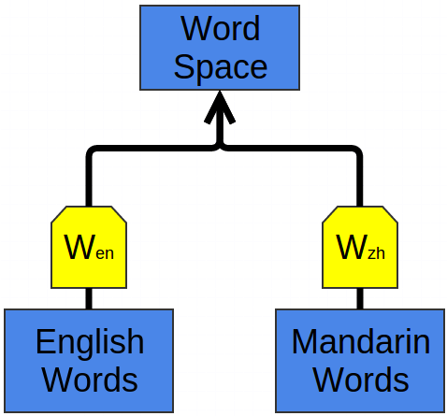
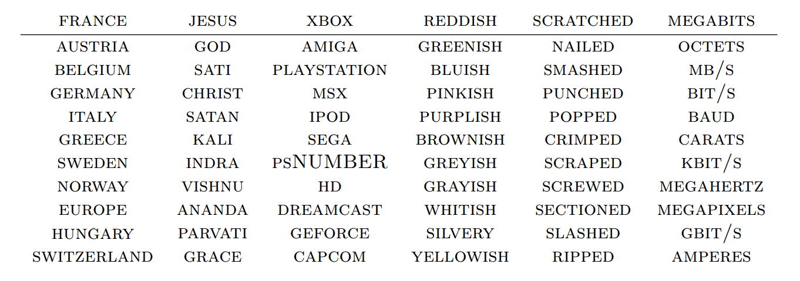
Vector space model
3-Shared representation: Similar words in different languages map to the same space vicinity
W_en and W_zh are word embedding
for English and Chinese.
It’s great for translation
4- Finding word clusters:

Slide 32
Vector space model
Other successful embeddings:
Turian embedding (Turian et al., 2010)
SENNA embedding (Collobert et al., 2011)
Eigenword (Dhillon et al., 2015)
The generalization of these method to sentences and documents
Sentene2vec and Doc2vec
Still sparse
There are a lot of application that benefit from vector space models
Parsing, Stemming, Segmentation
Named Entity recognition, Word sense disambiguation, Sentiment analysis Coreference resolution
Question Answering,, topic modeling
Summarization, Machine translation, dialog systems

Slide 33
Evaluation
Question:
How do you evaluate a search engine results?
How do you evaluate a translation system?
Solution: recruit human subjects, train them and ask them to assess the output
Problems:
Inconsistent results
Slow to evaluate
Costly
It’s hard to define the ground truth:
Subjective opinions on results are very common!

Slide 34
Evaluation
Automatic and Manual evaluation
Manual evaluation needs human subjects to assess the system
Automatic evaluation doesn’t need humans. They work based on predefined criteria, corpuses or standards.
Automatic evaluation methods are favored today by most
However, recognizing that manual evaluations remain valuable, it is common practice to periodically conduct studies that establish a correlation between results of automatic and manual evaluations.

Slide 35
Evaluation
Formative and Summative evaluation
“When the cook tastes the soup, that’s formative; when the customer tastes the soup, that’s summative”
Formative evaluations tend to be light weight and iterative
Summative evaluations are typically conducted once a system is complete

Slide 36
Evaluation
Inter-annotator agreement and upper bounds
In many NLP tasks we need to annotate text, e.g. POS tagging
It is a common practice to compare the performance of multiple human judges for two reasons:
1- if human beings cannot reach substantial agreement about the annotation it is likely that the task is too difficult or poorly defined
2- It is generally agreed that human inter-annotation defined an upper limit on our ability to measure performance

Slide 37
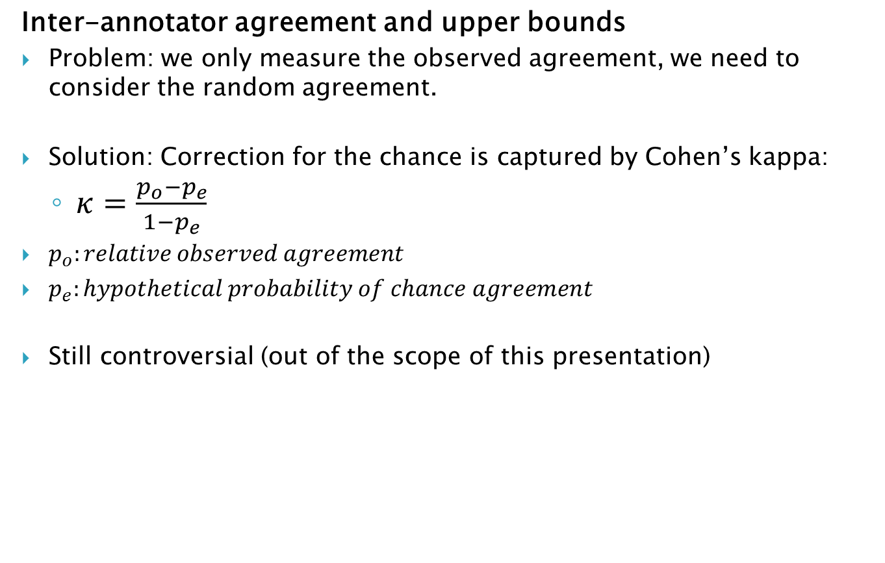
Evaluation
Inter-annotator agreement and upper bounds
Problem: we only measure the observed agreement, we need to consider the random agreement.
Solution: Correction for the chance is captured by Cohen’s kappa:
$κ=\frac{p_{o}−p_{e}}{1−p_{e}}$
$p_{o}:relative observed agreement$
$p_{e}:hypothetical probability of chance agreement$
Still controversial (out of the scope of this presentation)

Slide 38
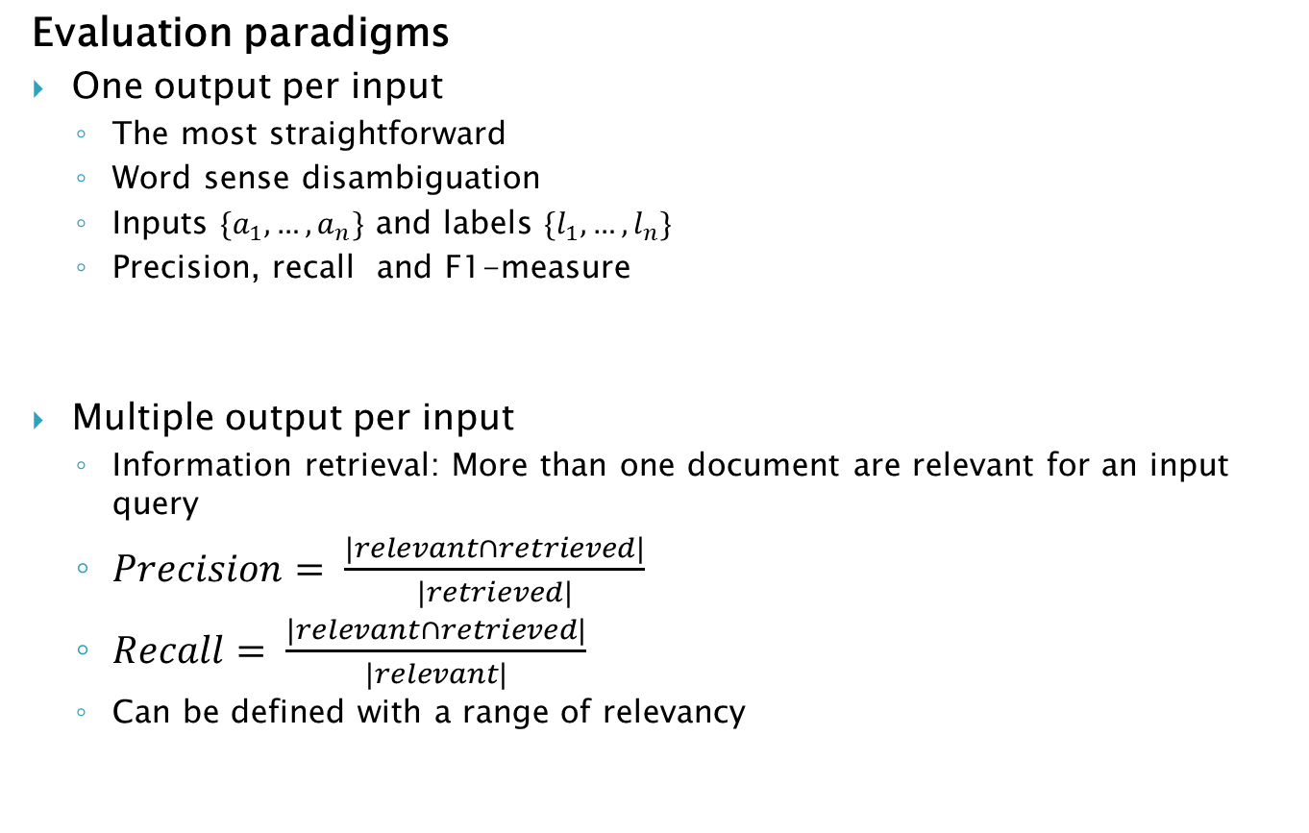
Evaluation
Evaluation paradigms
One output per input
The most straightforward
Word sense disambiguation
Inputs $\{a_{1},…,a_{n}\}$ and labels $\{l_{1},…,l_{n}\}$
Precision, recall and F1-measure
Multiple output per input
Information retrieval: More than one document are relevant for an input query
$Precision= \frac{|relevant∩retrieved|}{|retrieved|}$
$Recall= \frac{|relevant∩retrieved|}{|relevant|}$
Can be defined with a range of relevancy

Slide 39
Evaluation
Evaluation paradigms
Text output for each input
Machine translation and text summarization: Desired output can be expressed in many different ways
Human judges
Broke the text into pieces that can be compared via exact matching: n-gram and then compare to golden standard provided by human translators
Operationalized in BLEU metric for translation and ROUGE metric for summarization
Structured output for inputs
Syntactic trees
The same idea: broke the output into pieces and compare n-grams

Slide 40
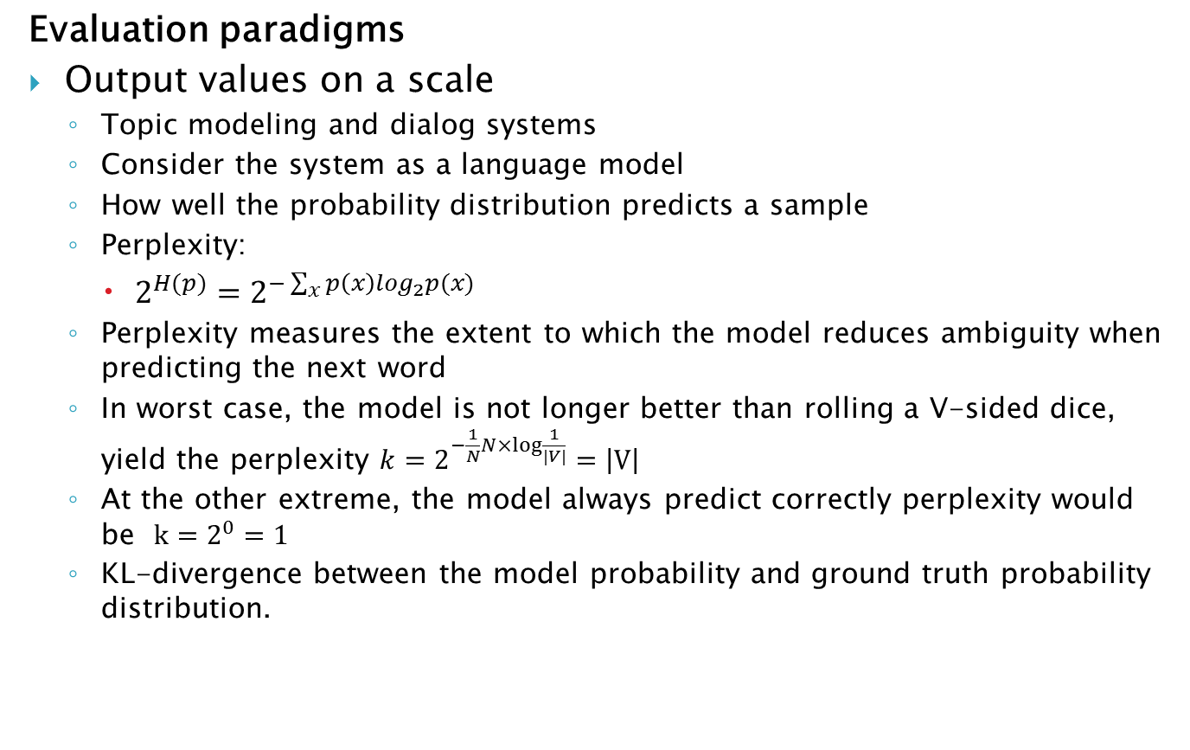
Evaluation
Evaluation paradigms
Output values on a scale
Topic modeling and dialog systems
Consider the system as a language model
How well the probability distribution predicts a sample
Perplexity:
$2^{H(p)}=2^{−\sum_{x}{p\left(x\right)\log_{2}p(x)}}$
Perplexity measures the extent to which the model reduces ambiguity when predicting the next word
In worst case, the model is not longer better than rolling a V-sided dice, yield the perplexity $k=2^{−\frac{1}{N}N×log⁡\frac{1}{|V|}}=\left|V\right|$
At the other extreme, the model always predict correctly perplexity would be $k=2^{0}=1$
KL-divergence between the model probability and ground truth probability distribution.

Slide 41
Thank you
Thank you
Thank you

