Slide 1
A General Overview of Natural language processing
By: Rohola Zandie
August 2017

Slide 2
History of NLP
In 1950, Alan Turing published his famous article "Computing Machinery and Intelligence" which proposed what is now called the Turing test as a criterion of intelligence
His approach heavily influenced by behaviorism.
It was a response to depth psychology of Sigmund Freud.
In order to be justified in ascribing a mental state to an entity, there must be some true claims about the observable behavior of that entity.
The most important behavior of human is manifested in language

Slide 3
History of NLP
In 1957, Noam Chomsky’s “Syntactic Structures” revolutionized Linguistics with 'universal grammar', a rule based system of syntactic structures.
During the 70's many programmers began to write 'conceptual ontologies', which structured real-world information into computer-understandable data.
During this time, many chatterbots were written including PARRY, Racter, and Jabberwacky.
Starting in the late 1980s, there was a revolution in NLP with the introduction of machine learning algorithms for language processing.
Recent research has increasingly focused on unsupervised and semi-supervised learning algorithms.

Slide 4
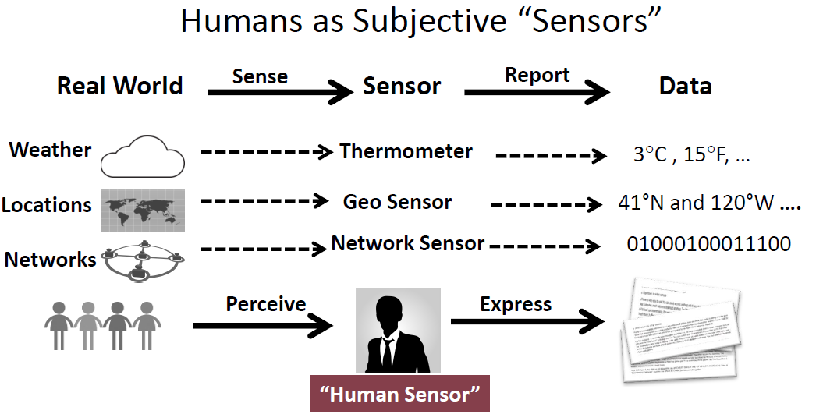
Text vs Non-Text Data

Slide 5
Big Picture
Consider the Turing test again
To pass the test we need to “understand” the human dialog
What “understand” means?
To reason about conversations
To be knowledgeable
To give relevant answers
...

Slide 6
Solutions
Logic is the systematic study of human reasoning
Dated back to Aristotle
A lot of logical systems
To reason we need to solve the “representation” problem
How human mind represent the external world?
How to deal with inherent ambiguity in language?
Ontology is one way to address the representation and logic problem
Ontology is a formal naming and definition of the types, properties, and interrelationships of the entities that really or fundamentally exist for a particular domain of discourse
Rose
Red
hasColor

Slide 7
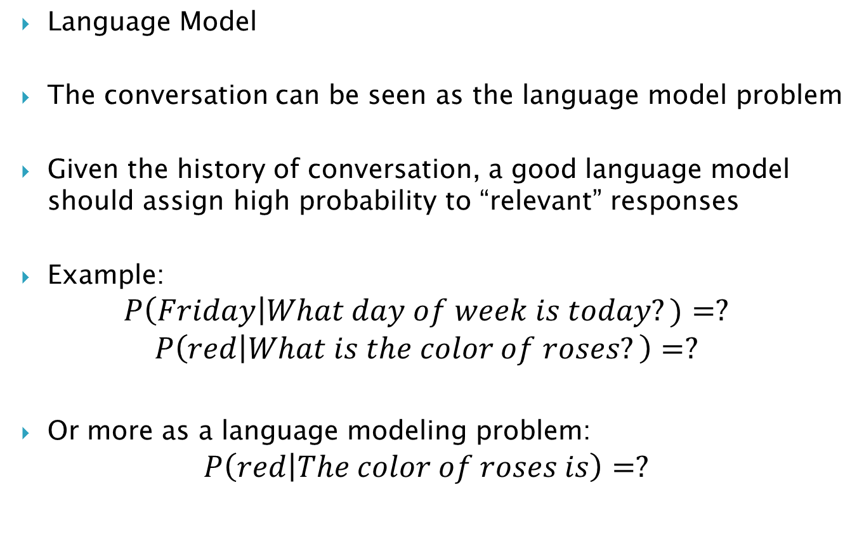
Solutions
Language Model
The conversation can be seen as the language model problem
Given the history of conversation, a good language model should assign high probability to “relevant” responses
Example:
$$P\left(Friday\right|What day of week is today?)=?$$
$$P\left(red | What is the color of roses?\right)=?$$
Or more as a language modeling problem:
$$P\left(red | The color of roses is\right)=?$$

Slide 8
Solutions
How we know the system really “understand”?
There should be an evaluation method
Solution:
Human judge(Turing original solution)
Other more objective criteria's

Slide 9
Challenges
Ambiguity
Knowledge Representation
Language Model
Evaluation

Slide 10
Ambiguity
I made her duck
I cooked waterfowl for her benefit (to eat)
I cooked waterfowl belonging to her
I created the (plaster?) waterfowl she owns
I caused her to quickly lower her head or body
I recognized the true identity of her spy waterfowl
I waved my magic wand and turned her into undifferentiated waterfowl

Slide 11
Ambiguity
Ambiguity is pervasive
I caused her to quickly lower her head or body
Part of speech: “duck” can be a Noun or Verb
I cooked waterfowl belonging to her.
Part of speech:
“her” is passive pronoun (“of her”)
“her” is dative pronoun (“for her”)
I made the (plaster) duck statue she owns
Word Meaning : “make” can mean “create” or “cook”

Slide 12
Ambiguity
Grammar: make can be (Syntactic ambiguity)
Transitive: (verb has a noun direct object)
Ditransitive: (verb has 2 noun objects)
Action-transitive (verb has a direct object + verb)
I caused [her] [to move her body]
I
cooked
[waterfowl belonging to her]
Object
I
made
[her]
into
[undifferentiated waterfowl
Object 1
Object 2
I
caused
[her]
[to move her body]
Object
Verb

Slide 13
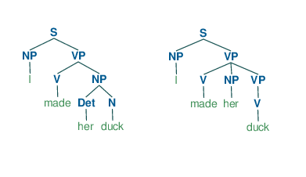
Ambiguity
Lexical ambiguity
Duck can be Noun or Verb
Syntactic ambiguity
Different Parse trees
Generated in python
Semantic ambiguity
Make can be “create” or “cook”
Metaphors
a figure of speech in which a word or phrase is applied to an object or action to which it is not literally applicable
He drowned in a sea of grief

Slide 14
Knowledge Representation
Designing computer representations that capture information about the world
Question answering
Dialog systems
Factual knowledge: The scientifically verified facts about the world.
Water boils at 100 C
The minimum price of the book titled “Introduction to Security” by David Walters now is 41$
Common sense knowledge: Collection of information that an ordinary person is expected to know. (general to specific)
Preconditions of actions and events
Effects (post conditions) of actions and events
Subjects and objects of actions
Behaviors of devices
Stereotypical situations or scripts
Human goals and needs
Emotions
Plans and strategies
Story themes

Slide 15
Knowledge Reasoning
Formal reasoning:
Deductive reasoning: logical deduction
Based mostly on first and second order logic
All men are mortal.
Socrates is a man.
Therefore, Socrates is mortal.
Inductive reasoning:
Based mostly on Bayes inference:
All biological life forms that we know of depend on liquid water to exist.
Therefore, if we discover a new biological life form it will probably depend on liquid water to exist.

Slide 16
Knowledge Reasoning
Informal reasoning (Heuristics reasoning)
Influenced heavily by Cognitive biases
Example:
The effort heuristic: the quality or worth of an object is determined from the perceived amount of effort that went into producing that object
Suffer from cognitive biases: For example they tend to search for, interpret and recall information in a way that confirms one's preexisting beliefs or hypotheses
Folk psychology, naïve physics, political debates and everyday reasoning
In order to simulate human behavior we need to incorporate human errors!

Slide 17
Knowledge Reasoning
Deductive
representation:
Semantic nets, system architecture, frames and ontologies
reasoning:
Inference engines, theorem provers.
Inductive
representation
Feature vectors
reasoning
Statistical reasoning (Bayes inference)

Slide 18
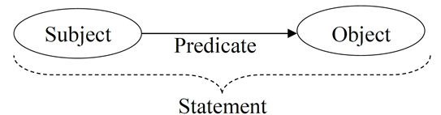
Ontology
Ontology is a formal way for naming properties, types and relationships between some entities in a domain of discourse.
The statement is a predicate based on formal second order logic.
Subject and Object can be classes or instances.
relationship between two classes : Lions eat deer
relationship between two individuals: John loves Jessica.

Slide 19
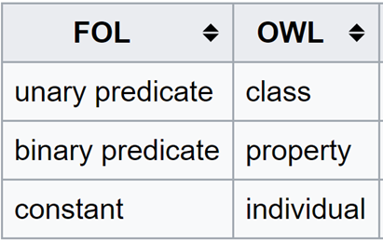
Ontology
The most widely used language for ontology is OWL. It consists of:
Individuals
Classes
Attributes
Relations
…
Example:
Unary predicates:
P(x)= x is a person
x belongs to the “person” class
Binary predicates
R(x,y)= x has age y
y is the “age” property of x
Constant
C= John
John is an individual of class student

Slide 20
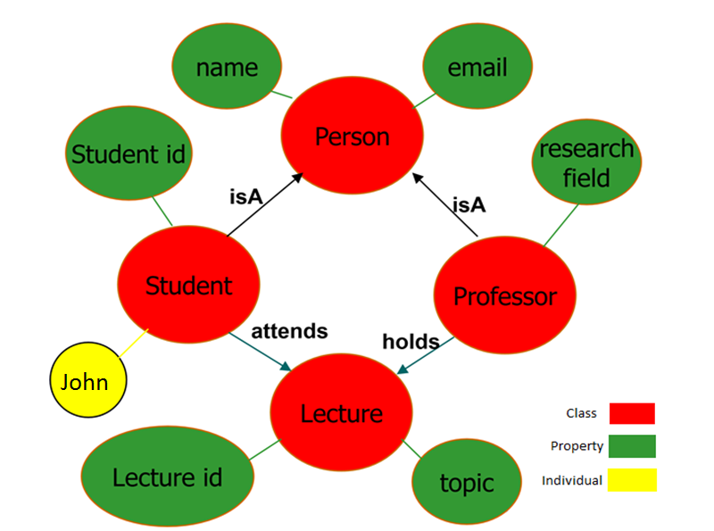
Ontology

Slide 21
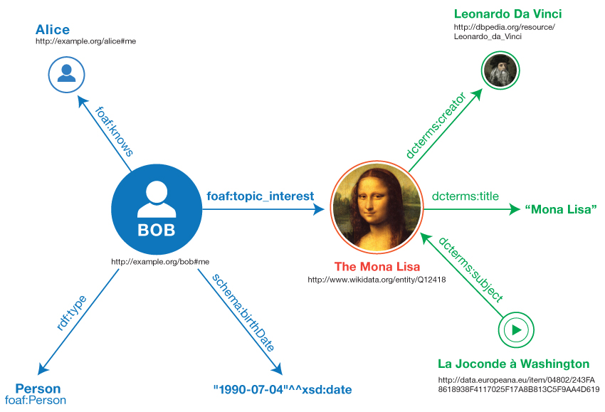
Ontology
The extension of this idea to web is called semantic web.
Imagine all the resources on the web make a big ontology.

Slide 22


Ontology
Linked Data: a method of publishing structured data so that it can be interlinked and become more useful through semantic queries.
It is based on web 2.0 technologies: RDF, URI’s, OWL
The most important datasets of Linked Data known as Knowledge bases are:
Dbpedia:
a dataset containing extracted data from Wikipedia
3.4 million concepts described by 1 billion triples
YAGO:
has knowledge of more than 10 million entities
contains more than 120 million facts about these entities
Cyc:
a comprehensive ontology and knowledge base of everyday common sense knowledge
FOAF
a dataset describing persons, their properties and relationships

Slide 23
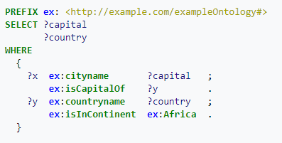
Ontology
Semantic query: Semantic queries enable the retrieval of both explicitly and implicitly derived information based on syntactic, semantic and structural information contained in data.
It is mainly based on SPARQL
Example: What are all the country capitals in Africa?

Slide 24
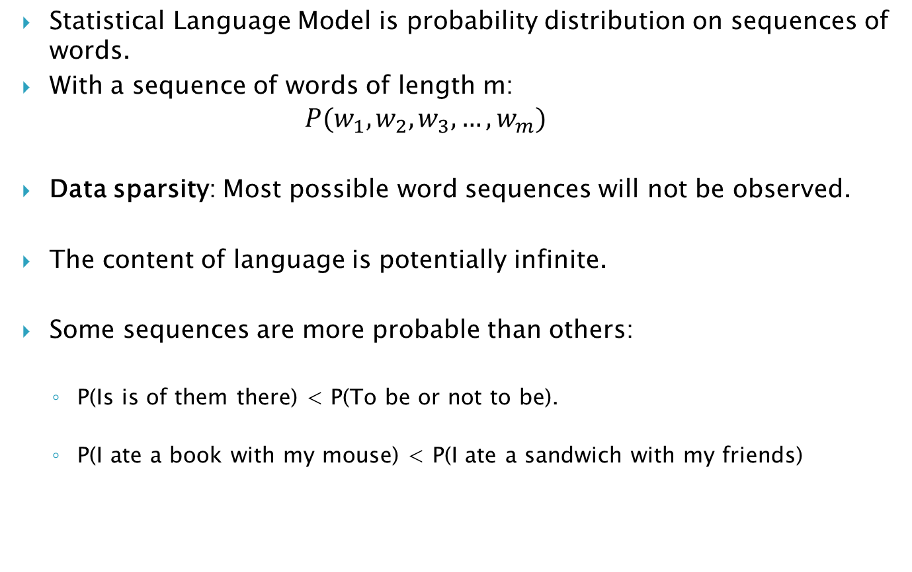
Language Model
Statistical Language Model is probability distribution on sequences of words.
With a sequence of words of length m:
$$P(w_{1},w_{2},w_{3},…,w_{m})$$
Data sparsity: Most possible word sequences will not be observed.
The content of language is potentially infinite.
Some sequences are more probable than others:
P(Is is of them there) < P(To be or not to be).
P(I ate a book with my mouse) < P(I ate a sandwich with my friends)

Slide 25
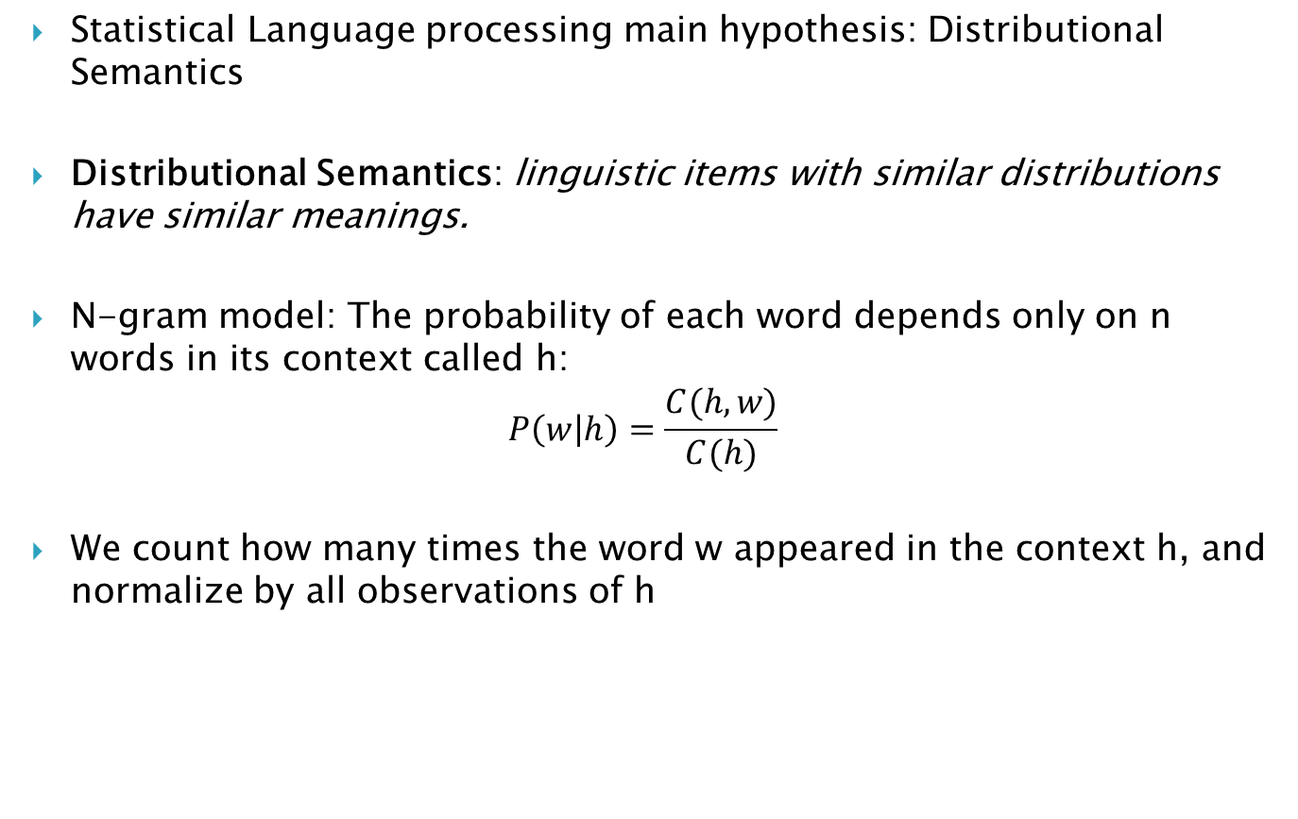
Language Model
Statistical Language processing main hypothesis: Distributional Semantics
Distributional Semantics: linguistic items with similar distributions have similar meanings.
N-gram model: The probability of each word depends only on n words in its context called h:
$$P\left(w | h\right)=\frac{C(h,w)}{C(h)}$$
We count how many times the word w appeared in the context h, and normalize by all observations of h

Slide 26
Language Model
Many histories h are similar, but n-grams assume exact match of h
Practically, n-grams have problems with representing patterns over more than a few words
With increasing order of the n-gram model, the number of possible parameters increases exponentially
There will be never enough of training data to estimate parameters of high order N-grams

Slide 27
Language Model
In most cases we use n=2 or n=3
When n=1 the language model is bag of words:
Order doesn’t matter!
No Grammar
Keep multiplicity
We need another way for representing words as vectors that takes into account the context or documents it appears in.
Observation: Words does not distributed uniformly across documents.
Observation: Some words are more probable in some documents

Slide 28
Vector space model
Vector space model is an algebraic model for representing words and text documents as numerical real valued vectors
Simple modeling: consider each word as an index vector. A sentence represented as:
TF-IDF: the above model can be modified in two ways
Term frequency
Terms that occur more frequently are more important
Inverse of document frequency
A word like “the” occurs very frequently(almost uniformly) among documents and have less information than a word like “book”
Book | Lion | Read | … | Can | Single | The | a
1 | 0 | 1 |  | 1 | 0 | 1 | 1

Slide 29
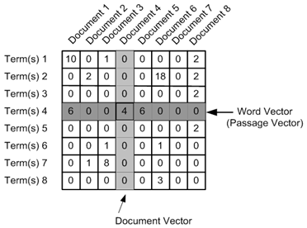
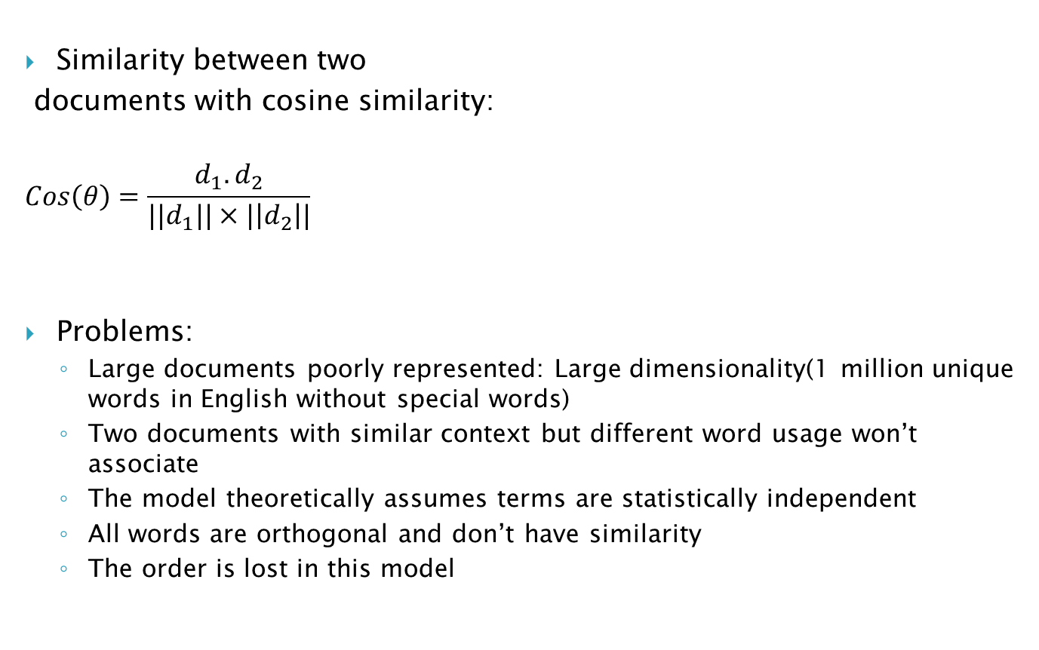
Vector space model
Similarity between two
documents with cosine similarity:
$$Cos\left(θ\right)=\frac{d_{1}.d_{2}}{{||d}_{1}||×|\left|d_{2}\right||}$$
Problems:
Large documents poorly represented: Large dimensionality(1 million unique words in English without special words)
Two documents with similar context but different word usage won’t associate
The model theoretically assumes terms are statistically independent
All words are orthogonal and don’t have similarity
The order is lost in this model

Slide 30
Vector space model
Generalized Vector space model: Introduces term correlation to alleviate the orthogonality assumption.
Correlation between words can be defined in many different ways:
Semantic similarity relatedness in Wordnet, DBPedia, YAGO Taxonomy and other Linked Open Data
Compute frequency co-occurrence statistics from large corpora
Explicit Semantic Analysis: Introduces using of inverted index on large corpora like Wikipedia.
Each word can be represented as the vector of all Wikipedia articles that the word occurred in them.
For example: consider “meet”
Article1 | Article2 | Article3 | … | Article(n-2) | Article(n-1) | Article(n)
3 | 0 | 1 |  | 2 | 0 | 0

Slide 31
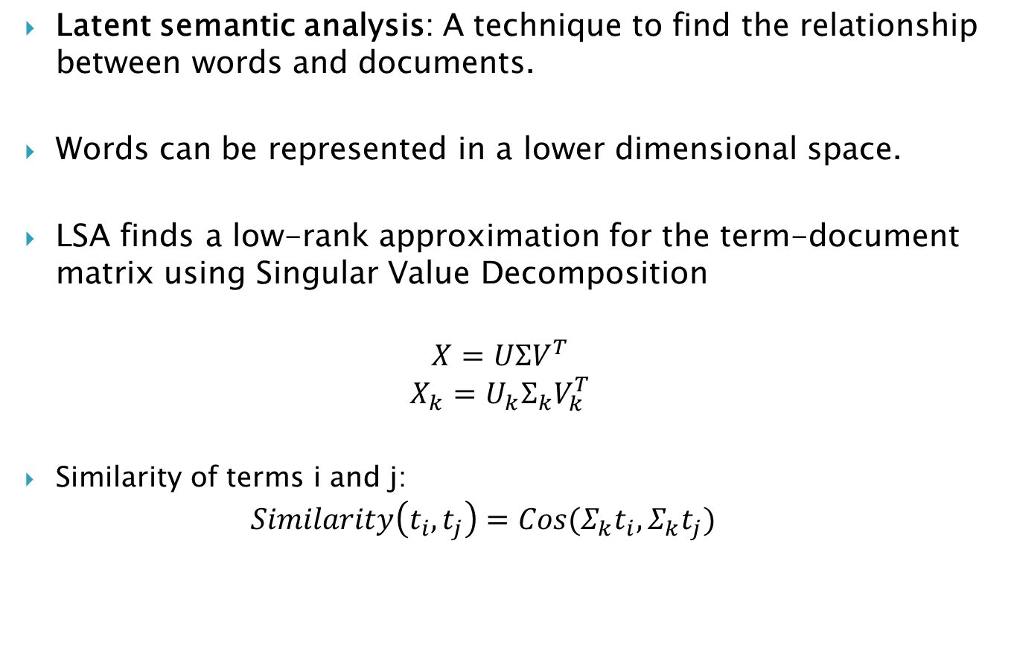
Vector space model
Latent semantic analysis: A technique to find the relationship between words and documents.
Words can be represented in a lower dimensional space.
LSA finds a low-rank approximation for the term-document matrix using Singular Value Decomposition
$$X=UΣV^{T}$$
$$X_{k}=U_{k}Σ_{k}V_{k}^{T}$$
Similarity of terms i and j:
$$Similarity\left(t_{i},t_{j}\right)=Cos(Σ_{k}t_{i},Σ_{k}t_{j})$$

Slide 32
Vector space model
The result is that some dimensions combined (usaully synonym words)
{(car), (truck), (flower)} ↦ {(1.3452 * car + 0.2828 * truck), (flower)}
Problems:
The interpretation of new dimensions are not always easy
{(car), (bottle), (flower)} ↦ {(1.3452 * car + 0.2828 * bottle), (flower)}
Cannot Capture polysemy: Multiple meaning of one word
It has Bag of words limitations

Slide 33
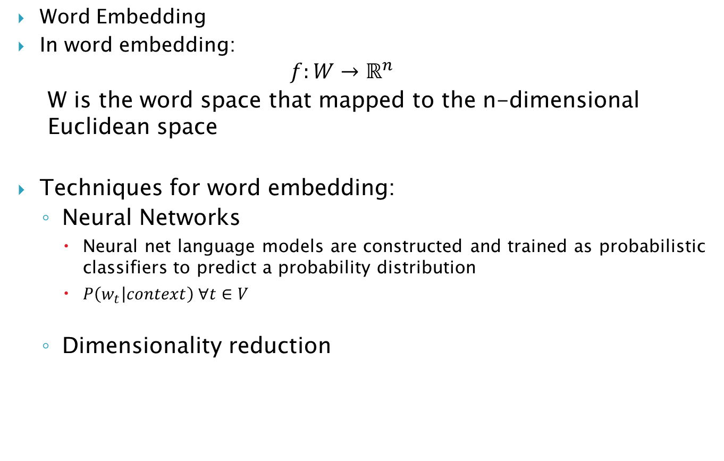
Vector space model
Word Embedding
In word embedding:
$$f:W→ℝ^{n}$$
W is the word space that mapped to the n-dimensional Euclidean space
Techniques for word embedding:
Neural Networks
Neural net language models are constructed and trained as probabilistic classifiers to predict a probability distribution
$P\left(w_{t} | context\right) ∀t∈V$
Dimensionality reduction

Slide 34
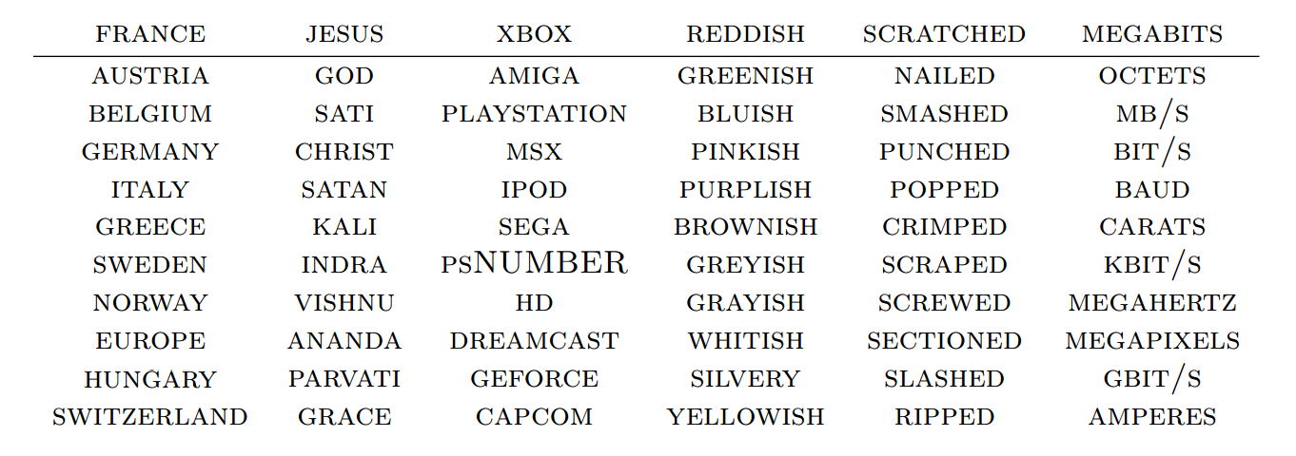
Vector space model
Word2Vec: A shallow two layer neural network trained to reconstruct linguistic context.
Input: a large corpus of text
Output: a vector space, typically of several hundred dimensions
W(‘‘cat")=(0.2, -0.4, 0.7, ...)
W(‘‘mat")=(0.0, 0.6, -0.1, ...)
Remarkable properties:
Words clustering

Slide 35
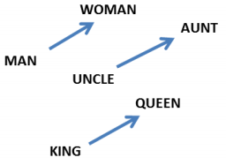
Vector space model
Analogy:
W(‘‘woman")−W(‘‘man") ≃ W(‘‘aunt")−W(‘‘uncle")
W(‘‘woman")−W(‘‘man") ≃ W(‘‘queen")−W(‘‘king")
Shared representation: Similar words in different languages map to the same space vicinity
It’s great for translation

Slide 36
Vector space model
Other successful embeddings:
Turian embedding (Turian et al., 2010)
SENNA embedding (Collobert et al., 2011)
Eigenword (Dhillon et al., 2015)
The generalization of these method to sentences and documents
Sentene2vec and Doc2vec
Still sparse
There are a lot of applications that benefit from vector space models
Parsing, Stemming, Segmentation
Named Entity recognition, Word sense disambiguation, Sentiment analysis Coreference resolution
Question Answering, topic modeling
Summarization, Machine translation, dialog systems

Slide 37
Evaluation
Question:
How do you evaluate a search engine results?
How do you evaluate a translation system?
How do you evaluate a Chabot?
Solution: recruit human subjects, train them and ask them to assess the output
Problems:
Inconsistent results
Slow to evaluate
Costly
It’s hard to define the ground truth:
Subjective opinions on results are very common!

Slide 38
Evaluation
Automatic and Manual evaluation
Manual evaluation needs human subjects to assess the system
Automatic evaluation doesn’t need humans. They work based on predefined criteria, corpuses or standards.
Automatic evaluation methods are favored today by most
However, recognizing that manual evaluations remain valuable, it is common practice to periodically conduct studies that establish a correlation between results of automatic and manual evaluations.

Slide 39
Evaluation
Inter-annotator agreement and upper bounds
In many NLP tasks we need to annotate text, e.g. POS tagging
It is a common practice to compare the performance of multiple human judges for two reasons:
if human beings cannot reach substantial agreement about the annotation it is likely that the task is too difficult or poorly defined
2. It is generally agreed that human inter-annotation defined an upper limit on our ability to measure performance

Slide 40
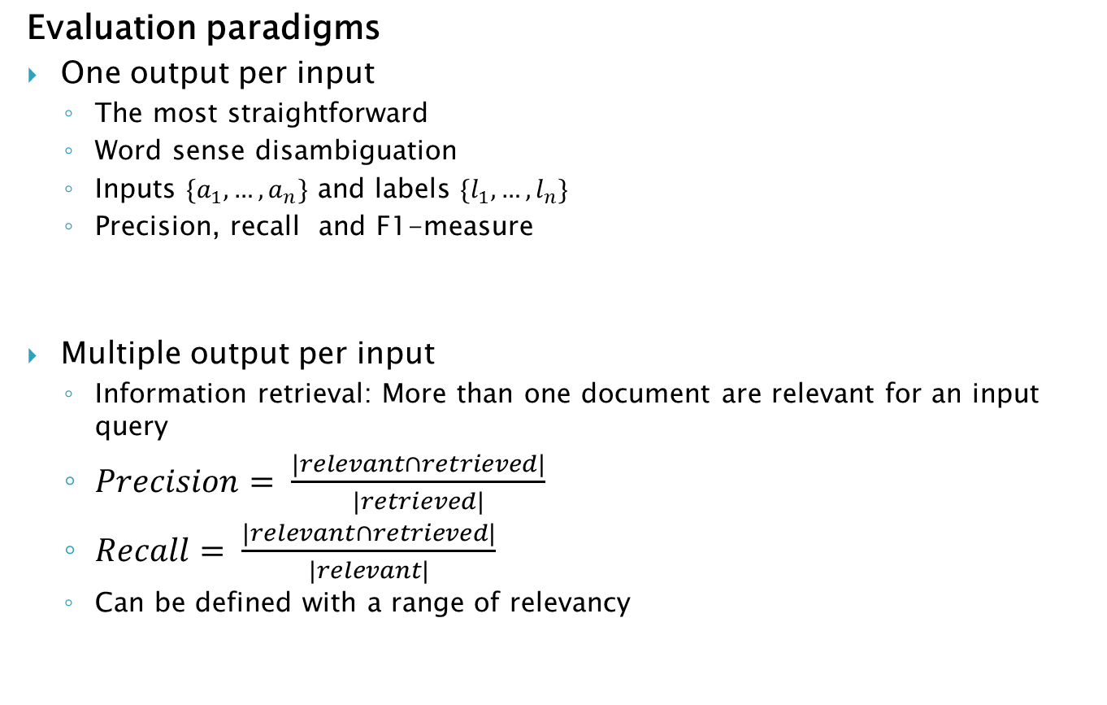
Evaluation
Evaluation paradigms
One output per input
The most straightforward
Word sense disambiguation
Inputs $\{a_{1},…,a_{n}\}$ and labels $\{l_{1},…,l_{n}\}$
Precision, recall and F1-measure
Multiple output per input
Information retrieval: More than one document are relevant for an input query
$Precision= \frac{|relevant∩retrieved|}{|retrieved|}$
$Recall= \frac{|relevant∩retrieved|}{|relevant|}$
Can be defined with a range of relevancy

Slide 41
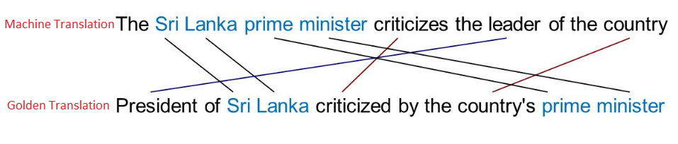
Evaluation
Evaluation paradigms
Text output for each input
Machine translation and text summarization: Desired output can be expressed in many different ways
Human judges
Broke the text into pieces that can be compared via exact matching: n-gram and then compare to golden standard provided by human translators
Operationalized in BLEU metric for translation and ROUGE metric for summarization

Slide 42
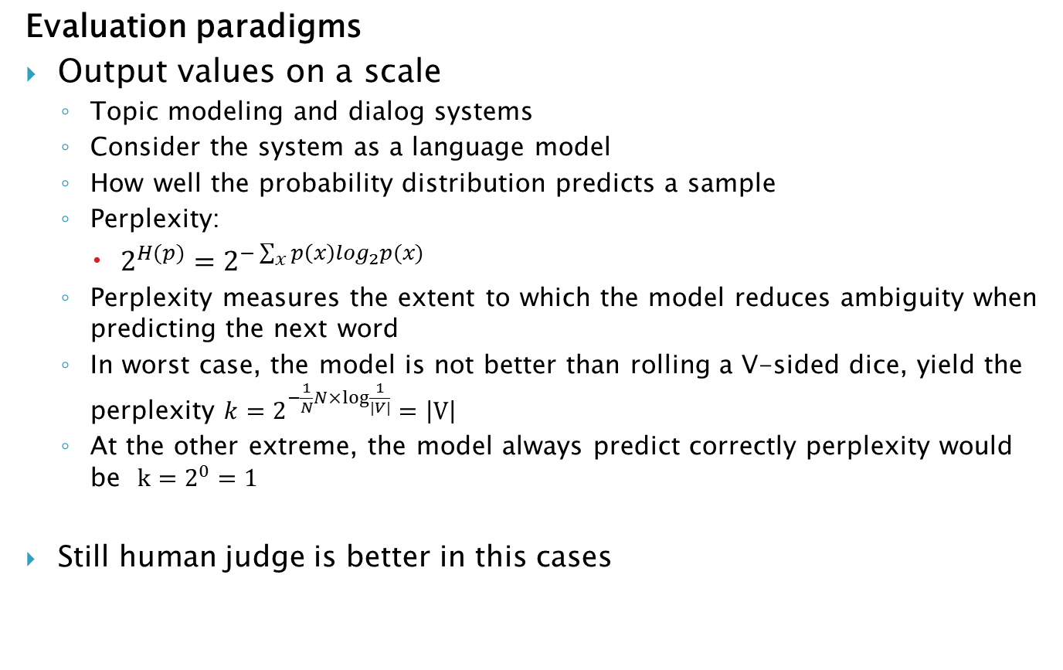
Evaluation
Evaluation paradigms
Output values on a scale
Topic modeling and dialog systems
Consider the system as a language model
How well the probability distribution predicts a sample
Perplexity:
$2^{H(p)}=2^{−\sum_{x}{p\left(x\right)\log_{2}p(x)}}$
Perplexity measures the extent to which the model reduces ambiguity when predicting the next word
In worst case, the model is not better than rolling a V-sided dice, yield the perplexity $k=2^{−\frac{1}{N}N×log⁡\frac{1}{|V|}}=\left|V\right|$
At the other extreme, the model always predict correctly perplexity would be $k=2^{0}=1$
Still human judge is better in this cases

Slide 43
Thank you
Thank you
Thank you

