Slide 1
Sentimental Analysis of Customers reviews of Amazon Products
By – ARCHIT DUBEY

Slide 2
INTRODUCTION
classify feelings using NLTK, Naive Bayes classifiers (Multinomial NB, Bernoulli NB), and Logistic Regression.
create a straightforward classifier for Amazon reviews.
comprehend consumer feelings and their influence on product perception by extracting information from the reviews.
research advances the field of sentiment analysis and benefits both product development and consumer happiness.

Slide 3
Data Exploration
Number of product – 49.
Average review per product – 707.35
Total number of rows – 34660
Total number of columns – 21
Counting the frequency of each value in rating column
5 - 23775
4 – 8541
3 – 1499
2 – 402
1 - 410

Slide 4
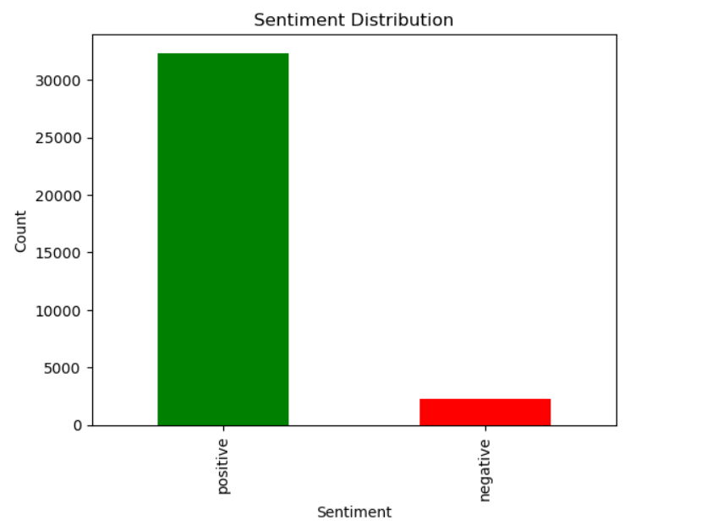
Data Exploration
Sentiment Distribution for Amazon reviews
Positive sentiment – 32316 (93.33%)
Negative sentiment – 2311 (6.67%)

Slide 5
METHODS
Simple Classifier
Training and Evaluating a Naive Bayes Classifier using NLTK
Multinomial Naive Bayes model
Bernoulli Naive Bayes model
Logistic Regression model
Plotting Confusion Matrix
Comparing Classifiers with Receiver Operating Characteristic (ROC) Curve
Classification Report for Different Classifiers

Slide 6
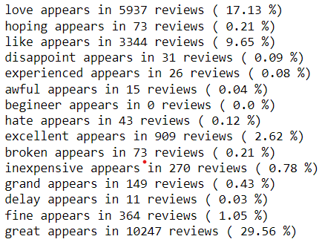
METHODS
Simple Classifier OF 15 common words

Slide 7
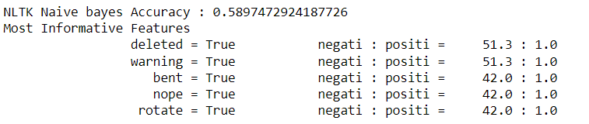
METHODS
Training and Evaluating a Naive Bayes Classifier using NLTK
The result of the code displays the about 0.59 accuracy of the NLTK Naive Bayes classifier on the testing dataset. It suggests that the classifier has an accuracy of about 59% when predicting the sentiment of reviews. The terms that are most strongly related with either positive or negative sentiment are shown in the "Most Informative Features" section. For instance, the use of the phrases "deleted," "warning," "bent," "nope," and "rotate" is very suggestive of unfavorable feeling.

Slide 8
Multinomial Naive Bayes Classifier, Bernoulli Naive Bayes Classifier AND Logistic Regression Classifier METHODS
Multinomial Naive Bayes model achieves an accuracy of 93.30% on the test data. It suggests that the Multinomial Naive Bayes approach works effectively for this sentiment analysis task.
The accuracy of the Bernoulli Naive Bayes model on the test data is 92.04%. The accuracy score suggests that the Bernoulli Naive Bayes approach is as effective in this sentiment analysis task, while having somewhat inferior performance than the Multinomial Naive Bayes model
On the test data, the Logistic Regression model's accuracy is 93.73%. The accuracy score shows that in this sentiment analysis test, the Logistic Regression technique performs better than both the Multinomial Naive Bayes and Bernoulli Naive Bayes models.

Slide 9
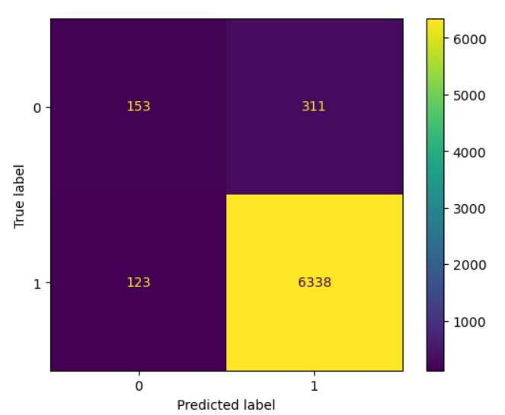
METHODS
Plotting Confusion Matrix
These figures allow us to assess the effectiveness of the logistic regression model. A high number of true positives (6338) and true negatives (153) show that the majority of occurrences are being classified properly. Indicating regions where the model is off, it also contains some false negatives (123) and false positives (311).

Slide 10
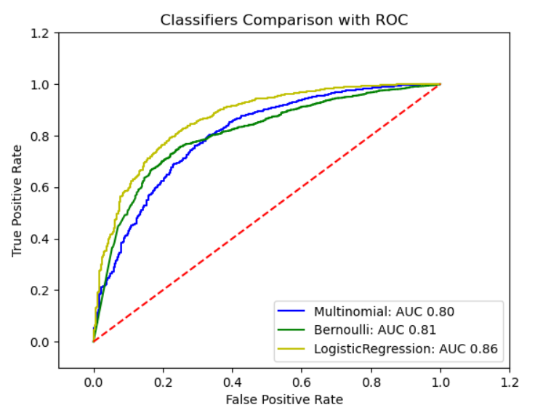
METHODS
Comparing Classifiers with Receiver Operating Characteristic (ROC) Curve
The Plot displays the AUC (Area Under the Curve) values for each classifier in the prediction results. Here are the AUC values for each classifier:
Multinomial: 0.80 , Bernoulli: 0.81 and Logistic Regression: 0.86
Logistic Regression classifier has the highest AUC value, indicating better performance compared to the Multinomial and Bernoulli classifiers.

Slide 11
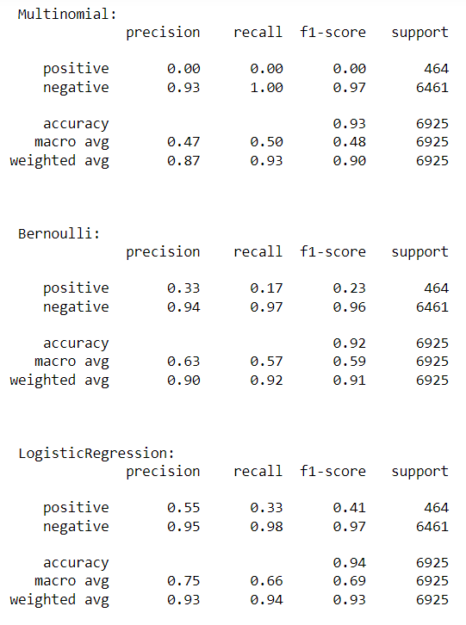
METHODS
Classification Report for Different Classifiers

Slide 12
RESULTS
The 'Bernoulli' classifier shows lower precision, recall, and F1-score for the positive class, indicating a difficulty in correctly identifying positive sentiment.
The 'LogisticRegression' classifier performs relatively better with balanced precision, recall, and F1-score for both positive and negative classes.
'LogisticRegression' classifier achieves the highest accuracy of 0.94, followed by the 'Multinomial' classifier with 0.93 accuracy, and the 'Bernoulli' classifier with 0.92 accuracy.

Slide 13
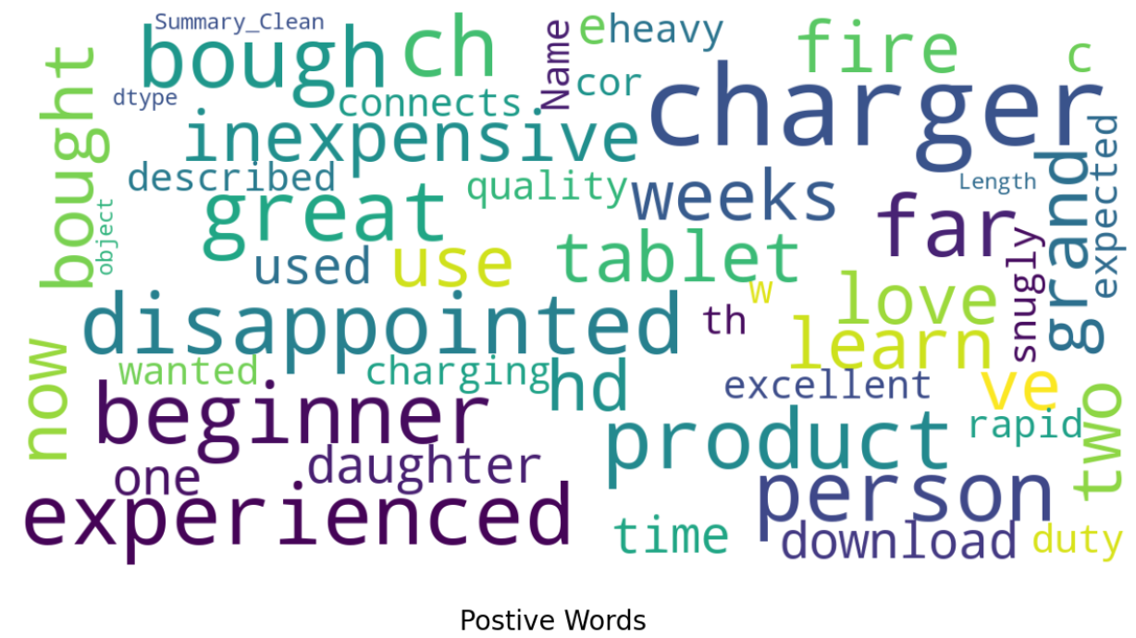
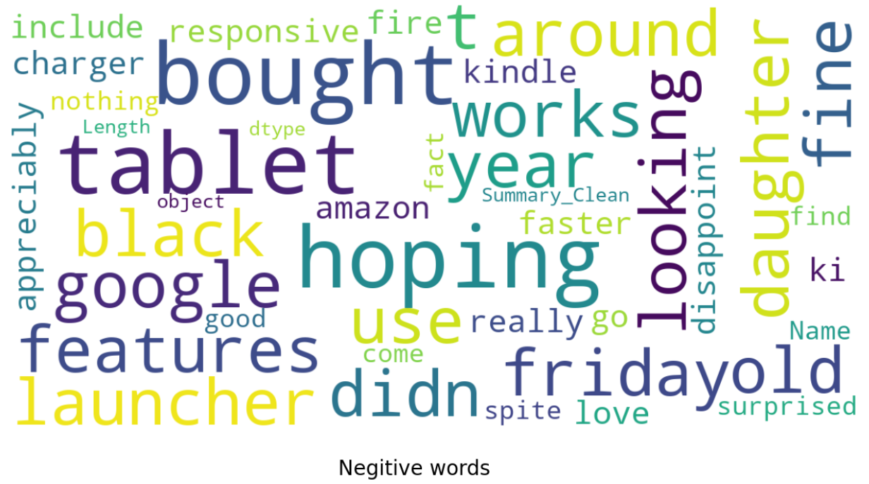
RESULT - Word Cloud visualization
Positive
Negative

Slide 14
CONCLUSION
Classifiers used: Multinomial Naive Bayes, Bernoulli Naive Bayes, and Logistic Regression
Objective: Analyze sentiment of customer reviews for Amazon items
Insights from initial analysis:
Extracted specific columns from the dataset and handled missing values
Sample consisted of 49 goods with an average of 707.35 reviews per item
Sentiment distribution: 93.33% favorable, 6.67% unfavorable
Additional insights from customer reviews:
Positive words like "great," "like," and "excellent" were commonly used
Negative adjectives like "disappoint" and "awful" were less frequent
Classifier performance based on accuracy:
Multinomial Naive Bayes: 93.30%
Bernoulli Naive Bayes: 92.04%
Logistic Regression: 93.73% (highest accuracy)

Slide 15
CONCLUSION
Logistic Regression model outperformed others in differentiating positive and negative classifications (higher AUC value of 0.86)
Classification reports provided further details on each classifier's performance:
Bernoulli classifier struggled with distinguishing good sentiment
Multinomial classifier performed better in identifying negative sentiment
Logistic Regression classifier achieved balanced performance for both positive and negative classes
Overall, most customer evaluations on Amazon were positive
Logistic Regression model proved to be the most accurate in predicting sentiment
Study results can contribute to improving customer satisfaction, product development, and understanding customer emotions in reviews.

