Slide 1


eMission Application
C3J

Slide 2


Agenda
C3J
Emission Tracking
Remaining Challenges
What’s Next?
Requirements

Slide 3
Project Workflow
Emission Tracking
Remaining Challenges
Next Steps
Problem: out of control carbon emissions
Solution: calculate carbon footprint and track vehicle emissions
How will we calculate carbon emissions?
How will we generate revenue (if for-profit)?
How will we reward our users to keep them engaged?
Begin Sprint 1 Inception Plan
Create an application prototype using Figma.

Slide 4
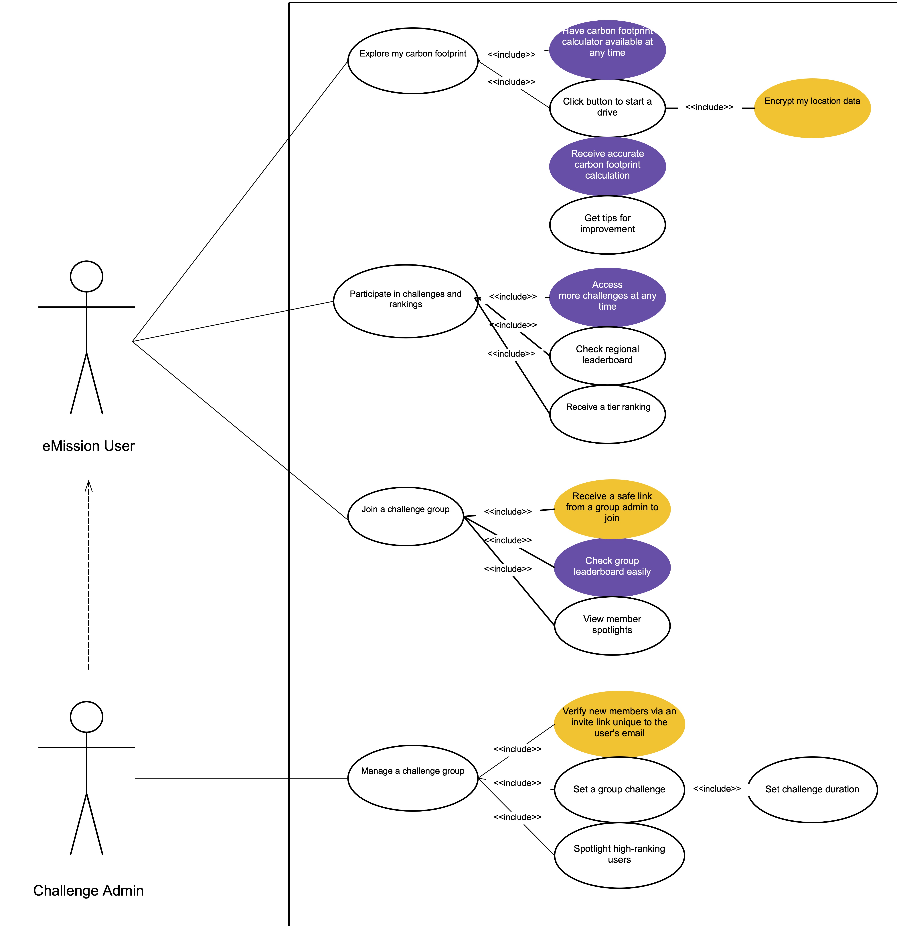
Explore my carbon footprint
Participate in challenges and rankings
Join a challenge group
Manage a challenge group

Slide 5
Thank you
Any Questions?

