Slide 1

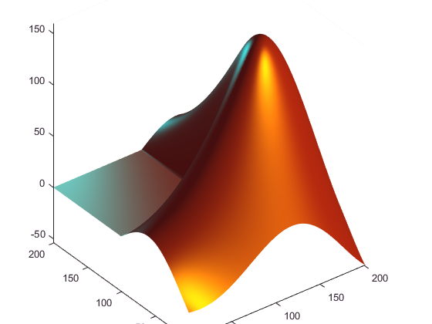




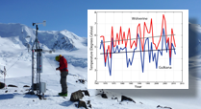





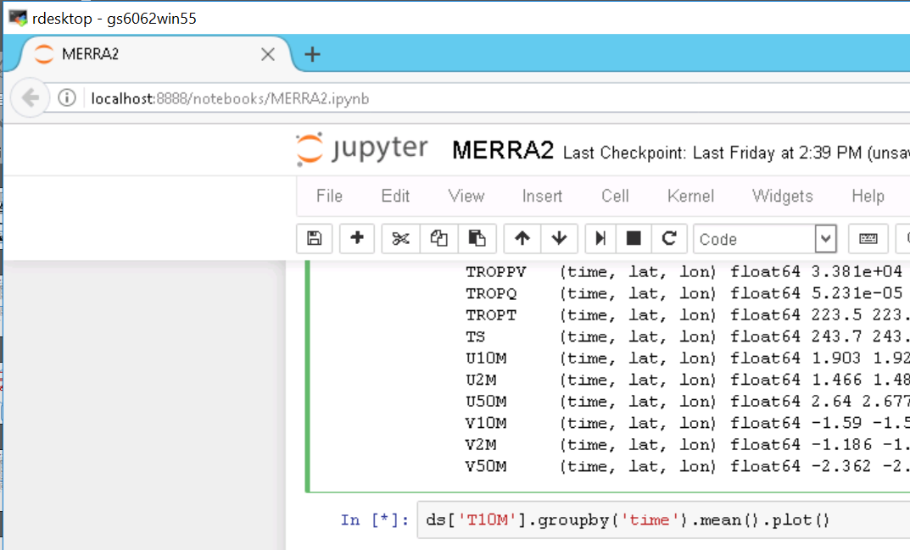

Raster (gridded)
Vector (point, line, polygon)
Time series
terminal access (Linux VM)
run scripts to operate on data directly within ADAPT
rivers; glacier polygons, weather station locations
air temperature at a weather station
web browser
download files from himat.org and nsidc.org using web map interface
e.g remote sensing data; climate grids
Share data internally to HiMAT?
-> preliminary products; not for distribution; needs QC
Windows VM
ArcGIS, Python (notebooks)
direct connection
access data directly from remote GIS software, Matlab/Python scripts
ADAPT
-> simple file structure: store datasets in folders
-> especially suitable for large grids
-> full MODIS, Landsat archive
-> only approved HiMAT members can access
relational database
the existing GLIMS database
password protection on tables not ready for release in public-facing GLIMS
secure ftp
copy needed files to local computer
use ADAPT only as a file storage service
Share data to the world?
-> full metadata, QC
NSIDC DAAC
-> long-term archive
-> detailed metadata
web browser
ftp access

