Slide 1
SALES REPORT FOR PIZZA SHOP
USING SQL

Slide 2
Introduction
This PowerPoint presentation provides us with insights into the pizza shop's sales data, allowing us to choose various business improvement strategies.
Structured Query Language, or SQL, is the technology utilized to produce insights.

Slide 3
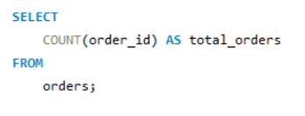

1. Retrieve the total number of orders placed.
Query
Results

Slide 4
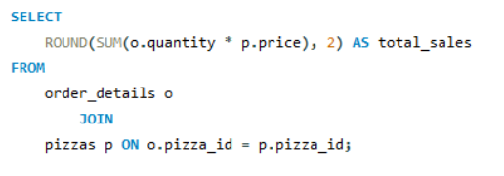

2. Calculate the total revenue generated from pizza sales.
Query
Results

Slide 5
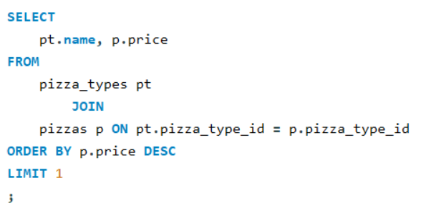

3. Identify the highest-priced pizza.
Query
Results

Slide 6
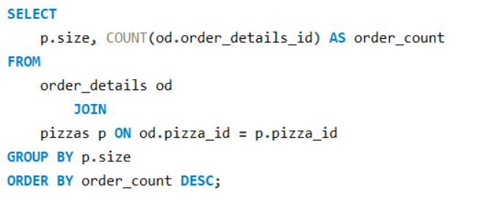
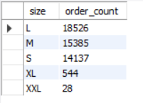
4. Identify the most common pizza size ordered.
Query
Results

Slide 7
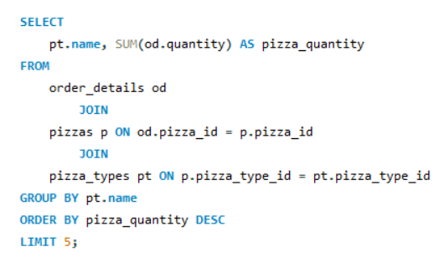
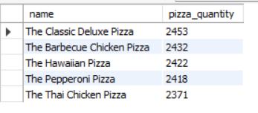
5. List the top 5 most ordered pizza types along with their quantities.
Query
Results

Slide 8
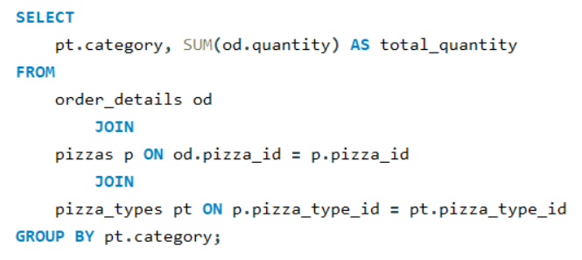
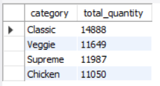
6. Join the necessary tables to find the total quantity of each pizza category ordered.
Query
Results

Slide 9
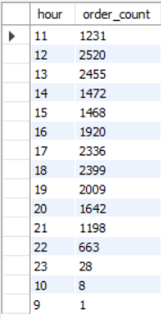
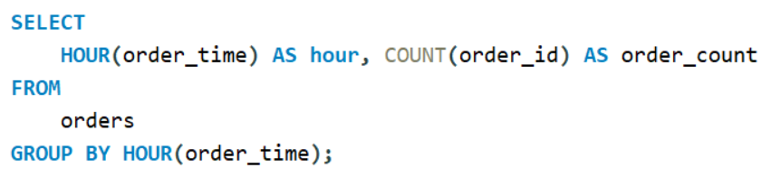
7. Determine the distribution of orders by hour of the day.
Query
Results

Slide 10
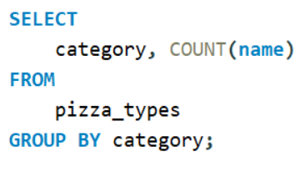
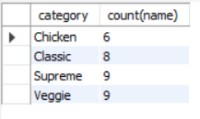
8. Join relevant tables to find the category-wise distribution of pizzas.
Query
Results

Slide 11
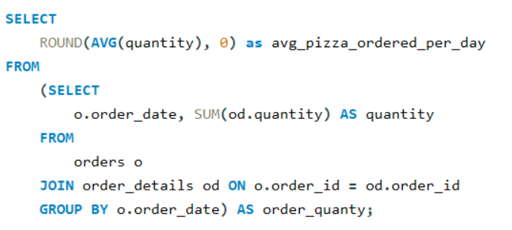

9. Group the orders by date and calculate the average number of pizzas ordered per day.
Query
Results

Slide 12
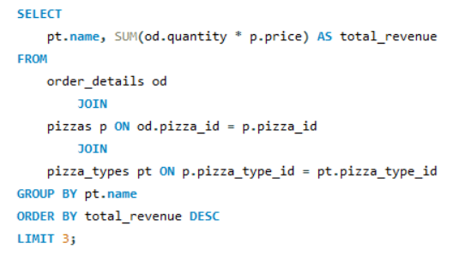

10. Determine the top 3 most ordered pizza types based on revenue.
Query
Results

Slide 13
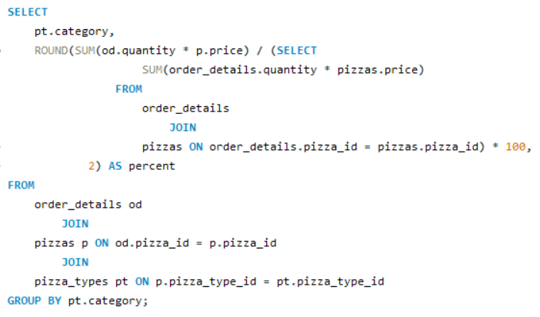
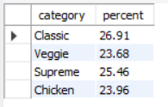
11. Calculate the percentage contribution of each pizza type to total revenue.
Query
Results

Slide 14
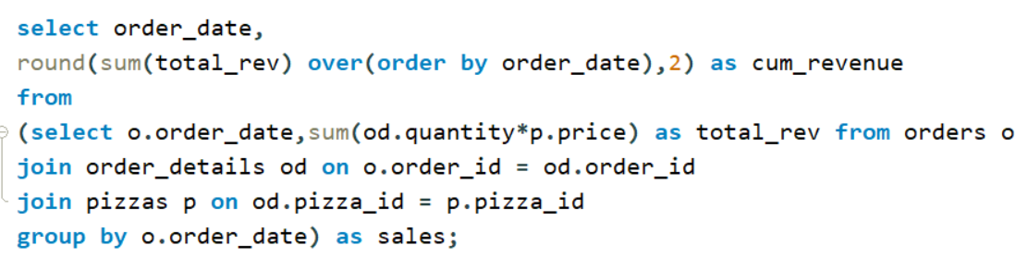
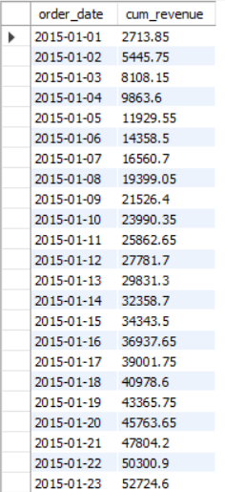
12. Analyze the cumulative revenue generated over time.
Query
Results

Slide 15
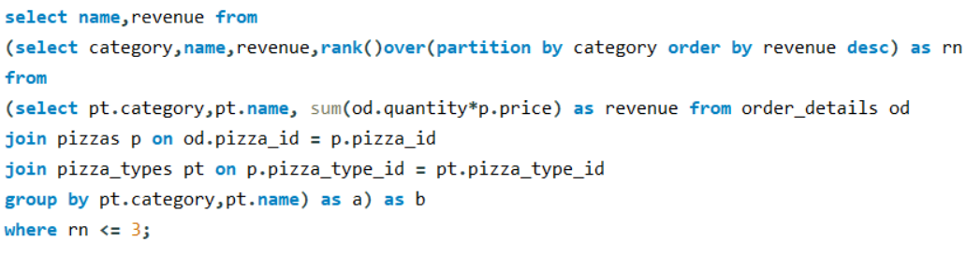
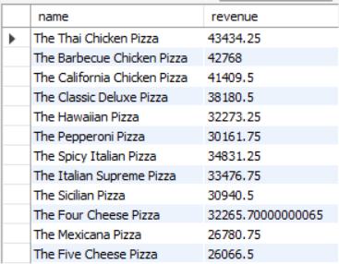
13. Determine the top 3 most ordered pizza types based on revenue for each pizza category.
Query
Results

